Slide 1
CSC478 Final Project
Allstate Claims Analysis and Prediction
By Yiming WANG

Slide 2
Agenda
1
Objectives
2
Data Preprocessing
3
Data Transformation
4
Pattern Discovery & Evaluation
5
Model Selection

Slide 3
Step 1. Objectives
This project is a data analysis competition holds by insurance company Allstate (deadline of the competition is 12 Dec 2016, not due yet).
The data set is real world insurance claims.
The objective of this project is to predict the value of ‘loss’ in each claims (continuous value) in test set.

Slide 4
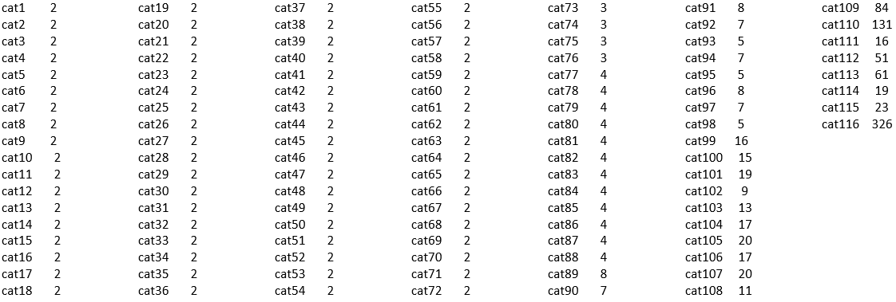
Step 2. Data Preprocessing
The data contains 188,319 tuples for training and 125,547 tuples for testing. There are 116 categorical and 14 continuous attributes.
Check how many different categorical value in each categorical variable.

Slide 5
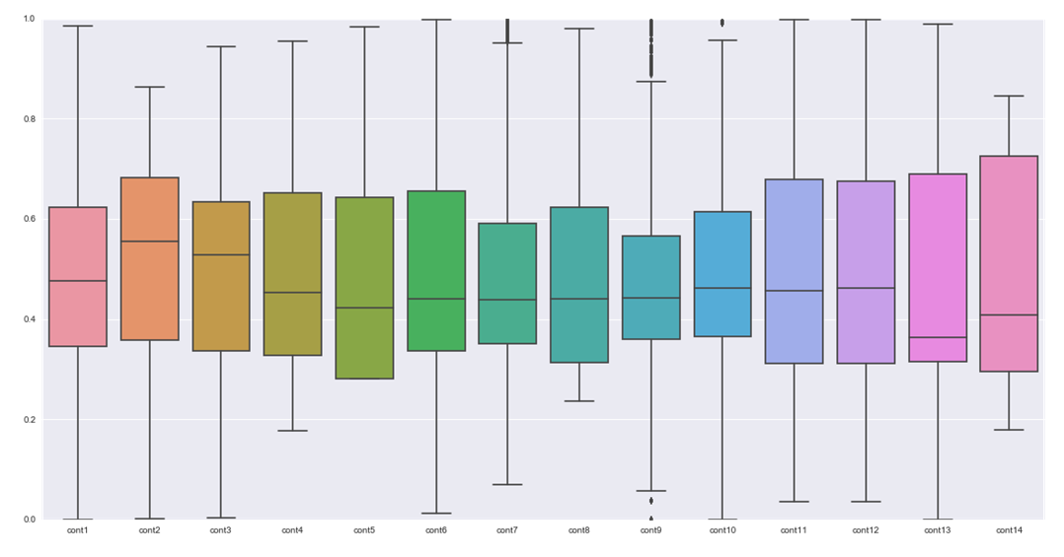
Step 2. Data Preprocessing
Plot continuous features

Slide 6
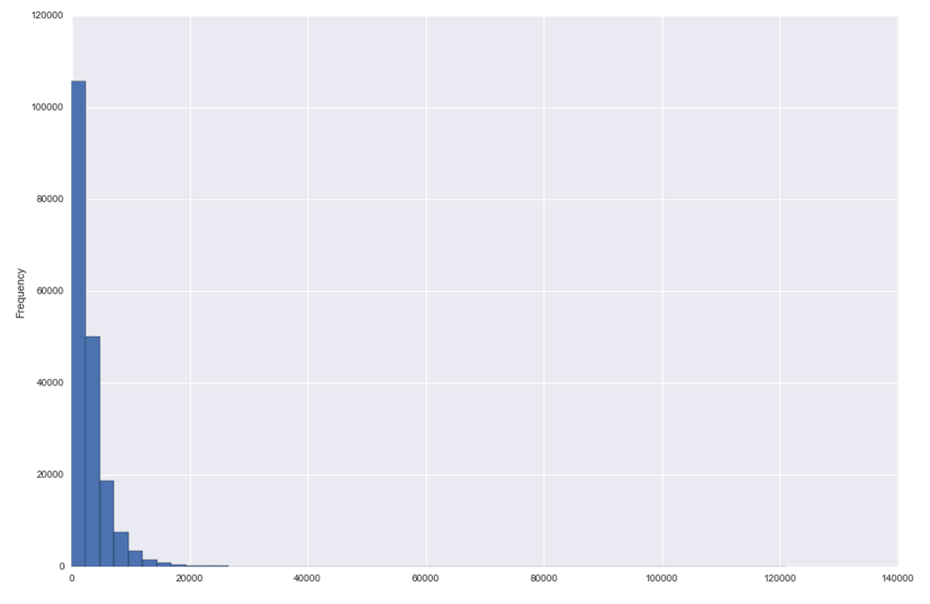
Step 2. Data Preprocessing
Plot target data

Slide 7
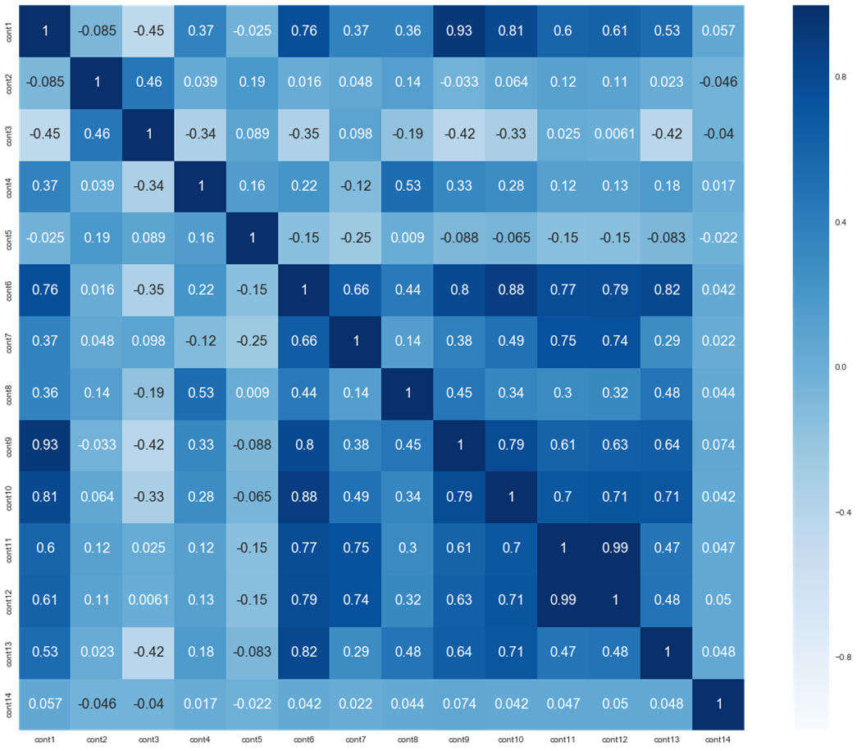
Step 2. Data Preprocessing
Heat map of the correlation between continuous features:

Slide 8
Step 2. Data Preprocessing – data cleaning
After checking, the data is clean. No missing value.
Some extremely data, but since the data set is right skewed, would not treat them as outlier.

Slide 9
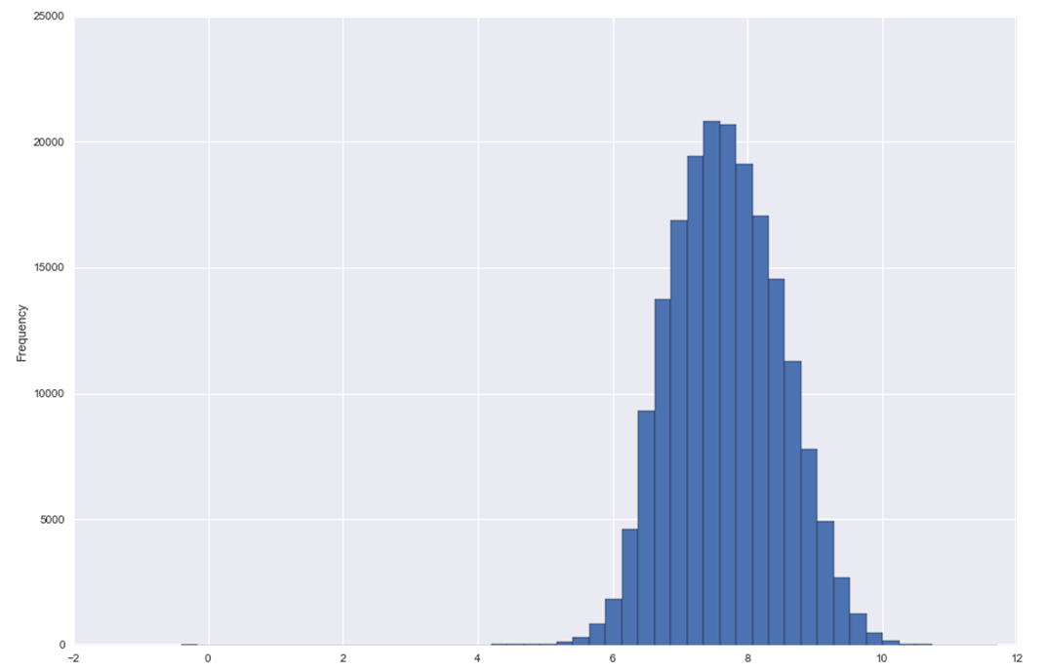
Step 3. Data transformation
Log() transform target value ‘loss’:

Slide 10
Step 3. Data transformation – Split data
Use cross_validation .train_test_split () from sklearn package to split data into 80% training set and 20% testing set.

Slide 11
Step 3. Data transformation - Dimensionality reduction
PCA, at least 95% information
Use decomposition.PCA() function from sklearn package
When n_components=60 it could catch 0.95405298740329614 information

Slide 12
Step 4. Pattern Discovery & Evaluation
Algorithms would be tested:
Regression models: Linear Regression, Ridge Regression, Stochastic Gradient Descent Regression;
Supervised learning: KNN, Decision Tree;
Random Forest.
Cross validation plus MAE (mean_absolute_error) and MAPE (mean_absolute_percentage_error) would be used to value the performance.

Slide 13
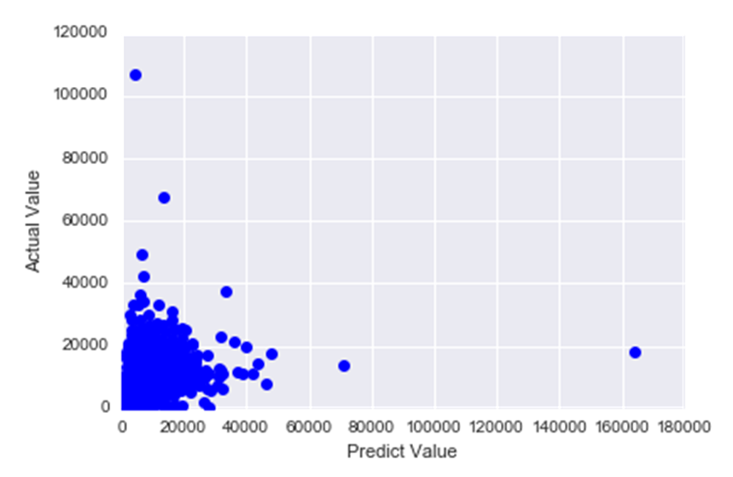
Linear Regression
Use the LinearRegression() function in sklearn package:
Return best model with:
Mae=1287.7041325114733 Mape=0.54173169267283827

Slide 14

Ridge Regression
Use Ridge() function in sklearn package:
Return best model with:
mae=1287.365393293152 mape=0.54168809725527556

Slide 15
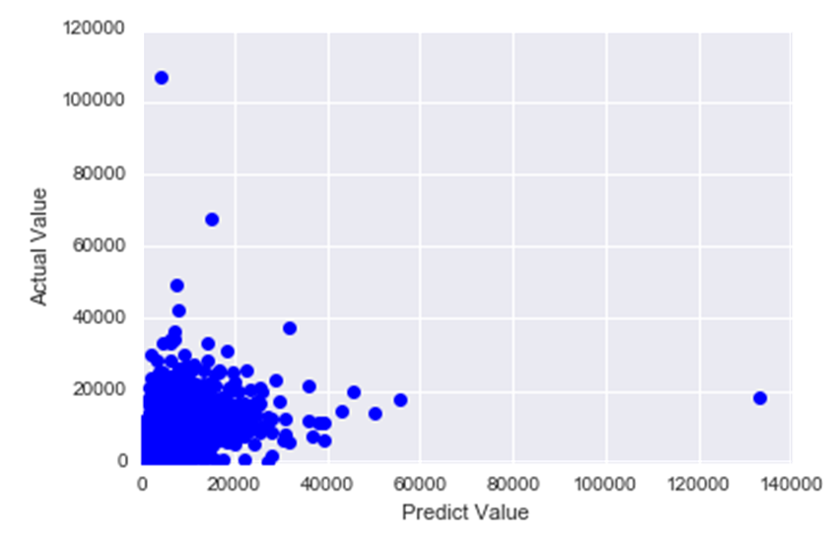
Stochastic Gradient Descent Regression
Use SGDRegressor() in sklearn package:
Return best model with:
mae= 1302.3575877161838 mape= 0.55744896931658261

Slide 16
K-Nearest Neighbors
Use KNeighborsRegressor() function in sklearn package.
Test different value of k from 1 to 20.
Since the data set is real-valued vector spaces, so, compare the performance between metric=“euclidean” and “manhattan”.
The best result is K=13, with Manhattan metric:
Mae= 1566.5540245156499
Mape=0.5696674177146013

Slide 17
KNN – by dimensionality reduced data
The computation time of KNN is extremely long due to data size and feature numbers. So, try the data which has been dimensionality reduction by PCA, the best return is:
Mae=1763.67082785
Mape=0.729602461388
The runing time speed up because 70 features reduced by PCA. But the model accuracy is bad. So, skip it.

Slide 18
Decision Tree
Since the target value is numerical, so, use the DecisionTreeRegressor() function from sklearn package instead of DecisionTreeClassifier() function.
Test parameter:depth from 1 to 20, return best model max depth=9:
Mae=1289.6021754801441,
Mape=0.55920380985414342

Slide 19
Random Forest
Use RandomForestRegressor() function from sklearn package.
For the parameter of max_depth. If in default, then nodes are expanded until all leaves are pure or until all leaves contain less than min_samples_split samples. So, would use the default.
Test n_estimators from 1 to 30:
When n_estimators=30, return best result:
Mae=1221.2938413187214
Mape=0.52190918201266601

Slide 20
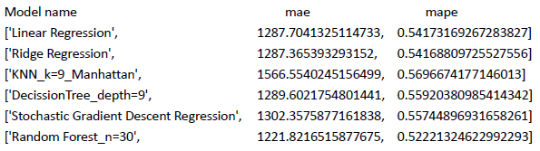
Step 5. Model Selection
Random Forest with n_estimators=30 is the best model we are looking for. Would use it to do prediction.

Slide 21
Conclusion
The data set has no label, so, we can’t have some interpretation about the data itself.
But, still get from this project:
For data set with a lot of tuple, KNN is very slow, much slower than decision tree and random forest. Regression algorithms are always fast.
PCA can reduce dimensionality, but on the other hand, the accuracy reduced. It is a trade-off, depends on different data set.
The mae=1221.82, mape=0.5222 for the best model look scary. But, since the data set is large (180K tuples), and the range of target value is wide (120K), the mae and mape of the best model is not bad.

Slide 22
Thank You

