Slide 1
Credit Prediction Problem
Group 4 Abhishek Gupta, Wandi Zhang, Yiming Ge, Yu Long & Russ Kaehler

Slide 2



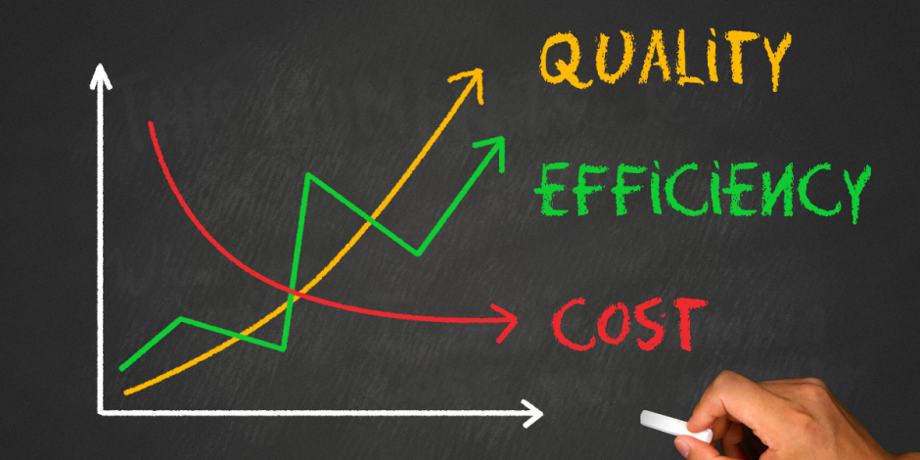
Problem Overview
Loans can be risky
Loans can take a long time to process
Difficult to determine who will pay off loans
Loan automation will increase efficiency

Slide 3
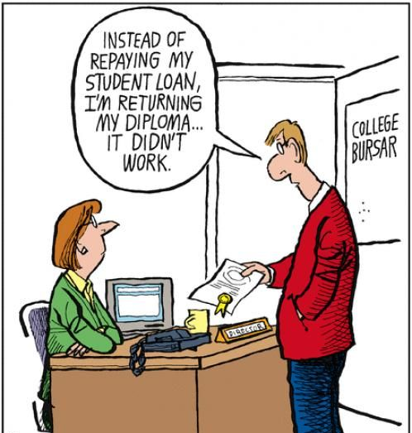
Goals
Determine who will pay loans without default
Give loans to less risky clients
Speed up loan processing time

Slide 4

Dataset Overview
Application_train.csv - 292,139 x 122
Credit_card_balance.csv - 1,048,575 x 23
Previous_application.csv - 1,670,214 x 37
Application_to_score.csv - 15,372 x 122

Slide 5
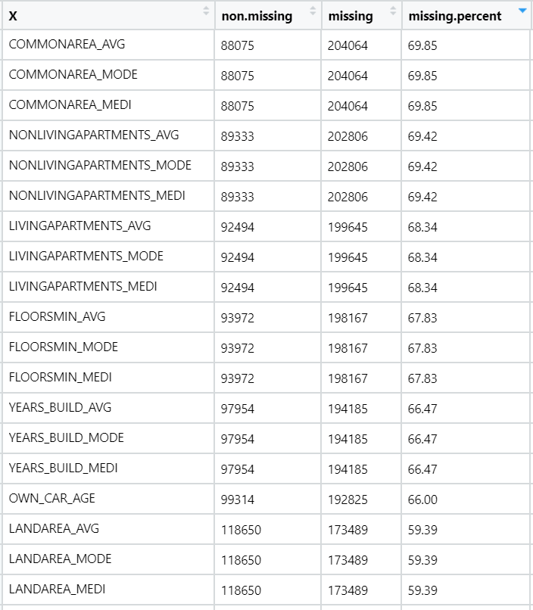
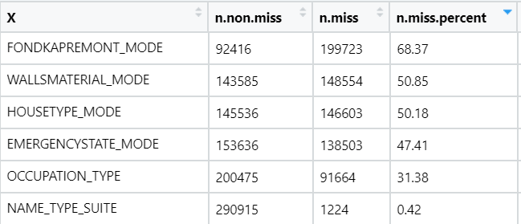

Dataset Quality Check - Application Train
Numerical Columns
Categorical Columns

Slide 6
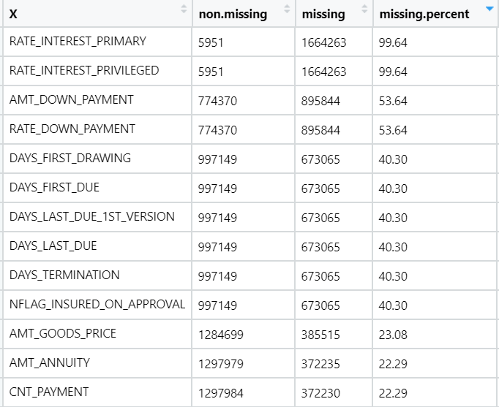
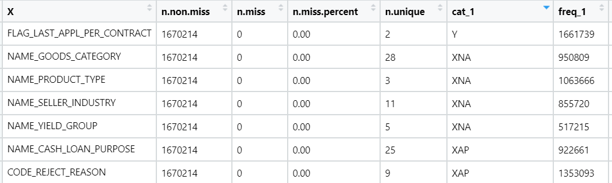
Dataset Quality Check - Previous Applications
Numerical Columns
Categorical Columns

Slide 7
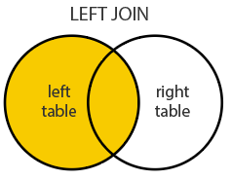
Adding in Additional Datasets
2 Approaches Used.
1st - Added all columns to Main data
2nd - Selected a subset of important features before joining.
Left Join is used to merge the data sets using SK_ID_CURR as the key.

Slide 8
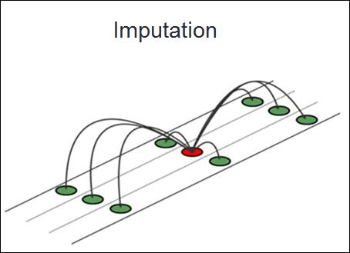
Feature Engineering
Removed Columns with high amount of NA Values.
Data imputation is done using Mice package.
Dummy variables created for categorical features.
Features are combined into new columns - Financial ratios and age groups.
Counted the previous applications and calculated how many of them were approved, refused, cancelled, and unused offers.
Calculated Avg Monthly Credit Limit

Slide 9

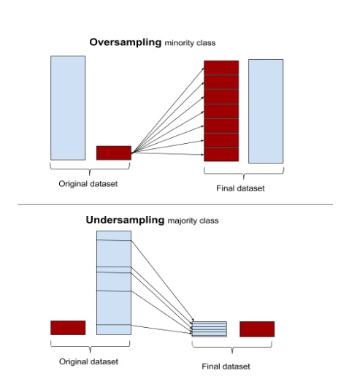

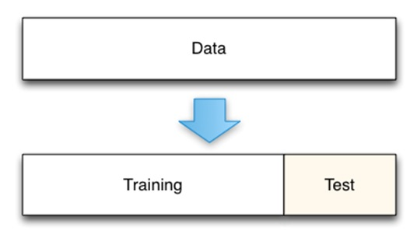
Techniques Used
10% DataSet used for Feature Selection
Train & Test Split
Under, Over, and Both Sampling
Tuning

Slide 10
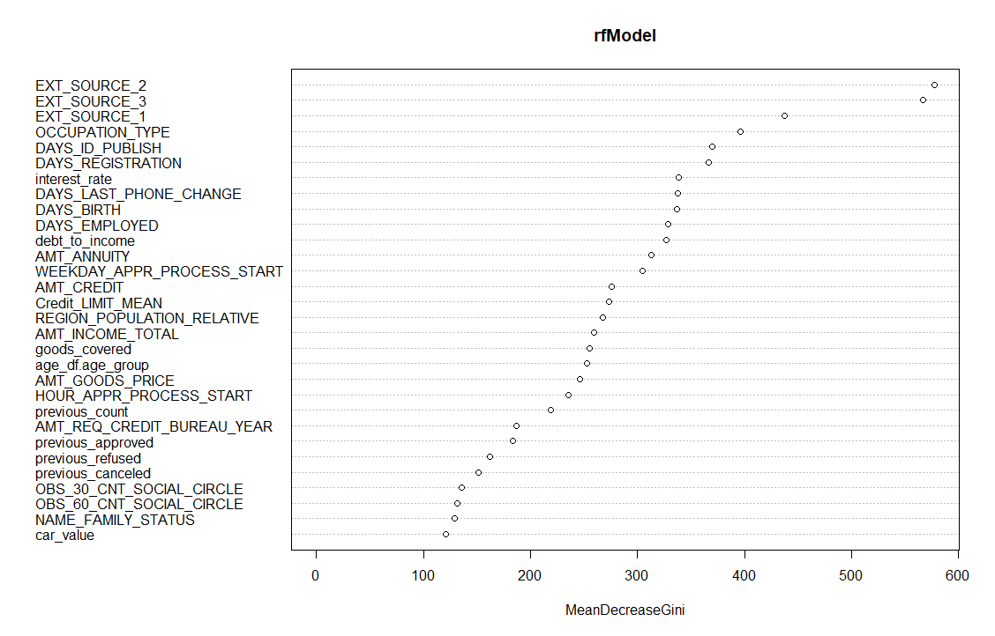
Feature Importance
Features are selected using Random Forest
All 3 Data Sets contributed to important features
The count of of previous application, how many of them were approved, refused, and cancelled impacts our model.
The Mean Monthly Credit Card Limit impact our Model.

Slide 11
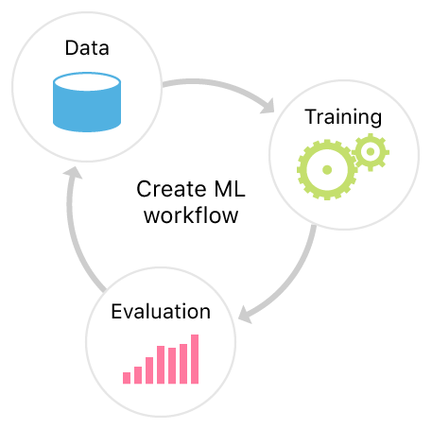
Models We Created Using the Dataset
XGBoost
CatBoost
GBM
Logistic Regression
Random Forest

Slide 12
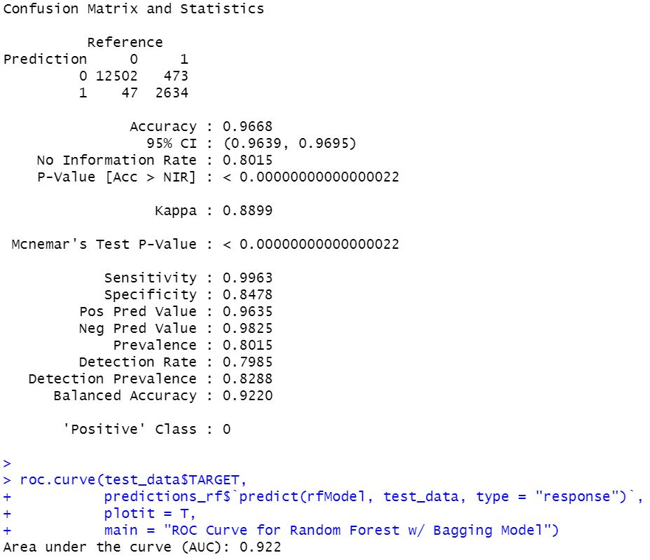
Random Forest Model
Balancing Used - 20% Both
Accuracy | 0.9668
Sensitivity (T+, Recall) | 0.9963
Specificity (T-) | 0.8478
Precision | 0.9825
F | 0.91
G | 0.912
AUC | 0.922

Slide 13
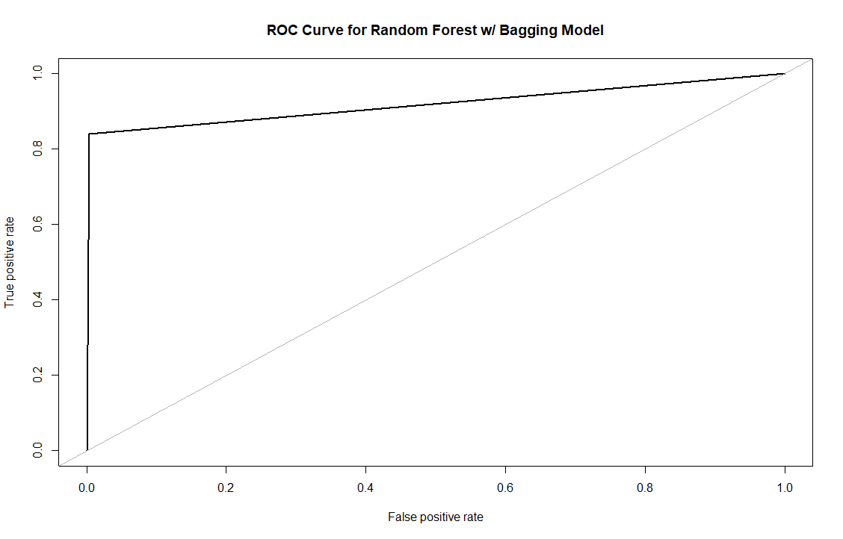
Roc Curve - Random Forest
ROC Curve of Random Forest (AUC): 0.922

Slide 14
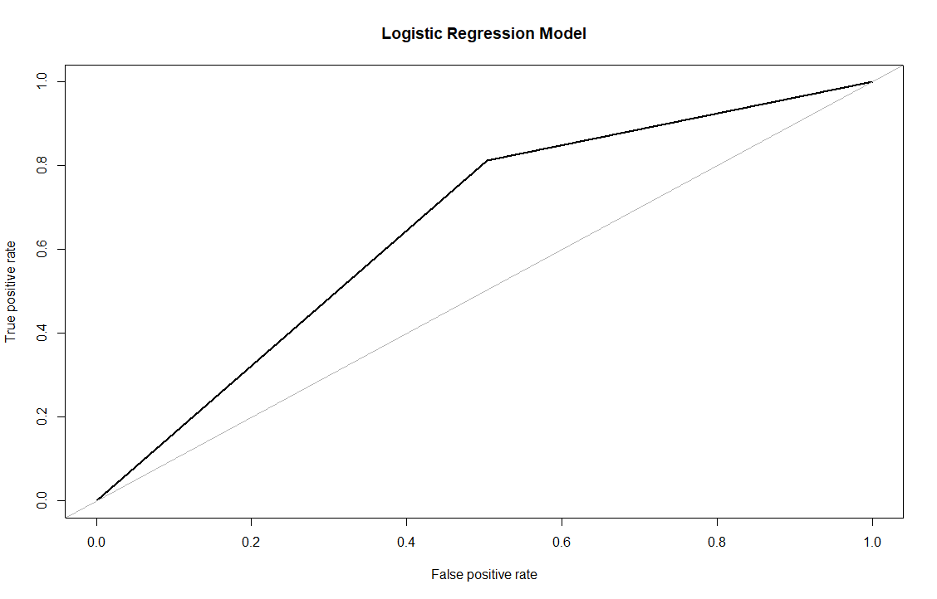
Roc Curve - Logistic Regression
ROC Curve of Logistic Regression (AUC): 0.654

Slide 15
XGBoost
 | xgboost unbalanced | xgboost unbalanced FS | xgboost oversample | xgboost oversample FS | xgboost undersample | xgboost undersample FS | xgboost both sampling | xgboost both FS
Accuracy | 0.9086 | 0.9104 | 0.9051 | 0.9037 | 0.7922 | 0.789 | 0.8766 | 0.9037
P-Value | 0.9999 | 0.9995 | 1 | 1 | 1 | 1 | 1 | 1
Sensitivity | 0.0713 | 0.0685 | 0.0899 | 0.107 | 0.428 | 0.4237 | 0.1812 | 0.1067
Specificity | 0.9814 | 0.9836 | 0.9759 | 0.9729 | 0.824 | 0.8208 | 0.9371 | 0.973
Balanced Accuracy | 0.5263 | 0.526 | 0.5329 | 0.54 | 0.6259 | 0.6222 | 0.5591 | 0.534
f-score | 0.9526 | 0.9529 | 0.9501 | 0.9481 | 0.8843 | 0.8804 | 0.9338 | 0.9021
g-score | 0.953 | 0.9534 | 0.9534 | 0.9534 | 0.8857 | 0.8821 | 0.9338 | 0.9485
AUC | 0.6431 | 0.6424 | 0.658 | 0.6392 | 0.665 | 0.6559 | 0.6469 | 0.6412
precision | 0.9828 | 0.9846 | 0.9774 | 0.9732 | 0.8368 | 0.8308 | 0.9402 | 0.9732
recall | 0.9242 | 0.9232 | 0.9243 | 0.9243 | 0.9375 | 0.9365 | 0.9274 | 0.9243

Slide 16
CatBoost
 | catboost unbalanced | catboost unbalanced FS | catboost oversample | catboost oversample FS | catboost underample | catboost underample FS | catboost both sampling | catboost both sampling FS
Accuracy | 0.9186 | 0.9181 | 0.8625 | 0.8617 | 0.8368 | 0.8441 | 0.798 | 0.7817
P-Value | 0.7562 | 0.8133 | 1 | 1 | 1 | 1 | 1 | 1
Sensitivity | 0.0302 | 0.0316 | 0.3046 | 0.2888 | 0.3822 | 0.3262 | 0.4339 | 0.3922
Specificity | 0.9953 | 0.9945 | 0.9106 | 0.9111 | 0.876 | 0.8888 | 0.82943 | 0.8153
Balanced Accuracy | 0.5127 | 0.5131 | 0.6076 | 0.6 | 0.6291 | 0.6075 | 0.6317 | 0.6038
f-score | 0.957 | 0.9564 | 0.9269 | 0.9223 | 0.9187 | 0.9198 | 0.8901 | 0.8747
g-score | 0.9577 | 0.9572 | 0.927 | 0.9224 | 0.9189 | 0.9199 | 0.8913 | 0.8767
precision | 0.9945 | 0.9953 | 0.9207 | 0.9165 | 0.9003 | 0.9024 | 0.847 | 0.8197
recall | 0.9222 | 0.9205 | 0.9332 | 0.9282 | 0.9378 | 0.9378 | 0.9379 | 0.9376
AUC | 0.7098 | 0.6948 | 0.6666 | 0.6359 | 0.7032 | 0.7129 | 0.6603 | 0.642

Slide 17
GBM
 | GBM unbalanced | GBM unbalanced FS | GBM oversampling | GBM oversampling FS | GBM undersample | GBM undersample FS | GBM both sampling | GBM both sampling FS
Accuracy | 0.9177 | 0.9183 | 0.8349 | 0.8248 | 0.8287 | 0.8337 | 0.7271 | 0.7216
P-Value | 0.6466 | 0.5719 | 1 | 1 | 1 | 1 | 1 | 1
Sensitivity | 0.0407 | 0.0337 | 0.448 | 0.4368 | 0.4256 | 0.4298 | 0.6096 | 0.632
Specificity | 0.9953 | 0.9965 | 0.869 | 0.8592 | 0.8644 | 0.8695 | 0.7376 | 0.7295
Balanced Accuracy | 0.518 | 0.5151 | 0.6586 | 0.648 | 0.645 | 0.6496 | 0.6736 | 0.6808
Precision | 0.9952824 | 0.9965239 | 0.8818125 | 0.8790813 | 0.8805711 | 0.8789572 | 0.7484792 | 0.7382992
Recall | 0.9220242 | 0.9222197 | 0.9442967 | 0.9450153 | 0.9410906 | 0.9426175 | 0.957288 | 0.9556484
F-Score | 0.9572537 | 0.9579331 | 0.9119856 | 0.9108567 | 0.9098256 | 0.9096749 | 0.8401031 | 0.8330298
G-Score | 0.9579533 | 0.9586521 | 0.91252 | 0.9114523 | 0.9103281 | 0.910231 | 0.8464692 | 0.8399729
AUC | 0.7432 | 0.7422 | 0.7278 | 0.7338 | 0.7403 | 0.7432 | 0.7443 | 0.7372

Slide 18

Recommendation
External Sources are best at predicting the defaulters and so we should consider adding more external information.
Males are more likely to default at 10% as compared to females at 7%.
90.5% Contracts are Cash Loans with a 8% default rate while rest are revolving loans with a default rate of 5%.

Slide 19
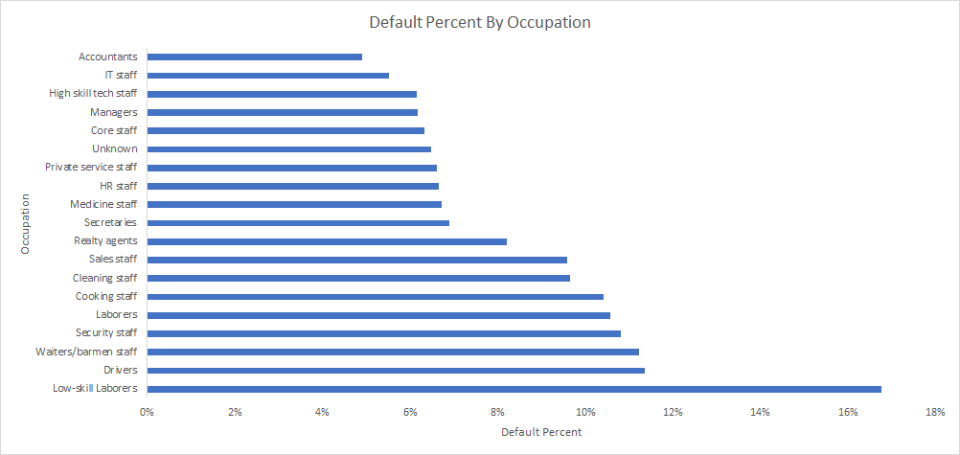
Recommendation
Low-skill Laborers are the most likely to default

Slide 20
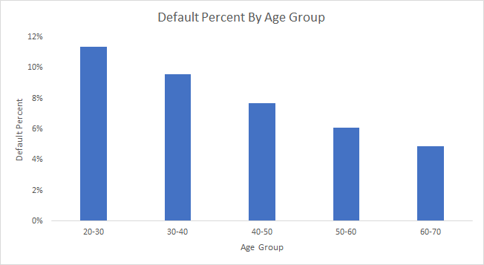
Recommendation
Younger applicants are the most likely to default

Slide 21

Recommendation
Create a tool like a website or mobile app and let the users add their information.
Based on the model coded in the backend, tell them if they should forget about getting a loan from us or whether they should move ahead and invest their time in further processing of application.
Tell them how they can improve their chances of getting a loan.

Slide 22
THANK YOU
Group 4

