Slide 1

Underage Alcohol Consumption
Group 8
Yiming Ge, Zhixuan Lei, Zhixin Zhou, Yichen Ni

Slide 2
Agenda
This presentation contains three parts.
01
02
03
Underage drinking is dangerous
Student alcohol consumption dataset analysis
How to prevent underage drinking
Underage drinking is risky
Data about consequences of underage drinking
An overview of the dataset
Gender, family, social and academic factors related to alcohol
Underage drinking is a social issue
Measures to reduce underage drinking

Slide 3



Dangers of Underage Drinking
Everyone knows drinking is dangerous. Data shows exactly how risky underage drinking is.
Deaths & Injuries of Young People
Increases Risk of Alcoholism
Affects Brain Development
On average, alcohol is the factor of deaths of 4358 young people and 188,000 ER visits every year.
Teenagers who start drinking before 15 years old are 4 times more likely to be alcohol dependent.
Alcohol can affect children’s brains which continue developing into their early 20s.

Slide 4




Dataset Summary
This is an executive-level summary of the information in the student alcohol consumption dataset.
1044
25%
5%
20%
Total number of records in the sample
By the age of 17, % of students who have had at least one drink
% of students who have high alcohol consumption on weekdays
% of students who have high alcohol consumption on weekends

Slide 5
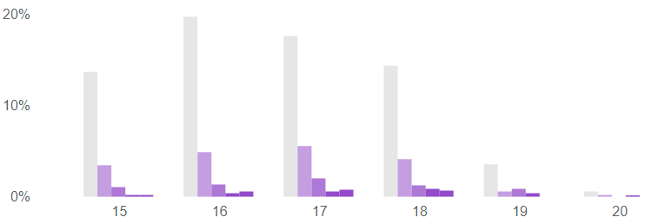
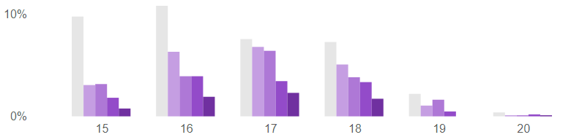
Age Distribution
Age is an important factor in underage drinking. Elder students tend to drink more.
A majority of students in the dataset are < 18 yrs.
Students drink more as they grow older, especially on weekends
Alcohol consumption by age (weekdays)
% of students under 18
72%
% of total students
Underage drinking is more severe on weekends
Age
Alcohol consumption by age (weekends)
% of underage students with high alcohol consumptions on weekends
% of total students
20%
Age

Slide 6
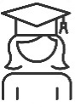

Gender Difference
The data shows male students drink more than female, and the difference is huge.
Female Students
Male Students
Only 9% of female students have high alcohol consumptions on weekends
While 34% of male students have high alcohol consumptions on weekends
9%
34%
Female students from all age groups drink less than 2.5 alcohol on average
Male students’ avg. alcohol consumption continue increasing to 17 years old

Slide 7
Family Influence
Mother’s education level and father’s vocation are factors that influence student alcohol consumption.
A majority of students’ parents work in service or other industry
Students whose fathers work in services drink more on average
Fathers’ vocation industry components
Fathers’ vocation industry by avg. alcohol consumption
Students whose mothers have low education drink more on average
Mothers’ vocation industry components
Mother’s education level by avg. alcohol consumption

Slide 8
Social & Stress Factors
Social factors have important effects on high alcohol consumption, especially going out with friends.
Survey Question
Family educational support (Yes or No)
Attended nursery school (Yes or No)
Wants to take higher education (Yes or No)
Quality of family relationship (Good or Bad)
Internet access at home (Yes or No)
With a romantic relationship (Yes or No)
Frequency of going out with friends (Low or High)
Hours of free time after school (Low or High)
Average Alcohol Consumption
Low
High
Low
High
Low
High
Low
High
Low
High
Low
High
Low
High
Low
High

Slide 9
Academic Performance
Students who drink more, no matter on weekdays or weekends, tend to score lower in exams.
Students who drink more on weekends score lower in final exams despite the study time
Students who drink more on weekdays score even lower than those who drink on weekends
The correlation between study time and final grade
(weekends alcohol consumption)
The correlation between study time and final grade
(weekdays alcohol consumption)

Slide 10
Academic Performance
Students who drink more on weekends and weekdays tend to score lower in language course.
Students who drink little alcohol score higher as study time increases
Students who drink more on both weekends and weekdays score lower in language course
The correlation between study time and final grade
(Low alcohol consumption)
The correlation between study time and final grade
(high alcohol consumption)

Slide 11



Preventing Underage Drinking
Underage drinking is a severe social problem. Measures can be taken to reduce underage drinking.
Law Response
Other Response
Since US set the National Minimum Drinking Age as 21 in 1958, % of underage drinking decreased over the years
Parents
Look out for signs of alcohol abuse, such as rebelliousness, anxiety, behavioral problems etc.
% of high school seniors who have 5+ drink during the last 12 months
Schools
Provide students with the knowledge, motivation and opportunities to be alcohol-free
Internet
Exposing to social media contents with alcohol might increase underage drinking

Slide 12
Reference Page
Bellow are the reference and footnotes of this project.
Data source: Kaggle, UCI Machine Learning;
https://www.kaggle.com/uciml/student-alcohol-consumption
More source info: P. Cortez and A. Silva. Using Data Mining to Predict Secondary School Student Performance. In A. Brito and J. Teixeira Eds., Proceedings of 5th Future Business Technology Conference (FUBUTEC 2008) pp. 5-12, Porto, Portugal, April, 2008, EUROSIS, ISBN 978-9077381-39-7.
In this project, high alcohol consumption is defined as students reporting they drink 4-5 alcohol in the survey. Low alcohol consumption is defined as students reporting they drink 1-2 alcohol in the survey.
Why is underage drinking a problem?
https://www.niaaa.nih.gov/publications/brochures-and-fact-sheets/underage-drinking
https://www.drugrehab.com/addiction/alcohol/underage-drinking/
https://www.cdc.gov/alcohol/fact-sheets/underage-drinking.htm
The 21 legal drinking age in the US:
https://www.consumer.ftc.gov/articles/0386-21-legal-drinking-age
Social media influences on underage drinking：
https://www.ncbi.nlm.nih.gov/pmc/articles/PMC4432862/

