Slide 1

Harriott Hotels Analysis
Yiming Ge

Slide 2
General Data Summary
568 M
100 K
3 days
87K
Total revenue from 2014 to 2016 is 568 million. 1.22 million transactions in total..
Total guests are 100 thousand. 40% are female(40.07K) and 60% are male (59.93K).
Average stays for each costumer is almost 3 days (2.7 days)
Costumers’ average household income is 86.74 thousand (higher than US HHI median 59 thousand) and the avg. NPS is 7.59

Slide 3
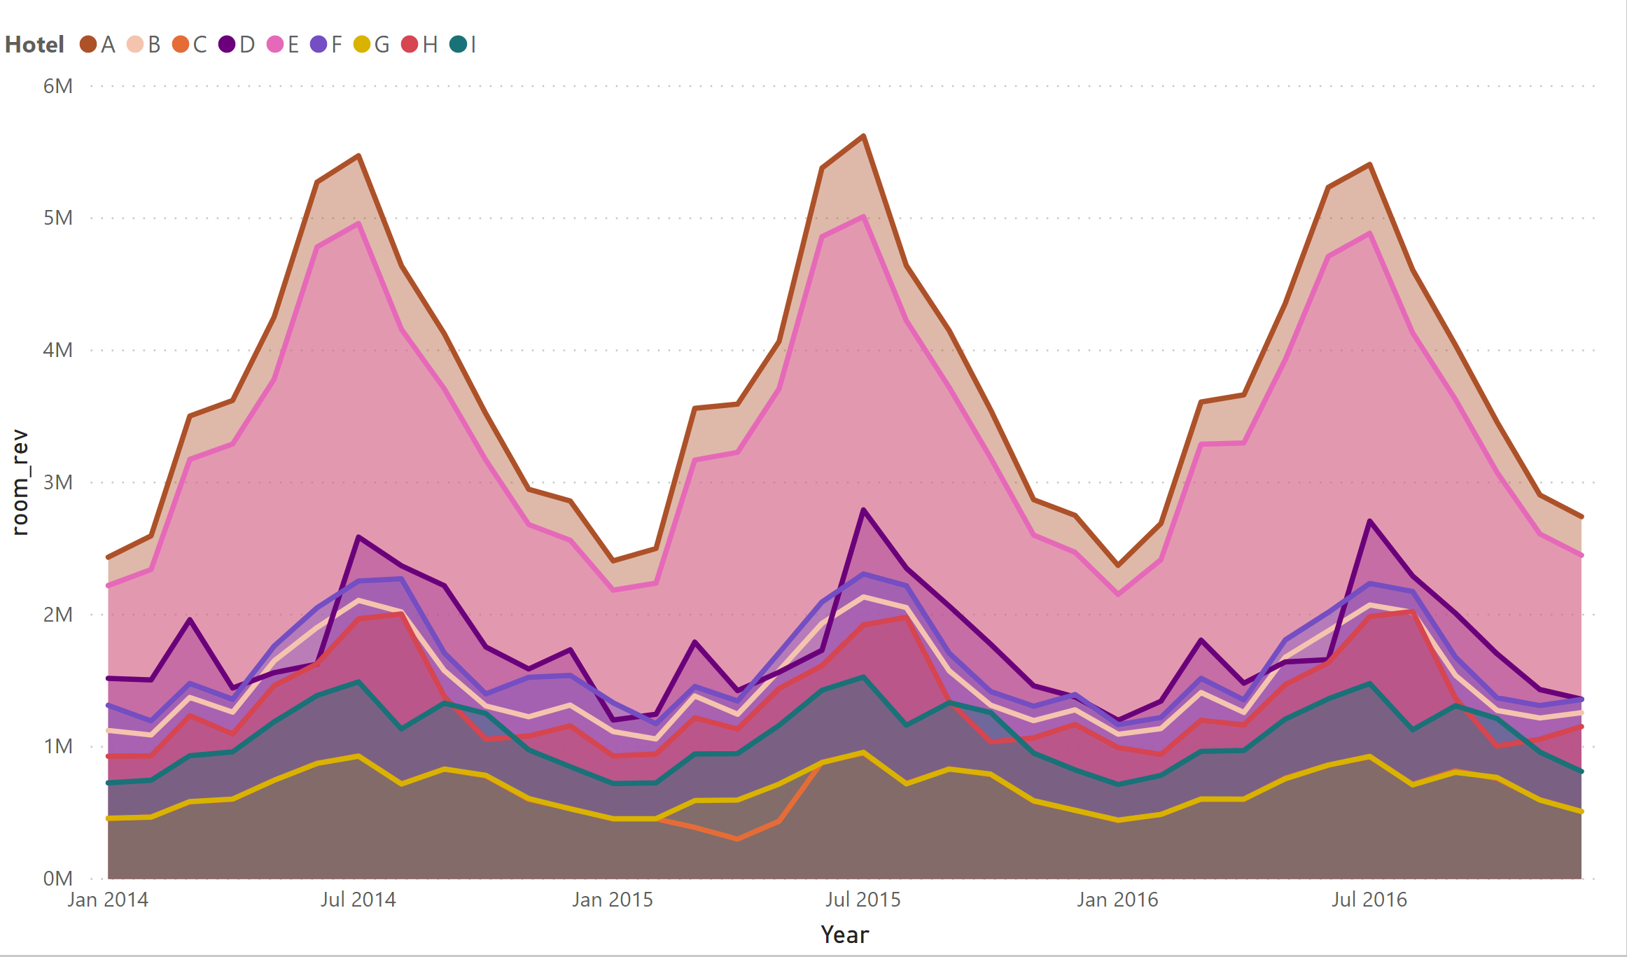
Revenue Analysis
Revenue Trend
A and E hotel have very large amount of revenue and all 9 hotels have same revenue trend

Slide 4
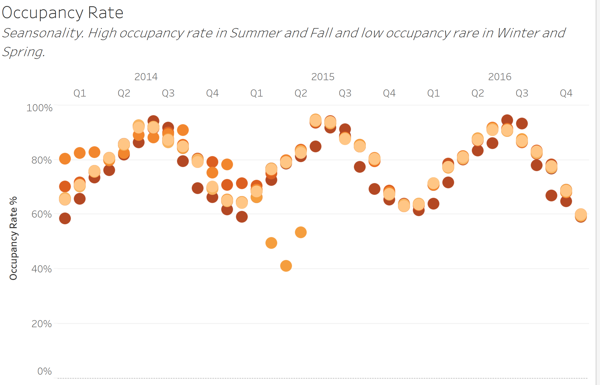
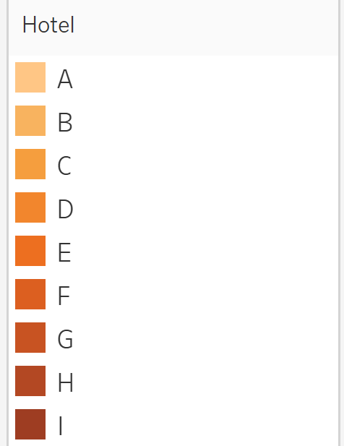
Occupancy Analysis

Slide 5
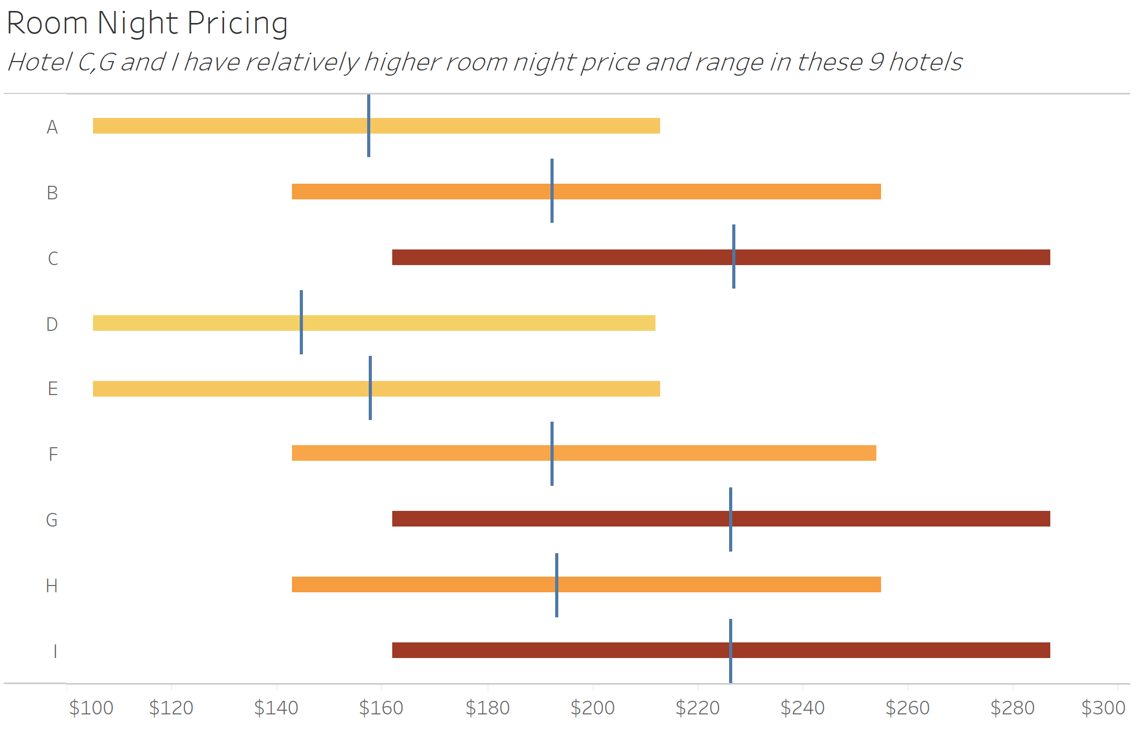
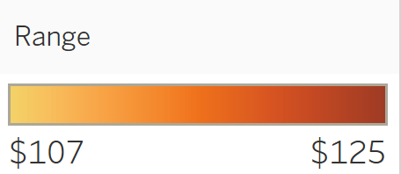
Room Night Price

Slide 6
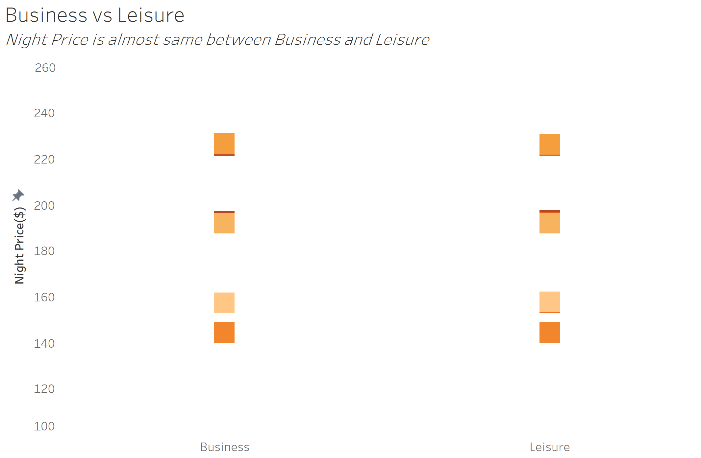
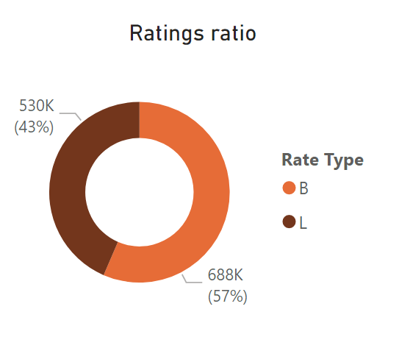
Business Price vs Leisure Price

Slide 7
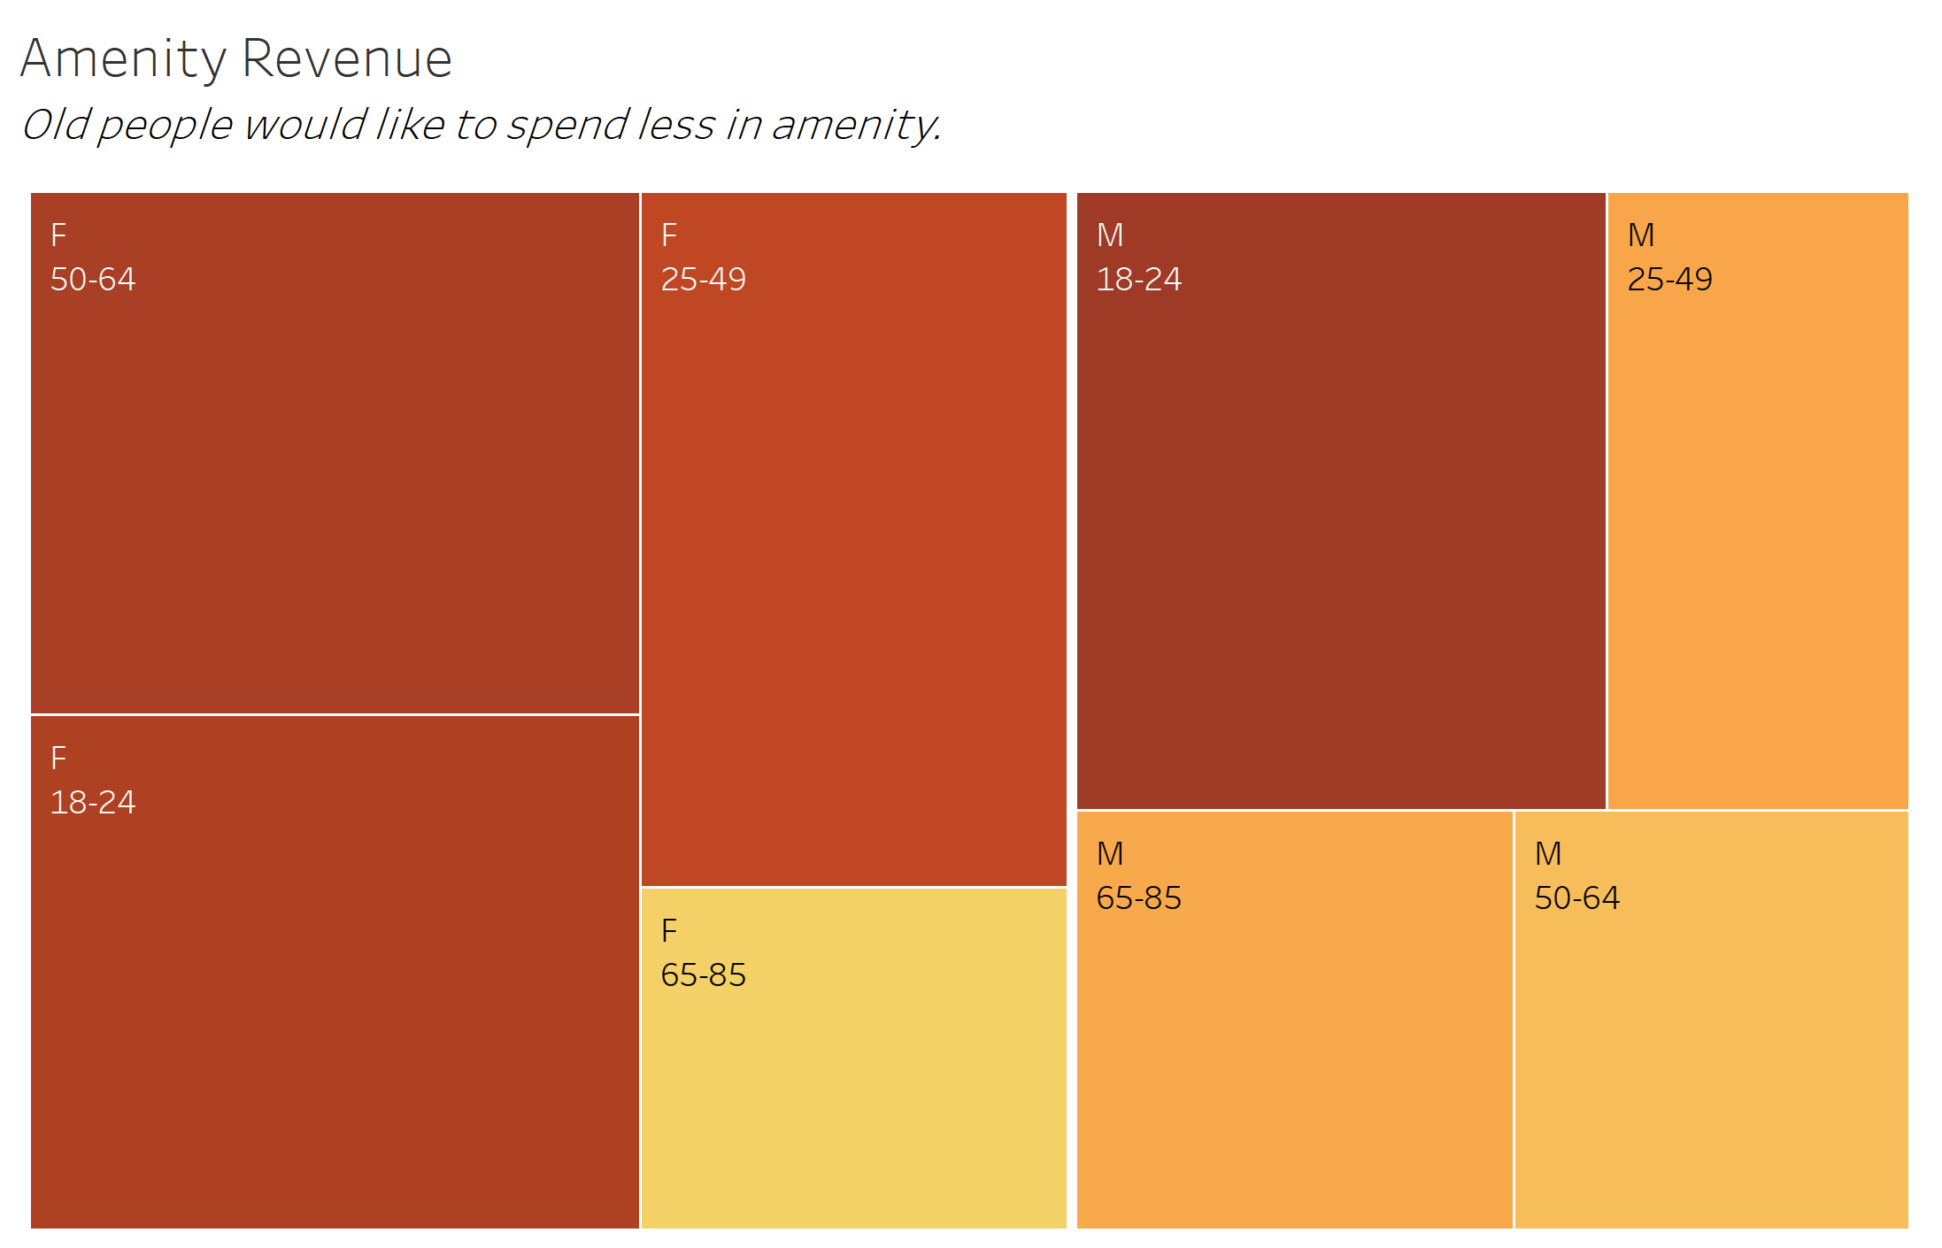
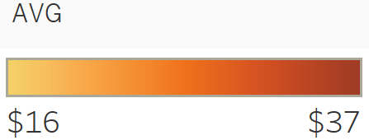
Customers Age Analysis

Slide 8
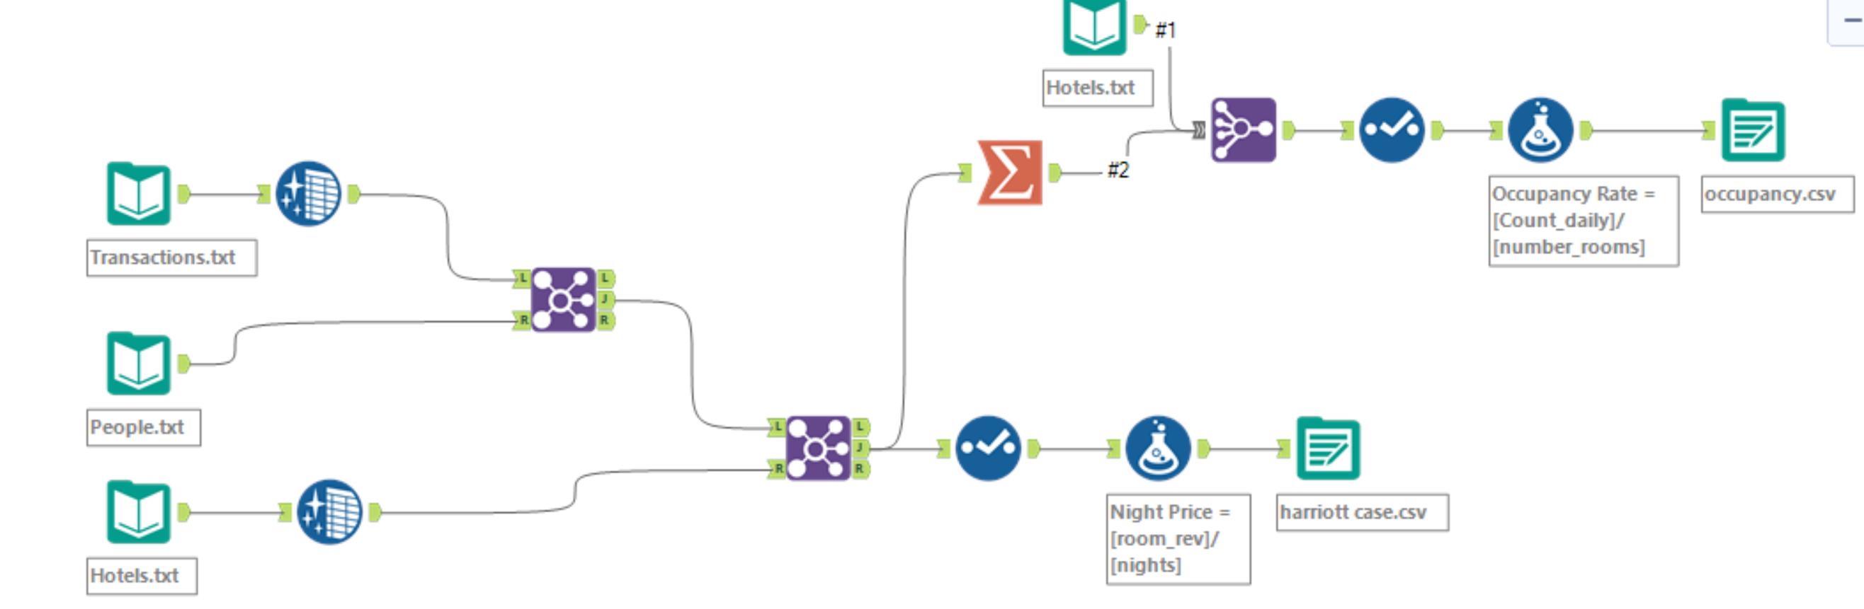
Data Processing
1. Clean Nulls in both Hotels and Transactions data.
2. Join people and transactions with person_id, then join with Hotels with hotel_id.
3. Change String to Double and use room_rev/nights to calculate night price.
4. Count trans_id and group by checkin and hotel_id to get Count_daily.
5. Change String to Double and use Count_daily divided by number_rooms to get Occupancy Rate.

