Slide 1

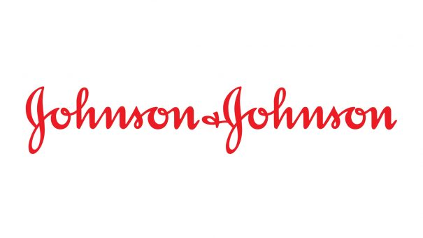
J&J Organizational Structure Analysis
Yiming Ge
4/22/2020

Slide 2
Executive Summary
11076
99%
$76K
4.38
Data collected from 11076 IT focused employees(43%) and contract workers(57%) in J&J.
Majority:
34% from USA and 32% from India
44% in Pharmaceutical Department
99% employees have the regular and full-time job in J&J.
The average annual salary is 76K in J&J.
Annual salary for Leadership & Strategy is 3 times higher than average: 239K.
USA annual average salary(13.6K) is 4.38 times higher than Indian salary(3.1k) in J&J.

Slide 3
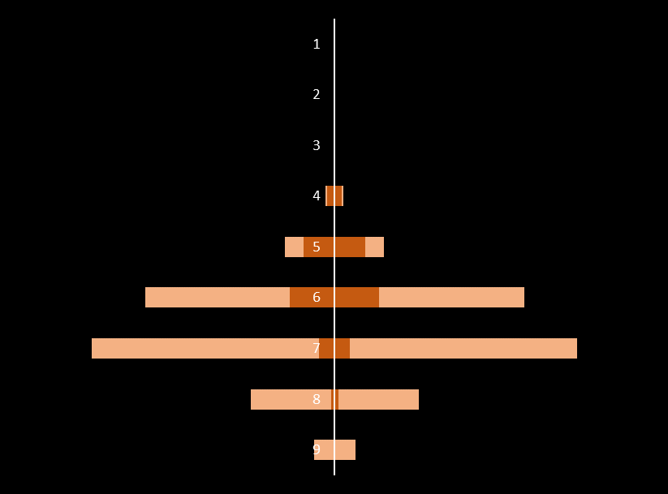
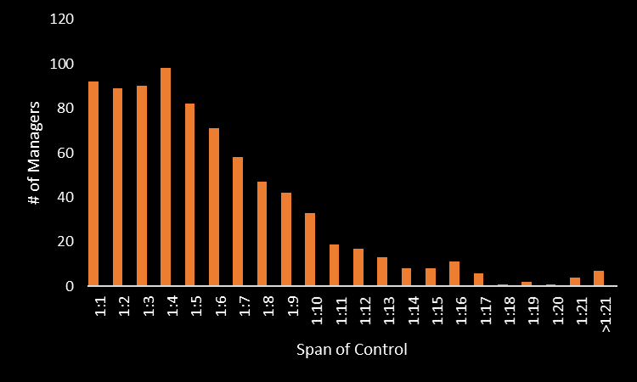
Spans and Layers Analysis
Overabundance of managers in Level 4 and 5.
Few managers in level 7, 8 and 9.
Skew to the right. Most managers in J&J supervised five or even less employees on average.
The efficiency of managers is questionable.

Slide 4
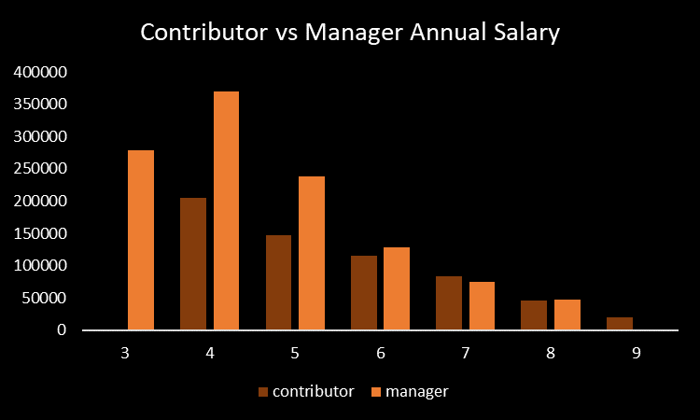
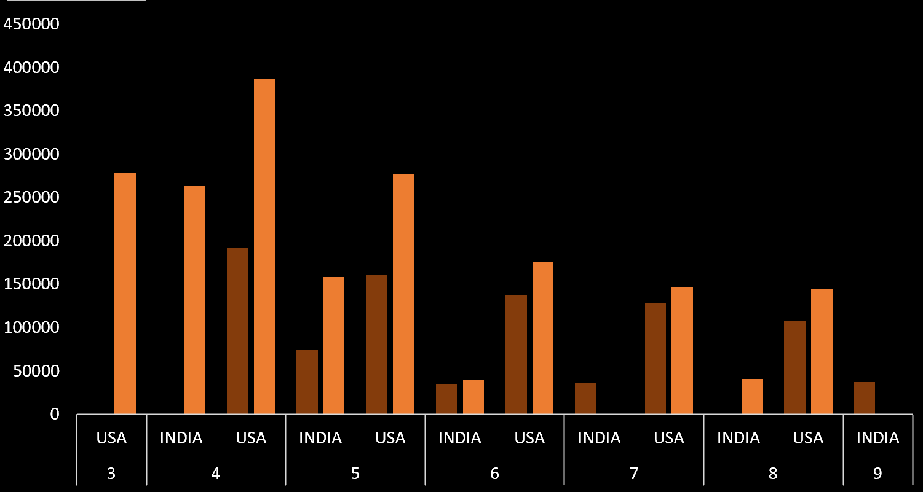
Annual Salary Analysis
Managers in level 4 and 5 have very high compensation. In lower level managers have almost same salary as contributors. Salary structure worth revising.
In high level, Indian has similar salary with American. However in low level, the compensation for India is far behind the United State.

