Slide 1

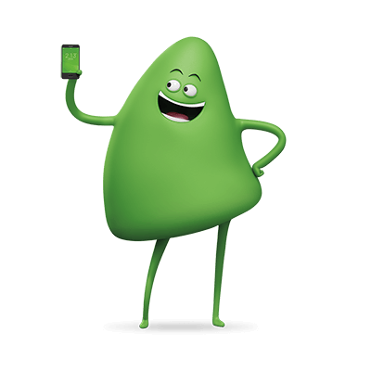


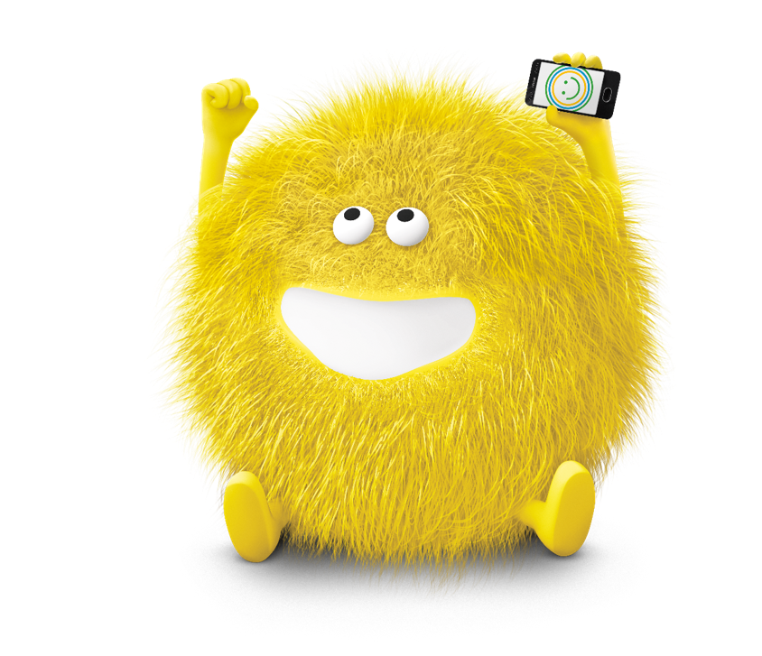

Customers Segmentation Analysis
35.97 THOUSAND
CUSTOMERS INFO
Customers use cricket for avg. 19.5 months
Churn Rate
Income Group Beyond Level 5
Avg. Age Of Customers
MONTHLY
Customers call
avg. 483 mins
28%
61.5%
43
Customers make avg 1.6 customer care calls
88% customers experienced dropped & blocked calls
3% customers got the retention calls.
Rate of
Making Referrals
Customers pay avg. $56.5
for cricket
5%

