Slide 1
Using Bayer Pattern to Detect
Fake Images
Larry Liu, Ziyao Wang, Eric Cao, Olasunade Ladenegan
February 2024

Slide 2
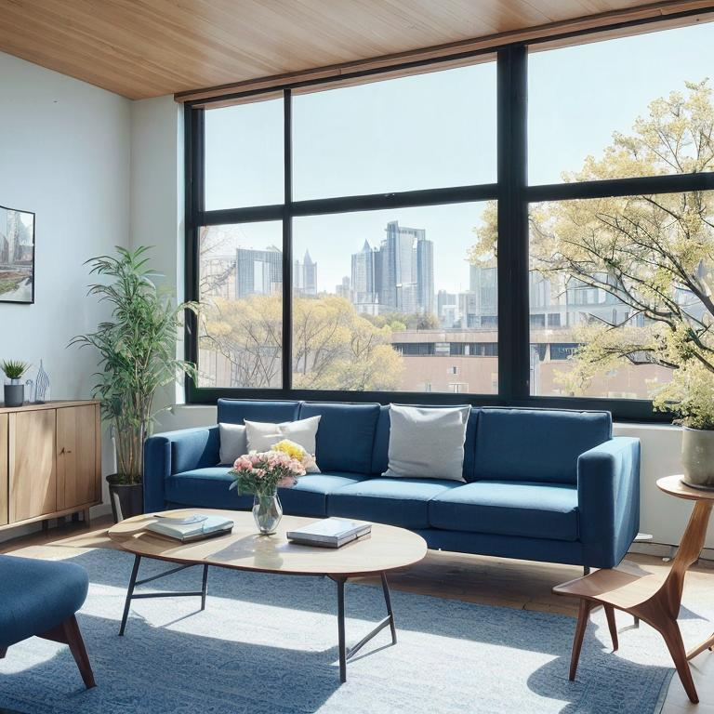
Synthesized Images
Even human eyes may fail to recognize images synthesized by deep learning.
Many deep generative algorithms are available:
Generative adversarial networks
Variational autoencoder
Diffusion and score-based models
…
Image generated by model “Landscape_photoreal”
CityEdge. Landscape_photoreal, 2023. URL https://huggingface.co/digiplay/Landscape_PhotoReal_v1. [Online; accessed 02-February-2024].

Slide 3
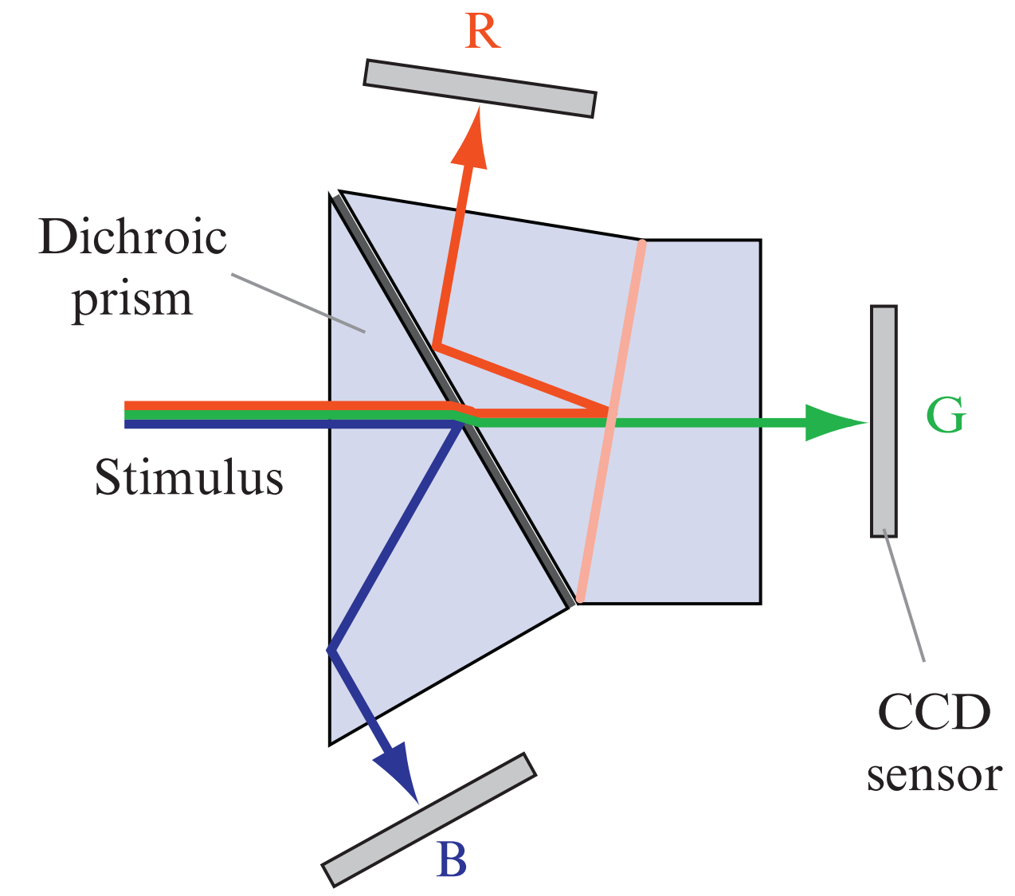
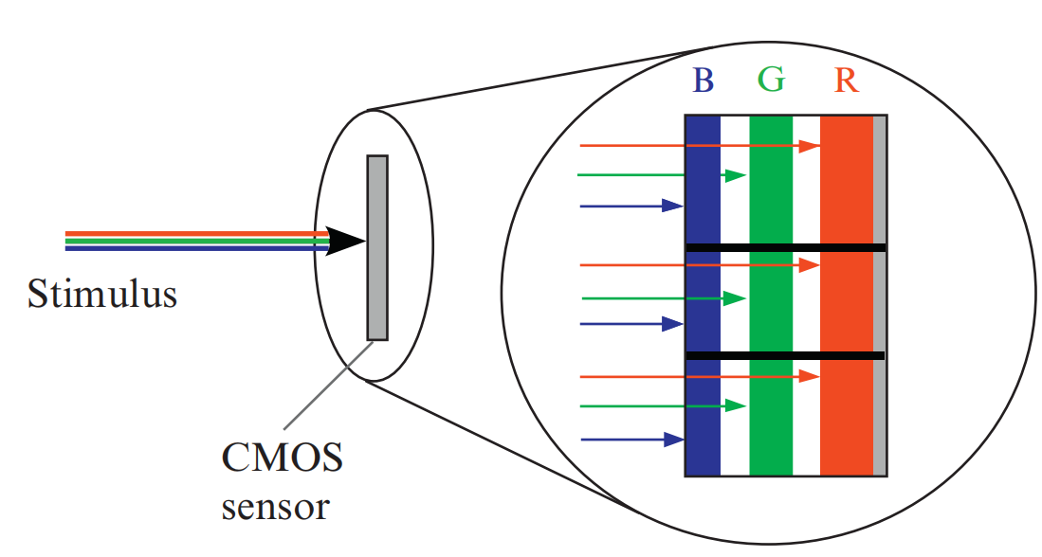
Cameras and Photosensors
CMOS and CCD photosensors convert light intensity to analog signals.
Can’t record intensity of different wavelength.
For an image to be colorful, at least three color components are needed at each pixel position.
Image source: Olivier Losson, Ludovic Macaire, and Yanqin Yang. Comparison of color demosaicing methods. In Advances in Imaging and electron Physics, volume 162, pages 173–265. Elsevier, 2010.

Slide 4
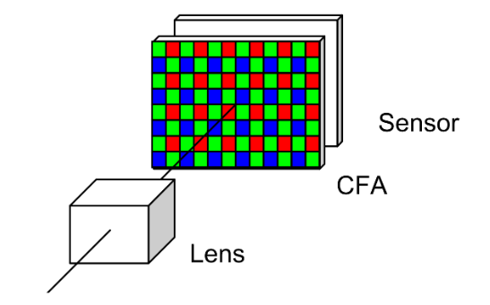
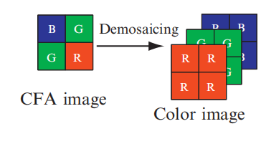
Cameras and Photosensors
Cameras with three sensors are structurally complex and expensive.
Cover a color filter array over the sensor to capture one primary color component at each location.
Interpolate the missing colors in the post-processing pipeline.
Image source: Xin Li, Bahadir Gunturk, and Lei Zhang. Image demosaicing: A systematic survey. In Visual Communications and Image Processing 2008, volume 6822, pages 489–503. SPIE, 2008.
Image source: Olivier Losson, Ludovic Macaire, and Yanqin Yang. Comparison of color demosaicing methods. In Advances in Imaging and electron Physics, volume 162, pages 173–265. Elsevier, 2010.

Slide 5
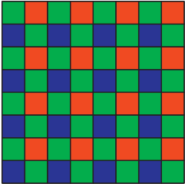
Bayer Filter
Introduced by Bryce Bayer in the Kodak company in 1976
Cone cells in human eyes can better resolve green in daylight vision
Image source: Olivier Losson, Ludovic Macaire, and Yanqin Yang. Comparison of color demosaicing methods. In Advances in Imaging and electron Physics, volume 162, pages 173–265. Elsevier, 2010.

Slide 6
Bayer Filter
Introduced by Bryce Bayer in the Kodak company in 1976
Cone cells in human eyes can better resolve green in daylight vision
Image source: Olivier Losson, Ludovic Macaire, and Yanqin Yang. Comparison of color demosaicing methods. In Advances in Imaging and electron Physics, volume 162, pages 173–265. Elsevier, 2010.

Slide 7
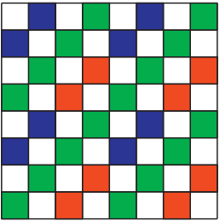
Kodak’s CFA 2.0
Featuring panchromatic filters that is transparent to all light.
Can capture a greater range of light even in dark environments.
Less accurate on color.
Image source: Olivier Losson, Ludovic Macaire, and Yanqin Yang. Comparison of color demosaicing methods. In Advances in Imaging and electron Physics, volume 162, pages 173–265. Elsevier, 2010.

Slide 8
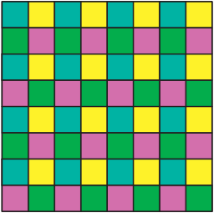
CYM-Based Filters
Use cyan, magenta, and yellow as primary color components.
Less light-absorbing blocks.
CYM is a subtractive color space. RGB is an additive color space. Interpolating the missing colors at each position is trickier.
Image source: Olivier Losson, Ludovic Macaire, and Yanqin Yang. Comparison of color demosaicing methods. In Advances in Imaging and electron Physics, volume 162, pages 173–265. Elsevier, 2010.

Slide 9
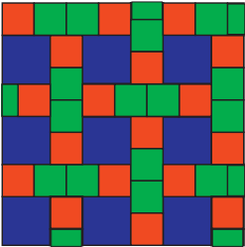
Burtoni Filter
Proposed by Ronald H H Kroger
Drew inspiration from the cone cells of cichlid fish
Reduce aliasing artifacts by incorporating more spatial frequencies and geometris of different colors
Trickier to demosaic
Image source: Olivier Losson, Ludovic Macaire, and Yanqin Yang. Comparison of color demosaicing methods. In Advances in Imaging and electron Physics, volume 162, pages 173–265. Elsevier, 2010.

Slide 10
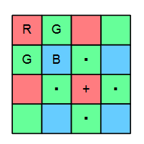
Demosaicing of Bayer Patterned Color Images
Digital cameras use charge-coupled device (CCD) sensor, with the CCD pixels preceded in the optical path by a color filter array (CFA) in a Bayer mosaic pattern
Demosaicing: the problem of interpolating back the images captured by CFA
Image source: Henrique S Malvar, Li-wei He, and Ross Cutler. High-quality linear interpolation for demosaicing of bayer-patterned color images. In
2004 IEEE International Conference on Acoustics, Speech, and Signal Processing, volume 3, pages iii–485. IEEE, 2004.

Slide 11
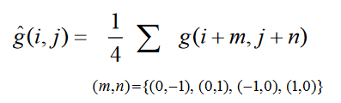
Bilinear Interpolation
At pixel position (i,j), estimating the green value:

Slide 12
Bilinear Interpolation
Pros:
Simple to compute
Cons:
Generates significant artifacts, especially across edges and other high-frequency content

Slide 13
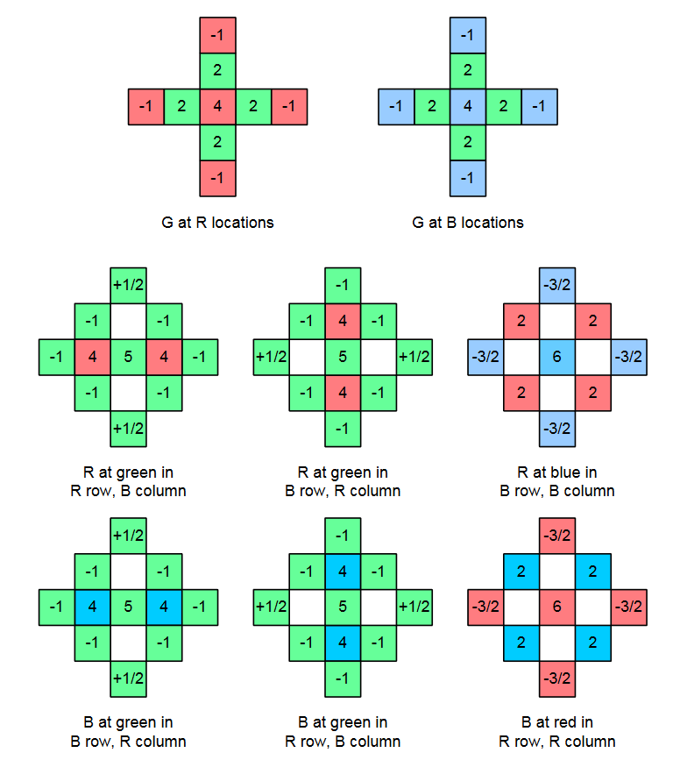
Gradient-corrected bilinear interpolation
Edges have much stronger luminance than chrominance components
There’s a sharp luminance change at that pixel when there’s a sharp change in one color channel
Image source: Henrique S Malvar, Li-wei He, and Ross Cutler. High-quality linear interpolation for demosaicing of bayer-patterned color images. In
2004 IEEE International Conference on Acoustics, Speech, and Signal Processing, volume 3, pages iii–485. IEEE, 2004.

Slide 14

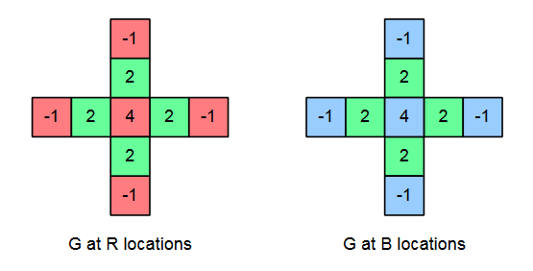
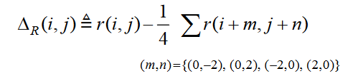
Gradient-corrected bilinear interpolation

Slide 15
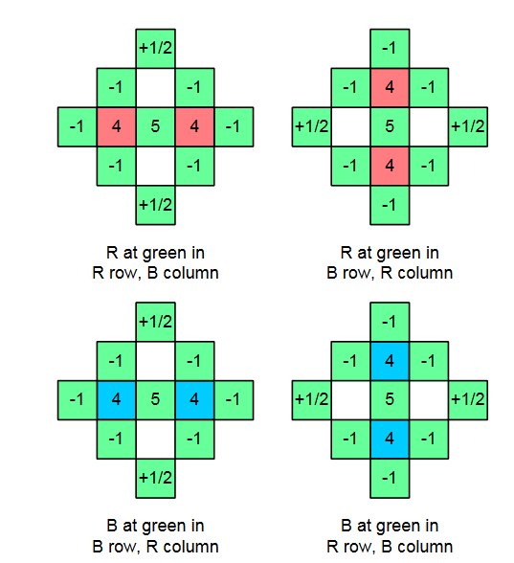

Gradient-corrected bilinear interpolation

Slide 16
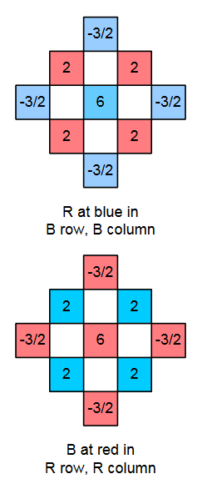

Gradient-corrected bilinear interpolation

Slide 17
Gradient-corrected bilinear interpolation
Gain factor:

Slide 18
Metrics for Evaluation
The three primary metrics that would be used for evaluation of our hypothesis are
PSNR
SSIM
VMAF

Slide 19
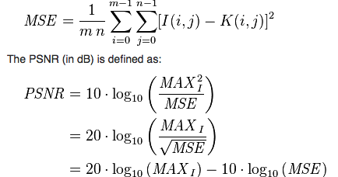
Peak Signal-to-Noise Ratio (PSNR)
The peak signal to noise ratio is the ratio of the maximum possible signal power to the power of the distorting noise that affects the quality of its representation.
PSNR values are measured in decibels (dB).
The higher the PSNR value, the better the image quality.

Slide 20

Structural Similarity Index Measure (SSIM)
The SSIM metric is a perception based model that uses structural information to measure the quality of images
It breaks image distortion into the 3 components below to quantify image quality.
Luminance
Contrast
Structure
SSIM values are on a scale of 0 -1
It aligns well with the Human Visual System and has great accuracy.

Slide 21
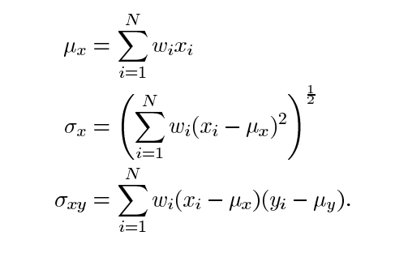
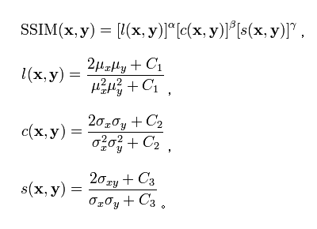
Structural Similarity Index Measure (SSIM)

Slide 22
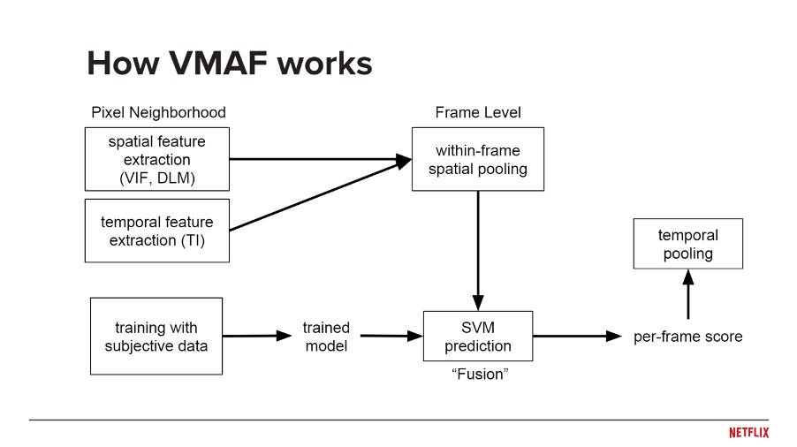
Video Multimethod Assessment Fusion (VMAF)
VMAF is a metric that was developed by Netflix and 3 universities
VMAF combines multiple image quality metrics using machine learning to predict image quality.
VMAF scores range from 0-100.

Slide 23
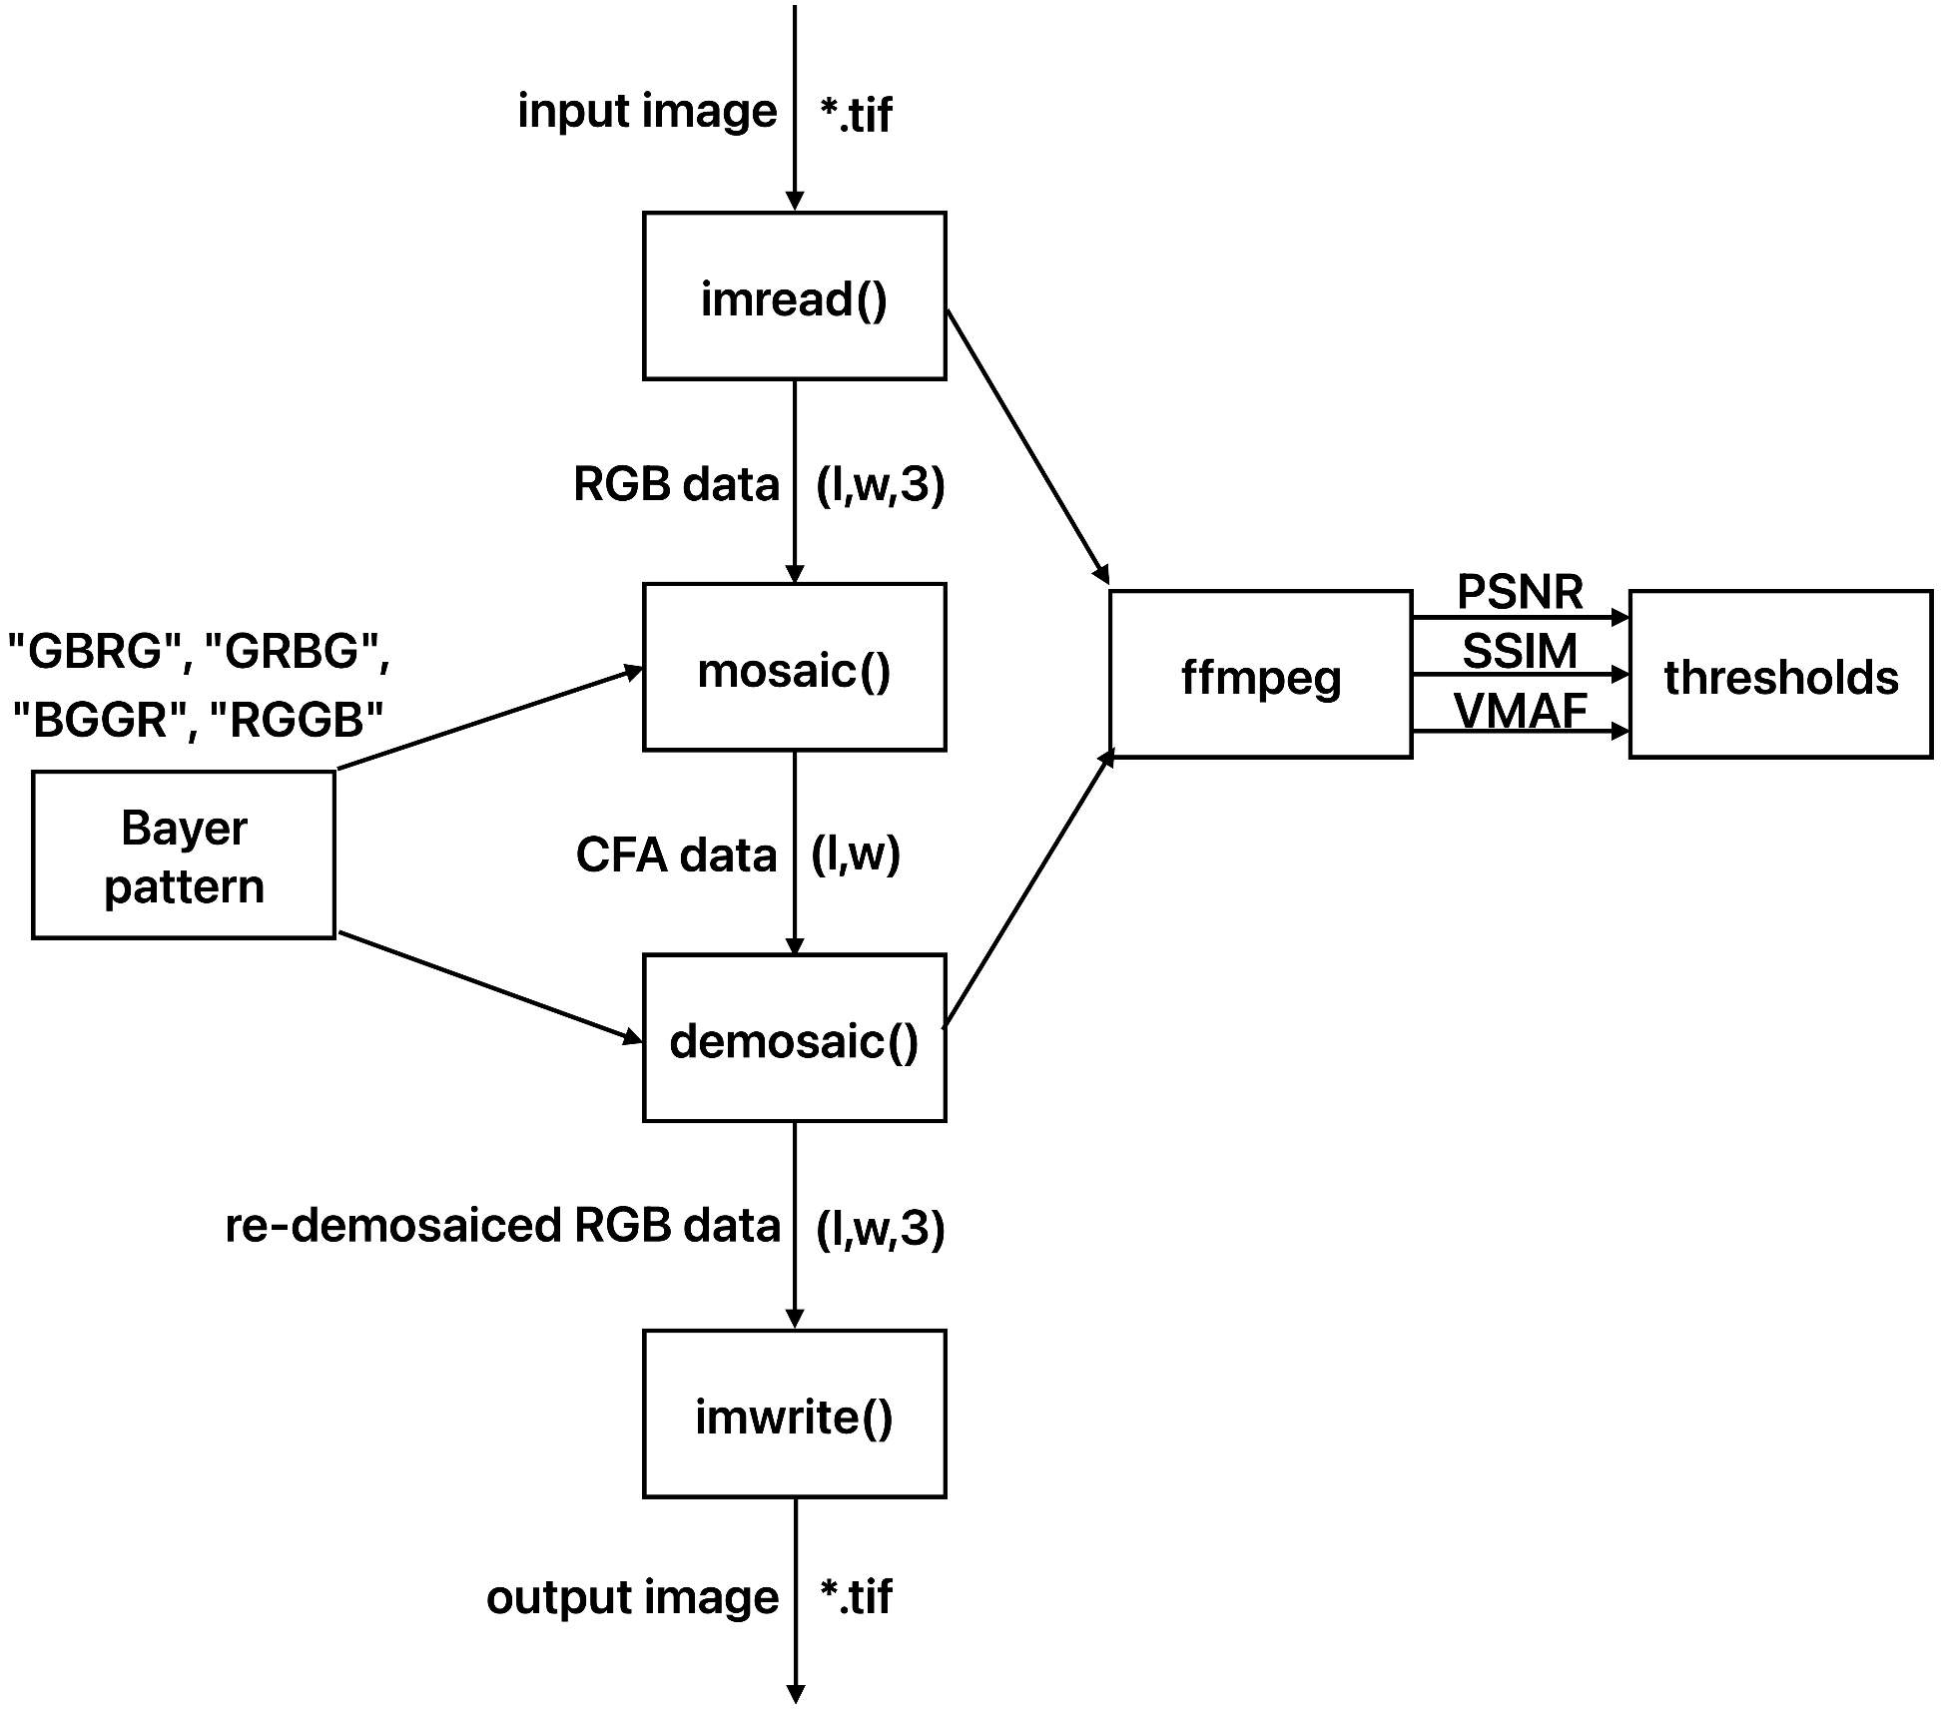
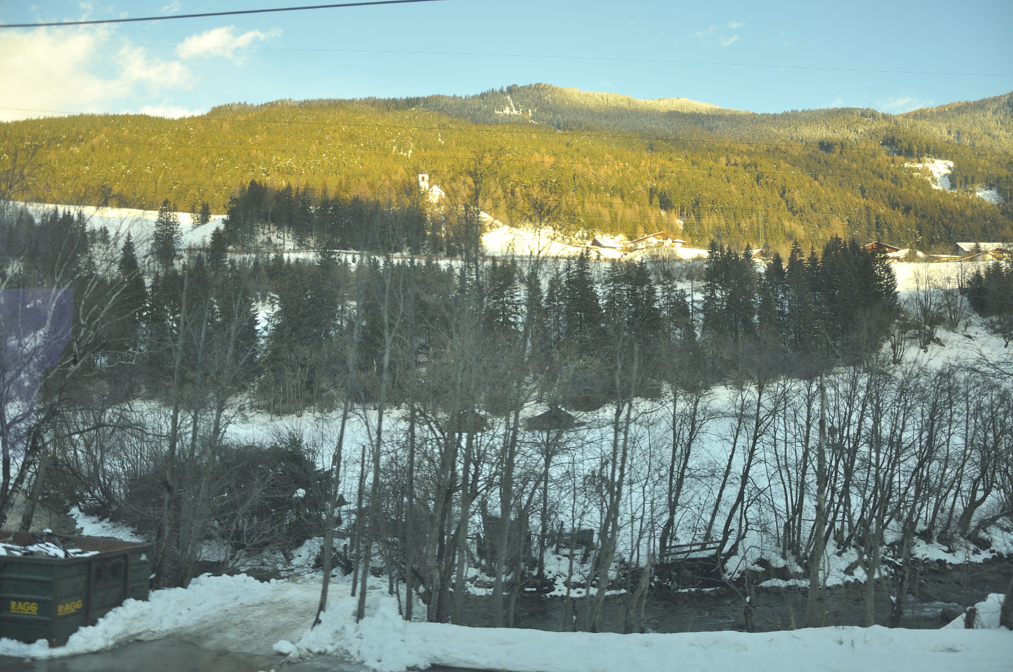
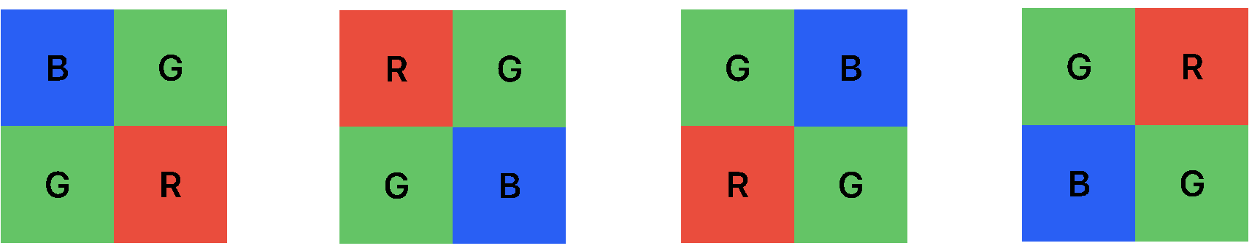
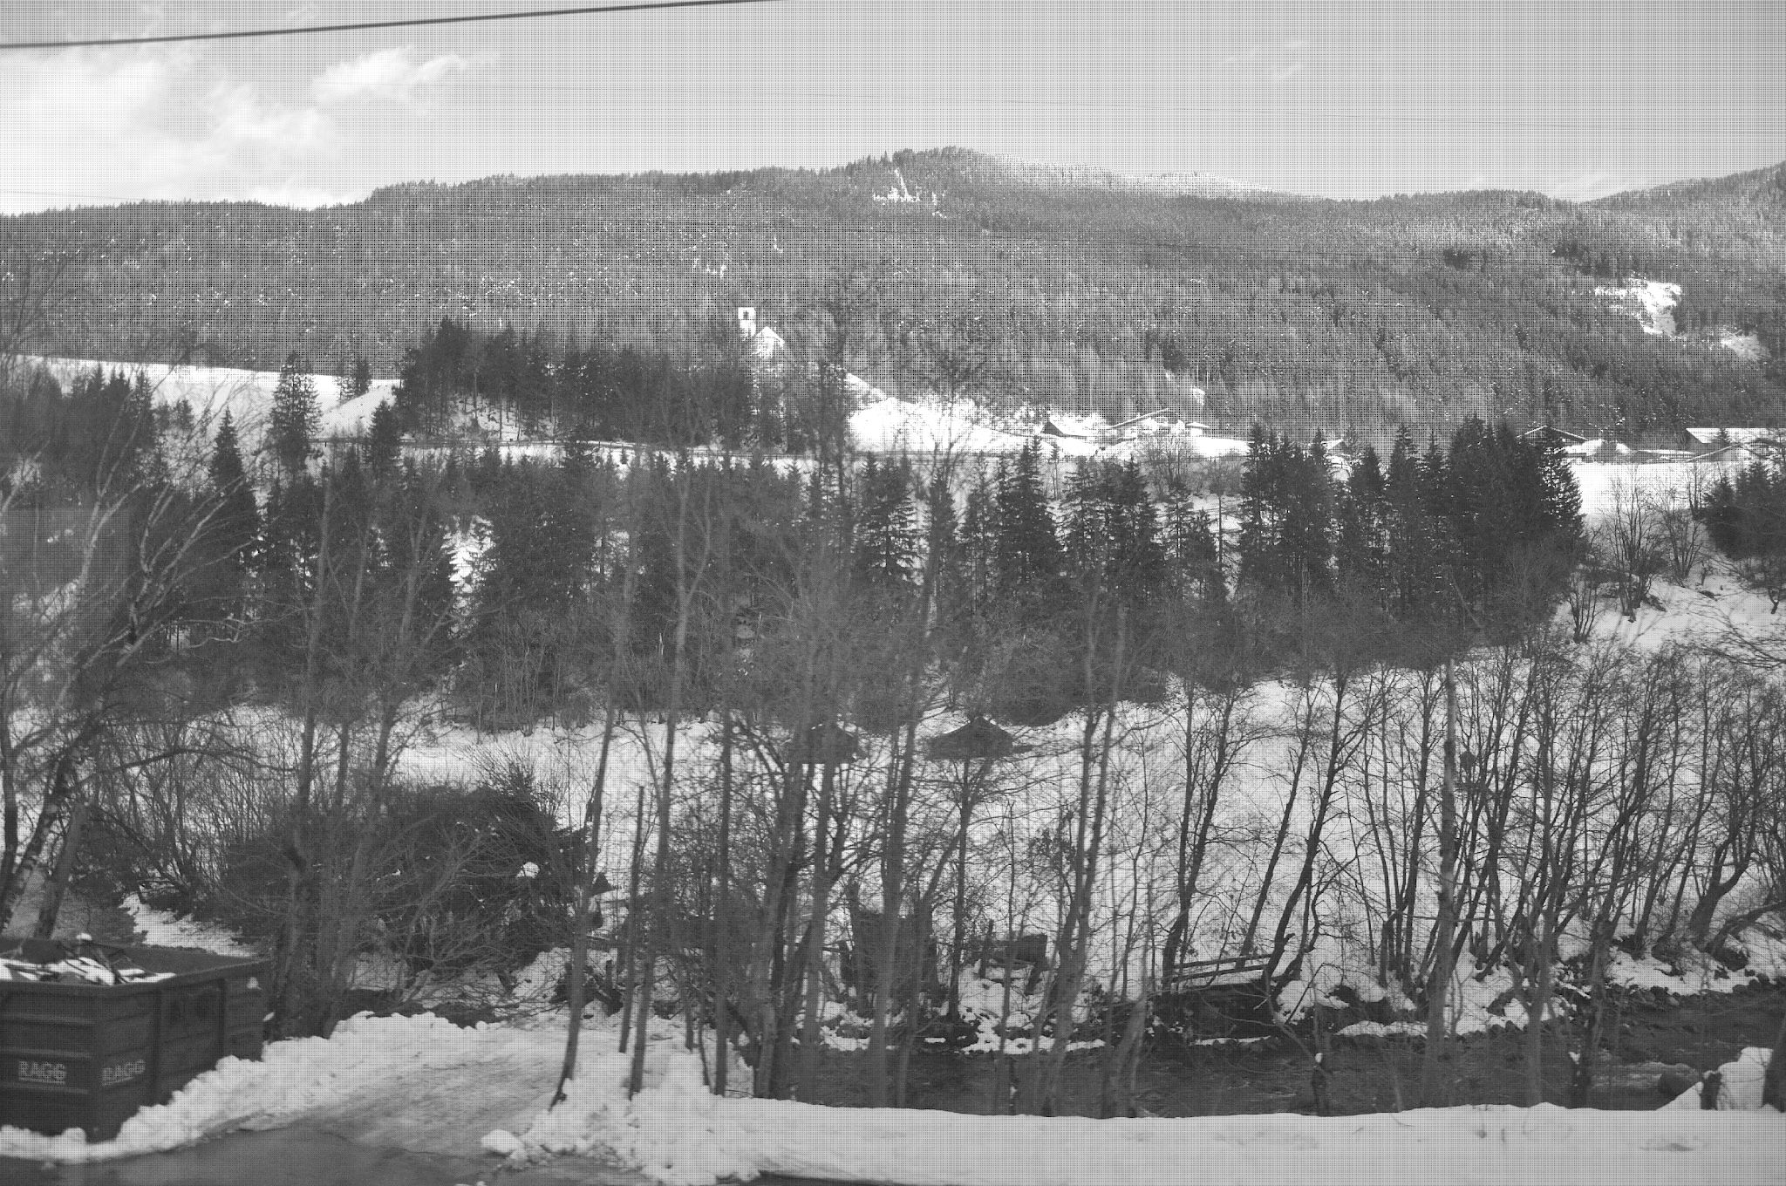

Implementation
Re-demosaicing
Evaluation

Slide 24
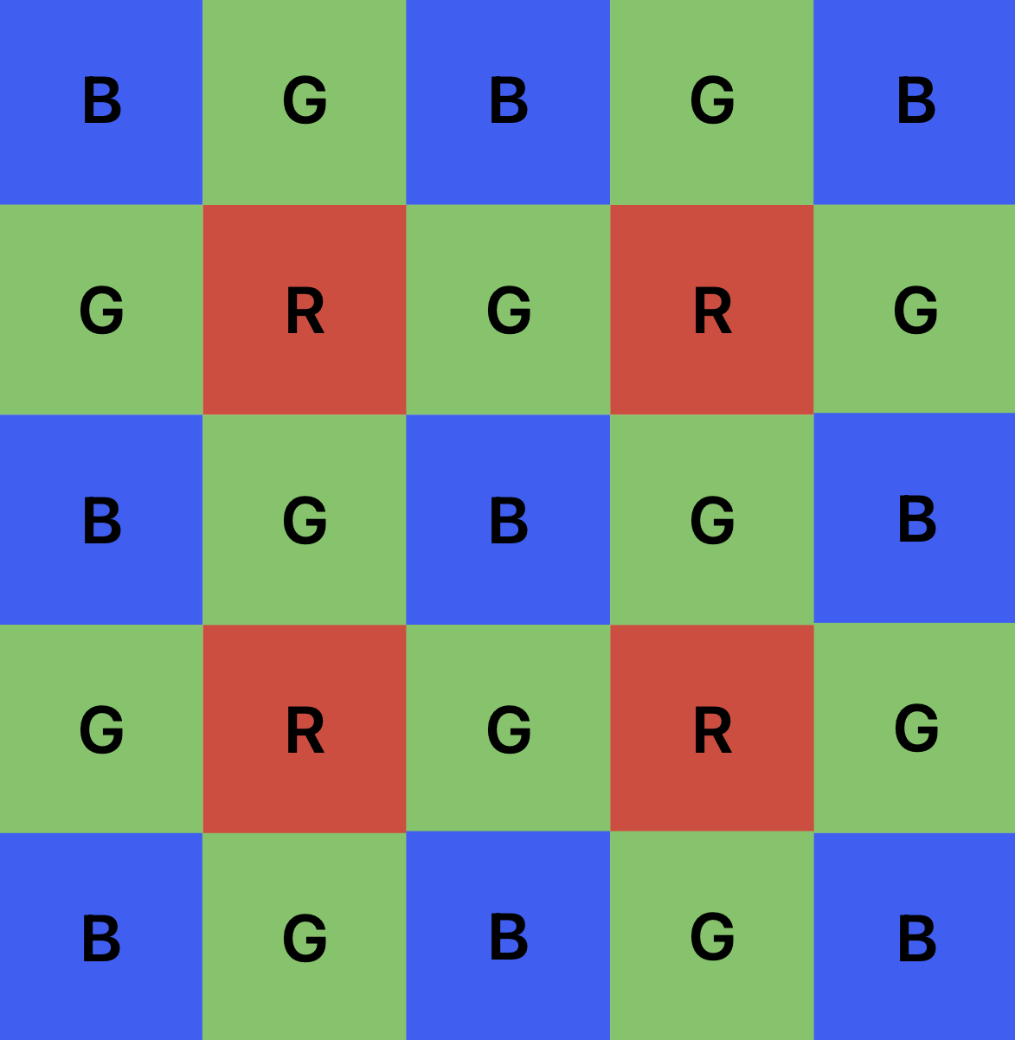

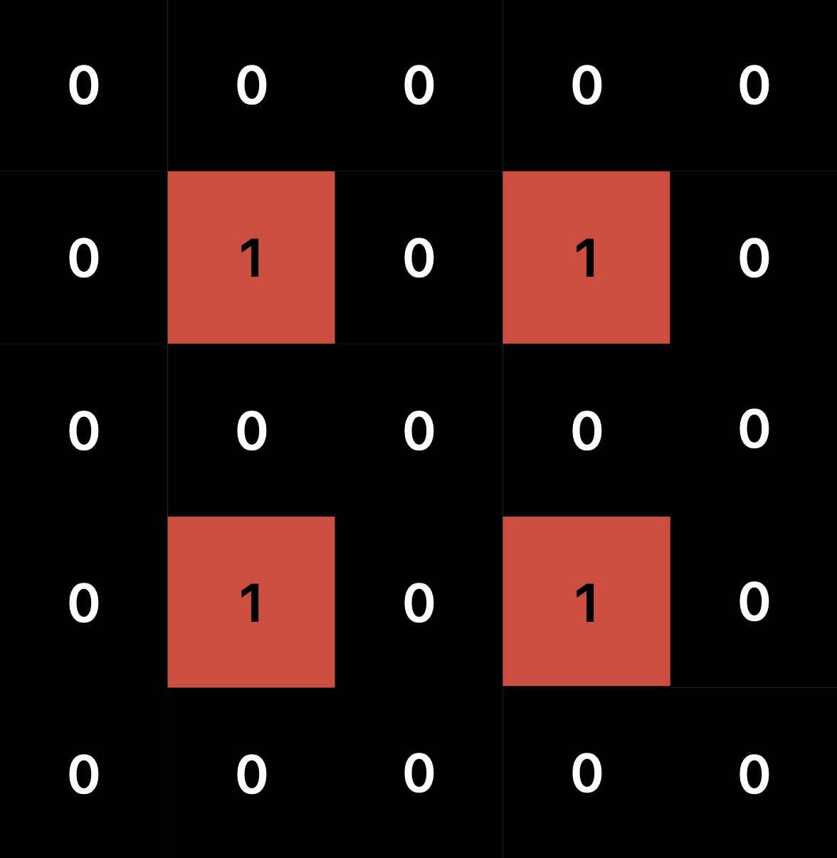

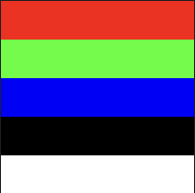


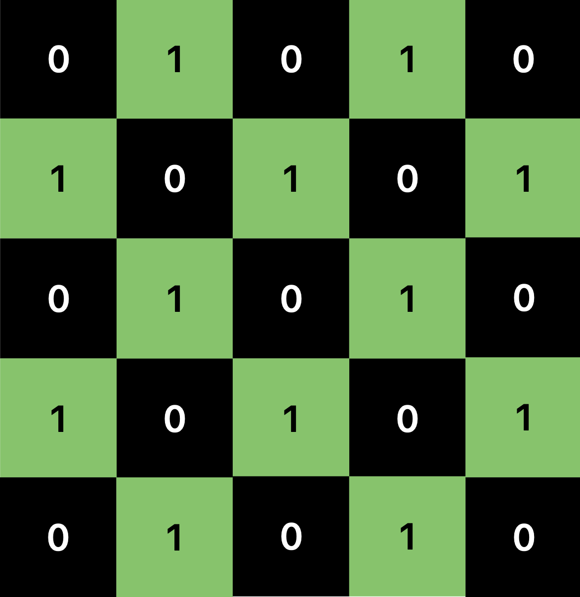
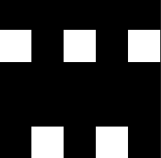

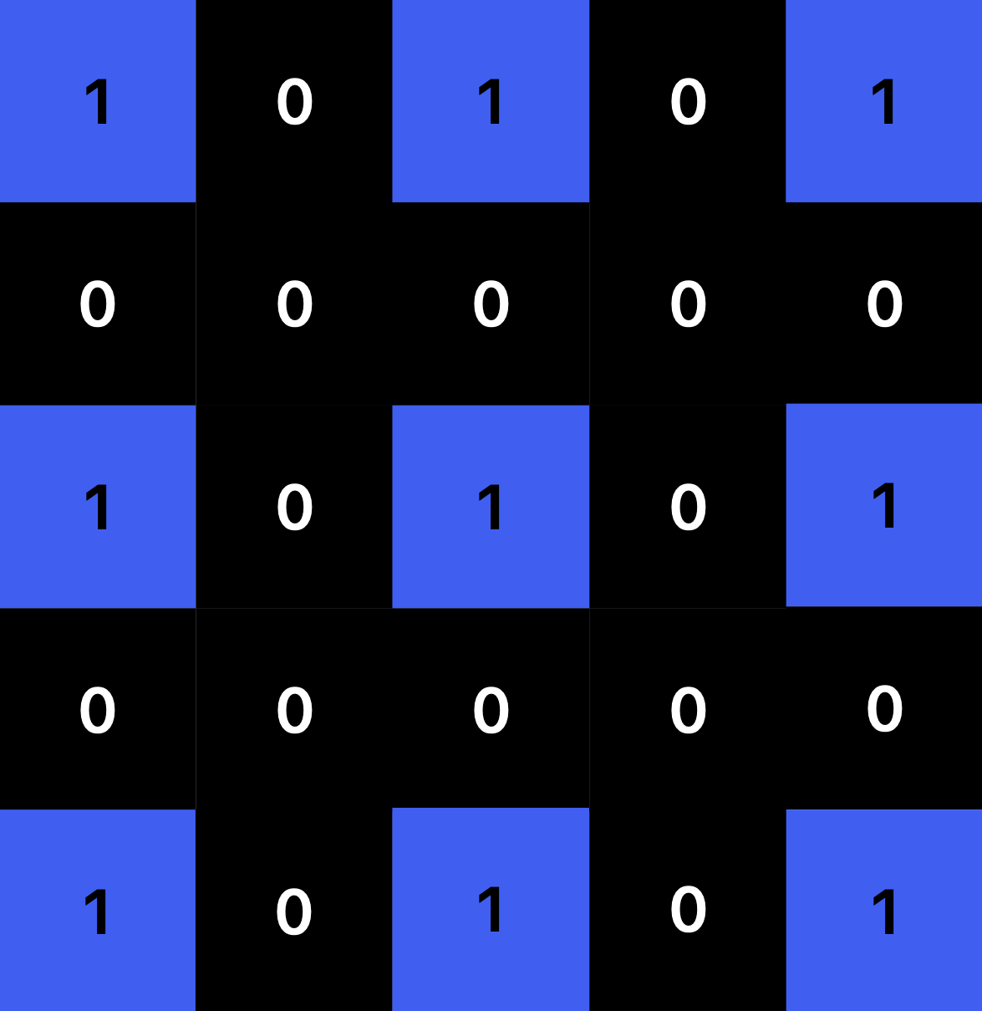
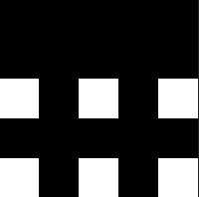
Mosaic(): RGB -> CFA
RGB channels
BGGR mask
selected RGB
R
✕
=
5x5x3 RGB image
5x5 CFA image
G
✕
=
B
✕
=

Slide 25
Demosaic(): CFA -> RGB
Gradient-corrected bilinear interpolation [Malvar et. al. 2004]
5x5 convolution kernels to correct bilinear interpolation
OpenCV.filter2D()
PyTorch.conv2d()

Slide 26
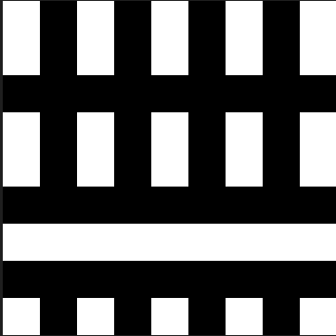
PyTorch.conv2d(): corrected interpolation
9x9 reflection101 CFA
5x5 CFA image
reflectionpad(2)
(2+5+2)✕(2+5+2)

Slide 27
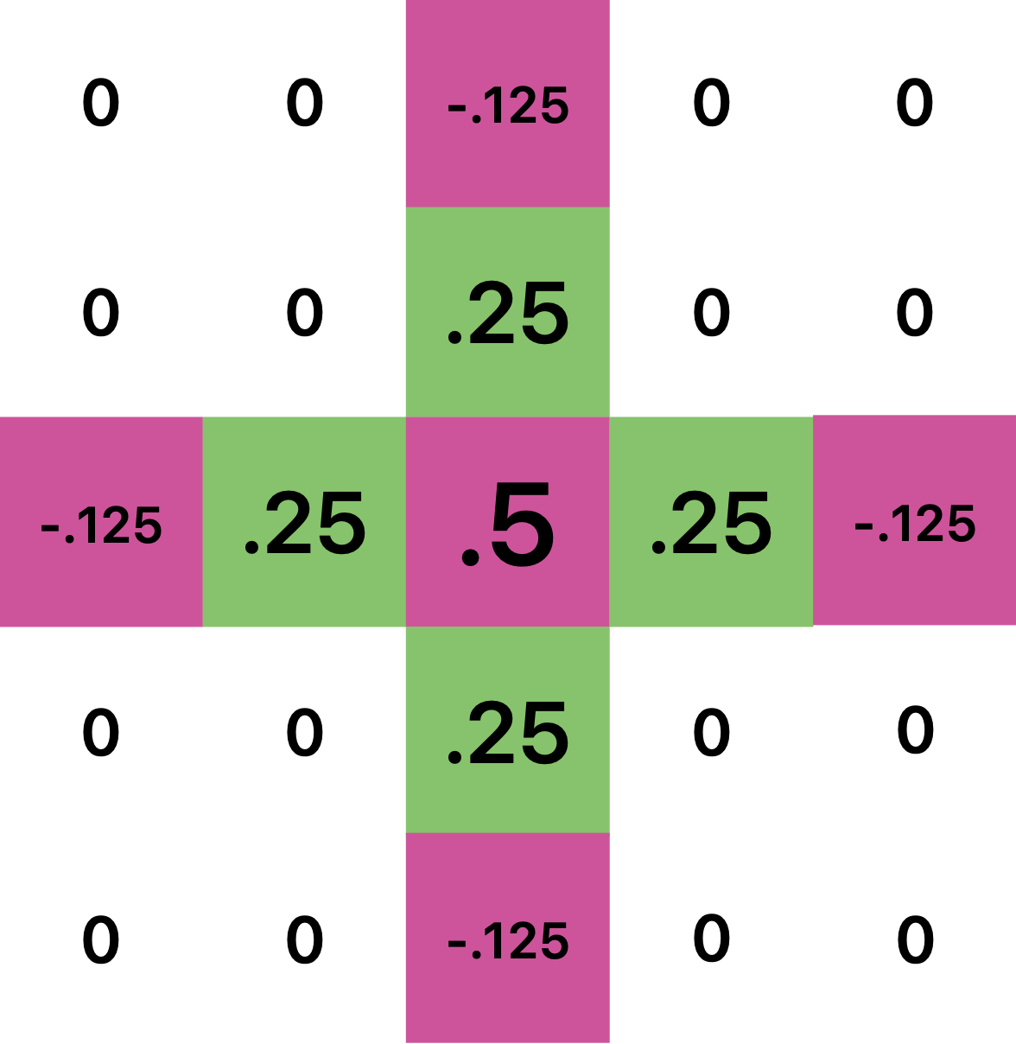

conv2d(9x9_reflection_CFA, 5x5_GR_GB_kernel)
5x5 GR_GB kernel
5x5 G channel

Slide 28
PSNR, SSIM, VMAF: poor similarity -> fake image
measure similarity between original and re-demosaiced image
normal distribution, quantiles as thresholds
logistic regression, learn thresholds

Slide 29
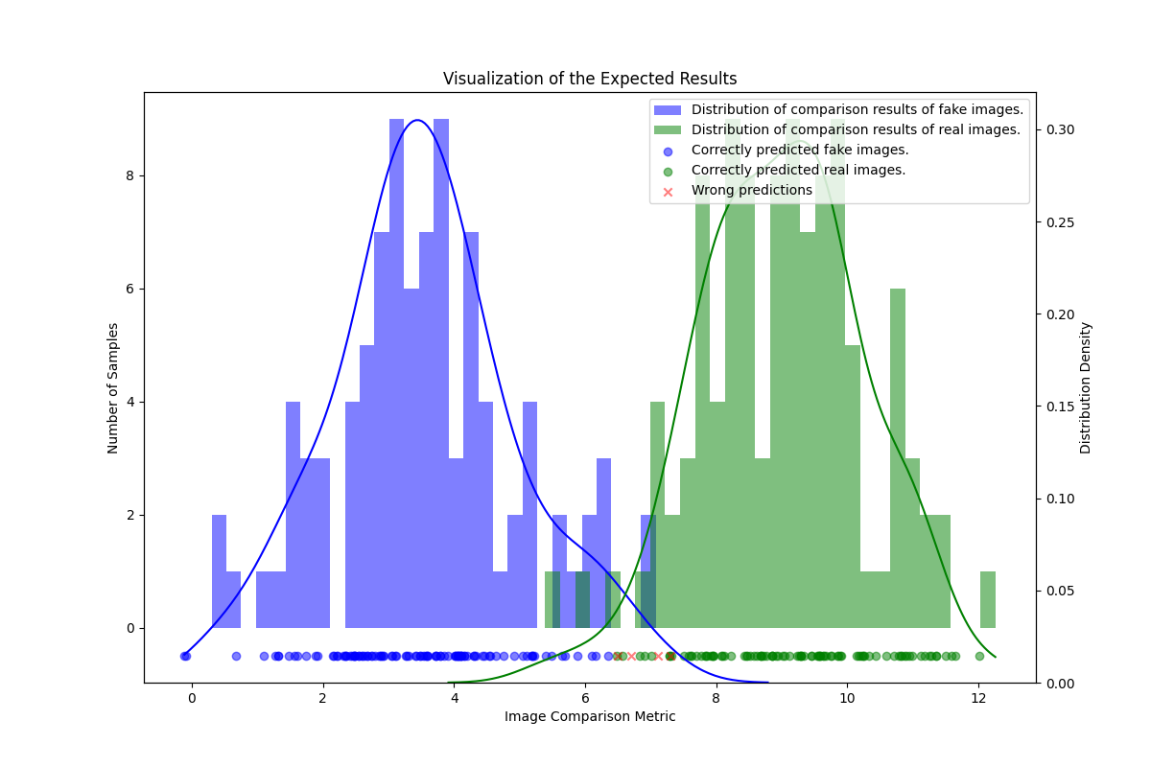

Slide 30
