Slide 1
Image Classification with Ensemble Stacking Techniques
Eric Cao
Shauna Song

Slide 2
Goal
Improve image classification accuracy
Combine strengths of different Network
Minimize loss and reduce overfitting
Enhance the stability of the image classification system
Demonstrate better performance of ensemble stacking compared to individual models

Slide 3
Method
Image classification - CNN(eg. LeNet, AlexNet, ResNet, VGG16)
Ensemble learning - stacking
Combines multiple neural network models to improve overall performance
Reduces both bias and variance for better classification results
Drawbacks:
Task-dependent: The effectiveness of ensemble learning depends on the specific task and the choice of base models.
At risk of overfitting: Ensemble stacking, if not properly managed, can lead to overfitting.

Slide 4
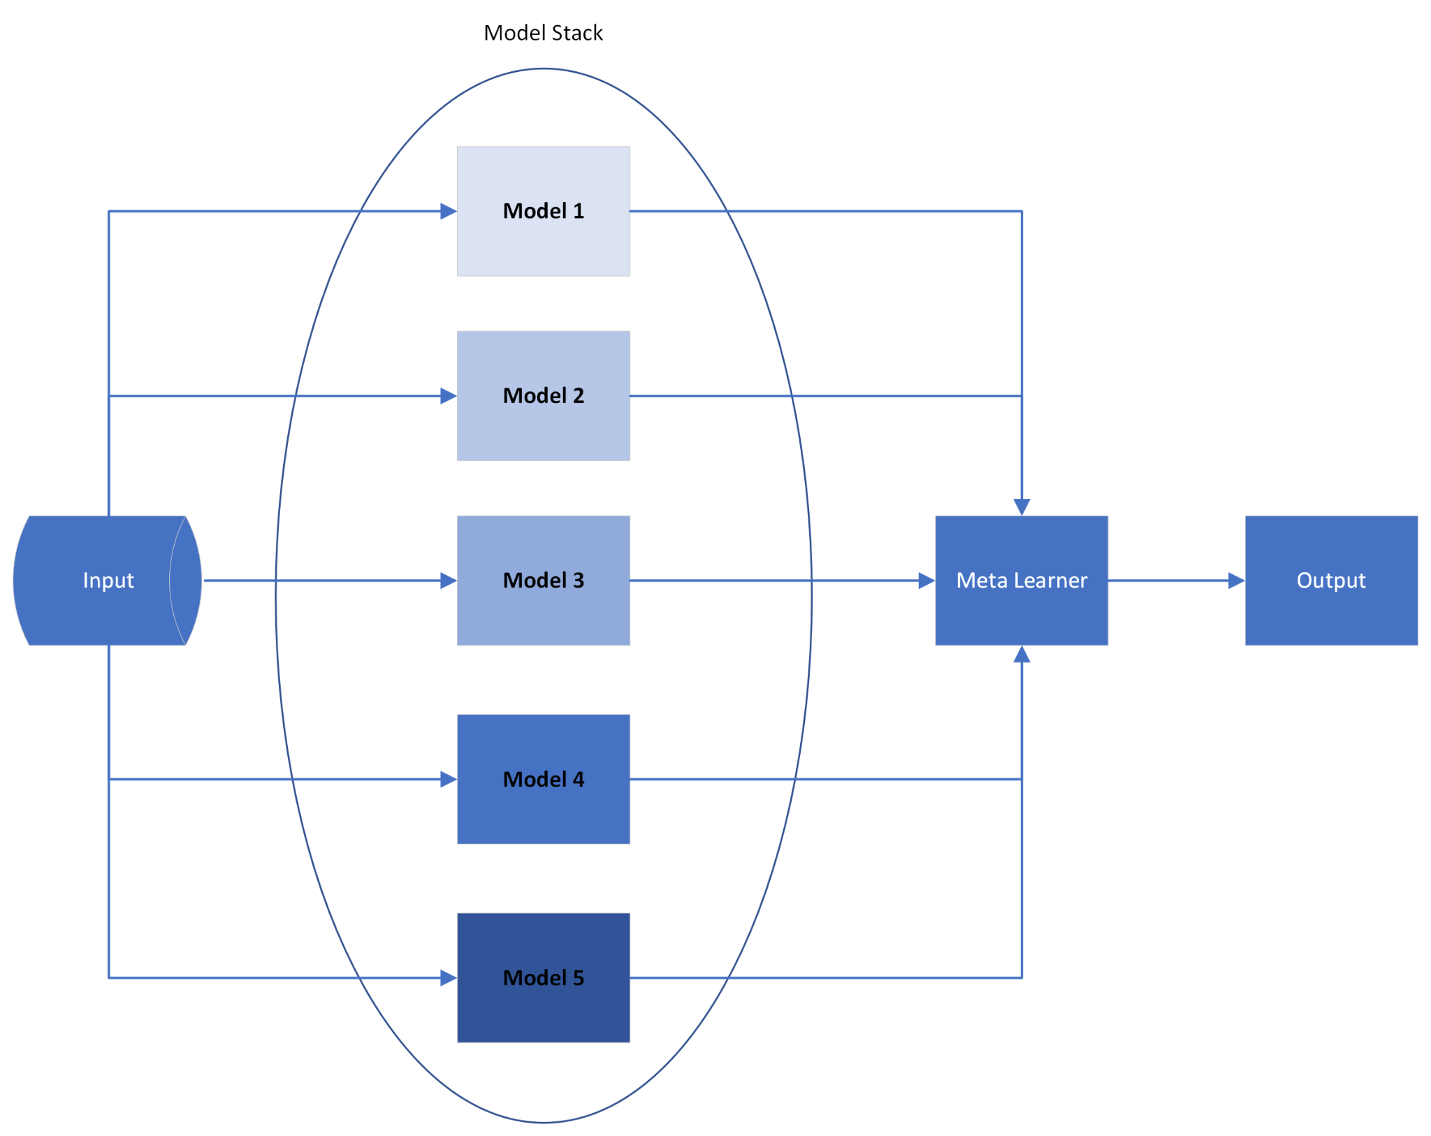

Slide 5
Data set - CIFAR-10
Widely-used benchmark for image classification tasks
Contains 60,000 color images of size 32x32 pixels
Small image size results in lower computational requirements
10 distinct classes: airplanes, automobiles, birds, cats, deer, dogs, frogs, horses, ships, and trucks
Balanced distribution: 6,000 images per class (5,000 for training, 1,000 for testing)

Slide 6
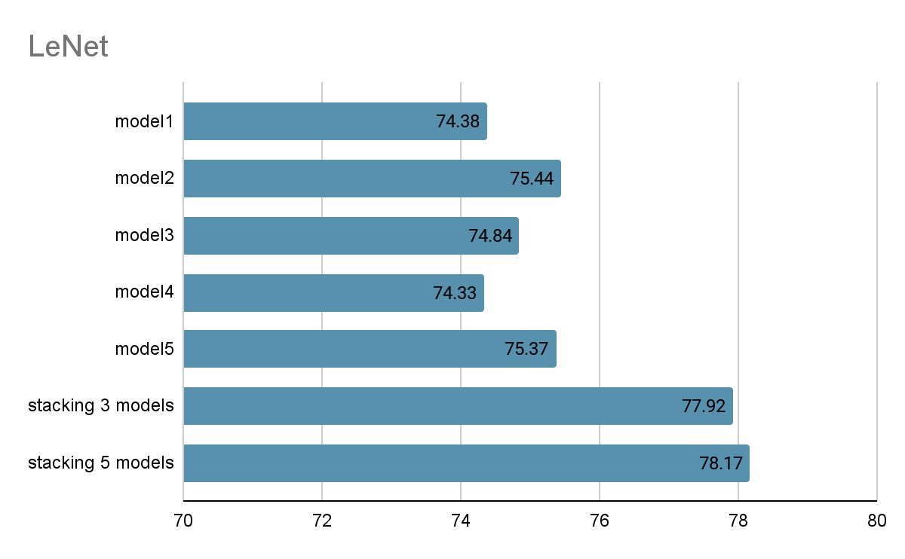
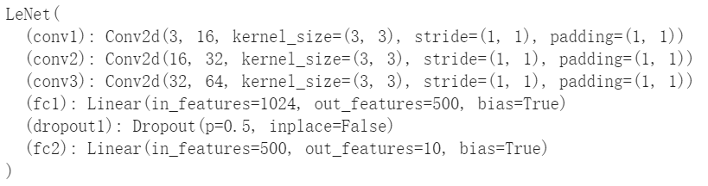
Experiment -LeNet
result:

Slide 7
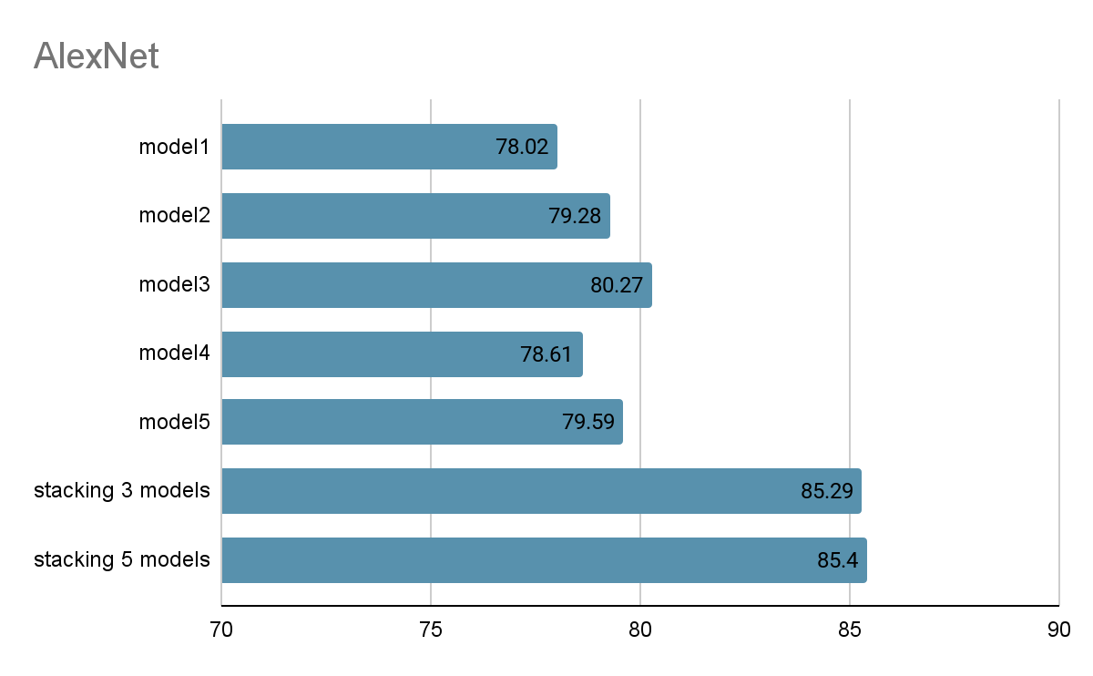
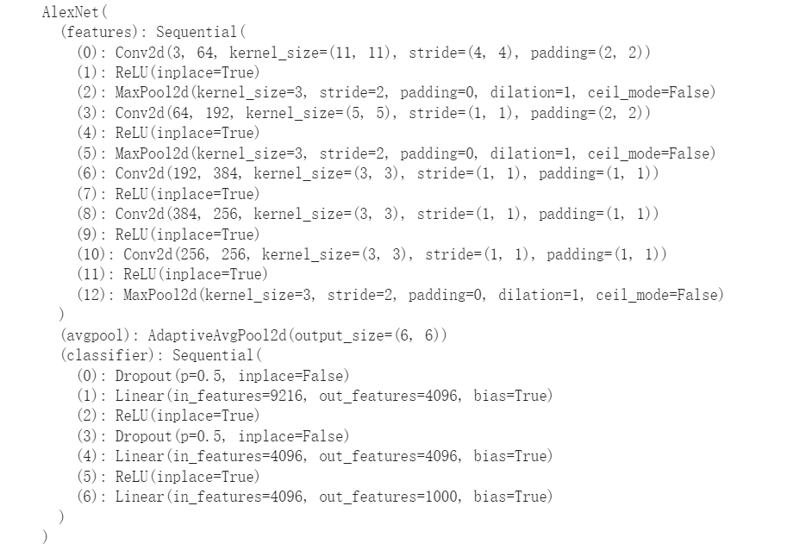
Experiment- Alexnet

Slide 8
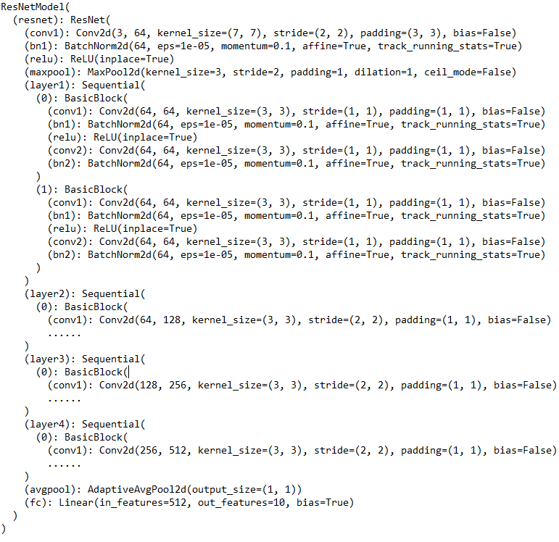
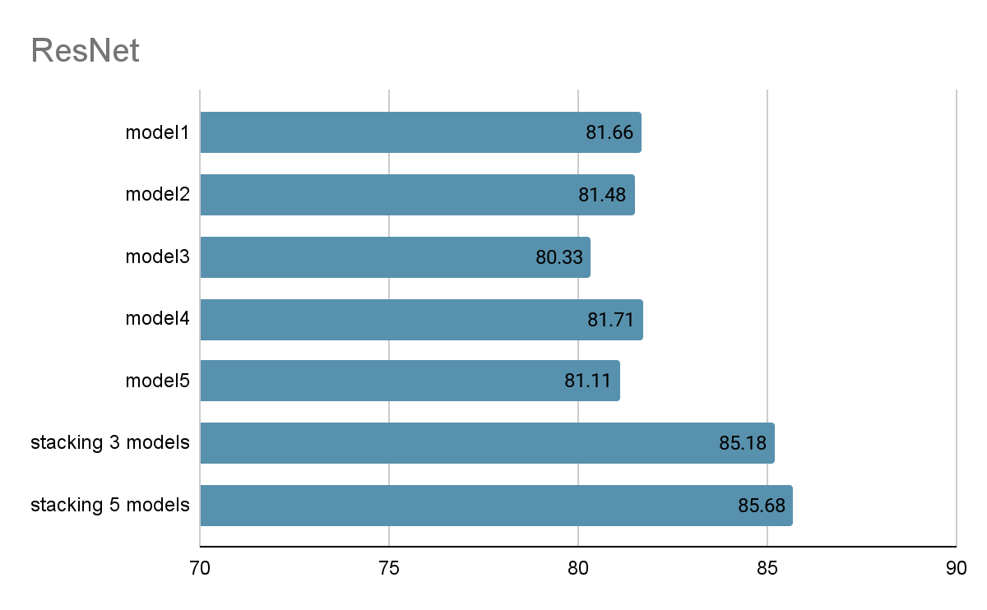
Experiment-Resnet

Slide 9
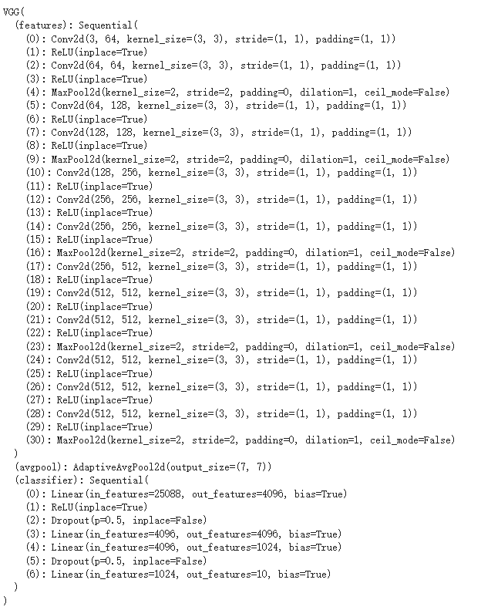
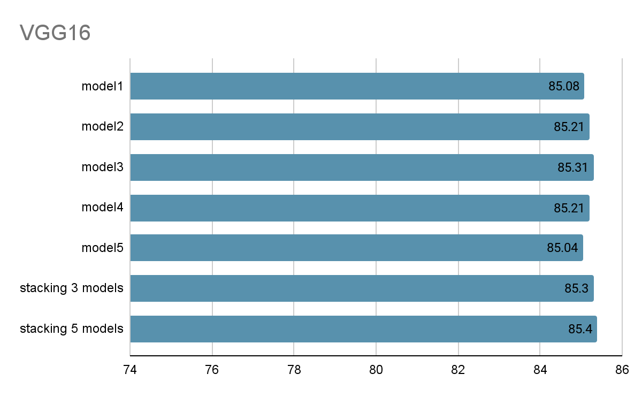
Experiment -VGG16

Slide 10
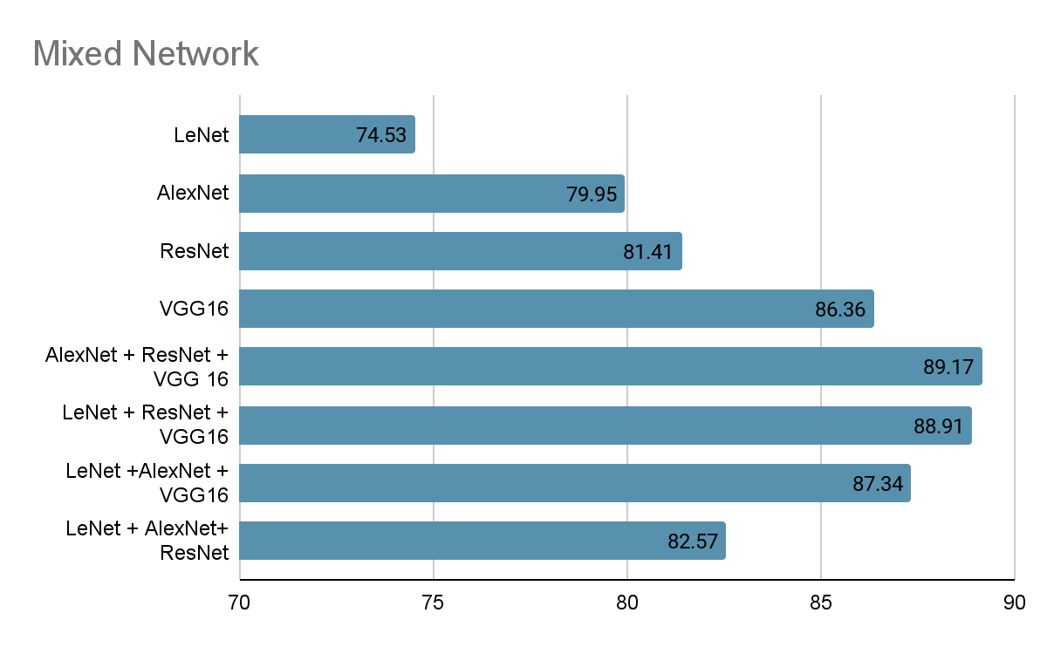
Experiment-Mixed network
LeNet 74.53
AlexNet 79.95
ResNet 81.41
VGG16 86.36
AlexNet + ResNet + VGG16 89.17
LeNet + AlexNet + VGG16 88.91
LeNet + ResNet + VGG16 87.34
LeNet + AlexNet + ResNet 82.57

Slide 11
Conclusion
Stacking boosts performance but requires more computing power.
Stacking more models yield better results, but with small improvements.
Mixed network ensembles yield better performance improvements, but at higher computational costs.

Slide 12
Future direction
Evaluate ensemble learning improvement using Vision Transformer
Utilize model soups, which improve accuracy by averaging the weights of multiple models' parameters without increasing inference time

