Slide 1
Age-Invariant Face Recognition Using Deep Learning
By: Eric Cao, Yanjun Meng, Akhil Rajavaram

Slide 2
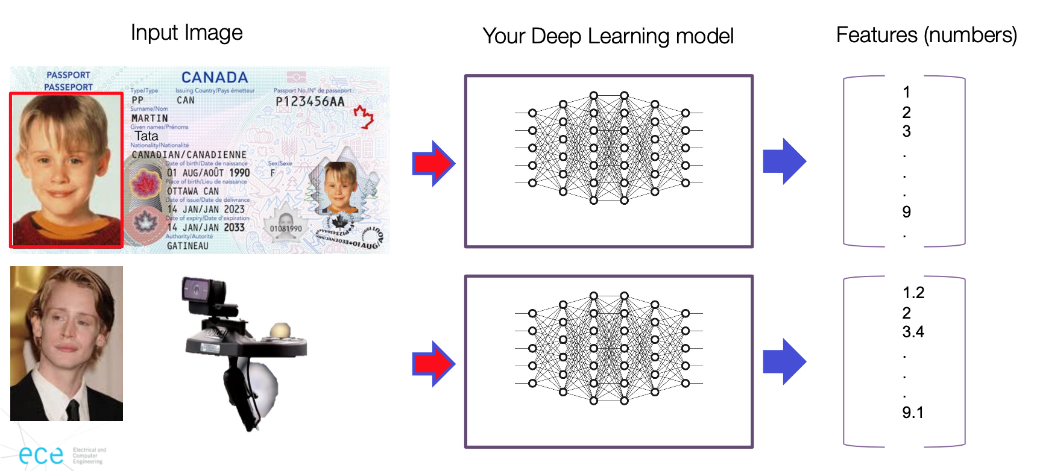
Introduction – Goal
Design a deep learning network to verify identity regardless of age
Demonstration from course materials

Slide 3
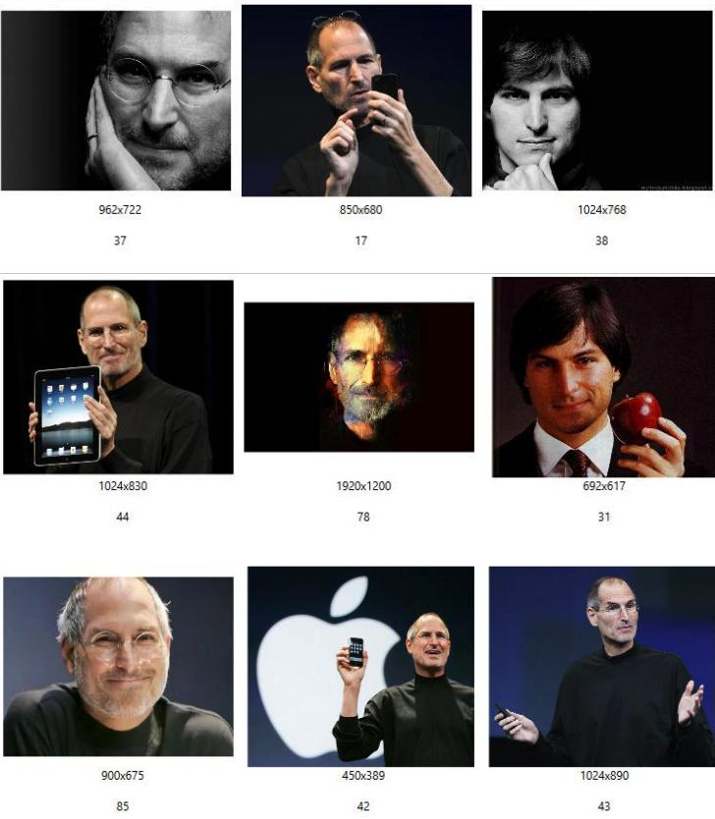
Dataset - M1SM (Training)
Over 10 million images of nearly 100,000 individuals.
Includes a wide range of ages, poses, and expressions.
Large-scale dataset with wide age diversity.
Original dataset contains noise and requires cleaning.
Sample Image from the dataset (src)

Slide 4
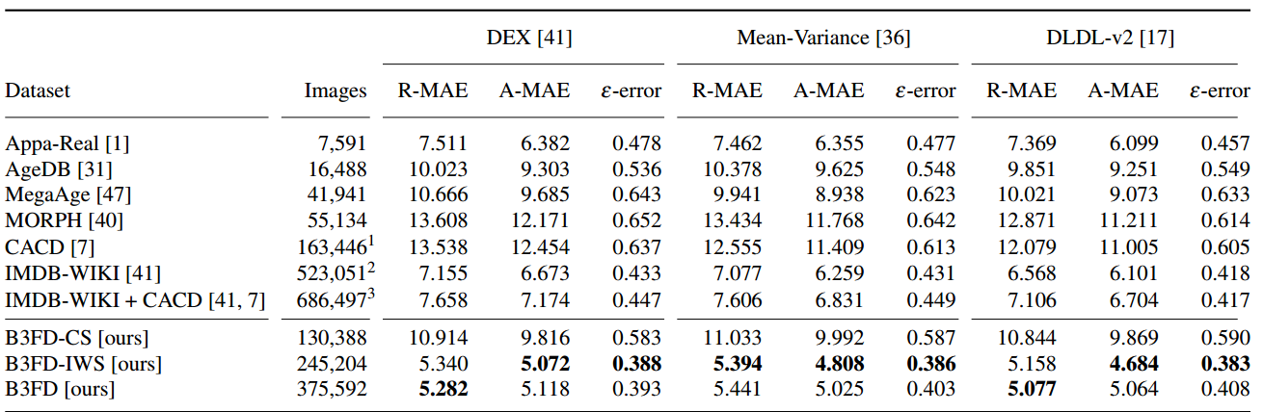
Dataset - B3FD (Training and Testing)
375,592 facial image samples with age labels and 53,759 unique individuals.
Cleaned M1SM dataset of faulty samples for refined age estimation.
Automated cleaning may introduce biases in age distribution or other characteristics.
Comparison of B3FD to other datasets (src)

Slide 5
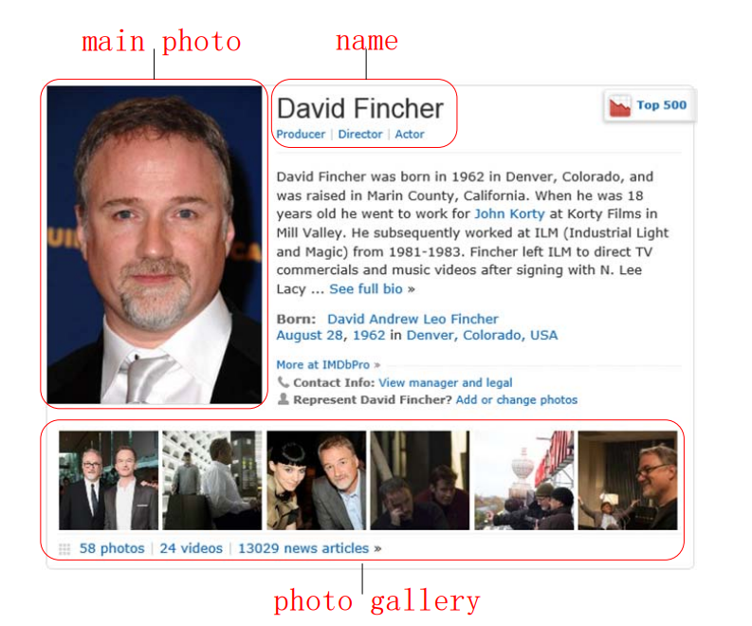
Dataset - Casia-WebFace (Testing)
494,414 images of 10,575 subjects.
Images scraped from the IMDB website semi-automatically.
Used extensively for evaluating face recognition algorithms on standard benchmark
Known for incorrect labels and images that do not belong to the labeled subject
“main photo” is used as initial seed and the 58 photos in the “photo gallery” need to be annotated (src)

Slide 6
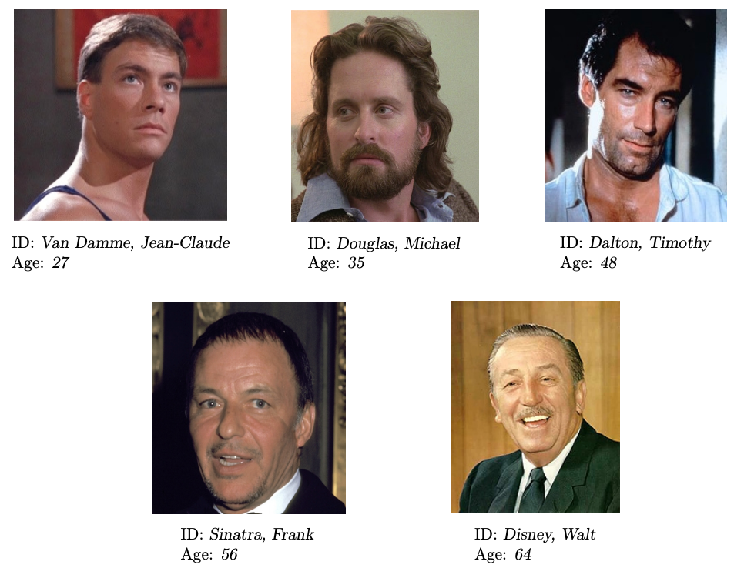
Dataset - AgeDB (Testing)
16,488 images of 568 distinct subjects.
Manual Collection which ensures accurate, noise-free age labels.
Smaller size in comparison to other datasets
Limited number of subjects, better for benchmarking than training.
Sample images from the dataset (src)

Slide 7
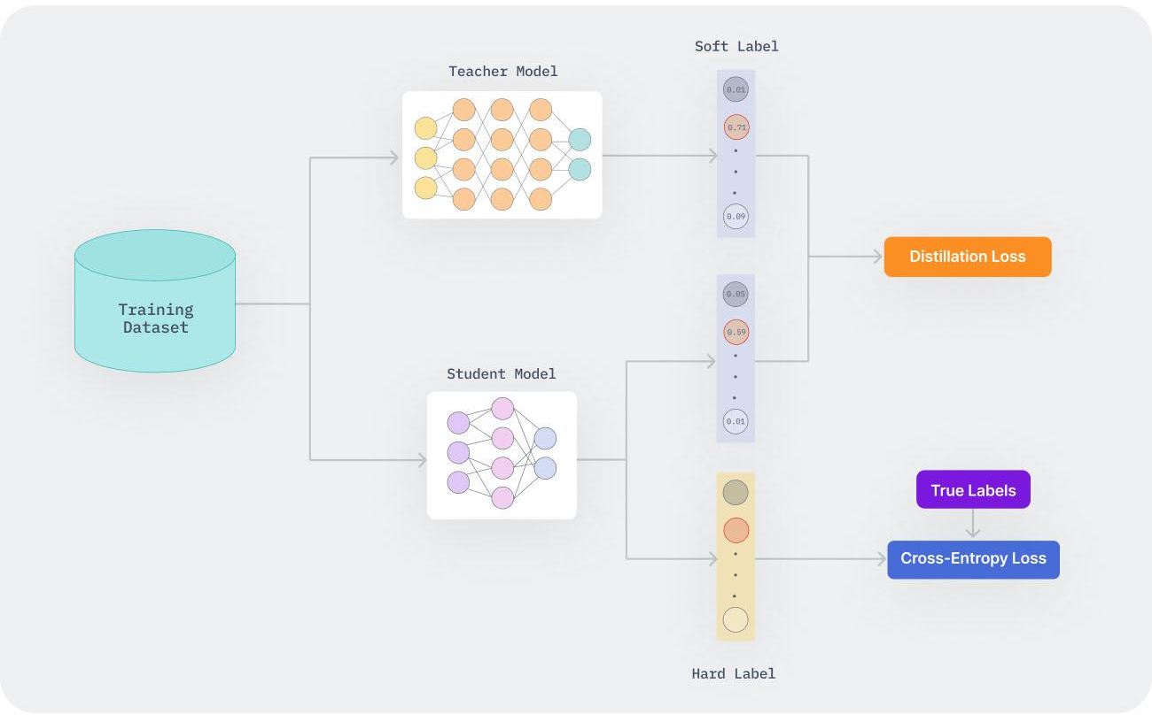
Model – Knowledge Distillation
Training a smaller student model to emulate a larger teacher model to distill knowledge.
Reduces model size and computational requirements.
Ideally student model learns to extract features that are invariant to age-related changes in the face.
Overview of the knowledge distillation training framework (src)

Slide 8
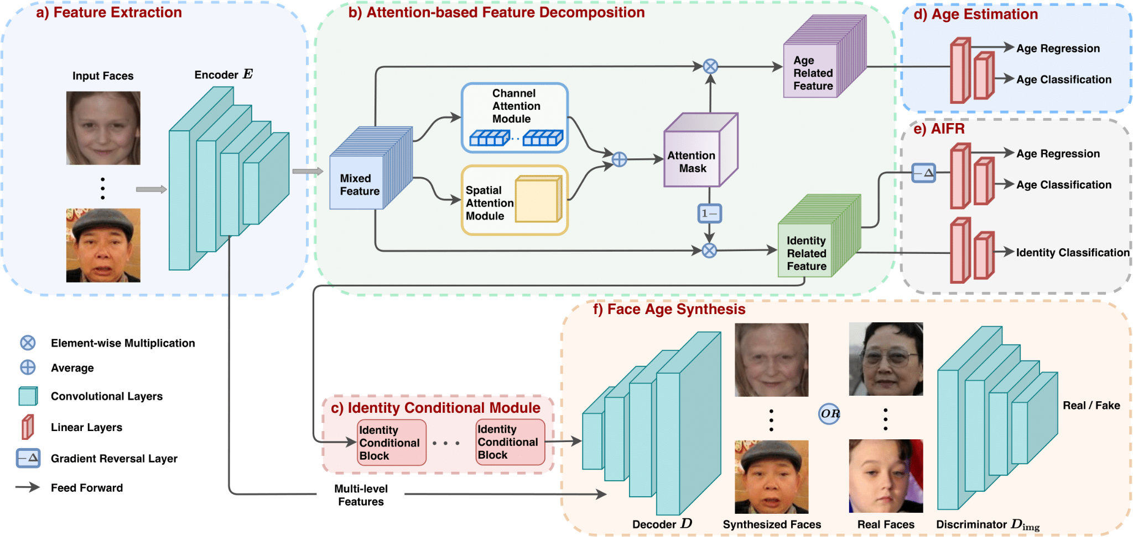
Model - MTLFace
Separates mixed face features into identity- and age-related components using an attention mechanism.
Decorrelates identity features from age features, which is essential for AIFR as it reduces the intra-class discrepancy caused by aging.
Overview of the MTLFace methodology (src)

Slide 9
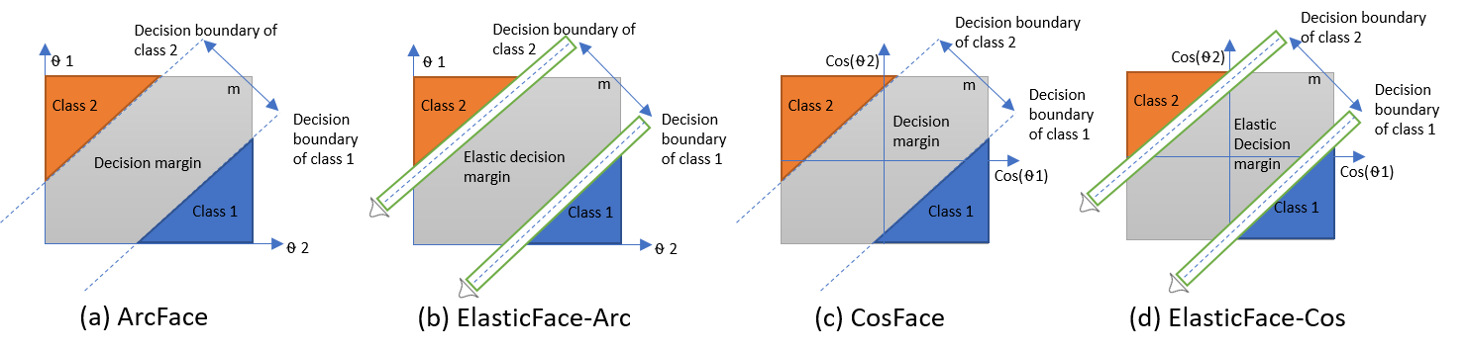
Model – ElasticFace
The Elastic Margin Loss function introduces a dynamic margin into the training process.
Employs a margin that is randomly drawn from a normal distribution during each training iteration.
Allows the decision boundary to adjust dynamically to make features of the same individual more compact while ensuring features of different individuals are well-separated.
Has the ability to learn more complex decision boundaries and better generalize to new data.
Depiction of how the dynamic margin affects decision boundaries (src)

Slide 10
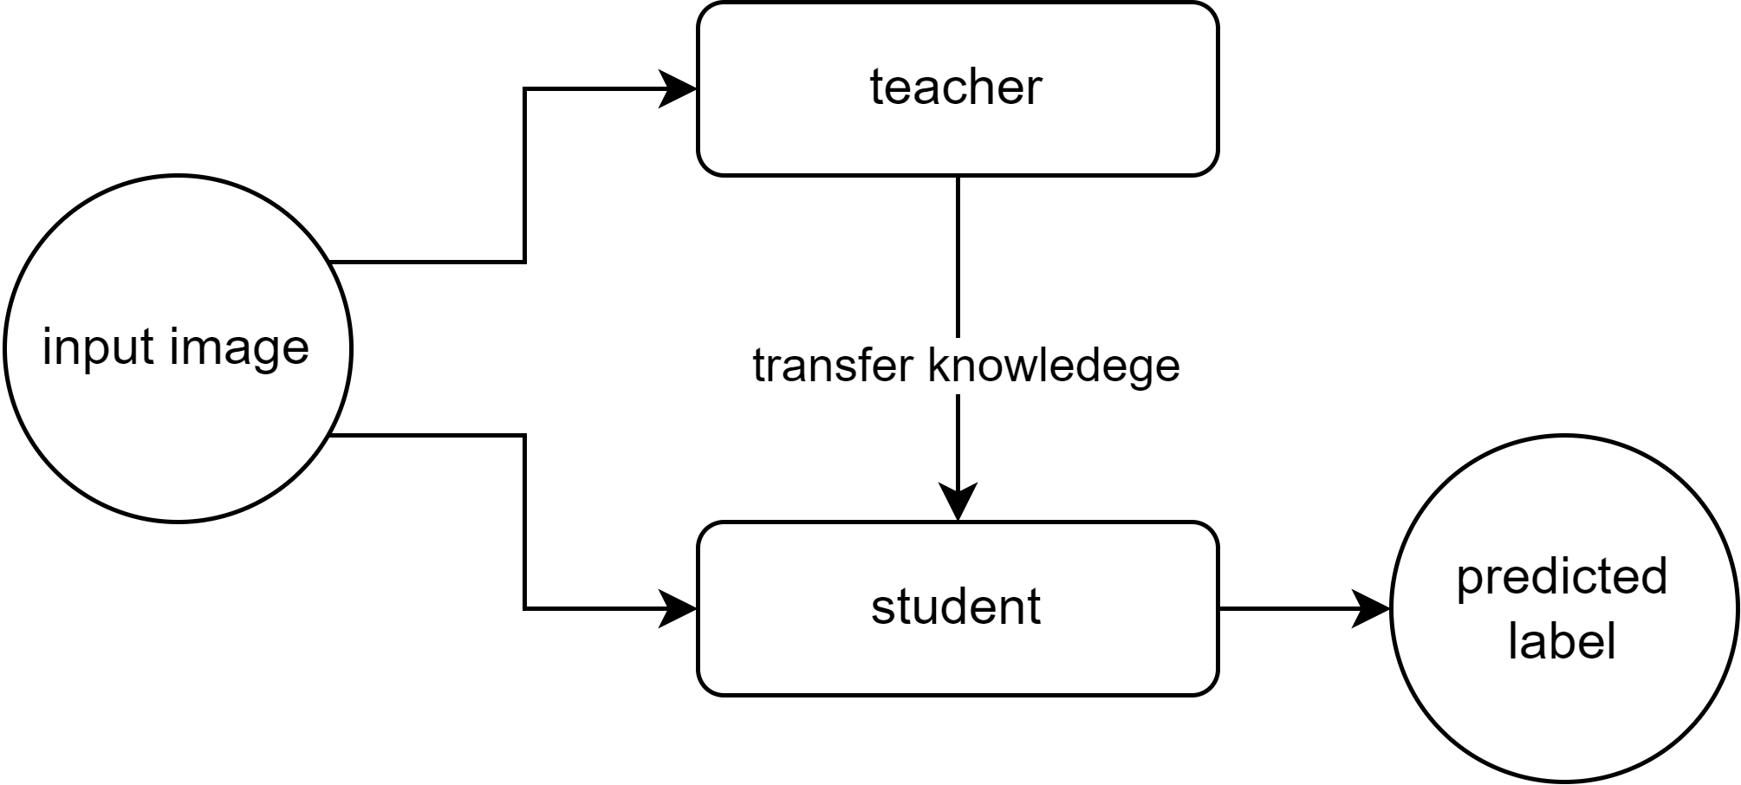
Methodology - OursKD

Slide 11
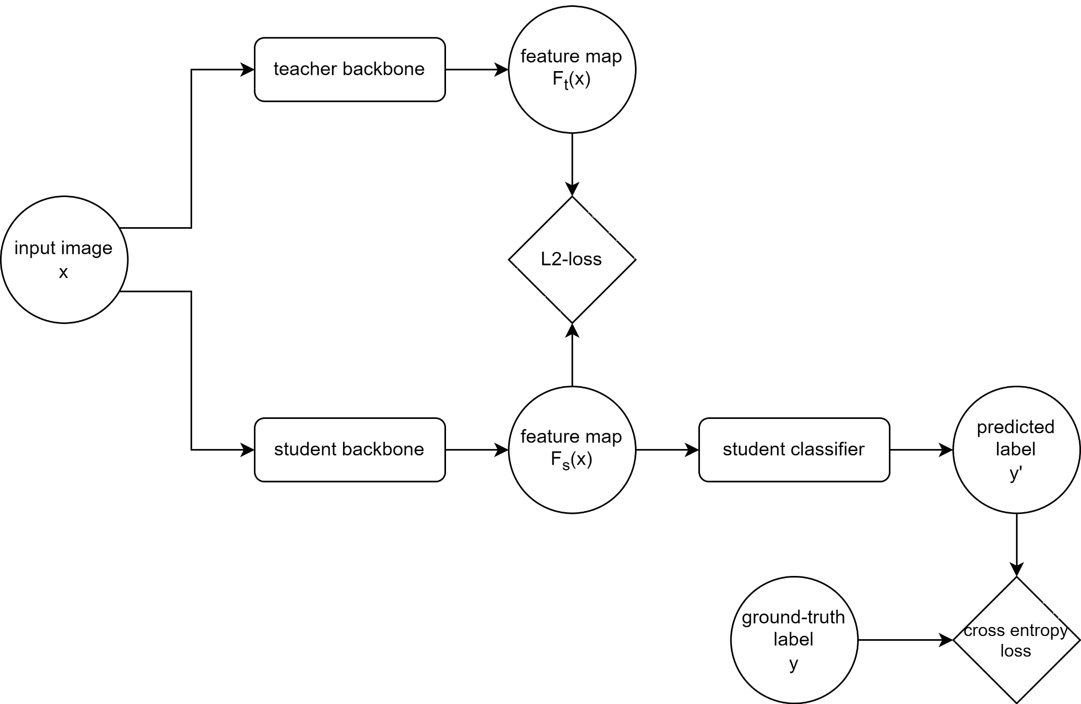
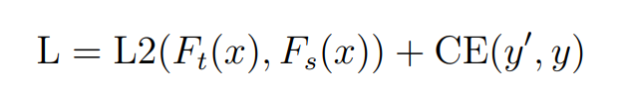
Loss function
L2 loss
Cross entropy loss

Slide 12
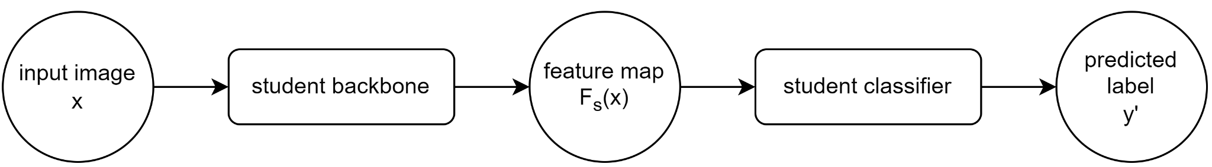
Performance Metrics
Accuracy of prediction
Representativeness of feature map

Slide 13
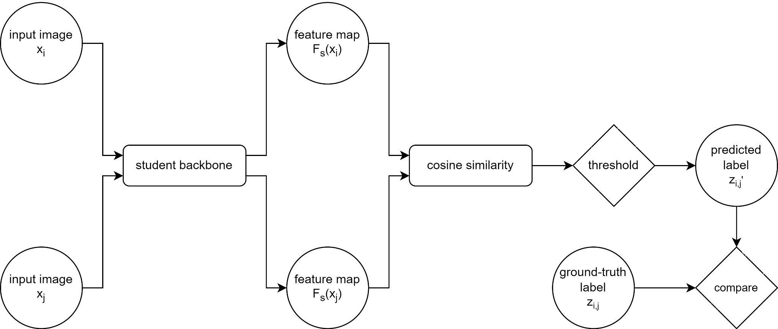
Performance Metrics

Slide 14
Results
Verification Accuracies of Individual Models
Verification Accuracies of KD Models
Model | Train set | Test accuracy
 |  | B3FD | AgeDB | CASIA
ElasticFace | B3FD | 91% | 57% | 68%
MTLFace | B3FD | 96.3% | 77.4% | 82.2%
ElasticFace | MS1MV2 | 87.1% | 98.3% | 96.1%
Model |  | Test accuracy
Student-B3FD | Teacher-MS1M | B3FD | AgeDB | CASIA
ElasticFace | ElasticFace | 95.7% | 76.5% | 82.1%
MTLFace | ElasticFace | 96.0% | 76.5% | 82.6%
First two rows trained by us from scratch on B3FD, evaluated on unseen datasets AgeDB and CASIA by us
Last row trained by authors on MS1M, evaluated on new dataset B3FD by us
Both student models were pretrained on B3FD, then trained alongside a teacher pretrained on MS1M, lastly evaluated on unseen datasets AgeDB and CASIA

Slide 15
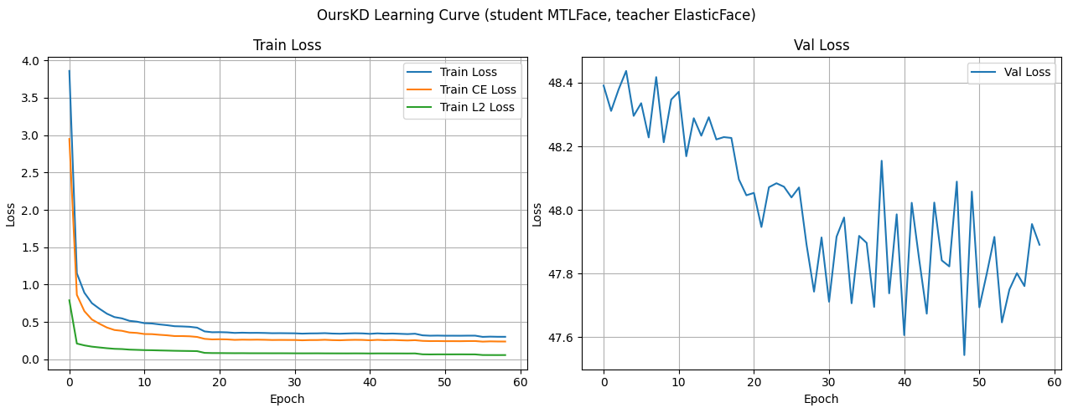
Results

Slide 16
Results
Using (1) pretrained weights or architectures that differed from teacher (2) models that are pretrained on larger datasets helped improve verification accuracy and generalization capacity
Reason: more diverse feature maps
(1) Accuracy with v.s. without using pretrained weights
(2) Accuracy using B3FD- v.s. MS1M-trained teacher
Model |  | Test accuracy
Student | Teacher-MS1M | B3FD | AgeDB | CASIA
MTLFace-scratch | ElasticFace | 83.4% | 59.6% | 67.3%
MTLFace-B3FD | ElasticFace | 96.0% | 76.5% | 82.6%
Model |  | Test accuracy
Student-B3FD | Teacher | B3FD | AgeDB | CASIA
ElasticFace | ElasticFace-B3FD | 90.8% | 64.7% | 71.8%
ElasticFace | ElasticFace-MS1M | 95.7% | 76.5% | 82.1%

Slide 17
Limitations
Did not optimize training script for ElasticFace on B3FD → could have led to better baseline → altered subsequent comparisons
Did not fine tune loss terms for using MTLFace as a student → suboptimal or conflicting effects → could not outperform individual MTLFace model
Comparison between individual v.s. KD-ElasticFace model
Comparison between individual v.s. KD-MTLFace model
Model |  | Test accuracy
Student | Teacher | B3FD | AgeDB | CASIA
ElasticFace | n/a | 91% | 57% | 68%
ElasticFace | ElasticFace | 95.7% | 76.5% | 82.1%
Model |  | Test accuracy
Student | Teacher | B3FD | AgeDB | CASIA
MTLFace | n/a | 96.3% | 77.4% | 82.2%
MTLFace | ElasticFace | 95.7% | 76.5% | 82.1%

Slide 18
Future Work
To transfer learned features more effectively
Fine tuning hyperparameters and other settings
Innovative loss terms
To improve generalization
Impacts of dataset quality and scope
More new, unseen data
Stronger prediction head

