Slide 1
Deep Generative Learing: Denoising Diffusion Model

Slide 2
Deep Generative Learing
learning to generative data:
Given observed samples x from a distribution of interest, the goal of a generative model is to learn to model its true data distribution p(x).
samples data from true data distribution, train neural network with data, samples from neural network to create generative distribution

Slide 3
application
content generation
text to image generation
representation learning
artistic tools
image super-resolution

Slide 4
denosing diffusion probabilistic models
2 process:
forward diffusion process: add noise
gradually add noise to input
reverse diffusion process: denoise
learns to generative data

Slide 5
Related Work

Slide 6
Math part

Slide 7
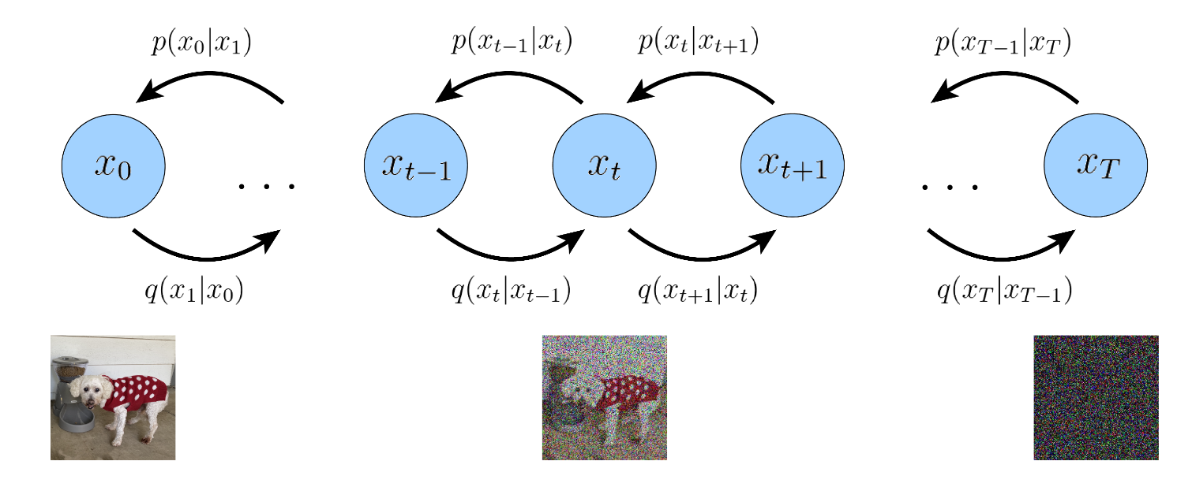
Notation

Slide 8

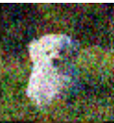
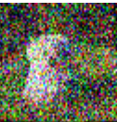

Forward process
: object distribution that given by a less noised object

Slide 9

Reverse process
: object distribution that given by a more noised object

Slide 10
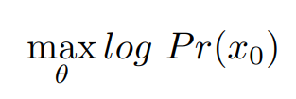
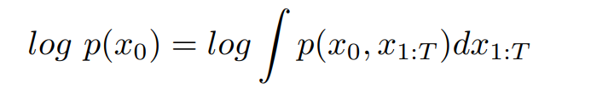
Maximun likelihood estimation(MLE)

Slide 11
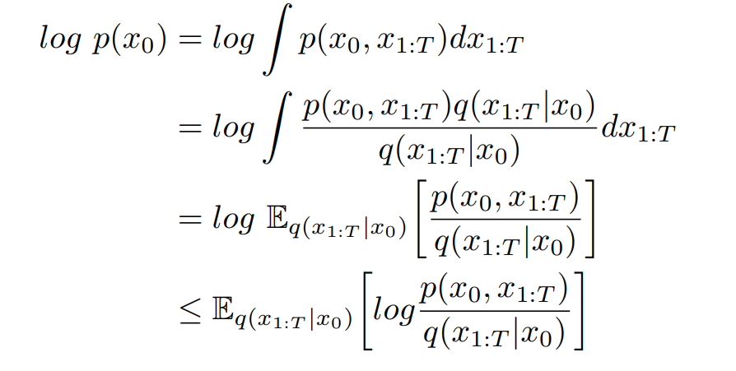
Evidence Lower Bound (ELBO)

Slide 12
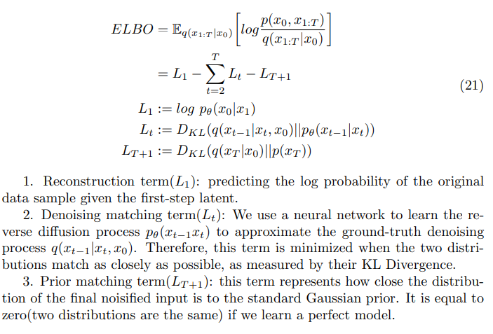
Evidence Lower Bound (ELBO)

Slide 13

Reconstruction term:
Predicting the log probability of the original data sample given the first-step noised image, it can be approximated and optimized using a Monte Carlo estimate.

Slide 14

Prior matching term:
Represents how close the distribution of the final noisified input is to the standard Gaussian prior. It is equal to zero(two distributions are the same) if we learn a perfect model.

Slide 15
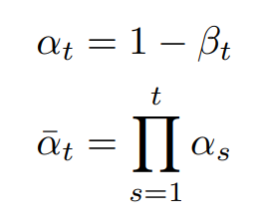


Recall the forward process

Slide 16
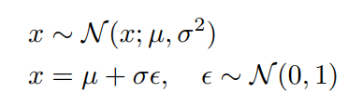
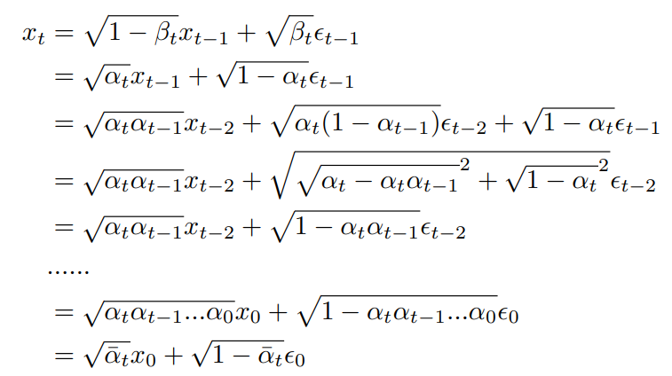
Sample object reparameterization trick:

Slide 17

Recall the forward process

Slide 18
Denoising matching term:
Use a neural network to learn the reverse diffusion process pθ(xt−1xt) to approximate the ground-truth denoising process q(xt−1|xt, x0). Therefore, this term is minimized when the two distributions match as closely as possible, as measured by their KL Divergence.

Slide 19
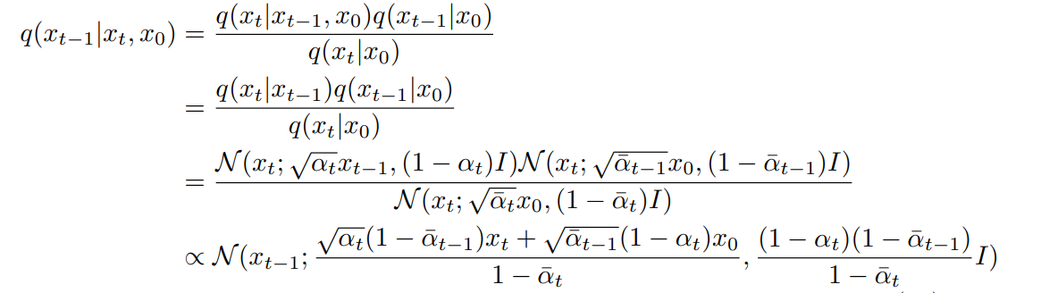

Slide 20
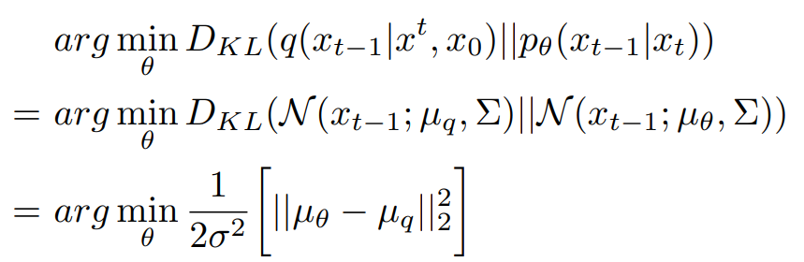
Loss function

Slide 21
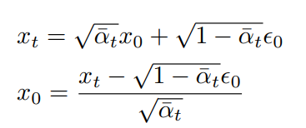



Simplify the Loss function

Slide 22

Loss function

