Slide 1
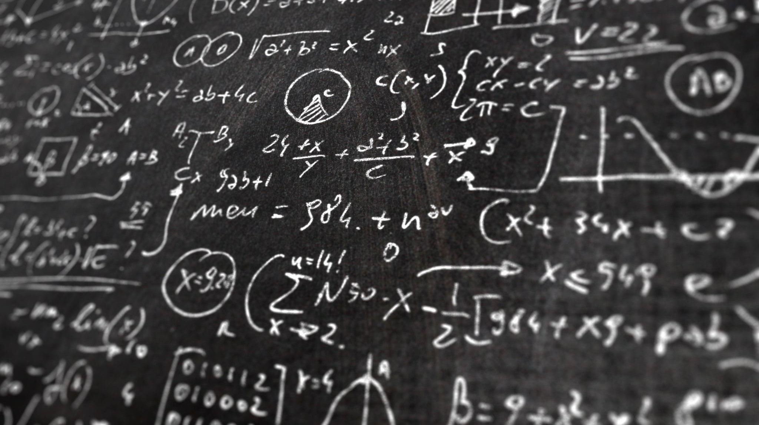
Introduction to DDPM
Denoising Diffusion Probabilistic Models
Group 3
Eric Cao, Peihua Jin, Shengnan Song
Notes:
Today, we’re excited to share with you something really cool about DDPM which stands for Denoising Diffusion Probabilistic Models. I believe everyone here has heard of stable diffusion or midjourney, pretty fun, right?

Slide 2
What Is Diffusion?
In non-equilibrium statistical physics, the diffusion process refers to:
--“The movement of particles or molecules from an area of high concentration to an area of low concentration, driven by a gradient in concentration.”
Notes:
Before we understand Diffusion models, let’s quickly understand the meaning of the term “Diffusion.” Diffusion (or Diffusion process) is a well-known and explored domain in physics.
In simple terms, diffusion is like how a smell spreads in a room – it moves from where it's strong to where it's weak.

Slide 3
What Are Diffusion Models?
In simple terms – “Diffusion Models are a class of probabilistic generative models that turn noise to a representative data sample.”
Unconditional image generation - converts noise into any “random representative data sample.”
Conditional image generation - the model is provided additional information via text
Notes:
In DDPMs, we use this idea but in a computer way. We start with a bunch of noise, which is like random, messy data, and then we carefully remove this noise to make something useful, like an image.
Basically, there are two main types of these models:
One that the generation process is not controlled or guided, and the model can generate an image of any nature.
The other uses some hints, like a sentence, to make a specific kind of image. Just pretty much what midjourney does.

Slide 4

A bit of history
Diffusion models in deep learning were first introduced by Sohl-Dickstein et al. in the seminal 2015 paper “Deep Unsupervised Learning using Nonequilibrium Thermodynamics.” Unfortunately, it remained behind the curtains for a while.
But, in 2019, Song et al. published a paper, “Generative Modeling by Estimating Gradients of the Data Distribution,” using the same principle but a different approach. In 2020, Ho et al. published the paper, now-popular “Denoising Diffusion Probabilistic Models” (DDPM for short).
After 2020, research in diffusion models took off 🚀. Much progress has been made in creating, training, and improving diffusion-based generative modeling in a relatively short time.
Notes:
This idea is pretty new. It started around 2015, and it really took off in the last few years. Now, it's a hot topic because it can do some amazing things.

Slide 5
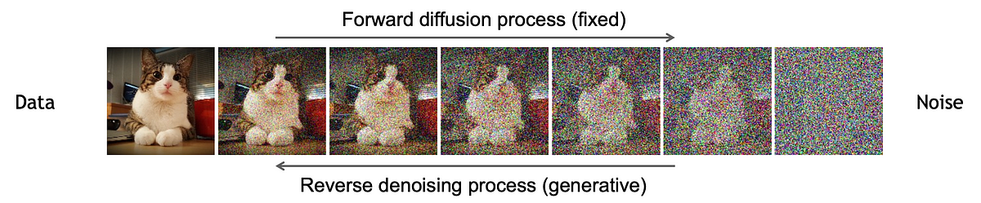
How It Works?
The diffusion method can be summarized as follows:
…systematically and slowly destroy the structure in a data distribution through an iterative forward diffusion process. We then learn a reverse diffusion process that restores structure in data, yielding a highly flexible and tractable generative model of the data. This approach allows us to rapidly learn, sample from, and evaluate probabilities in deep generative models …
– Deep Unsupervised Learning using Nonequilibrium Thermodynamics, 2015
Notes:
So, how does it work? Imagine it like a puzzle. First, we mix up the puzzle pieces – that's adding noise, right, which we called as forward process Then, the DDPM is like someone who's really good at puzzles. It puts the pieces back together to make a clear picture with the help of our well-trained neural networks. This is the reverse process.

Slide 6
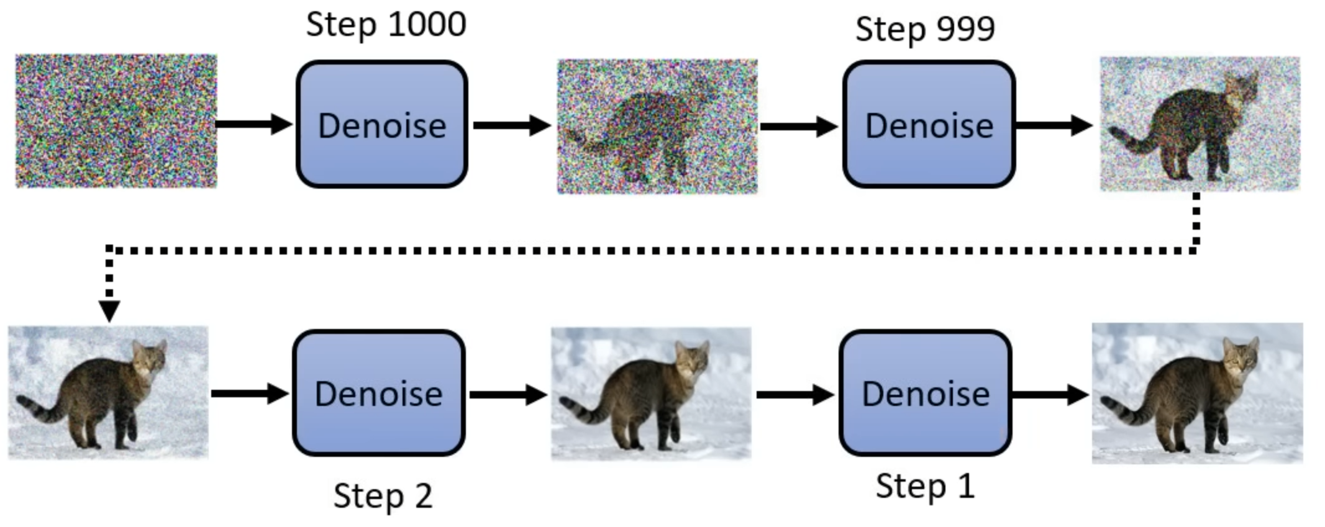
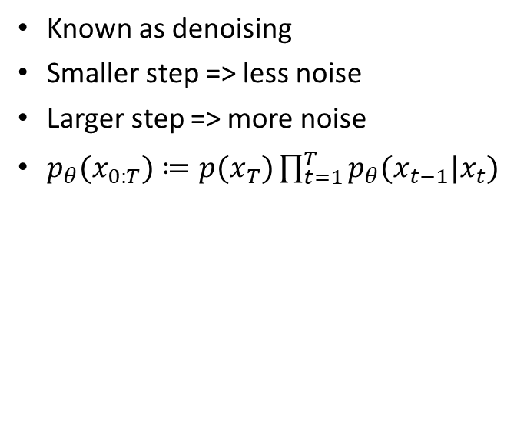
Reverse Process
Notes:
Now lets focus on the reverse process first. Between every two pictures there is a module called denoise where we subtract something to get a picture with less noise. By doing this over and over, we end up with a nice, clear picture. Notice that every iterations has a related step number. And surprisingly, it start from 1000 then reduces to 1. But for now, you just need to know larger number represents more noise, where step 1 gives the clearest picture.

Slide 7
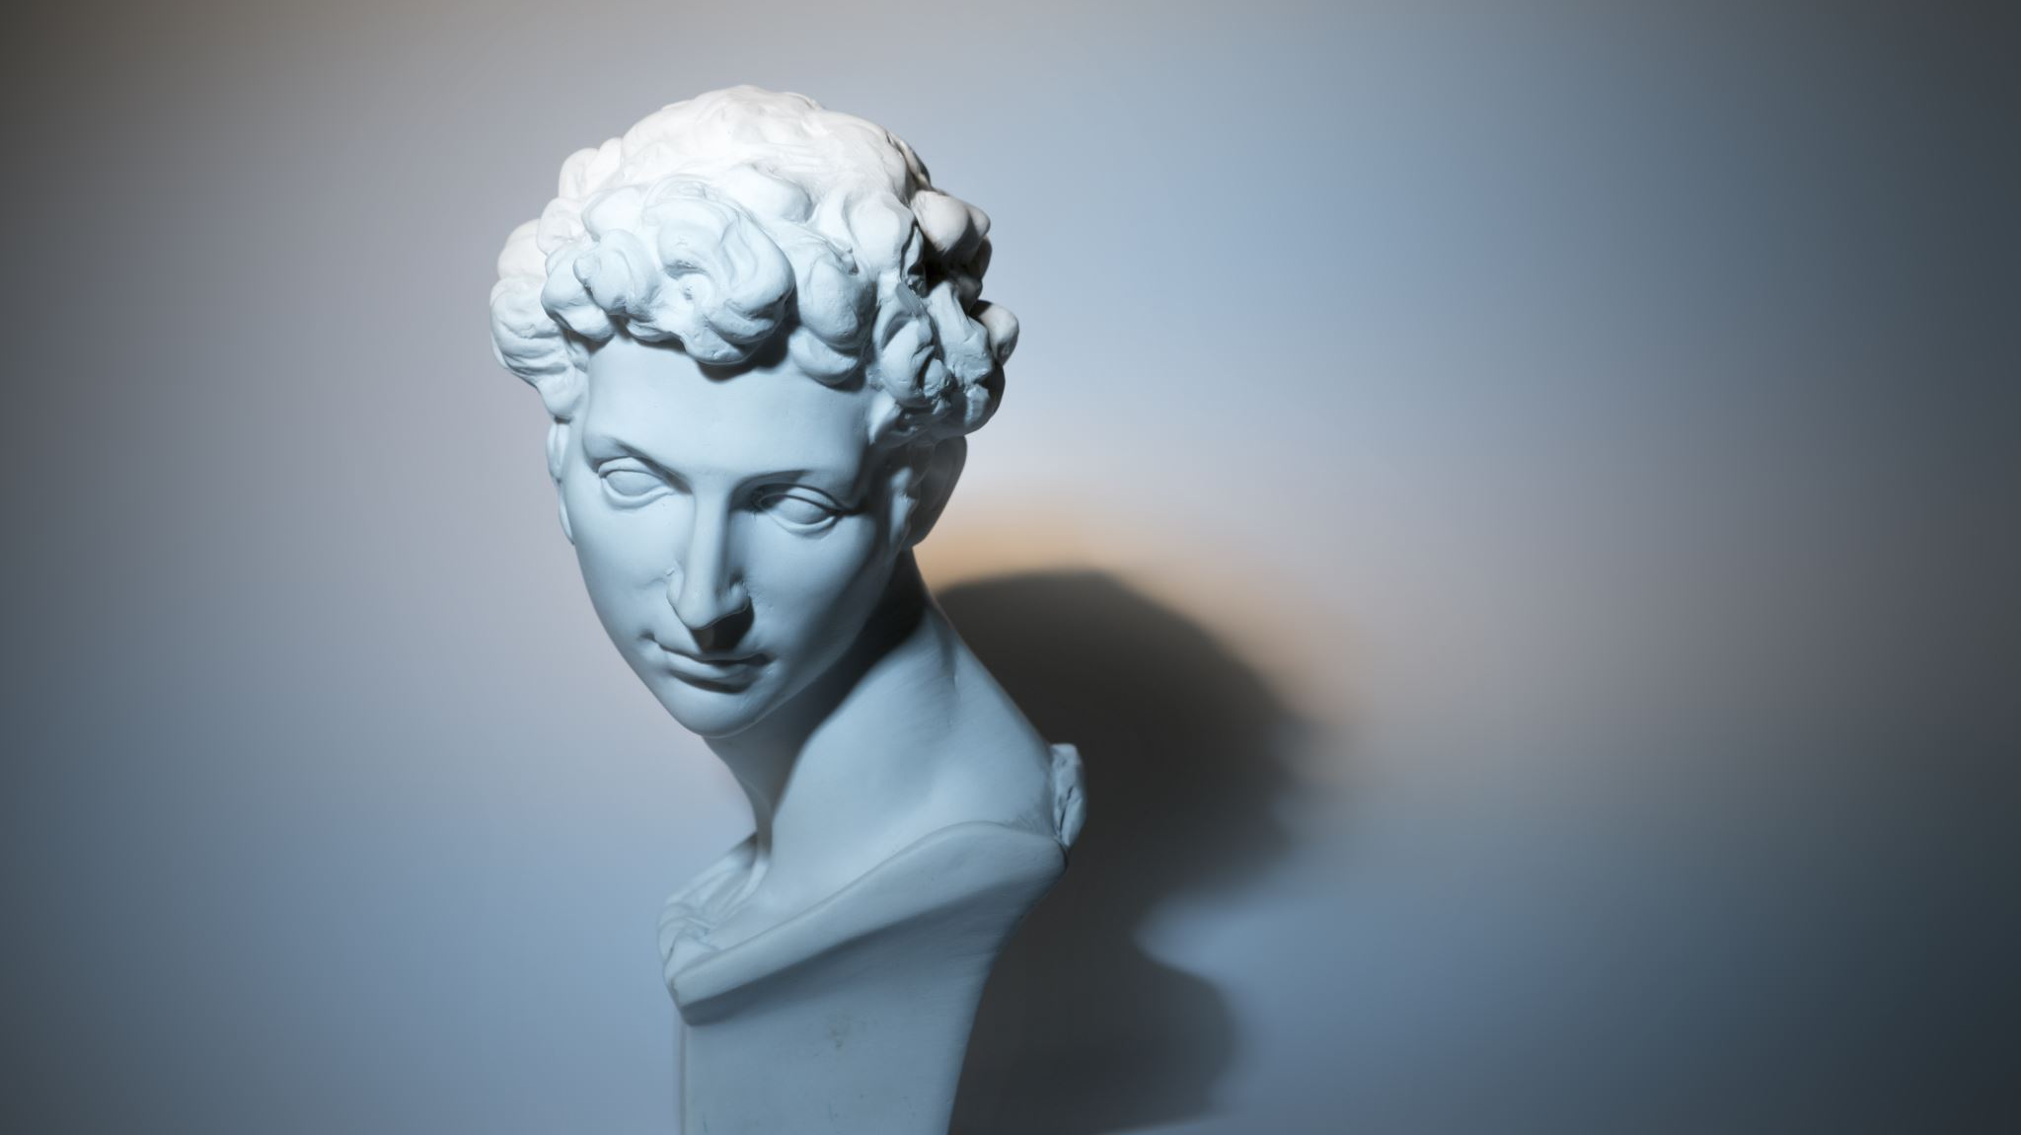
“The sculpture is already complete within the marble block, before I start my work. It is already there, I just have to chisel away the superfluous material.” ― Michelangelo
Notes:
For better understanding, there's a famous quote from Michelangelo, a great artist, said that when he looked at a block of marble, he saw the sculpture inside it. He just had to remove the extra marble to reveal it. DDPMs are similar – they find the hidden picture in the noise.
And here comes the question, think about that how can our neural network know whether the output is correct or not?

Slide 8
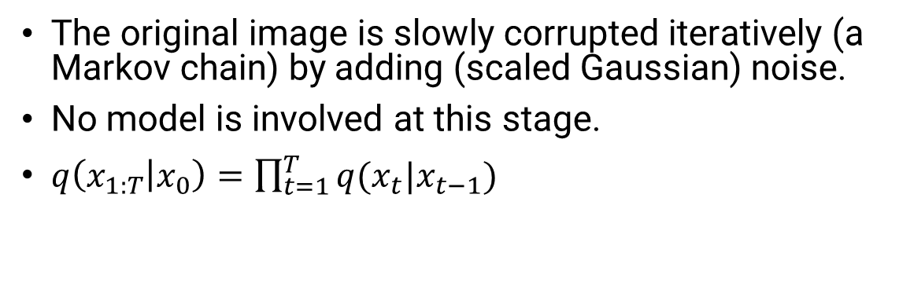
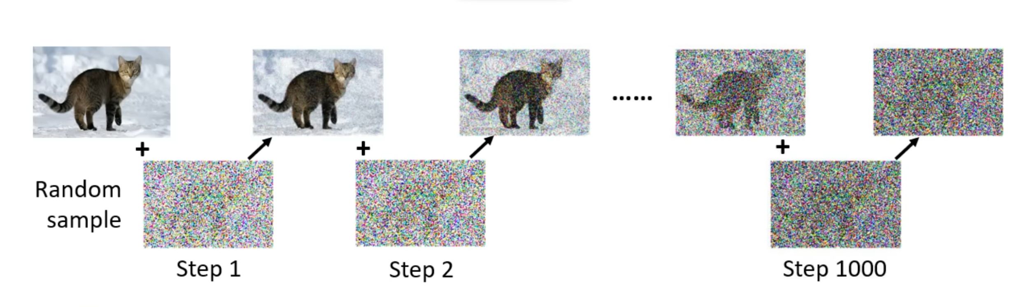
Forward Process
Notes:
Before answering that question, we would zoom in the forward process for now. It keeps adding noise with a Markov chain where the distribution at a particular time step only depends on the sample from the immediately previous step and no model is involved. Again, we notice that the step number here 1 is the original clearest picture and higher steps means more noise. In this case, after 1000 rounds, we finished the forward process.

Slide 9
Forward Process
Input
Ground truth
Input
Notes:
Now let’s connect this slide to our reverse learning process and answer the previous question on how we know whether the output is correct or not?
Once we done the forward process, we also have collected plenty of training sets just like the box showing here. Our picture and the corresponding step number would be the input and the red box will be the output. After doing enough training, our neural network model can then tell whether we got the expected output or not.

Slide 10
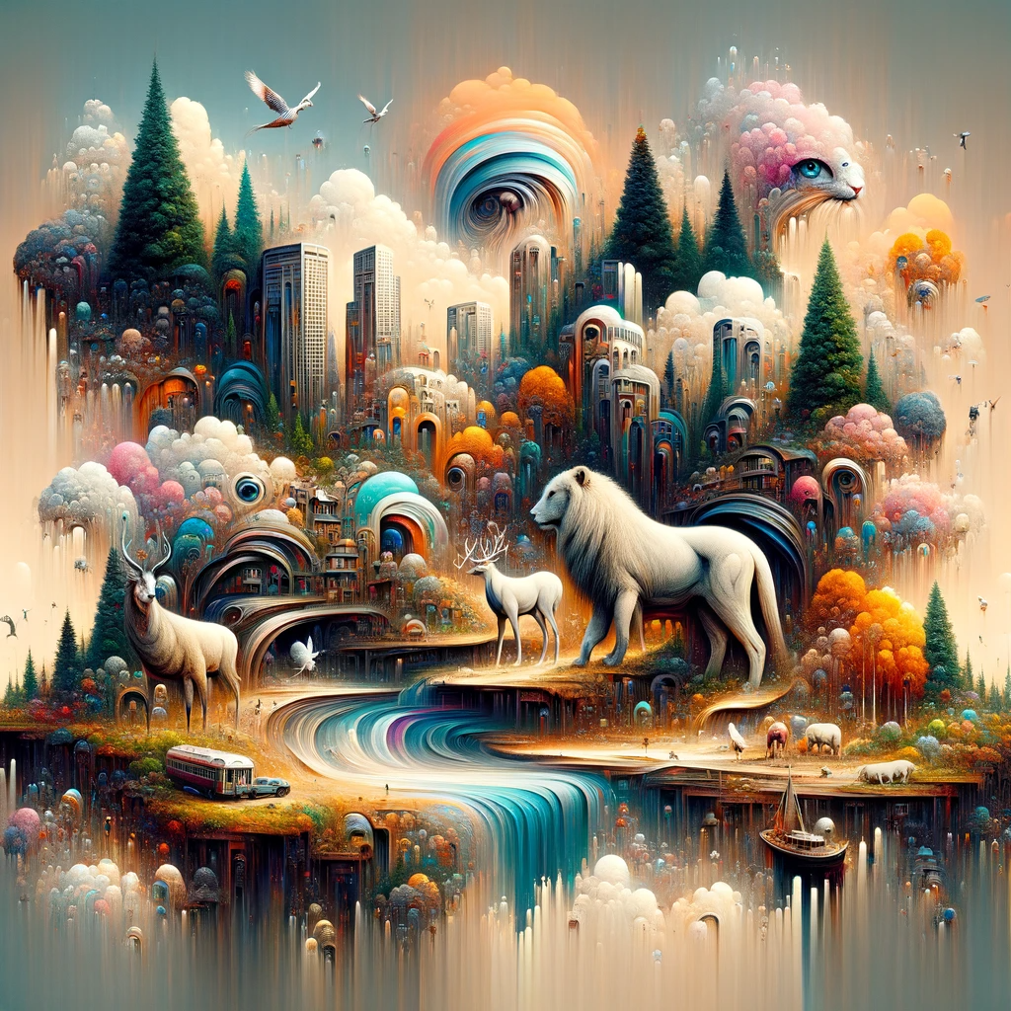
Dall-E 2 by OpenAI
Description: DALL-E 2 is an advanced AI model developed by OpenAI, capable of generating high-quality, creative images from textual descriptions.
Innovations: Create detailed, imaginative, and sometimes whimsical images that can combine unrelated concepts in a coherent visual format.
Applications: Creative industries for conceptual art, advertising, and generating visual ideas from textual descriptions.

Slide 11

Imagen by Google
Description: Imagen, developed by Google, is a state-of-the-art text-to-image AI model. It's renowned for generating photorealistic images from descriptive text, pushing the boundaries of AI's capability in understanding and rendering detailed visuals.
Innovations: Fidelity and resolution in image generation, as well as its ability to handle nuanced and complex descriptions.
Applications: Marketing, content creation, and education.

Slide 12

Stable Diffusion by StabilityAI
Description: Stable Diffusion is an AI model by StabilityAI designed for generating high-quality images from text prompts.
Innovations: Balance between image quality and computational efficiency.
Applications: Aids in democratizing AI art creation, allowing artists, educators.
Notes:
.

Slide 13

Midjourney
Description: Midjourney is an AI tool that specializes in creating artistic and visually striking images from text descriptions.
Innovations: Artistic styles and abstract imagery, offering a different perspective on AI-generated art.
Applications: Artists, designers, and creatives seeking innovative and unconventional visual interpretations of their ideas.

Slide 14
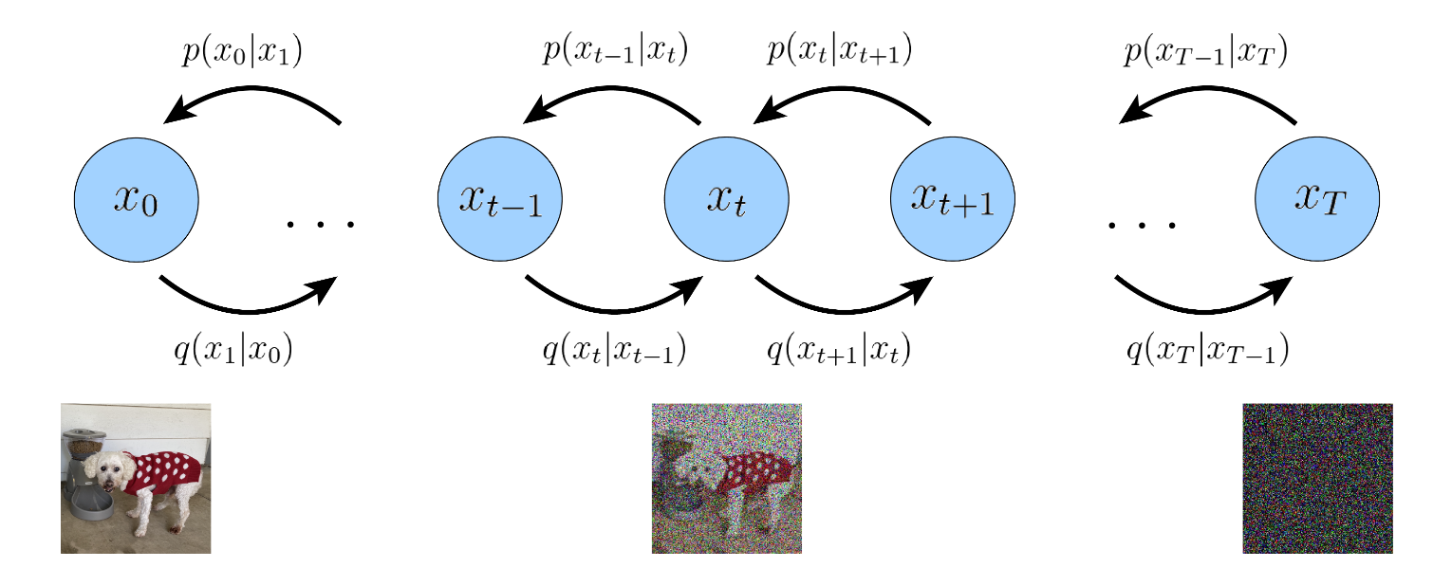
Notation
xt: object on timestep t
q: forward diffusion process
p: reverse diffusion process
Notes:
Now, let's dive into the math part and start with some basic notation. first, we will define the object as x with a number t as a subscript, this number will determine at which timestep we are, so x0 refers to the original object, and as time passes, we add more and more noise, this number will increase. with sufficient timestep, the object will follow an isotropic Gaussian, we call it x capital T, which is the object output in our final step. Next, we will define two functions q and p that describe forward and reverse diffusion process.

Slide 15

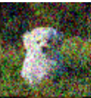

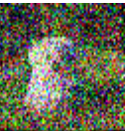
Forward process
Distribution of a less noised object given by a more noised object
Define variance beta ranging from 0 to 1 in a schedule of time step
Scaling factor to mean is for avoid the variance explode
Notes:
q xt given xt-1 correspond to the forward process, it takes in an object and return an object with a little bit more noise added, so xt-1 goes in and out comes with xt. And we define the q function as a distribution shown on the screen, a normal distribution that outputs xt with variance beta t ranging between zero and one, and the mean of this normal distribution is xt-1 times the scaling factor square root of 1 - beta t. The reason of having this scaling factor is to avoid the variance exploding, if we do not scale x before adding noise, all the noise will add up to increase the overall variance.

Slide 16

Reverse process
Distribution of a more noised object given by a less noised object
Output approximate by a neural network with parameter theta
Optimize the diffusion model by doing gradient descent on the loss function to optimize the parameter theta
Notes:
the second function p is for the reverse process, p takes in an object with more noise and produces a less noise object by using a neural network. we also express this p function as a normal distribution with mean mu theta and variance sigma theta. So in this case, we will have a neural network with parameter theta to approximate the distribution p which we can sample from to get xt-1. In this presentation, we will not focus on the structure of the neural network, but on the math part of how to optimize the diffusion model. In order to doing that, we need to train our neural network by doing gradient descent on the loss function of diffusion model.

Slide 17
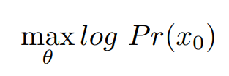
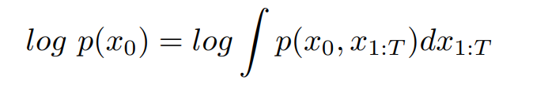
Maximum likelihood estimation
The probability of x0 is hard to calculate
x0 depends on x1, x2, … xT
Notes:
The next problem comes with what is the loss function. We need to do the maximum likelihood estimation to find that. But there is a problem, the prior probability of x0 is not computable because it depends on other timestep objects x1 to x capital T, and we don't know their joint probability distribution.

Slide 18
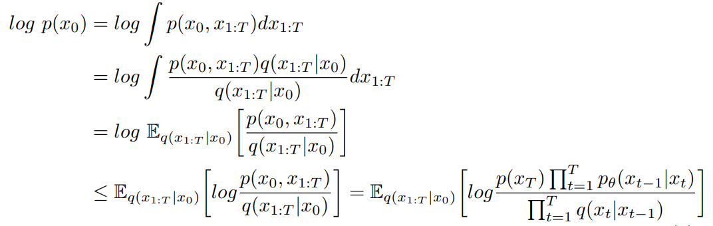
Evidence Lower Bound(ELBO)
ELBO is always smaller than the evidence
Maximize the ELBO is a proxy objective to maximize the evidence
Notes:
As a solution, we can compute its lower bound Here, we called it the Evidence Lower Bound, Evidence in this case is the log-likelihood of the observed data x0, and the Evidence lower bound is always smaller than the evidence, which means if we maximize the Evidence lower bound, the log-likelihood will also increase. Therefore, maximizing the Evidence Lower Bound becomes a proxy objective to optimize the diffusion model. Now, after some derivation, we get a Evidence Lower Bound here, the upper part is reverse process, and lower is forward process. And, to calculate this whole term, we need to do further derivation.

Slide 19
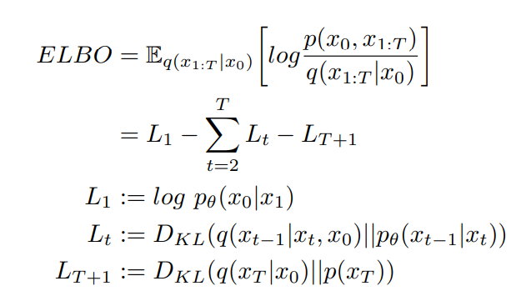
Evidence Lower Bound(ELBO)
L1: Reconstruction term
Lt: Denoising matching term
LT+1: Prior matching term
Notes:
We can see we derive it into three terms, each term is computed of at most one random variable at a time. This formulation has an elegant interpretation, we will go through each individual term one by one.

Slide 20

Reconstruction term
Predict the log probability of the original data sample given the first-step noised object.
It can be approximated and optimized using a Monte Carlo estimate.
Notes:
the first term L1 we call it Reconstruction term, it predicts the log probability of the original data sample given the first-step noised object. It can be approximated by using a Monte Carlo estimate. For example, suppose objects are images, we know that, in practice, the image pixel value is the intensity of different color components, so we assume that each color component is divided into 256 bins, and we can compute this log probability of landing in the correct bin.

Slide 21

Prior matching term
The KL divergence between two distribution
Represents how close the distribution of the final noisified input is to the standard Gaussian prior
It is equal to zero(two distributions are the same) if we learn a perfect model
Notes:
The third term Lt+1, the prior matching term. This term is measured by KL-divergence, it compare the difference between two distribution, if these two distributions are the same, the KL-divergence is equal to zero, on the other hand, if there is a big difference between two distributions, this KL-divergence will be a large positive number. so in this case, Lt+1 represents how close the distribution between the final noised object is to the standard Gaussian noise. we already know the p x capital T is a standard Gaussian noise, and question come with how to compute the q x capital T given by x0

Slide 22

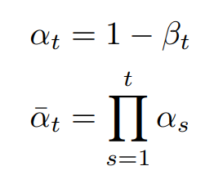

Rewrite forward process
Define:
Notes:
Recall the forward process q function, it describes one forward step of adding noise. To get the final noised object x capital T from the original object x0, we need to add T iteration of noise, that is repeat q function T times. There is an easier way to do that in one step, and we need to define a little more notations to achieve that. we will define alpha t as equal to 1-beta t and define the cumulative product of alphas from all timesteps, which is just multiplying all alphas together. Ok, then we can rewrite the forward diffusion process in terms of alphas.

Slide 23
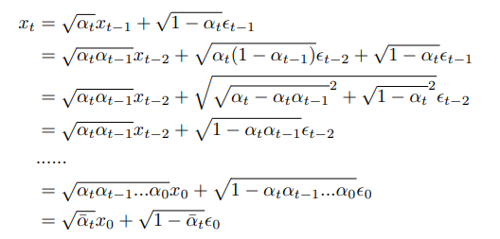
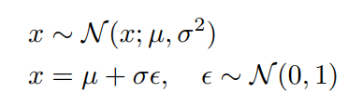

Sample object from forward process
reparameterization trick:
Notes:
Next, we can sample xt from this distribution, to do that, we apply the reparameterization trick and get a formula of xt in terms of xt-1 and noise epsilon. The Epsilon is the white noise that sampled from a standard normal distribution with mean zero and variance 1. Then, we can extend the earlier timestep xt-2 by plugin to xt-1 using the same formula, and repeat this step by t-3, t-4, and so on until t equals zero. So finally we get a formula of xt given x0, and we can rewrite the product of all alphas to the cumulative alphas to shorten the formula. Therefore we can get the distribution q(xt|x0) at any timestep t. Then we calculate the Lt+1 term.

Slide 24
Denoising matching term
Use the neural network to learn the reverse diffusion process pθ to approximate the ground-truth denoising process q
This term is minimized when the two distributions match as closely as possible, as measured by their KL Divergence.
Notes:
Now, take a look at the second term Lt, the Denoising matching term, that is the most important term we need to focus on. We use a neural network to learn the reverse diffusion process pθ(xt−1|xt) to approximate the ground-truth denoising process q(xt−1|xt, x0). According to the KL-divergence properties, this term is minimized when the two distributions match as closely as possible. The problem comes with this term is how to calculate q(xt−1|xt, x0).

Slide 25
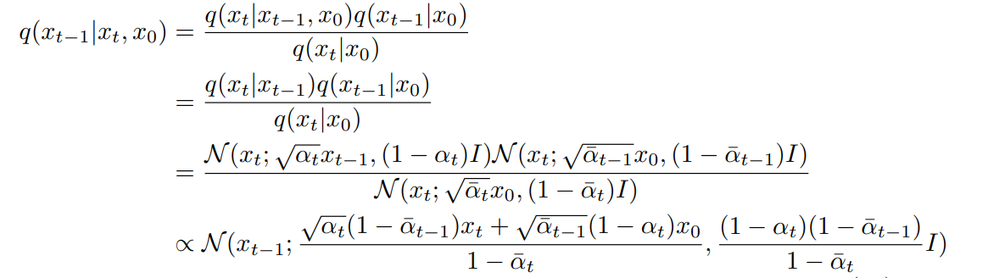
Ground-truth denoising process
Mean is a formula of xt and x0
Variance is irrelevant to object x
Notes:
We can get this distribution by using the Bayes rule. After derivation, we get this normal distribution with mean and variance shown on screen. we can see the variance here is irrelevant to object x, but alphas, we know that alphas are fixed value for each timestep, so the variance of ground-truth denoising distribution are also fixed for each timestep t

Slide 26
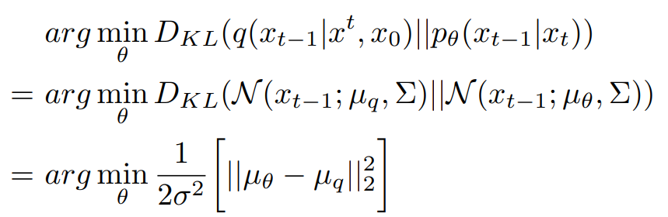
Loss function
mean squared error between the actual mean and predicted mean of denoising process
Notes:
So we only focus on mean prediction in our neural network. Therefore, we decided to use a simple mean squared error between the actual mean and predicted mean of denoising process as our loss function. and we finally can do gradient descent with it on our neural network, but this loss function is not simple yet, we can do further derivation to simplify it.

Slide 27
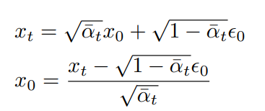



Reformulation
Recall the formula of sampling xt from x0:
Reformulate the mean of ground-truth denoising process and the reverse diffusion process:
Notes:
Recall the function of xt given x0 and noise, we can rewrite this to a formula of x0 in terms of xt and noise, plug in this formula into the mean of ground truth denoising diffusion distribution we just derived, we can cancel out the xt-1 term and the mean of this distribution only relate to current xt and the noise epsilon. Then we can also write the predicted mean in this form.

Slide 28

Loss function
mean squared error between the actual noise and predicted noise
Notes:
Also plugin these two mean values to the loss function, we can get a simple loss function only related to noise. So we can use our network only to predict the noise epsilon and the loss function is the mean squared error between the actual noise and predicted noise.

Slide 29
Summary
Diffusion process: adding noise and denoising
Maximum likelihood estimation
Evidence lower bound
Loss function
Notes:
After this heavy math derivation, finally, we are done, let's summarize what we learned, diffusion models are generative models with two processes, forward and reverse process. In the forward step, we gradually add noise to an object over a lot of timesteps until the object turns into a complete noise. And in the reverse process, we denoise the object by using a neural network. To train the neural network, we need to do gradient descent on the loss function of the diffusion model. To find the loss function, we apply the maximum likelihood estimation on the prior probability of the original object, we found this value is uncomputable, so we turn into a proxy objective which is the evidence lower bound. To do derivation on that, we get a loss function that measures the difference between the predicted mean and ground truth mean of the denoising step. To do further reformulation, we get a loss function that only predicts the noise.

