Slide 1


DC229226 Yiming Luo
Individual Digital Story
0
Designing an Academic and Career Development Website for Computer Science Students
Yiming Luo, DC229226
Team 02

Slide 2


DC229226 Yiming Luo
Individual Digital Story
01
My contribution in the Team project
Overall Page design
Design and develop Master’s Page
Design and develop Career’s Page
Design and develop Job’s page
Design and develop AI Chat page
Notes:
Hello everyone. Today I'll talk about the core services and data requirements of our project. This is platform providing precise information for CS students' dual paths: further studies and employment.

Slide 3
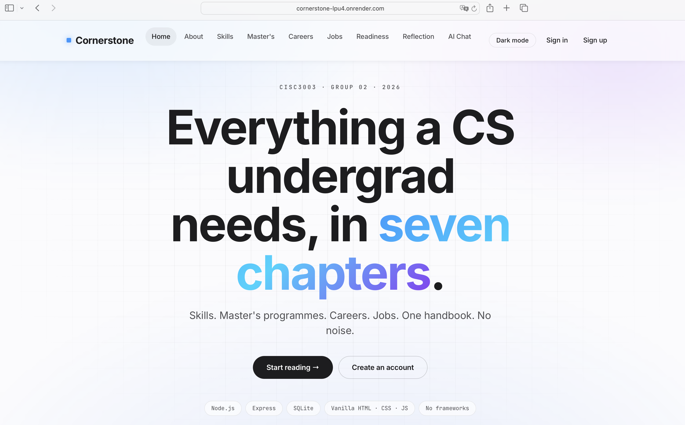
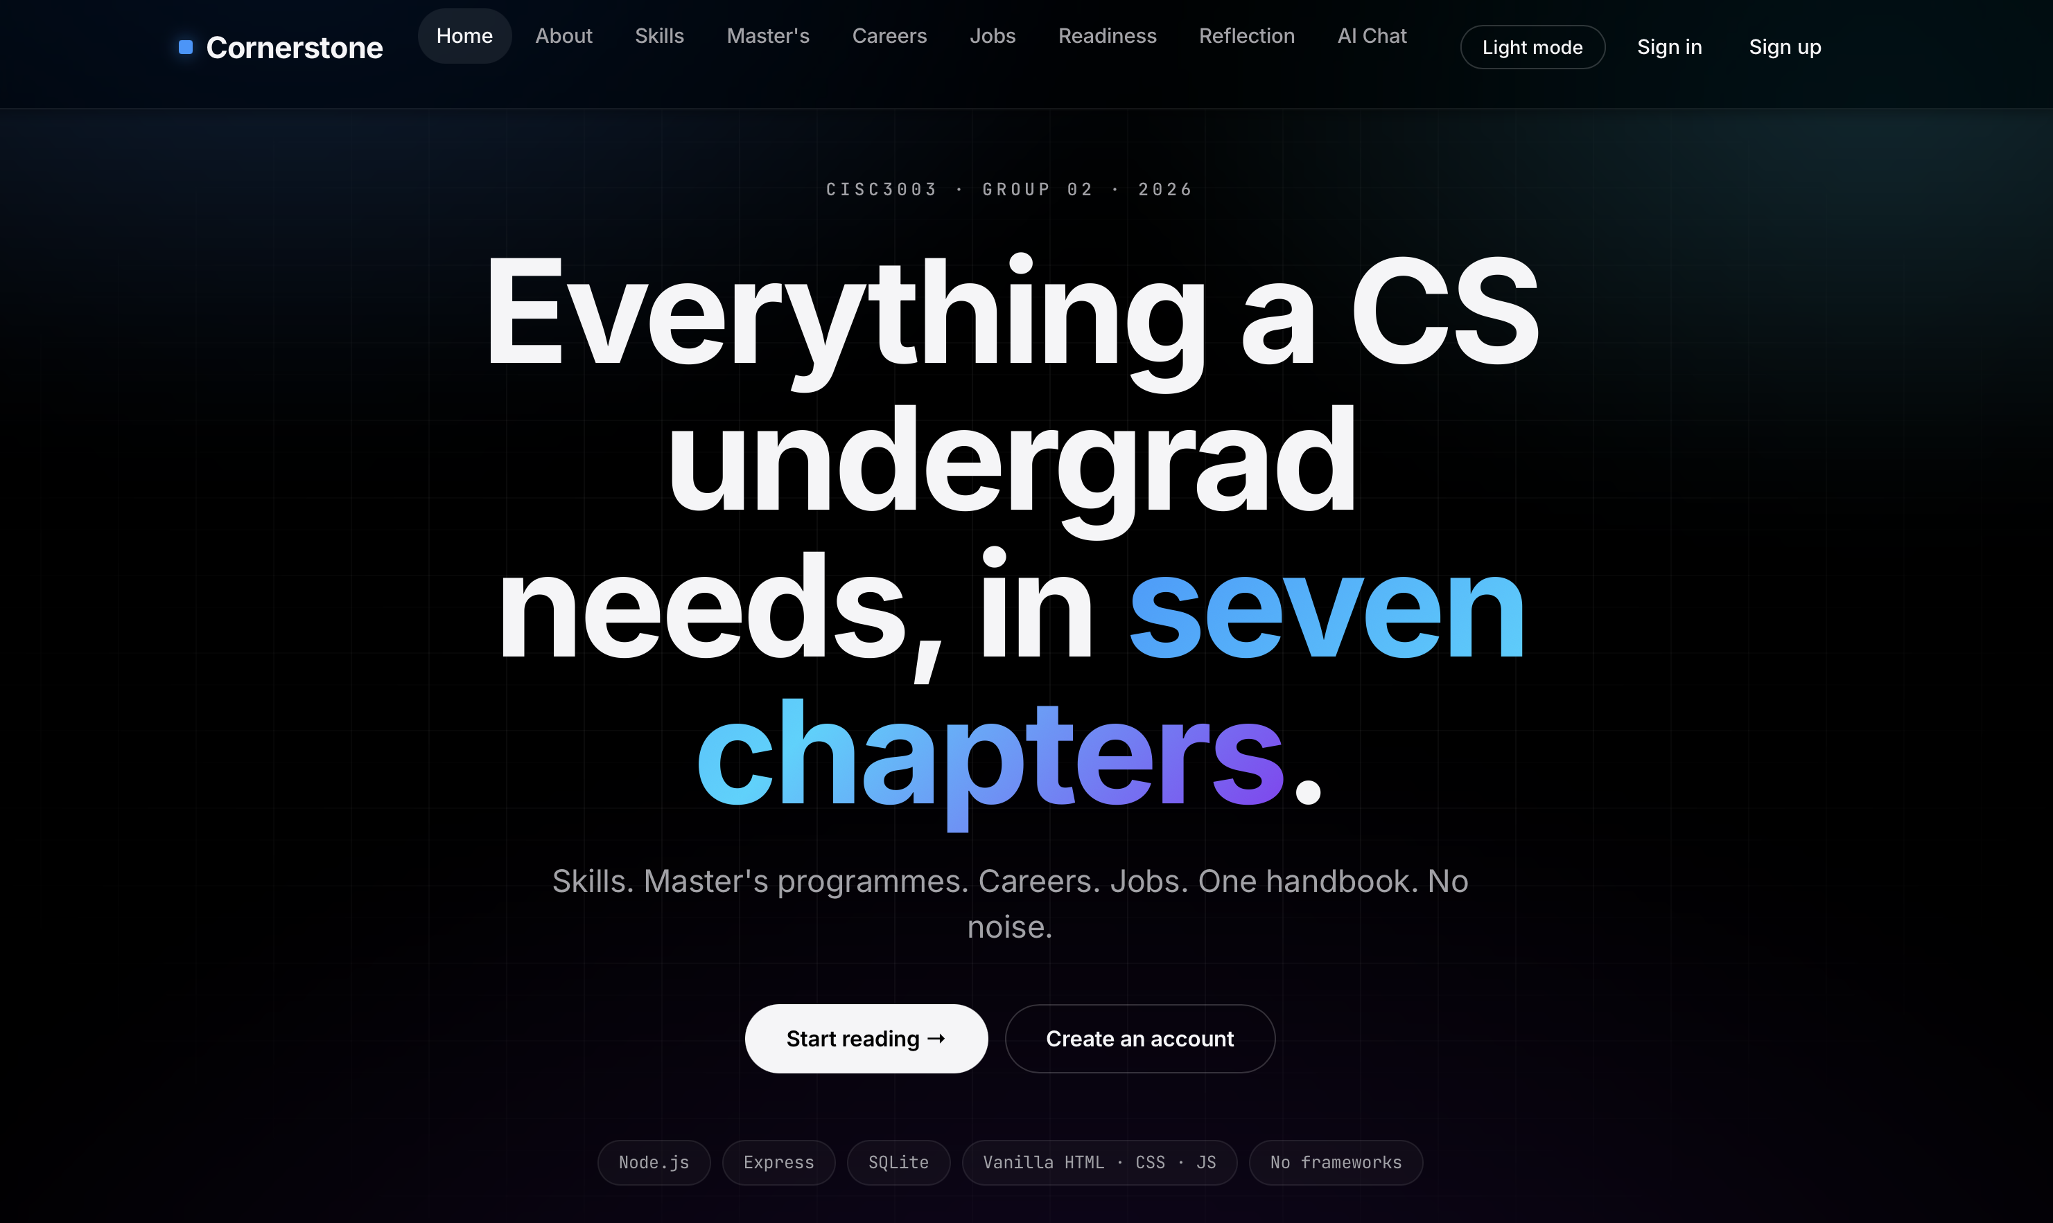
DC229226 Yiming Luo
Individual Digital Story
Overall Page design
Light mode
Dark mode

Slide 4

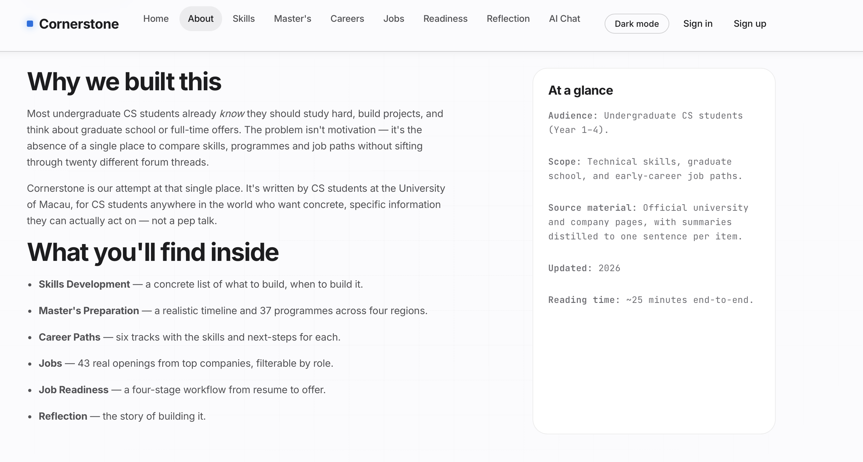
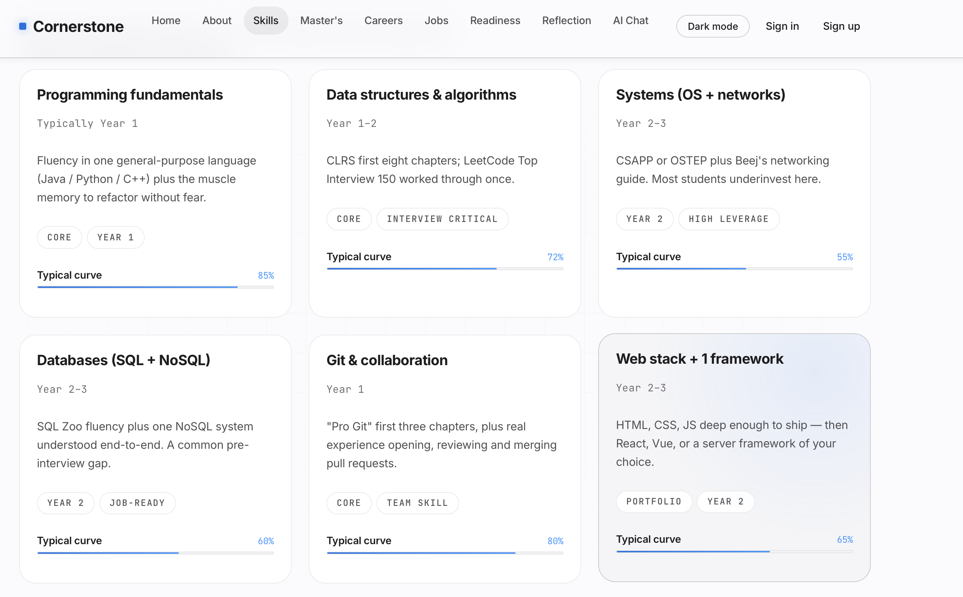
DC229226 Yiming Luo
Individual Digital Story
My main contribution 1 - Overall Page design
The website is organized into eight sections.
prepare for
direct employment
· Recommendations for mainstream technical positions (SDE, AI, data science, etc.)
· Job postings and requirements from renowned technology companies
· Skill matching suggestions and career development paths
About section
Skills section
Notes:
We focus on two parts: First, postgraduate applications, it offers global university ratings, major comparisons, and application strategies. Second, the direct employment, compiling mainstream technical roles and hiring requirements from top companies. Our homepage allows users to switch between these two tracks seamlessly.

Slide 5
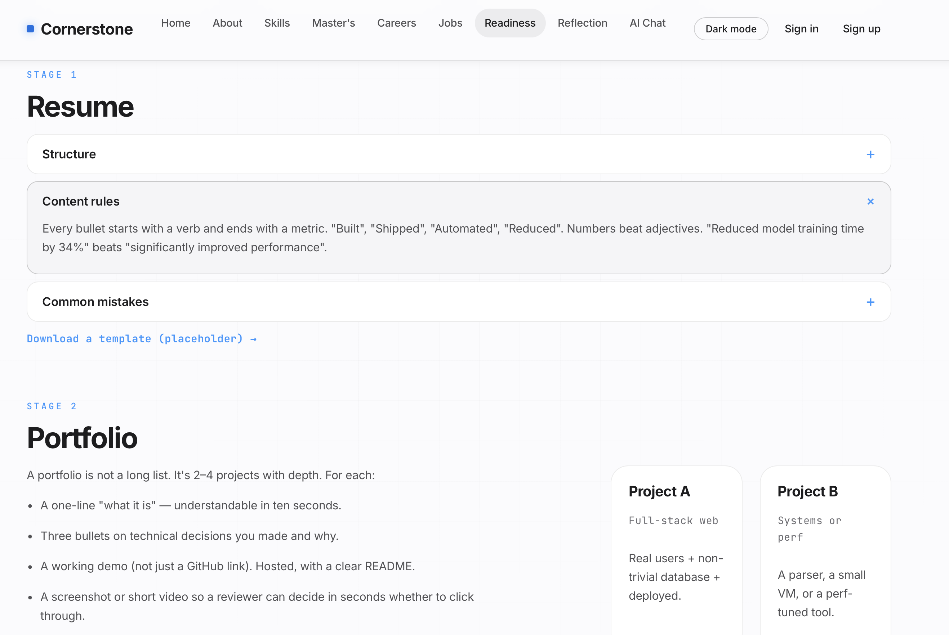
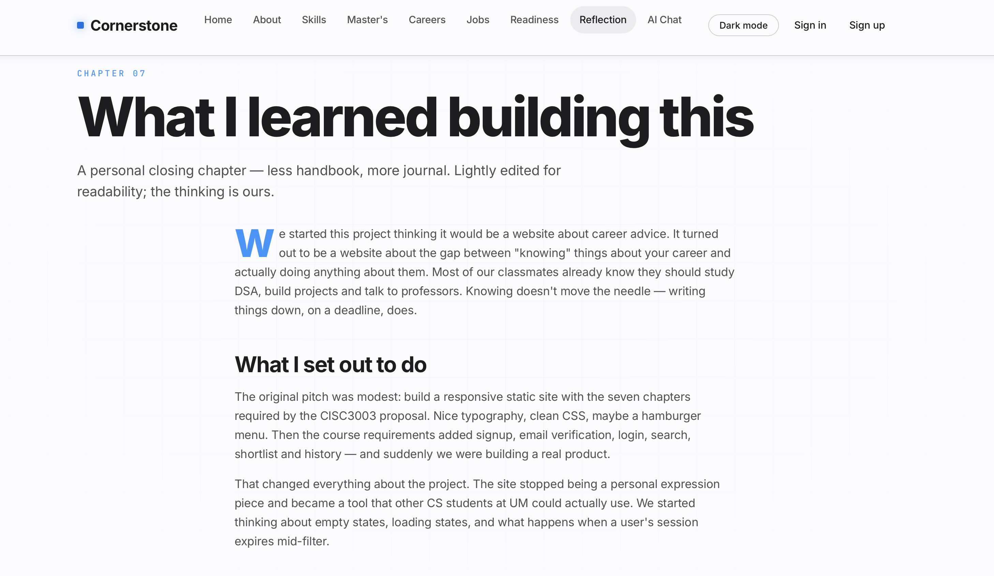
DC229226 Yiming Luo
Individual Digital Story
My main contribution 1 - Overall Page design
The website is organized into eight sections.
prepare for
direct employment
· Recommendations for mainstream technical positions (SDE, AI, data science, etc.)
· Job postings and requirements from renowned technology companies
· Skill matching suggestions and career development paths
Readiness section
Reflection section
Notes:
We focus on two parts: First, postgraduate applications, it offers global university ratings, major comparisons, and application strategies. Second, the direct employment, compiling mainstream technical roles and hiring requirements from top companies. Our homepage allows users to switch between these two tracks seamlessly.

Slide 6
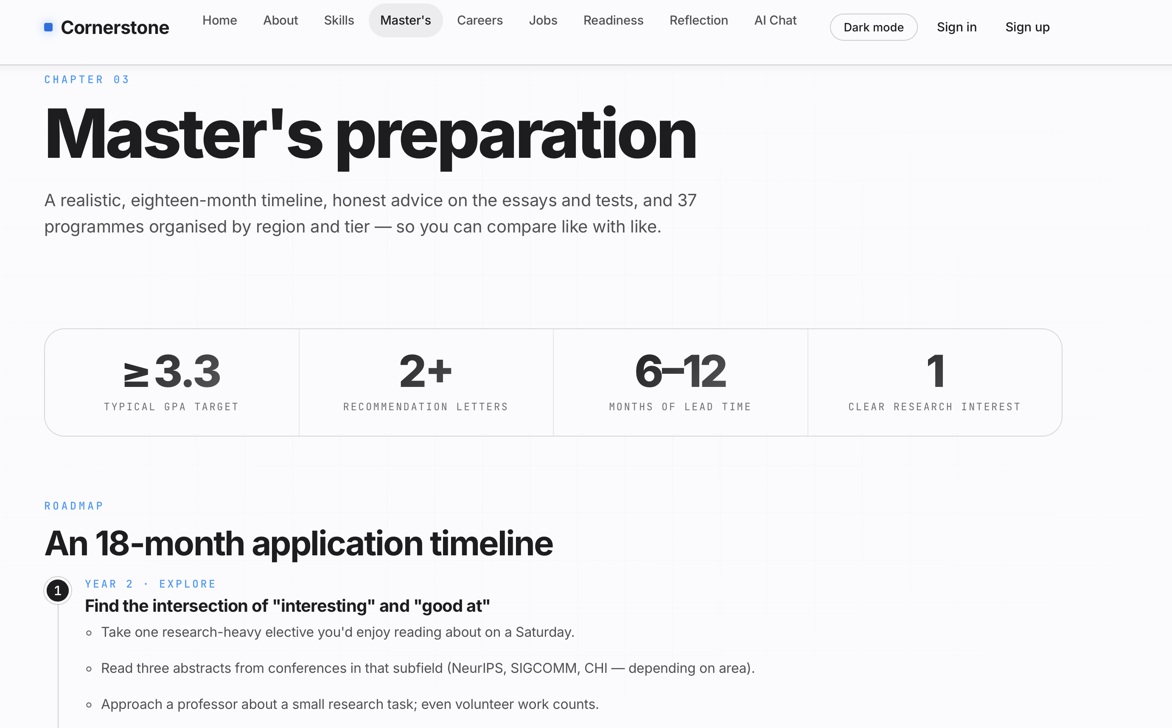
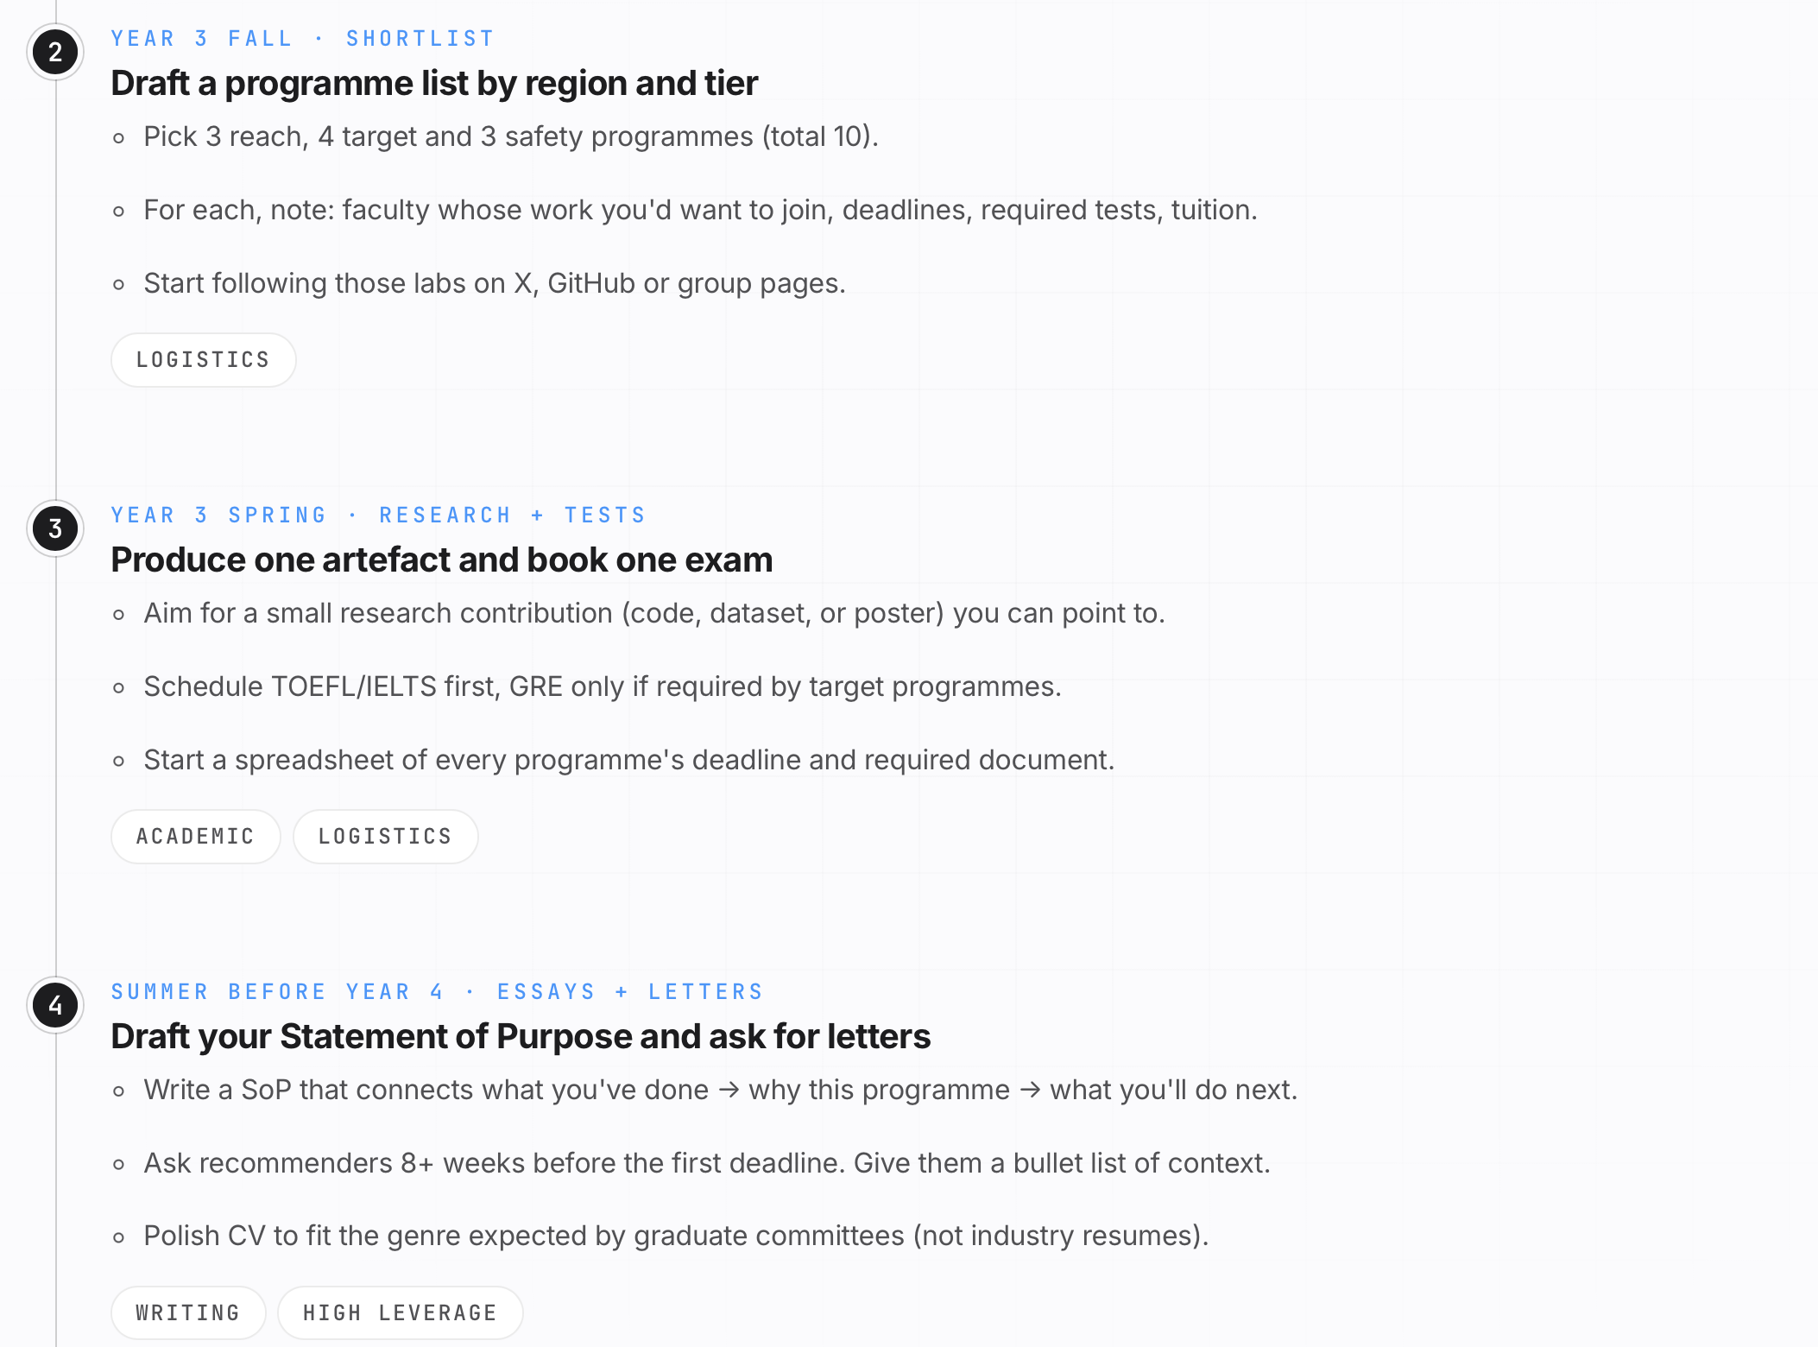
DC229226 Yiming Luo
Individual Digital Story
My main contribution 2 – Design and develop Master’s page
First, on the Master’s page, I introduced how students can prepare for graduate school applications.
prepare for
direct employment
· Recommendations for mainstream technical positions (SDE, AI, data science, etc.)
· Job postings and requirements from renowned technology companies
· Skill matching suggestions and career development paths
Notes:
We focus on two parts: First, postgraduate applications, it offers global university ratings, major comparisons, and application strategies. Second, the direct employment, compiling mainstream technical roles and hiring requirements from top companies. Our homepage allows users to switch between these two tracks seamlessly.

Slide 7
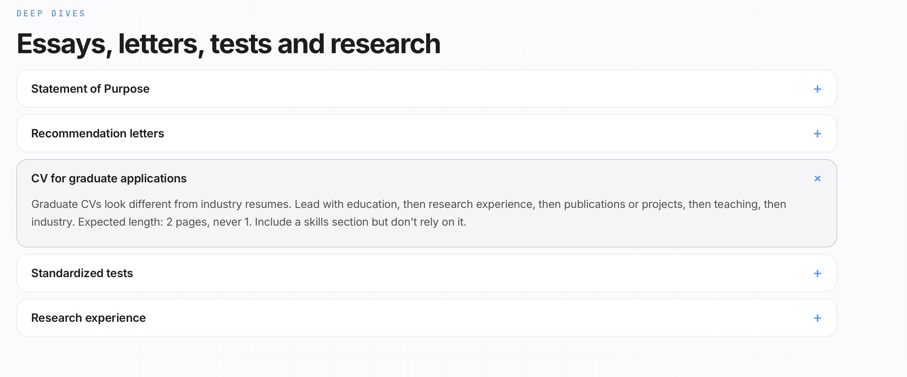
DC229226 Yiming Luo
Individual Digital Story
My main contribution 2 – Design and develop Master’s page
prepare for
direct employment
· Recommendations for mainstream technical positions (SDE, AI, data science, etc.)
· Job postings and requirements from renowned technology companies
· Skill matching suggestions and career development paths
Second, I introduced the materials required for Master’s applications and explained how to prepare them effectively.
Notes:
We focus on two parts: First, postgraduate applications, it offers global university ratings, major comparisons, and application strategies. Second, the direct employment, compiling mainstream technical roles and hiring requirements from top companies. Our homepage allows users to switch between these two tracks seamlessly.

Slide 8
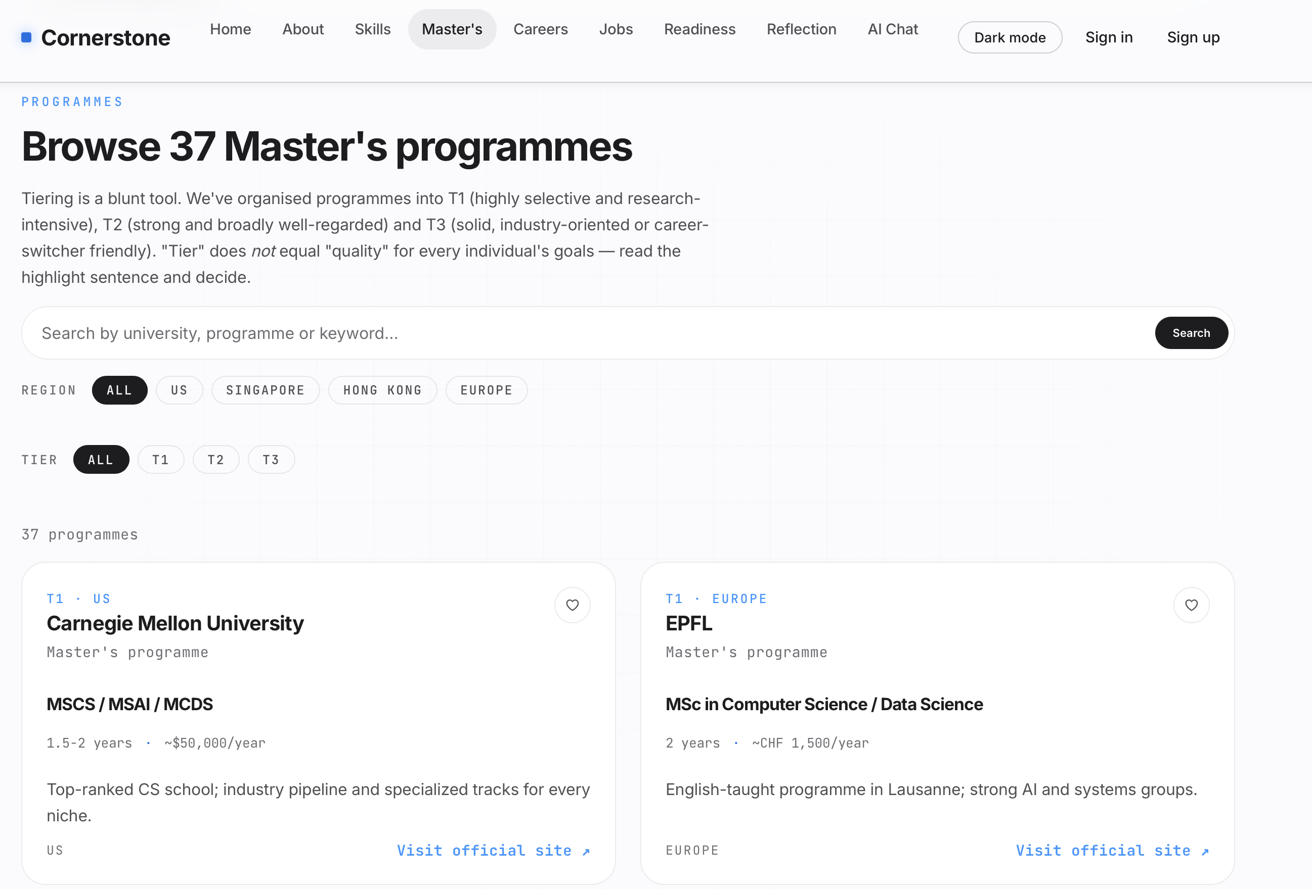
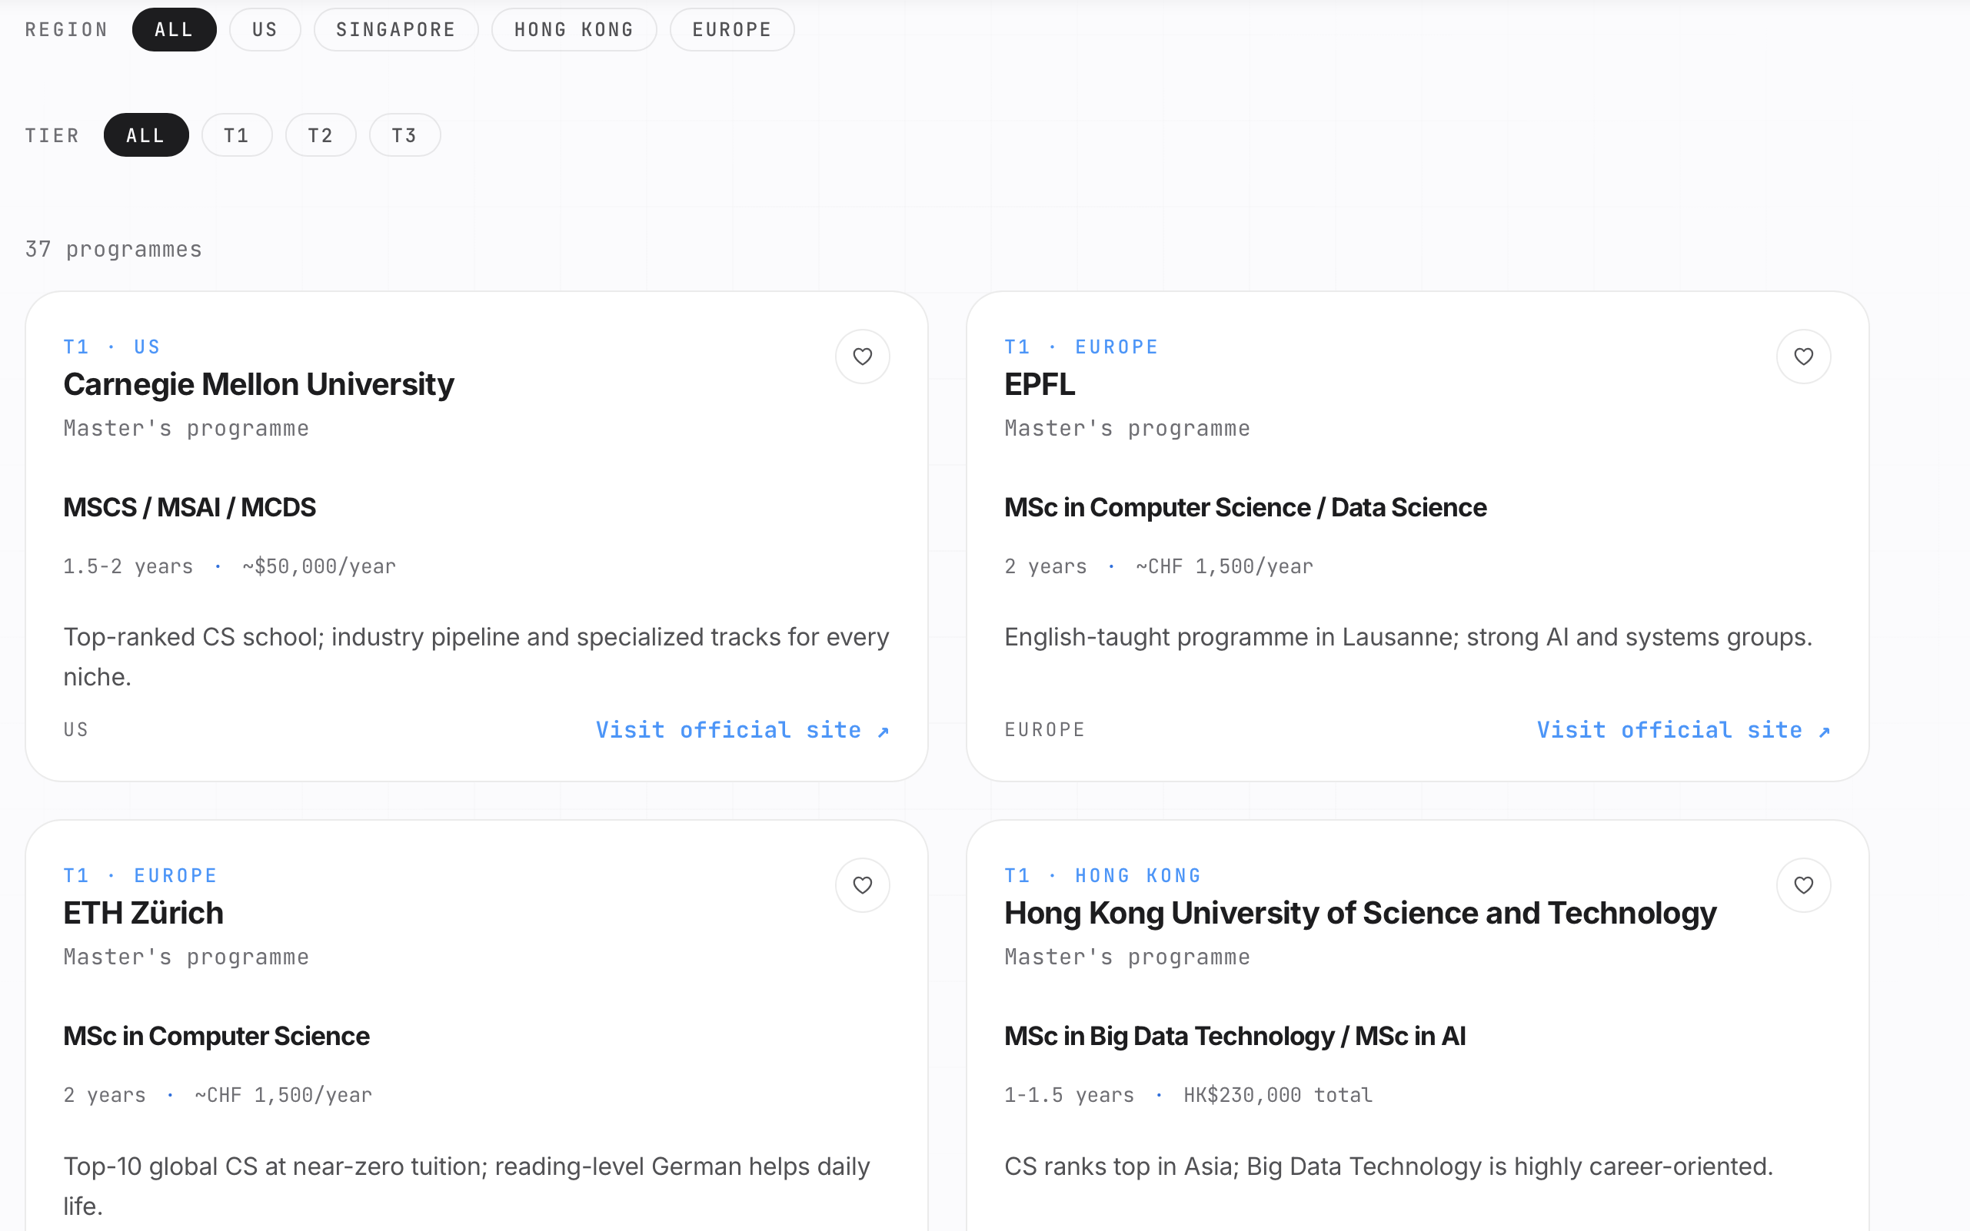
DC229226 Yiming Luo
Individual Digital Story
My main contribution 2 – Design and develop Master’s page
prepare for
direct employment
· Recommendations for mainstream technical positions (SDE, AI, data science, etc.)
· Job postings and requirements from renowned technology companies
· Skill matching suggestions and career development paths
I introduced a wide range of graduate programs to help students gain a better understanding of their options.
Notes:
We focus on two parts: First, postgraduate applications, it offers global university ratings, major comparisons, and application strategies. Second, the direct employment, compiling mainstream technical roles and hiring requirements from top companies. Our homepage allows users to switch between these two tracks seamlessly.

Slide 9
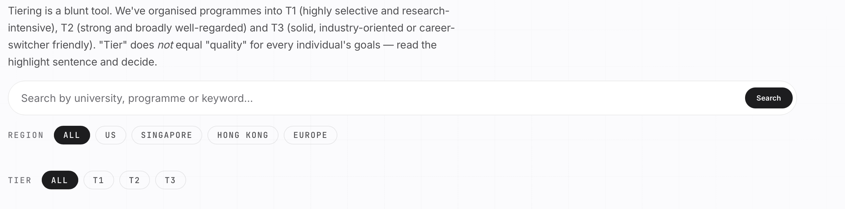
DC229226 Yiming Luo
Individual Digital Story
My main contribution 2 – Design and develop Master’s page
Users can search by keywords, or filter programs based on region and level of application difficulty.
prepare for
direct employment
· Recommendations for mainstream technical positions (SDE, AI, data science, etc.)
· Job postings and requirements from renowned technology companies
· Skill matching suggestions and career development paths
Notes:
We focus on two parts: First, postgraduate applications, it offers global university ratings, major comparisons, and application strategies. Second, the direct employment, compiling mainstream technical roles and hiring requirements from top companies. Our homepage allows users to switch between these two tracks seamlessly.

Slide 10
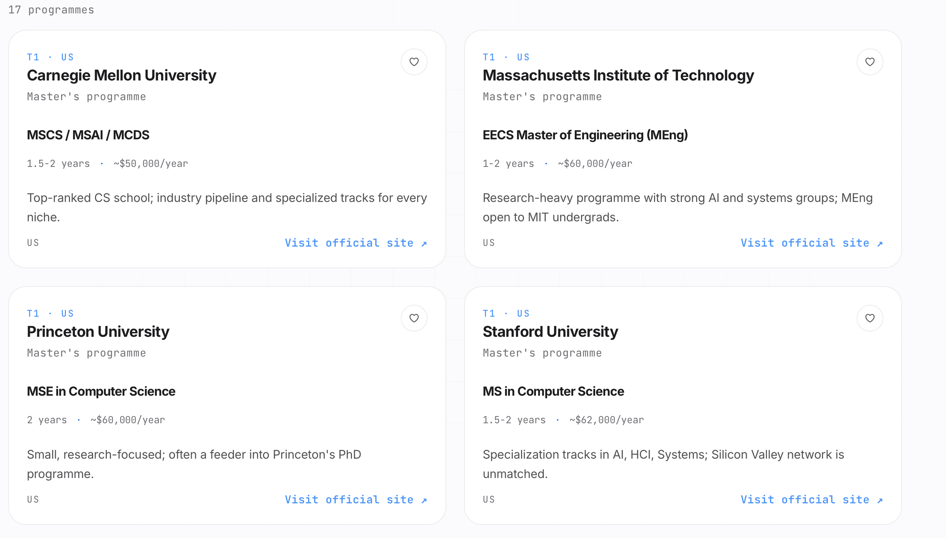
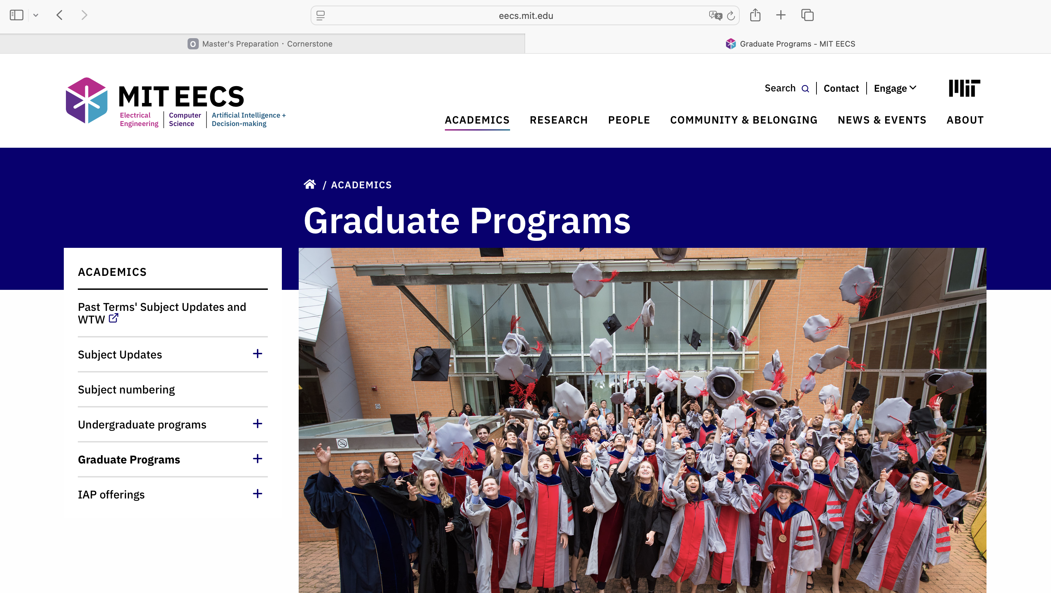
DC229226 Yiming Luo
Individual Digital Story
My main contribution 2 – Design and develop Master’s page
prepare for
direct employment
· Recommendations for mainstream technical positions (SDE, AI, data science, etc.)
· Job postings and requirements from renowned technology companies
· Skill matching suggestions and career development paths
We also provide direct links: by clicking the buttons, users can navigate to the corresponding graduate programs at each university for more detailed information.
Notes:
We focus on two parts: First, postgraduate applications, it offers global university ratings, major comparisons, and application strategies. Second, the direct employment, compiling mainstream technical roles and hiring requirements from top companies. Our homepage allows users to switch between these two tracks seamlessly.

Slide 11
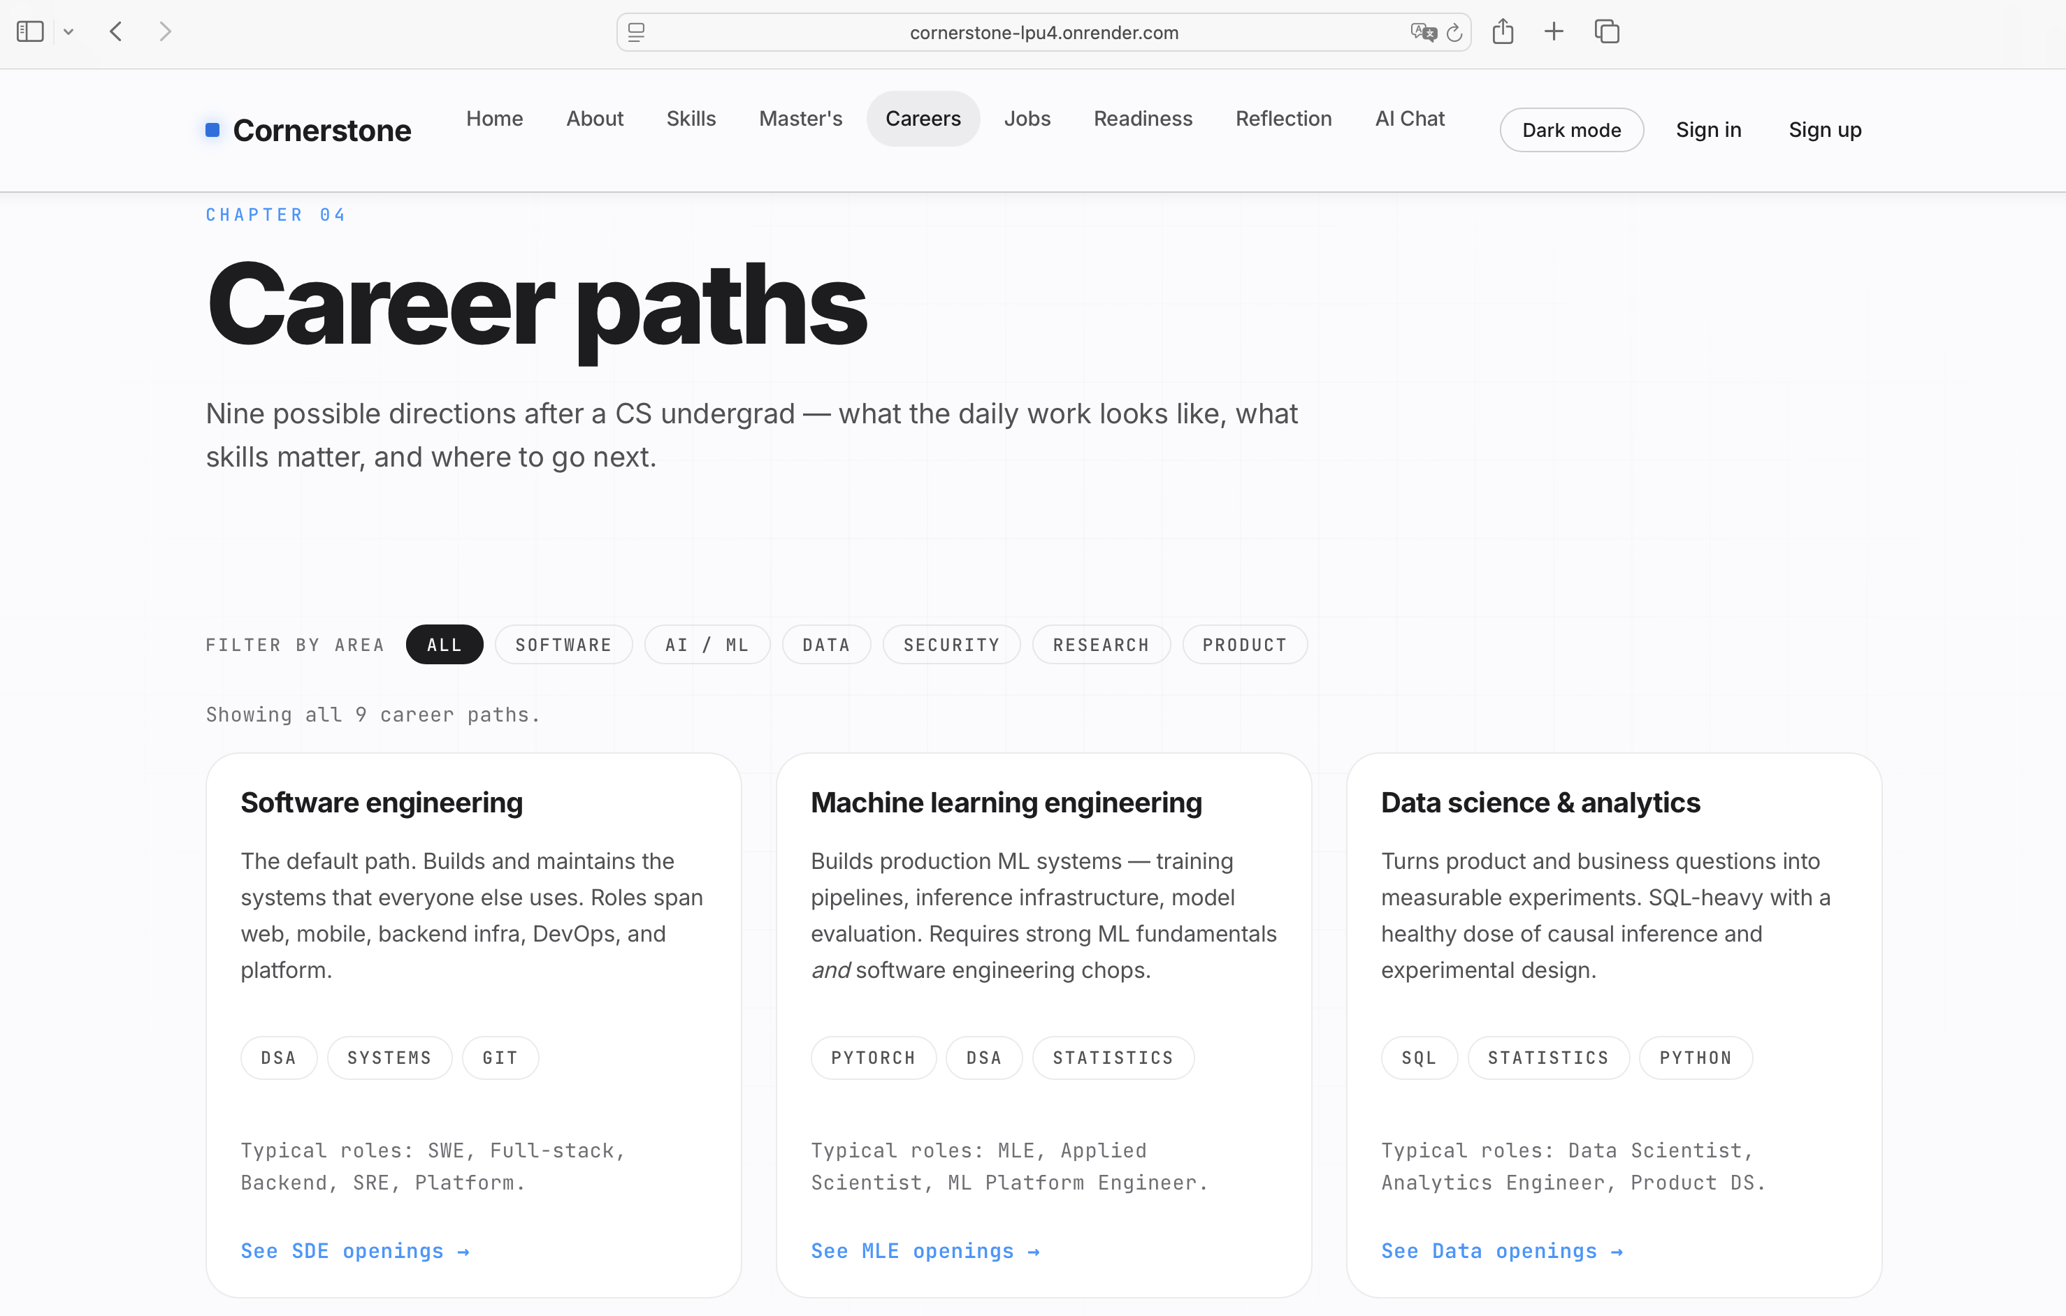
DC229226 Yiming Luo
Individual Digital Story
My main contribution 2 – Design and develop Careers page
To help students gain a more detailed understanding of career planning, we designed a Careers page.
prepare for
direct employment
· Recommendations for mainstream technical positions (SDE, AI, data science, etc.)
· Job postings and requirements from renowned technology companies
· Skill matching suggestions and career development paths
Notes:
We focus on two parts: First, postgraduate applications, it offers global university ratings, major comparisons, and application strategies. Second, the direct employment, compiling mainstream technical roles and hiring requirements from top companies. Our homepage allows users to switch between these two tracks seamlessly.

Slide 12

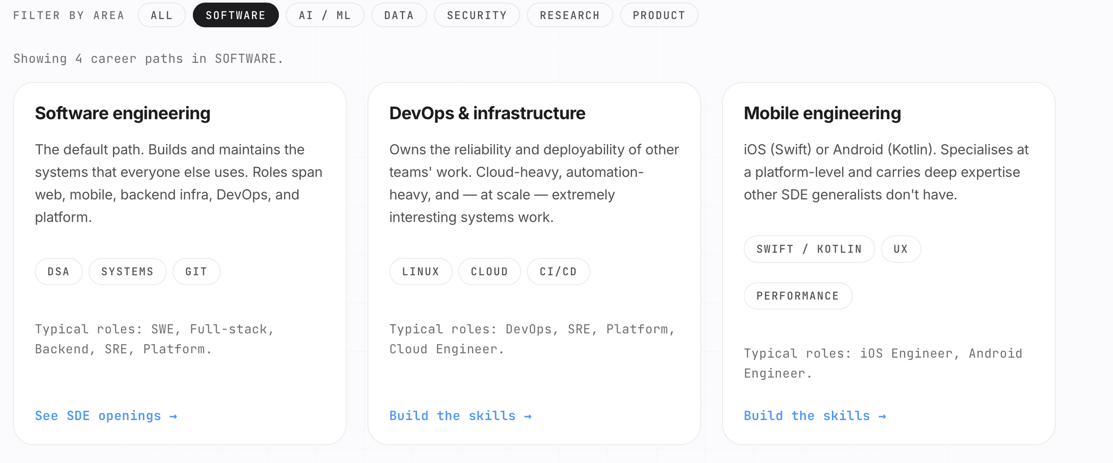
DC229226 Yiming Luo
Individual Digital Story
My main contribution 2 – Design and develop Careers page
We provide six career categories
By clicking on a specific category, users can view the detailed types of jobs included within it.
prepare for
direct employment
· Recommendations for mainstream technical positions (SDE, AI, data science, etc.)
· Job postings and requirements from renowned technology companies
· Skill matching suggestions and career development paths
Notes:
We focus on two parts: First, postgraduate applications, it offers global university ratings, major comparisons, and application strategies. Second, the direct employment, compiling mainstream technical roles and hiring requirements from top companies. Our homepage allows users to switch between these two tracks seamlessly.

Slide 13
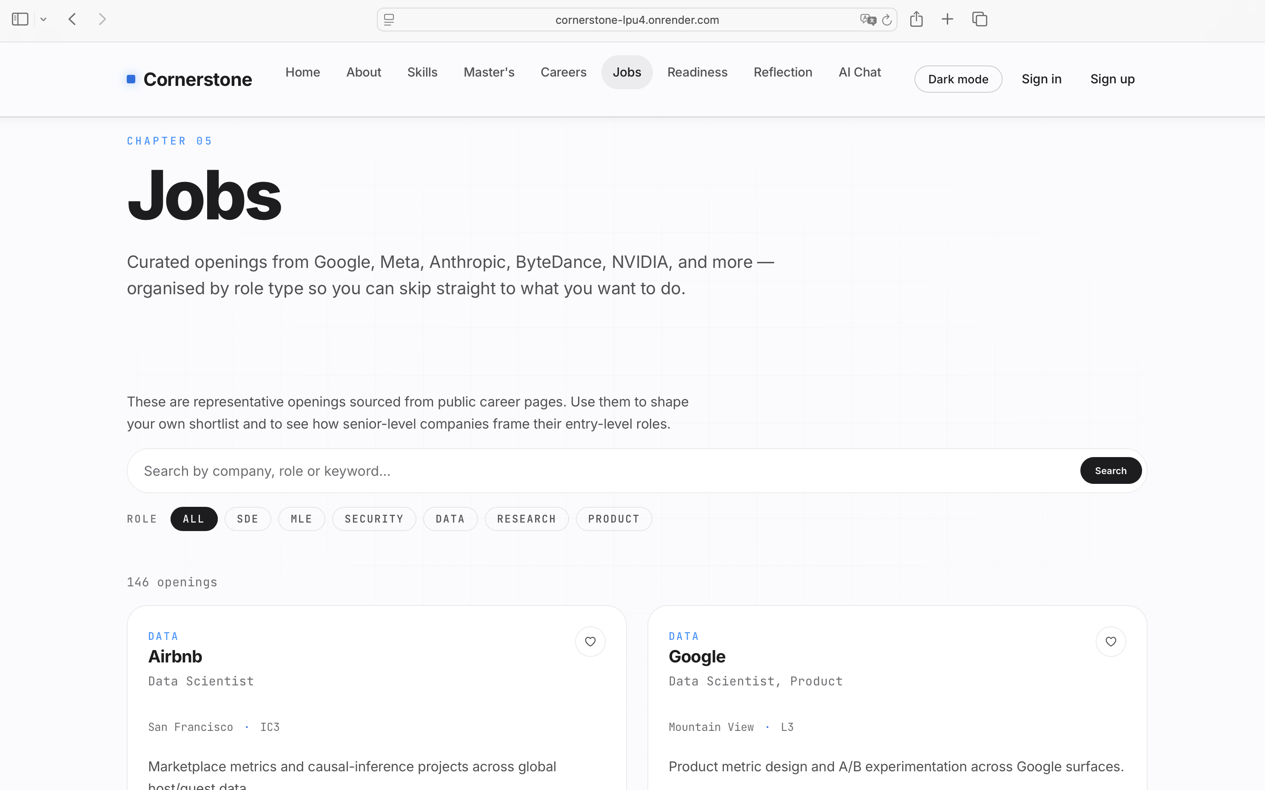
DC229226 Yiming Luo
Individual Digital Story
My main contribution 4 – Design and develop Jobs page
The main purpose of the Jobs page is to help students submit their resumes and understand which positions are currently open for applications.
for
direct employment
· Recommendations for mainstream technical positions (SDE, AI, data science, etc.)
· Job postings and requirements from renowned technology companies
· Skill matching suggestions and career development paths
Notes:
We focus on two parts: First, postgraduate applications, it offers global university ratings, major comparisons, and application strategies. Second, the direct employment, compiling mainstream technical roles and hiring requirements from top companies. Our homepage allows users to switch between these two tracks seamlessly.

Slide 14
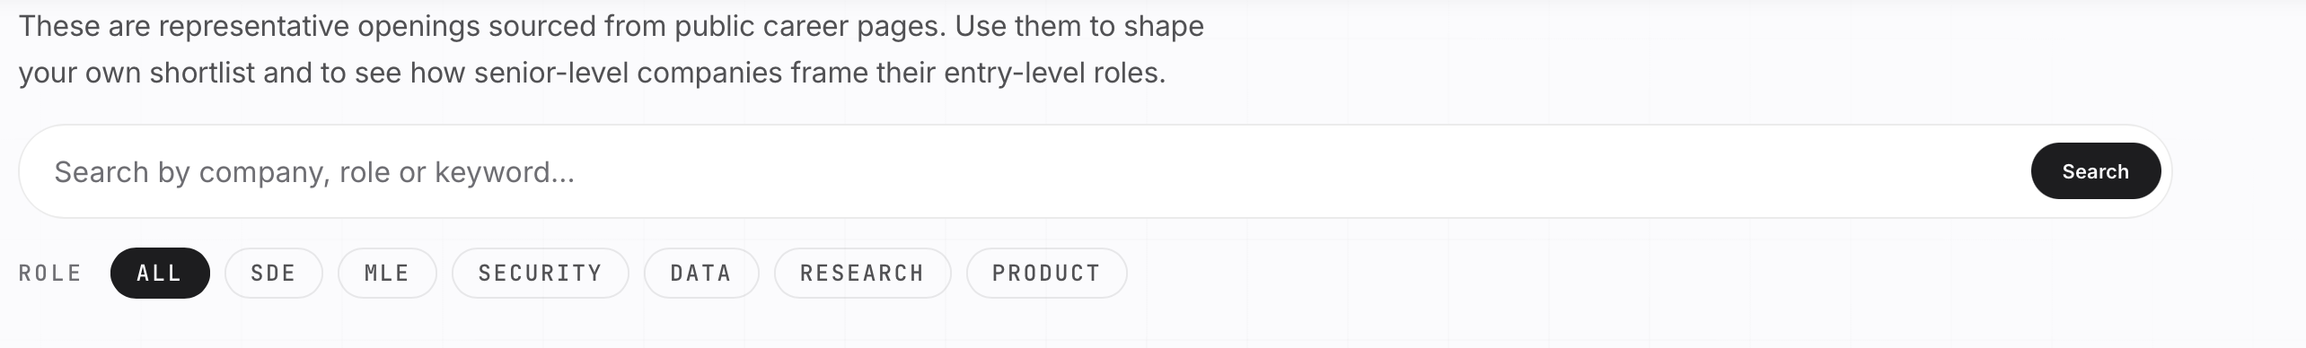
DC229226 Yiming Luo
Individual Digital Story
My main contribution 4 – Design and develop Jobs page
· Recommendations for mainstream technical positions (SDE, AI, data science, etc.)
· Job postings and requirements from renowned technology companies
· Skill matching suggestions and career development paths
We divided all positions into six categories, allowing users to search for relevant jobs either by category filters or by keywords.
Notes:
We focus on two parts: First, postgraduate applications, it offers global university ratings, major comparisons, and application strategies. Second, the direct employment, compiling mainstream technical roles and hiring requirements from top companies. Our homepage allows users to switch between these two tracks seamlessly.

Slide 15
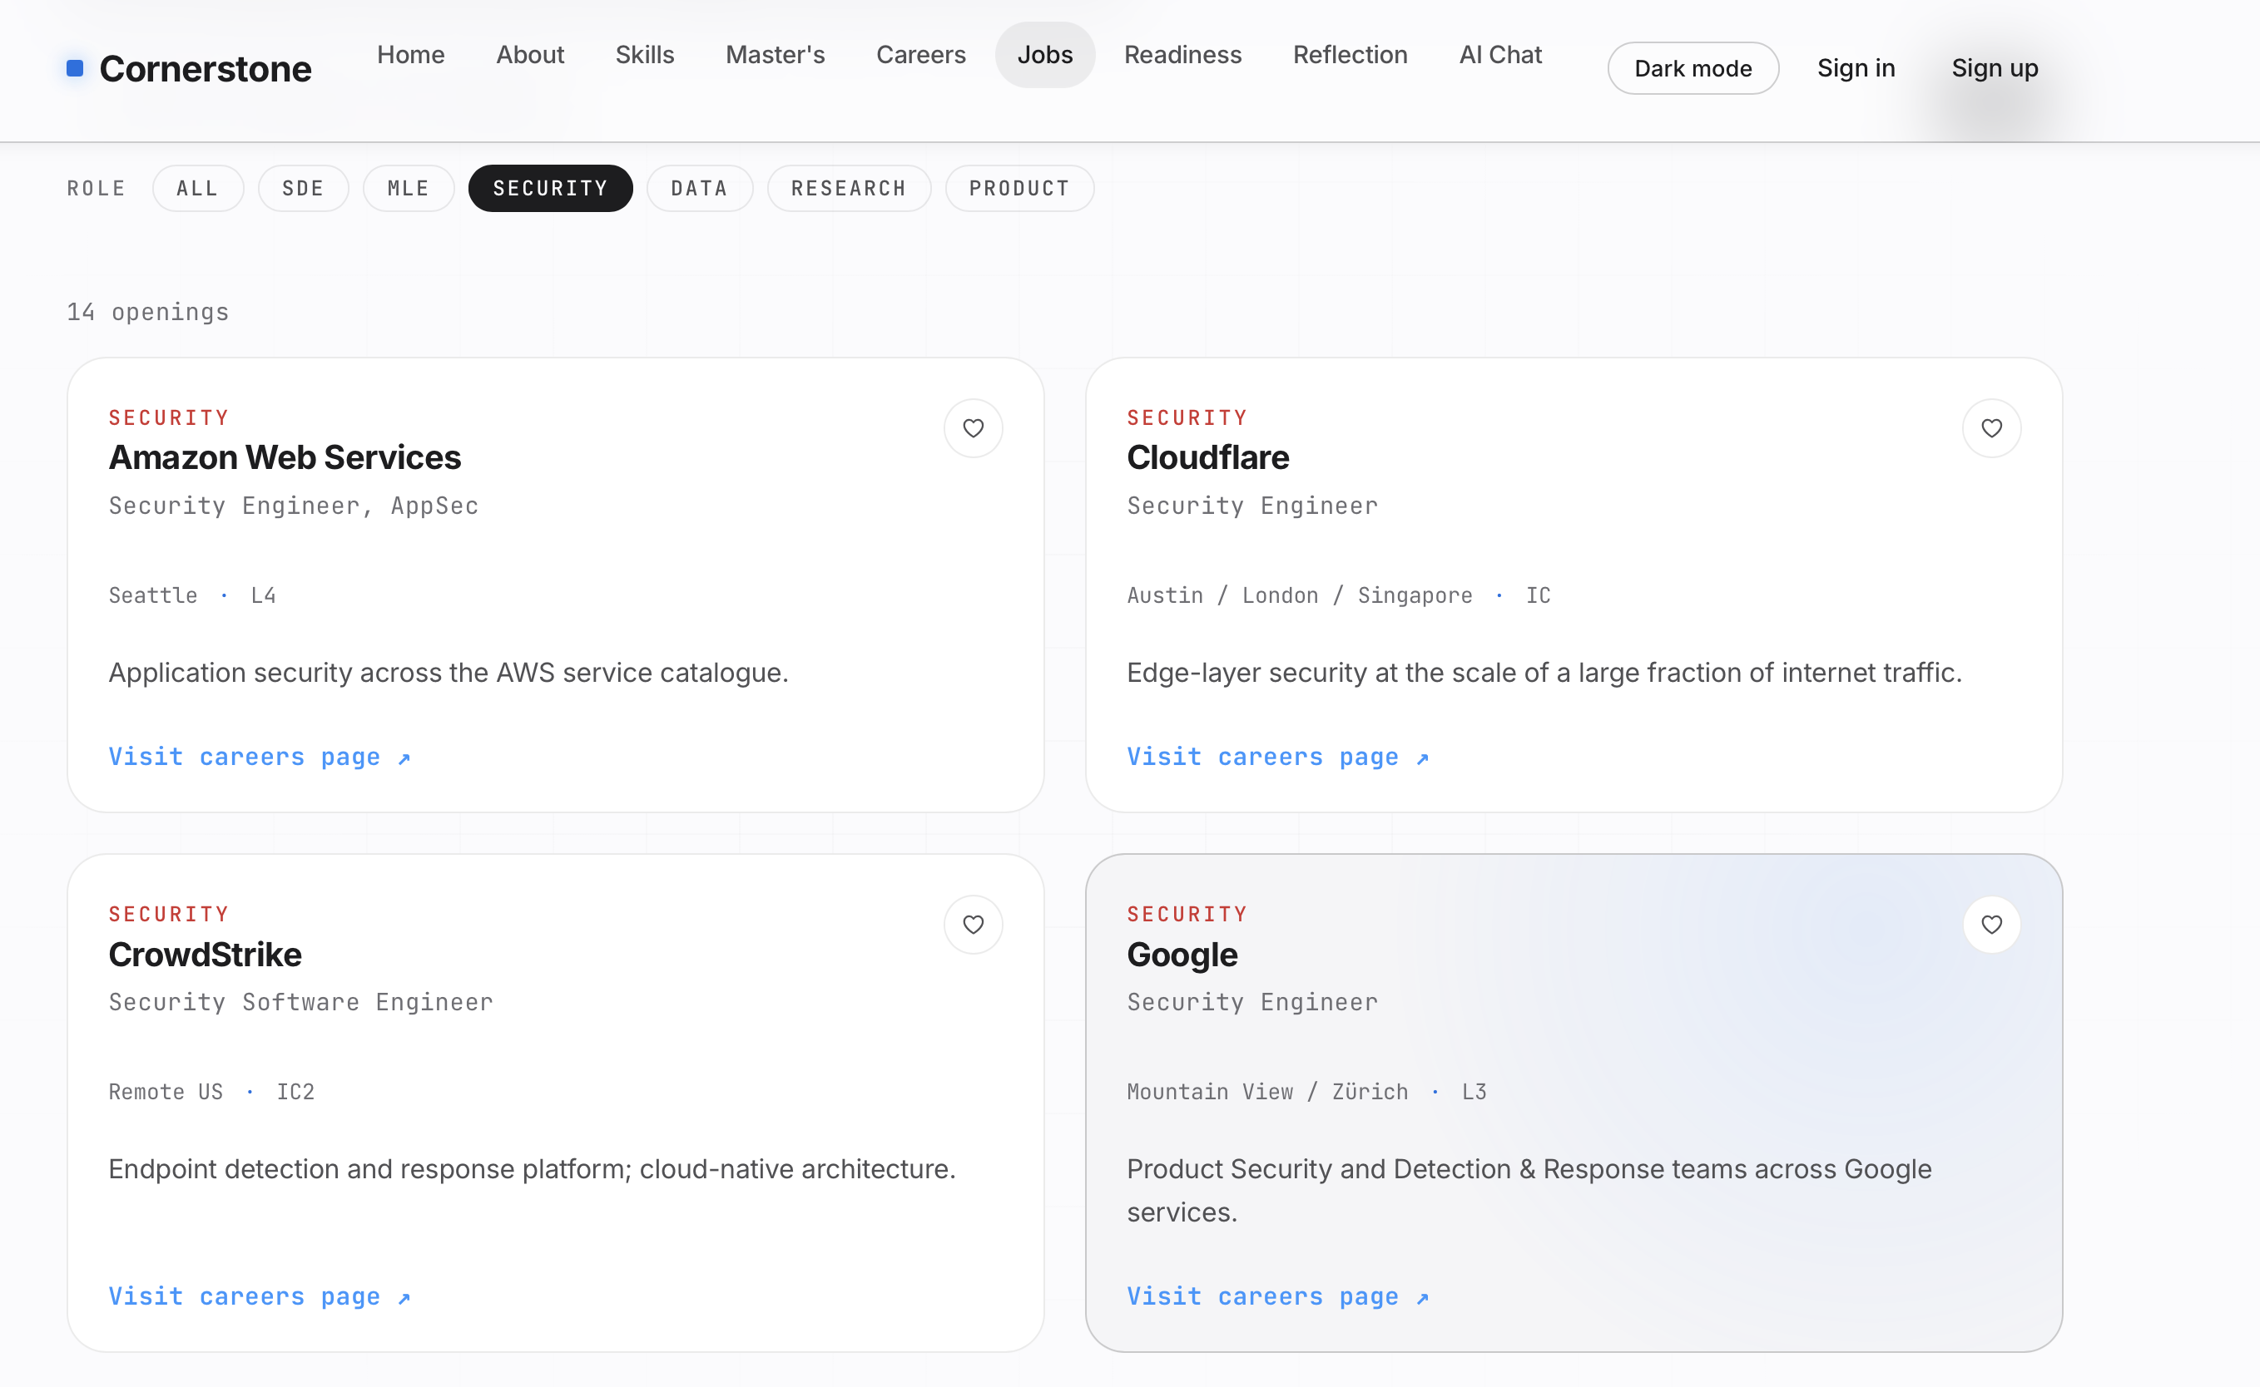
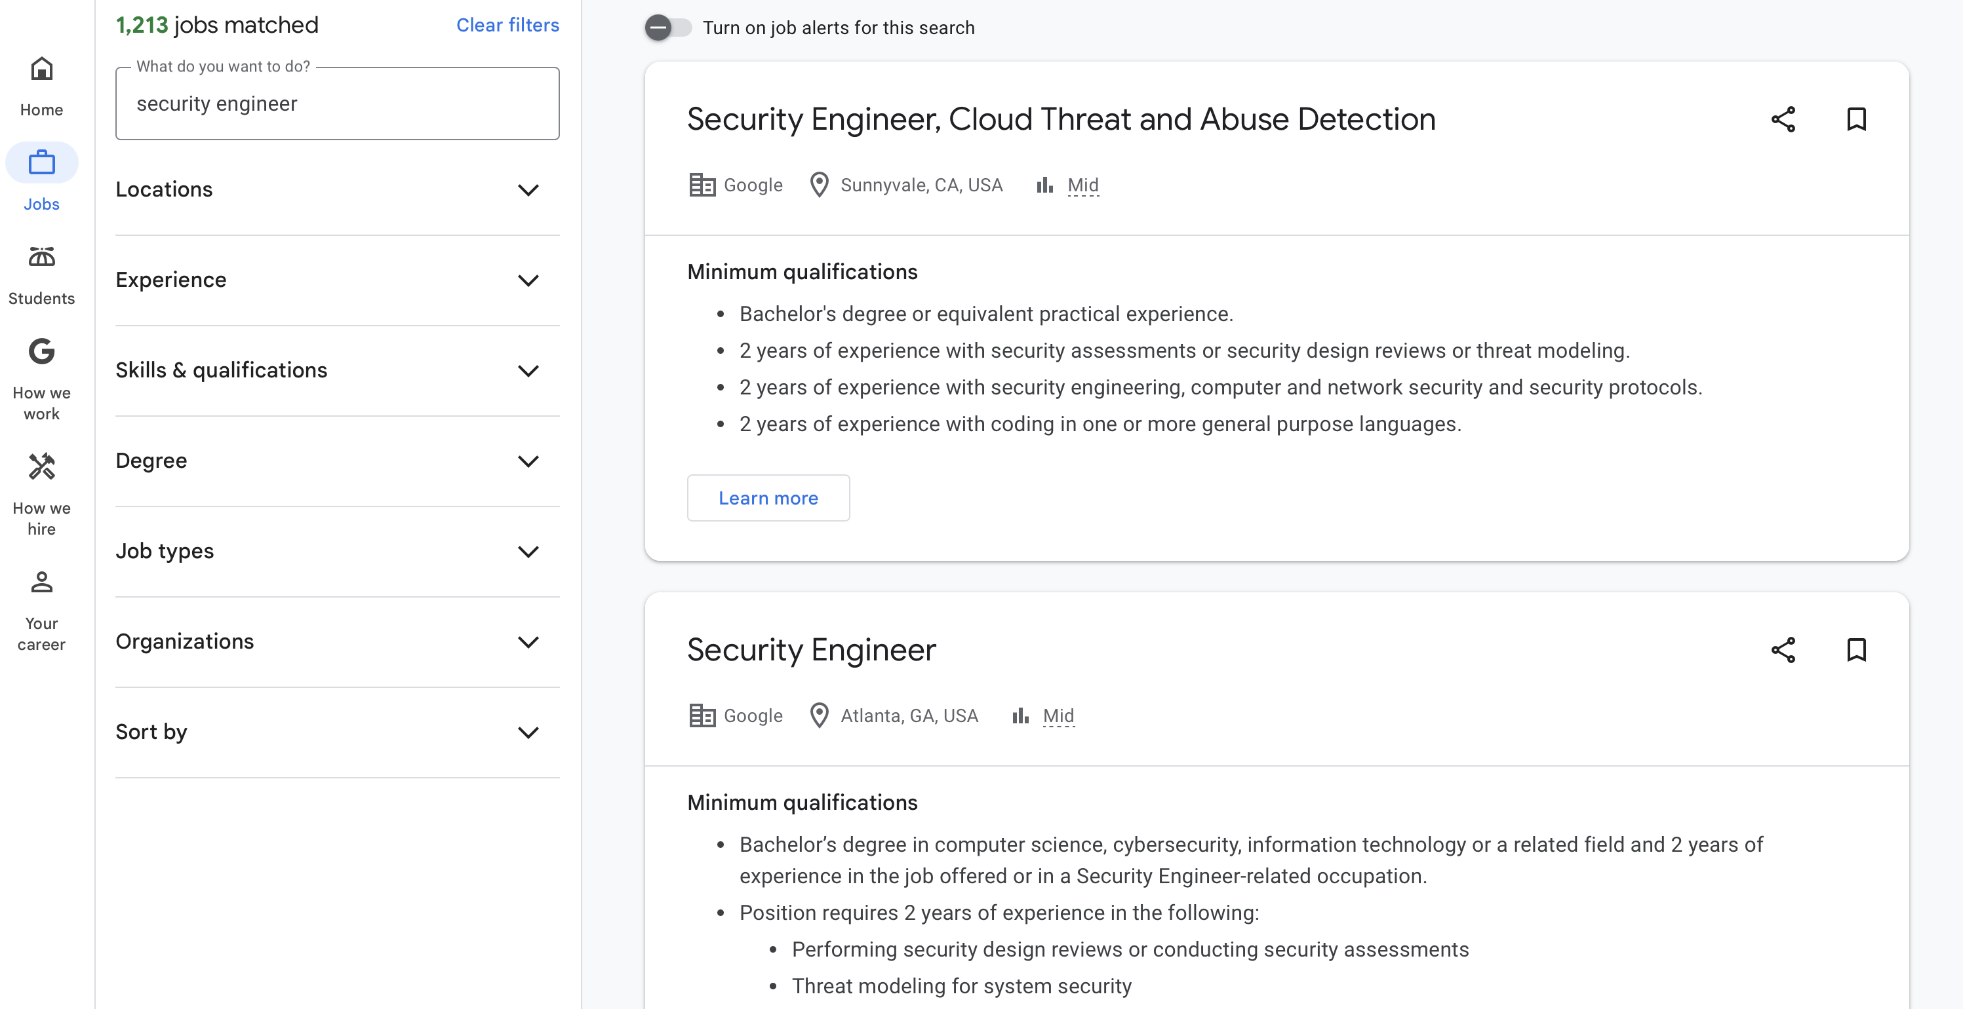
DC229226 Yiming Luo
Individual Digital Story
My main contribution 4 – Design and develop Jobs page
Users can then click on a relevant company, which will redirect them to all Security-related positions offered by that company. In this example, this function is implemented for Google.
· Recommendations for mainstream technical positions (SDE, AI, data science, etc.)
· Job postings and requirements from renowned technology companies
· Skill matching suggestions and career development paths
For example, here we select “Security” for demonstration purposes.
Notes:
We focus on two parts: First, postgraduate applications, it offers global university ratings, major comparisons, and application strategies. Second, the direct employment, compiling mainstream technical roles and hiring requirements from top companies. Our homepage allows users to switch between these two tracks seamlessly.

Slide 16
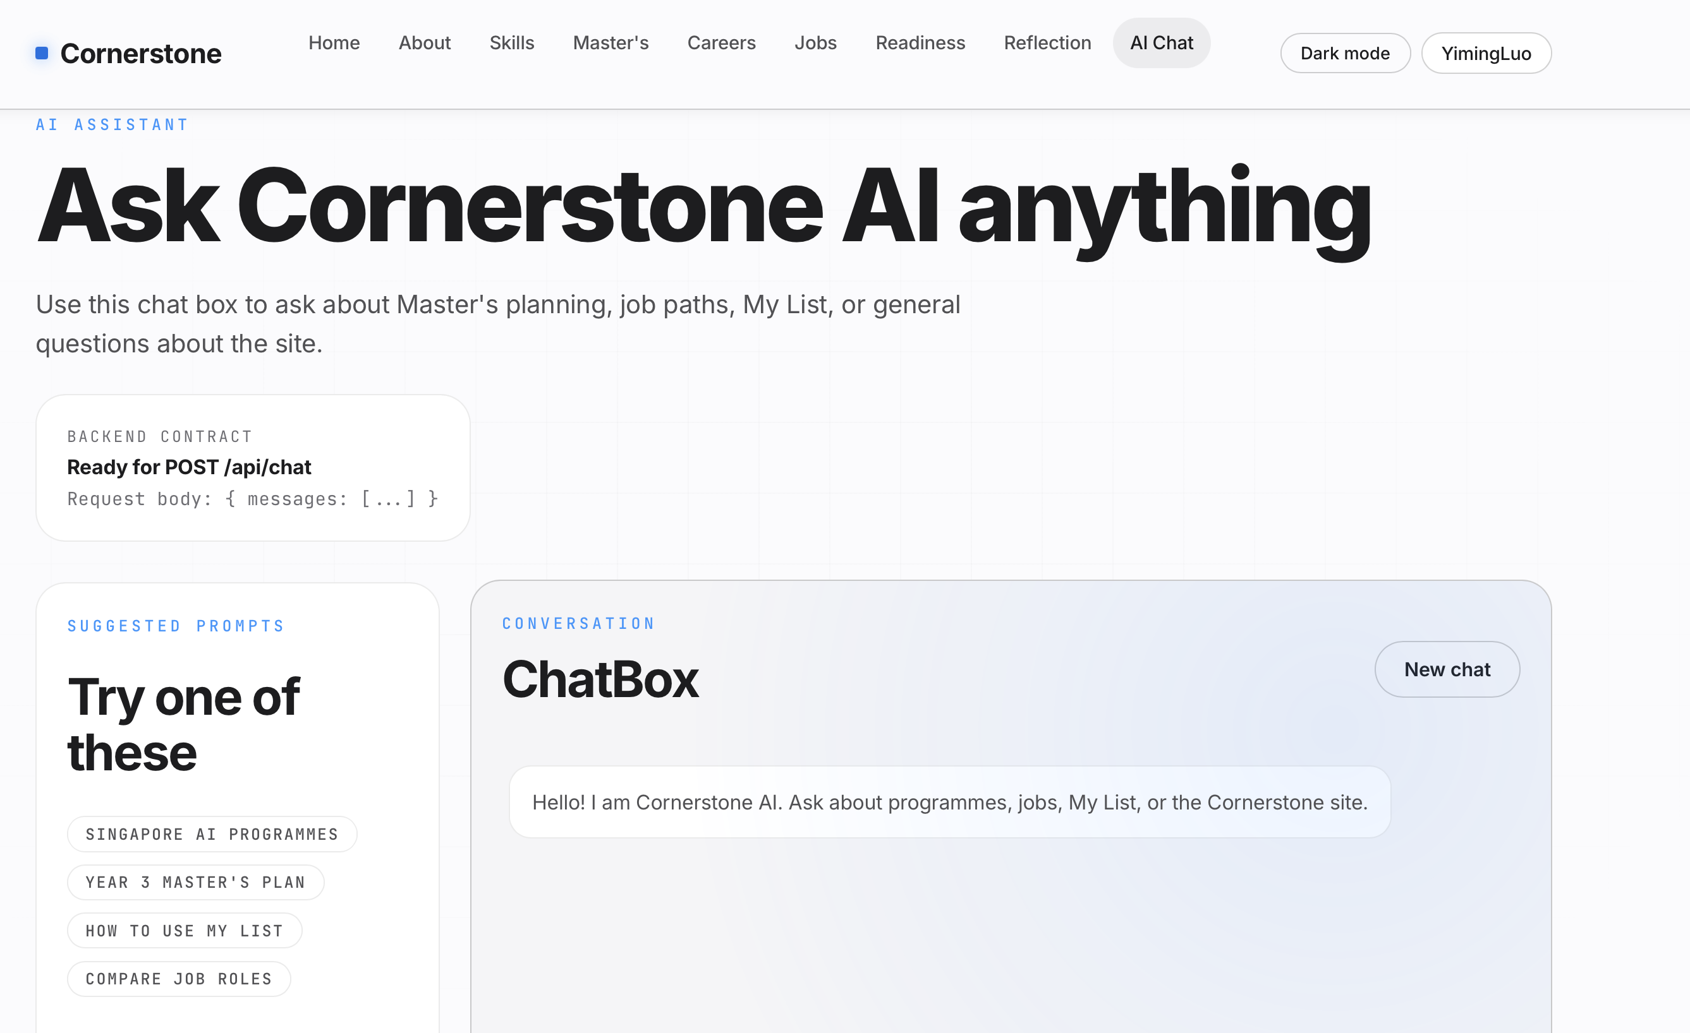
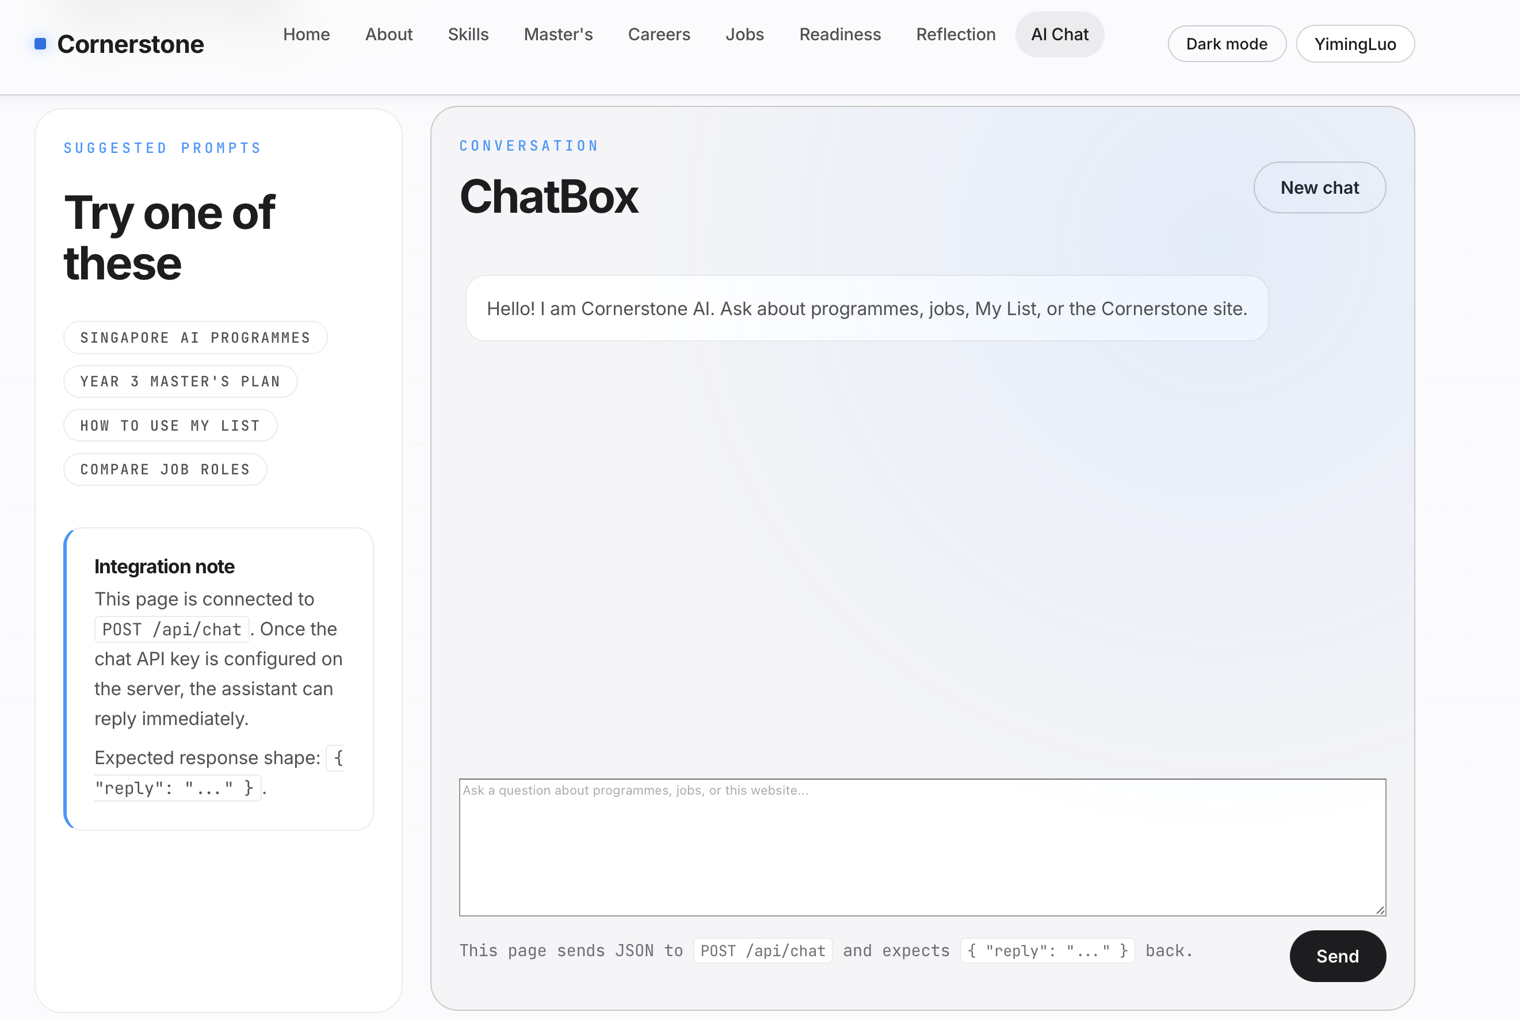
DC229226 Yiming Luo
Individual Digital Story
My main contribution 5 – Design and develop AI Chat page
· Recommendations for mainstream technical positions (SDE, AI, data science, etc.)
· Job postings and requirements from renowned technology companies
· Skill matching suggestions and career development paths
We also provide an AI assistant to help users with career and application planning.
After logging in, users can interact with the AI assistant and ask it to help them with personalized planning.
Notes:
We focus on two parts: First, postgraduate applications, it offers global university ratings, major comparisons, and application strategies. Second, the direct employment, compiling mainstream technical roles and hiring requirements from top companies. Our homepage allows users to switch between these two tracks seamlessly.

Slide 17
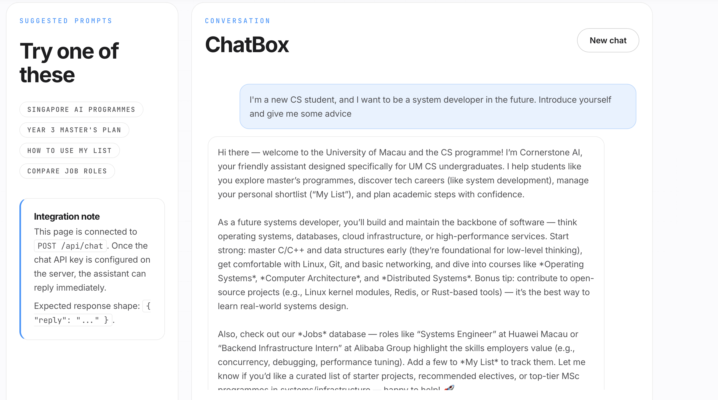
DC229226 Yiming Luo
Individual Digital Story
My main contribution 5 – Design and develop AI Chat page
· Recommendations for mainstream technical positions (SDE, AI, data science, etc.)
· Job postings and requirements from renowned technology companies
· Skill matching suggestions and career development paths
The AI Chat feature helps users make better use of the website and provides additional career advice based on the website’s content.
Notes:
We focus on two parts: First, postgraduate applications, it offers global university ratings, major comparisons, and application strategies. Second, the direct employment, compiling mainstream technical roles and hiring requirements from top companies. Our homepage allows users to switch between these two tracks seamlessly.

Slide 18
DC229226 Yiming Luo
Individual Digital Story
Summary
Designed and developed the overall page structure
Designed the general layout and structure of the website.
Organized the website into multiple sections.
Helped users navigate academic, career, job, and AI-assisted planning resources.
Designed and developed the Master’s Page
Introduced how students can prepare for Master’s applications.
Presented a wide range of graduate programs.
Added keyword search and filters based on region and application difficulty.
Provided direct links to official university graduate program pages.
Designed and developed the Careers Page
Designed the page to support students’ career planning.
Helped students understand different career directions in computer science.
Designed and developed the Jobs Page
Designed the page to help students find open positions.
Helped students understand which jobs are currently available for application.
Divided all positions into six categories, create category-based filtering and keyword-based job search.
Provided company links for specific job categories.
Designed and developed the AI Chat Page
Designed the AI Chat feature to support academic and career planning.
Allowed users to interact with the AI assistant after logging in.
Supported personalized planning for students’ future development.
· Recommendations for mainstream technical positions (SDE, AI, data science, etc.)
· Job postings and requirements from renowned technology companies
· Skill matching suggestions and career development paths
Notes:
We focus on two parts: First, postgraduate applications, it offers global university ratings, major comparisons, and application strategies. Second, the direct employment, compiling mainstream technical roles and hiring requirements from top companies. Our homepage allows users to switch between these two tracks seamlessly.

