Slide 1
Control Barrier Function

Slide 2

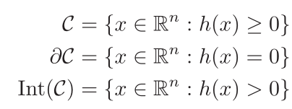


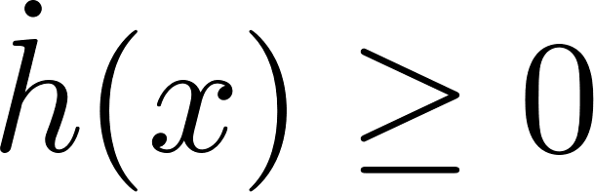
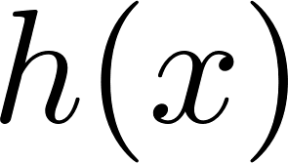
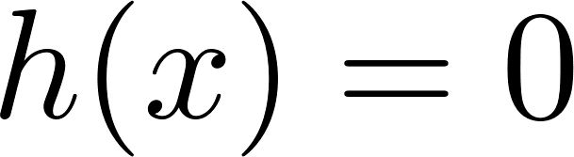
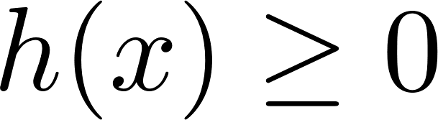
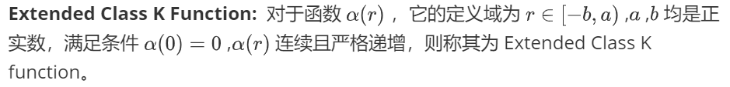
Zero Barrier Functions
ZBF的作用：保证了一个集合的前向不变性
简易证明（ZBF保证集合前向不变的原因）：
Given a set
defined by
is a continuously differentiable function
ZBF 定义:
这意味着在集合边界上的时候， ， 值不变或者增加，而边界上， ，因此
, 集合前向不变。
While barrier functions are important tools to verify invariance of a set, they cannot be directly used to design a controller enforcing invariance.
Ames A D, Xu X, Grizzle J W, et al. Control barrier function based quadratic programs for safety critical systems[J]. IEEE Transactions on Automatic Control, 2016, 62(8): 3861-3876.

Slide 3
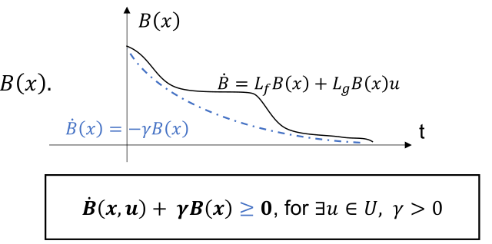
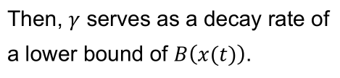
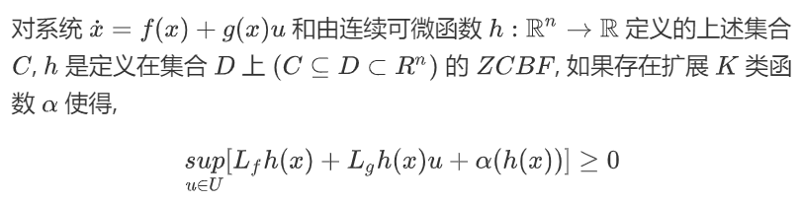
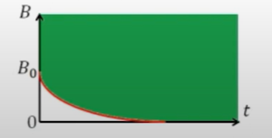



Zero Control Barrier Functions
ZCBF的作用：通过控制输入，保证了一个集合的前向不变性
特殊形式ZCBF
Given a set
defined by
is a continuously differentiable function
ZCBF 定义:
The stricter condition is imposed by 𝜸 becoming smaller. It requires 𝐵(𝑥) to decay more slowly.
可行域
these conditions are stronger than necessary
earlier version
Ames A D, Coogan S, Egerstedt M, et al. Control barrier functions: Theory and applications[C]//2019 18th European control conference (ECC). IEEE, 2019: 3420-3431.
Ames A D, Xu X, Grizzle J W, et al. Control barrier function based quadratic programs for safety critical systems[J]. IEEE Transactions on Automatic Control, 2016, 62(8): 3861-3876.

Slide 4
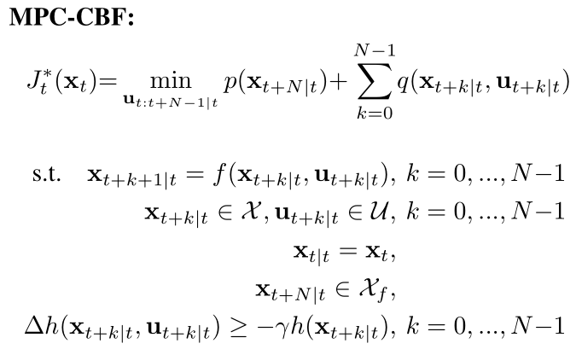
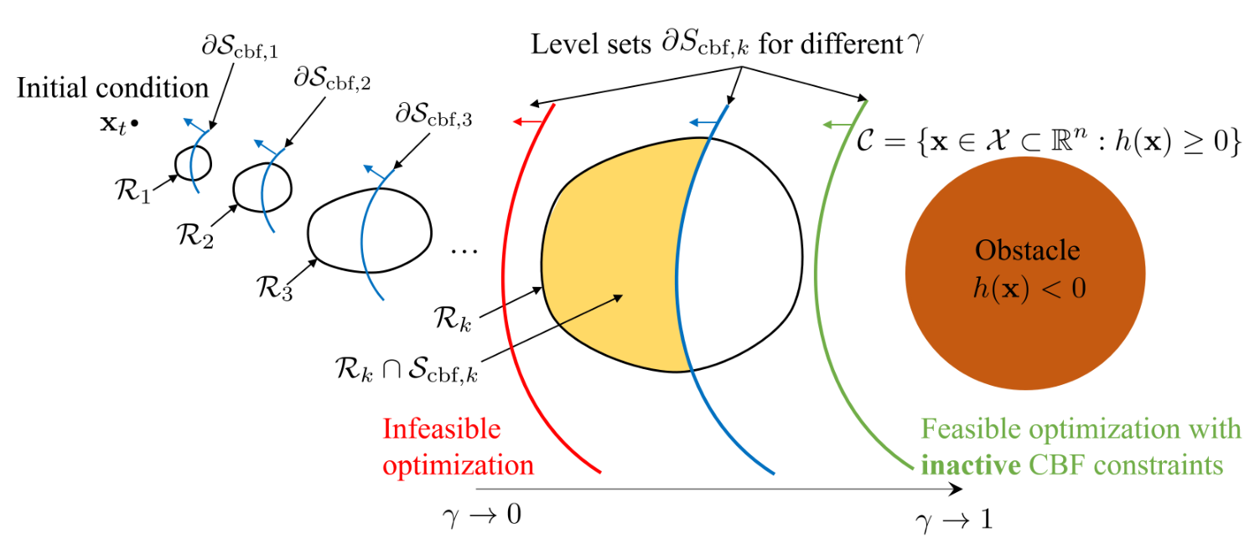
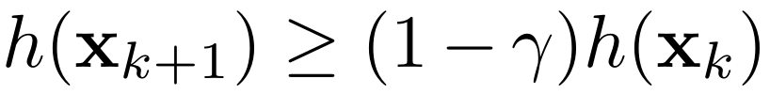


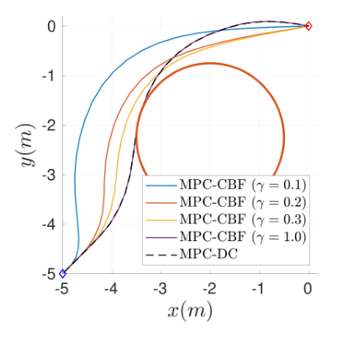
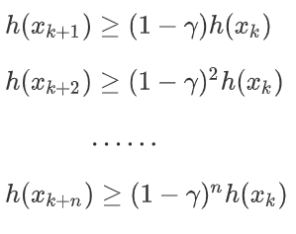
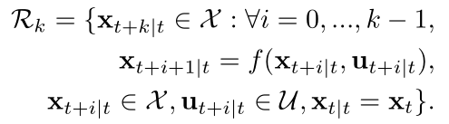


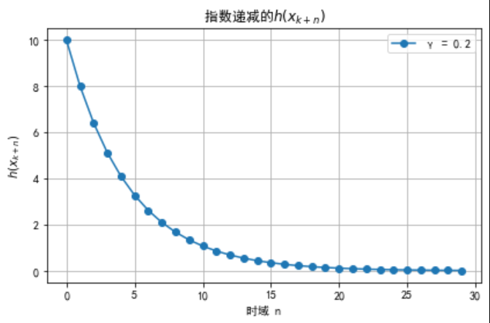
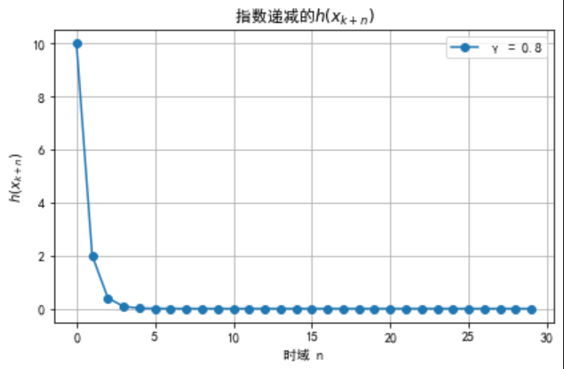
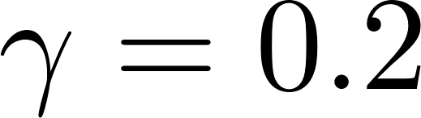
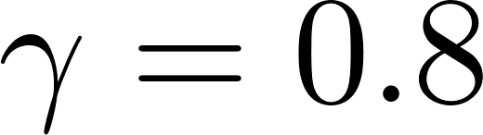
Discrete-time Control Barrier Functions
DCBF定义：
参数对可行性的影响
的下确界以
的比率指数式衰减
feasible set
superlevel set
level set
Zeng J, Zhang B, Sreenath K. Safety-critical model predictive control with discrete-time control barrier function[C]//2021 American Control Conference (ACC). IEEE, 2021: 3882-3889.

Slide 5
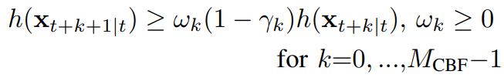


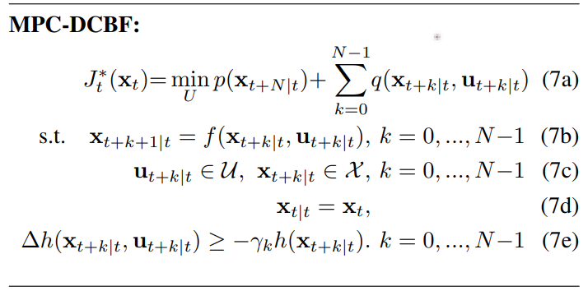
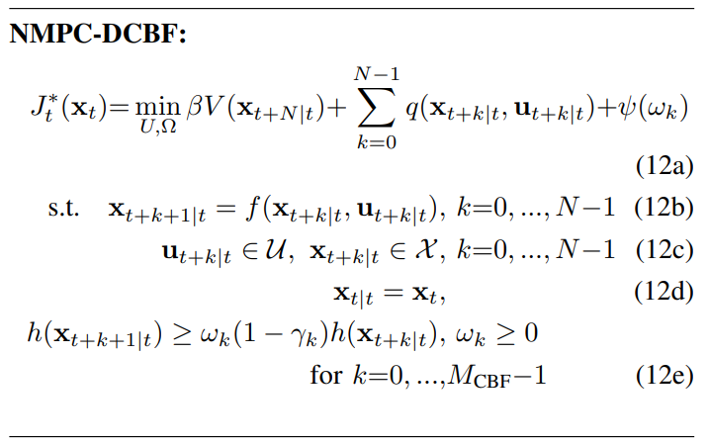
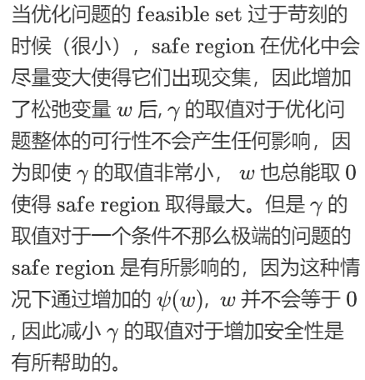
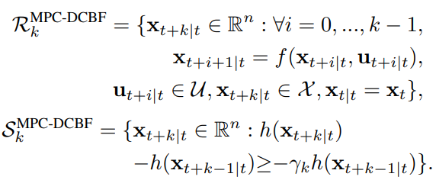
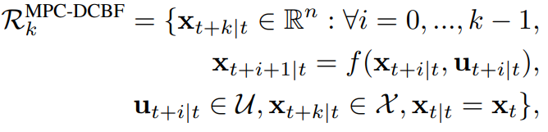
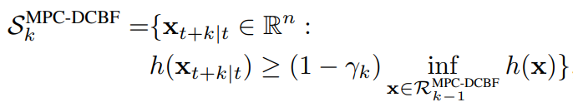
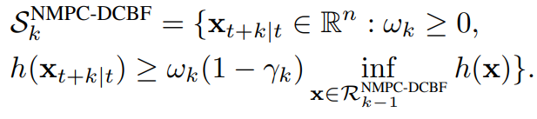

Enhancing Feasibility and Safety of MPC-DCBF
当每一步的safe region与feasible set的交集非空，整个优化问题就有解。
Reachable set
Reachable set
Safety region
Safety region
Zeng J, Li Z, Sreenath K. Enhancing feasibility and safety of nonlinear model predictive control with discrete-time control barrier functions[C]//2021 60th IEEE Conference on Decision and Control (CDC). IEEE, 2021: 6137-6144.

Slide 6
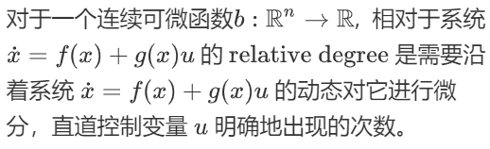
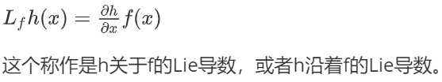


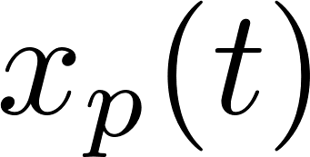
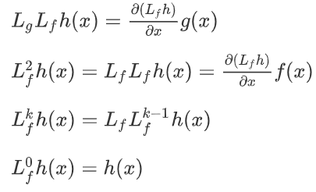
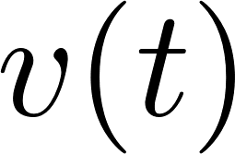
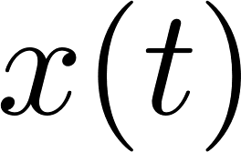
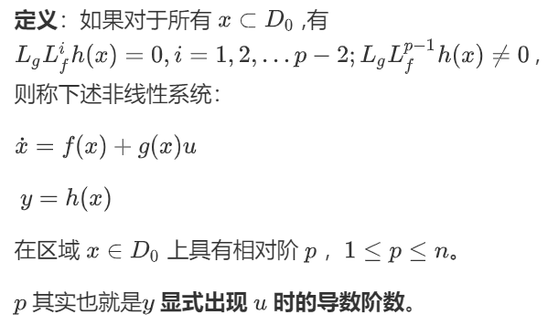


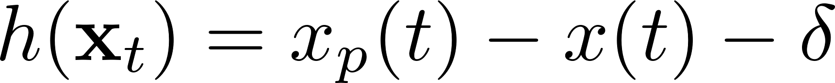
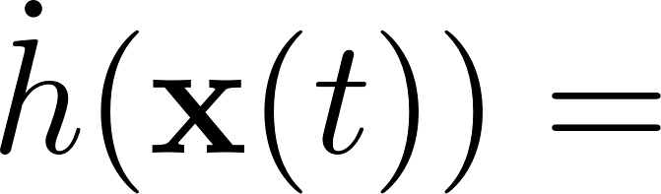

Lie derivative and Relative degree
Lie 导数定义 ：
Relative degree 定义（好理解版本）:
Example: Simplified Adaptive Cruise Control
前车恒定速度
前车位置
Relative degree 定义:
本车速度
本车位置
0
Nonlinear Systems: Control 3[M]. Springer Science & Business Media, 2012.
Xiao W, Belta C. Control barrier functions for systems with high relative degree[C]//2019 IEEE 58th conference on decision and control (CDC). IEEE, 2019: 474-479.

Slide 7
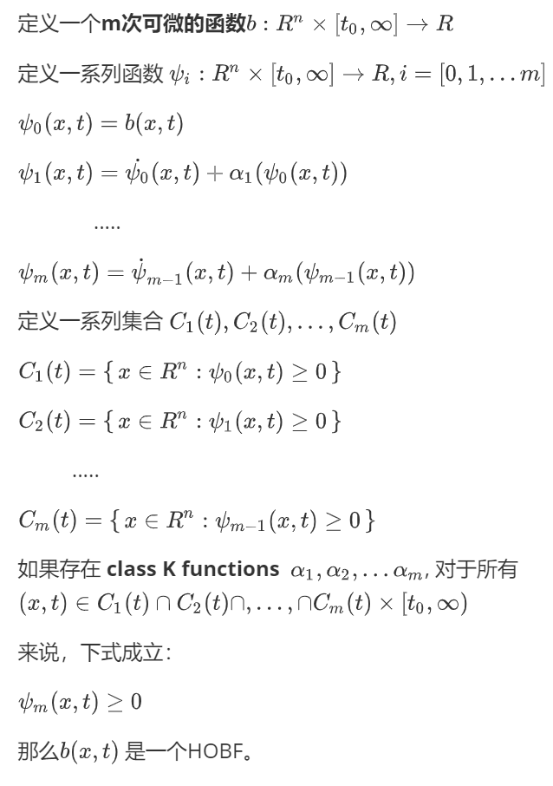

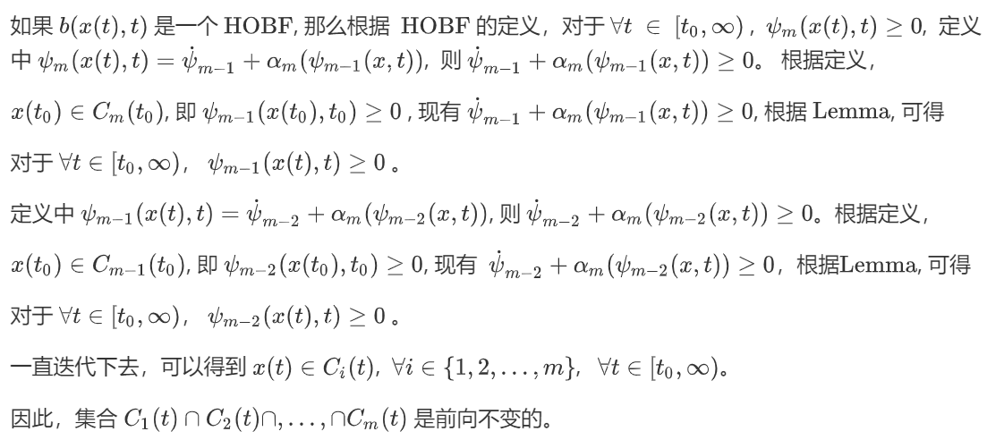
High order Barrier Functions
HOBF的作用：保证了多个集合的交集的前向不变性
需要证明的是：
HOBF定义：
Xiao W, Belta C. Control barrier functions for systems with high relative degree[C]//2019 IEEE 58th conference on decision and control (CDC). IEEE, 2019: 474-479.

Slide 8
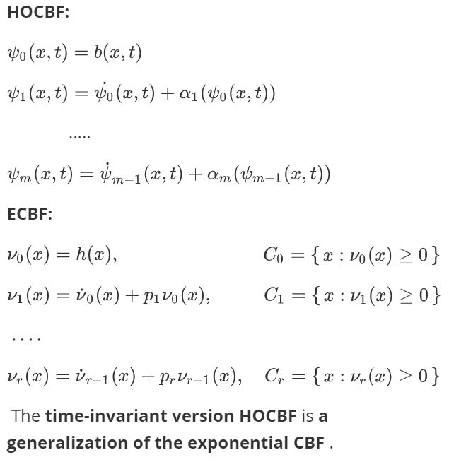
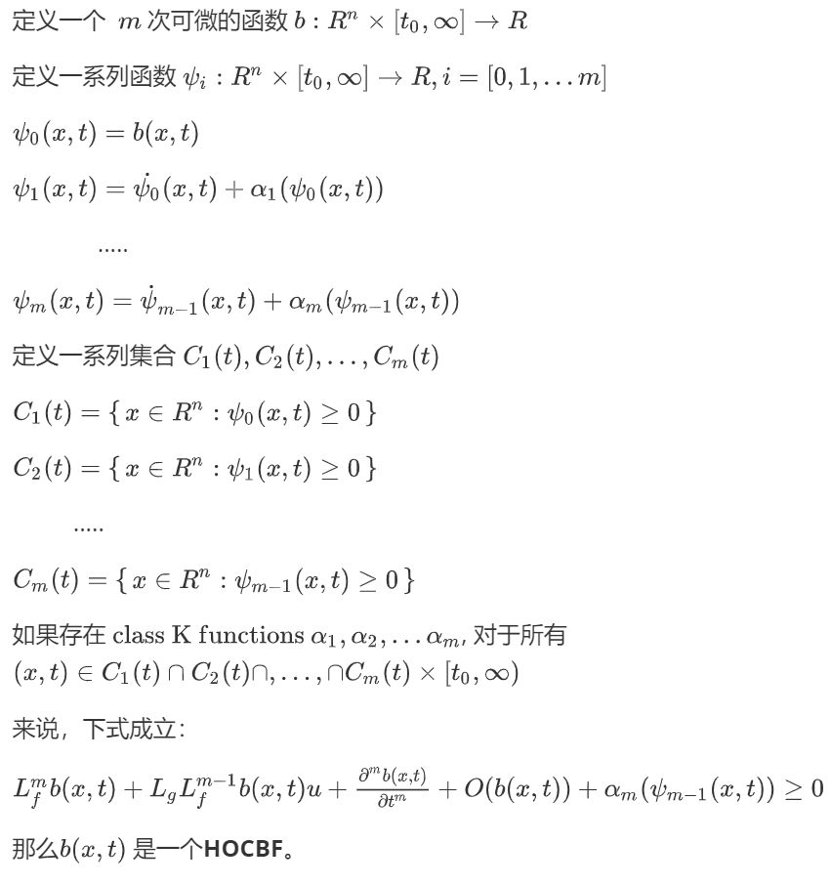


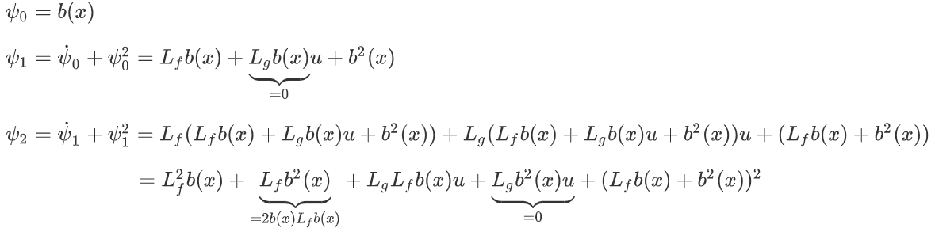
High order Control Barrier Functions
HOCBF的作用：通过控制输入，保证了多个集合的交集的前向不变性
特殊形式的 HOCBF
Example: Simplified Adaptive Cruise Control
HOCBF定义：
Xiao W, Belta C. Control barrier functions for systems with high relative degree[C]//2019 IEEE 58th conference on decision and control (CDC). IEEE, 2019: 474-479.
Ames A D, Coogan S, Egerstedt M, et al. Control barrier functions: Theory and applications[C]//2019 18th European control conference (ECC). IEEE, 2019: 3420-3431.

Slide 9
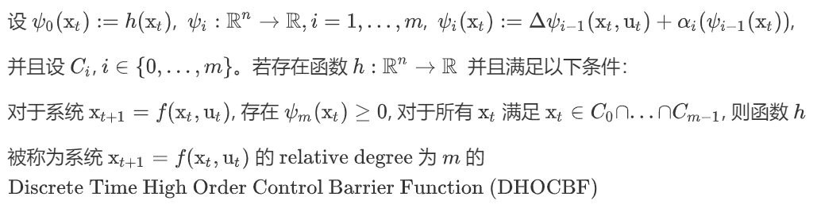
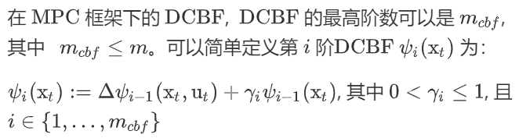
Discrete-Time High-Order Control Barrier Function
HOCBF定义：
DHOCBF定义：
Liu S, Zeng J, Sreenath K, et al. Iterative convex optimization for model predictive control with discrete-time high-order control barrier functions[C]//2023 American Control Conference (ACC). IEEE, 2023: 3368-3375.

Slide 10
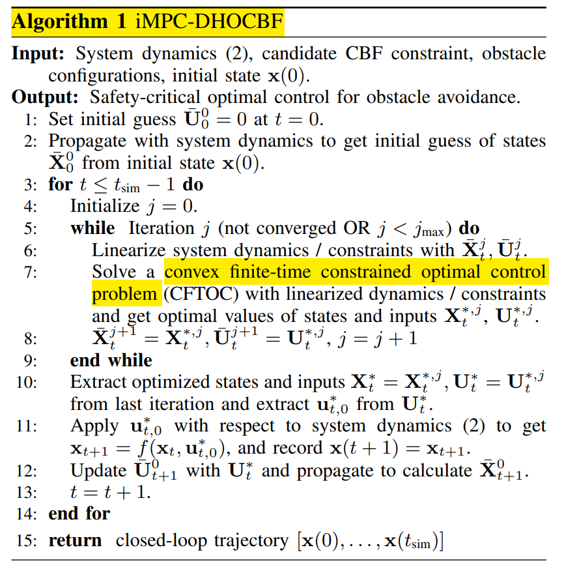


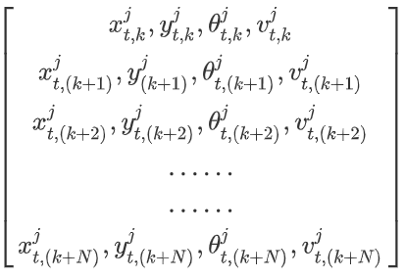
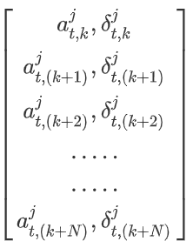

Algorithm 1 : iMPC-DHOCBF
( Discrete-Time High-Order Control Barrier Function )
t 时刻第 j 个 iteration 的一组 N 个时域估计的 states vector 和控制输入 vector，0 时刻时，一组 N 个时域的控制输入都为 0。
is within a user-defined normalized convergence criteria
Liu S, Zeng J, Sreenath K, et al. Iterative convex optimization for model predictive control with discrete-time high-order control barrier functions[C]//2023 American Control Conference (ACC). IEEE, 2023: 3368-3375.

Slide 11

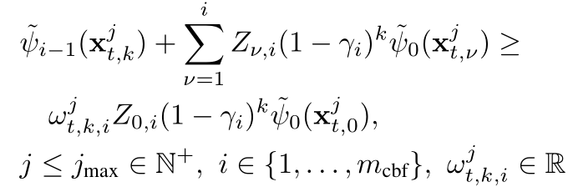
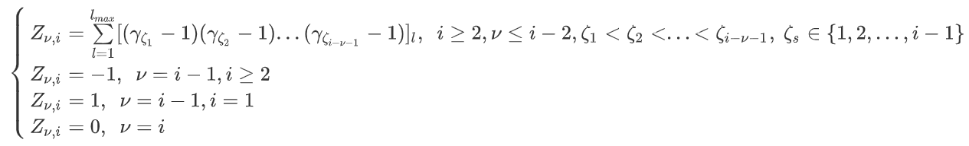
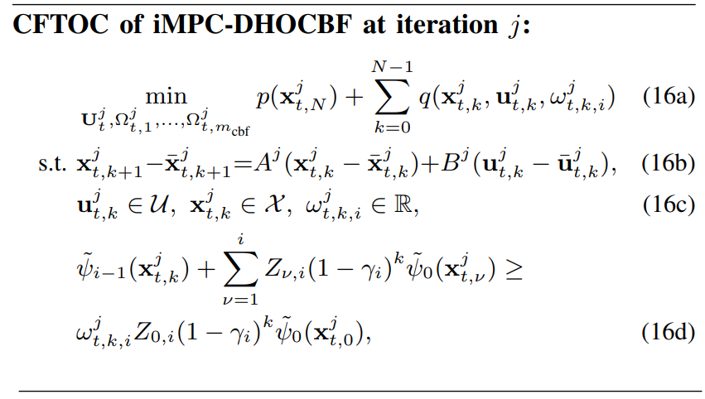


Linearization of DCBF & DHOCBF
求导次数增加
Steps in MPC 增加
Liu S, Zeng J, Sreenath K, et al. Iterative convex optimization for model predictive control with discrete-time high-order control barrier functions[C]//2023 American Control Conference (ACC). IEEE, 2023: 3368-3375.

Slide 12





从向量的角度
红色向量：
绿色向量：
O

Slide 13


实验部分推导

Slide 14



