Slide 1


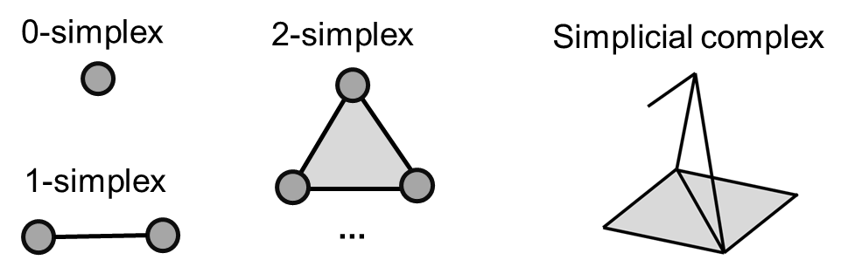
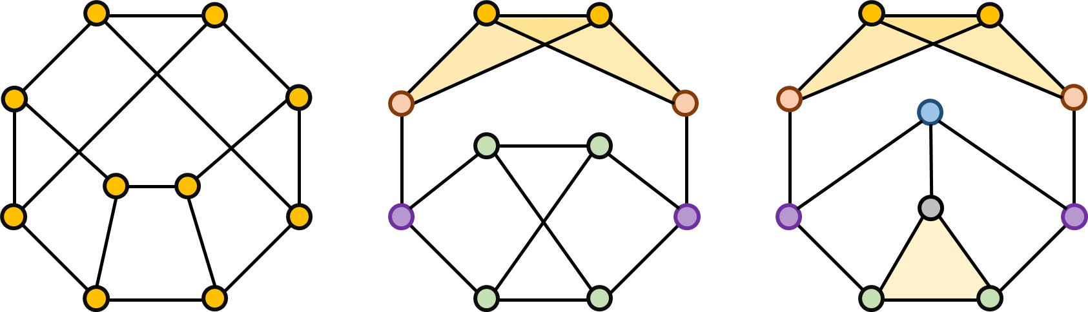
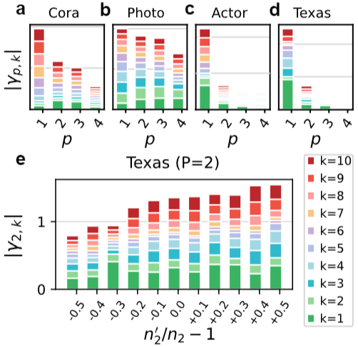
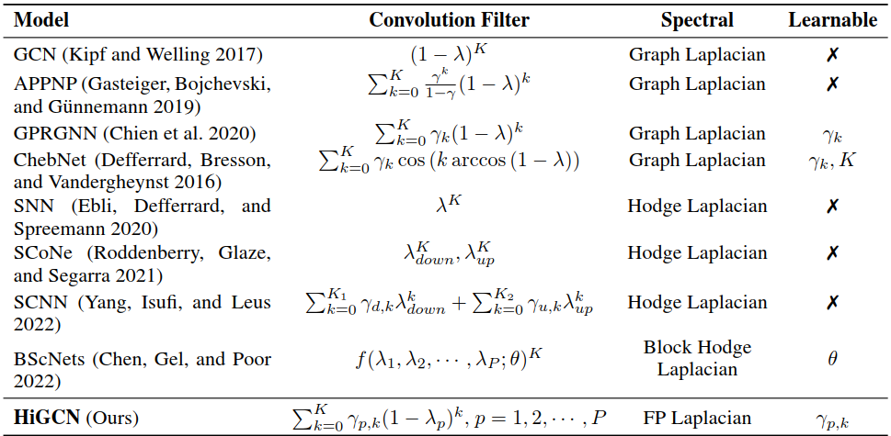
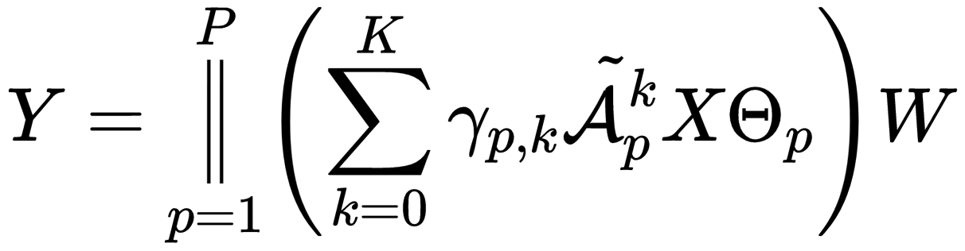
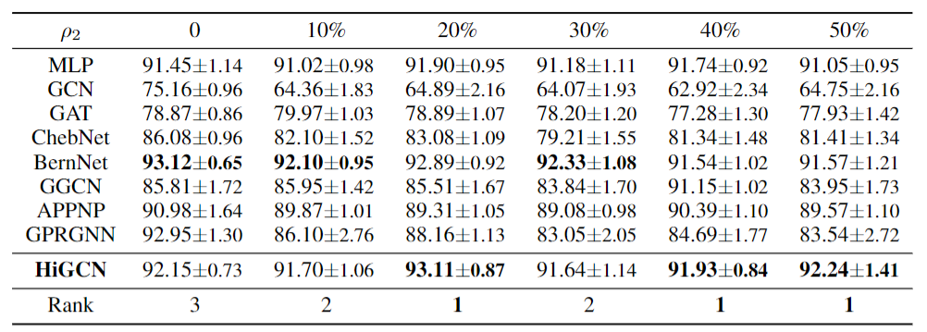
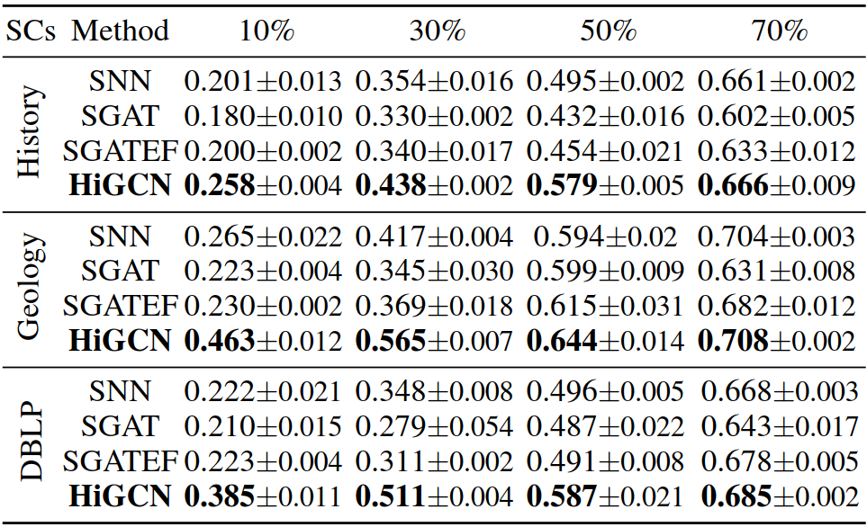
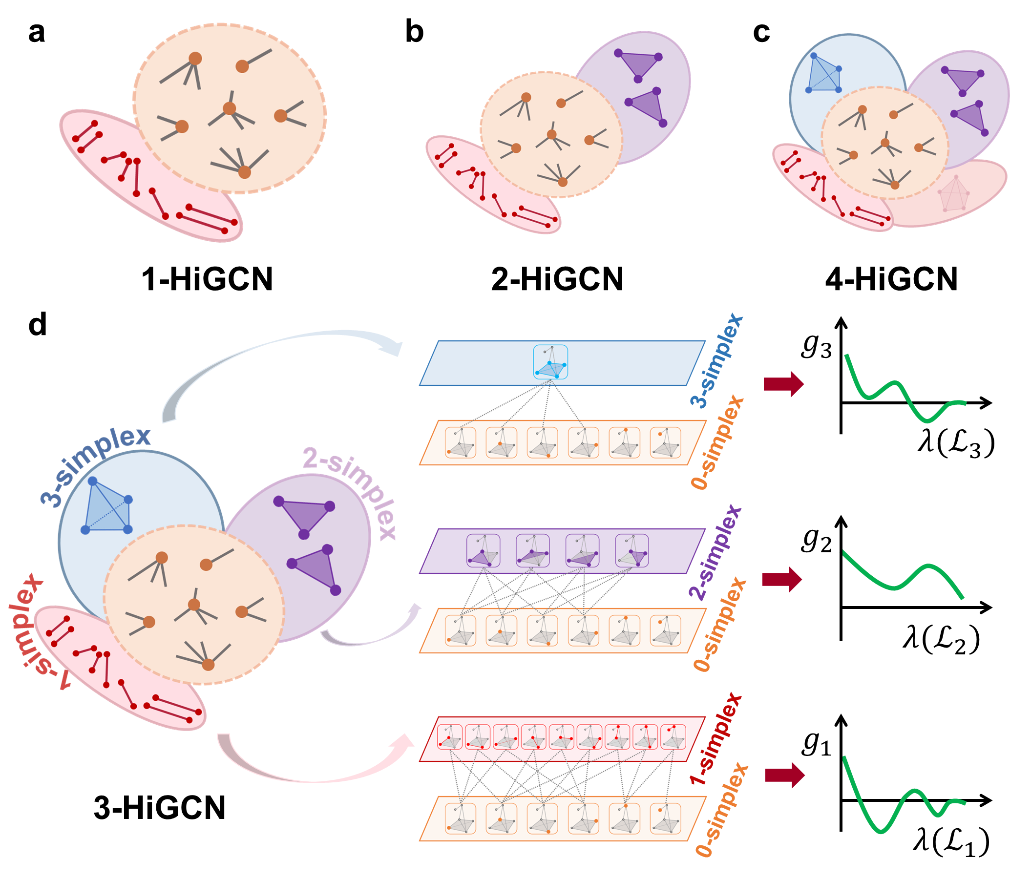
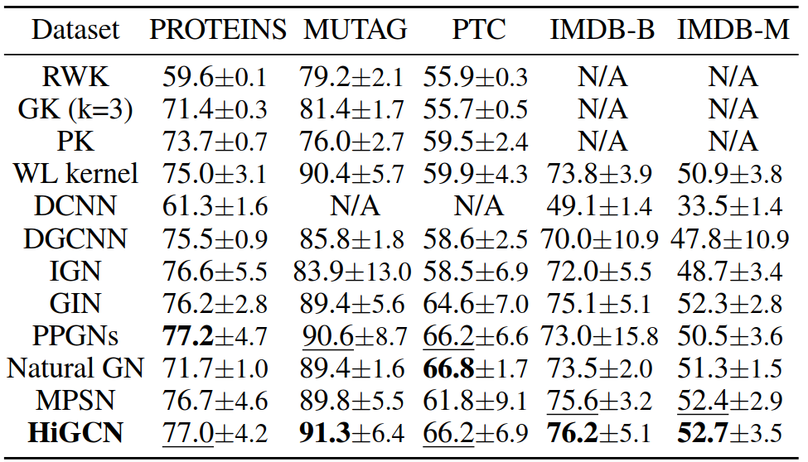






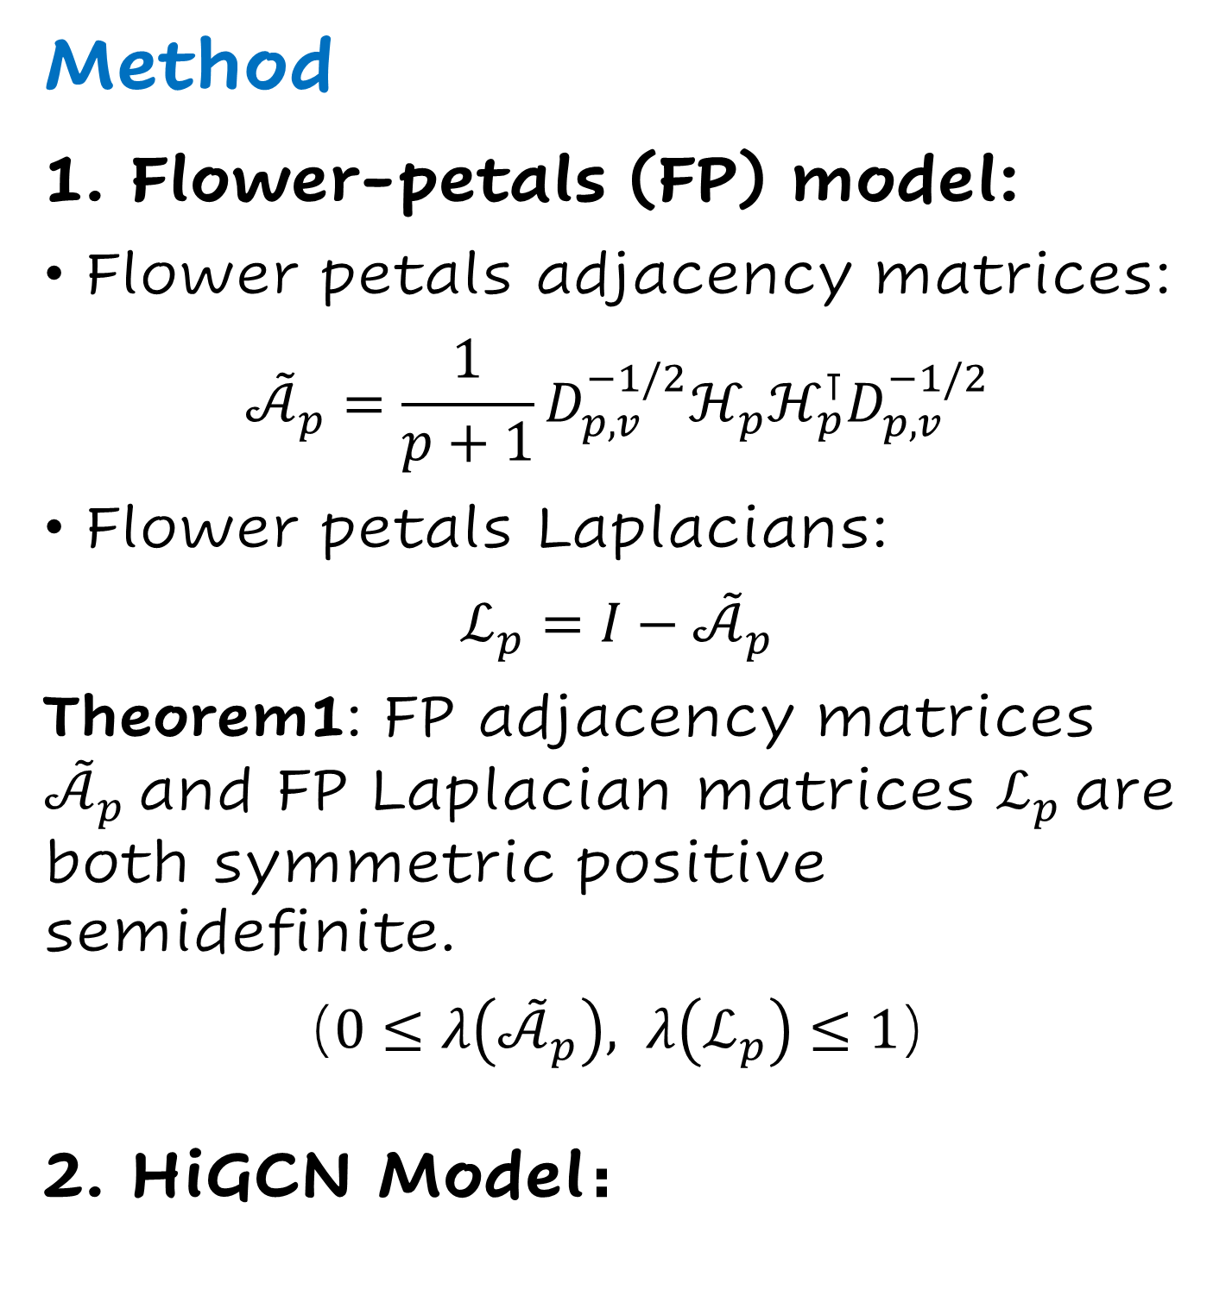
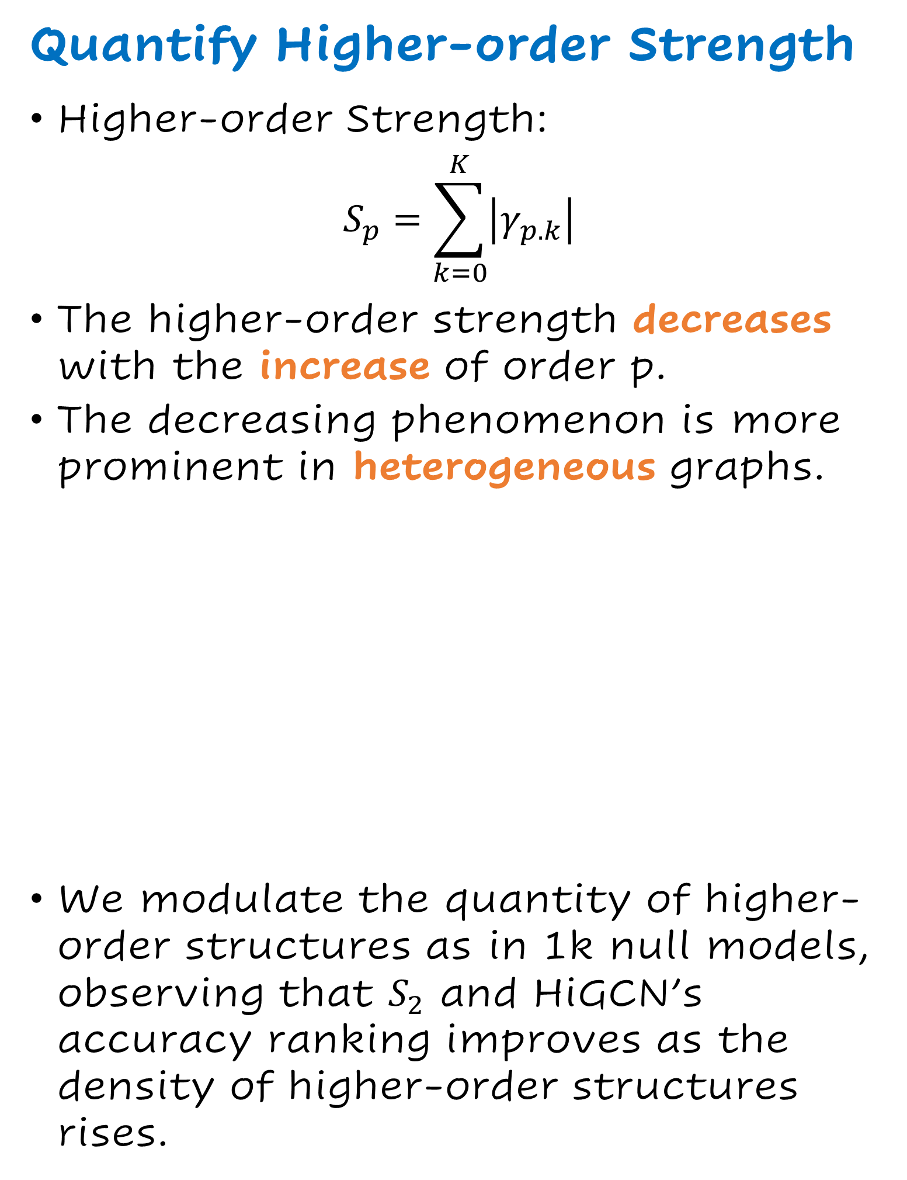
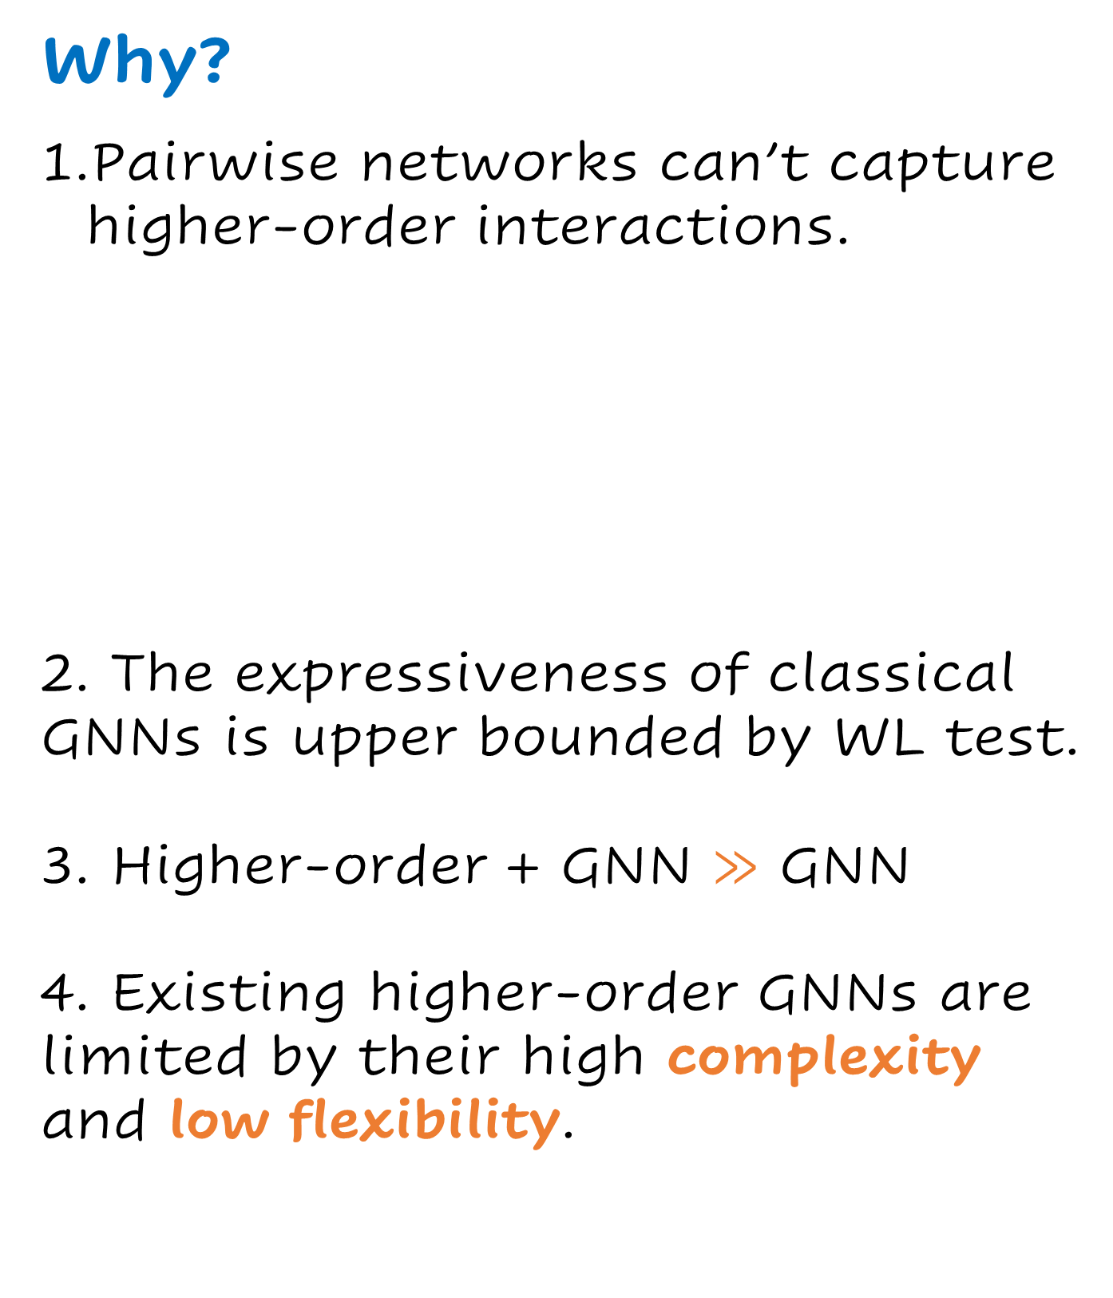
Higher-order Graph Convolutional Network
with Flower-Petals Laplacians on Simplicial Complexes
Yiming Huang; Yujie Zeng; Qiang Wu; Linyuan Lü
{yiming_huang, yujie_zeng}@std.uest.edu.cn, {qiang.wu, linyuan.lv}@uestc.edu.cn
AAAI2024
Why?
Pairwise networks can’t capture higher-order interactions.
2. The expressiveness of classical GNNs is upper bounded by WL test.
3. Higher-order + GNN $≫$ GNN
4. Existing higher-order GNNs are limited by their high complexity and low flexibility.
Expressive Ability
Define the higher-order version WL test (HWL) and simplified higher-order WL test (SHWL)
Theorem2: SHWL with clique complex lifting is strictly more powerful than the WL test.
HiGCN is more expressive than traditional GCNs.
Quantify Higher-order Strength
Higher-order Strength:
$$S_{p}=\sum_{k=0}^{K}{\left|γ_{p.k}\right|}$$
The higher-order strength decreases with the increase of order p.
The decreasing phenomenon is more prominent in heterogeneous graphs.
We modulate the quantity of higher-order structures as in 1k null models, observing that $S_{2}$ and HiGCN’s accuracy ranking improves as the density of higher-order structures rises.
Method
1. Flower-petals (FP) model:
Flower petals adjacency matrices:
$${\tilde{𝒜}}_{p}=\frac{1}{p+1}D_{p,v}^{−1/2}ℋ_{p}ℋ_{p}^{⊺}D_{p,v}^{−1/2}$$
Flower petals Laplacians:
$$ℒ_{p}=I−{\tilde{𝒜}}_{p}$$
Theorem1: FP adjacency matrices ${\tilde{𝒜}}_{p}$and FP Laplacian matrices $ℒ_{p}$are both symmetric positive semidefinite.
（$0≤λ\left({\tilde{𝒜}}_{p}\right), λ\left(ℒ_{p}\right)≤1$）
2. HiGCN Model：
Relation to other GCNs
HiGCN generalizes pairwise graph-based GCNs, showing superiority for exploiting higher-order information.
Experiments
Superior in node/graph classification & simplicial data imputation
HiGCN is highly-scalable
Conclusion
New representation
Propose a novel higher-order representation, which can easily model the interactions between different order simplices and is highly scalable.
New model
We propose a higher-order GNN model based on this novel representation with superior expressiveness.
New perspective
We quantify the strength of higher-order interactions in a data-driven manner.
AAAI2024, Paper ID: 14056

