Slide 1
ECE 264 Fall 2020 Advanced C Programming
Yung-Hsiang Lu
Purdue University

Slide 2
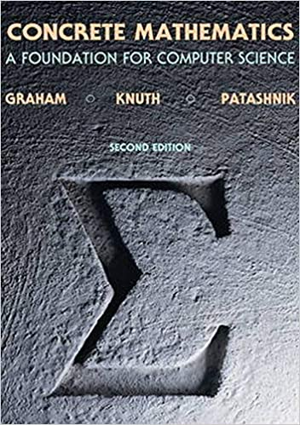

Homework Who Gets the Cake? (Inspired by 1.3 of Concrete Mathematics)

Slide 3
Let’s Play a Game
0
7
1
A group of n people.
There is only one slice of cake.
Who gets the cake?
The people form a circle.
A number k (k > 1) is selected
We use an array. In C, array index starts
from zero (not one).
6
2
5
3
4

Slide 4
Count to k
0
1
7
3
2
1
The kth person is removed
Keep counting
Wrap around to the beginning
n = 8 in this case
choose k = 5
This example uses 0, 1, 2… because array
indexes start from zero.
6
2
3
2
5
1
4
3
5
4

Slide 5
0
0
1
1
2
3
2
7
3
1
7
5
1
4
5
4
5
1
1
3
6
2
4
3
2
6
2
4
2
Skip
Skip
4
4
3
2
3
2
5
1
3
5
1
3
5
5
4
4

Slide 6
0
1
3
2
7
5
1
4
5
1
Skip
5
2
1
6
2
4
3
2
4
3
Skip
4
3
2
5
1
3
5
4

Slide 7
0
1
Original | 0 | 1 | 2 | 3 | 4 | 5 | 6 | 7
Count | 1 | 2 | 3 | 4 | 5 | 1 | 2 | 3
3
2
7
5
1
4
5
1
Skip
5
2
1
6
2
4
3
2
4
3
Skip
4
3
2
5
1
3
5
4

Slide 8
Original | 0 | 1 | 2 | 3 | 4 | 5 | 6 | 7
Count | 1 | 2 | 3 | 4 | 5 | 1 | 2 | 3
Original | 0 | 1 | 2 | 3 |  | 5 | 6 | 7
Count | 4 | 5 | 1 | 2 |  | 3 | 4 | 5

Slide 9
Original | 0 | 1 | 2 | 3 | 4 | 5 | 6 | 7
Count | 1 | 2 | 3 | 4 | 5 | 1 | 2 | 3
Original | 0 | 1 | 2 | 3 |  | 5 | 6 | 7
Count | 4 | 5 | 1 | 2 |  | 3 | 4 | 5
Original | 0 |  | 2 | 3 |  | 5 | 6
Count | 1 |  | 2 | 3 |  | 4 | 5

Slide 10
Original | 0 | 1 | 2 | 3 |  | 5 | 6 | 7
Count | 1 | 2 | 3 | 4 | 5 | 1 | 2 | 3
Original | 0 | 1 | 2 | 3 |  | 5 | 6 | 7
Count | 4 | 5 | 1 | 2 |  | 3 | 4 | 5
Original | 0 |  | 2 | 3 |  | 5 | 6
Count | 1 |  | 2 | 3 |  | 4 | 5
Original | 0 |  | 2 | 3 |  | 5 | 6
Count | 1 |  | 2 | 3 |  | 4

Slide 11
Original | 0 | 1 | 2 | 3 | 4 | 5 | 6 | 7
Count | 1 | 2 | 3 | 4 | 5 | 1 | 2 | 3
Original | 0 | 1 | 2 | 3 |  | 5 | 6 | 7
Count | 4 | 5 | 1 | 2 |  | 3 | 4 | 5
Original | 0 |  | 2 | 3 |  | 5 | 6
Count | 1 |  | 2 | 3 |  | 4 | 5
Original | 0 |  | 2 | 3 |  | 5
Count | 1 |  | 2 | 3 |  | 4
Original |  |  | 2 | 3
Count | 5 |  | 1 | 2 |  | 3

Slide 12
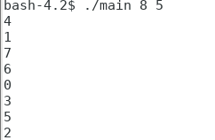
Original | 0 | 1 | 2 | 3 | 4 | 5 | 6 | 7
Count | 1 | 2 | 3 | 4 | 5 | 1 | 2 | 3
Original | 0 | 1 | 2 | 3 |  | 5 | 6 | 7
Count | 4 | 5 | 1 | 2 |  | 3 | 4 | 5
Original | 0 |  | 2 | 3 |  | 5 | 6
Count | 1 |  | 2 | 3 |  | 4 | 5
Original | 0 |  | 2 | 3 |  | 5
Count | 1 |  | 2 | 3 |  | 4
The program takes two numbers: n and k.
prints the order of removed people.
Original | 0 |  | 2 | 3
Count | 5 |  | 1 | 2 |  | 3

Slide 13
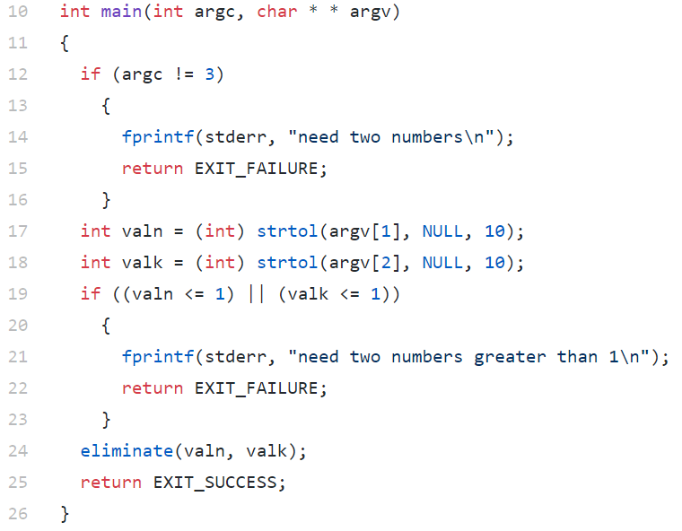
main.c

Slide 14
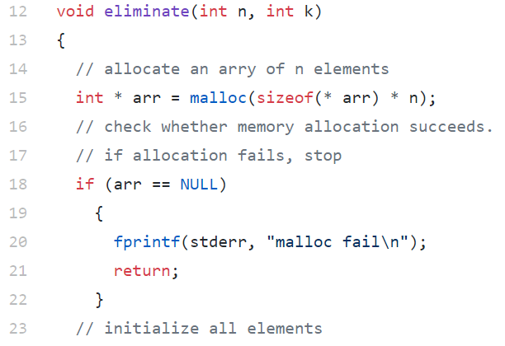
Each element is
an int
eliminate.c

Slide 15
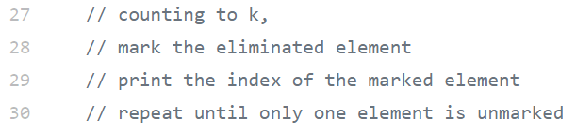

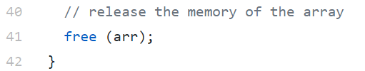
You decide what information to store
eliminate.c

Slide 16
Fill your code. Use as many lines as necessary.

Slide 17
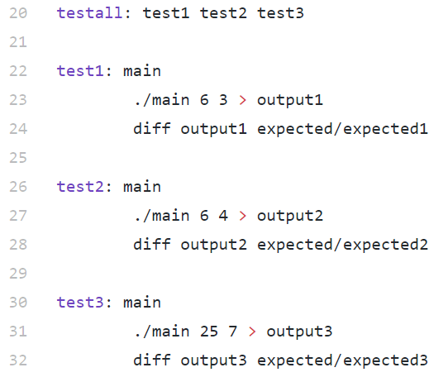
Makefile

Slide 18
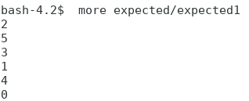
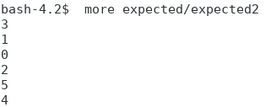
input: 6 3
input: 6 4

