Slide 1
Advancement of UTI

Slide 2
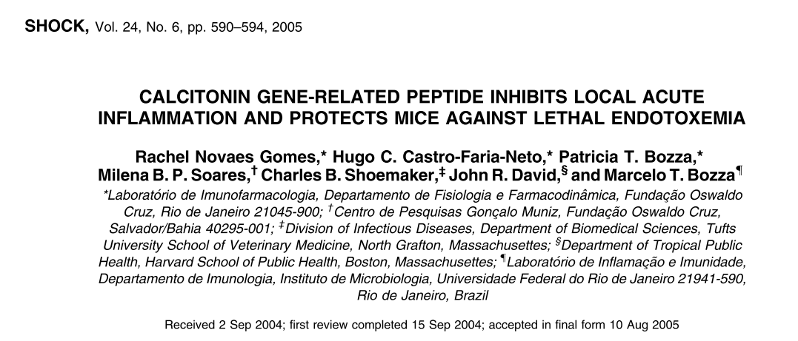

Slide 3
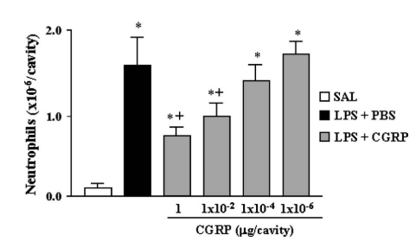
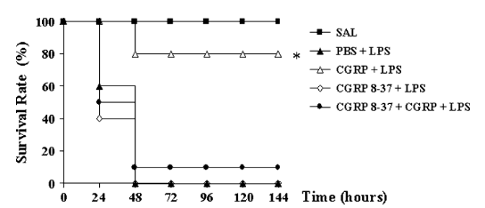
CGRP
a potent microvascular vasodilator
localized in central and peripheral nerve system neurons
negative regulate immune system
CGRP inhibits neutrophil recruitment of local acute inflammation
CGRP inhibits TNF-a (macrophage) serum levels and enhance IL-6 and IL-10 levels

Slide 4
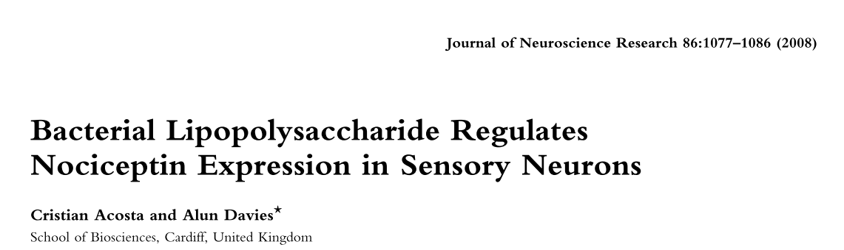
Nociceptin: 致痛素，痛敏肽

Slide 5
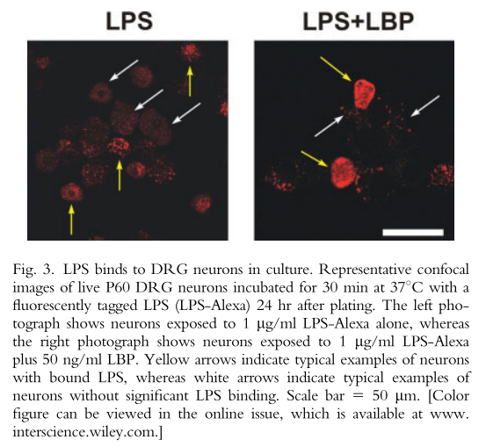
The immune system LPS receptor complex: CD-14, MD-2, TLR4
DRG neurons LPS receptor complex: CD-14, MD-1, TLR4
LPS stimulate DRG to express N/OFQ
LBP (lipopolysaccharide-binding protein) enhance LPS binding to DRG
Notes:
5

Slide 6
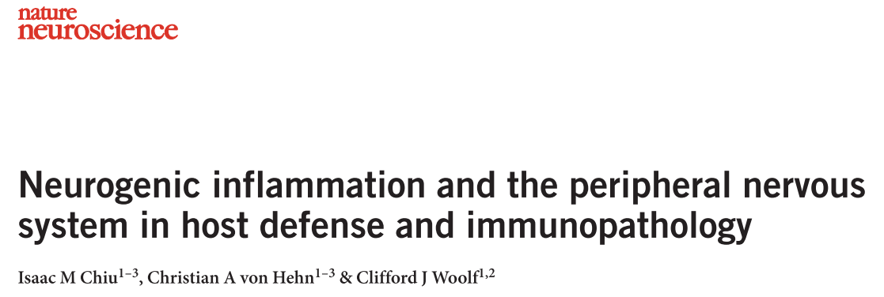
2012

Slide 7
Nociceptor neurons has danger recognition receptors, and can response to danger as immune cells.
TRPV
TLRs
p2x
DAMP receptors
PRRs
Sensory neuronal control innate and adaptive immunity
interact with mast cells, dendritic cells and neuropeptides induce degranulation or cytokine production in these cells.
mediators released from sensory neurons – neuropeptides, chemokines and glutamate – are chemotactic (neutrophils, eosinophils, macrophage, T cell, leukocytes)

Slide 8
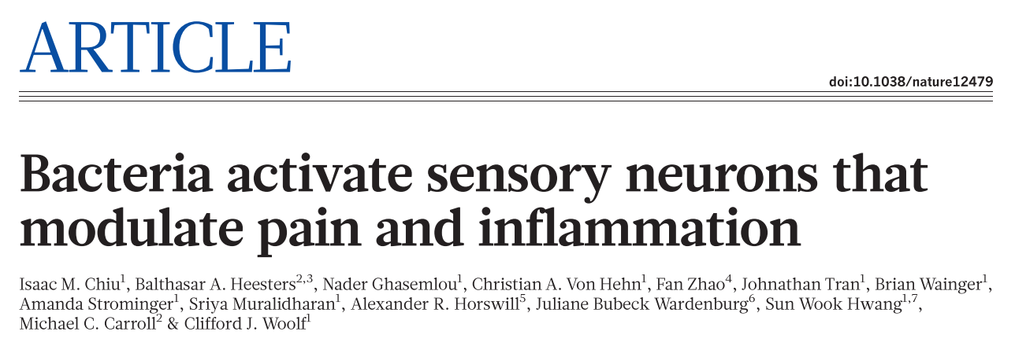

Slide 9
α-haemolysin activate nociceptors neurons by binding to A disintegrin and metalloprotease 10
Formyl peptides induce calcium flux of DRG
Granulocytes near DRG fibres after infection
Nav1.8 deleted mice showed increased infiltration of neutrophils / monocyte at infection sites
Nav1.8 deleted mice lymph node size increased
CGRP, galanin and somatostain receptors highly expressed in neutrophils, monocytes and macrophages
CGRP, galanin and somatostain all suppress TNF-α release from macrophages after infection
CGRP injection suppress lymph node size after infection, but didn’t alter inflammation

Slide 10
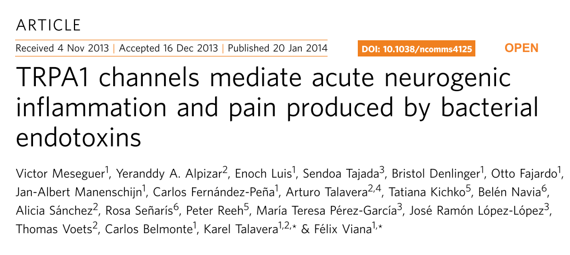

Slide 11
TRPA1-expression peripheral sensory afferents are directly activated by LPS in a TLR4-independent manner

Slide 12
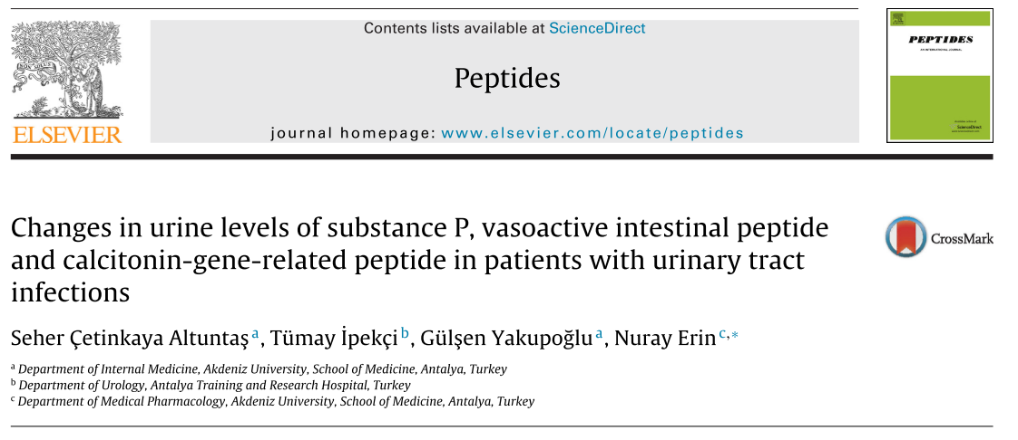

Slide 13
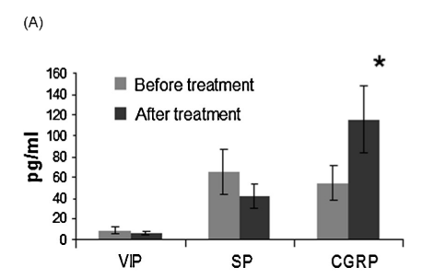
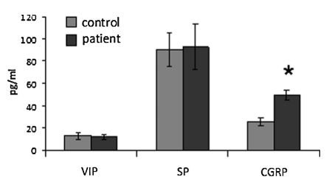
Notes:
there was a significant increase in urinary CGRP levels after antibiotic treatment

Slide 14
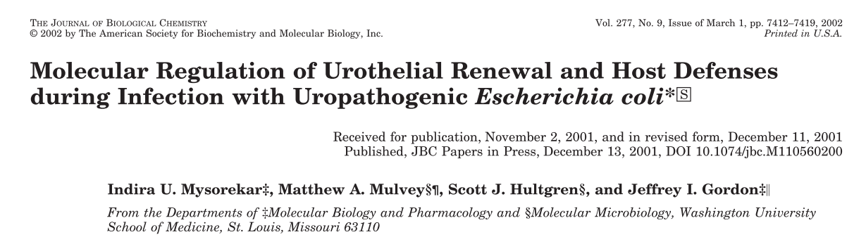

Slide 15
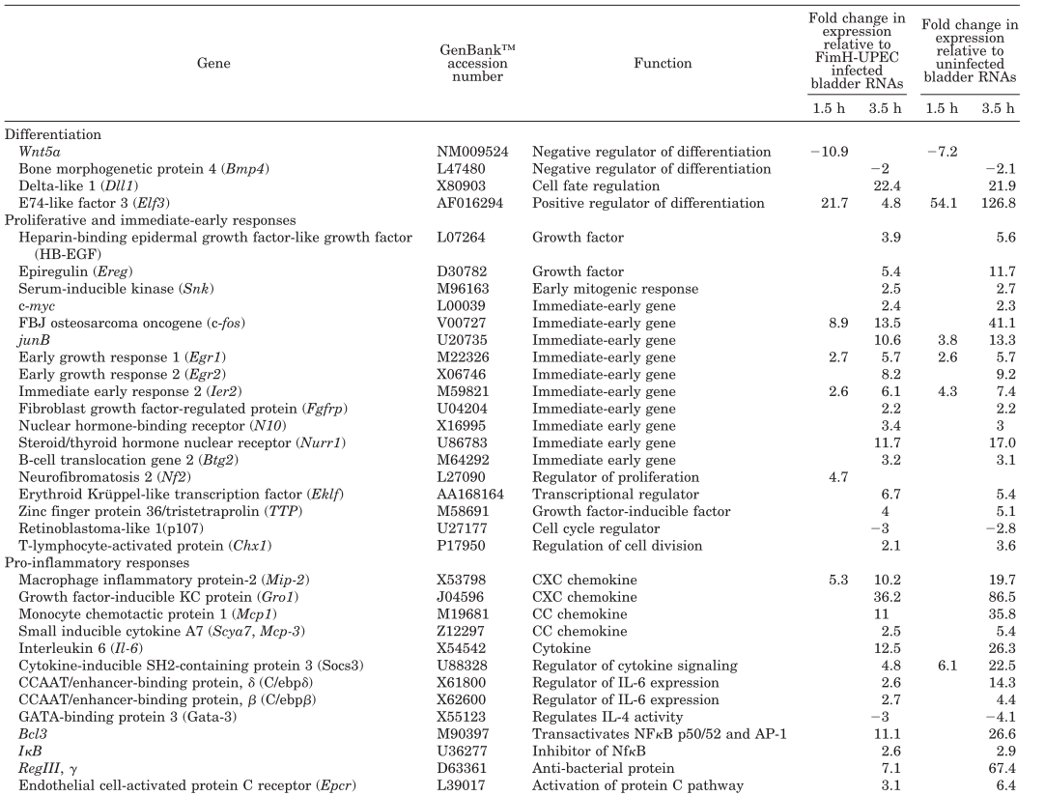

Slide 16
Differentiation
FimH+ E.coli attachment suppresses differentiation of basal / intermediate cells
Bmp4 → Bmp4Ia / Bmp4Ib → phosphorylation Smad1 → promoter differentiation
heparan sulfate D-glucosaminyl-3-O- sulfotransferase 1 (3-Ost1) binds to Bmp4
Wnt5a → Fz(3/4/6) receptors → incresase intracellular Ca²⁺ → activate Ca²⁺ dependent kinase CamKII → promotor cell differentiation
delta-like 1 (Dll1) → Notch receptors → negatively regulate cell differentiation

Slide 17
Proliferation, early response, Pro-inflammatory
FimH+ E.coli infection activation series of genes involved in immediate early response
Elf3 : epithelial specific member of the ETS transcription factor family, activate number of genes involved differentiation
iNOS (Elf3 target)
HB-EGF
Mip-2 (human IL-8), chemoattractant for neutrophils
Cebpb
Bcl3
Socs3

Slide 18
neuron-immune interaction
response sequential: epithelial → sensory neuron → immune system
inspection time points: 2h, 6h, 24h, 7days
urine volume
UPEC colonize position

