Slide 1
Lab meeting
尹纯友
2020/12/30

Slide 2
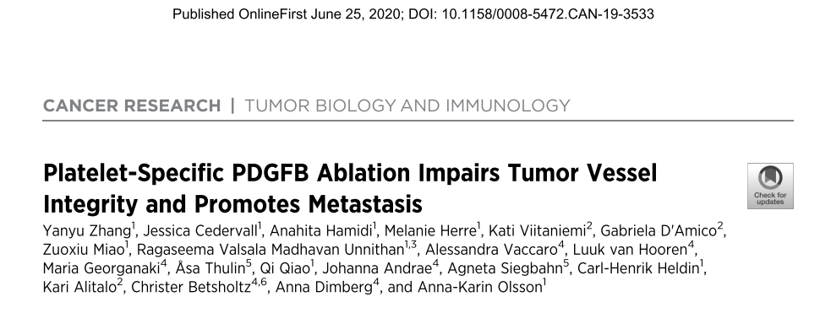
Notes:
2

Slide 3
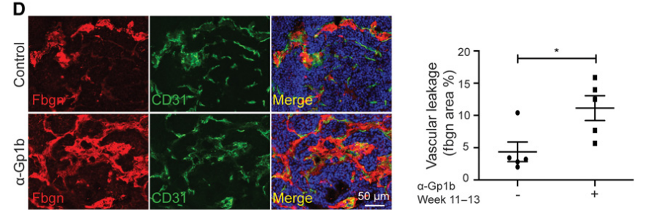
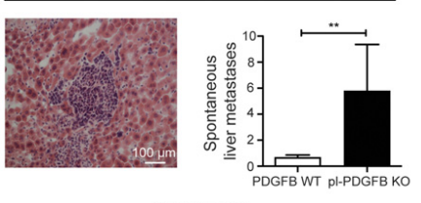
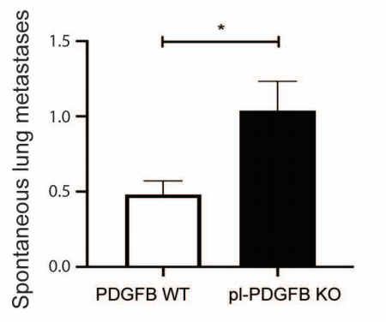
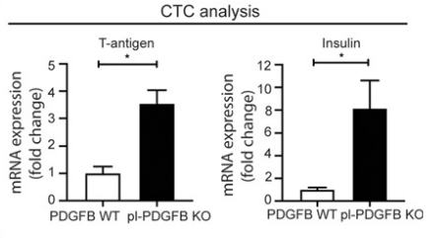
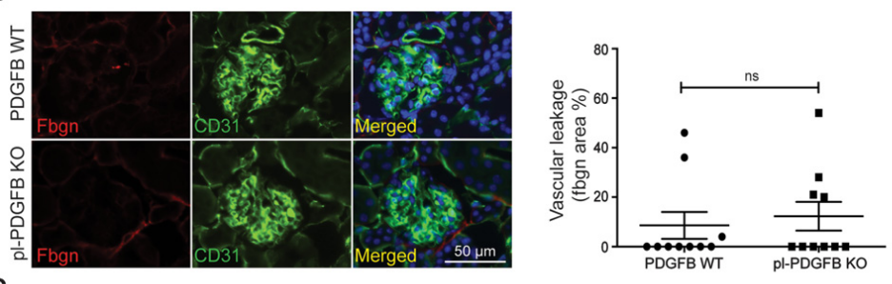
How to quantify the depletion effects?
Vascular leakage
Number of circulating tumor cells
Metastasis to liver or lung
Notes:
3

Slide 4
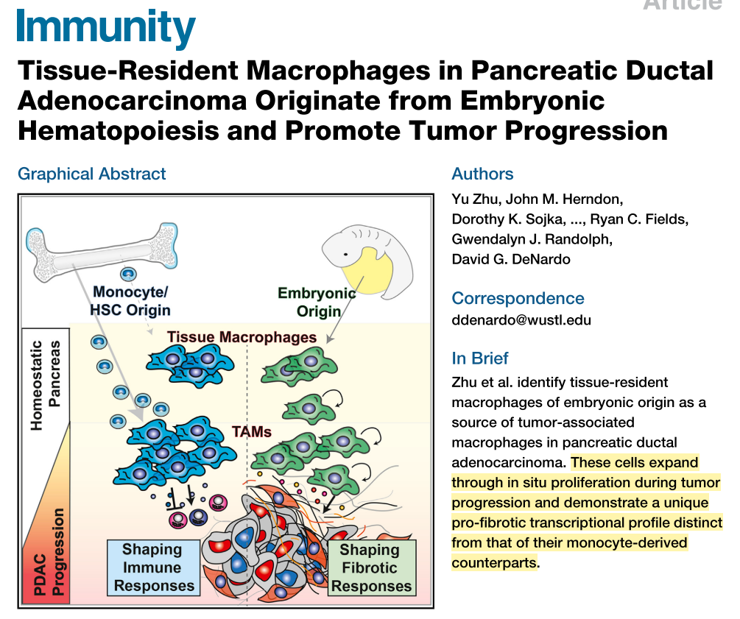
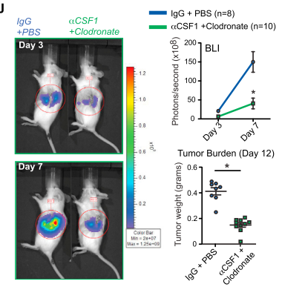
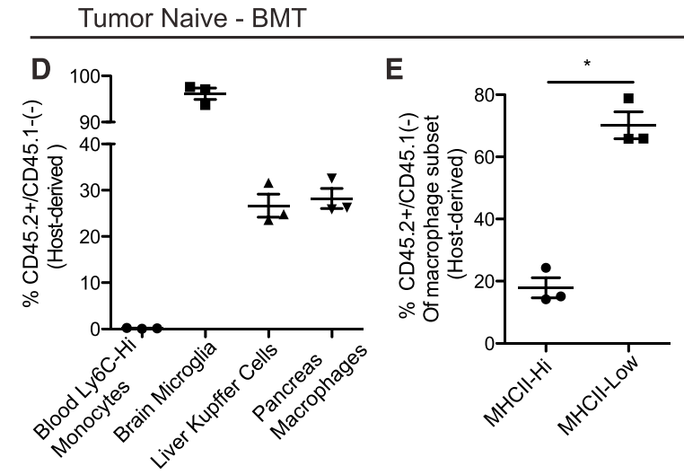
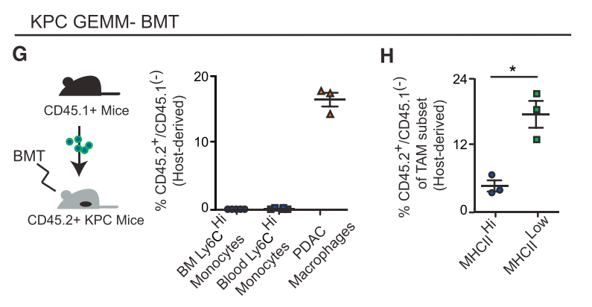
Notes:
4

Slide 5
对侧肾 肾内肿瘤

Slide 6
plans
Pdgfb Knockout or Cx3cr1^{CreER} ｘiDTR depletion effects:
  Tumor volume
  Vascular density
  Intra tumor CD8+ T cell
  Vascular leakage
  Circulating tumors
  Metastatsis
Pdgfb mediates tumorgenic effects
  纯化 SM-MФ，检测 Pdgfb 在静息和肿瘤内的表达变化

Slide 7
kidney macrophage after LPS challenge

Slide 8
Control 48h 72h

Slide 10
Urine total protein after LPS challenge

Slide 11
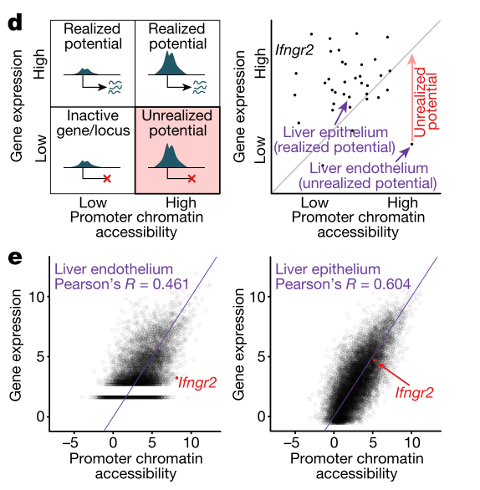
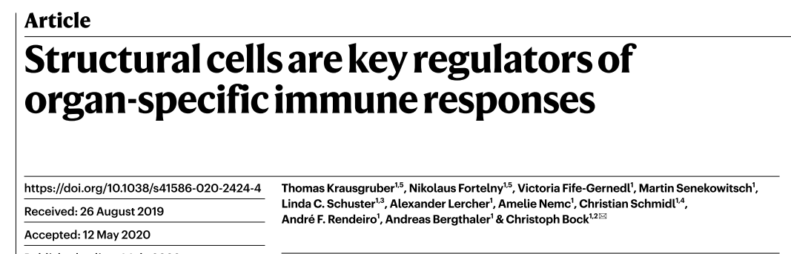
Notes:
11

Slide 12
plans
where the macrophage comes from?
  migrate from medulla
  derive from blood monocyte
LPS 后尿蛋白的变化
去掉 macrophage 后打 LPS 尿蛋白的变化

