Slide 1
Week 5
Matt

Slide 2
Homework
1. NER transformer
Study
Custom dataset
2. API
Fixed URL
AI model demo visualize (Gradio/Streamlit)

Slide 3
Sentence_id | Text | POS_Tag | NER | Label
Crime_Data sentence id | Text token | POS Tag text properties | Named entities | Self Label
N:Name
M:Numeric
Other:Other

Slide 4
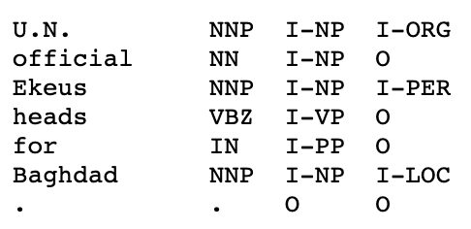
NER Transformer [Keras example]
DatasetDict({
train: Dataset({
features: ['id', 'tokens', 'pos_tags', 'chunk_tags', 'ner_tags'],
num_rows: 14041
})
validation: Dataset({
features: ['id', 'tokens', 'pos_tags', 'chunk_tags', 'ner_tags'],
num_rows: 3250
})
test: Dataset({
features: ['id', 'tokens', 'pos_tags', 'chunk_tags', 'ner_tags'],
num_rows: 3453
})
})
Conll_dataset 2003

Slide 5
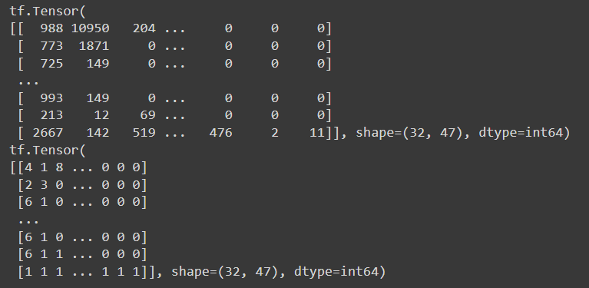
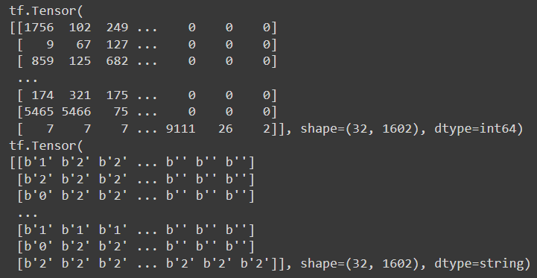
Experiment 1
NER transformer training on [Self Label]
Datatype problem

Slide 6
Runtime type change from CPU to GPU (solved)
Notes:
https://blog.csdn.net/shizheng_Li/article/details/123478662

Slide 7
由於資料大小問題，不能與example中訓練方法一樣

Slide 8
Sentence_id | Text | POS_Tag | NER | Label
Crime_Data sentence id | Text token | POS Tag text properties | Named entities | Self Label
問題：
以extract id作爲一組資料集的方式會導致資料維度太大
解決方法：
1. 降低batch size
2. 再從extract去提取更短的句子（人工判斷）
3. 將extract拆分成詞，一個token一個token去訓練

Slide 9
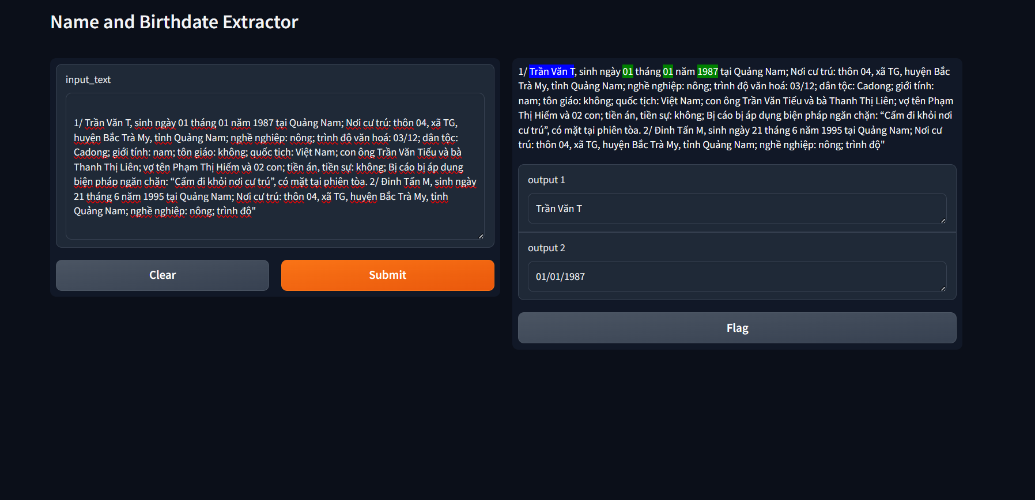
Gradio
Notes:
https://dev.to/codemee/zai-windows-zhi-xing-gradio-fen-xiang-lian-jie-de-zhu-yi-shi-xiang-4nfb

Slide 10
Combine ner model and gradio
1. Download the ner_model
2. Set a customize input (one time)
3. Gradio setup

Slide 11
Download the model and dependencies
To run the prediction, two thing require
1. ner_model
2. dictionary, store the token(text) to ID(int), used to convert the string token into int type for training and inference.

Slide 12
Set a customize input
Data preprocessed before training, inference
Steps:
The data manipulation involves several key steps:
Tokenization: The input text is tokenized into individual tokens using whitespace as the delimiter. Special characters like , and ; are removed using regular expressions.
Formatting for Model Input: The tokenized text is formatted into a string compatible with the model input. The length of the tokenized text is prefixed to the tokenized text itself, followed by tab-separated tokens and corresponding tags. Tags are initially set to 0, indicating the absence of named entities.
String Lookup: A vocabulary is loaded from a pickle file containing token-to-ID mappings. The tokens are looked up in this vocabulary, converting them into token IDs.
Data Mapping: The formatted data is mapped to training data format by splitting it into tokens and tags, and then converting tokens into token IDs.
Padding: The mapped data is padded to ensure uniform length across samples, essential for batch processing.
Model Prediction: The padded data is fed into the loaded NER model for prediction. The model outputs logits, from which the predicted tag IDs are extracted.
Post-processing: Predicted tag IDs are mapped back to their corresponding tag labels ([PAD], N, M, other). This results in a list of predicted tags for each token.
Result: The final result is a list of predicted tags corresponding to the input tokens.

Slide 13
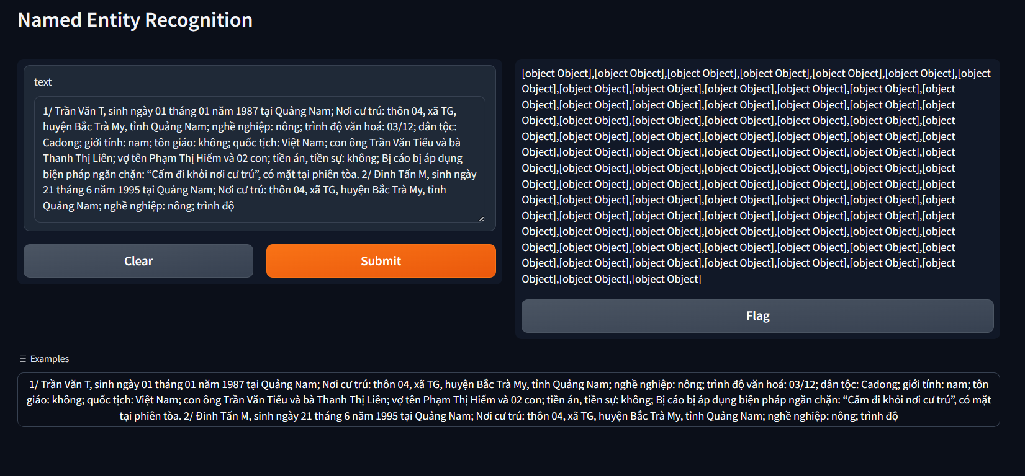
Gradio with NER model

Slide 14
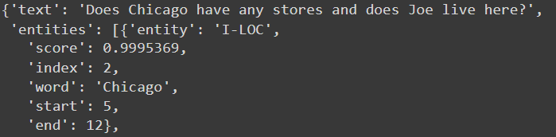
Gradio NER
https://www.gradio.app/guides/named-entity-recognition
You may find this documentation, to correctly output and visualize like the documentation. You need to have these two element for ner
Input_text: [String]
entities: [dict]

Slide 15
