Slide 1
Week 4
Matt

Slide 2
Homework
1. Deploy the api (demo) using web
In docker
Localhost & gcp & aws
2 Study NER transformer
Run code and understand it

Slide 3
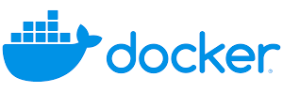

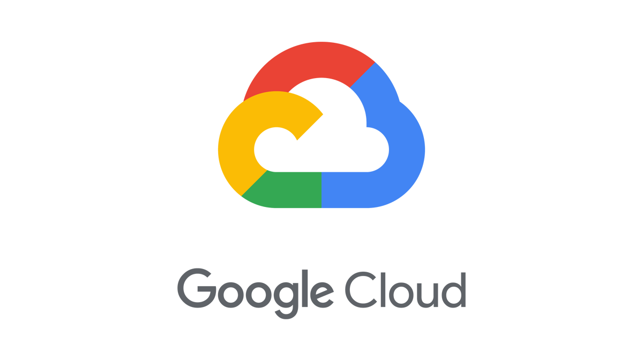



Slide 4
Structure of API (demo)
Input – Sentence
Output – Name, Birthdate
Method: Regular Expression
Python-docker
|---template
|---index.html
|---extract.html
|---app.py
|---name_info_identify.py
|---requirement.txt
|---Dockerfile

Slide 5
Localhost
Obstacle:
Docker is running, but cannot access from web page
Method to solve:
Change the port
Add a host configuration in app.py
Reference: https://forums.docker.com/t/docker-is-running-but-i-cannot-access-localhost-flask-application/82193

Slide 6
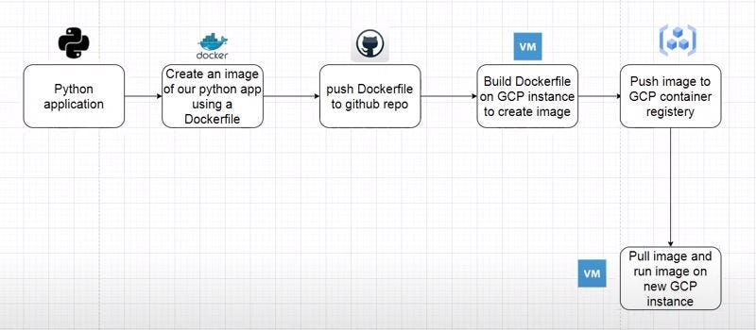
Setup docker on GCP
Reference:
https://medium.com/artificialis/building-and-pushing-docker-images-to-google-cloud-platform-eef77d9c3361
https://docs.docker.com/engine/install/ubuntu/?source=post_page-----eef77d9c3361--------------------------------
Notes:
https://medium.com/google-developer-experts/building-a-flask-app-using-docker-and-deploy-to-google-cloud-run-8f311ad36040

Slide 7
Dockerfile
# Use an official Python runtime as a parent image
FROM python:3.9-slim
# Set the working directory in the container
WORKDIR /app
# Copy the current directory contents into the container at /app
COPY . /app
# Install any needed packages specified in requirements.txt
RUN pip install --no-cache-dir -r requirements.txt
# Make port 5000 available to the world outside this container
EXPOSE 5000
# Define environment variable
ENV NAME World
# Run app.py when the container launches
ENTRYPOINT [ "python" ]
CMD [ "app.py" ]
Cloudbuild.yaml
steps:
- name: 'gcr.io/cloud-builders/docker'
args: ['build', '-t', 'gcr.io/intern-project-415606/python-docker', '.']
- name: 'gcr.io/cloud-builders/docker'
args: ['push', 'gcr.io/intern-project-415606/python-docker']

Slide 8
NER transformer
https://huggingface.co/datasets/conll2003
https://en.wikipedia.org/wiki/Inside%E2%80%93outside%E2%80%93beginning_(tagging)
NER -> NER?

