Slide 1
Week 6
By Maπ

Slide 2
Continue Week5…
Error when training using CPU
No error when training using GPU
Similar error occur when inference with Gradio

Slide 3

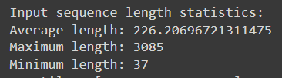
Solution
1. Test if tutorial’s code can run in CPU runtime (YES)
2. Check datashape difference.
Conll dataset (Keras tutorial)
Customize dataset (Vietnam)

Slide 4
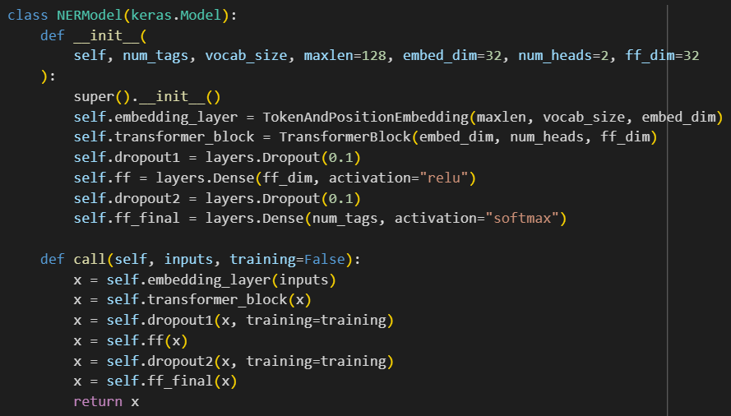
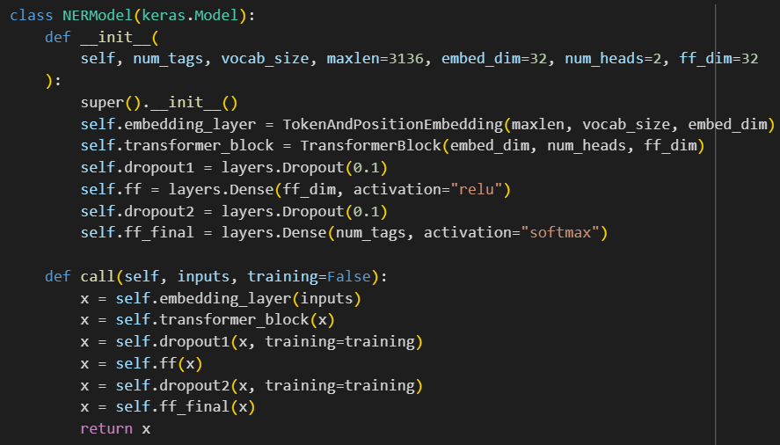
與batchsize無關
找包含128的code

Slide 5
Table of contents
0. Gradio Tensorflow NER model web demo(3/21)
1. Understand ner model custom dataset topic
1.1 token training relation(data process?/model training?)
1.2 explain code class
2. run and understand https://keras.io/examples/nlp/parameter_efficient_finetuning_of_gpt2_with_lora/

Slide 6
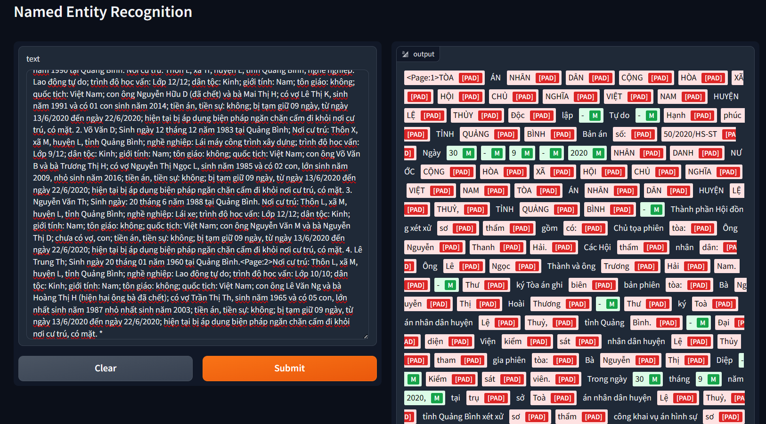
0 Gradio NER
Error when too many tokens
Now

Slide 7
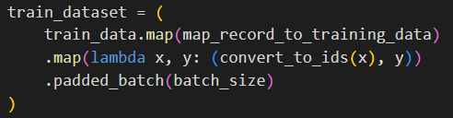
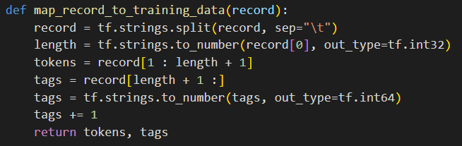

1.1 Token training relation
Token input size(training/inference)
Padding
Why?
Every sentence (tokens) have different length.
How?
Adding special token at the end of shorter sentence, until it meet the same length as the max length in same batch

Slide 8
1.2 Classes
class NERModel(keras.Model)
class TransformerBlock(layers.Layer):
class TokenAndPositionEmbedding(layers.Layer):

Slide 9

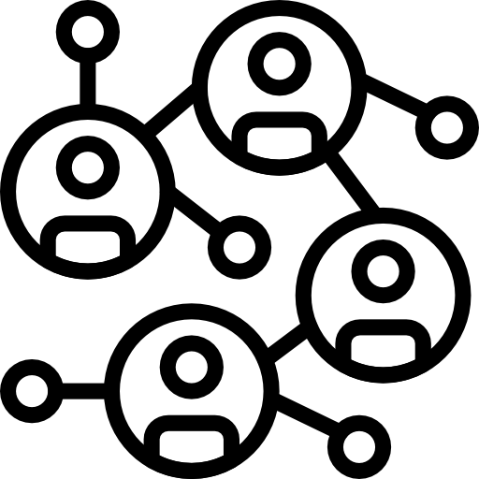
Transformer
NLP. Self-attention and feed-forward transformation.
Self-attention
Compute the relation and importance of word/token
Feed-forward Transformation
Feed-forward neural network, learn complex relationship and patterns
Normalization
Ensure similar distribution, helps with training stability

Slide 10
TokenAndPositionEmbedding
Token Embedding
Represents the semantic meaning or features of words
Position Embedding
Identity where and what kind/type of word will appear

Slide 11
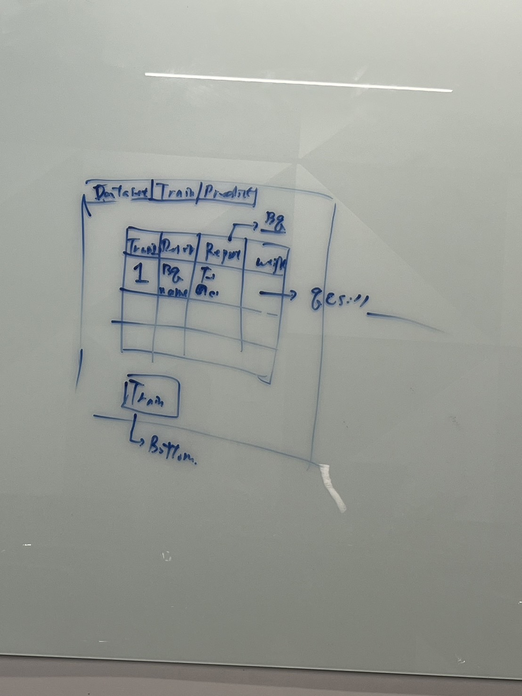
ML x DDD
Architecture

