Slide 1
Week 2 Report
Name: Matt

Slide 2
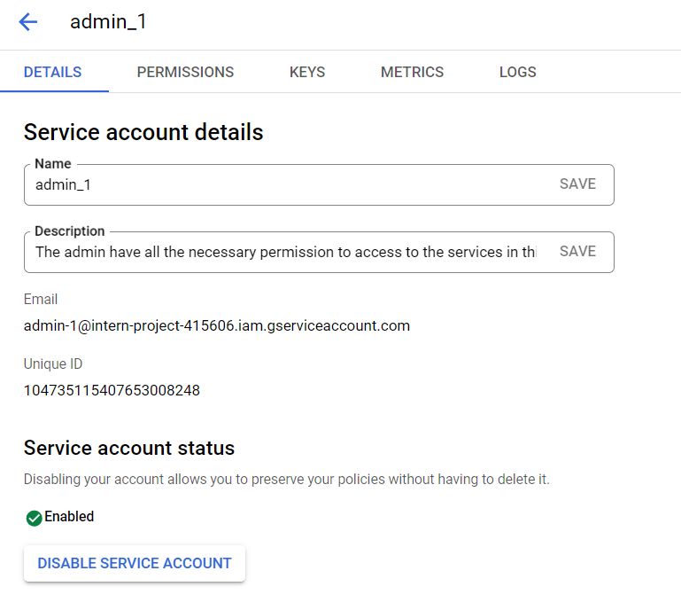
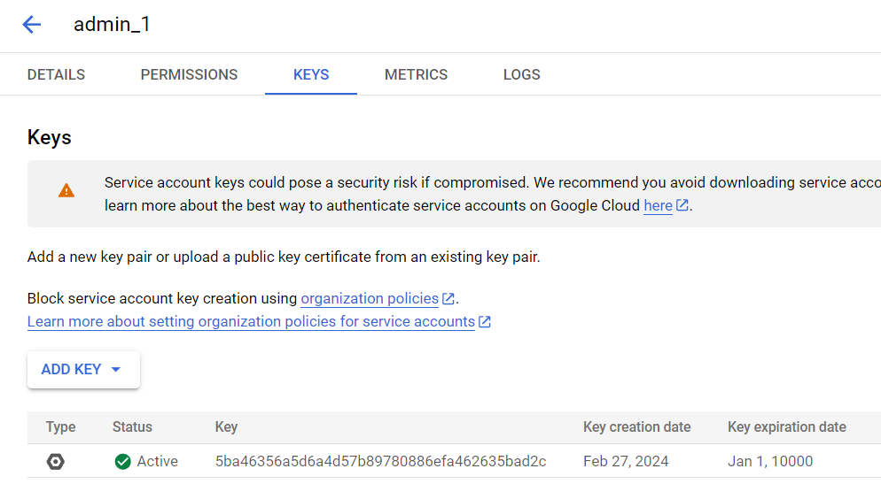
Connect GCP projects using python
1. Create new service account, download JSON key file
Notes:
https://zebrabi.com/guide/how-to-integrate-google-cloud-platform-into-python-seaborn/#Step-by-Step_Guide_Setting_Up_GCP_for_Python_Development

Slide 3
Access to the project
1.Install and initiate google cloud CLI
Install GoogleCloudSDK
2.Set up application default credentials
Notes:
https://cloud.google.com/docs/authentication/provide-credentials-adc
https://stackoverflow.com/questions/69478763/gcp-user-list-using-python

Slide 4
List permissions through [Python]
1. Cloud Resource Manager API has not been enabled for your project or it is currently disabled.
Enable in GCP console
2. 'resourcemanager.projects.getIamPolicy' is denied on the resource //cloudresourcemanager.googleapis.com/projects/intern-project.
Enable in GCP console
Project IAM Admin
(roles/resourcemanager.projectIamAdmin)
Provides permissions to administer allow policies on projects.
resourcemanager.projects.get
resourcemanager.projects.getIamPolicy
resourcemanager.projects.setIamPolicy

Slide 5

List project details [Python]
*Error: “The caller does not have permission”
結果爲看錯Project-ID成Project-Name
Result:

Slide 6
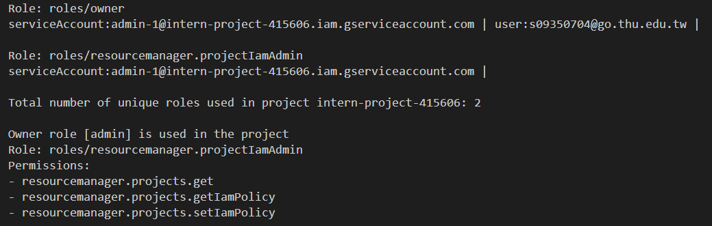
List roles [Python]

Slide 7
Bucket creation [Python]

Slide 8
Upload file to bucket [Python]

Slide 9
Polp Admin
Resource Manager IAM admin
resourcemanager.projects.get
resourcemanager.projects.getIamPolicy
resourcemanager.projects.setIamPolicy
Role/Viewer
View most Google Cloud resources. View Bucket, Object…etc

Slide 10
Adding Permission(Role)
In Cloud Storage
roles/storage.objectAdmin
orgpolicy.policy.get
resourcemanager.projects.get
resourcemanager.projects.list
storage.managedFolders.create
storage.managedFolders.delete
storage.managedFolders.get
storage.managedFolders.list
storage.multipartUploads.abort
storage.multipartUploads.create
storage.multipartUploads.list
storage.multipartUploads.listParts
storage.objects.create
storage.objects.delete
storage.objects.get
storage.objects.getIamPolicy
storage.objects.list
storage.objects.overrideUnlockedRetention
storage.objects.restore
storage.objects.setIamPolicy
storage.objects.setRetention
storage.objects.update
roles/storage.objectUser
orgpolicy.policy.get
resourcemanager.projects.get
resourcemanager.projects.list
storage.managedFolders.create
storage.managedFolders.delete
storage.managedFolders.get
storage.managedFolders.list
storage.multipartUploads.abort
storage.multipartUploads.create
storage.multipartUploads.list
storage.multipartUploads.listParts
storage.objects.create
storage.objects.delete
storage.objects.get
storage.objects.list
storage.objects.restore
storage.objects.update
Notes:
In retention period, the object cannot be modified or remove
Restore data from archieve, may cause more charges

Slide 11

Bigquery
Didn’t add role, but dataset loaded successful and can be query
(roles/bigquery.jobUser)
bigquery.config.get
bigquery.jobs.create
dataform.locations.*
dataform.locations.get
dataform.locations.list
dataform.repositories.create
dataform.repositories.list
resourcemanager.projects.get
resourcemanager.projects.list

Slide 12
Permission/Role
A role is a group of permissions that can be assigned to members.
IAM requires identity has appropriate permissions to use resource.
Identity: User, Group, Service Account
Primitive Role/ Basic Role
Predefined Role
Custom Role
Managed by GCP
Grant access to every resources
development stage
Managed by GCP
Only grant necessary access
Difficult to manage when number of role increases
Managed by USER
Higher security level
Production stage
More operation overhead
Notes:
https://avinetworks.comdocs/latest/gcp-roles-and-permissions/
https://medium.com/google-cloud/gcp-iam-roles-explained-af84955346e7
https://www.strongdm.com/blog/gcp-iam-roles

