Slide 1
ITCS 3143
YIN HANG KWOK
800831787
E01 - Matlab for DIP

Slide 2
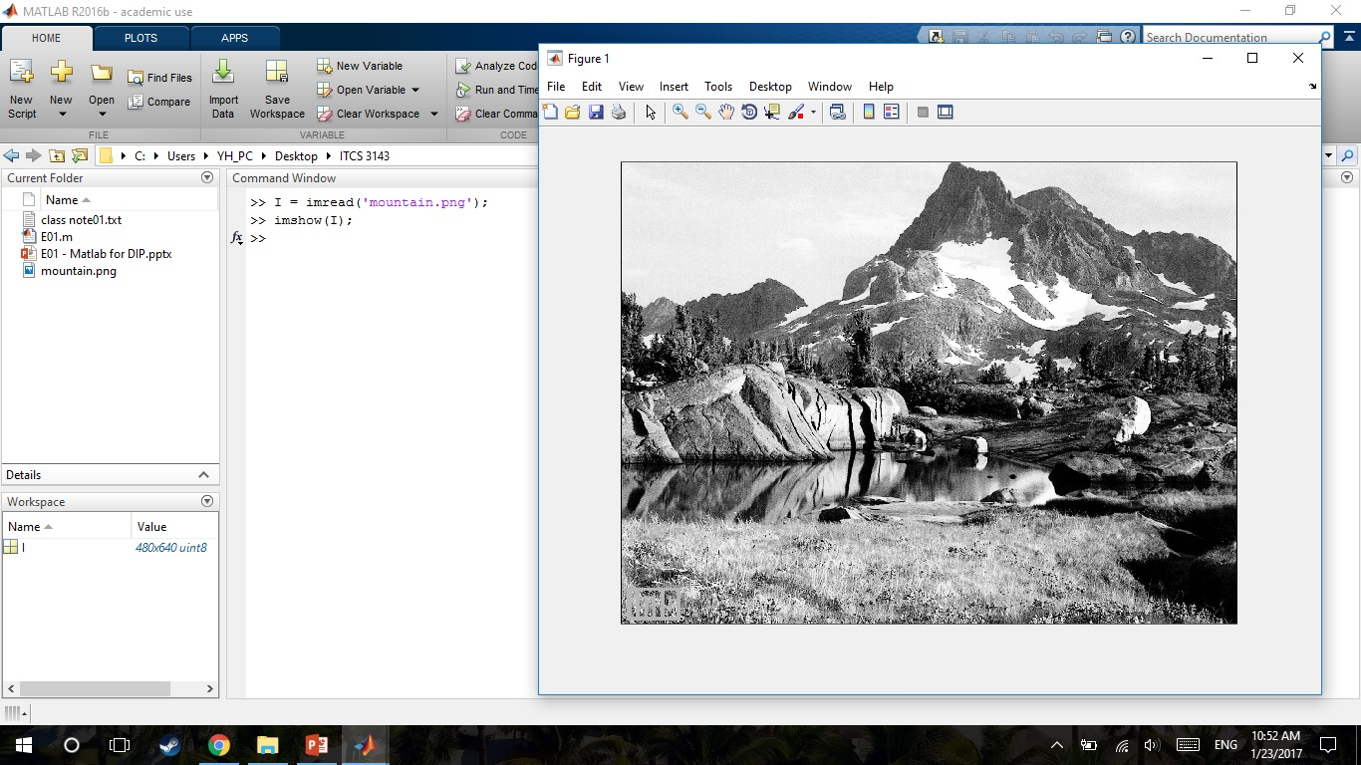
Input Image
>> I = imread('mountain.png');
>> imshow(I);

Slide 3
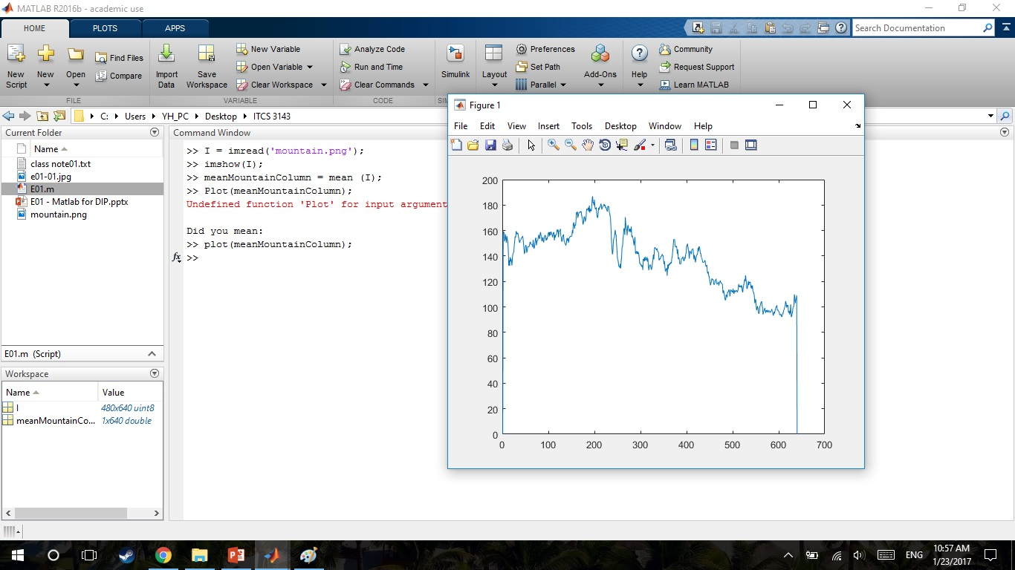
Plot of mean intensity for each column
meanMountainColumn = mean (I);
plot(meanMountainColumn);

Slide 4
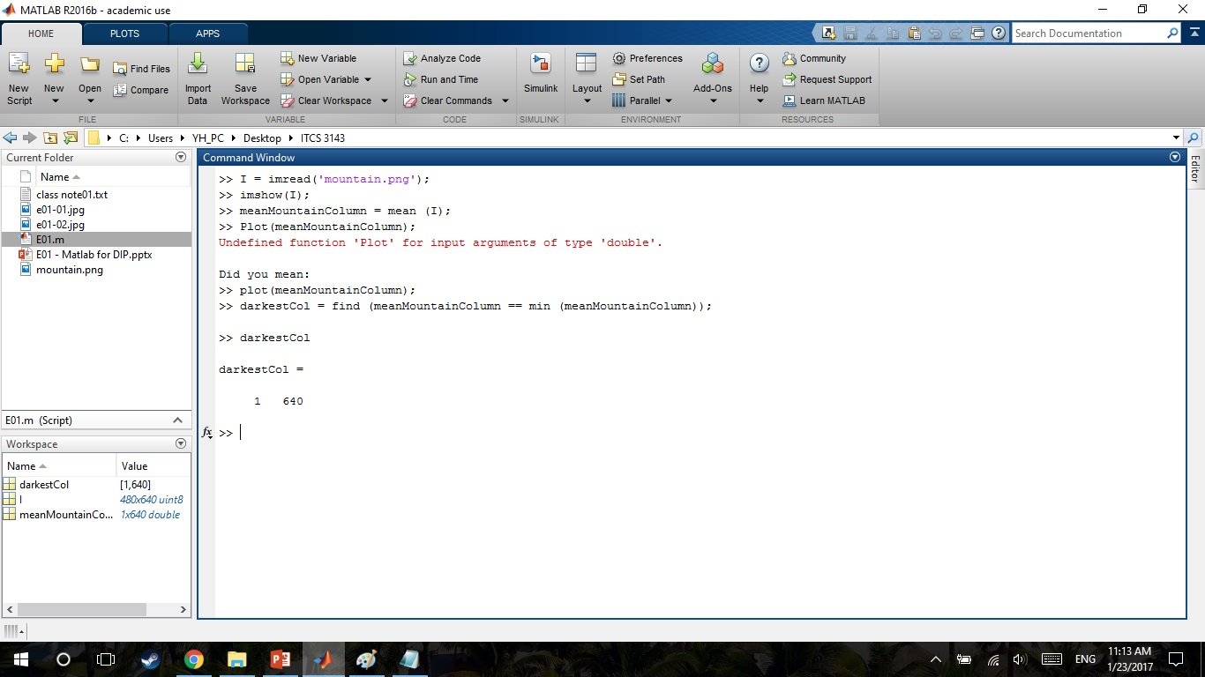
Column number with the smallest mean intensity value
darkestCol = find (meanMountainColumn == min (meanMountainColumn));
darkestCol;

Slide 5
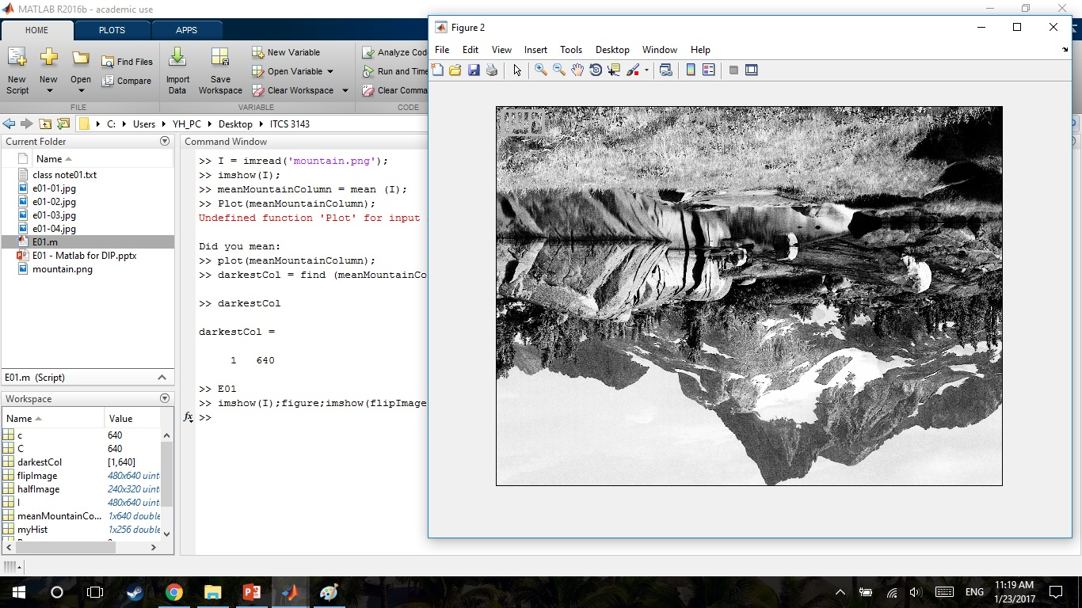
Flip image along horizontal line
[R,C] = size(I);
for r = 1:R
for c = 1:C
flipImage(r,c) = I(R-r+1,c);
end
End
E01
imshow(I);figure;imshow(flipImage);

Slide 6
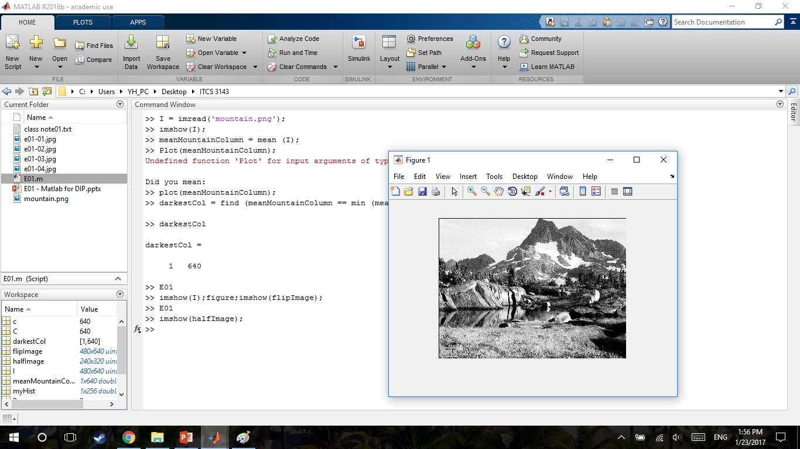
Original input image and half resolution image
halfImage = zeros(R/2,C/2,'uint8');
for r = 1:R/2
for c = 1:C/2
halfImage(r,c) = I(r*2-1,c*2-1);
end
end
Imshow(halfImage);

Slide 7
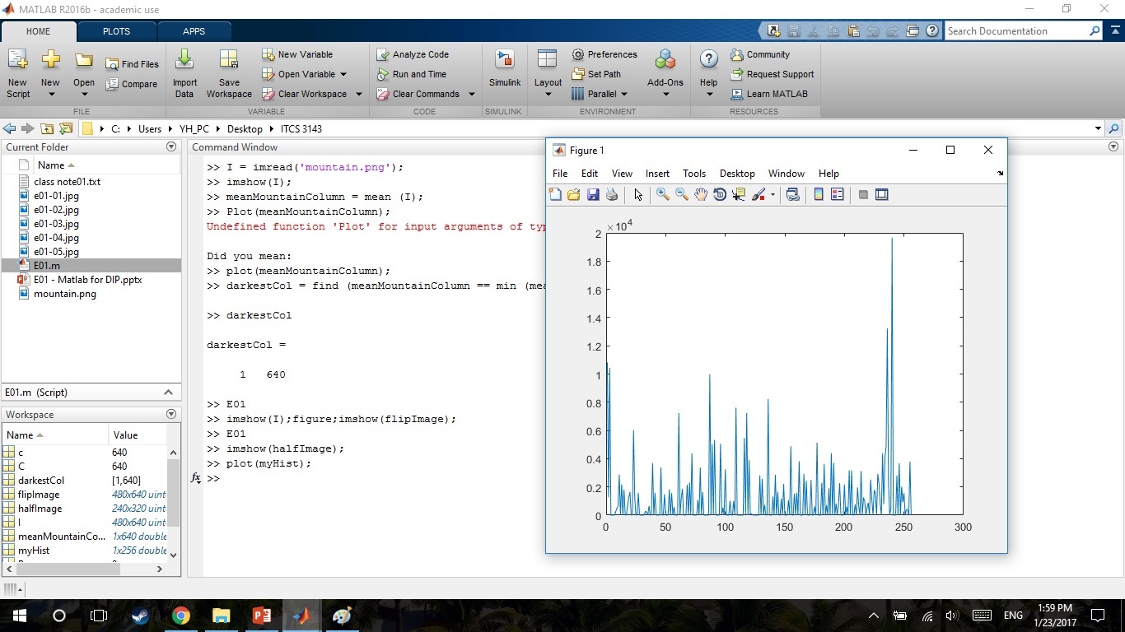
Histogram of input image.
myHist = zeros(1,256);
for r = 1:R
for c = 1:C
P = I(r,c);
myHist(P+1) = myHist(P+1)+1;
end
end

