Slide 1
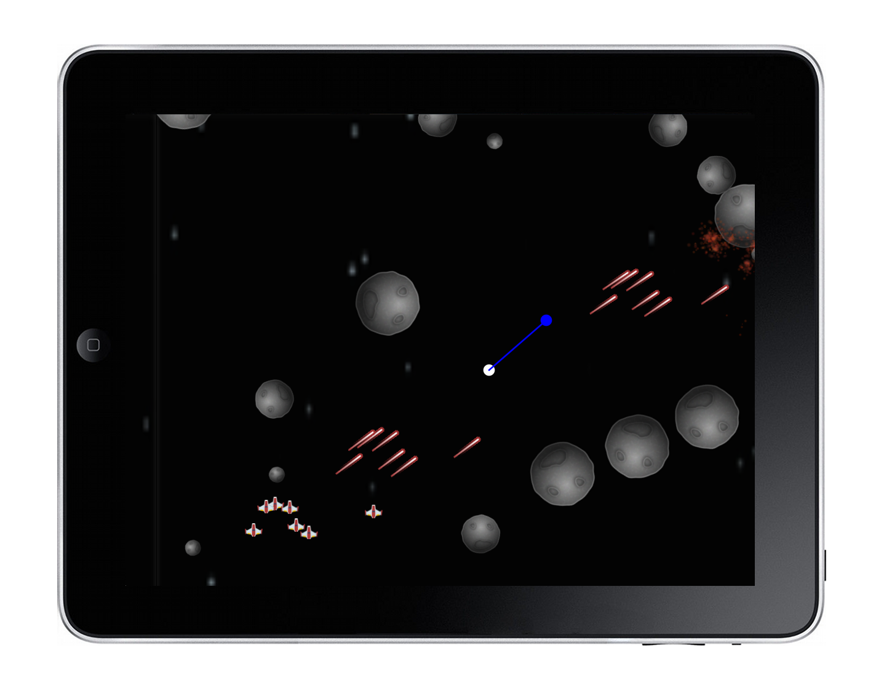



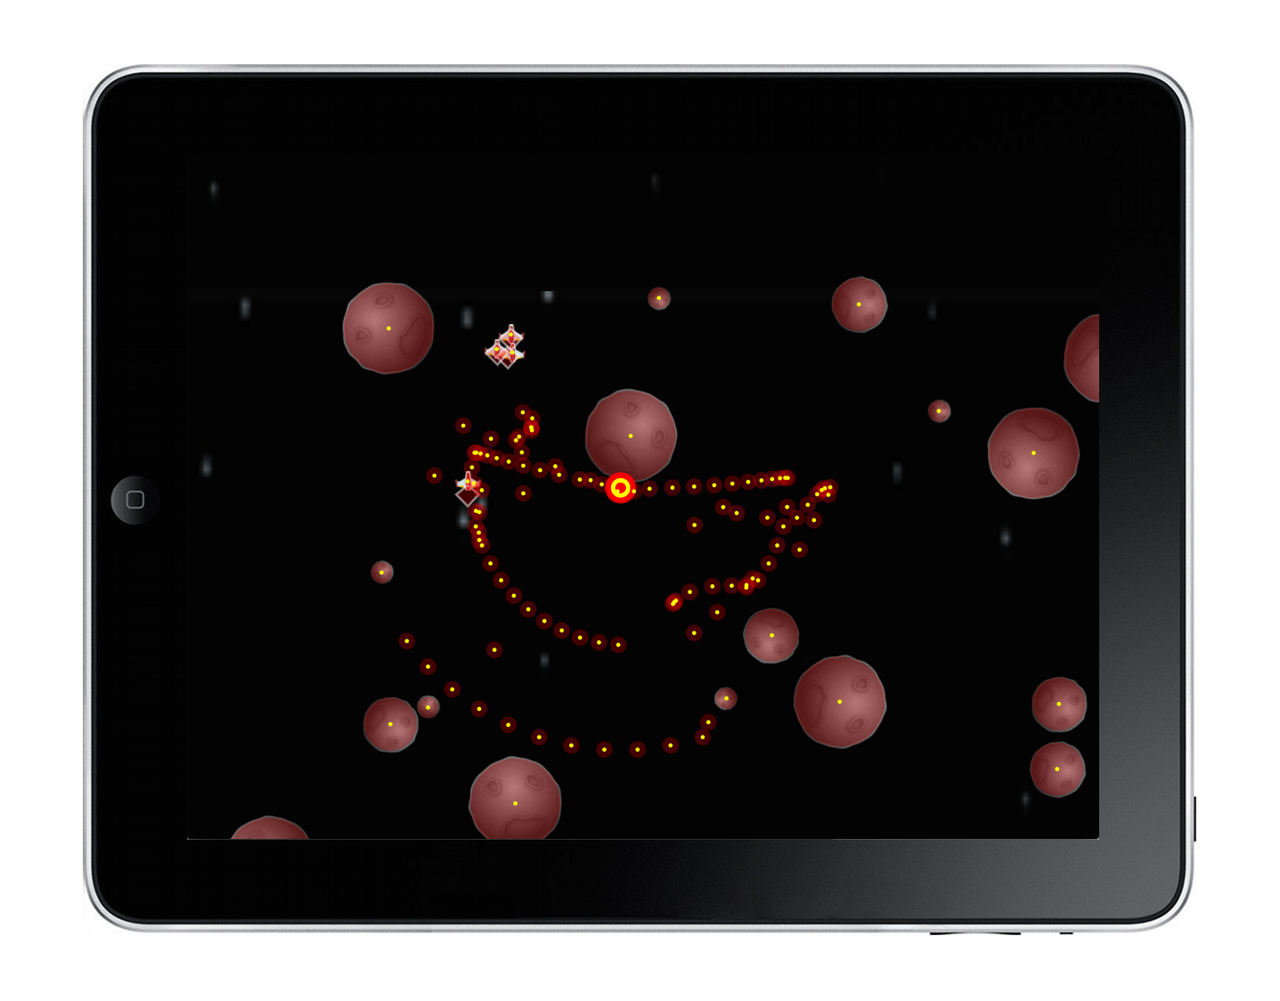
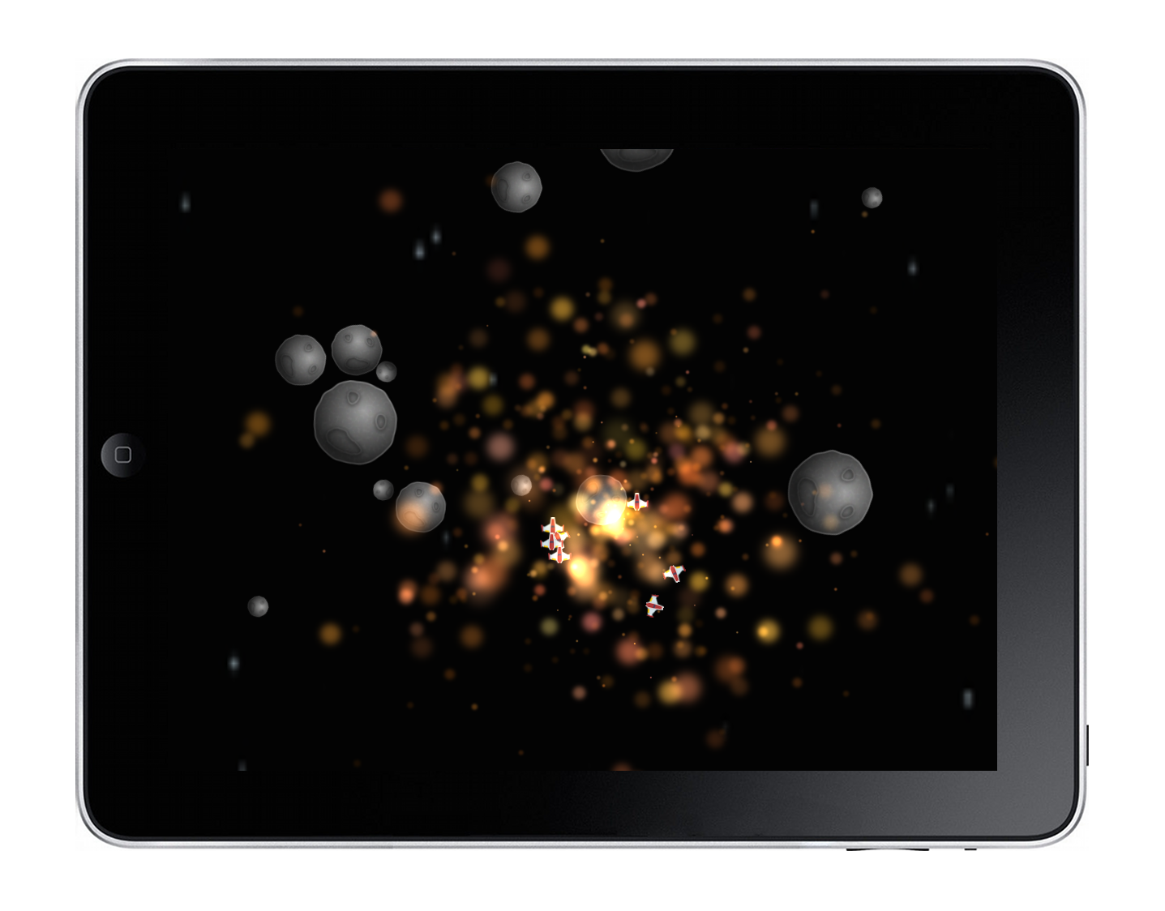

BattleSwarm
Matthew Rennie
The Game
Top-down 2D Infinite Space Shooter
Control a battle-group of starships
  Fly through space dodging asteroids and hunting enemies
  Keep your swarm alive!
  Use formations to mitigate damage/increase attack
Designed for the iPad
  Written in Objective-C
  Built on Cocos2D Game Engine
  Physics by
Challenges
Infinite Horizontal and Vertical Scrolling Starscape
Uses four starscape images as quadrants
Movement of CCPhysicsNode creates illusion of scrolling
Reposition starscape quadrant based on CCPhysicsNode position
Basic Formation Flocking
Members of the battlegroup move semi-independently and attempt to stay in formation
Delayed reaction when responding to irregular player control
New leader is elected when current leader is killed
Explosion Physics
On starship collision or destruction, “explosion” particles are emitted with a low density and a high impulse velocity
Collisions between particles and starships create illusion of ship being impacted by explosion
Velocity and angular velocity of ship is dampened so they appear to regain control
Notable Features
Multi-touch player control
  Left thumb controls movement
  Right thumb controls firing
  Angle between initial and subsequent touch position of thumb is flight or aim direction
Two camera modes
  Fly-through-space
  Follow-the-leader (when leader is impacted by explosions)
Assets
  Asteroids - Varied sizes, each with own drift and spin
  Asteroids - Randomly positioned and equally distributed regardless of screen position
  Enemy starships – attempt to collide with swarm
  Hero starships – with lasers!
Collision detection between dynamic bodies
Particle effects
  Generated using Particle Designer by 71 Squared
  Particle effect pooling for optimal performance

