Slide 1
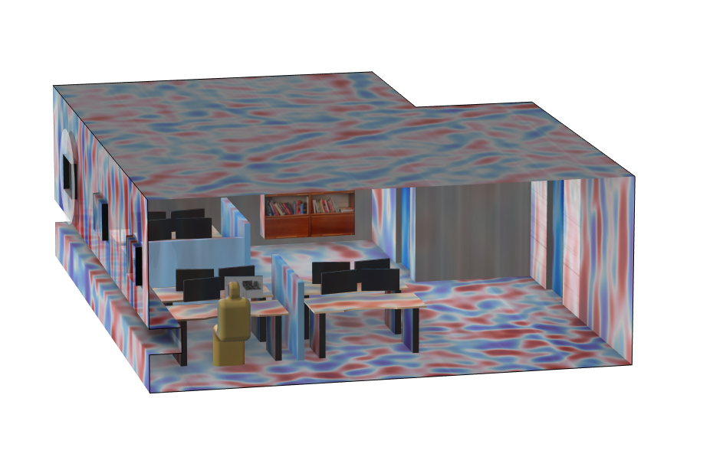
Acoustics of an Open-Plan Office Space

Slide 2
Background and Motivation
In this tutorial, the acoustics of an open-plan office space are analyzed using a wave-based approach in the time domain. An initial pulse is released and the room response is analyzed.
Realistic frequency-dependent impedance conditions for the ceiling, carpet, and gypsum walls are included using the General local reacting (rational approximation) impedance option. The input data is fitted using the Partial Fraction Fit function. Moreover, an open window is also modeled using an Absorbing Layer.
The model is solved with the Pressure Acoustics, Time Explicit interface using the Accelerated solver formulation that can be run on multiple GPUs.

Slide 3
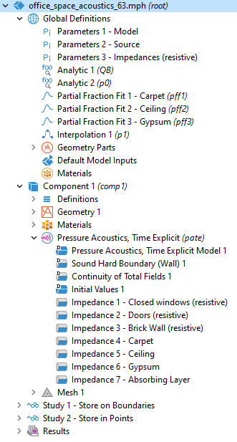
Model Setup
①
Import and fit of frequency dependent admittance for carpet, ceiling, and gypsum wall materials.
Fit performed with the Partial Fraction Fit function
Data generated using the Acoustic Treatment Boundary Calculator app
Rational approximation of frequency dependent surface data used.
①
②
②

Slide 4
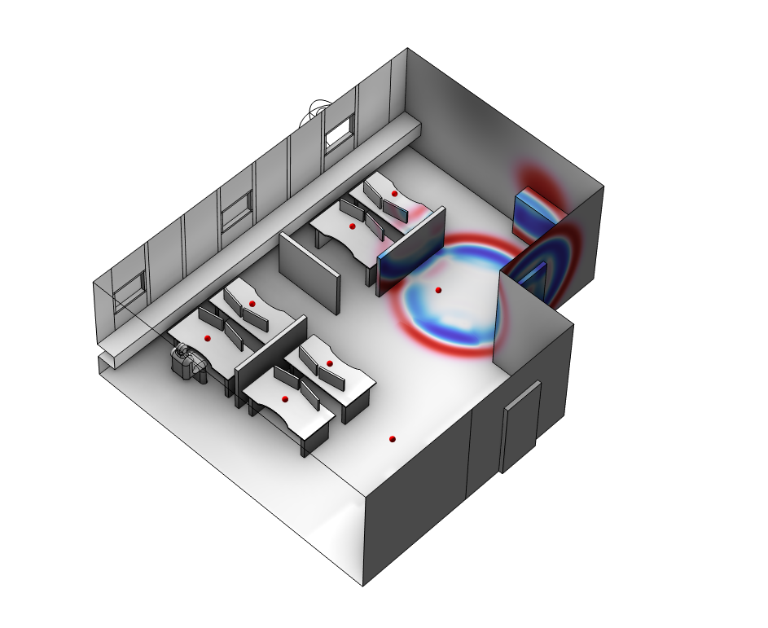
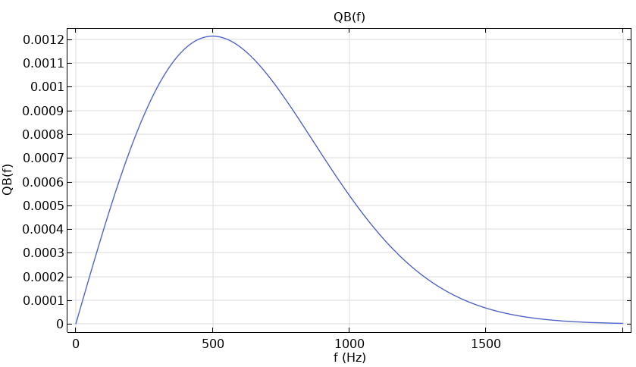
Model Setup
Source location using initial Gaussian pressure distribution.
Source frequency content:
Microphone points

Slide 5
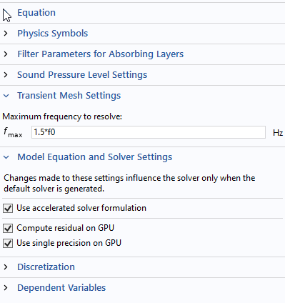
Model Solved on GPU
The model solves for 43⋅10⁶ DOFs. In study 1 it solves for 20 periods (0.027 s) at the 500 Hz signal center frequency, while in study 2 it solves for 0.4 s to generate data for the impulse response.
In study 1 the data is stored on all boundaries, while in study 2, it is only stored on selected receiver positions and the data is output 30 times per period.
As an example, study 2 solves in 3 h 22 min on two GPUs (NVIDIA® RTX-A6000 Ada). This particular card has 48 GB of memory. Note that the model requires about 46 GB of RAM, while it only takes up about 12 GB of the GPU memory.
The model is solved using single precision (the default) on the GPUs.
①
①
Settings for the accelerated solver as seem at the physics interface level.
NVIDIA is a trademark and/or registered trademark of NVIDIA Corporation in the U.S. and/or other countries.

Slide 6
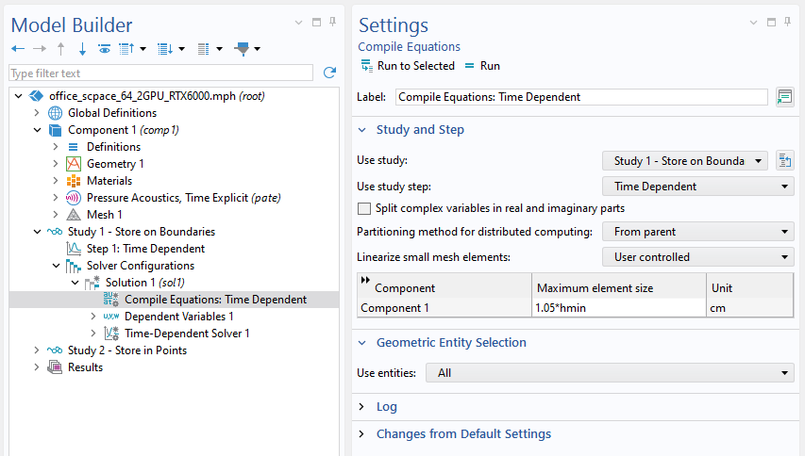
Importance of Mesh
In a time explicit model the smallest mesh element in the model dictates the time stepping. Hence, it is important to optimize the mesh.
Visualize the mesh element that controls the time stepping using the Results Template of the Cell Wave Time Scale
Linearize small mesh elements that are not important for the acoustics for teh given wavelength.
①
①
Linearize small mesh elements smaller than 1/10 of the wavelength. This will loosen the requirement for meshing curved surfaces and avoid too smal elements.

Slide 7
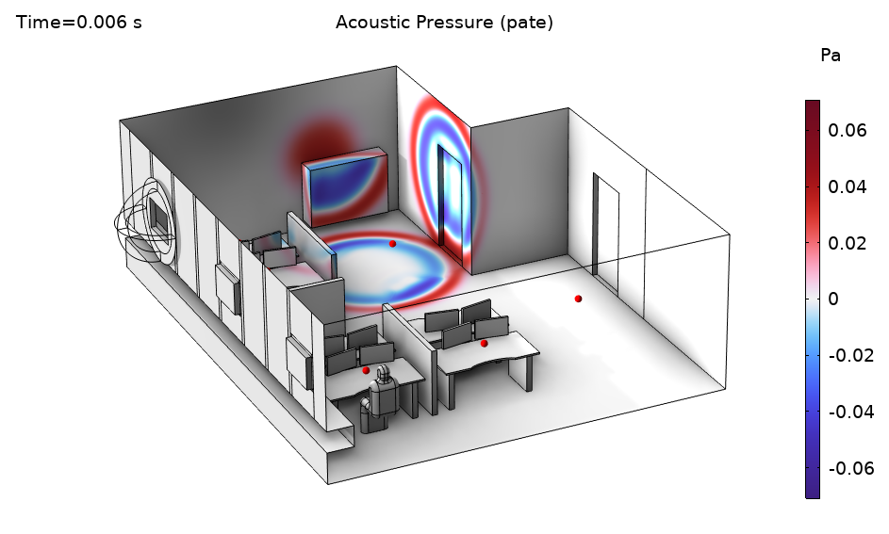
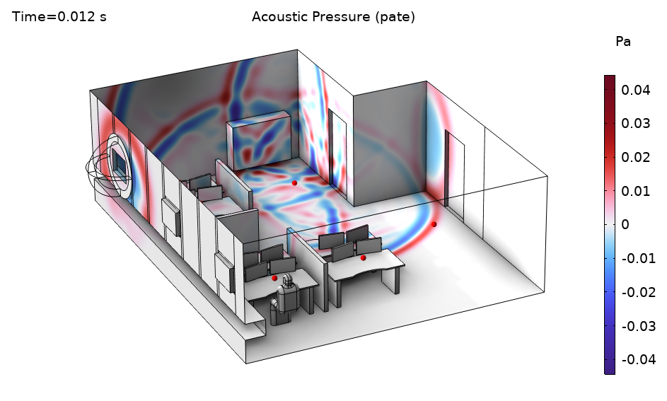
Results

Slide 8
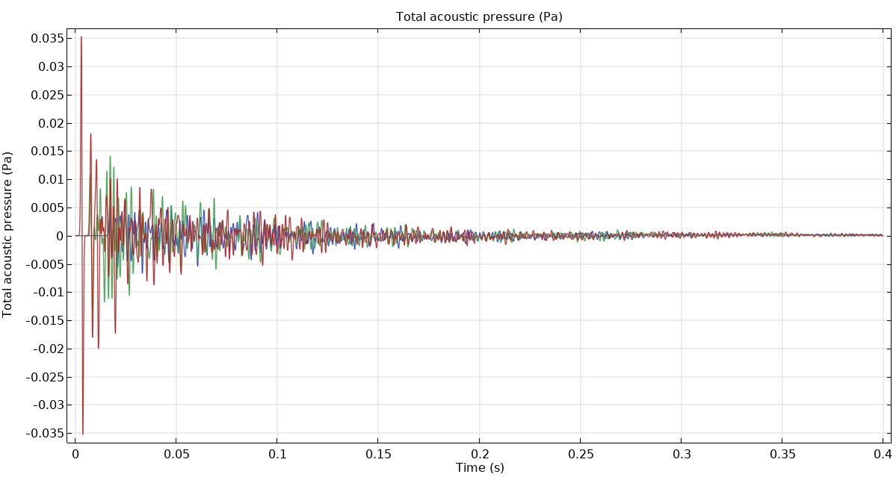
Microphone Response (3 points on the microphone array)

Slide 9
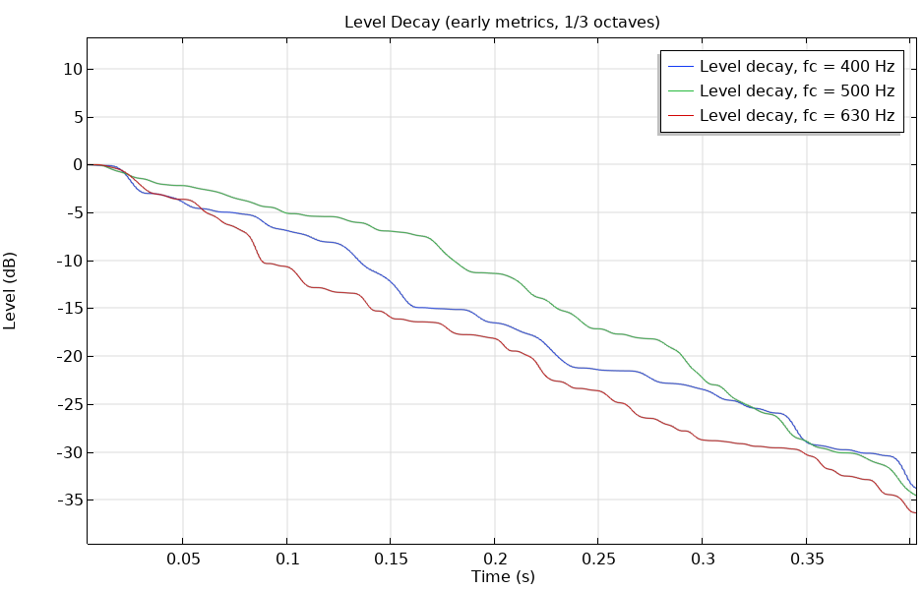
Acoustic Metrics 1/3 Octaves (1 microphone position)
Band center frequency (Hz) | D (%) | C50 (dB) | C80 (dB) | EDT (s) | T20 (s)
400 | 66.0 | 2.9 | 3.4 | 0.73 | 0.72
500 | 46.2 | -0.7 | 2.5 | 1.0 | 0.67
630 | 69.7 | 3.6 | 9.9 | 0.45 | 0.60
Based on T20 and the room volume (186 m³) the Schroeder frequency for the room is about 100 Hz.

