Slide 1
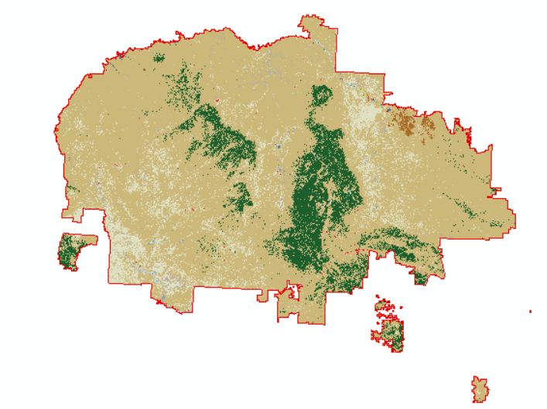
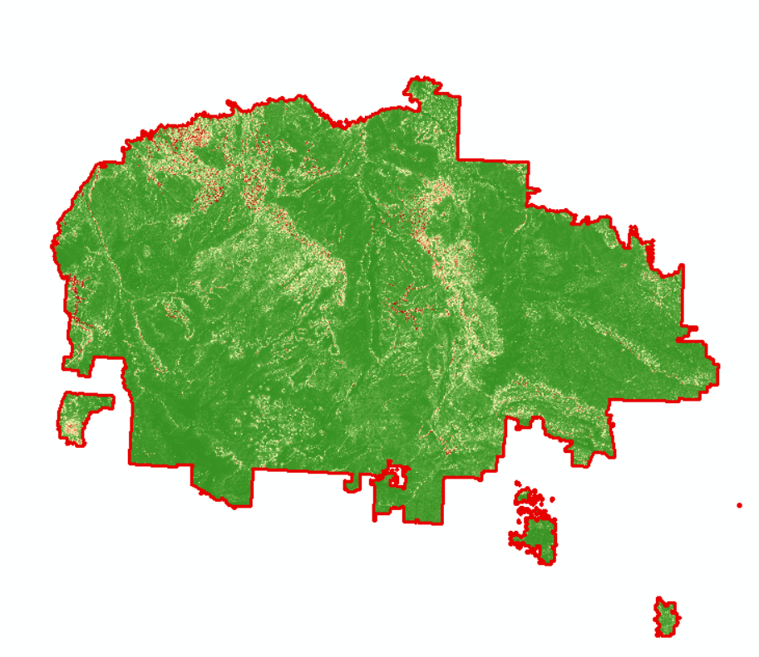
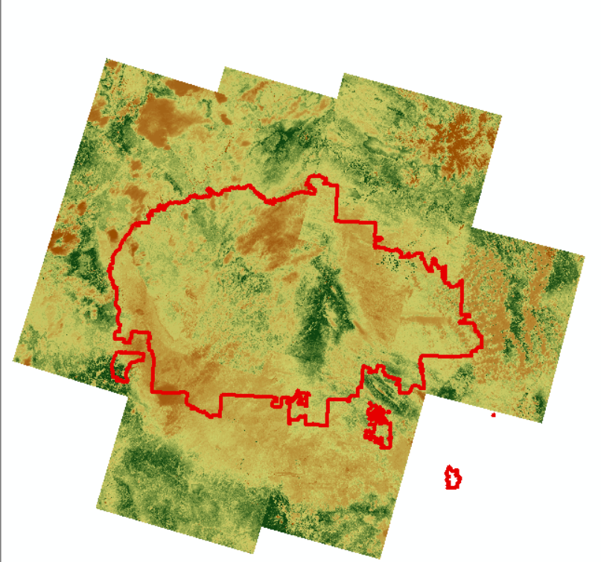
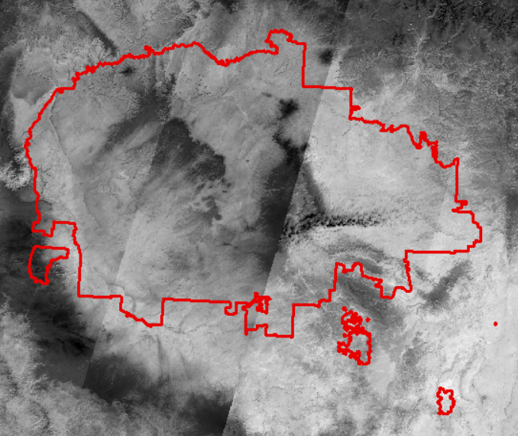

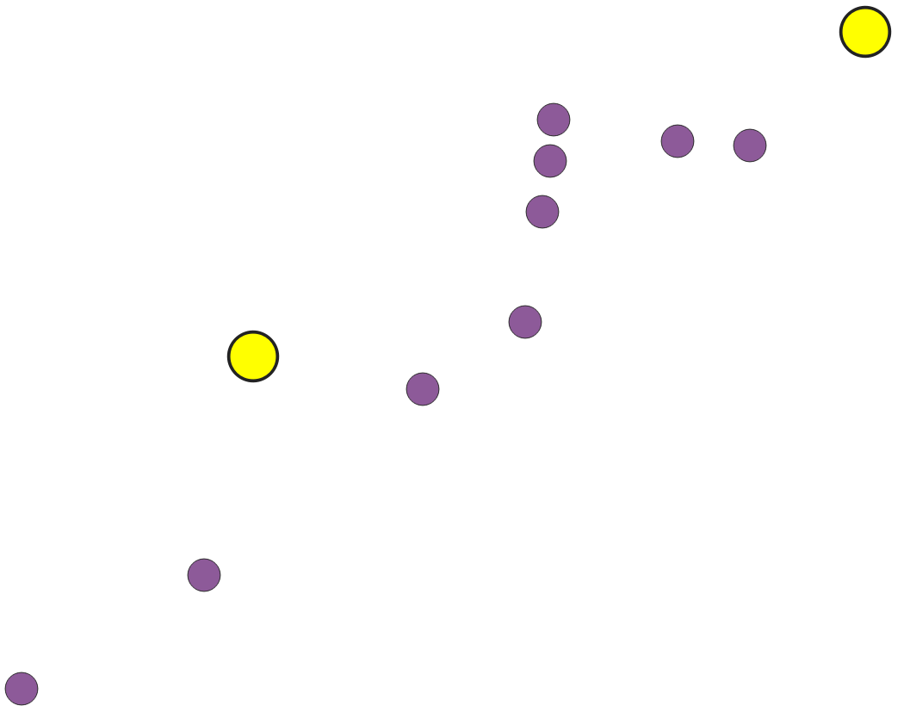
n dogs
Data 1
CWT
…
Dog 1
Data 2
…
…
Collect GPS
Data m-1
Data m
Calculate cumulative
environmental factors
Environmental
Data
…
Location of individual
every 15 mins
$$y = w_{1}x_{1} + w_{2}x_{2} + … +w_{m}x_{m} + ε$$
Regression
…
Cleaned data

Slide 2
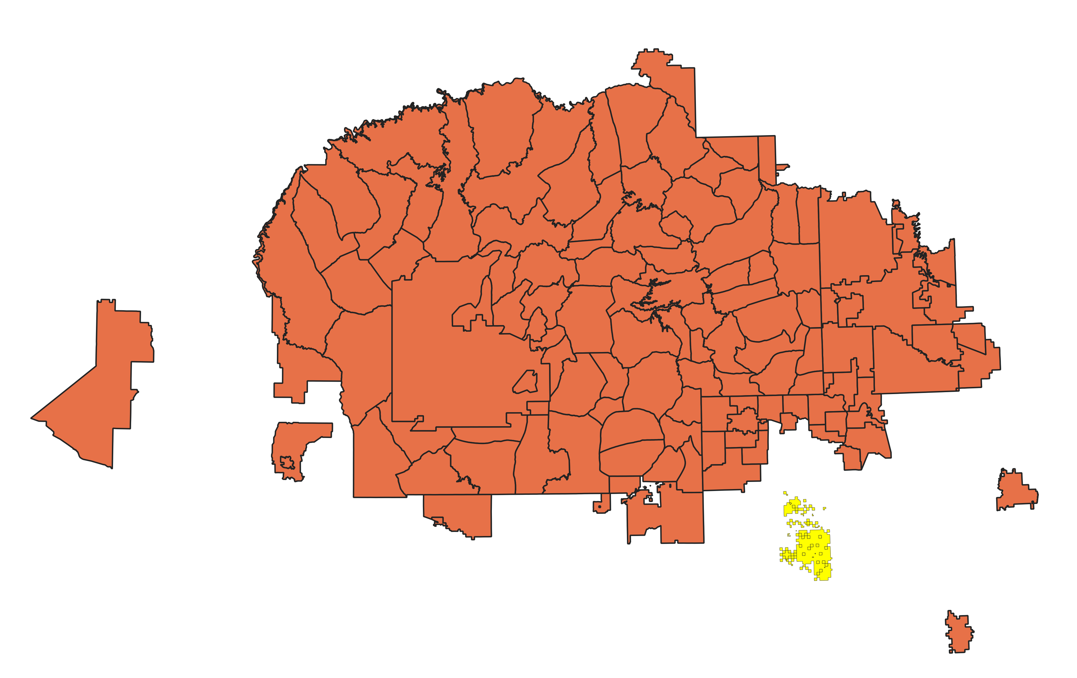
Ramah

Slide 3
GMT Time | Lat | Lon | Alt (meter) | Duration (second) | Temp (°C) | Satellites
6/24/2021 4:42:12 PM | 0 | 0 | 0 | 2 | 24.5 | 0
6/24/2021 5:01:10 PM | 0 | 0 | 0 | 70 | 29.5 | 0
6/24/2021 5:20:27 PM | 35.09 | -106.61 | 1556.9 | 41 | 27 | 5
6/24/2021 5:40:28 PM | 35.09 | -106.61 | 1542.0 | 27 | 25.5 | 5
Invalid GPS: Alt (Altitude) < 800 or Duration = 70 or Satellites (satellite number) < 4

Slide 4
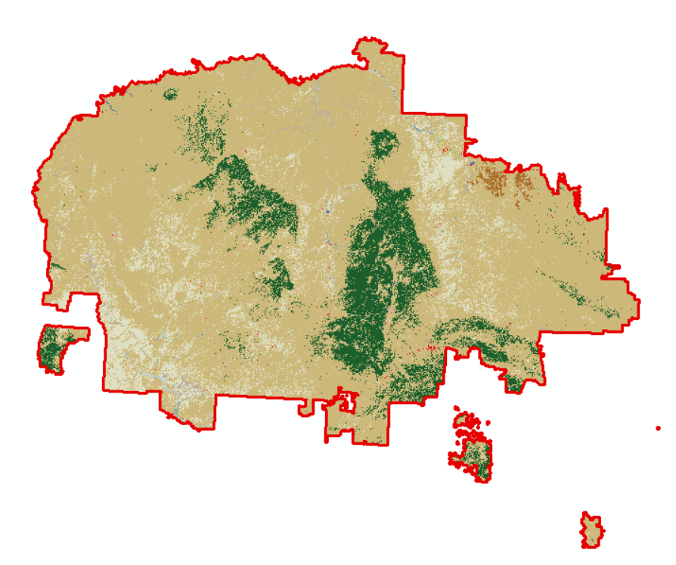
(T₄,R₄)
Time (T)
(T₂,R₂)
(T₃,R₃)
R₁
Location (Y)
(T₁,R₂)
Location (X)

Slide 5
Time | Temperature (‘F) | Precipitation
Day 1 | 77 | 3.759
Day 2 | 78 | 1.329
……
Day n | 72 | 1.352

