Slide 1

Procedure of using GPS to estimate
environmental exposure
 | A case study of estimating individual dog’s exposure to ticks in Ramah, Navajo Nation, AZ

Slide 2
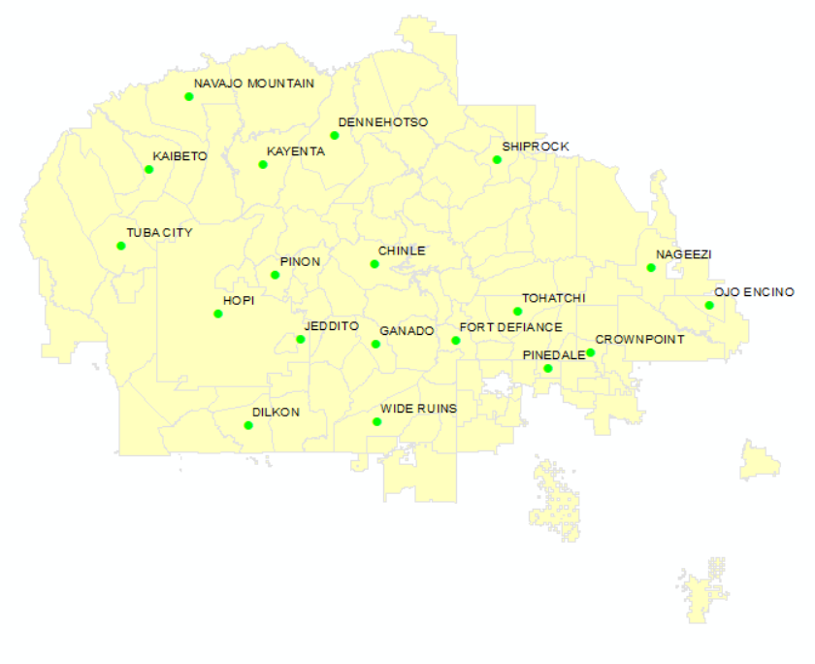
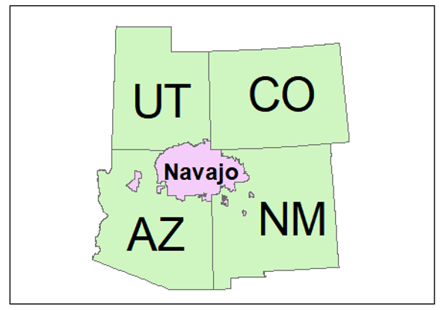
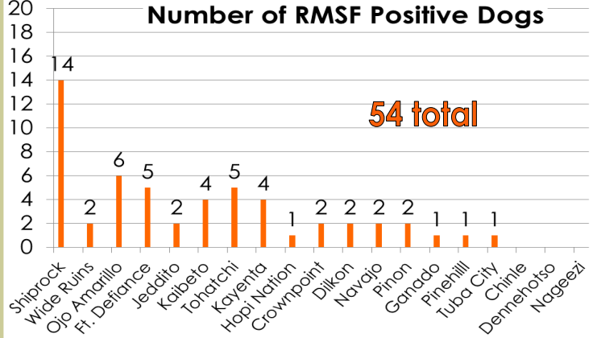
Foreign Animal Disease Task Force went to 19 communities to provide dog & cat vaccination shots. Tested 337 dogs and found 54 were positive for RMSF
Background
Notes:
Our study is located in Navajo Nation, which in the intersection of 4 states UT, CO, AZ and NM.
There is a team – FAD, send a task force group…..
And most of the RMSF positive dogs were found in the community Shiprock.
But beyond those listed communities, Ramah, which is located here, also care about their dogs’ health

Slide 3
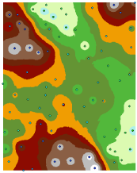
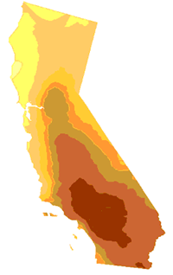
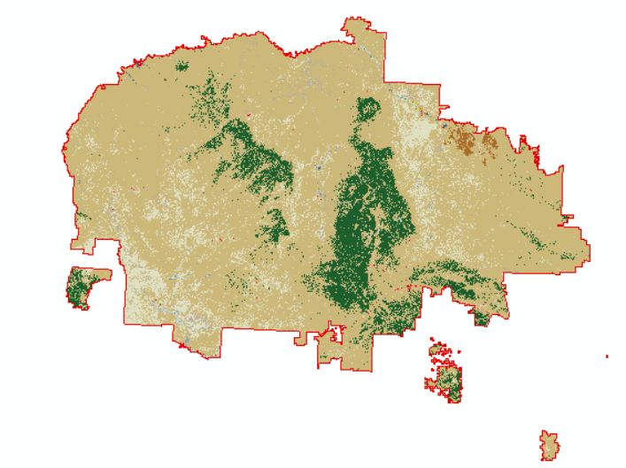
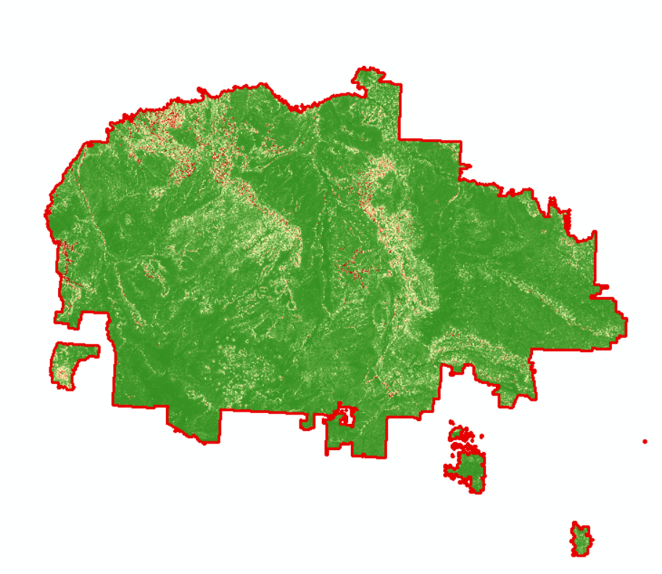

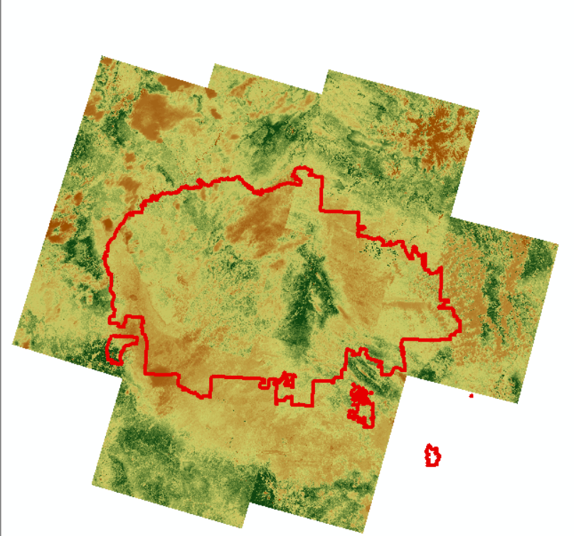

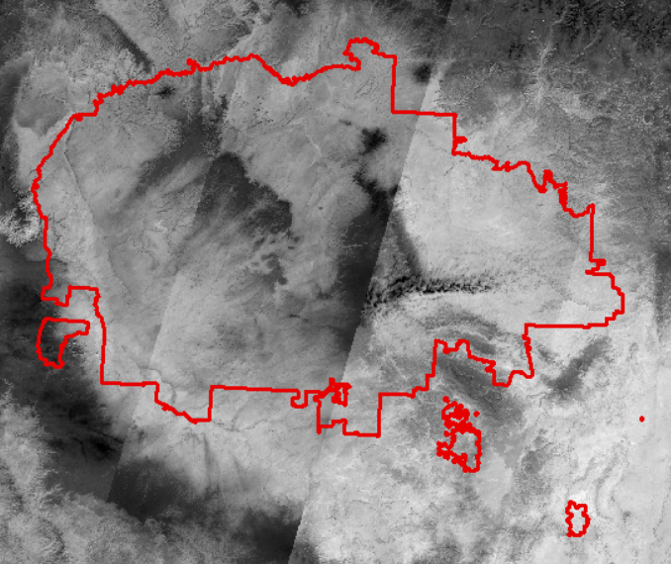

Interpolation
GIS-based multi-criteria model
Background
Notes:
However, all those methods are analyzing the exposure only in the spatial. They are methods to produce a risk map determining the risk value of each place.
We want to move one step ahead, We want to analyze the individual level of environmental exposure.
And find out which envriromental feature is the major factor.
In out study’s case, we want to find which environmental factor is increasing the possibility for ticks to attack dogs.

Slide 4
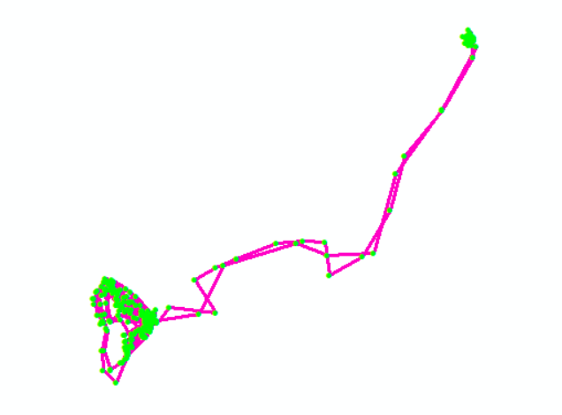
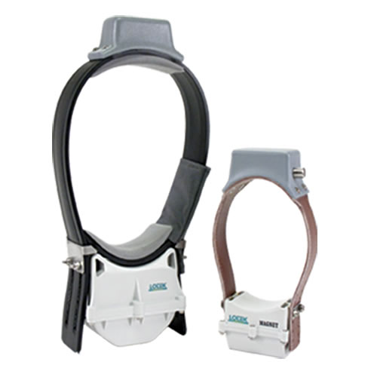
Which environment factors increase the possibility of
dogs getting exposed to ticks?
Research Question
Lotek
2-month period

Slide 5
Which environment factors increase the possibility of
dogs getting exposed to ticks?
Ticks #1
Week 1
Methodology
Ticks #2
Week 2
……
……
Ticks #8
Week 8
2-month period

Slide 6
Which environment factors increase the possibility of
dogs getting exposed to ticks?
$$y: 8 \left(week 1 – week 8\right)× 4 \left(dogs\right)=32$$
Methodology

Slide 7
Which environment factors increase the possibility of
dogs getting exposed to ticks?
X:
x1: Normalized Difference Vegetation Index, NDVI (raster: numeric)
x2: temperature (time series: numeric)
x3: wind index (raster: numeric)
x4: precipitation (time series: numeric)
x5: landscape (raster: category)
x6: travel distance (numeric)
$$y: 8 \left(week 1 – week 8\right)× 4 \left(dogs\right)=32$$
Methodology
Notes:
Catagorical
Ticks → health → body temperature
Test: temperature, house

Slide 8
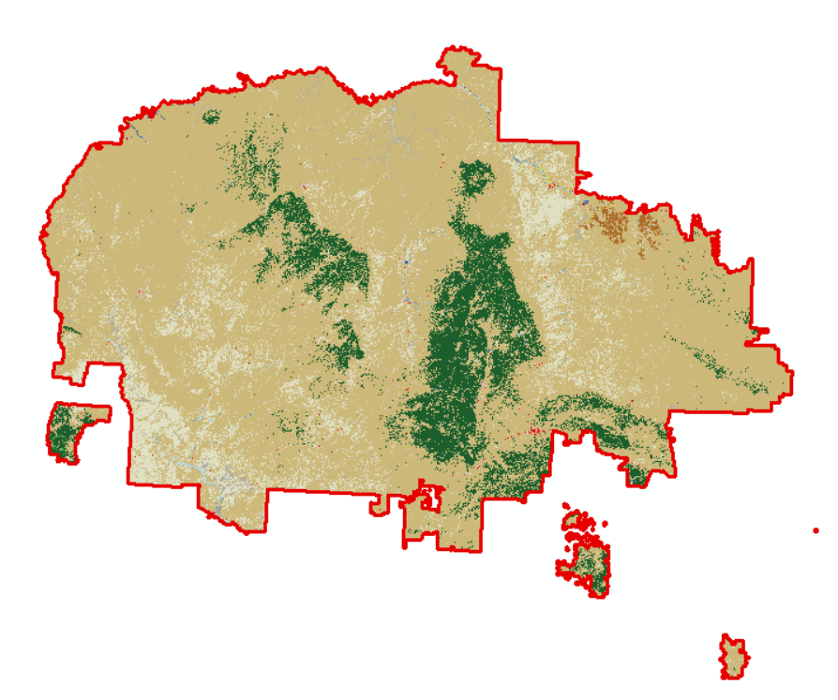


Which environment factors increase the possibility of
dogs getting exposed to ticks?
Raster:
R₁
R₂
R₃
$$E1=R1+R2+R3$$
Methodology
(T₄,R₄)
$$E2=R1+\left(T2−T1\right)∗R2+\left(T4−T3\right)∗R3$$
Time (T)
(T₂,R₂)
(T₃,R₃)
$$E2>E1$$
R₁
Location (Y)
(T₁,R₂)
Location (X)

Slide 9
Which environment factors increase the possibility of
dogs getting exposed to ticks?
Time series:
Time | Temperature (‘F) | Precipitation
Day 1 | 77 | 3.759
Day 2 | 78 | 1.329
……
Day n | 72 | 1.352
Methodology

Slide 10
Which environment factors increase the possibility of
dogs getting exposed to ticks?
Time series:
GMT Time | Lat | Lon | Precip | Temp (°C) | Day
6/24/2019 4:42:12 PM | 0 | 0 | 3.759 | 24.5 | Day 1
6/24/2019 5:01:10 PM | 0 | 0 | 3.759 | 24.5 | Day 1
…… |  |  | ……
6/24/2019 5:40:28 PM | 35.09127 | -106.617 | 1.352 | 25.5 | Day n
Methodology

Slide 11
Which environment factors increase the possibility of
dogs getting exposed to ticks?
Raster and Time series:
Methodology
Variable type | Compared pairs
Raster | Any Dog Any time
Time series | Different time

Slide 12
Which environment factors increase the possibility of
dogs getting exposed to ticks?
Environment data 1
Environment data 2
Collect data
with GPS device
Calculate cumulative
environmental factors
……
Workflow
Location of
individual
every 15 mins
Environment data n
Regression
Data
preprocessing
Data only with
valid records
$$y = w_{1}x_{1} + w_{2}x_{2} + … +w_{n}x_{n} + ε$$

Slide 13
Data and Methods
GMT Time | Lat | Lon | Alt (meter) | Duration (second) | Temp (°C) | DOP | Satellites
6/24/2019 4:42:12 PM | 0 | 0 | 0 | 2 | 24.5 | 0 | 0
6/24/2019 5:01:10 PM | 0 | 0 | 0 | 70 | 29.5 | 0 | 0
6/24/2019 5:20:27 PM | 35.09131 | -106.617 | 1556.96 | 41 | 27 | 1.6 | 5
6/24/2019 5:40:28 PM | 35.09127 | -106.617 | 1542.07 | 27 | 25.5 | 1.6 | 5
Notes:
Here is a sample dataset of the GPS data of one goat.
It contains Greenwich mean time, coordinates, elevation, temperatures, the duration of connecting to a satellite, and the DOP (dilution of precision), and the number of connected satellites.
In theory, at least 4 satellites are needed to estimate the 3D position. Thus, GPS data with 3 or fewer satellites number are considered invalid. Because the lowest elevation of Cove is over 1000 meters, GPS data with altitude below 1000 meters are also considered invalid.

Slide 14
Data simulation strategy:
GPS
Tick counts
Data

Slide 15
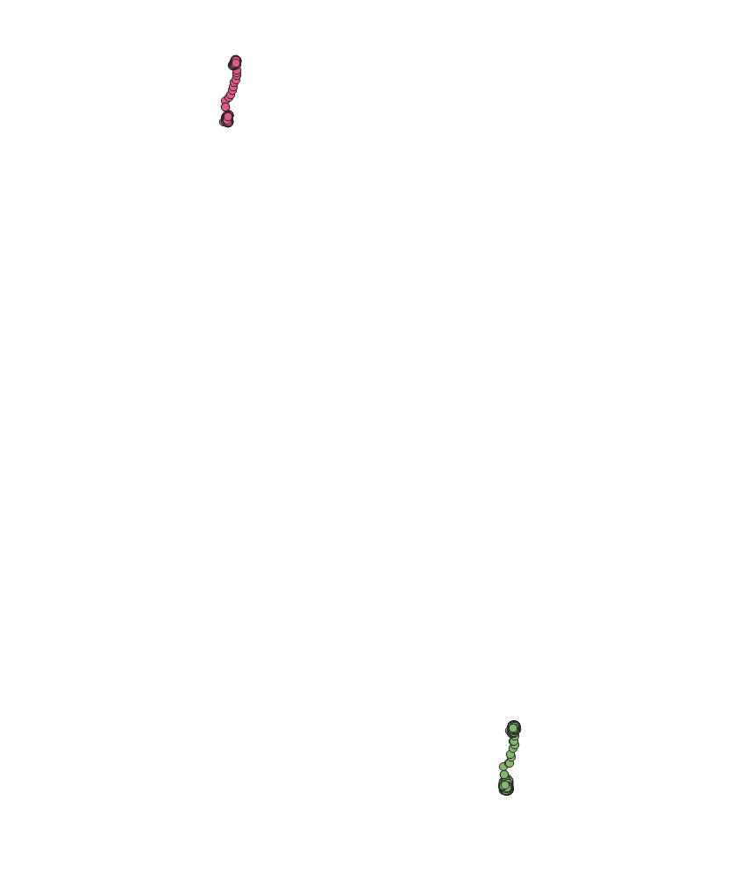
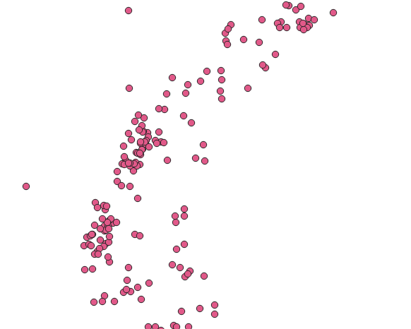
GPS
Data
Notes:
0.0001 degree

Slide 16
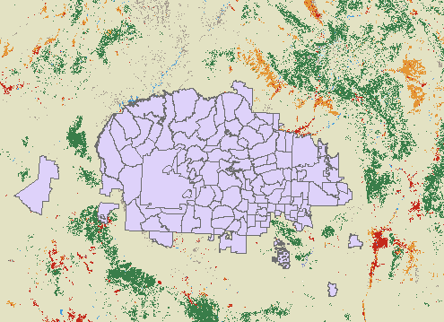
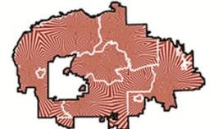
Raster
Land Use\Land Cover
Wind Index
NDVI
Data

Slide 17
Time series
Date | Precipitation
1-Oct-21 | 3.759
2-Oct-21 | 1.329
3-Oct-21 | 0
4-Oct-21 | 1.352
5-Oct-21 | 7.154
6-Oct-21 | 0
Date | Temperature (‘K)
1-Oct-21 | 274.718
2-Oct-21 | 274.16
3-Oct-21 | 276.696
4-Oct-21 | 277.094
5-Oct-21 | 280.424
6-Oct-21 | 277.892
Data

Slide 18
GPS related variables (has a raster map):
GPS no-related variables (not having a raster map):
Method

Slide 19
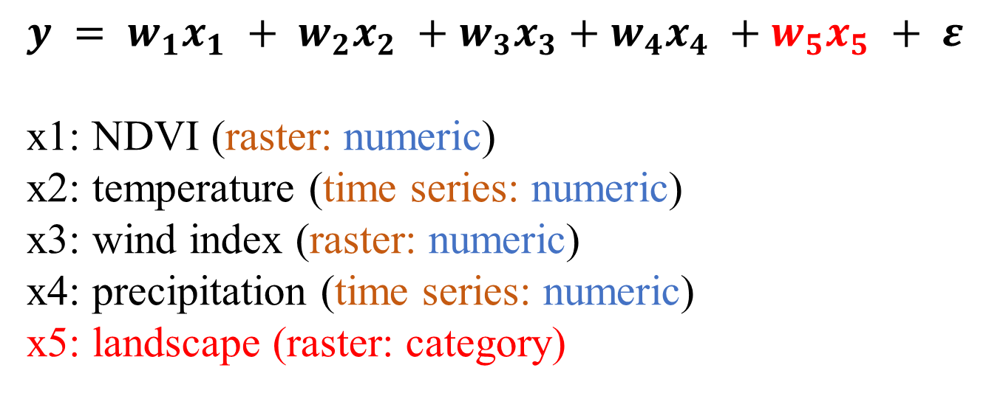
$$y = w_{1}x_{1} + w_{2}x_{2} +w_{3}x_{3}+w_{4}x_{4} +w_{5}x_{5} + ε$$
x1: NDVI (raster: numeric)
x2: temperature (time series: numeric)
x3: wind index (raster: numeric)
x4: precipitation (time series: numeric)
x5: landscape (raster: category)
Experiment

Slide 20
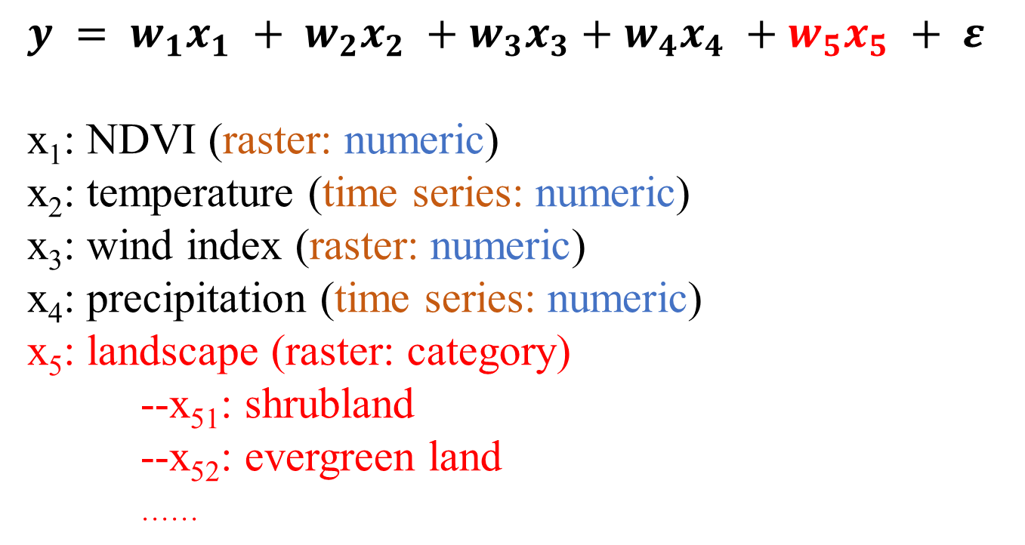
$$y = w_{1}x_{1} + w_{2}x_{2} +w_{3}x_{3}+w_{4}x_{4} +w_{5}x_{5} + ε$$
x₁: NDVI (raster: numeric)
x₂: temperature (time series: numeric)
x₃: wind index (raster: numeric)
x₄: precipitation (time series: numeric)
x₅: landscape (raster: category)
--x₅₁: shrubland
--x₅₂: evergreen land
……
Experiment
$$y = w_{1}x_{1} + w_{2}x_{2} +w_{3}x_{3}+w_{4}x_{4} +w_{51}x_{51}+w_{52}x_{52}+… + ε$$

Slide 21
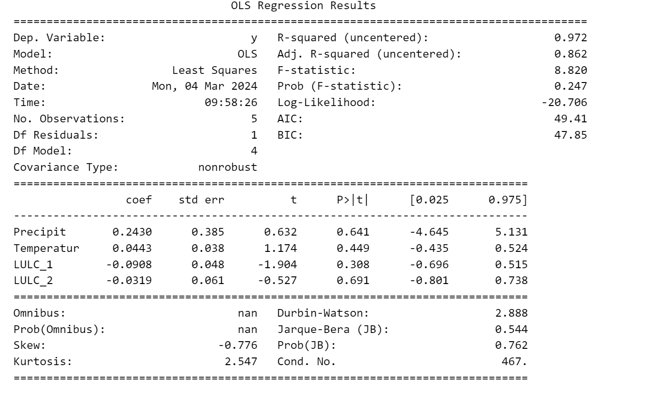
Experiment

Slide 22
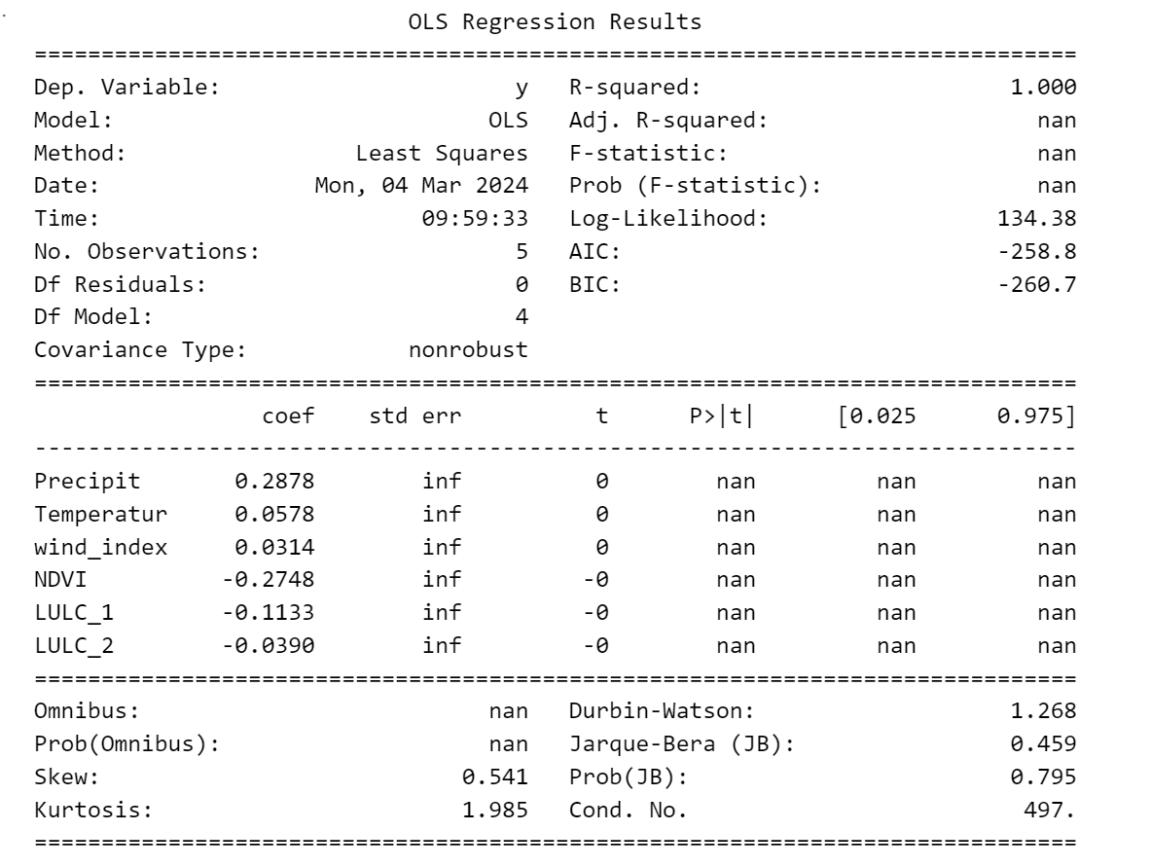
Experiment

Slide 23
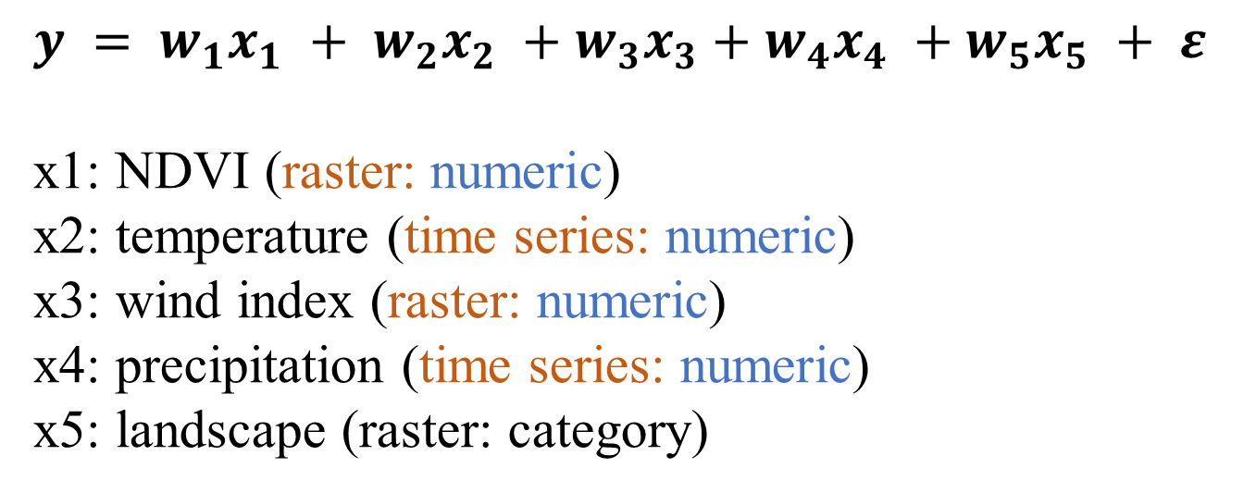
$$y = w_{1}x_{1} + w_{2}x_{2} +w_{3}x_{3}+w_{4}x_{4} +w_{5}x_{5} + ε$$
x1: NDVI (raster: numeric)
x2: temperature (time series: numeric)
x3: wind index (raster: numeric)
x4: precipitation (time series: numeric)
x5: landscape (raster: category)
Future Work
Notes:
Other models, and more potential related variables.

Slide 24
y = a1x1 + a2x2 + ... + anxn + c
Risk map
y = x
Future Plan

