Slide 1
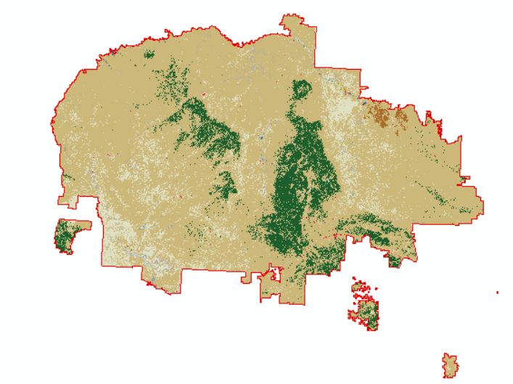
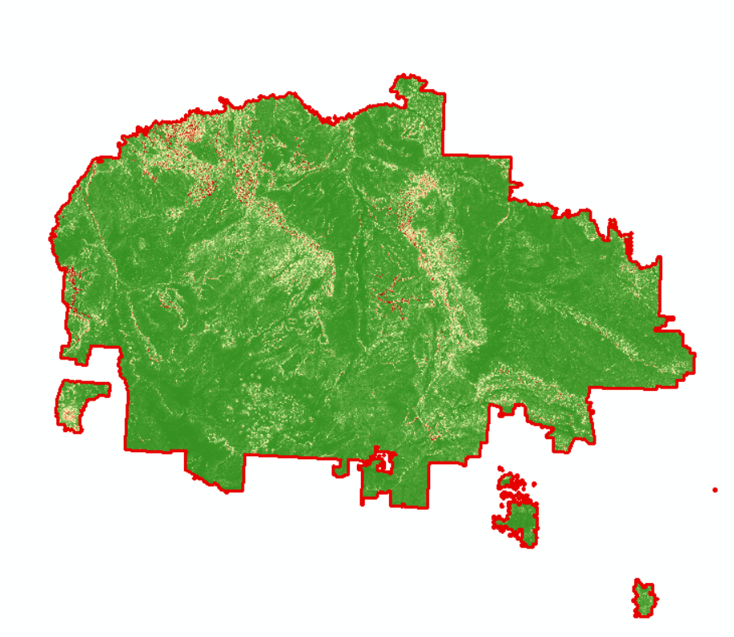
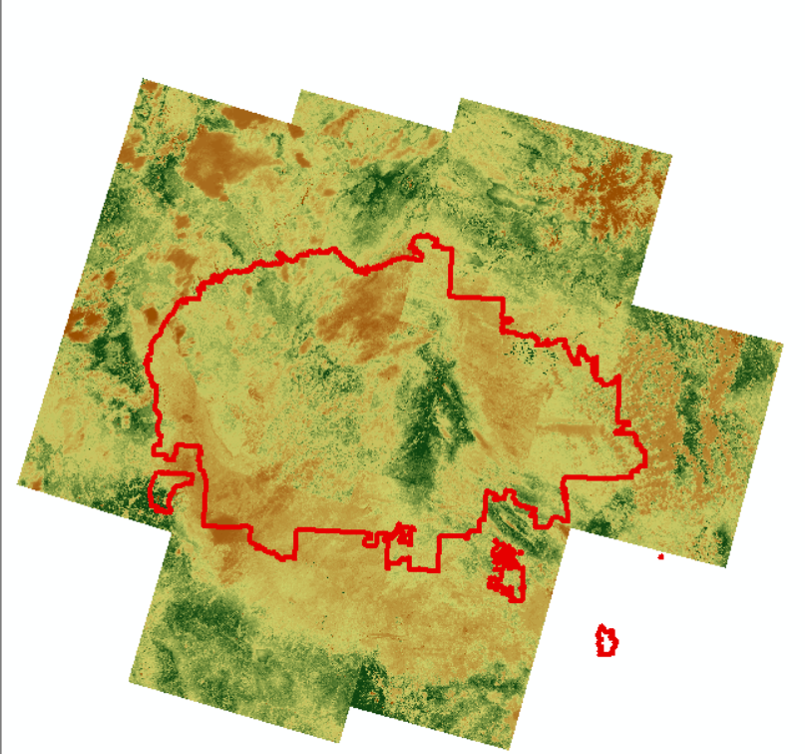
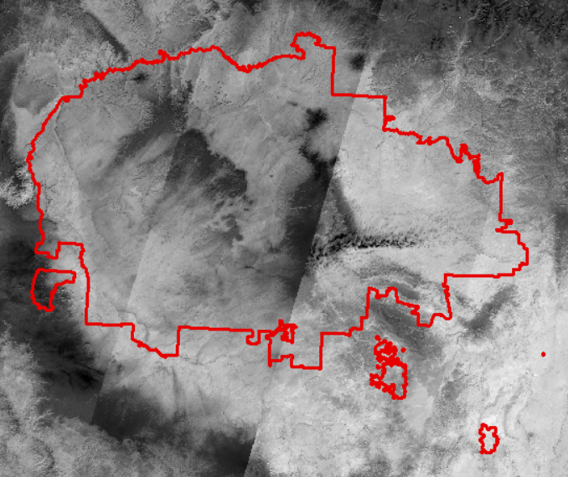

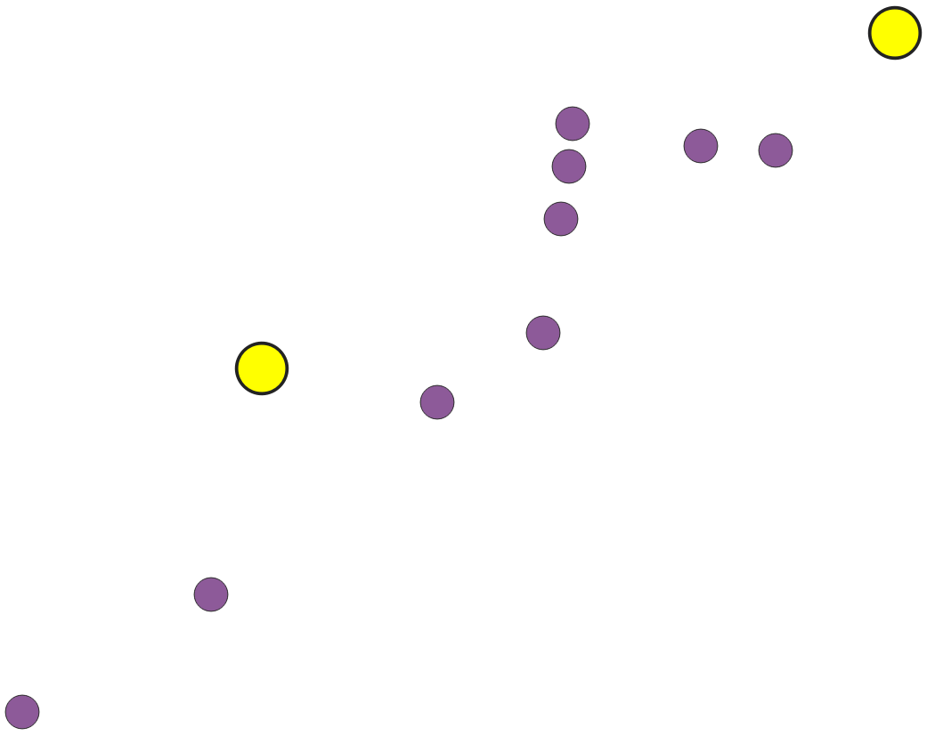
n dogs
Data 1
CWT
…
Dog 1
Data 2
…
…
Collect GPS
Data m-1
Data m
Calculate cumulative
environmental factors
Environmental
Data
…
Location of individual
every 15 mins
$$y = w_{1}x_{1} + w_{2}x_{2} + … +w_{m}x_{m} + ε$$
Regression
…
Cleaned data

Slide 2
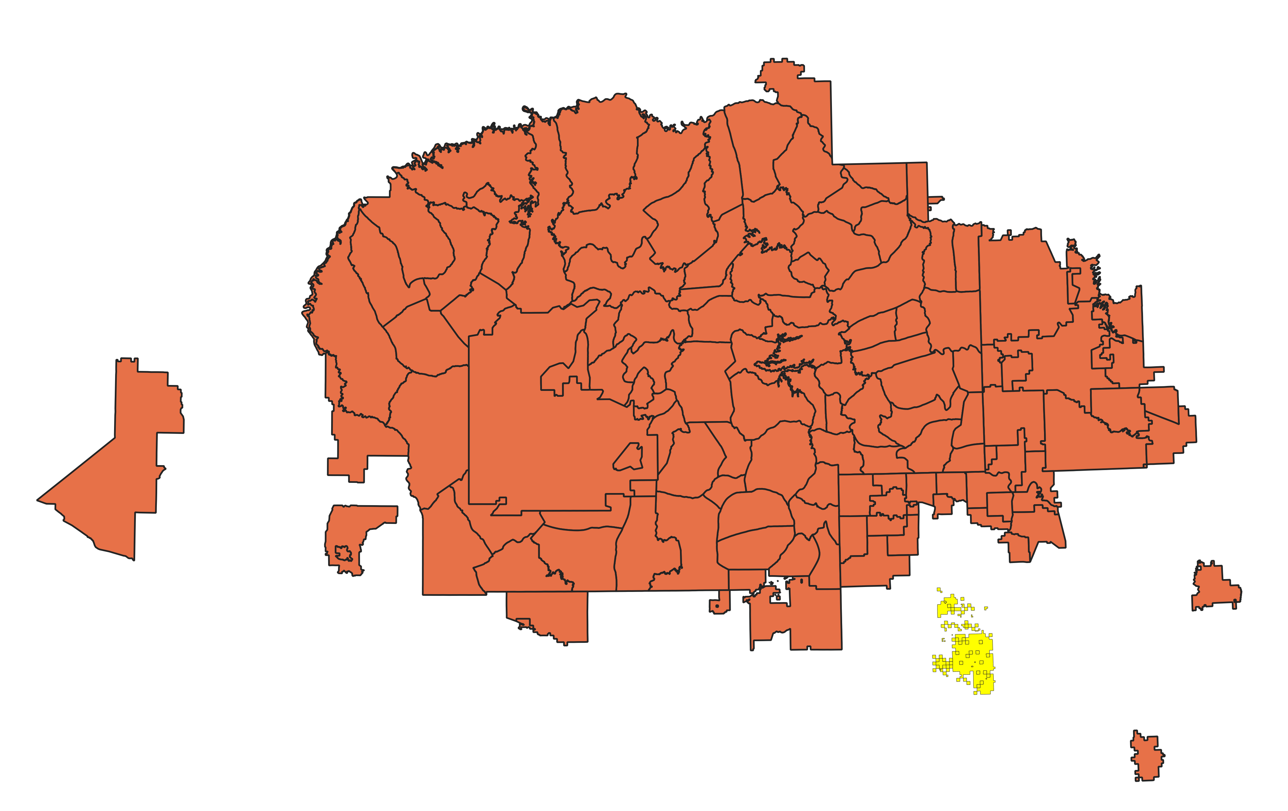
Ramah

