Slide 1

TickBase
 | 3/21/2024

Slide 2
Data simulation strategy:
GPS
Tick counts
Data

Slide 3
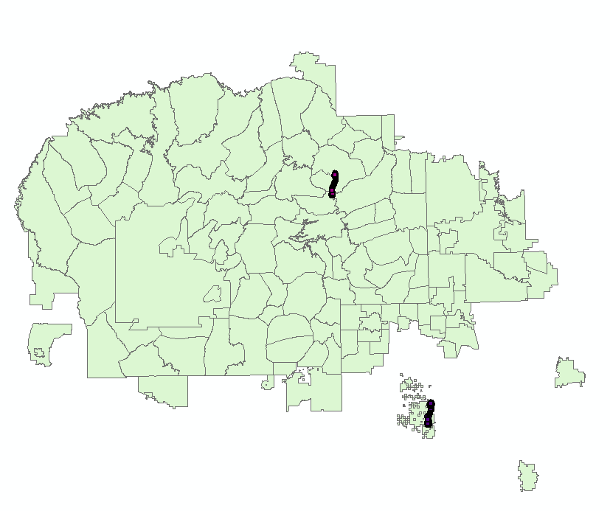
Data

Slide 4
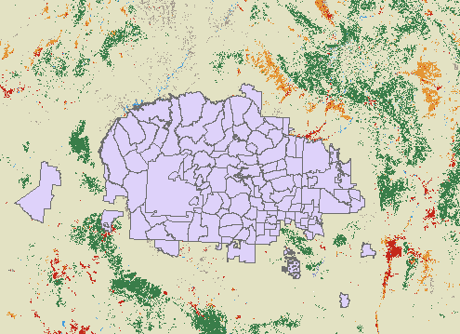
Land Use\Land Cover
Data

Slide 5
Data

Slide 6
Data

Slide 7
Data

Slide 8
Build a model y = a1x1 + a2x2 + ... + anxn + c based on GPS data
Y: [y_ramah_cove, y_ramah_blackMesa, y_..., y_...]
y_ramah_cove: the tick counts of the dog.
(tick counts in day 1 – path in day 1
tick counts in day 2 – path in day 2)
y2, y3, y4
X: [x1, x2, …, xn]
x1: NDVI (numeric) = x1_a + x1_b + …
x2: temperature (numeric)
x3: wind index (numeric)
x4: precipitation (numeric)
x5: landscape (Category)
x6: home-range (numeric, kernel density, cluster, …)
e.g. x1 = 0.5, x2 = 70, x3 = 0.6, x4 = 100, x5 = ‘evergreen forest’ = 1, 2
x5 = ‘bare land’ = 2, 5
x1 + x2 + x3 + x4 = + x5
Regression research
Method
Notes:
Catagorical
Ticks → health → body temperature
Test: temperature, house

Slide 9
Build a model y = a1x1 + a2x2 + ... + anxn + c based on GPS data
Y: [y_ramah_cove, y_ramah_blackMesa, y_..., y_...]
y_ramah_cove: the tick counts of the dog.
(tick counts in day 1 – path in day 1
tick counts in day 2 – path in day 2)
y2, y3, y4
X: [x1, x2, …, xn]
y ~ x1: NDVI (numeric) = x1_a + x1_b + …
y ~ x2: temperature (numeric)
y ~ x3: wind index (numeric)
y ~ x4: precipitation (numeric)
y ~ x5: LULC (Category) (residential/non-residential)
y ~ x6: home-range (numeric) ?
e.g. x1 = 0.5, x2 = 70, x3 = 0.6, x4 = 100, x5 = ‘evergreen forest’ = 1, 2
x5 = ‘bare land’ = 2, 5
x1 + x2 + x3 + x4 = + x5
Regression research
Method

Slide 10
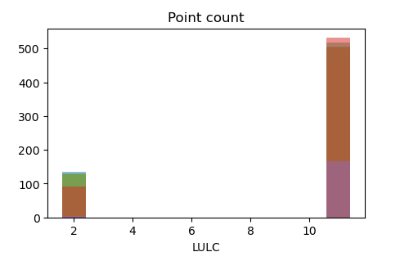
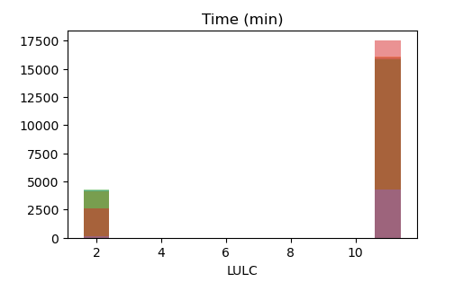
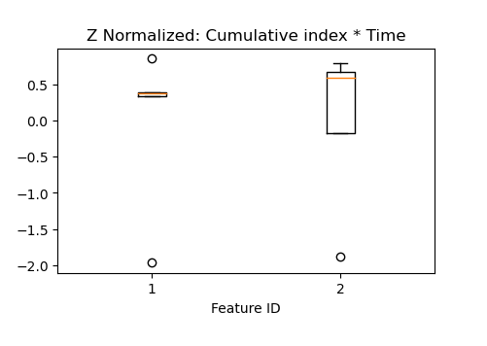
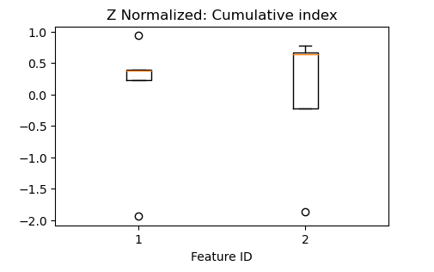
Method

Slide 11
Method

Slide 12
Method

Slide 13
Method

Slide 14
y = a1x1 + a2x2 + ... + anxn + c
Risk map
y = x
Future Plan

