Slide 1

Comparison of 2fac-fuzzy and 4fac-fuzzy
Leo
Date: 5/17/2024
Notes:
Afternoon, this is Leo. And I’m going to present our progress on the land surface temperature collection in NN.

Slide 2
GPS only fuzzy rules
 | Speed: High |  | Speed: Low
Distance: Low | Grazing Resting Travelling | Low Mid High | Grazing Resting Travelling | Low High Low
Distance: High | Grazing Resting Travelling | Mid Low High | Grazing Resting Travelling | High Mid Mid
Methodology
Notes:
And here is the rules for GPS only- fuzzy logic.

Slide 3
GPS & ODBA fuzzy rules
 | Speed | High |  |  |  |  |  | Low
 | ODBA | High |  |  | Low |  |  | High |  |  | Low
 | Std | High | Mid | Low | High | Mid | Low | High | Mid | Low | High | Mid | Low
Grazing Resting Travelling | Status: Inactive | Low Low High | Mid Low Mid | Low Low Mid | Low Mid High | Mid Mid High | Low High Mid | Low Mid Low | Mid Mid Low | Low High Low | Mid Mid Low | Mid High Low | Low High Low
Grazing Resting Travelling | Status: Active | Mid Low High | High Low Mid | Low Low Mid | Low Low High | Mid Low Mid | Low Low Mid | Mid Mid Mid | High Mid Mid | Mid High Low | Mid Mid Mid | Mid Mid Low | Mid High Low
Methodology

Slide 4
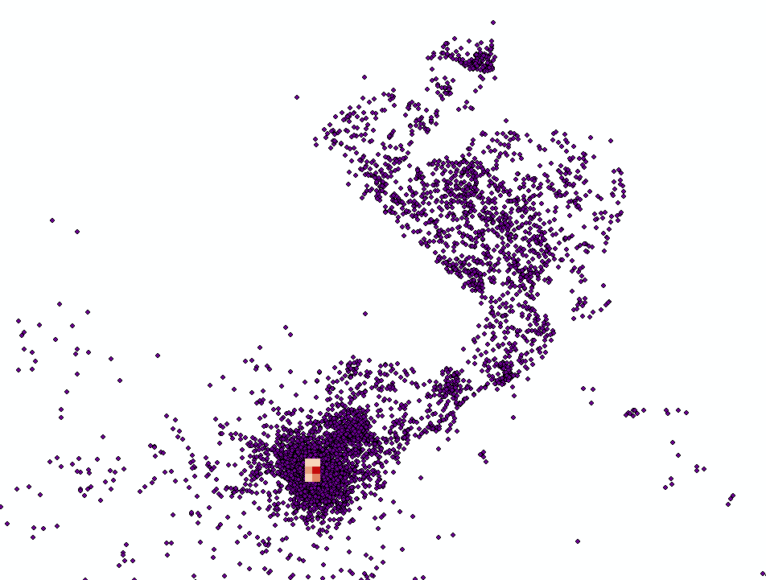
GPS & ODBA fuzzy rules
Methodology

Slide 5
GPS & ODBA fuzzy rules
 | Speed | High |  | Low
 | Std | High | Low | High | Low
Mid-act Low-act High-act | ODBA: High
Mid-act Low-act High-act | ODBA: Low
P.S., Mid-act can contain xxx, low-act can contain xxx, High-act …..
Methodology

Slide 6
GPS & ODBA fuzzy rules
 | Speed | High |  | Low
 | Std | High | Low | High | Low
Mid-act Low-act High-act | ODBA: High
Mid-act Low-act High-act | ODBA: Low |  |  |  | Low High Low
P.S., Mid-act can contain xxx, low-act can contain xxx, High-act …..
Methodology

Slide 7
GPS & ODBA fuzzy rules
 | Speed | High |  | Low
 | Std | High | Low | High | Low
Mid-act Low-act High-act | ODBA: High |  | Low Low High
Mid-act Low-act High-act | ODBA: Low |  |  |  | Low High Low
P.S., Mid-act can contain xxx, low-act can contain xxx, High-act …..
Methodology

Slide 8
GPS & ODBA fuzzy rules
 | Speed | High |  | Low
 | Std | High | Low | High | Low
Mid-act Low-act High-act | ODBA: High | Mid Low High | Low Low High
Mid-act Low-act High-act | ODBA: Low |  |  |  | Low High Low
P.S., Mid-act can contain xxx, low-act can contain xxx, High-act …..
Methodology

Slide 9
GPS & ODBA fuzzy rules
Mean(ODBA): High
Std(ODBA): High
Mean(ODBA): High
Std(ODBA): Low
Mean(ODBA): Low
Std(ODBA): High
Mean(ODBA): Low
Std(ODBA): Low
Methodology
ODBA

Slide 10
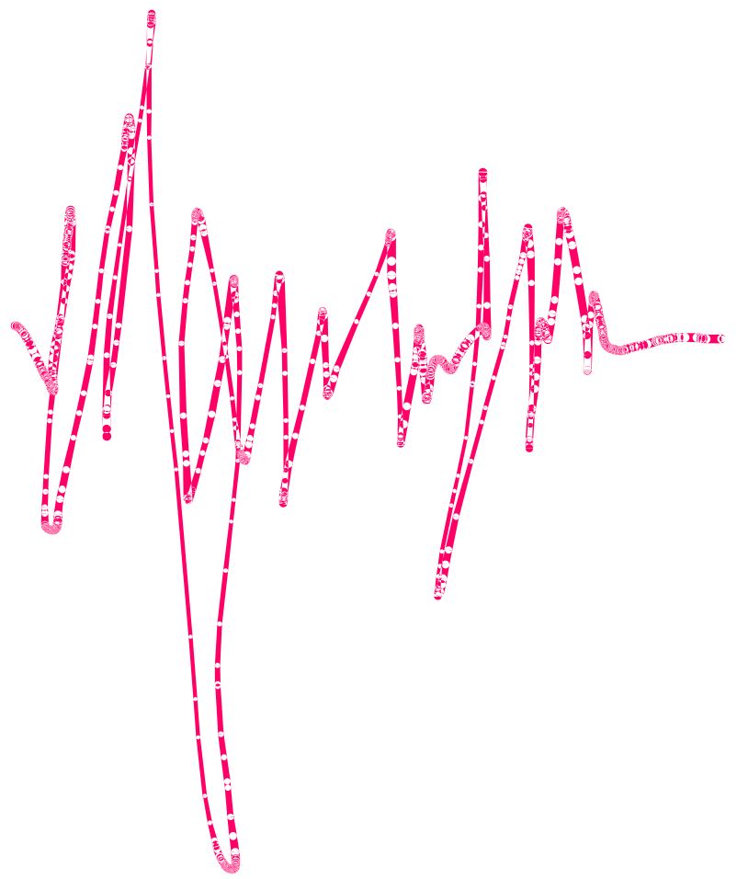
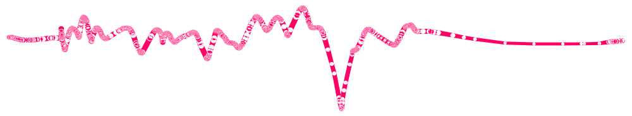

Slide 11
GPS & ODBA fuzzy rules
 | Speed | High |  | Low
 | Std | High | Low | High | Low
Mid-act Low-act High-act | ODBA: High | Mid Low High | Low Low High
Mid-act Low-act High-act | ODBA: Low |  |  |  | Low High Low
Methodology

Slide 12
GPS & ODBA fuzzy rules
 | Speed | High |  | Low
 | Std | High | Low | High | Low
Mid-act Low-act High-act | ODBA: High | Mid Low High | Low Low High
Mid-act Low-act High-act | ODBA: Low |  |  | Mid Mid Low | Low High Low
Methodology

Slide 13
GPS & ODBA fuzzy rules
 | Speed | High |  | Low
 | Std | High | Low | High | Low
Mid-act Low-act High-act | ODBA: High | Mid Low High | Low Low High | High Mid Mid
Mid-act Low-act High-act | ODBA: Low |  |  | Mid Mid Low | Low High Low
Methodology
Notes:
The low-act should be one level down, but considering the speed remains low, it remains to be mid
But the mid-act and high-act gain one level up.

Slide 14
CE = Real Exp + /theta

Slide 15
GPS & ODBA fuzzy rules
 | Speed | High |  | Low
 | Std | High | Low | High | Low
Mid-act Low-act High-act | ODBA: High | Mid Low High | Low Low High | High Mid Mid | Mid Low Mid
Mid-act Low-act High-act | ODBA: Low |  |  | Mid Mid Low | Low High Low
Methodology
Notes:
The high-act should gain one level up, but the speed remains to be low, so it is still low.
Both mid and low-act gain one level down.

Slide 16
GPS & ODBA fuzzy rules
 | Speed | High |  | Low
 | Std | High | Low | High | Low
Mid-act Low-act High-act | ODBA: High | Mid Low High | Low Low High | High Mid Mid | Mid Low Mid
Mid-act Low-act High-act | ODBA: Low |  | Mid Low High | Mid Mid Low | Low High Low
Methodology
Notes:
…..
And when we compare these 2 columns, it also make sense

Slide 17
CE = Real Exp + /theta

Slide 18
GPS & ODBA fuzzy rules
 | Speed | High |  | Low
 | Std | High | Low | High | Low
Mid-act Low-act High-act | ODBA: High | Mid Low High | Low Low High | High Mid Mid | Mid Low Mid
Mid-act Low-act High-act | ODBA: Low | Mid Low Mid | Mid Low High | Mid Mid Low | Low High Low
Methodology
Notes:
The resting should grow one level up, but considering the speed is high, it remains to low

Slide 19
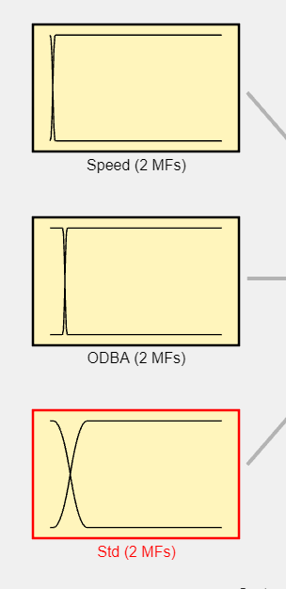
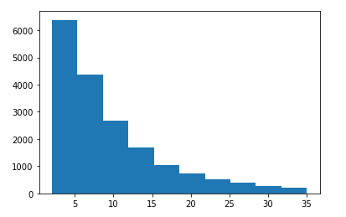
GPS & ODBA fuzzy rules
Low: 0.3
Mid: 0.6
High: 1.0
[2.035, 35.021] → 80%
Methodology

Slide 20
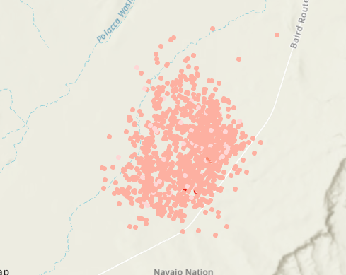
Low activity
Fuzzy results

Slide 21
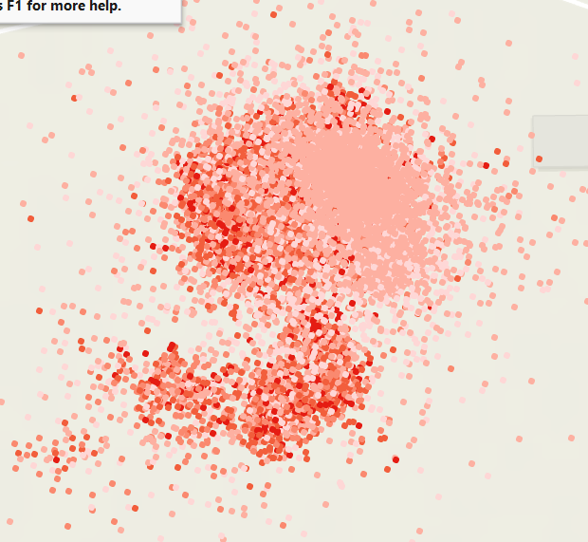
Low activity
Fuzzy results

Slide 22
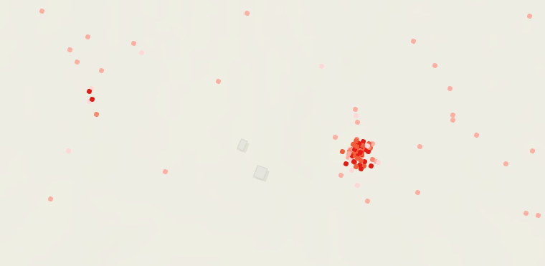
Low activity
Fuzzy results

Slide 23
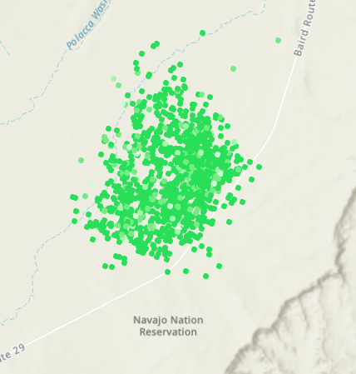
Mid activity
Fuzzy results

Slide 24
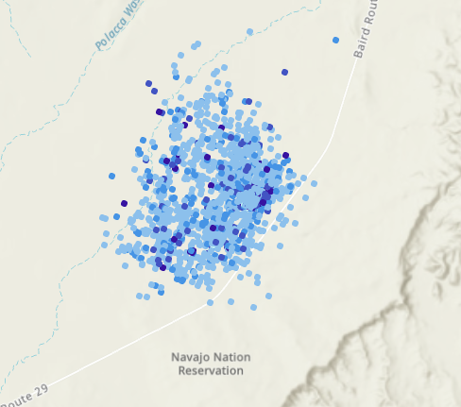
High activity
Fuzzy results

Slide 25
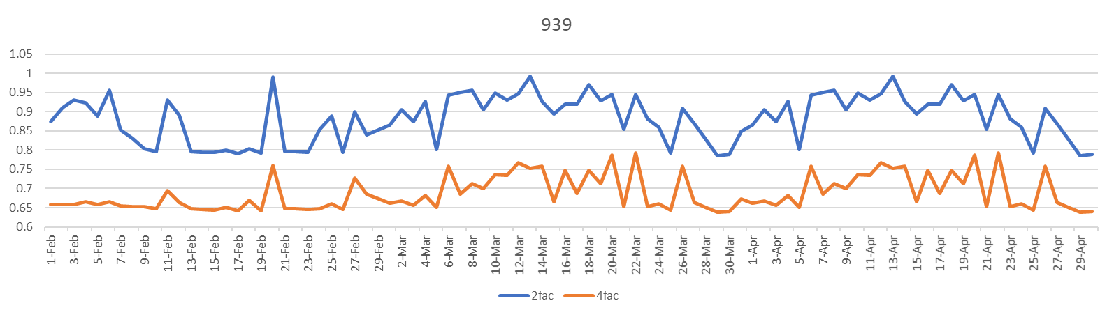
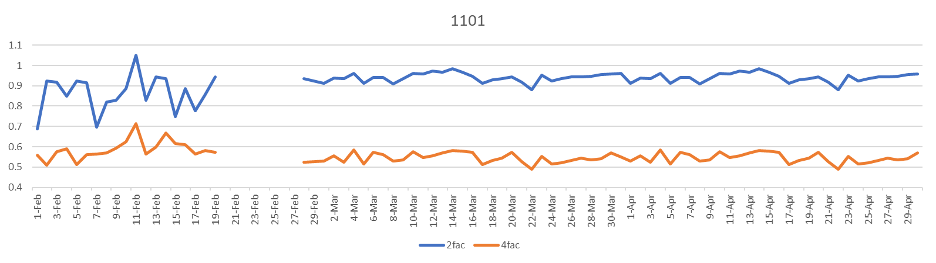
Cumulative Expo

Slide 26
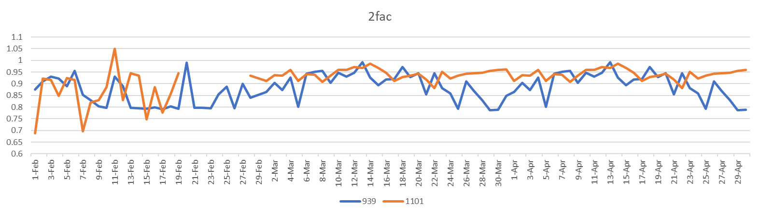
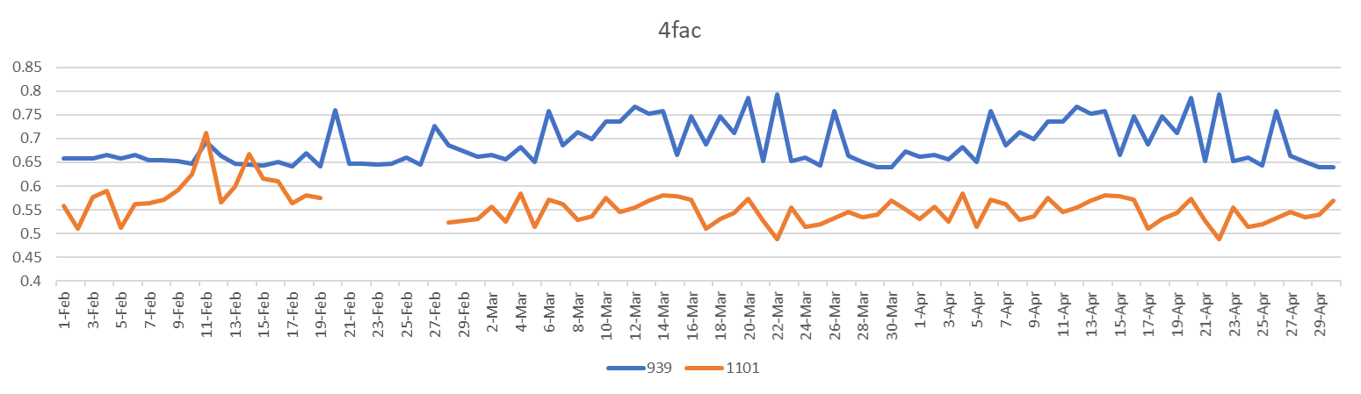
Cumulative Expo

Slide 27
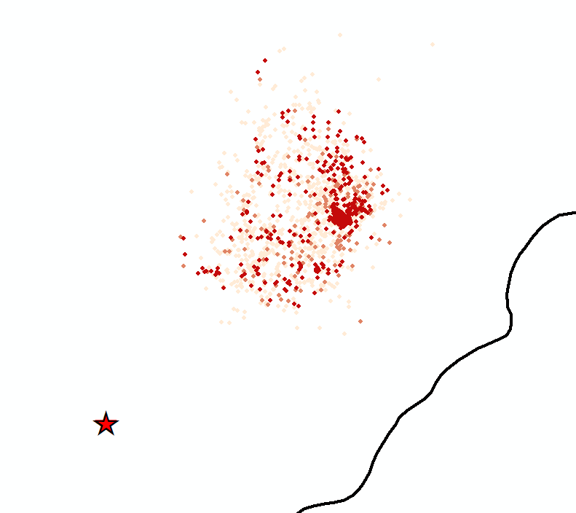
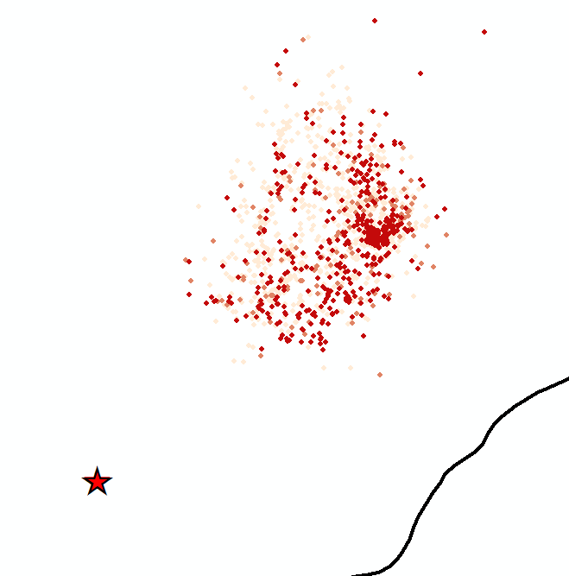
939 Resting
2fac
4fac
Possibility Map

Slide 28
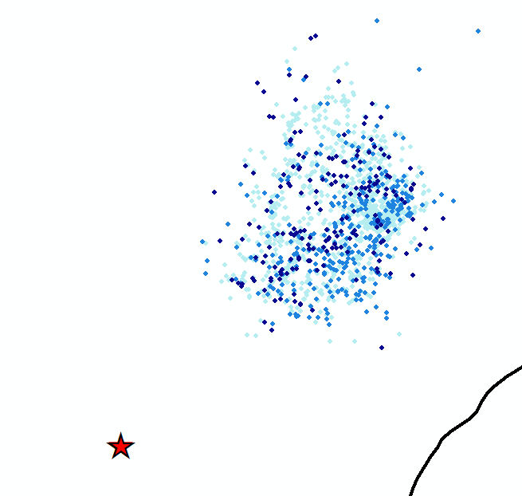
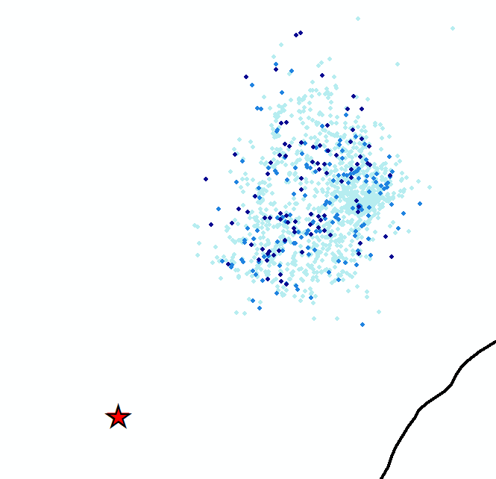
939 Traveling
2fac
4fac
Possibility Map

Slide 29
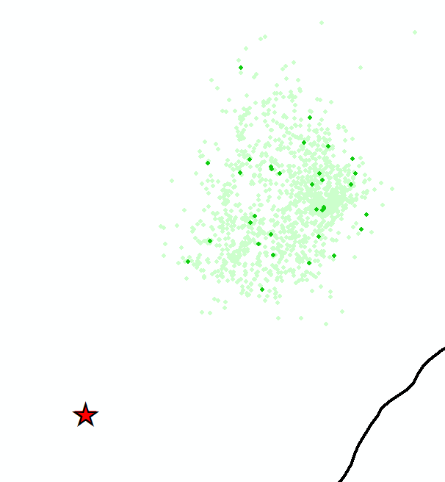
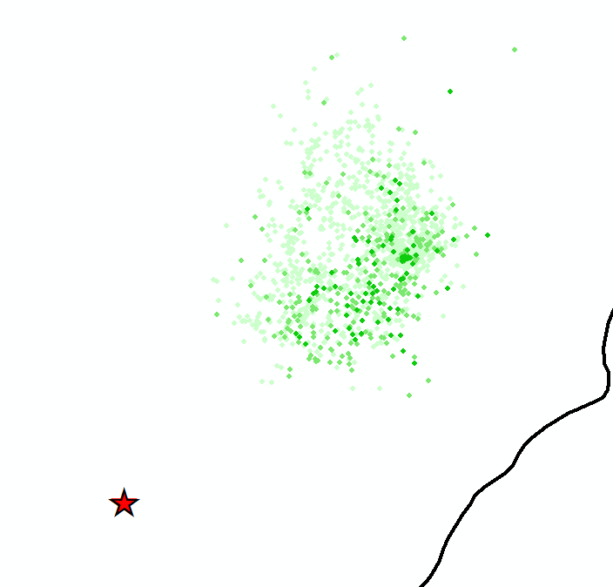
939 Grazing
2fac
4fac
Possibility Map

Slide 30
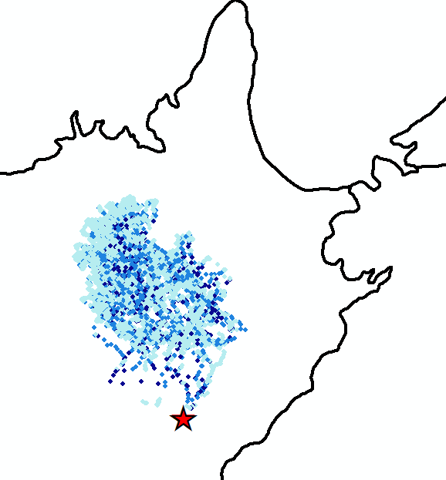
1101 Traveling
Possibility Map

Slide 31
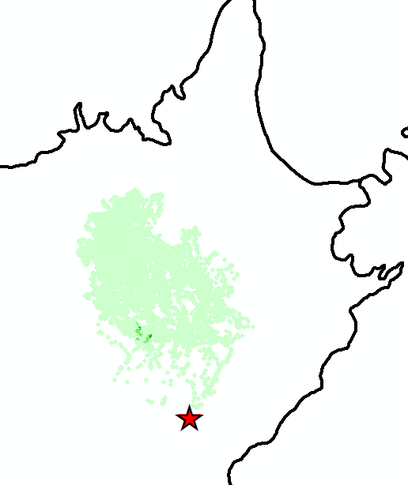
1101 Grazing
Possibility Map

Slide 32
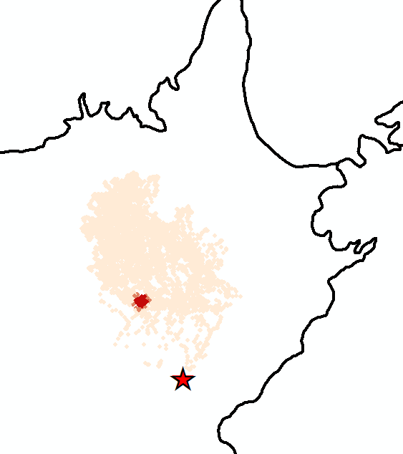
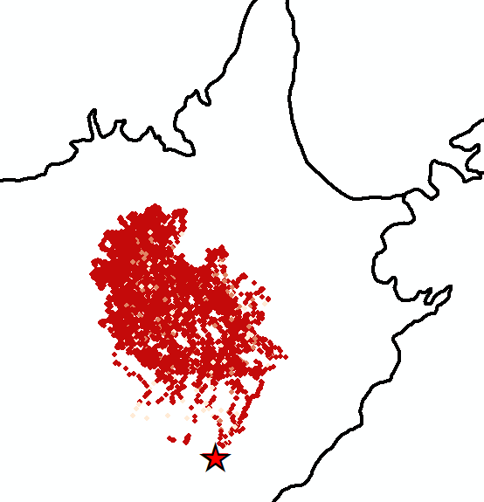
1101 Resting
Possibility Map

Slide 33
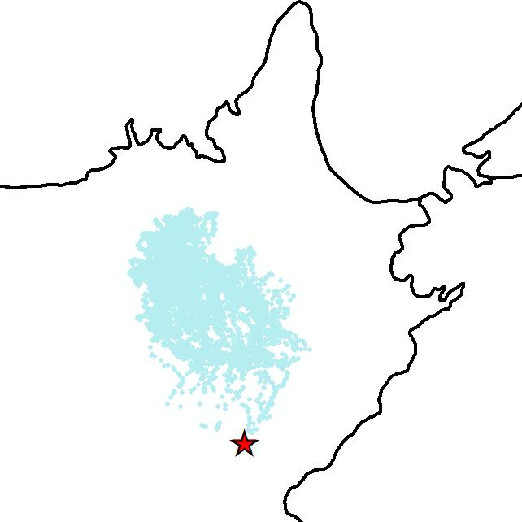
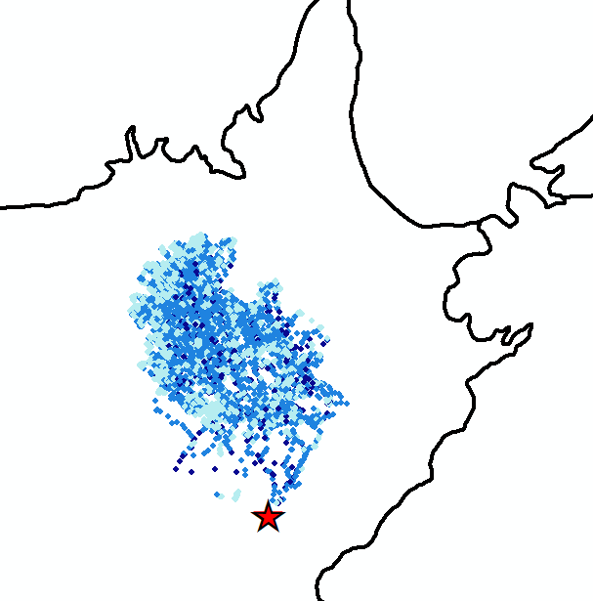
1101 Traveling
Possibility Map

Slide 34
1101 Traveling
Possibility Map

Slide 35
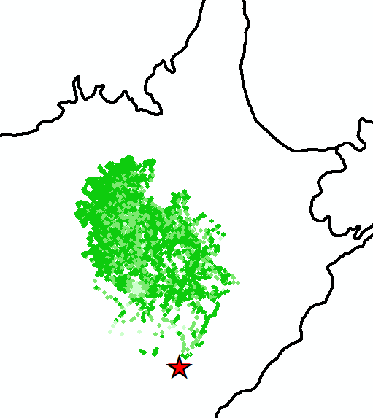
1101 Grazing
Possibility Map

Slide 36
1101 Grazing
Possibility Map

Slide 37
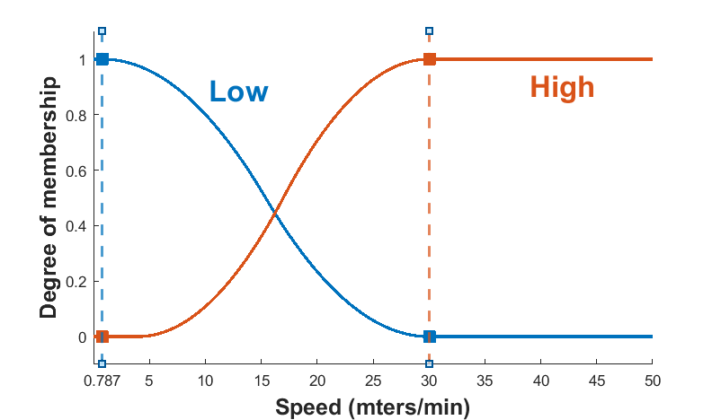
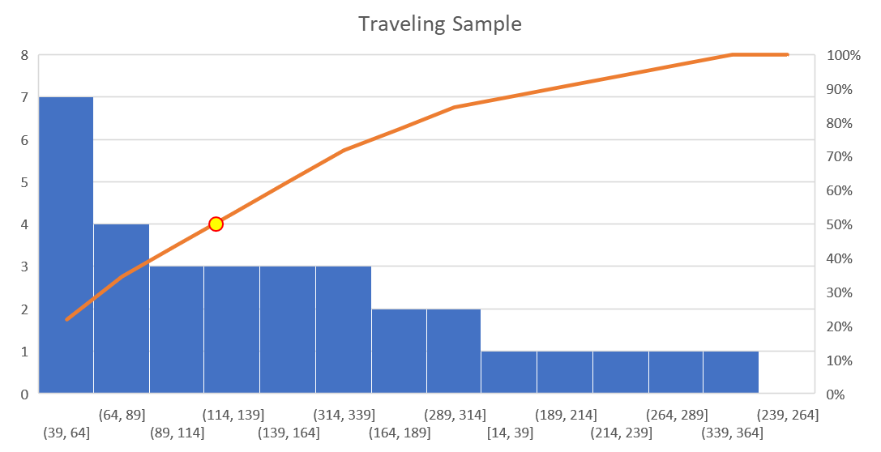
Data and Methods
0.787 meters/min
82.58 meters
Fuzzy Membership

Slide 38
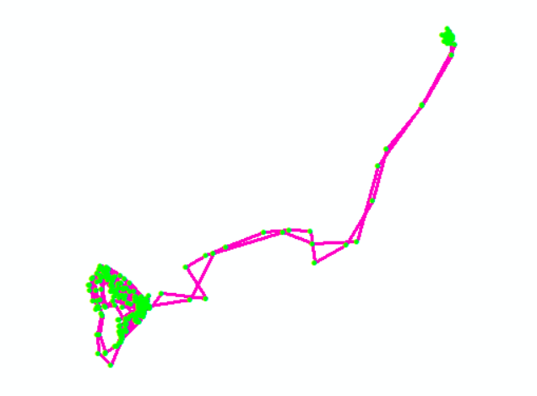
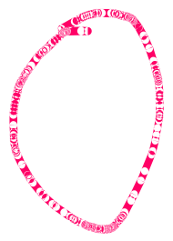
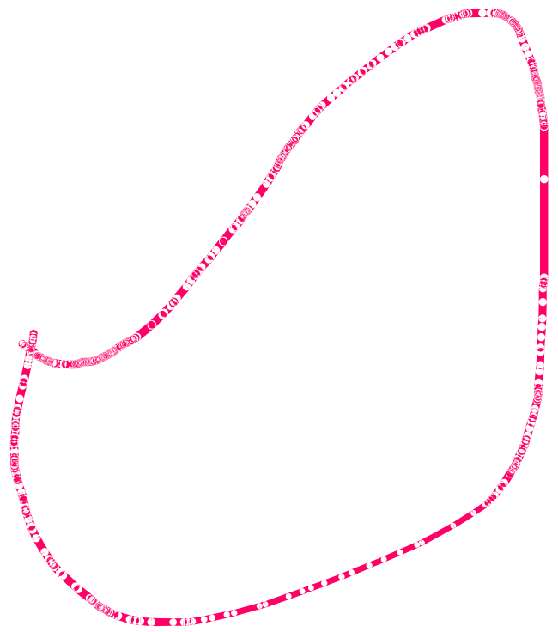
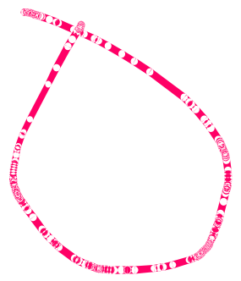
Data and Methods
Fuzzy Membership

Slide 39
[v1, v2 ,…. vn], max 95% min 95%
Fuzzy Membership

Slide 41
Data Mining with X, Y, Z data
Notes:
Afternoon, this is Leo. And I’m going to present our progress on the land surface temperature collection in NN.

Slide 42
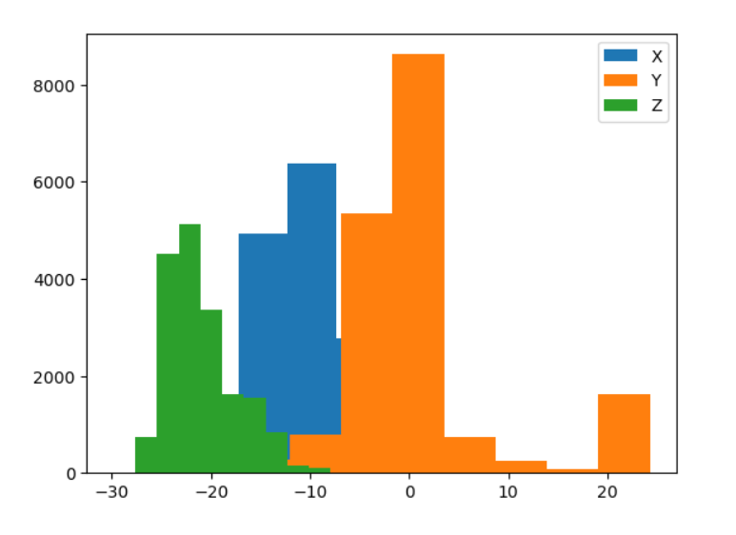
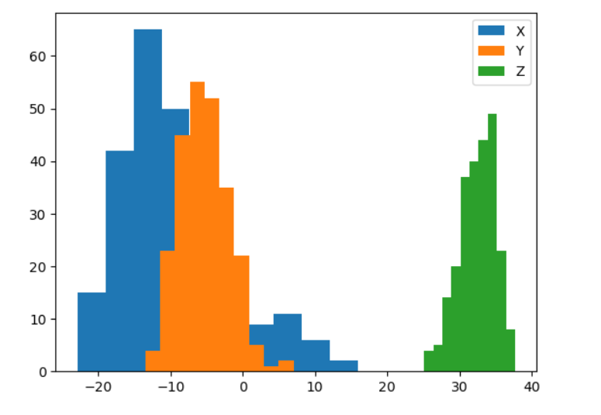
Class 1
Class 3
Hist

Slide 43


Hist

