Slide 1
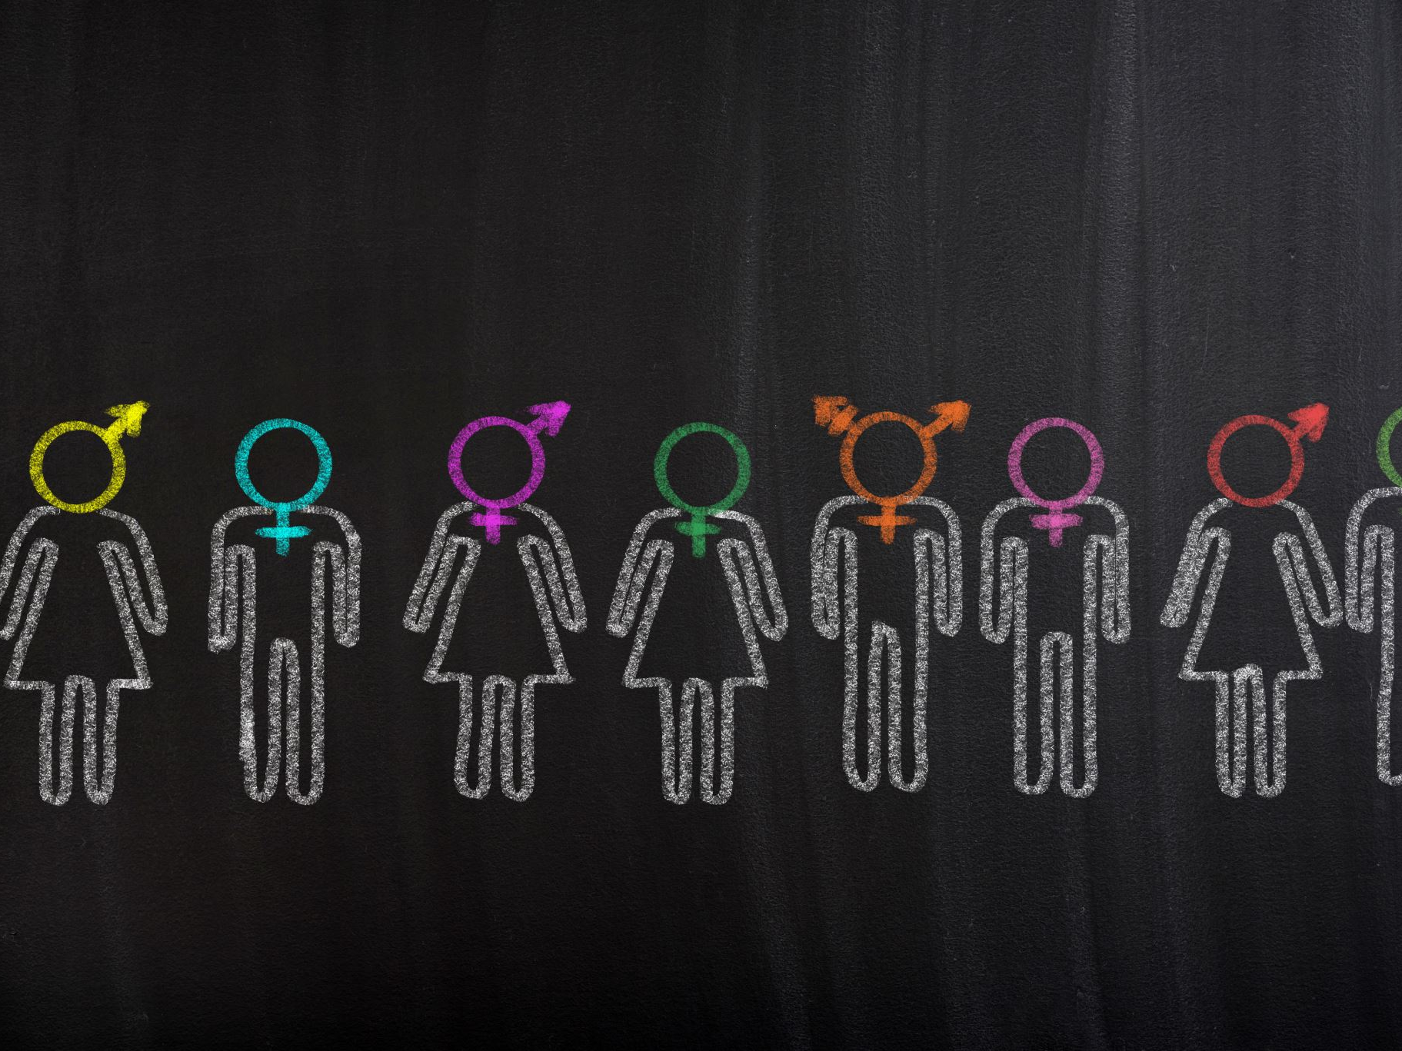
Gender Classification based on Images and Generative Modeling
INFO-6147 Deep Learning with Pytorch
Prof: Yousefhussien, Mohammed
Yin Yin Thu
15th April 2025

Slide 2
Outline
Dataset Overview
Data Preprocessing
Model Training & Hyperparameter Tuning
Model Evaluation
Other Pretrained Models
Integrated Application 1 to 4
Key Insights & Future Work
References

Slide 3
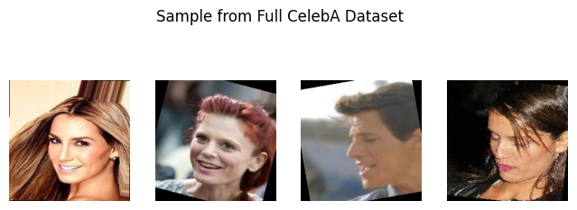
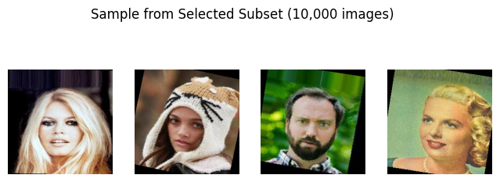
Dataset Overview
CelebA Dataset
Celebrity Images: 200, 000
Attributes: 40

Slide 4
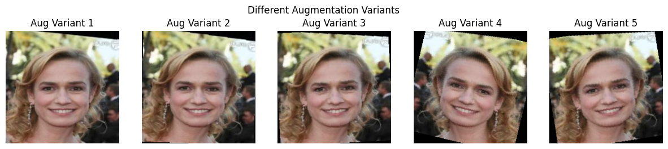
Data Preprocessing
CelebA subset (10 k images)
Resize 224 × 224, normalize (ImageNet μ/σ)
Augment: flip, ±15° rotation
Splits: 8 k train, 1 k val, 1 k test

Slide 5
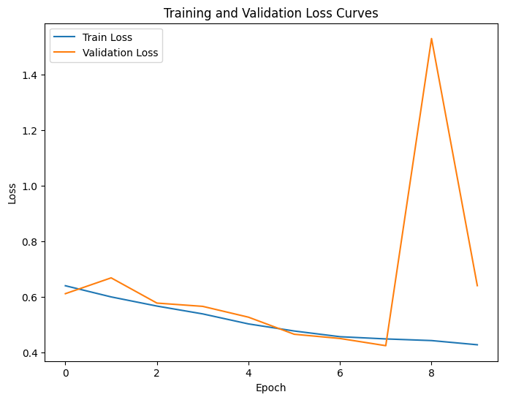
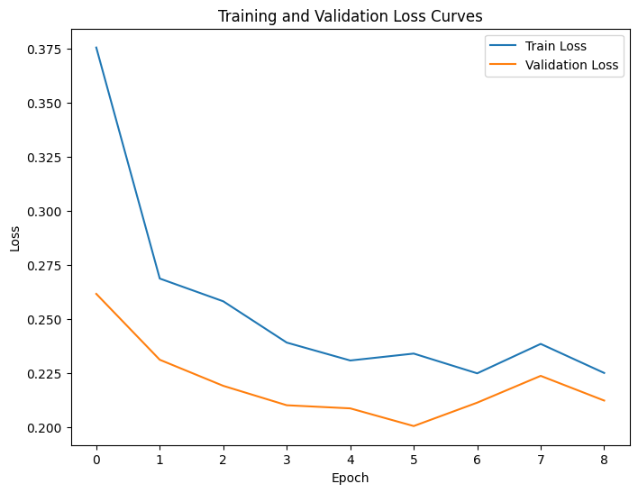
Model Training & Hyperparameter Tuning
SimpleCNN (3 conv blocks)
ResNet‑18 fine‑tuned (transfer learning)
BCEWithLogits + Adam (lr 1e‑3) for classifiers
Adam (lr 2e‑4)
Early stopping (patience 3), 10 epochs

Slide 6
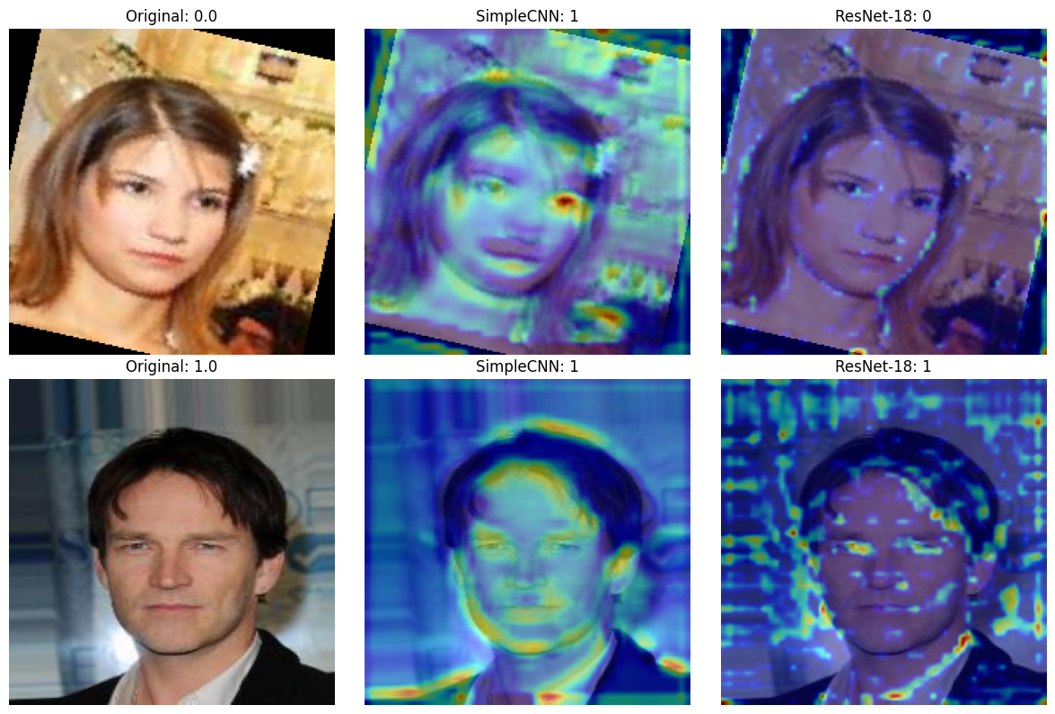
Model Evaluation
Evaluation and Grad-CAM Insights
SimpleCNN — Accuracy 67 %, F1 70.9 %
ResNet‑18 — Accuracy 91 %, F1 89.4 %
Transfer learning ⇒ +18 F1 points

Slide 7
Other Pretrained Models
DCGAN — generate -> synthetic faces
CycleGAN — image → cartoon
Open Router — Meta Llama 4 Maverick
Hugging Face — StableDiffusionPipeline

Slide 8
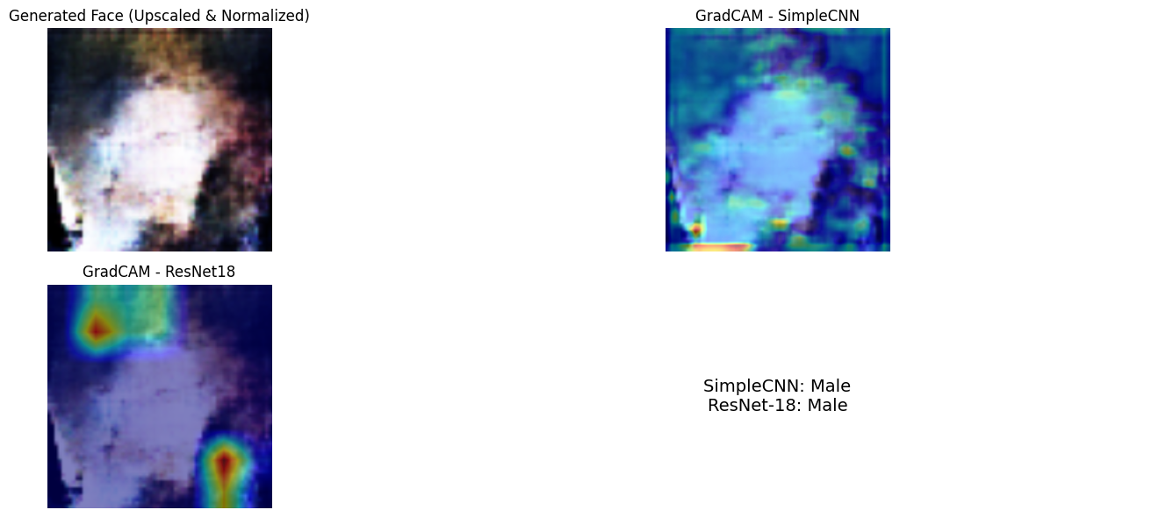
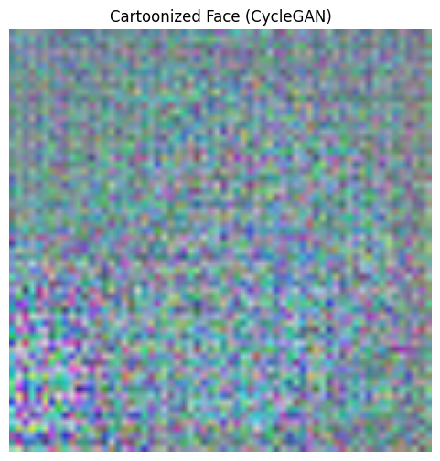
Integrated Application
1
Generative Model
DCGAN → Classify → CycleGAN
Using Grad‑CAM
Cartonize the image

Slide 9

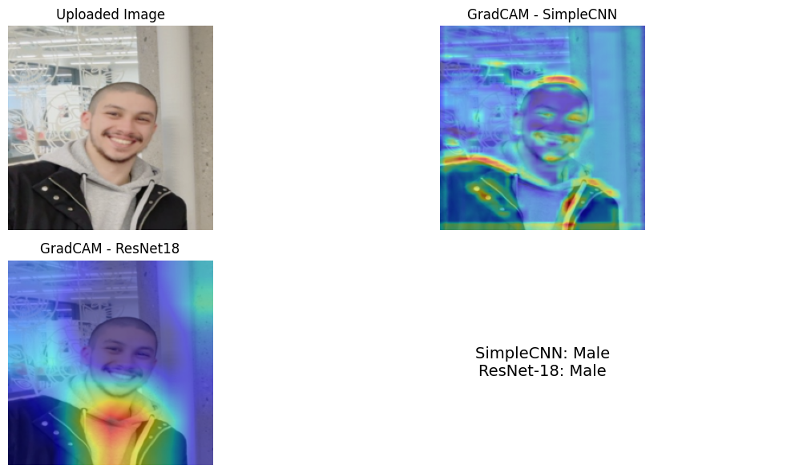
Integrated Application
2
Interactive Demo
Upload a photo
Classify Gender
Using Grad‑CAM

Slide 10
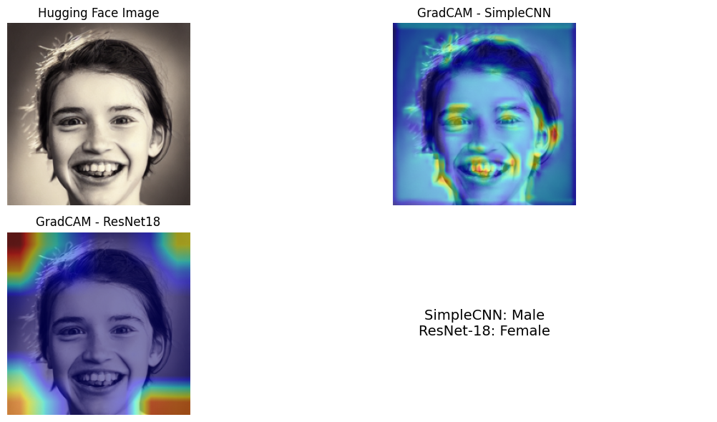
Integrated Application
3
Hugging Face StableDiffusionPipeline
Classify Gender
Using Grad‑CAM

Slide 11
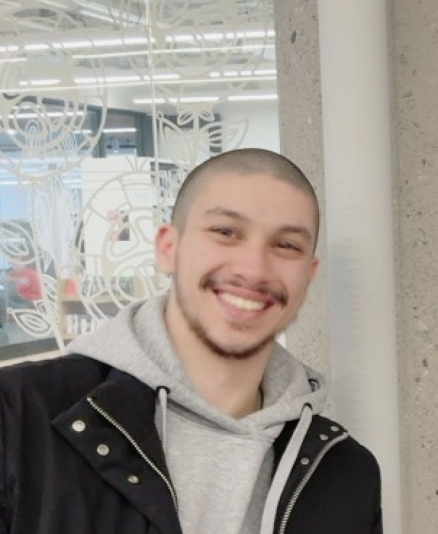
Integrated Application 4
Open Router (Meta Llama 4 Maverick) -> Classify Gender
The image depicts a man. The image depicts a man. The content of the image is a male individual wearing a black jacket over a gray hoodie, standing in front of a wall with an intricate white design and a concrete pillar to his right.

Slide 12
Discussion
Transfer learning with ResNet‑18 outperformed the custom CNN, underscoring the value of pre-trained features.
Generative augmentations and interpretability techniques improved model robustness and transparency.
User-centric features demonstrate system versatility for real-world deployment.
Images from Google

Slide 13



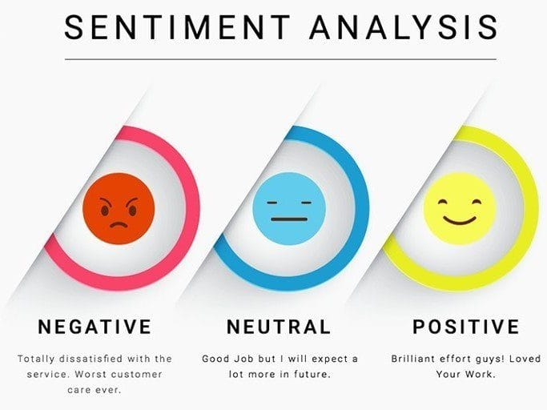
Insights & Future Work
This project showcases an end-to-end deep learning pipeline integrating classification, generative modeling, and interpretability.
Future work includes multi-attribute classification, high-resolution GAN training, advanced explainability, and deployment as a user-friendly web application.
Images from Google

Slide 14
References
Torchvision documentation, https://pytorch.org/vision
Grad-CAM paper, https://arxiv.org/abs/1610.02391
DCGAN paper, https://arxiv.org/abs/1511.06434
CycleGAN paper, https://arxiv.org/abs/1703.10593
https://huggingface.co/docs/diffusers/en/api/pipelines/stable_diffusion/text2img
https://www.youtube.com/watch?v=RxRD818Baos
https://openrouter.ai/meta-llama/llama-4-maverick:free

Slide 15
Thank you, Prof, Wassim and All !

