Slide 1
Sentiment Classification of Amazon Reviews
Yina Bao
DATS6501 Data Science Capstone Project
Dec 7, 2018

Slide 2
Motivation
In recent years, electronic commerce more and more dominates the market, and there has been a huge increase of interest from brands, companies and data scientists in sentiment analysis and the application to find the business intelligence insight.
Recent study from Zendesk mentioned that 45% of people share negative customer service experience and 30% share positive customer service experience via social media, which shows a high demand for mining the information and extracting the opinion and meaning for further analysis.
The model of classifying Amazon reviews can transfer to some text without labels, in order to give a sentiment suggestion (such as whether recommend a video on YouTube based one the comments).

Slide 3
Objective
Understanding customer’s sentiment based on descriptive text reviews. Review classification:
Negative
Not recommend
Text reviews
Positive
Recommended

Slide 4
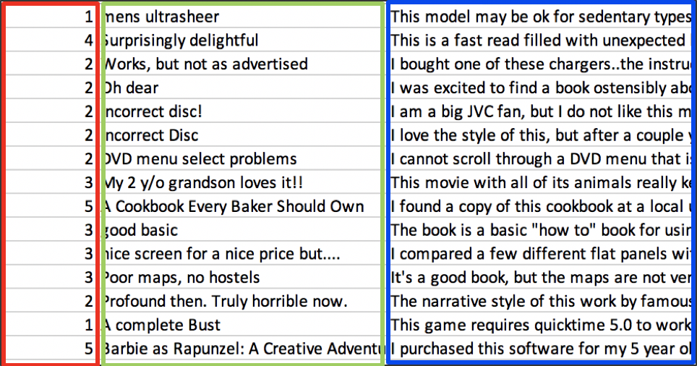
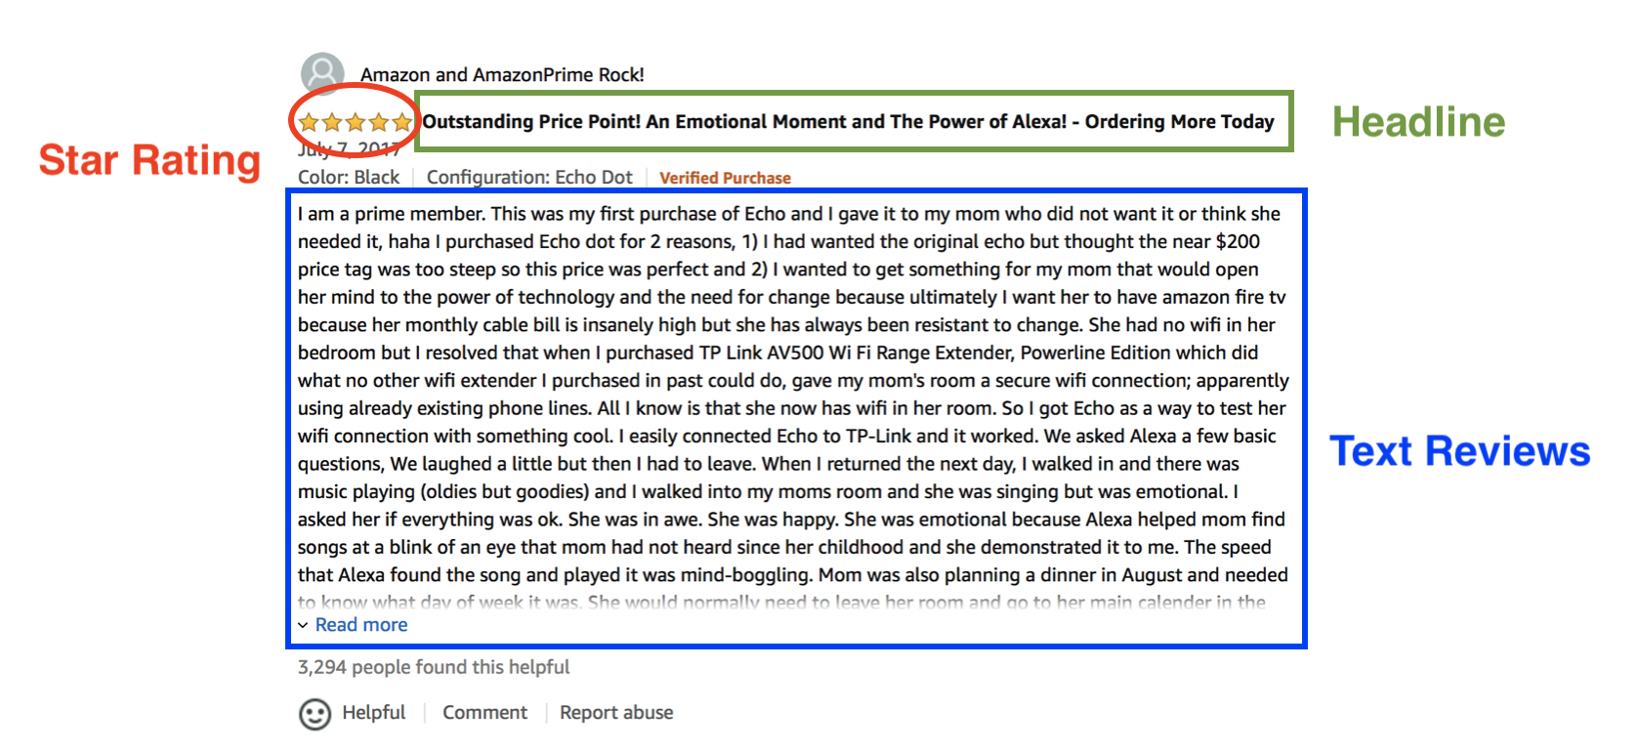
Dataset
Amazon product reviews dataset consists of star ratings (1-5), the headline and the descriptive customer reviews.
The original dataset is pre-split into a testing set and training set. Training set contains 3,000,000 reviews and testing set contains 650,000 reviews.
Link to Kaggle data page: https://www.kaggle.com/bittlingmayer/amazonreviews Link to dataset: https://drive.google.com/drive/folders/0Bz8a_Dbh9Qhbfll6bVpmNUtUcFdjYmF2SEpmZUZUcVNiMUw1TWN6RDV3a0JHT3kxLVhVR2M

Slide 5
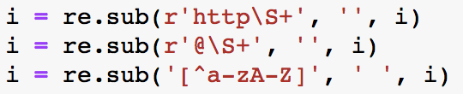
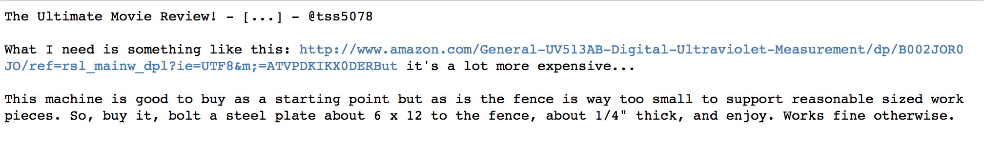
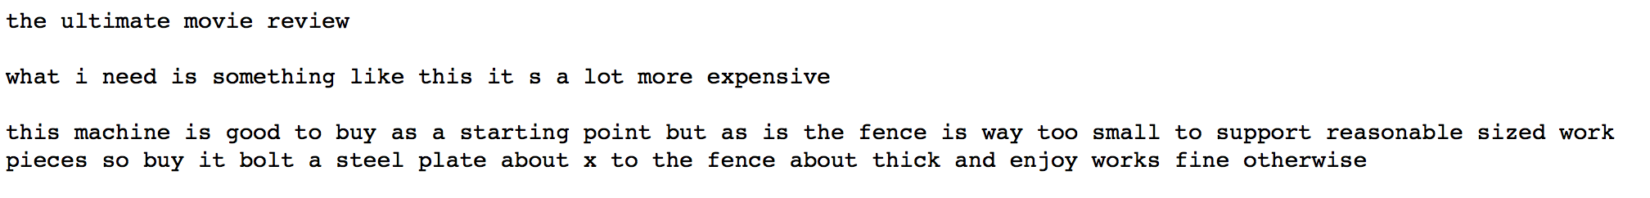
Preprocessing – clean data
Random select 200,000 data from original training set and 50,000 data from original testing set to create a smaller balanced dataset.
Cleaning the data:
Covert each word to lower case
Remove web link
Remove @ social media account
Remove non-alphabetic characters
Export as a csv file for saving the cleaning time.
Examples after cleaning

Slide 6
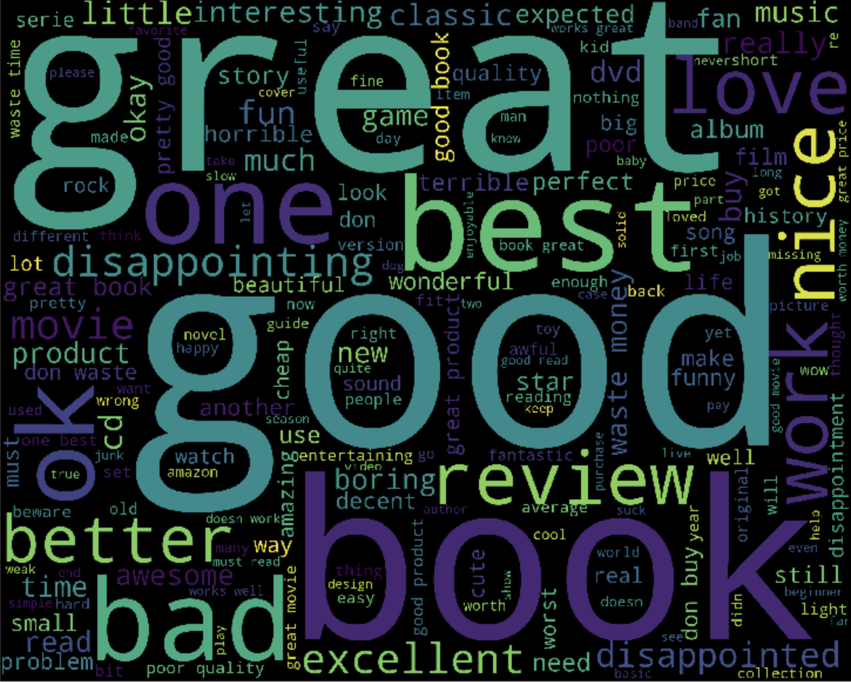
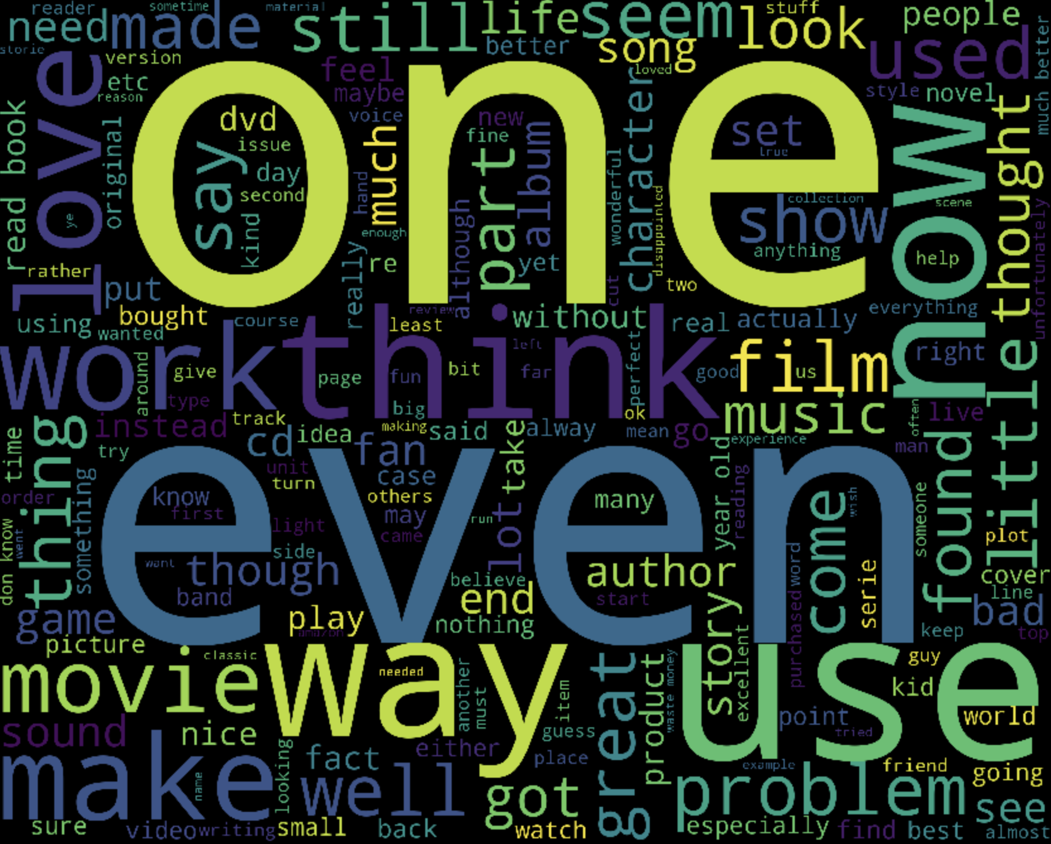
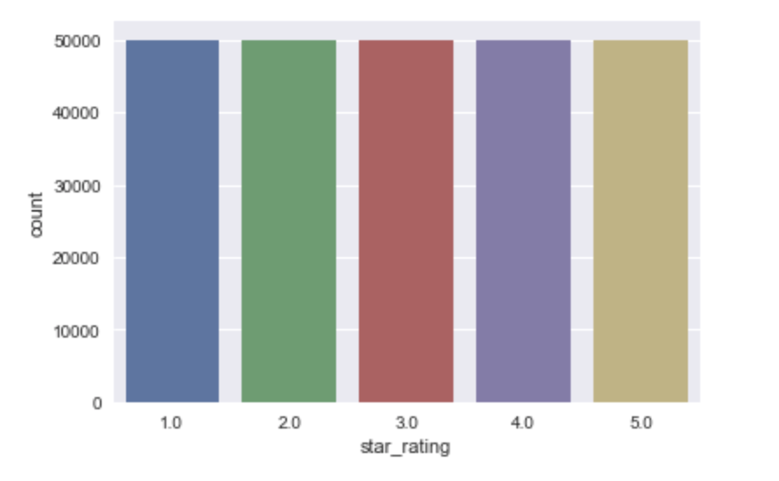
Word Cloud for headline
Word Cloud for text_reviews
Balanced data!

Slide 7
Preprocessing
Inputs:
Removing stop-words by nltk.corpus.stopwords , and stemming by nltk.stem.SnowballStemmer
Bag of words – numerical representation of text Using TfidfVectorizer (term frequency–inverse document frequency) and fit_transform method in sklearn to fit the model of bag of words to create the feature vectors.
Labels: Positive-1: contains star 4 and star 5 Negative-0: contains star 1 and star 2
Split 80% for training set and 20% for testing set.

Slide 8
Inputs comparison – Headline vs Reviews
F1-score | SVM | Naïve Bayes | Random Forest
Headline | 0.7872 (+/- 0.0051) | 0.7893 (+/- 0.0062) | 0.7733
Reviews | 0.8645 (+/- 0.0041) | 0.8406 (+/- 0.0037) | 0.8340
Classification by reviews has better performance.
Although headline contains lots of key words of sentiment, the headline is much shorter than reviews. Removing stop-words makes several empty inputs.
Use text_reviews column for following model comparison.

Slide 9
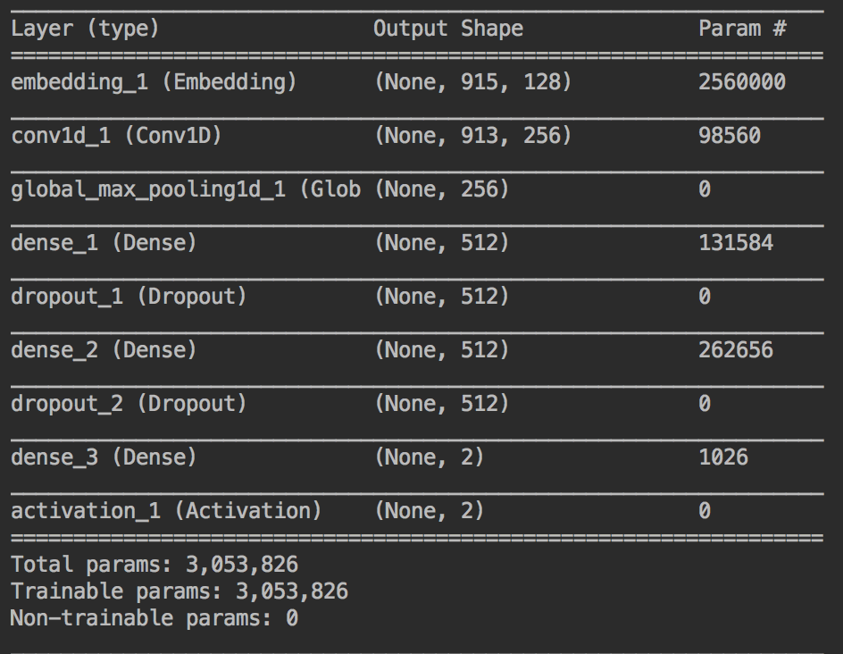
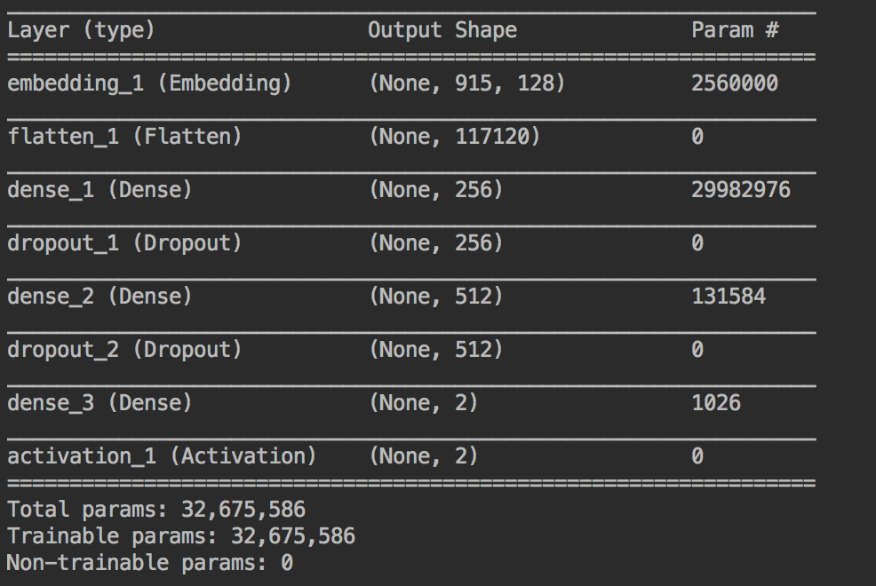
Models comparison
 | MLP | CNN | SVM | Naïve Bayes | Random Forest
Accuracy | 0.79 | 0.83 | 0.86 | 0.84 | 0.83
F1 score | 0.79 | 0.83 | 0.86 | 0.84 | 0.83

Slide 10
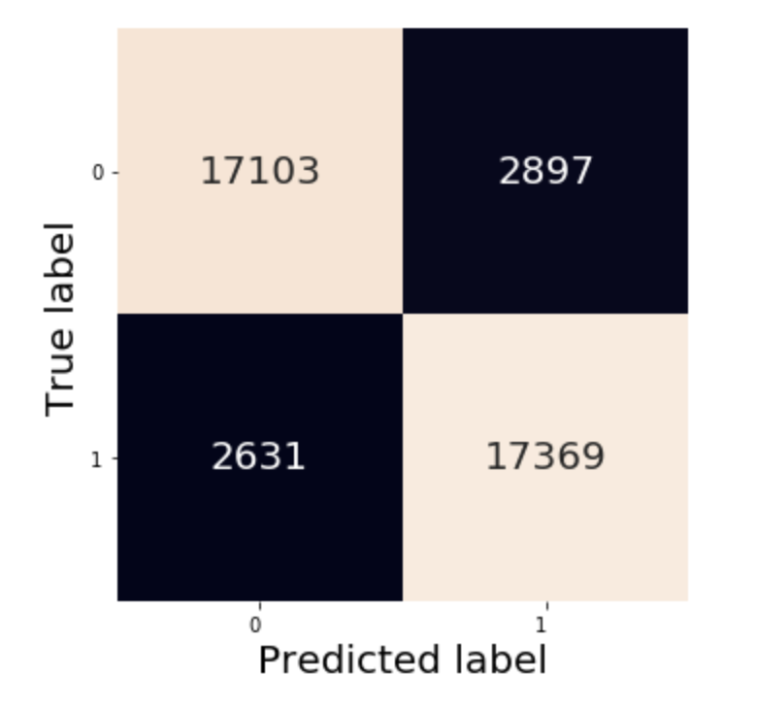
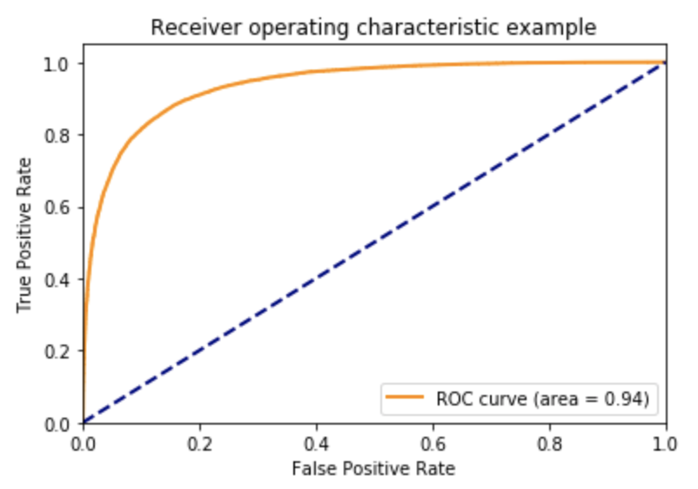
Confusion Matrix by SVM model
ROC curve by SVM

Slide 11
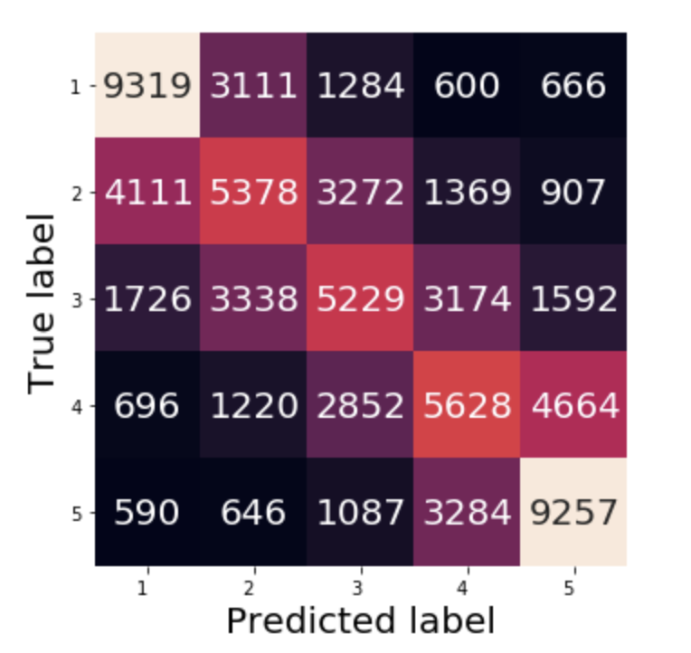
See what’s going on 5 classes…
SVM
Accuracy: 0.46
F1-score: 0.45
Based on the number and color on confusion matrix, star 1 and star 5 have the highest true positive rate.
Include 3 star in either positive or negative will decrease the accuracy to 0.77
Confusion matrix of SVM in 5 classes

Slide 12
Summary
SVM model has better results in sentiment classification
Using GridsearchCV to select the best hyper-parameter
Build up more layers of MLP & CNN might improve the performance
Problems of preprocessing:
Stopwords contain ”sentiment” words, such as ‘not’
Misspelling
Different languages
Bag of words not consider the order
Natural language is “versatile”, “elusory”…(such as sarcastic)

Slide 13
Future work
Pre- trained word embedding: Glove, FastText as transfer learning
Combine headline and text reviews
Lemmatizer
Classifying neutral reviews by our sentiment classification model, and clustering the neutral reviews to find some patterns (whether the positive-neutral reviews and negative-neutral reviews are clustered separately).
Classification based on 5 classes

Slide 14
Thank you

