Slide 1
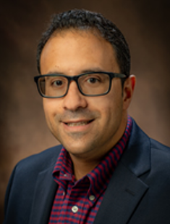
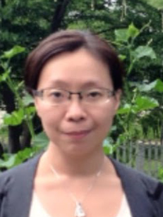
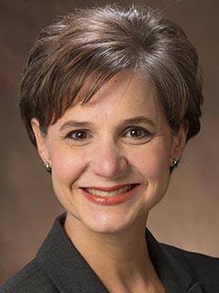
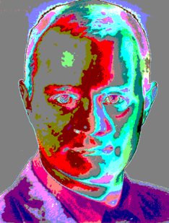
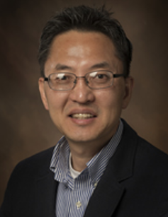
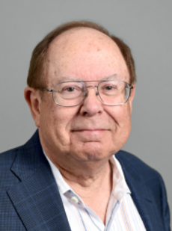
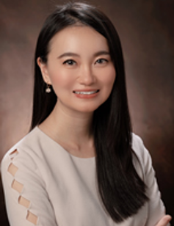
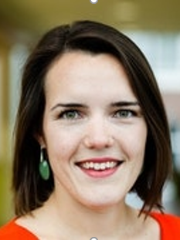
Fadel M. Megahed Miami University | Ying-Ju Tessa Chen University of Dayton | L. Allison Jones-Farmer Miami University | Sven Knoth Helmut-Schmidt-Universität
Younghwa (Gabe) Lee Miami University | Douglas C. Montgomery Arizona State University | Brooke Wang Miami University | Inez Zwetsloot University of Amsterdam

