Slide 1

Simple Jira Project
Team 9: Ying LUO, Khalil Hanna
Detailed Presentation Source in Confluence

Slide 2
Background
Task management software is any digital tool that helps you plan, track, and complete a unit of work
Often help to list, expense, and organize a given task or sub-task.

Slide 3
High Level View
Simple task management, including project, sprint, user story and issues, sprint could be broke down by many user stories, and user stories can be related to many issues
Team assignment for each project, Owner assigned to sprint / user story / issue (task/defect)
CRUD operations for all entities

Slide 4
Business Logic
For a small scale of development team, each team member could login system to manage all team projects related information
Each team could create development project, each project could have multiple sprint under it
Each sprint will have multiple user stories in certain period
Every team member could operate all the projects/sprints/user stories/issues under his team
Each user stories will have multiple issues related to it
Issues has two category of task and defect

Slide 5
Resource Management
Project Management:
Trello Board -- Tracking issue cards
Source Control:
Bitbucket
Knowledge Management:
Confluence

Slide 6
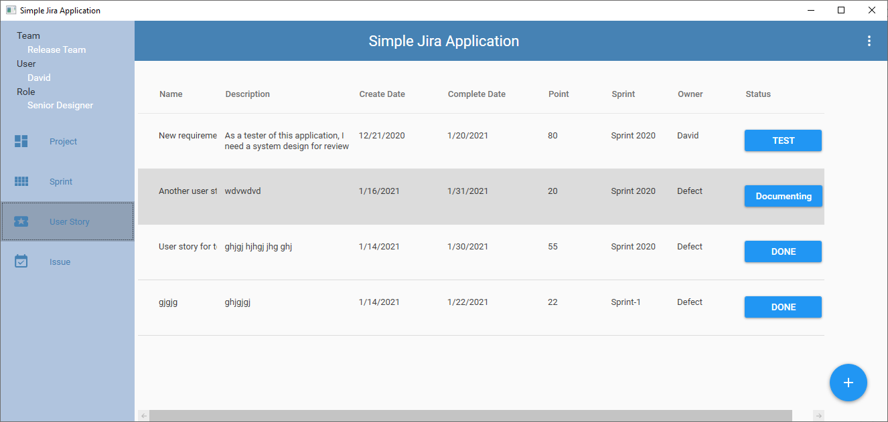
Main windows

Slide 7
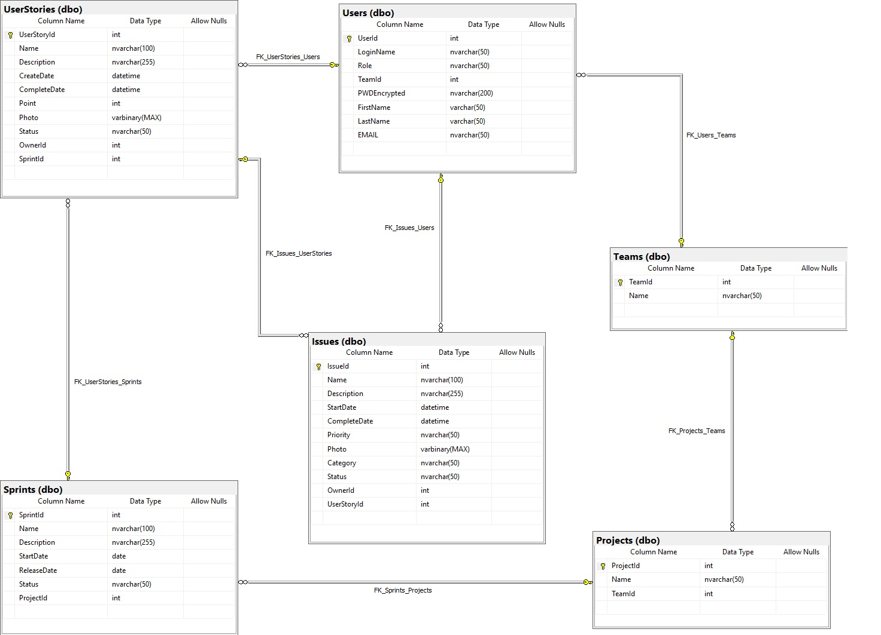
Database Structure

Slide 8
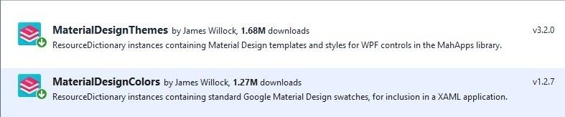
Libraries
Material Design In XAML and Dragablz for TabControl

Slide 9
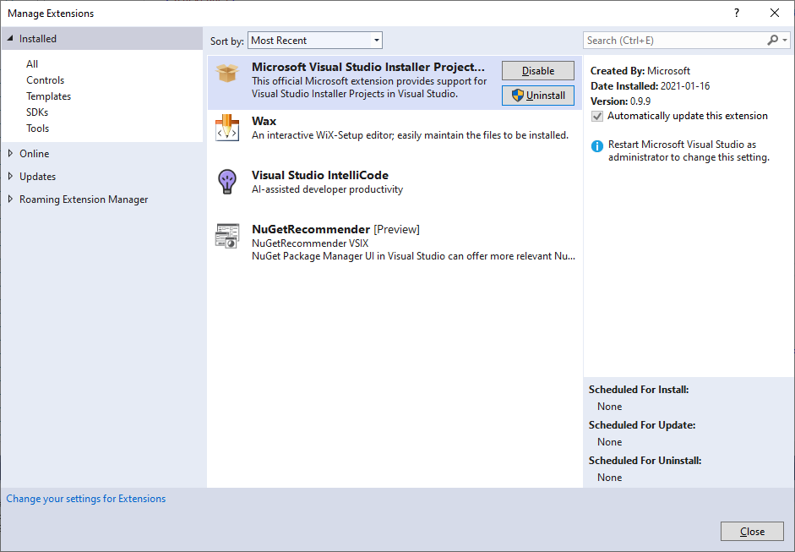
MS VS Installer Project

Slide 10
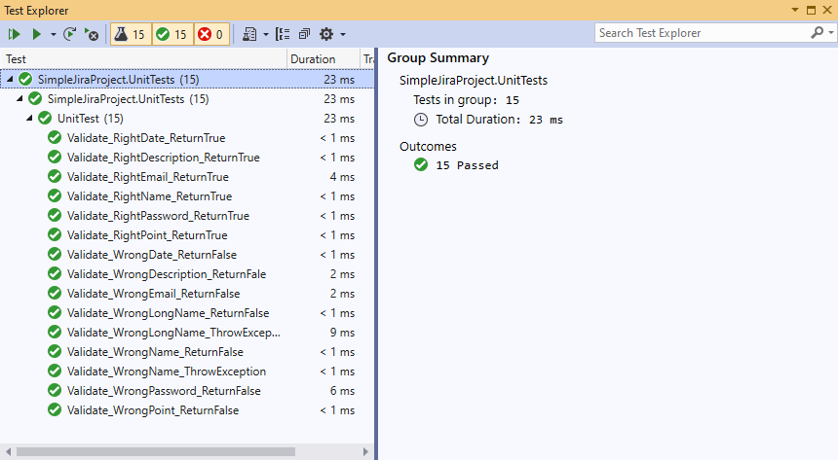
MS Unit Test

Slide 11
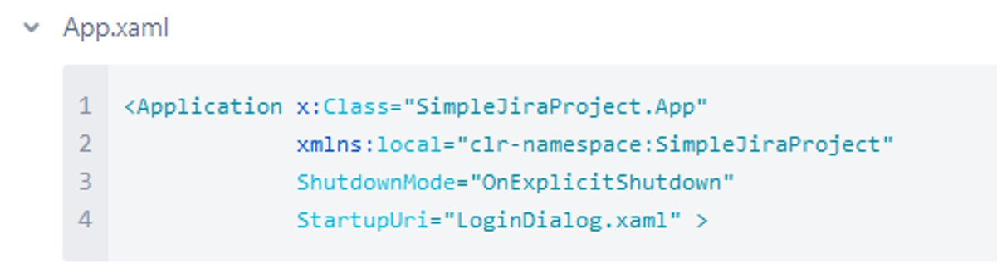
Challenges and Solutions
User Login / Logout

Slide 12
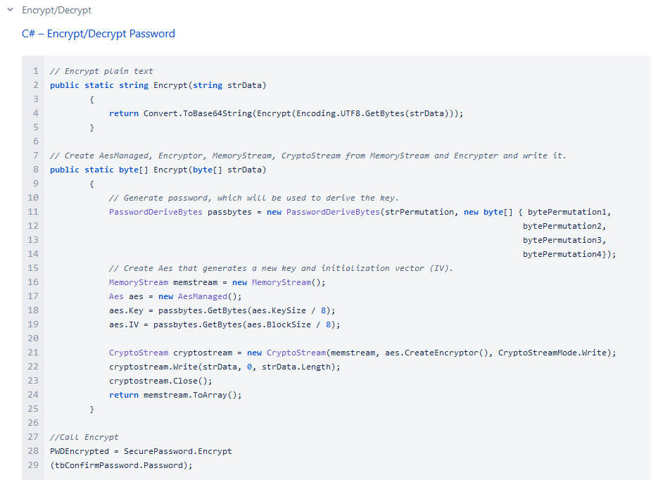
Challenges and Solutions
Secure Password by Advanced Encryption Standard (AES) Algorithm

Slide 13
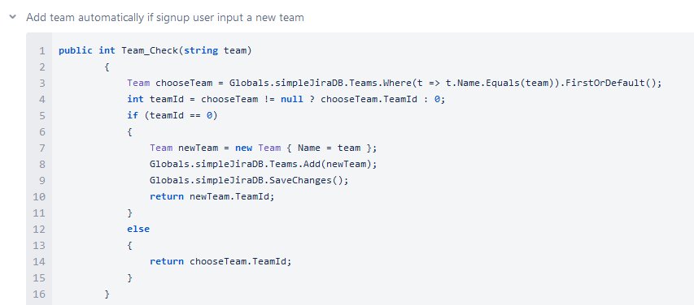
Challenges and Solutions
User Management

Slide 14
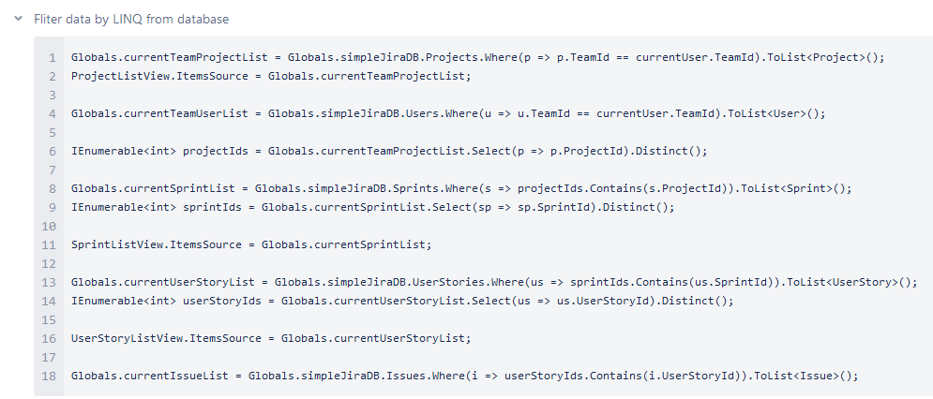
Challenges and Solutions
Different view according to different team

Slide 15
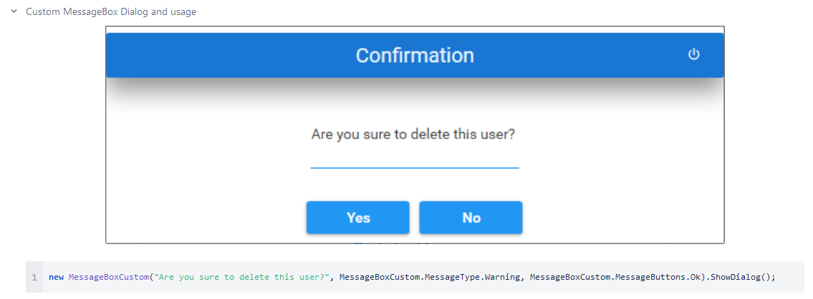
Challenges and Solutions
Custom MessageBox

Slide 16
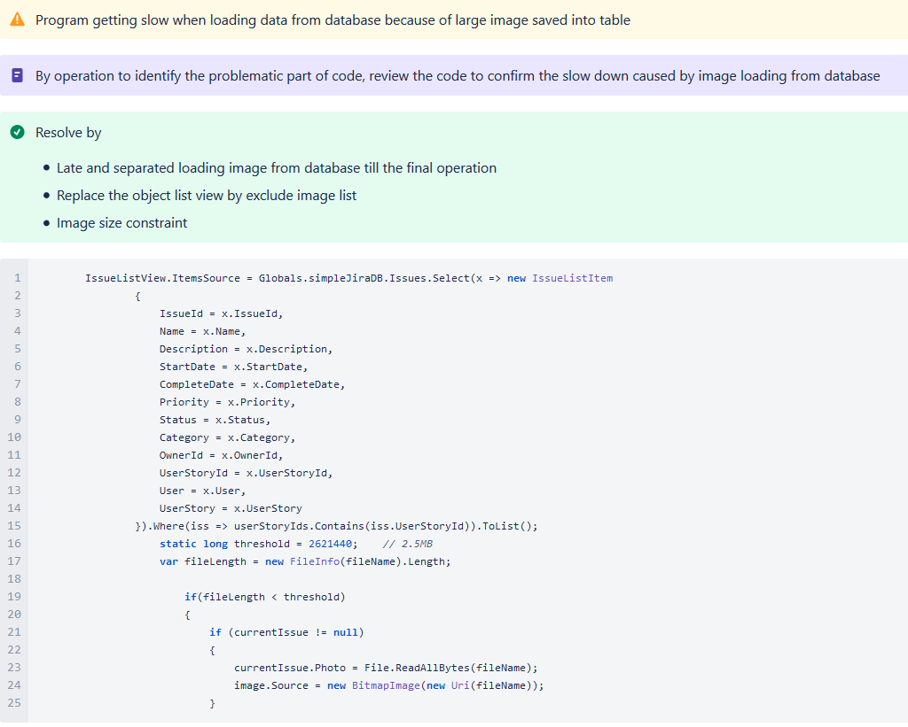
Challenges and Solutions
Performance Issue

Slide 17
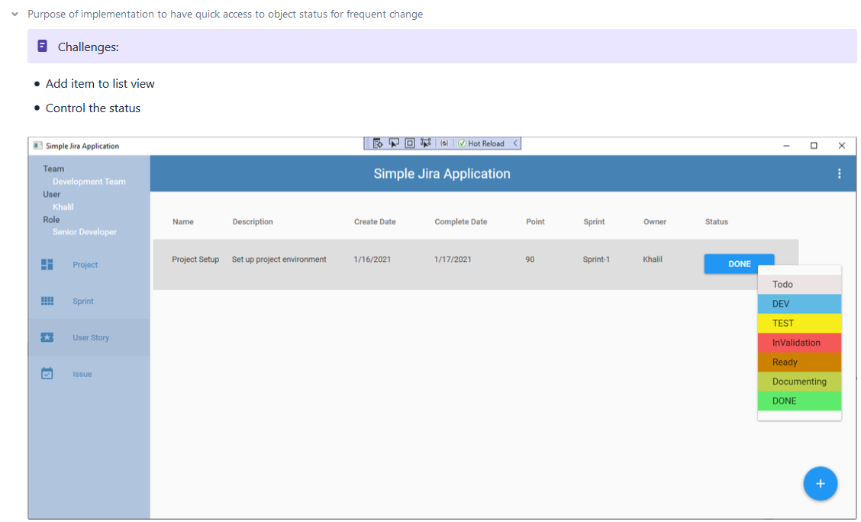
Challenges and Solutions
Status Update - color set and save change to database quickly

Slide 18
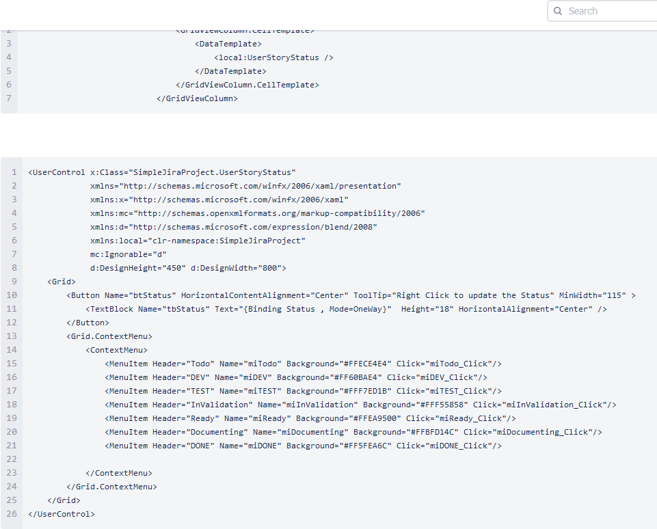
Challenges and Solutions
User Control

Slide 19
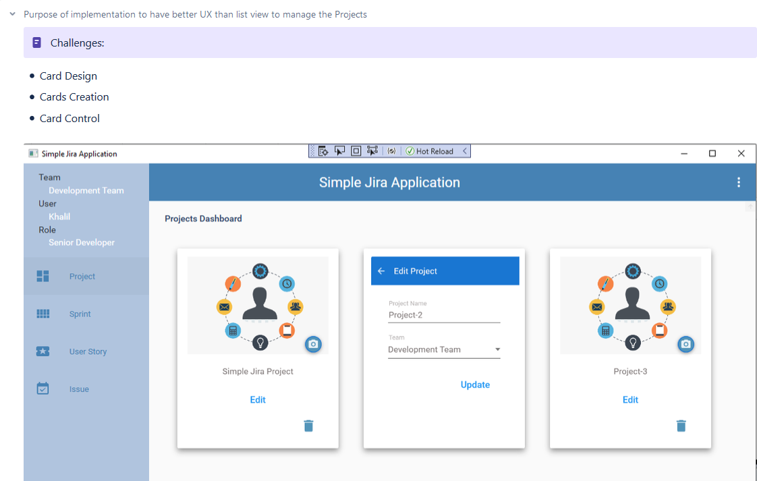
Challenges and Solutions
Project view - implemented by card rather than by list view

Slide 20
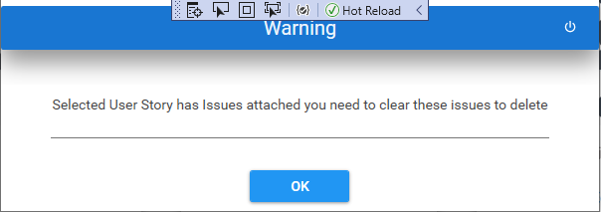
Challenges and Solutions
Delete Object - Handle delete related objects

Slide 21
Future Work
Provide search function in each list of view and main window
Statistic chart generated for each list of view
Add Project Themes
Enhance the user Roles to optimize the Teams works
UI/UX enhancement

Slide 22
Summary
Designing 6 tables database with 1-Many relationships, practiced Microsoft SQL server
Using C# entity framework to create WPF project by database-first approach
Practicing C# OOP skills and event handling
Practicing C#, WPF XAML
Adapt Material Design UI library on WPF
Create installer by MS VS installer project
MS Unit Test for API testing

