Slide 1

Ski Rentals Project
Team 8
Ying LUO
Khalil Hanna

Slide 2
Background
E-Commerce App is online electronic medium for commercial transaction
facilitated selling buying or rental product web App

Slide 3
Project Description
Create e-Commerce website for ski equipment rental
User management(admin/user registration)
Equipment management(CRUD operations)
Rental Rate by equipment & time period
Cart
Orders

Slide 4
Business Logic
Web app where users can browse all ski equipment that available for renting
User can check equipment details
User who want to place an order need to register or login
User can manage his account
User can add as items to his cart before order
Admin user can manage the stock and users

Slide 5
Resource Management
Project Management:
Trello Board cards
Daily Scrum
Source Control:
Bitbucket
Knowledge Management:
Confluence

Slide 6









Technologies, Framework & Libraries

Slide 7
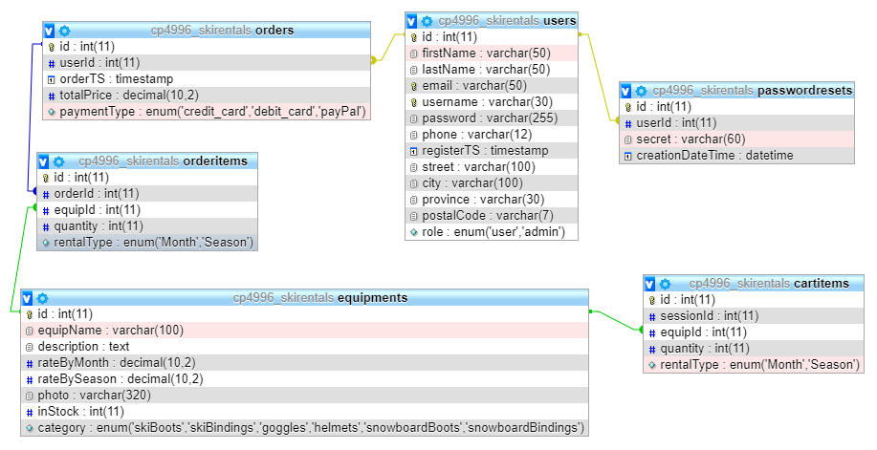

Slide 8
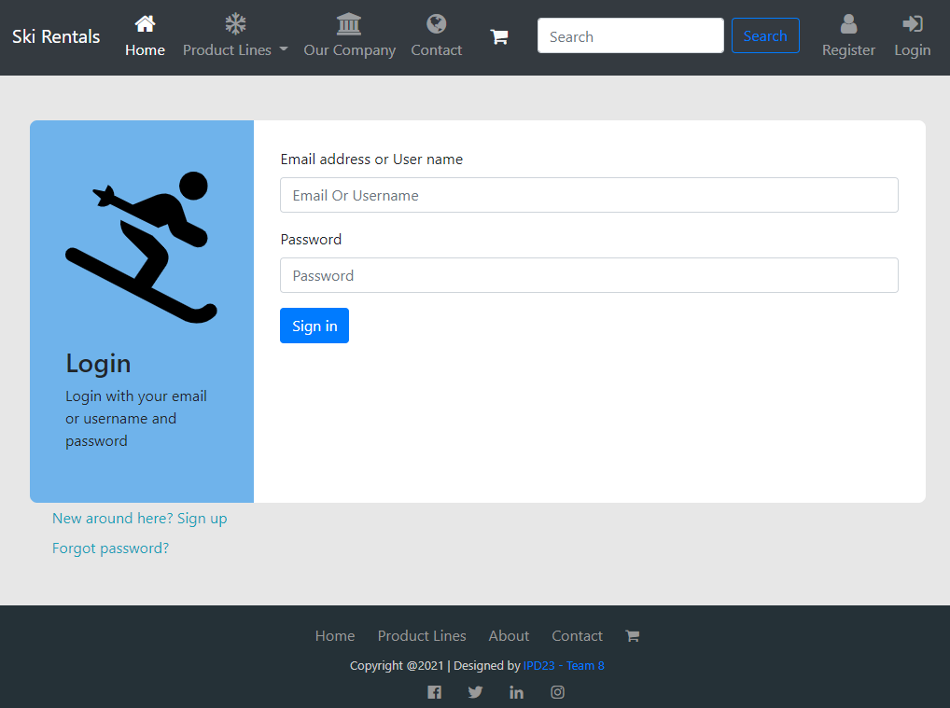
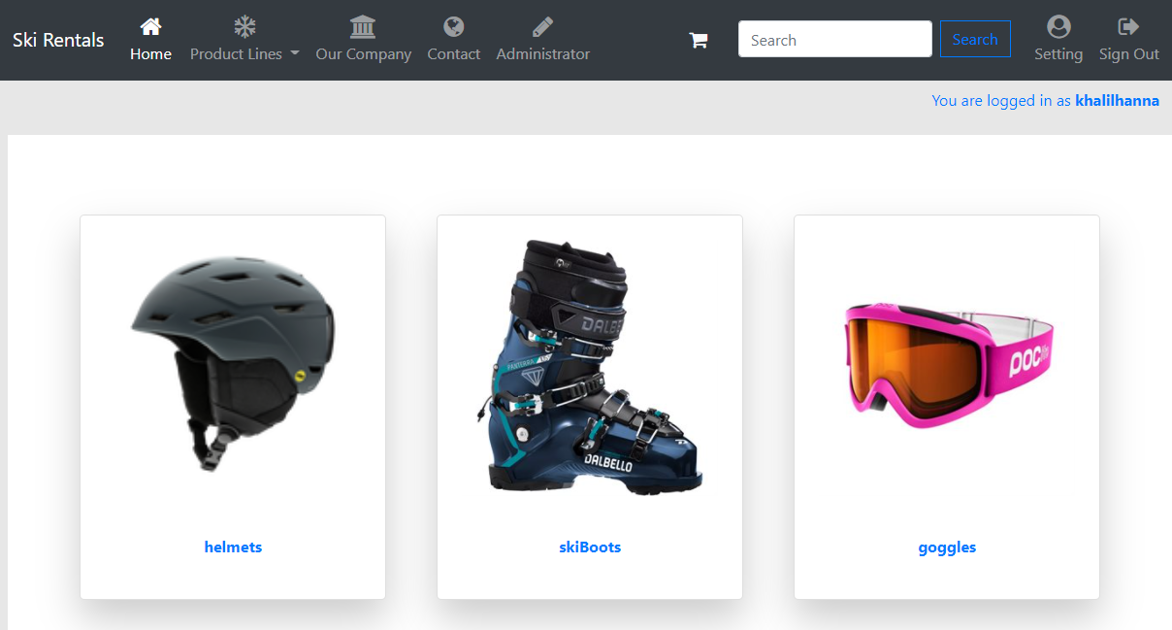
Login & Home Page

Slide 9
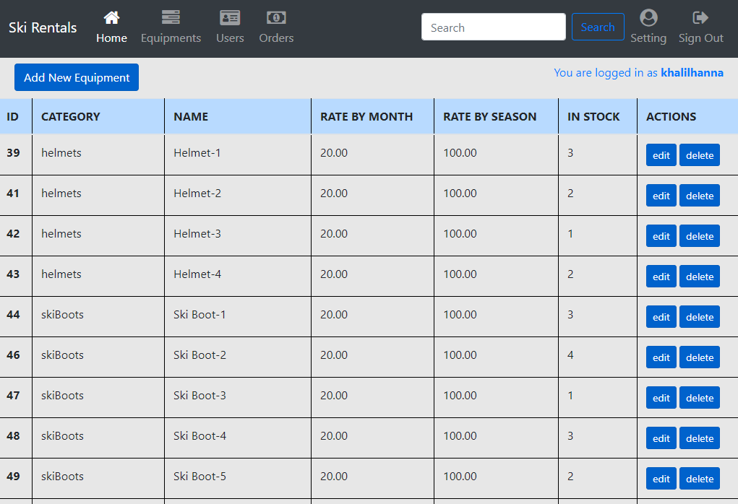
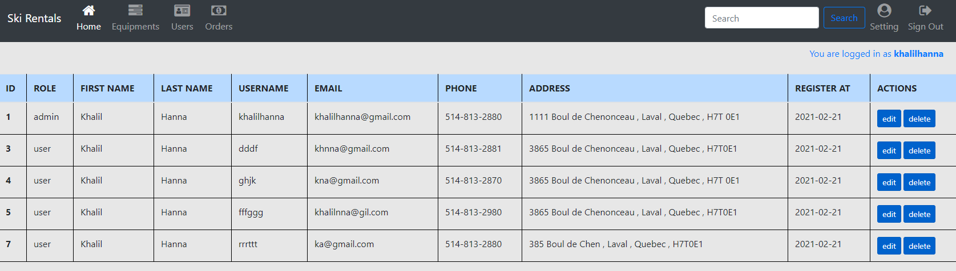
Admin View

Slide 10
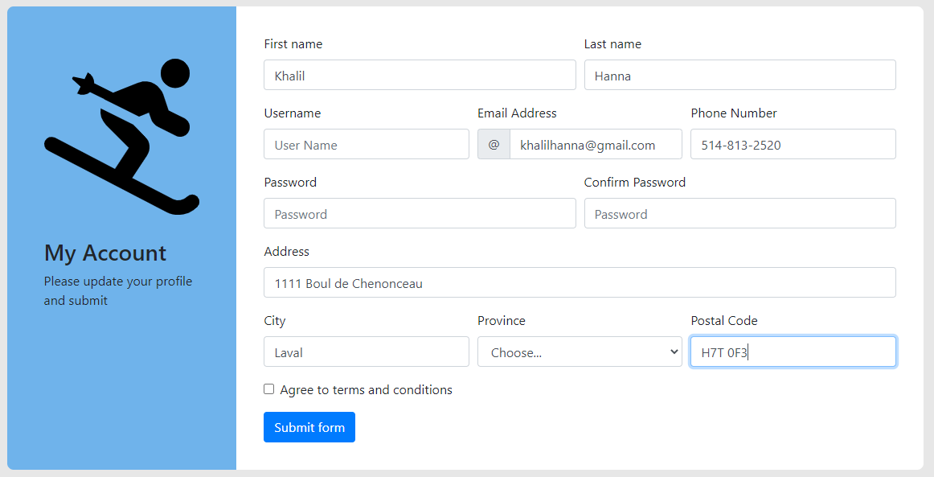
Registration & Account Management

Slide 11
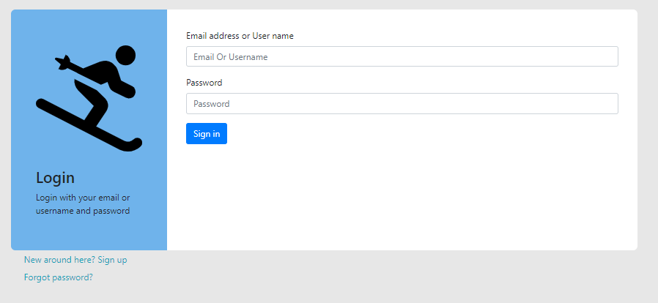
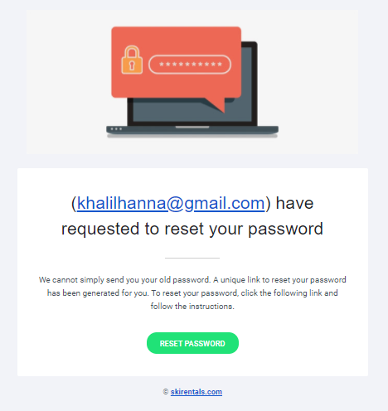
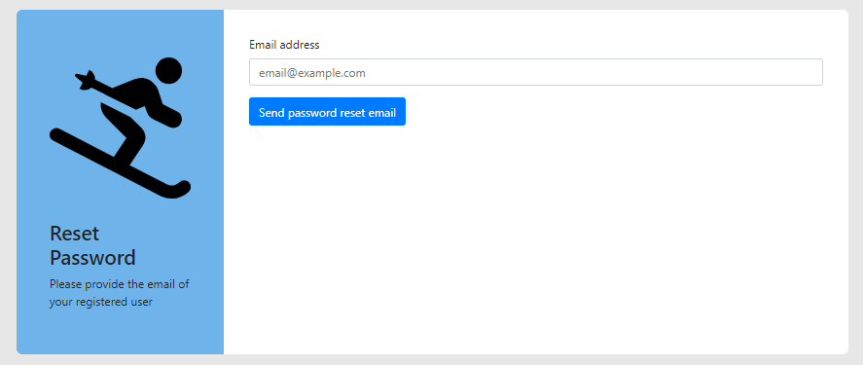
User Management
Login & Reset password

Slide 12
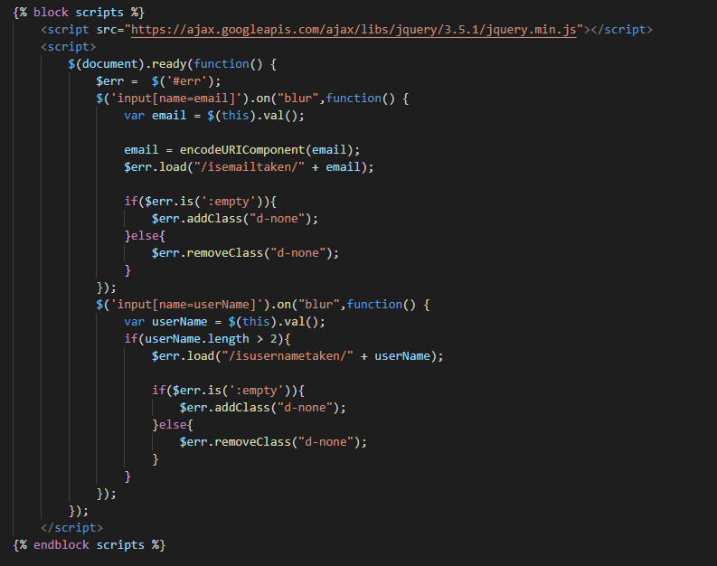
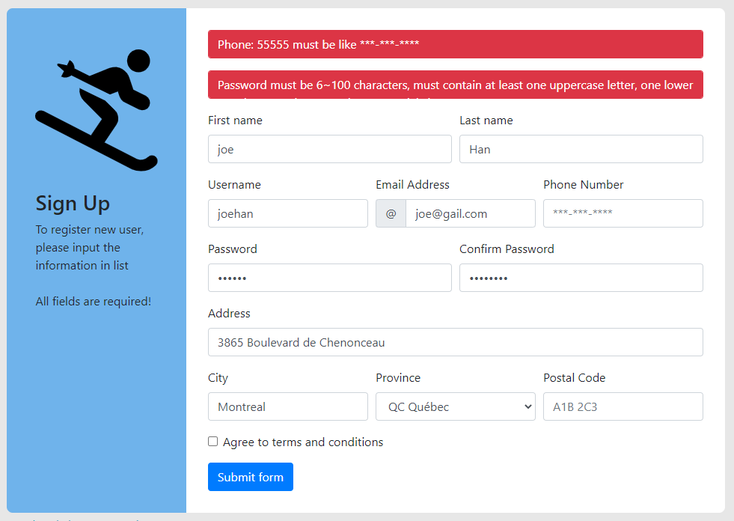
Challenges and Solutions
Custom Error Message

Slide 13
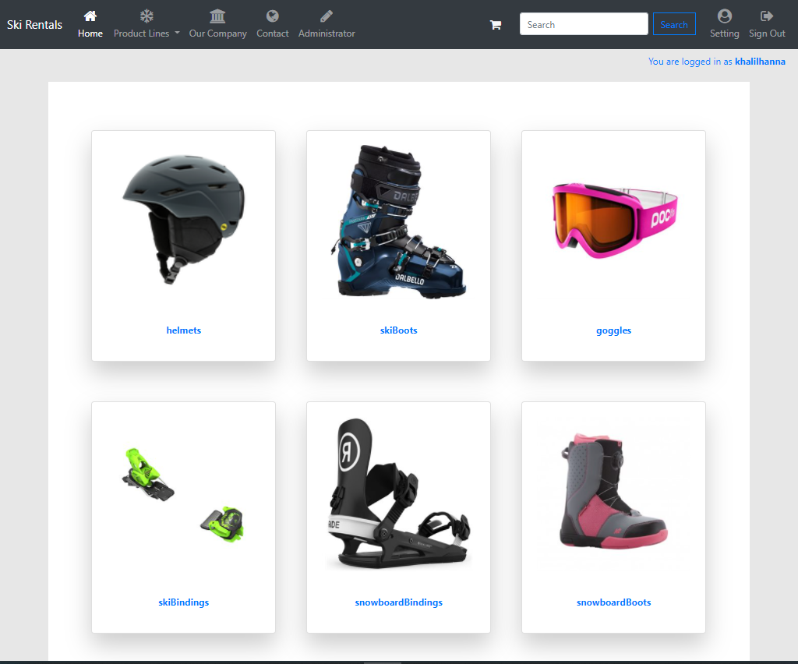
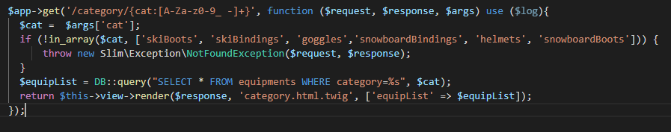
Challenges and Solutions
Dynamic Product Categories
(Get categories from Enum)

Slide 14

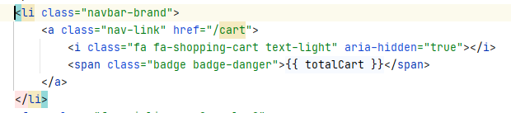
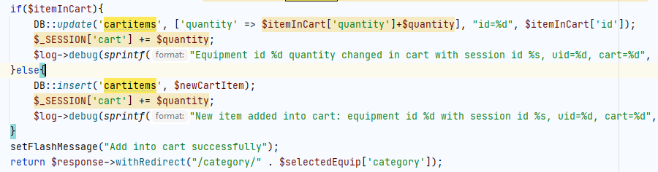
Challenges and Solutions
Add global variable for cart total quantity update

Slide 15
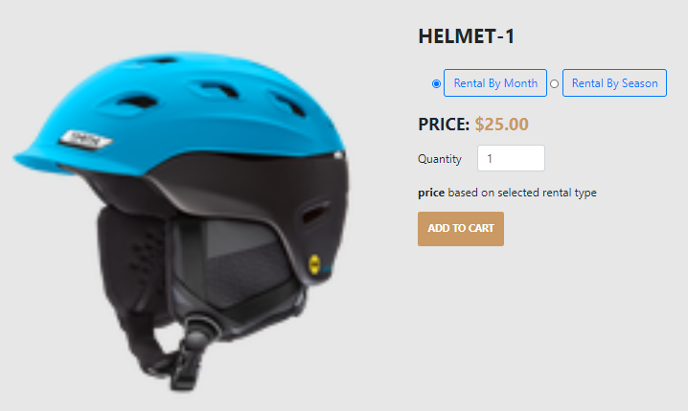
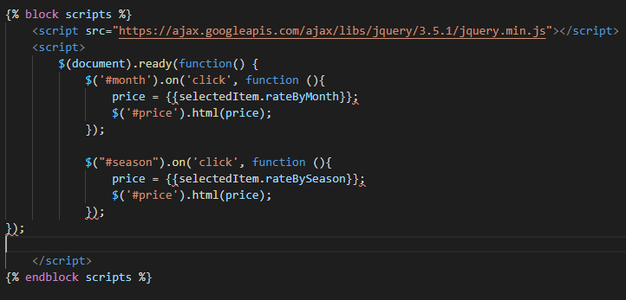
Challenges and Solutions
Item Description

Slide 16
Future Work for Next Sprint
Implement enhanced search
Transaction statistic analysis
UI/UX enhancement
equipment rental feedback with comments
Using REST API and Sorting
Manage the stock

Slide 17
Summary
Designing 6 tables database, practiced phpMyAdmin
Using PHP Framework and Libraries
Practicing Ajax
Adapt Bootstrap for style
Merging different technologies
Creating complete web app (front end, backend & database)

Slide 18


