Slide 1
Introduction to Algorithm
Tree

Slide 2
Tree classification
Binary Tree. (BT:complete/full binary tree)
Binary search tree. (BST)
Max/min Heap(priority queue).
Self-balancing search trees.(AVL)
Red-black tree.(RBT)
B+/B- tree. (B+/B-)
Winner/loser tree.
Devision tree
Forest
Random forest.

Slide 3
Tree algorithm
Binary tree traversal.
Construct Binary tree.
Binary search tree.
Tree traversal recursively.(用递归的方法)
preorder, inorder, postorder, levelorder.
Tree traversal iteratively.(用迭代的方法)(using stack/queue)
Morris Traversal.

Slide 4

Nature View of a Tree
leaves
branches
root

Slide 5

Computer Scientist’s View
root
leaves
branches
nodes

Slide 6
What is a Tree
A tree is a finite nonempty set of elements.
It is an abstract model of a hierarchical structure.
consists of nodes with a parent-child relation.
Applications:
Organization charts
File systems
Programming environments
Computers”R”Us
Sales
Manufacturing
R&D
US
International
Laptops
Desktops
Europe
Asia
Canada

Slide 7
Tree Terminology
Root: node without parent (A)
Siblings: nodes share the same parent
Internal node: node with at least one child (A, B, C, F)
External node (leaf ): node without children (E, I, J, K, G, H, D)
Ancestors of a node: parent, grandparent, grand-grandparent, etc.
Descendant of a node: child, grandchild, grand-grandchild, etc.
Depth of a node: number of ancestors
Height of a tree: maximum depth of any node (3). 从0开始
Degree of a node: the number of its children
Degree of a tree: the maximum number of its node.
Subtree: tree consisting of a node and its descendants
A
subtree
B
C
D
E
F
G
H
I
J
K

Slide 8
Tree Properties
Property Value
Number of nodes
Height
Root Node
Leaves
Interior nodes
Ancestors of H
Descendants of B
Siblings of E
Right subtree of A
Degree of this tree
A
B
C
D
E
F
G
H
I

Slide 9
Level and Depth
Level
1
2
3
4
node (13)
degree of a node
leaf (terminal)
nonterminal
parent
children
sibling
degree of a tree (3)
ancestor
level of a node
height of a tree (4)
3
1
2
2
1
2
3
2
2
3
3
3
3
0
1
3
3
0
0
0
0
4
0
4
0
4

Slide 10
Tree ADT(Abstract Data Type)
We use positions to abstract nodes
Generic methods:
integer size()
boolean isEmpty()
objectIterator elements()
positionIterator positions()
Accessor methods:
position root()
position parent(p)
positionIterator children(p)
Query methods:
boolean isInternal(p)
boolean isExternal(p)
boolean isRoot(p)
Update methods:
swapElements(p, q)
object replaceElement(p, o)
Additional update methods may be defined by data structures implementing the Tree ADT

Slide 11
Intuitive Representation of Tree Node
List Representation
( A ( B ( E ( K, L ), F ), C ( G ), D ( H ( M ), I, J ) ) )
The root comes first, followed by a list of links to sub-trees
How many link fields are needed in
such a representation?
Data
Link 1
Link 2
…
Link n

Slide 12
Trees
Every tree node:
object – useful information
children – pointers to its children
Data
Data
Φ
Φ
Data
Φ
Data
Φ
Φ
Data
Φ
Φ
Data
Φ
Φ
Data
Φ
Φ

Slide 13
A Tree Representation
A node is represented by an object storing
Element
Parent node
Sequence of children nodes
∅
B
∅
∅
A
D
F
B
A
D
F
∅
∅
C
E
C
E

Slide 14
Left Child, Right Sibling Representation
Data
Left Child
Right Sibling
A
B
C
D
E
F
G
H
I
J
K
L

Slide 15
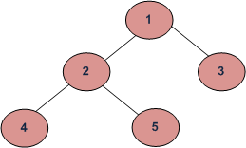
Tree Traversal (树的遍历)
Two main methods: 深度优先遍历
Preorder 根左右
Postorder 左右根
Recursive definition
Preorder:
visit the root
traverse in preorder the children (subtrees)
Postorder
traverse in postorder the children (subtrees)
visit the root
二叉树还有个一般的树没有的遍历次序，中序遍历（inorder)
(left->root->right)。
Depth First Traversals:
(a) Inorder (Left, Root, Right) : 4 2 5 1 3
(b) Preorder (Root, Left, Right) : 1 2 4 5 3
(c) Postorder (Left, Right, Root) : 4 5 2 3 1
Breadth First or Level Order Traversal : 1 2 3 4 5

Slide 16
Preorder Traversal
A traversal visits the nodes of a tree in a systematic manner
In a preorder traversal, a node is visited before its descendants
Application: print a structured document
Algorithm preOrder(v)
visit(v)
for each child w of v
preorder (w)
1
Become Rich
2
5
9
1. Motivations
2. Methods
3. Success Stories
3
4
6
7
8
1.1 Enjoy Life
1.2 Help Poor Friends
2.1 Get a CS PhD
2.2 Start a Web Site
2.3 Acquired by Google

Slide 17
Preorder Traversal - Recursive
vector<Dtype> BItree<Dtype>::bt_travelRe(TreeNode*& root) { if (root == NULL) { return vector<Dtype>(); } vector<Dtype> resultTree, leftTree, rightTree; resultTree.push_back(root->val); leftTree = bt_travelRe(root->left); rightTree = bt_travelRe(root->right); if (leftTree.size() != 0) { resultTree.insert(resultTree.end(),leftTree.begin(), leftTree.end()); } if (rightTree.size() != 0) { resultTree.insert(resultTree.end(),rightTree.begin(),rightTree.end()); } return resultTree; } 时间复杂度O(n), 空间复杂度O(n)

Slide 18
Preorder Traversal - (stack+Iterative)
vector<Dtype> BItree<Dtype>::bt_travelIt(TreeNode*& root) { vector<Dtype> result; stack<const TreeNode*> s; if (root != nullptr) { s.push(root); } while (!s.empty()) { const TreeNode *p = s.top(); s.pop(); result.push_back(p->val); if (p->right != nullptr) { s.push(p->right); } if (p->left != nullptr) { s.push(p->left); } } return result; } // 时间复杂度O(n), 空间复杂度O(n)

Slide 19
Preorder Traversal - (Morris)
算法步骤：
1. 如果当前节点的左孩子为空，则输出当前节点并将其右孩子作为当前节点。
2. 如果当前节点的左孩子不为空，在当前节点的左子树中找到当前节点在中序遍历下的前驱节点。
a) 如果前驱节点的右孩子为空，将它的右孩子设置为当前节点。输出当前节点（在这里输出，这是与中序遍历唯一一点不同）。当前节点更新为当前节点的左孩子。
b) 如果前驱节点的右孩子为当前节点，将它的右孩子重新设为空。当前节点更新为当前节点的右孩子。
3. 重复以上1、2直到当前节点为空。
Notes:
1. 如果当前节点的左孩子为空，则输出当前节点并将其右孩子作为当前节点。
2. 如果当前节点的左孩子不为空，在当前节点的左子树中找到当前节点在中序遍历下的前驱节点。
a) 如果前驱节点的右孩子为空，将它的右孩子设置为当前节点。输出当前节点（在这里输出，这是与中序遍历唯一一点不同）。当前节点更新为当前节点的左孩子。
b) 如果前驱节点的右孩子为当前节点，将它的右孩子重新设为空。当前节点更新为当前节点的右孩子。
3. 重复以上1、2直到当前节点为空。

Slide 20
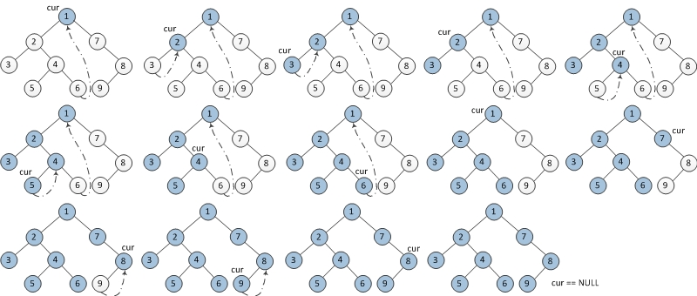
Preorder Traversal - (Morris)
Notes:
1. 如果当前节点的左孩子为空，则输出当前节点并将其右孩子作为当前节点。
2. 如果当前节点的左孩子不为空，在当前节点的左子树中找到当前节点在中序遍历下的前驱节点。
a) 如果前驱节点的右孩子为空，将它的右孩子设置为当前节点。输出当前节点（在这里输出，这是与中序遍历唯一一点不同）。当前节点更新为当前节点的左孩子。
b) 如果前驱节点的右孩子为当前节点，将它的右孩子重新设为空。当前节点更新为当前节点的右孩子。
3. 重复以上1、2直到当前节点为空。

Slide 21
Preorder Traversal - (Morris)
vector<Dtype> BItree<Dtype>::bt_travelMorris(TreeNode*& root) { vector<Dtype> result; TreeNode* cur = root, *prev = nullptr; while (cur != nullptr) { if (cur->left == nullptr) { result.push_back(cur->val); prev = cur; cur = cur->right; }else { TreeNode* node = cur->left; while(node->right != nullptr && node->right != cur) node = node->right; if (node->right == nullptr) { result.push_back(cur->val); node->right = cur; prev = cur; cur = cur->left; }else { node->right = nullptr; cur = cur->right; } } } return result; } // 时间复杂度 O(n), 空间复杂度O(1)
Notes:
1. 如果当前节点的左孩子为空，则输出当前节点并将其右孩子作为当前节点。
2. 如果当前节点的左孩子不为空，在当前节点的左子树中找到当前节点在中序遍历下的前驱节点。
a) 如果前驱节点的右孩子为空，将它的右孩子设置为当前节点。输出当前节点（在这里输出，这是与中序遍历唯一一点不同）。当前节点更新为当前节点的左孩子。
b) 如果前驱节点的右孩子为当前节点，将它的右孩子重新设为空。当前节点更新为当前节点的右孩子。
3. 重复以上1、2直到当前节点为空。

Slide 22
Postorder Traversal
In a postorder traversal, a node is visited after its descendants
Application: compute space used by files in a directory and its subdirectories
Algorithm postOrder(v)
for each child w of v
postOrder (w)
visit(v)
9
cs16/
8
3
7
homeworks/
programs/
todo.txt 1K
1
2
4
5
6
h1c.doc 3K
h1nc.doc 2K
DDR.java 10K
Stocks.java 25K
Robot.java 20K

Slide 23
Levelorder Traversal-recursive
1) Create an empty queue q
2) temp_node = root /*start from root*/
3) Loop while temp_node is not NULL
a) print temp_node->data.
b) Enqueue temp_node’s children (first left then right children) to q
c) Dequeue a node from q and assign it’s value to temp_node

Slide 24
Levelorder Traversal
template <typename Dtype> vector<Dtype> BItree<Dtype>::bt_LevelOrderRe(TreeNode*& root) { int height = bt_height(root); vector<Dtype> result; for (int i = 1; i <= height; i++) { // 遍历每一层 vector<Dtype> ret = bt_getLevel(root, i); if (ret.size() > 0) { result.insert(result.end(), ret.begin(), ret.end()); } } return result; }
Notes:
template <typename Dtype>
vector<Dtype> BItree<Dtype>::bt_getLevel(TreeNode*& root, int level) {
if (root == nullptr) {
return vector<Dtype>();
}
vector<Dtype> result, leftTree, rightTree;
if (level == 1) {
result.push_back(root->val);
}
else if (level > 1) {
leftTree = bt_getLevel(root->left, level - 1);
rightTree = bt_getLevel(root->right, level - 1);
}
if (leftTree.size() > 0) {
result.insert(result.end(), leftTree.begin(), leftTree.end());
}
if (rightTree.size() > 0) {
result.insert(result.end(), rightTree.begin(), rightTree.end());
}
return result;
}

Slide 25
Levelorder Traversal-Iterative
template <typename Dtype> vector<Dtype> BItree<Dtype>::bt_LevelOrderIt(TreeNode*& root) { if (root == nullptr) { return vector<Dtype>(); } vector<Dtype> result; queue<TreeNode*> bt_queue; bt_queue.push(root); while (bt_queue.empty() == false) { TreeNode* node = bt_queue.front(); result.push_back(node->val); bt_queue.pop(); if (node->left != NULL) { bt_queue.push(node->left); } if (node->right != NULL) { bt_queue.push(node->right); } } return result;}

Slide 26
Binary Tree
A binary tree is a tree with the following properties:
Each internal node has at most two children (degree of two)
The children of a node are an ordered pair
We call the children of an internal node left child and right child
Alternative recursive definition: a binary tree is either
a tree consisting of a single node, OR
a tree whose root has an ordered pair of children, each of which is a binary tree
Applications:
arithmetic expressions
decision processes
searching
A
B
C
D
E
F
G
H
I

Slide 27
BinaryTree ADT
The BinaryTree ADT extends the Tree ADT, i.e., it inherits all the methods of the Tree ADT
Additional methods:
position leftChild(p)
position rightChild(p)
position sibling(p)
Update methods may be defined by data structures implementing the BinaryTree ADT

Slide 28
Examples of the Binary Tree
Skewed Binary Tree
Complete Binary Tree
A
1
A
A
B
B
2
B
C
C
3
D
E
F
G
D
4
H
I
E
5

Slide 29
Differences Between A Tree and A Binary Tree
The subtrees of a binary tree are ordered; those of a tree are not ordered.
A
A
B
B
Are different when viewed as binary trees.
Are the same when viewed as trees.

Slide 30
Data Structure for Binary Trees
A node is represented by an object storing
Element
Parent node
Left child node
Right child node
∅
B
∅
∅
B
A
D
A
D
∅
∅
∅
∅
C
E
C
E

Slide 31
Arithmetic Expression Tree
Binary tree associated with an arithmetic expression
internal nodes: operators 操作符
external nodes: operands 操作数
Example: arithmetic expression tree for the expression (2 × (a − 1) + (3 × b))
+
×
×
2
−
3
b
a
1

Slide 32
Decision Tree
Binary tree associated with a decision process
internal nodes: questions with yes/no answer
external nodes: decisions
Example: dining decision
Want a fast meal?
Yes
No
How about coffee?
On expense account?
Yes
No
Yes
No
Starbucks
Spike’s
Al Forno
Café Paragon

Slide 33
Maximum Number of Nodes in a Binary Tree
The maximum number of nodes on depth i of a binary tree is 2^{i}, i>=0.
The maximum number of nodes in a binary tree of height k is 2^{k+1}-1, k>=0.
Prove by induction.

Slide 34
Relations between Number of Leaf Nodes and Nodes of Degree 2
For any nonempty binary tree, T, if n0 is the number of leaf nodes and n2 the number of nodes of degree 2, then n0=n2+1
PROOF:
Let n and B denote the total number of nodes and branches in T.
Let n0, n1, n2 represent the nodes with no children, single child, and two children respectively.
B+1=n
B=n1+2n2
n=n0+n1+n2
⇒ n₁+2n₂+1= n
⇒ n0=n2+1

Slide 35
Full Binary Tree
A full binary tree of a given height k has 2^{k+1}–1 nodes.
Height 3 full binary tree.

Slide 36
Labeling Nodes In A Full Binary Tree
Label the nodes 1 through 2^{k+1} – 1.
Label by levels from top to bottom.
Within a level, label from left to right.
1
2
3
4
5
6
7
8
9
10
11
12
13
14
15

Slide 37
Node Number Properties
1
2
3
4
5
6
7
8
9
10
11
12
13
14
15
Parent of node i is node i / 2, unless i = 1.
Node 1 is the root and has no parent.

Slide 38
Node Number Properties
1
2
3
4
5
6
7
8
9
10
11
12
13
14
15
Left child of node i is node 2i, unless 2i > n, where n is the number of nodes.
If 2i > n, node i has no left child.

Slide 39
Node Number Properties
1
2
3
4
5
6
7
8
9
10
11
12
13
14
15
Right child of node i is node 2i+1, unless 2i+1 > n, where n is the number of nodes.
If 2i+1 > n, node i has no right child.

Slide 40
Complete Binary Trees
A labeled binary tree containing the labels 1 to n with root 1, branches leading to nodes labeled 2 and 3, branches from these leading to 4, 5 and 6, 7, respectively, and so on.
A binary tree with n nodes and level k is complete if its nodes correspond to the nodes numbered from 1 to n in the full binary tree of level k.
1
1
2
3
2
3
4
5
6
7
4
5
6
7
8
9
10
11
12
13
14
15
8
9
Complete binary tree
Full binary tree of depth 3

Slide 41
Binary Tree Traversals
Let l, R, and r stand for moving left, visiting the node, and moving right.
There are six possible combinations of traversal
lRr, lrR, Rlr, Rrl, rRl, rlR
Adopt convention that we traverse left before right, only 3 traversals remain
lRr, lrR, Rlr
inorder, postorder, preorder

Slide 42
Inorder Traversal
In an inorder traversal a node is visited after its left subtree and before its right subtree
Algorithm inOrder(v)
if isInternal (v)
inOrder (leftChild (v))
visit(v)
if isInternal (v)
inOrder (rightChild (v))
6
2
8
1
4
7
9
3
5

Slide 43
Print Arithmetic Expressions
Specialization of an inorder traversal
print operand or operator when visiting node
print “(“ before traversing left subtree
print “)“ after traversing right subtree
Algorithm inOrder (v)
if isInternal (v){ print(“(’’)
inOrder (leftChild (v))}
print(v.element ())
if isInternal (v){
inOrder (rightChild (v))
print (“)’’)}
+
×
×
2
−
3
b
((2 × (a − 1)) + (3 × b))
a
1

Slide 44
Evaluate Arithmetic Expressions
recursive method returning the value of a subtree
when visiting an internal node, combine the values of the subtrees
Algorithm evalExpr(v)
if isExternal (v)
return v.element ()
else
x ← evalExpr(leftChild (v))
y ← evalExpr(rightChild (v))
◊ ← operator stored at v
return x ◊ y
+
×
×
2
−
3
2
5
1

Slide 45
Creativity: pathLength(tree) = Σ depth(v) ∀v ∈ tree
Algorithm pathLength(v, n)
Input: a tree node v and an initial value n
Output: the pathLength of the tree with root v
Usage: pl = pathLength(root, 0);
if isExternal (v)
return n
return
(pathLength(leftChild (v), n + 1) +
pathLength(rightChild (v), n + 1) + n)

Slide 46
Euler Tour Traversal (欧拉环游遍历)
Generic traversal of a binary tree
Includes a special cases the preorder, postorder and inorder traversals
Walk around the tree and visit each node three times:
on the left (preorder)
from below (inorder)
on the right (postorder)
+
L
×
R
×
B
2
−
3
2
5
1

Slide 47
Euler Tour Traversal
eulerTour(node v) {
perform action for visiting node on the left;
if v is internal then
eulerTour(v->left);
perform action for visiting node from below;
if v is internal then
eulerTour(v->right);
perform action for visiting node on the right;
}

Slide 48
Tree Traversal Summary
我们知道，树的基本遍历有4种方式，分别是：
先序遍历；中序遍历；后续遍历；层次遍历。事实上，知道任意两种方式，并不能唯一地确定树的结构.
但是，只要知道中序遍历和另外任意一种遍历方式，就一定可以唯一地确定一棵树.

Slide 49
BST(Binary Search Tree)

Slide 50
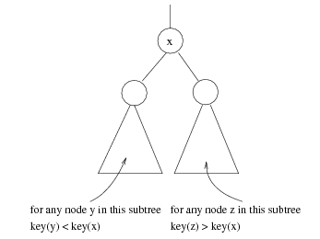
Binary Search Trees
A data structure for efficient searching, insertion and deletion.
Binary search tree property:
For every node X, all the keys in its left subtree are smaller than the key value in X.
All the keys in its right subtree are larger than the key value in X.

Slide 51
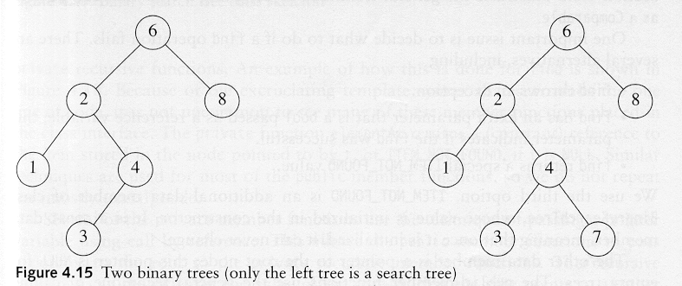
Binary Search Trees
A binary search tree
Not a binary search tree
BST的中序遍历必定是严格递增的。

Slide 52
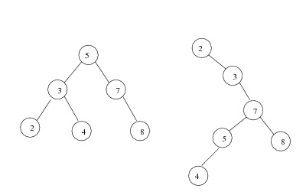
Binary Search Trees
Average depth of a node is O(log N)
Maximum depth of a node is O(N)

Slide 53
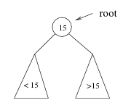
Binary Search Trees
If we are searching for 15, then we are done.
If we are searching for a key < 15, then we should search in the left subtree.
If we are searching for a key > 15, then we should search in the right subtree.

Slide 54
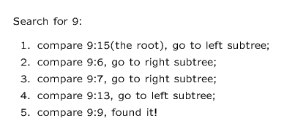
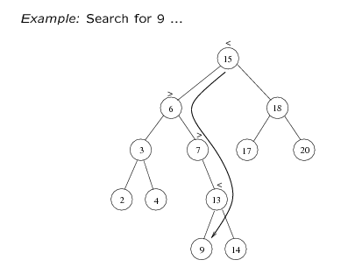
Binary Search Trees

Slide 55
BST-Searching
Find X: return a pointer to the node that has key X, or NULL if there is no such node
Time complexity: O(height of the tree)
BinaryNode * BinarySearchTree::Find(const float &x, BinaryNode *t) const
{
if (t == NULL)
return NULL;
else if (x < t->element)
return Find(x, t->left);
else if (t->element < x)
return Find(x, t->right);
else
return t; // match
}

Slide 56
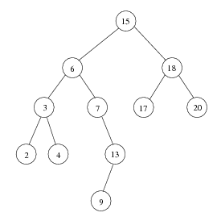
BST-Inorder Traversal
Inorder traversal of BST prints out all the keys in sorted order
Inorder: 2, 3, 4, 6, 7, 9, 13, 15, 17, 18, 20

Slide 57
BST- findMin/findMax
Goal: return the node containing the smallest (largest) key in the tree
Algorithm: Start at the root and go left (right) as long as there is a left (right) child. The stopping point is the smallest (largest) element
Time complexity = O(height of the tree)
BinaryNode * BinarySearchTree::FindMin(BinaryNode *t) const
{
if (t == NULL)
return NULL;
if (t->left == NULL)
return t;
return FindMin(t->left);
}

Slide 58
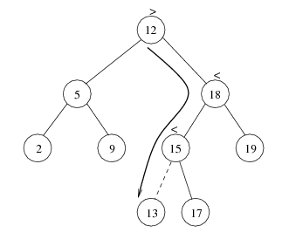
BST - Insertion
Proceed down the tree as you would with a find
If X is found, do nothing (or update something)
Otherwise, insert X at the last spot on the path traversed
Time complexity = O(height of the tree)

Slide 59


BST - deletion
When we delete a node, we need to consider how we take care of the children of the deleted node.
This has to be done such that the property of the search tree is maintained.

Slide 60
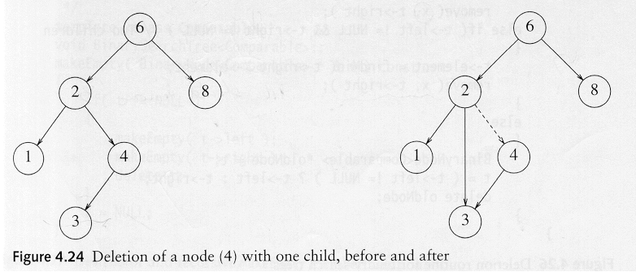
BST-deletion under different cases
Case 1: the node is a leaf
Delete it immediately
Case 2: the node has one child
Adjust a pointer from the parent to bypass that node

Slide 61
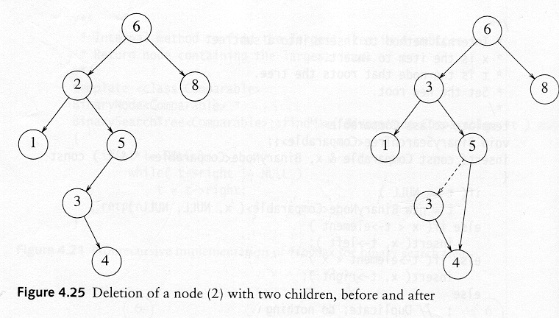
Deletion Case 3
Case 3: the node has 2 children
Replace the key of that node with the minimum element at the right subtree
Delete that minimum element
Has either no child or only right child because if it has a left child, that left child would be smaller and would have been chosen. So invoke case 1 or 2.
Time complexity = O(height of the tree)

Slide 62
AVL
(Georgy Adelson-Velsky and Landis' tree, named after the inventors) is a self-balancing binary search tree )

Slide 63
AVL Tree
Definition:
binary search tree 必须是二叉搜索树
For any node, the heights of left subtree and right subtree differ at most 1.
(if differ at most k, called BH(k) tree).
每个节点的左子树和右子树的高度差至多为1。
Theorem (Adel'son-Vel'skii and Landis 1962):
The height of an AVL tree with N internal nodes always lies between log (N +1 ) and 1..4404 log(N + 2) - 0.328

Slide 64
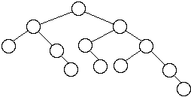
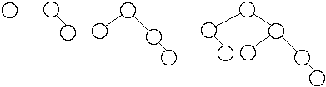
AVL Tree Examples
Worst case AVL trees
Figures in these slides are copied from:
http://www.eli.sdsu.edu/courses/fall96/cs660/notes/avl/avl.html#RTFToC2

Slide 65
AVL Tree
Insertion:
As normal binary search tree insertion
Reconstruct tree by rotation if some nodes become unbalanced
Deletion:
as normal binary search tree deletion
The node deleted will be either a leaf or have just one subtree (this is true for all binary search tree deletion)
if the deleted node has one subtree, then that subtree contains only one node
Traverse up the tree from the deleted node checking the balance of each node, balance the node by rotation if unbalanced
Theorem:
An insertion into an AVL tree requires at most one rotation to rebalance a tree. A deletion may require log(N) rotations to rebalance the tree.

Slide 66
AVL树失衡调整
节点的插入或删除都有可能导致AVL树失去平衡，因此，失衡调整是插入与删除操作的基础。
AVL树的失衡调整可以分为四种情况，我们逐一分析。
假设我们要为数组a[]={4，5，6，3，2，8，7，0，1}构建一棵AVL树。

Slide 67
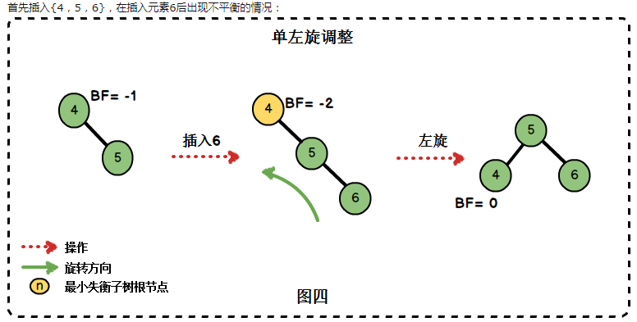
AVL 情况一：左单旋转
Notes:
当我们在右子树插入右孩子导致AVL失衡时，我们需要进行单左旋调整。旋转围绕最小失衡子树的根节点进行。
在删除新节点时也有可能会出现需要单左旋的情况。
左旋代码如下：
/*左旋转操作*/
/*pnode为最小失衡子树的根节点*/
/*返回旋转后的根节点*/
template<typename T>
AVLTreeNode<T>* AVLTree<T>::leftRotation(AVLTreeNode<T>* proot)
{
AVLTreeNode<T>* prchild = proot->rchild;
proot->rchild = prchild->lchild;
prchild->lchild = proot;
proot->height = max(height(proot->lchild),height(proot->rchild))+1; //更新节点的高度值
prchild->height = max(height(prchild->lchild), height(prchild->rchild)) + 1; //更新节点的高度值
return prchild;
};
结合例子进行分析：
参数proot为最小失衡子树的根节点，在图四中为节点4
若节点5有左子树，则该左子树成为节点4的右子树
节点4成为节点5的左子树
最后更新节点的高度值

Slide 68
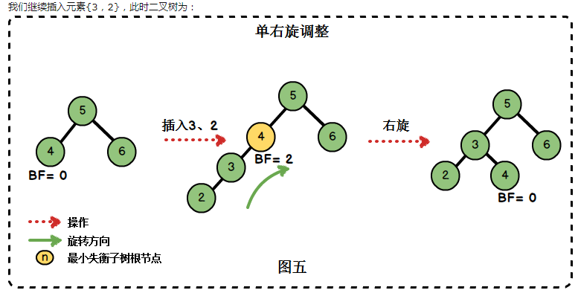
AVL 情况二：右单旋转
Notes:
插入3、2后出现了不平衡的情况。此时的插入情况是“在左子树上插入左孩子导致AVL树失衡”，我们需要进行单右旋调整。
单右旋代码为：
/*右旋转操作*/
/*pnode为最小失衡子树的根节点*/
/*返回旋转后的根节点*/
template <typename T>
AVLTreeNode<T>* AVLTree<T>::rightRotation(AVLTreeNode<T>*proot)
{
AVLTreeNode<T>* plchild = proot->lchild;
proot->lchild = plchild->rchild;
plchild->rchild = proot;
proot->height = max(height(proot->lchild), height(proot->rchild)) + 1; //更新节点的高度值
plchild->height = max(height(plchild->lchild), height(plchild->rchild)) + 1; //更新节点的高度值
return plchild;
};
结合例子进行分析：
参数proot为最小失衡子树的根节点，在图四中为节点4
若节点3有右子树，则该右子树成为节点4的左子树
节点4成为节点3的左子树
调整节点的高度值

Slide 69
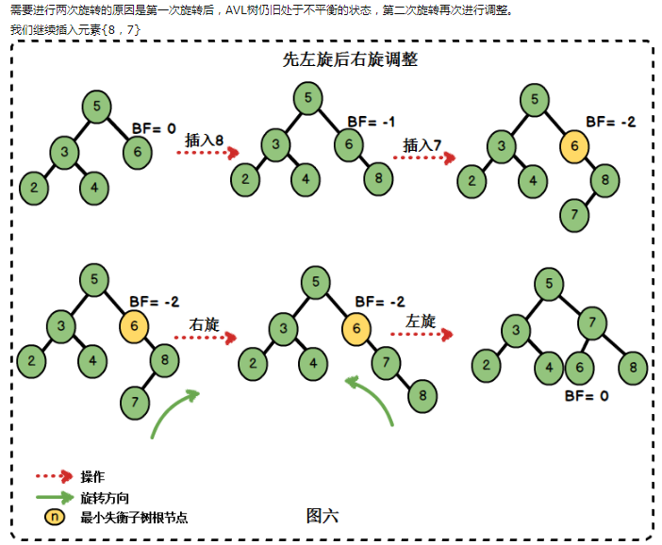
AVL 情况三：先右旋后左旋
Notes:
这种情况，总结起来就是“在右子树上插入左孩子导致AVL树失衡",此时我们需要进行先右旋后左旋的调整。
调整的代码为：
/*先右旋再左旋*/
/*参数proot为最小失衡子树的根节点*/
/*返回旋转后的根节点*/
template<typename T>
AVLTreeNode<T>* AVLTree<T>::rightLeftRotation(AVLTreeNode<T>* proot)
{
proot->rchild = rightRotation(proot->rchild);
return leftRotation(proot);
};
结合例子进行分析：
首先对最小不平衡子树的根节点（也就是节点6）的右孩子（也就是8）进行右旋操作
再对节点6进行一次左旋操作

Slide 70
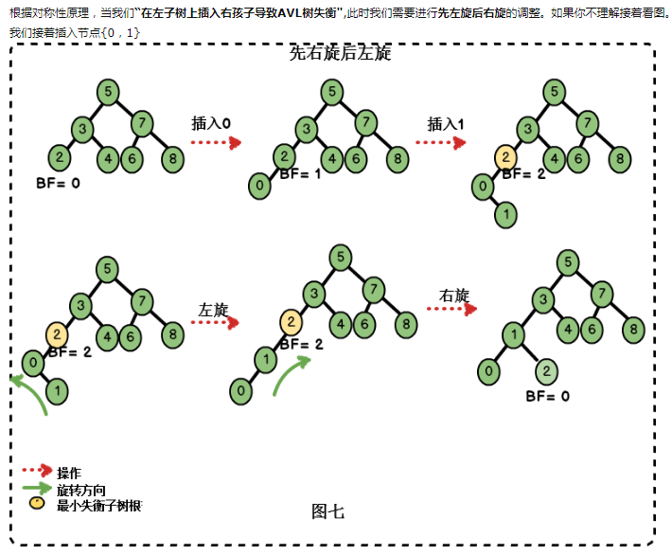
AVL 情况四：先左旋后右旋
Notes:
调整的代码:
/*先左后右做旋转*/
/*参数proot为最小失衡子树的根节点*/
/*返回旋转后的根节点*/
template <typename T>
AVLTreeNode<T>* AVLTree<T>::leftRightRotation(AVLTreeNode<T>* proot)
{
proot->lchild= leftRotation(proot->lchild);
return rightRotation(proot);
};
结合例子进行分析：
首先对最小不平衡子树的根节点（也就是节点2）的左孩子（也就是0）进行左旋操作
再对节点2进行一次右旋操作

Slide 71
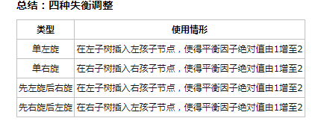
AVL 失衡调整

Slide 72
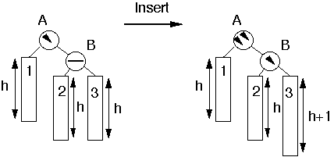
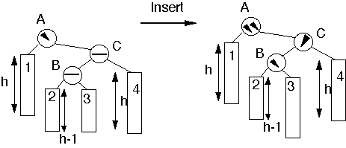
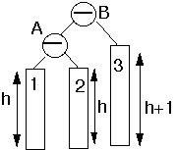
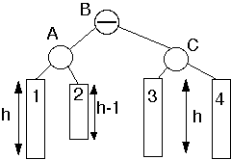
AVL tree insertion examples
Insert into subtree 3
Insert into subtree 2 or 3
Perform single rotation
Perform double rotation
Notes:
/*插入操作*/
/*递归地进行插入*/
/*返回插入后的根节点*/
template <typename T>
AVLTreeNode<T>* AVLTree<T>::insert(AVLTreeNode<T>* &pnode, T key)
{
if (pnode == nullptr) //寻找到插入的位置
{
pnode = new AVLTreeNode<T>(key, nullptr, nullptr);
}
else if (key > pnode->key) //插入值比当前结点值大，插入到当前结点的右子树上
{
pnode->rchild = insert(pnode->rchild, key);
if (height(pnode->rchild) - height(pnode->lchild) == 2) //插入后出现失衡
{
if (key > pnode->rchild->key) //情况一：插入右子树的右节点，进行左旋
pnode=leftRotation(pnode);
else if (key < pnode->rchild->key) //情况三：插入右子树的左节点,进行先右再左旋转
pnode=rightLeftRotation(pnode);
}
}
else if (key < pnode->key) //插入值比当前节点值小，插入到当前结点的左子树上
{
pnode->lchild = insert(pnode->lchild, key);
if (height(pnode->lchild) - height(pnode->rchild) == 2) //如果插入导致失衡
{
if (key < pnode->lchild->key) //情况二：插入到左子树的左孩子节点上，进行右旋
pnode = rightRotation(pnode);
else if (key>pnode->lchild->key)
pnode = leftRightRotation(pnode);//情况四：插入到左子树的右孩子节点上，进行先左后右旋转
}
}
pnode->height = max(height(pnode->lchild), height(pnode->rchild)) + 1;
return pnode;
};

Slide 73
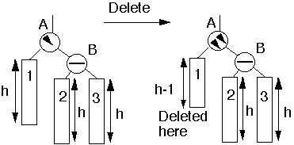
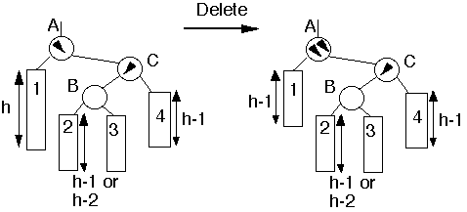
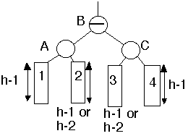
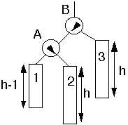
AVL tree deletion examples
Deletion from subtree 1
Deletion from subtree 1
Perform single rotation
Perform double rotation
Notes:
删除节点也可能导致AVL树的失衡，实际上删除节点和插入节点是一种互逆的操作：
删除右子树的节点导致AVL树失衡时，相当于在左子树插入节点导致AVL树失衡，即情况情况二或情况四。
删除左子树的节点导致AVL树失衡时，相当于在右子树插入节点导致AVL树失衡，即情况情况一或情况三。
另外，AVL树也是一棵二叉排序树，因此在删除节点时也要维护二叉排序树的性质。
删除的代码实现：
*删除指定元素*/
template<typename T>
AVLTreeNode<T>* AVLTree<T>::remove(AVLTreeNode<T>* & pnode, T key)
{
if (pnode != nullptr)
{
if (key == pnode->key) //找到删除的节点
{
//因AVL也是二叉排序树，删除节点要维护其二叉排序树的条件
if (pnode->lchild != nullptr&&pnode->rchild != nullptr) //若左右都不为空
{
// 左子树比右子树高,在左子树上选择节点进行替换
if (height(pnode->lchild) > height(pnode->rchild))
{
//使用左子树最大节点来代替被删节点，而删除该最大节点
AVLTreeNode<T>* ppre = maximum(pnode->lchild); //左子树最大节点
pnode->key = ppre->key; //将最大节点的值覆盖当前结点
pnode->lchild = remove(pnode->lchild, ppre->key); //递归地删除最大节点
}
else //在右子树上选择节点进行替换
{
//使用最小节点来代替被删节点，而删除该最小节点
AVLTreeNode<T>* psuc = minimum(pnode->rchild); //右子树的最小节点
pnode->key = psuc->key; //将最小节点值覆盖当前结点
pnode->rchild = remove(pnode->rchild, psuc->key); //递归地删除最小节点
}
}
else
{
AVLTreeNode<T> * ptemp = pnode;
if (pnode->lchild != nullptr)
pnode = pnode->lchild;
else if (pnode->rchild != nullptr)
pnode = pnode->rchild;
delete ptemp;
return nullptr;
}
}
else if (key > pnode->key)//要删除的节点比当前节点大，则在右子树进行删除
{
pnode->rchild = remove(pnode->rchild, key);
//删除右子树节点导致不平衡:相当于情况二或情况四
if (height(pnode->lchild) - height(pnode->rchild) == 2)
{
//相当于在左子树上插入右节点造成的失衡（情况四）
if (height(pnode->lchild->rchild)>height(pnode->lchild->lchild))
pnode = leftRightRotation(pnode);
else//相当于在左子树上插入左节点造成的失衡（情况二）
pnode = rightRotation(pnode);
}
}
else if (key < pnode->key)//要删除的节点比当前节点小，则在左子树进行删除
{
pnode->lchild= remove(pnode->lchild, key);
//删除左子树节点导致不平衡：相当于情况三或情况一
if (height(pnode->rchild) - height(pnode->lchild) == 2)
{
//相当于在右子树上插入左节点造成的失衡（情况三）
if (height(pnode->rchild->lchild)>height(pnode->rchild->rchild))
pnode = rightLeftRotation(pnode);
else//相当于在右子树上插入右节点造成的失衡（情况一）
pnode = leftRotation(pnode);
}
}
return pnode;
}
return nullptr;
};
删除节点时，如果节点同时拥有左子树和右子树，则在高度教低的子树上选择最大（或最小）元素进行替换，这样能保证替换后不会再出现失衡的现象。

Slide 75
Red-black Tree
由于红黑树本质上就是一棵二叉查找树

Slide 76
RB-Tree 性质
前面我们已经说过，红黑树，本质上来说就是一棵二叉查找树，但它在二叉查找树的基础上增加了着色和相关的性质使得红黑树相对平衡，从而保证了红黑树的查找、插入、删除的时间复杂度最坏为O(log n)。
但它是如何保证一棵n个结点的红黑树的高度始终保持在h = logn的呢？这就引出了红黑树的5条性质：
1）每个结点要么是红的，要么是黑的。
2）根结点是黑的。
3）每个叶结点（叶结点即指树尾端NIL指针或NULL结点）是黑的。
4）如果一个结点是红的，那么它的俩个儿子都是黑的。
5）对于任一结点而言，其到叶结点树尾端NIL指针的每一条路径都包含相同数目的黑结点。
正是红黑树的这5条性质，使得一棵n个结点是红黑树始终保持了logn的高度，从而也就解释了上面我们所说的“红黑树的查找、插入、删除的时间复杂度最坏为O(log n)”这一结论的原因。

Slide 77
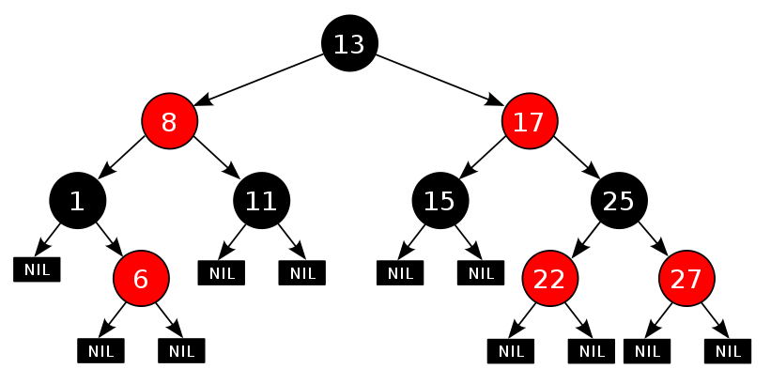
RB-Tree
Notes:
上文中我们所说的 "叶结点" 或"NULL结点"，它不包含数据而只充当树在此结束的指示，这些结点以及它们的父结点，在绘图中都会经常被省略。

Slide 79
Balanced Search Trees
To implement a symbol table, Binary Search Trees work pretty well, except…
The worst case is O(n) and it is embarassingly likely to happen in practice – if the keys are sorted, or there are lots of duplicates, or various kinds of structure
Ideally we would want to keep a search tree perfectly balanced, like a heap
But how can we insert or delete in O(log n) time and re-balance the whole tree?
Three approaches: randomize, amortize, or optimize

Slide 80
Randomized BSTs
The randomized approach: introduce randomized decision making.
Dramatically reduce the chance of worst case.
Like quicksort, with random pivot
This algorithm is simple, efficient, broadly applicable – but went undiscovered for decades (until 1996!) [Only the analysis is complicated.]
Can you figure it out? How to introduce randomness in the created structure of the BST?

Slide 81
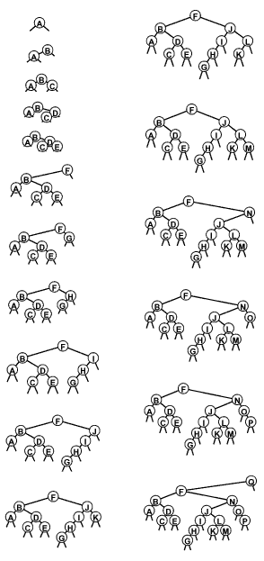
Random BSTs
Idea: to insert into a tree with n nodes,
with probability 1/(n+1) make the new node the root.
otherwise insert normally.
(this decision could be made at any point along the insertion path.)
result: about 2 n ln n comparisons to build tree; about 2 ln n for search
(that’s about 1.4 lg n)

Slide 82
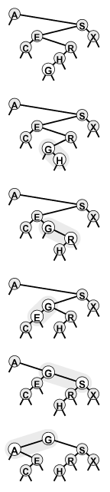
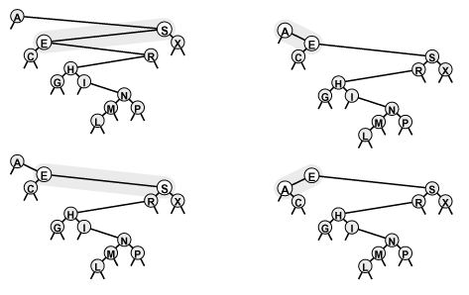
How to insert at the root?
You might well ask: “that’s all well and good, but how do we insert at the root of a BST?”
I might well answer: Insert normally. Then rotate to move it up in the tree, until it is at the top.
Left and Right rotations:
Rotate to the top!

Slide 83
Randomized BST analysis
The average case is the same for BSTs and RBSTs: but the essential point is that the analysis for RBSTs assumes nothing about the order of the insertions
The probability that the construction cost is more than k times the average is less than e^{-k}
E.g. to build a randomized BST with 100,000 nodes, one would expect 2.3 million comparisons. The chance of 23 million comparisons is 0.01 percent.
Bottom line:
full symbol table ADT
straightforward implementation
O(log N) average case: bad cases provably unlikely

Slide 84
Splay Trees 伸展树
Use root insertion
Idea: let’s rotate so as to better balance the tree
The difference between standard root insertion and splay insertion seem trivial: but the splay operation eliminates the quadratic worst case
The number of comparisons used for N splay insertions into an initially empty tree is O(N lg N) – actually, 3 N lg N.
amortized algorithm: individual operations may be slow, but the total runtime for a series of operations is good.

Slide 85
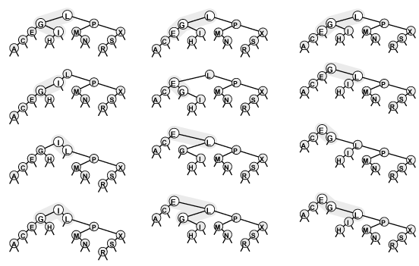
Splay Insertion
Orientations differ: same as root insertion
Orientations the same: do top rotation first
(brings nodes on search path closer to the root—how much?)

Slide 86
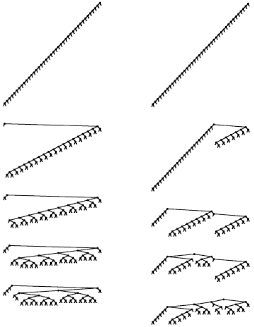
Splay Tree
When we insert, nodes on the search path are brought half way to the root.
This is also true if we splay while searching.
Trees at right are balanced with a few splay searches
left: smallest, next smallest, etc
right: random
Result: for M insert or search ops in an N-node splay tree, O((N+M)lg(N+M)) comparisons are required.
This is an amortized result.

Slide 87
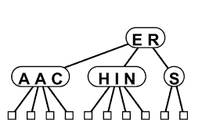
234 Intro
234 Trees are are worst-case optimal: Θ(log n) per operation
Idea: nodes have 1, 2, or 3 keys and 2, 3, or 4 links.
Subtrees have keys ordered analogously to a binary search tree.
A balanced 234 search tree has all leaves at the same level.
How would search work?
How would insertion work?
split nodes on the way back up?
or split 4-nodes on the way down?

Slide 88
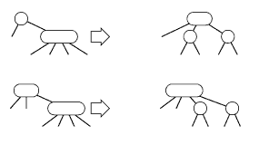
Top-down vs. Bottom-up
Top-down 2-3-4 trees split nodes on the way down. But splitting a node means pushing a key back up, and it may have to be pushed all the way back up to the root.
It’s easier to split any 4-node on the way down.
2-node with 4-node child: split into 3-node with two 2-node children
3-node with 4-node child: split into 4-node with two 2-node children
Thus, all searches end up at a node with space for insertion

Slide 89
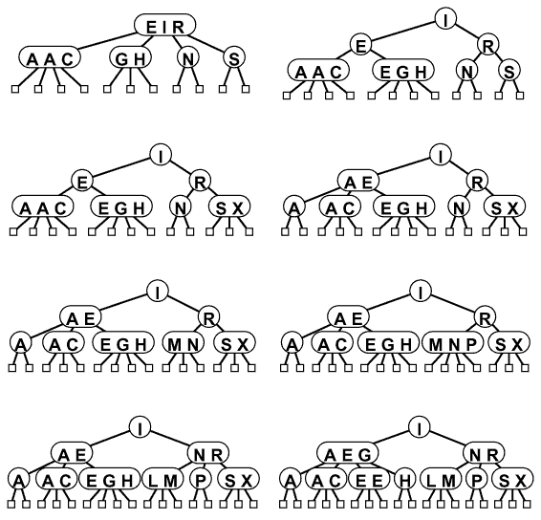
Construction Example

Slide 90
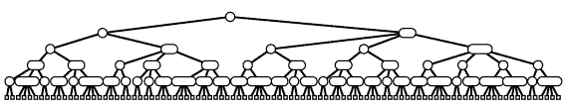
234 Balance
All paths from the top to the bottom are the same height
What is that height?
worst case: lgN (all 2-nodes)
best case: lgN/2 (all 4-nodes)
height 10-20 for a million nodes; 15-30 for a billion
Optimal!
(But is it fast?)

Slide 91
Implementation Details
Actually, there are many 234-tree variants:
splitting on the way up vs. down
2-3 vs. 2-3-4 trees
Implementation is complicated because of the large number of cases that have to be considered.
Can we improve the optimal balanced-tree approach, for fewer cases and strictly binary nodes?

Slide 92
B-trees
What about using even more keys? B-trees
Like a 234 tree, but with many keys, say b=100 or 500
Usually enough keys to fill a 4k or 16k disk block
Time to find an item: O(log_{b}n)
E.g. b=500: can locate an item in 500 with one disk access, 250,000 with 2, 125,000,000 with 3
Used for database indexes, disk directory structures, etc., where the tree is too large for memory and each step is a disk access.
Drawback: wasted space

Slide 93
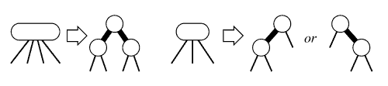
Red-Black Trees
Idea: Do something like a 2-3-4 Tree, but using binary nodes only
The correspondence it not 1-1 because 3-nodes swing either way
Add a bit per node to mark as Red or Black
Black links bind together the 2-3-4 tree; red links bind the small binary trees holding 2, 3, or 4 nodes. (Red nodes are drawn with thick links to them.)
Two red nodes in a row are not needed (or allowed)

Slide 94
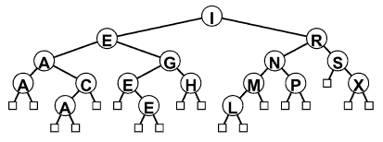
Red-Black Tree Example
This tree is the same as the 2-3-4 tree built a few slides back, with the letters “ASEARCHINGEXAMPLE”
Notice that it is quite well balanced.
(How well?)
(We’ll see in a moment.)

Slide 95
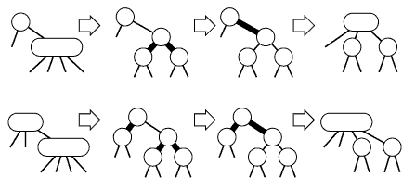
RB-Tree Insertion
How do we search in a RB-tree?
How do we insert into a RB-tree?
normal BST insert; new node is red
How do we perform splits?
Two cases are easy: just change colors!

Slide 96
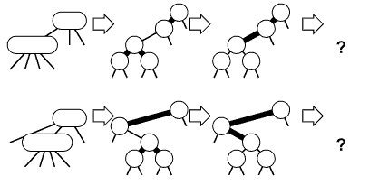
RB-Tree Insertion 2
Two cases require rotations:
Two adjacent red nodes – not allowed!
If the 4-node is on an outside link, a single rotation is needed
If the 4-node is on the center link, double rotation

Slide 97
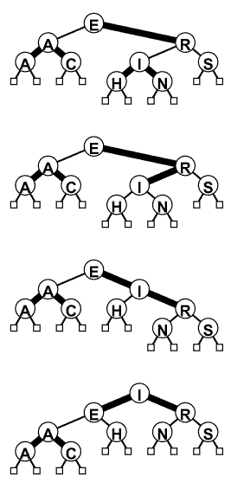
RB-Tree Split
We can use the red-black abstraction directly
No two red nodes should be adjacent
If they become adjacent, rotate a red node up the tree
(In this case, a double rotation makes I the root)
Repeat at the parent node
There are 4 cases
Details a bit messy:
leave to STL!

Slide 98
Red-Black Tree Insertion
link RBinsert(link h, Item item, int sw)
{ Key v = key(item);
if (h == z) return NEW(item, z, z, 1, 1);
if ((hl->red) && (hr->red))
{ h->red = 1; hl->red = 0; hr->red = 0; }
if (less(v, key(h->item)))
{
hl = RBinsert(hl, item, 0);
if (h->red && hl->red && sw) h = rotR(h);
if (hl->red && hll->red)
{ h = rotR(h); h->red = 0; hr->red = 1;
} else {
hr = RBinsert(hr, item, 1);
if (h->red && hr->red && !sw) h = rotL(h);
if (hr->red && hrr->red)
{ h = rotL(h); h->red = 0; hl->red = 1; }
return h;
}
void STinsert(Item item)
{ head = RBinsert(head, item, 0); head->red = 0; }

Slide 99
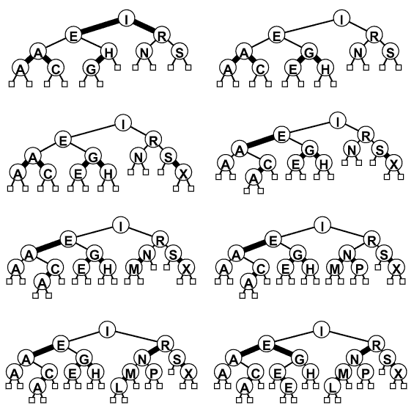
RB Tree Construction

Slide 100
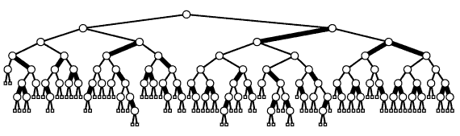
Red-Black Tree Summary
RB-Trees are BSTs with add’l properties:
Each node (or link to it) is marked either red or black
Two red nodes are never connected as parent and child
All paths from the root to a leaf have the same black-length
How close to being balanced are these trees?
According to black nodes: perfectly balanced
Red nodes add at most one extra link between black nodes
Height is therefore at most 2 log n.

Slide 101
Comparisons
There are several other balanced-tree schemes, e.g. AVL trees
Generally, these are BSTs, with some rotations thrown in to maintain balance
Let STL handle implementation details for you
Build Tree Search Misses
N BST RBST Splay RB Tree BST RBST Splay RB
5000 4 14 8 5 3 3 3 2
50000 63 220 117 74 48 60 46 36
200000 347 996 636 411 235 294 247 193

Slide 102
Summary
Goal: Symbol table implementation
O(log n) per operation
Randomized BST: O(log n) expected
Splay tree: O(log n) amortized
RB-Tree: O(log n) worst-case
The algorithms are variations on a theme: rotate during insertion or search to improve balance

Slide 103
STL Containers using RB trees
set: container for unique items
Member functions:
insert()
erase()
find()
count()
lower_bound()
upper_bound()
iterators to move through the set in order
multiset: like set, but items can be repeated

Slide 104
总结
AVL树: 最早的平衡二叉树之一。应用相对其他数据结构比较少。windows对进程地址空间的管理用到了AVL树。
红黑树: 平衡二叉树，广泛用在C++的STL中。如map和set都是用红黑树实现的
B/B+树: 用在磁盘文件组织 数据索引和数据库索引。
Trie树(字典树): 用在统计和排序大量字符串，如自动机。

