Slide 1
Introduction to Machine learning
Model Validation Techniques in Machine Learning

Slide 2
Model Validation Techniques
Outcomes analysis.
Cross-validation.
Variable importance tables.

Slide 3
Model Validation – Outcomes analysis
Compare modeled results to actual data.
Simply plot the range of the independent variable against both the actual and predicted outcome along with the number of observations.

Slide 4
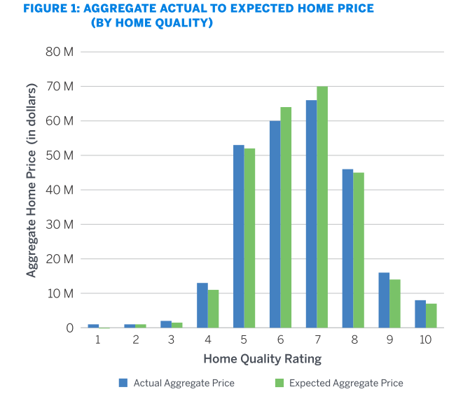
Model Validation – Outcomes analysis

Slide 5
Model Validation – Cross-validation
Cross-validation is a common strategy to help ensure that a model isn’t overfitting the sample data it’s being developed with.
Sample data is most commonly split at an 80-20 level, with 80% being used to fit or train the model and 20% being held out to test the model.
More rigorous approaches to cross-validation also exist, including k-fold validation, in which the cross-validation process is repeated many times with different splits of the sample data.

Slide 6
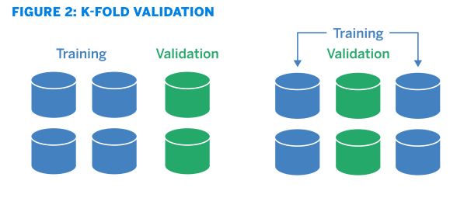
Model Validation – Cross-validation

Slide 7
Model Validation – Feature Importance Charts
FIC charts show which variables are the most important in producing output.
Variable importance tables are generally output from the model estimation process. For model validation, it is critical to evaluate the variable importance table to evaluate if the most influential variables make intuitive sense and are consistent with results from other model approaches.

Slide 8
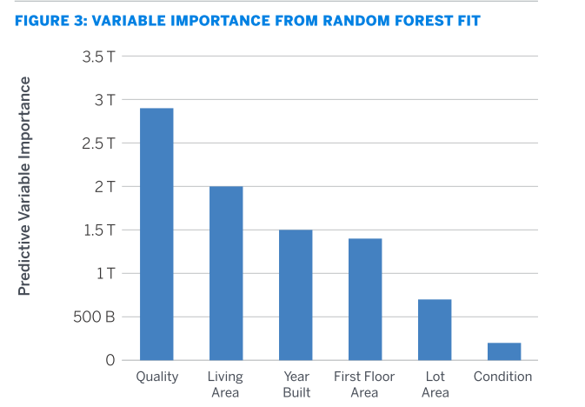
Model Validation – Feature Importance Charts

