Slide 1
Introduction to Algorithm
Divide and conquer(分治法)

Slide 2
Divide and Conquer
Step 1: If the problem size is small, solve this problem directly; otherwise, split the original problem into 2 sub-problems with equal sizes.
Step 2: Recursively solve these 2 sub-problems by applying this algorithm.
Step 3: Merge the solutions of the 2 sub- problems into a solution of the original problem.

Slide 3
Divde_Conquer recurrence relation
The computing time of Divde_Conquer is
T(n) is the time for Divde_Conquer on any input size n.
g(n) is the time to compute the answer directly (for small inputs)
f(n) is the time for dividing P and combining the solutions.
n small
otherwise

Slide 4
Divide and Conquer
A problem of size n
(instance)
subproblem 1
of size n/2
subproblem 2
of size n/2
a solution to
subproblem 1
a solution to
subproblem 2
a solution to
the original problem
It general leads to a recursive algorithm!

Slide 5
Divide-and-Conquer Examples
Sorting: mergesort and quicksort
Binary tree traversals
Binary search (?)
Multiplication of large integers
Matrix multiplication: Strassen’s algorithm
Closest-pair and convex-hull algorithms

Slide 6
Example1: Merge Sort

Slide 7
Example2: Quick Sort
Select a pivot (partitioning element) – here, the first element
Rearrange the list so that all the elements in the first s positions are smaller than or equal to the pivot and all the elements in the remaining n-s positions are larger than or equal to the pivot (see next slide for an algorithm)
Exchange the pivot with the last element in the first (i.e., ≤) subarray — the pivot is now in its final position
Sort the two subarrays recursively
p
A[i]≤p
A[i]≥p

Slide 8
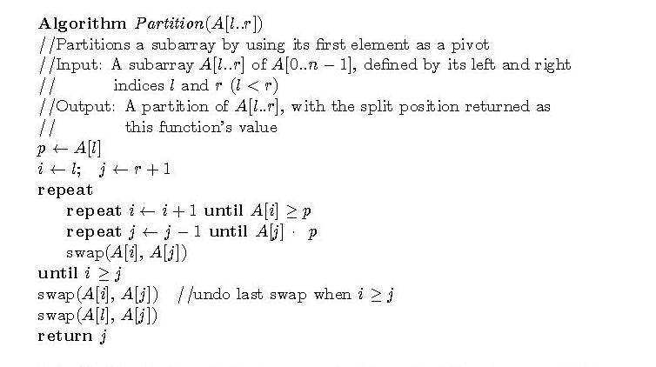
Example2: Quick Sort

Slide 9
Example2: Quick Sort
5 3 1 9 8 2 4 7
2 3 1 4 5 8 9 7
1 2 3 4 5 7 8 9
1 2 3 4 5 7 8 9
1 2 3 4 5 7 8 9
1 2 3 4 5 7 8 9

