Slide 1
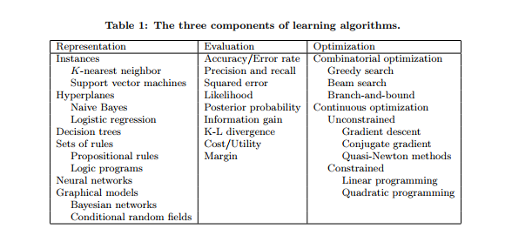
Introduction to Machine Learning
Regression

Slide 2
Regression
Linear Regression (线性回归)
Locally weighted linear regression(LWLR: 局部加权回归)
Ridge regression and stagewise linear regression(岭回归, 分段回归)

Slide 3

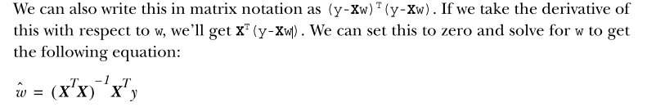
1. Linear Regression
Squared error:
def standRegres(xArr,yArr): xMat = mat(xArr); yMat = mat(yArr).T xTx = xMat.T*xMat if linalg.det(xTx) == 0.0: print "This matrix is singular, cannot do inverse" return ws = xTx.I * (xMat.T*yMat) return ws

Slide 4
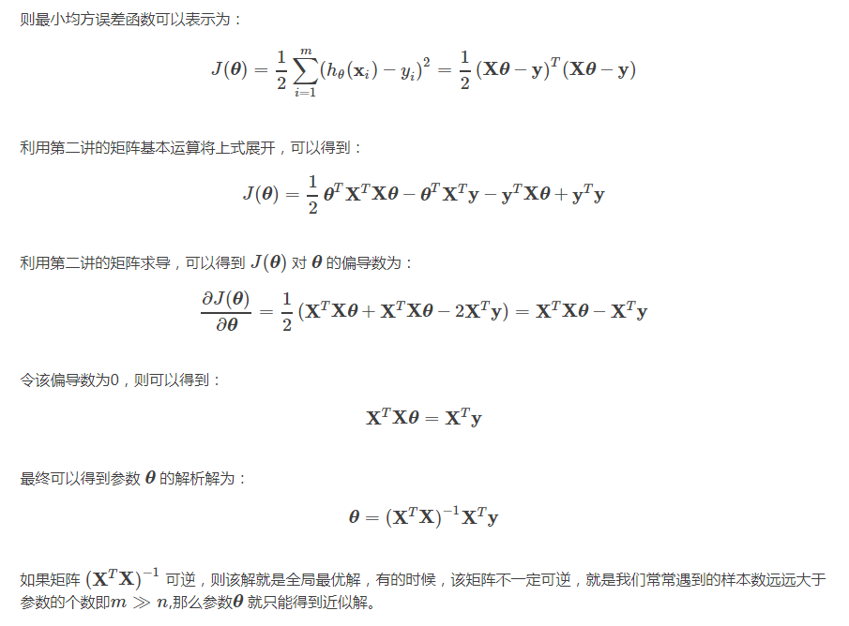
对权重w求导

Slide 5



2. Locally weighted linear regression
where W is a matrix that’s used to weight the data points.
LWLR uses a kernel something like the kernels demonstrated in support vector
machines to weight nearby points more heavily than other points. You can use any kernel you like. The most common kernel to use is a Gaussian. The kernel assigns a weight given by：
def lwlr(testPoint,xArr,yArr,k=1.0): # xMat = mat(xArr); yMat = mat(yArr).T m = shape(xMat)[0] weights = mat(eye((m))) for j in range(m): # next 2 lines create weights matrix diffMat = testPoint - xMat[j,:] weights[j,j] = exp(diffMat*diffMat.T/(-2.0*k**2)) xTx = xMat.T * (weights * xMat) if linalg.det(xTx) == 0.0: print "This matrix is singular, cannot do inverse" return ws = xTx.I * (xMat.T * (weights * yMat)) return testPoint * ws
Notes:
In LWLR we give a weight to data points near our data point of interest
1. 在一个数据集中，如果采用线性回归的算法，数据之间的影响是比较大的，此算法对所有数据一视同仁，并不会很理智的去筛选出有用的数据。
2. LWLR加入了权值概念，为每一个数据定义一个权值系数。如果认为这个数据有用，那这个数据对应的权值相应就比较大；相反如果认为这个数据偏差太大，其对应的权值系数就会很小。这样一来，让有用的数据影响性增大，偏差太大的数据影响性减小，最后会使整个系统更加准确的预计出y值。

Slide 6
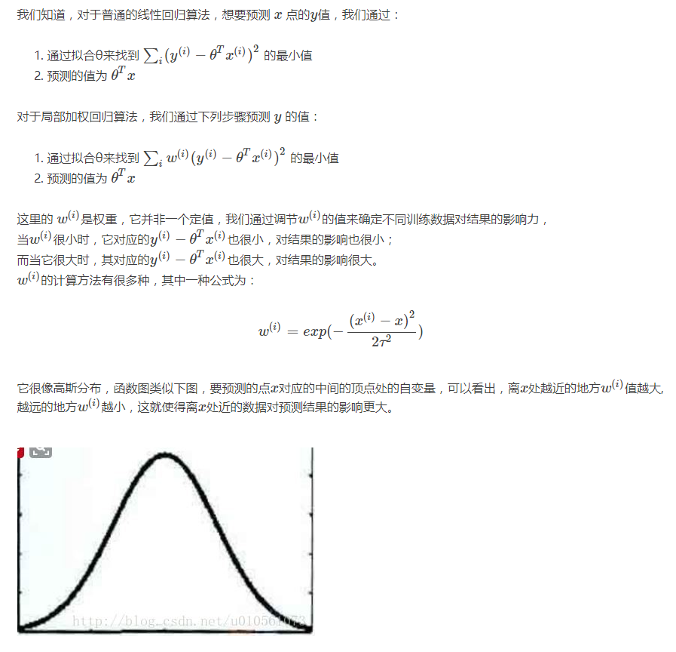
2. Locally weighted linear regression

Slide 7

3. Lasso Regression
The only difference is that we’re taking the absolute value instead of the square of all
the weights.
岭回归是采用的正则化的方法进行特征的选择，使用的是
而lasso采用的则是 ，即lasso是在平方误差的基础上增加
Notes:
\sum_{i=1}^{m}(y_{i} - x^{T}w_{j})^{2} + \lambda \sum_{j=0}^{p}\left | w_{j} \right |

Slide 8


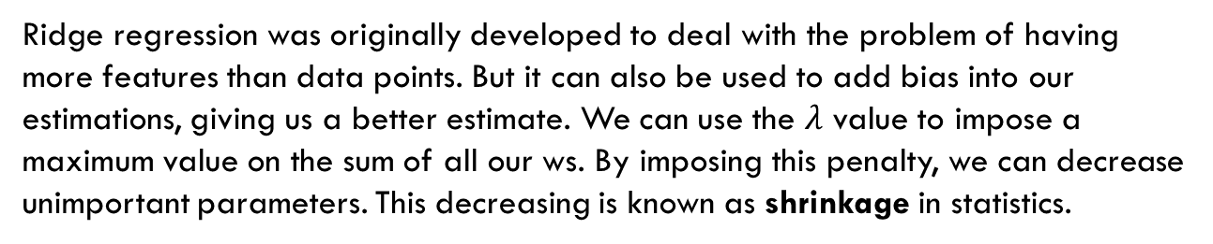
4.Redge Regression
Ridge regression was originally developed to deal with the problem of having more features than data points. But it can also be used to add bias into our estimations, giving us a better estimate. We can use the $λ$ value to impose a maximum value on the sum of all our ws. By imposing this penalty, we can decrease unimportant parameters. This decreasing is known as shrinkage in statistics.
def ridgeRegres(xMat,yMat,lam=0.2): xTx = xMat.T*xMat denom = xTx + eye(shape(xMat)[1])*lam if linalg.det(denom) == 0.0: print "This matrix is singular, cannot do inverse" return ws = denom.I * (xMat.T*yMat) return ws
Notes:
\sum_{i=1}^{m}(y_{i} - x^{T}w_{j})^{2} + \lambda \sum_{j=0}^{p}{w_{j}}^{2}

Slide 9
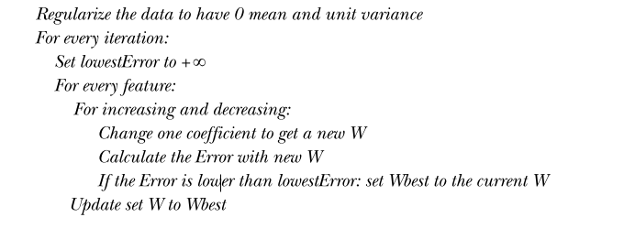
5. Forward stagewise regression

Slide 10
Shrinkage methods
Ridge regression is an example of a shrinkage method. Shrinkage methods impose a constraint on the size of the regression coefficients. Another shrinkage method that’s powerful is the lasso. The lasso is difficult to compute, but stagewise linear regression is easy to compute and gives results close to those of the lasso.
Shrinkage methods can also be viewed as adding bias to a model and reducing the variance. The bias/variance tradeoff is a powerful concept in understanding how altering a model impacts the success of a model.
The methods explored in this chapter are powerful. Sometimes our data will have complex interactions, perhaps nonlinear interactions that will be difficult to model with linear models. The next chapter explores a few techniques that use trees to cre-ate forecasts for our data.

Slide 11
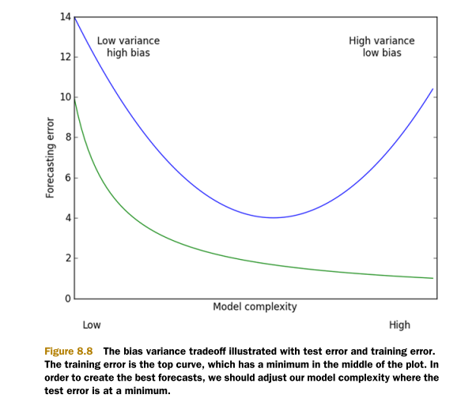
Bias & Variance trade-off

Slide 12
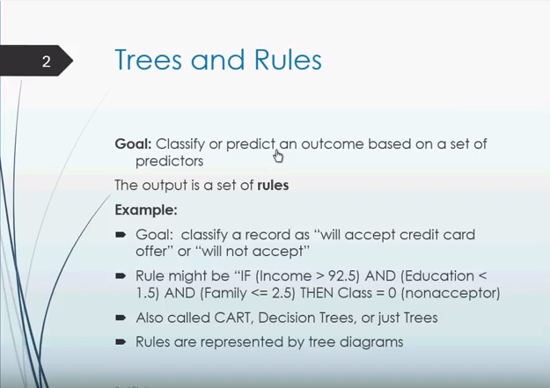
6. Tree-based regression
CART: Classification and Regression Tree.

Slide 13
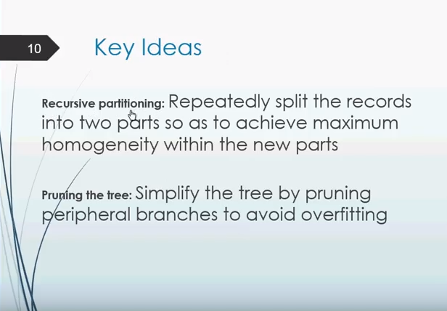
CART: Classification and Regression Tree.

Slide 14
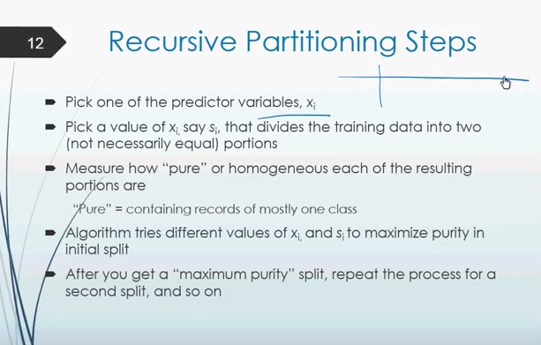
CART: Classification and Regression Tree.

Slide 15
CART: Classification and Regression Tree.

Slide 16
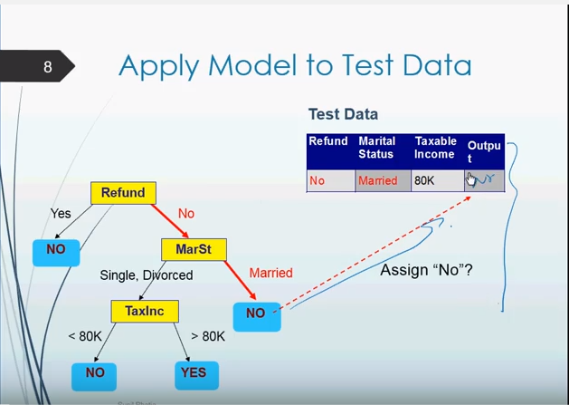
CART: Classification and Regression Tree.

Slide 17
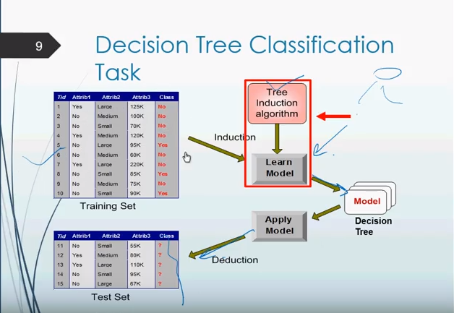
CART: Classification and Regression Tree.

