Slide 1

Chapter 4
Divide-and-Conquer
Copyright © 2007 Pearson Addison-Wesley. All rights reserved.

Slide 2
Divide-and-Conquer
The most-well known algorithm design strategy:
Divide instance of problem into two or more smaller instances
Solve smaller instances recursively
Obtain solution to original (larger) instance by combining these solutions

Slide 3
Divide-and-Conquer Technique (cont.)
a problem of size n
(instance)
subproblem 1
of size n/2
subproblem 2
of size n/2
a solution to
subproblem 1
a solution to
subproblem 2
a solution to
the original problem
It general leads to a recursive algorithm!

Slide 4
Divide-and-Conquer Examples
Sorting: mergesort and quicksort 归并排序，快速排序
Binary tree traversals 二叉树遍历
Binary search (?) 二分查找
Multiplication of large integers 大整数相乘
Matrix multiplication: Strassen’s algorithm 矩阵相乘
Closest-pair and convex-hull algorithms 最近对和凸包

Slide 5
General Divide-and-Conquer Recurrence
T(n) = aT(n/b) + f (n) where f(n) ∈ Θ(n^{d}), d ≥ 0
Master Theorem: If a < b^{d}, T(n) ∈ Θ(n^{d})
If a = b^{d}, T(n) ∈ Θ(n^{d} log n)
If a > b^{d}, T(n) ∈ Θ(n^{log b a} )
Note: The same results hold with O instead of Θ.
Examples: T(n) = 4T(n/2) + n ⇒ T(n) ∈ ?
T(n) = 4T(n/2) + n² ⇒ T(n) ∈ ?
T(n) = 4T(n/2) + n³ ⇒ T(n) ∈ ?
Θ(n^2)
Θ(n^2log n)
Θ(n^3)

Slide 6
Mergesort
Split array A[0..n-1] into about equal halves and make copies of each half in arrays B and C
Sort arrays B and C recursively
Merge sorted arrays B and C into array A as follows:
Repeat the following until no elements remain in one of the arrays:
compare the first elements in the remaining unprocessed portions of the arrays
copy the smaller of the two into A, while incrementing the index indicating the unprocessed portion of that array
Once all elements in one of the arrays are processed, copy the remaining unprocessed elements from the other array into A.

Slide 7
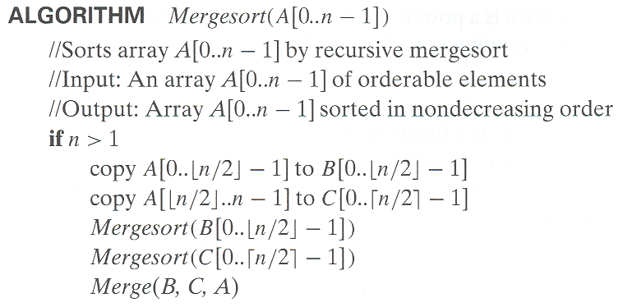
Pseudocode of Mergesort

Slide 8
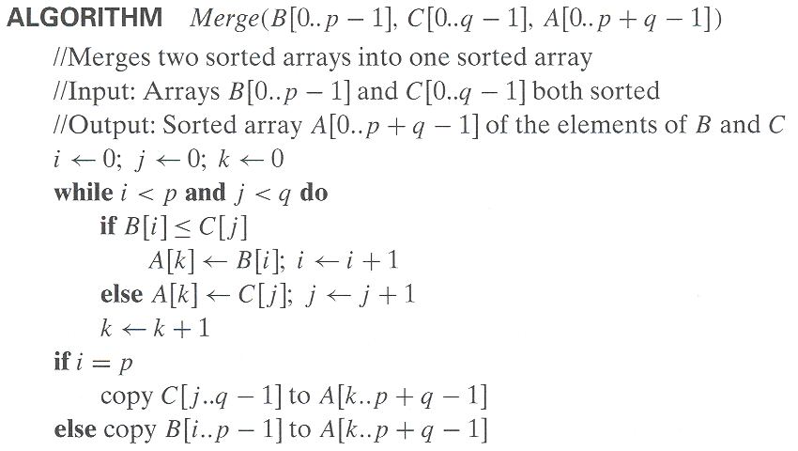
Pseudocode of Merge
Time complexity: Θ(p+q) = Θ(n) comparisons

Slide 9
Mergesort Example
The non-recursive version of Mergesort starts from merging single elements into sorted pairs.
Notes:
Go over this example in detail, then do another example of merging, something like:
(1 2 5 7 9)
(3 4 6)

Slide 10
Analysis of Mergesort
All cases have same efficiency: Θ(n log n)
Number of comparisons in the worst case is close to theoretical minimum for comparison-based sorting:
⎡log₂ n!⎤ ≈ n log₂ n - 1.44n
Space requirement: Θ(n) (not in-place)
Can be implemented without recursion (bottom-up)
T(n) = 2T(n/2) + Θ(n), T(1) = 0
Notes:
even if not analyzing in detail, show the recurrence for mergesort in worst case:
T(n) = 2 T(n/2) + (n-1)
worst case comparisons for merge

Slide 11
Quicksort
Select a pivot (partitioning element) – here, the first element
Rearrange the list so that all the elements in the first s positions are smaller than or equal to the pivot and all the elements in the remaining n-s positions are larger than or equal to the pivot (see next slide for an algorithm)
Exchange the pivot with the last element in the first (i.e., ≤) subarray — the pivot is now in its final position
Sort the two subarrays recursively
p
A[i]≤p
A[i]≥p

Slide 12
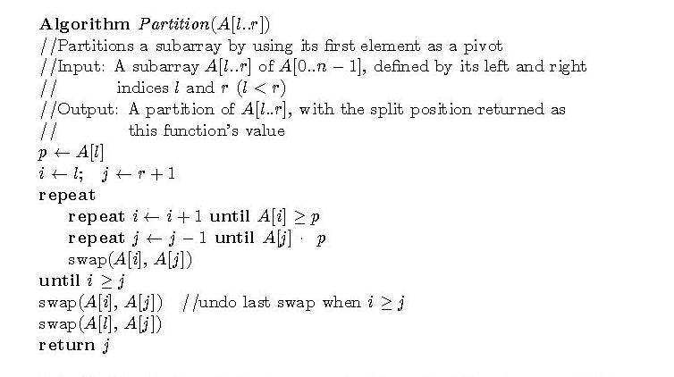
Partitioning Algorithm
or i > r
or j = l
<
Time complexity: Θ(r-l) comparisons

Slide 13
Quicksort Example
5 3 1 9 8 2 4 7
2 3 1 4 5 8 9 7
1 2 3 4 5 7 8 9
1 2 3 4 5 7 8 9
1 2 3 4 5 7 8 9
1 2 3 4 5 7 8 9

Slide 14
Analysis of Quicksort
Best case: split in the middle — Θ(n log n)
Worst case: sorted array! — Θ(n²)
Average case: random arrays — Θ(n log n)
Improvements:
better pivot selection: median of three partitioning
switch to insertion sort on small subfiles
elimination of recursion
These combine to 20-25% improvement
Considered the method of choice for internal sorting of large files (n ≥ 10000)
T(n) = T(n-1) + Θ(n)

Slide 15
Binary Search
Very efficient algorithm for searching in sorted array:
K
vs
A[0] . . . A[m] . . . A[n-1]
If K = A[m], stop (successful search); otherwise, continue
searching by the same method in A[0..m-1] if K < A[m]
and in A[m+1..n-1] if K > A[m]
l ← 0; r ← n-1
while l ≤ r do
m ← ⎣(l+r)/2⎦
if K = A[m] return m
else if K < A[m] r ← m-1
else l ← m+1
return -1

Slide 16
Analysis of Binary Search
Time efficiency
worst-case recurrence: C_{w} (n) = 1 + C_{w}( ⎣n/2⎦ ), C_{w} (1) = 1 solution: C_{w}(n) = ⎡log₂(n+1)⎤ This is VERY fast: e.g., C_{w}(10⁶) = 20
Optimal for searching a sorted array
Limitations: must be a sorted array (not linked list)
Bad (degenerate) example of divide-and-conquer because only one of the sub-instances is solved
Has a continuous counterpart called bisection method for solving equations in one unknown f(x) = 0 (see Sec. 12.4)

Slide 17
Binary Tree Algorithms
Binary tree is a divide-and-conquer ready structure!
Ex. 1: Classic traversals (preorder, inorder, postorder)
Algorithm Inorder(T)
if T ≠ ∅ a a
Inorder(T_{left}) b c b c
print(root of T) d e   d e
Inorder(T_{right})    
Efficiency: Θ(n). Why?
Each node is visited/printed once.

Slide 18
Binary Tree Algorithms (cont.)
Ex. 2: Computing the height of a binary tree
h(T) = max{h(T_{L}), h(T_{R})} + 1 if T ≠ ∅ and h(∅) = -1
Efficiency: Θ(n). Why?

Slide 19
Multiplication of Large Integers
Consider the problem of multiplying two (large) n-digit integers represented by arrays of their digits such as: A = 12345678901357986429 B = 87654321284820912836 The grade-school algorithm:
a₁ a₂ … a_{n} b₁ b₂ … b_{n} (d₁₀) d₁₁d₁₂ … d_{1n}
(d₂₀) d₂₁d₂₂ … d_{2n}
… … … … … … …
(d_{n0}) d_{n1}d_{n2} … d_{nn}
Efficiency: Θ(n²) single-digit multiplications

Slide 20
First Divide-and-Conquer Algorithm
A small example: A ∗ B where A = 2135 and B = 4014
A = (21·10² + 35), B = (40 ·10² + 14)
So, A ∗ B = (21 ·10² + 35) ∗ (40 ·10² + 14)
= 21 ∗ 40 ·10⁴ + (21 ∗ 14 + 35 ∗ 40) ·10² + 35 ∗ 14
In general, if A = A₁A₂ and B = B₁B₂ (where A and B are n-digit,
A₁, A₂, B₁, B₂ are n/2-digit numbers),
A ∗ B = A₁ ∗ B₁·10^{n} + (A₁ ∗ B₂ + A₂ ∗ B₁) ·10^{n/2} + A₂ ∗ B₂
Recurrence for the number of one-digit multiplications M(n):
M(n) = 4M(n/2), M(1) = 1 Solution: M(n) = n²

Slide 21
Second Divide-and-Conquer Algorithm
A ∗ B = A₁ ∗ B₁·10^{n} + (A₁ ∗ B₂ + A₂ ∗ B₁) ·10^{n/2} + A₂ ∗ B₂
The idea is to decrease the number of multiplications from 4 to 3:
(A₁ + A₂ ) ∗ (B₁ + B₂ ) = A₁ ∗ B₁ + (A₁ ∗ B₂ + A₂ ∗ B₁) + A₂ ∗ B_{2,} I.e., (A₁ ∗ B₂ + A₂ ∗ B₁) = (A₁ + A₂ ) ∗ (B₁ + B₂ ) - A₁ ∗ B₁ - A₂ ∗ B_{2,} which requires only 3 multiplications at the expense of (4-1) extra add/sub.
Recurrence for the number of multiplications M(n): M(n) = 3M(n/2), M(1) = 1 Solution: M(n) = 3^{log 2n} = n^{log 23} ≈ n^{1.585}
What if we count both multiplications and additions?

Slide 22
Example of Large-Integer Multiplication
2135 ∗ 4014
= (21*10^2 + 35) * (40*10^2 + 14)
= (21*40)*10^4 + c1*10^2 + 35*14
where c1 = (21+35)*(40+14) - 21*40 - 35*14, and
21*40 = (2*10 + 1) * (4*10 + 0)
= (2*4)*10^2 + c2*10 + 1*0
where c2 = (2+1)*(4+0) - 2*4 - 1*0, etc.
This process requires 9 digit multiplications as opposed to 16.

Slide 23
Conventional Matrix Multiplication
Brute-force algorithm
c₀₀ c₀₁ a₀₀ a₀₁ b₀₀ b₀₁
= *
c₁₀ c₁₁ a₁₀ a₁₁ b₁₀ b₁₁
a₀₀ * b₀₀ + a₀₁ * b₁₀ a₀₀ * b₀₁ + a₀₁ * b₁₁
=
a₁₀ * b₀₀ + a₁₁ * b₁₀ a₁₀ * b₀₁ + a₁₁ * b₁₁
8 multiplications
Efficiency class in general: Θ (n³)
4 additions

Slide 24
Strassen’s Matrix Multiplication
Strassen’s algorithm for two 2x2 matrices (1969):
c₀₀ c₀₁ a₀₀ a₀₁ b₀₀ b₀₁
= *
c₁₀ c₁₁ a₁₀ a₁₁ b₁₀ b₁₁
m₁ + m₄ - m₅ + m₇ m₃ + m₅
=
m₂ + m₄ m₁ + m₃ - m₂ + m₆
m₁ = (a₀₀ + a₁₁) * (b₀₀ + b₁₁)
m₂ = (a₁₀ + a₁₁) * b₀₀
m₃ = a₀₀ * (b₀₁ - b₁₁)
m₄ = a₁₁ * (b₁₀ - b₀₀)
m₅ = (a₀₀ + a₀₁) * b₁₁
m₆ = (a₁₀ - a₀₀) * (b₀₀ + b₀₁)
m₇ = (a₀₁ - a₁₁) * (b₁₀ + b₁₁)
7 multiplications
18 additions

Slide 25
Strassen’s Matrix Multiplication
Strassen observed [1969] that the product of two matrices can be computed in general as follows:
C₀₀ C₀₁ A₀₀ A₀₁ B₀₀ B₀₁
= *
C₁₀ C₁₁ A₁₀ A₁₁ B₁₀ B₁₁
M₁ + M₄ - M₅ + M₇ M₃ + M₅
=
M₂ + M₄ M₁ + M₃ - M₂ + M₆

Slide 26
Formulas for Strassen’s Algorithm
M₁ = (A₀₀ + A₁₁) ∗ (B₀₀ + B₁₁)
M₂ = (A₁₀ + A₁₁) ∗ B₀₀
M₃ = A₀₀ ∗ (B₀₁ - B₁₁)
M₄ = A₁₁ ∗ (B₁₀ - B₀₀)
M₅ = (A₀₀ + A₀₁) ∗ B₁₁
M₆ = (A₁₀ - A₀₀) ∗ (B₀₀ + B₀₁)
M₇ = (A₀₁ - A₁₁) ∗ (B₁₀ + B₁₁)

Slide 27
Analysis of Strassen’s Algorithm
If n is not a power of 2, matrices can be padded with zeros.
Number of multiplications:
M(n) = 7M(n/2), M(1) = 1
Solution: M(n) = 7^{log 2n} = n^{log 27} ≈ n^{2.807} vs. n³ of brute-force alg.
Algorithms with better asymptotic efficiency are known but they
are even more complex and not used in practice.
What if we count both multiplications and additions?

Slide 28
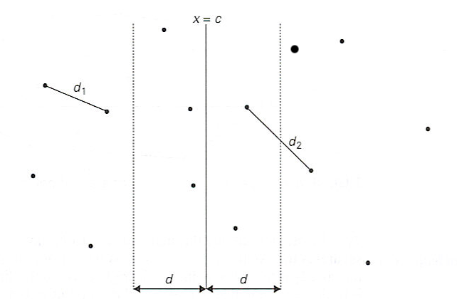
Closest-Pair Problem by Divide-and-Conquer
Step 0 Sort the points by x (list one) and then by y (list two).
Step 1 Divide the points given into two subsets S₁ and S₂ by a vertical line x = c so that half the points lie to the left or on the line and half the points lie to the right or on the line.

Slide 29
Closest Pair by Divide-and-Conquer (cont.)
Step 2 Find recursively the closest pairs for the left and right subsets.
Step 3 Set d = min{d₁, d₂}
We can limit our attention to the points in the symmetric vertical strip of width 2d as possible closest pair. Let C₁ and C₂ be the subsets of points in the left subset S₁ and of the right subset S₂, respectively, that lie in this vertical strip. The points in C₁ and C₂ are stored in increasing order of their y coordinates, taken from the second list.
Step 4 For every point P(x,y) in C₁, we inspect points in C₂ that may be closer to P than d. There can be no more than 6 such points (because d ≤ d₂)!
Notes:
Unfortunately, d is not necessarily the smallest distance between all pairs of points in S1 and
S2 because a closer pair of points can lie on the opposite sides separating the line. When we
combine the two sets, we must examine such points. (Illustrate this on the diagram)

Slide 30
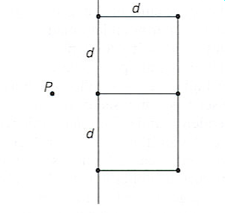
Closest Pair by Divide-and-Conquer: Worst Case
The worst case scenario is depicted below:

Slide 31
Efficiency of the Closest-Pair Algorithm
Running time of the algorithm (without sorting) is:
T(n) = 2T(n/2) + M(n), where M(n) ∈ Θ(n)
By the Master Theorem (with a = 2, b = 2, d = 1)
T(n) ∈ Θ(n log n)
So the total time is Θ(n log n).

Slide 32
Quickhull Algorithm
Convex hull: smallest convex set that includes given points. An O(n^3) bruteforce time is given in Levitin, Ch 3.
Assume points are sorted by x-coordinate values
Identify extreme points P₁ and P₂ (leftmost and rightmost)
Compute upper hull recursively:
find point P_{max} that is farthest away from line P₁P₂
compute the upper hull of the points to the left of line P₁P_{max}
compute the upper hull of the points to the left of line P_{max}P₂
Compute lower hull in a similar manner
P_{max}
P₂
P₁

Slide 33
Efficiency of Quickhull Algorithm
Finding point farthest away from line P₁P₂ can be done in linear time
Time efficiency: T(n) = T(x) + T(y) + T(z) + T(v) + O(n), where x + y + z +v <= n.
worst case: Θ(n²) T(n) = T(n-1) + O(n)
average case: Θ(n) (under reasonable assumptions about distribution of points given)
If points are not initially sorted by x-coordinate value, this can be accomplished in O(n log n) time
Several O(n log n) algorithms for convex hull are known

