Slide 1
Introduction to Algorithm
Tree

Slide 2
Tree classification
Binary Tree. (BT:complete/full binary tree)
Binary search tree. (BST)
Max/min Heap(priority queue).
Self-balancing search trees.(AVL)
Red-black tree.(RBT)
B+/B- tree. (B+/B-)
Winner/loser tree.
Devision tree
Forest
Random forest.

Slide 3
Tree algorithm
Binary tree traversal.
Construct Binary tree.
Binary search tree.
Tree traversal recursively.(用递归的方法)
preorder, inorder, postorder, levelorder.
Tree traversal iteratively.(用迭代的方法)(using stack/queue)
Morris Traversal.

Slide 4

Nature View of a Tree
leaves
branches
root

Slide 5

Computer Scientist’s View
root
leaves
branches
nodes

Slide 6
What is a Tree
A tree is a finite nonempty set of elements.
It is an abstract model of a hierarchical structure.
consists of nodes with a parent-child relation.
Applications:
Organization charts
File systems
Programming environments
Computers”R”Us
Sales
Manufacturing
R&D
US
International
Laptops
Desktops
Europe
Asia
Canada

Slide 7
Tree Terminology
Root: node without parent (A)
Siblings: nodes share the same parent
Internal node: node with at least one child (A, B, C, F)
External node (leaf ): node without children (E, I, J, K, G, H, D)
Ancestors of a node: parent, grandparent, grand-grandparent, etc.
Descendant of a node: child, grandchild, grand-grandchild, etc.
Depth of a node: number of ancestors
Height of a tree: maximum depth of any node (3). 从0开始
Degree of a node: the number of its children
Degree of a tree: the maximum number of its node.
Subtree: tree consisting of a node and its descendants
A
subtree
B
C
D
E
F
G
H
I
J
K

Slide 8
Tree Properties
Property Value
Number of nodes
Height
Root Node
Leaves
Interior nodes
Ancestors of H
Descendants of B
Siblings of E
Right subtree of A
Degree of this tree
A
B
C
D
E
F
G
H
I

Slide 9
Level and Depth
Level
1
2
3
4
node (13)
degree of a node
leaf (terminal)
nonterminal
parent
children
sibling
degree of a tree (3)
ancestor
level of a node
height of a tree (4)
3
1
2
2
1
2
3
2
2
3
3
3
3
0
1
3
3
0
0
0
0
4
0
4
0
4

Slide 10
Tree ADT(Abstract Data Type)
We use positions to abstract nodes
Generic methods:
integer size()
boolean isEmpty()
objectIterator elements()
positionIterator positions()
Accessor methods:
position root()
position parent(p)
positionIterator children(p)
Query methods:
boolean isInternal(p)
boolean isExternal(p)
boolean isRoot(p)
Update methods:
swapElements(p, q)
object replaceElement(p, o)
Additional update methods may be defined by data structures implementing the Tree ADT

Slide 11
Intuitive Representation of Tree Node
List Representation
( A ( B ( E ( K, L ), F ), C ( G ), D ( H ( M ), I, J ) ) )
The root comes first, followed by a list of links to sub-trees
How many link fields are needed in
such a representation?
Data
Link 1
Link 2
…
Link n

Slide 12
Trees
Every tree node:
object – useful information
children – pointers to its children
Data
Data
Φ
Φ
Data
Φ
Data
Φ
Φ
Data
Φ
Φ
Data
Φ
Φ
Data
Φ
Φ

Slide 13
A Tree Representation
A node is represented by an object storing
Element
Parent node
Sequence of children nodes
∅
B
∅
∅
A
D
F
B
A
D
F
∅
∅
C
E
C
E

Slide 14
Left Child, Right Sibling Representation
Data
Left Child
Right Sibling
A
B
C
D
E
F
G
H
I
J
K
L

Slide 15
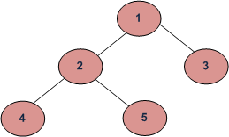
Tree Traversal (树的遍历)
Two main methods: 深度优先遍历
Preorder 根左右
Postorder 左右根
Recursive definition
Preorder:
visit the root
traverse in preorder the children (subtrees)
Postorder
traverse in postorder the children (subtrees)
visit the root
二叉树还有个一般的树没有的遍历次序，中序遍历（inorder)
(left->root->right)。
Depth First Traversals:
(a) Inorder (Left, Root, Right) : 4 2 5 1 3
(b) Preorder (Root, Left, Right) : 1 2 4 5 3
(c) Postorder (Left, Right, Root) : 4 5 2 3 1
Breadth First or Level Order Traversal : 1 2 3 4 5

Slide 16
Preorder Traversal
A traversal visits the nodes of a tree in a systematic manner
In a preorder traversal, a node is visited before its descendants
Application: print a structured document
Algorithm preOrder(v)
visit(v)
for each child w of v
preorder (w)
1
Become Rich
2
5
9
1. Motivations
2. Methods
3. Success Stories
3
4
6
7
8
1.1 Enjoy Life
1.2 Help Poor Friends
2.1 Get a CS PhD
2.2 Start a Web Site
2.3 Acquired by Google

Slide 17
Preorder Traversal - Recursive
vector<Dtype> BItree<Dtype>::bt_travelRe(TreeNode*& root) { if (root == NULL) { return vector<Dtype>(); } vector<Dtype> resultTree, leftTree, rightTree; resultTree.push_back(root->val); leftTree = bt_travelRe(root->left); rightTree = bt_travelRe(root->right); if (leftTree.size() != 0) { resultTree.insert(resultTree.end(),leftTree.begin(), leftTree.end()); } if (rightTree.size() != 0) { resultTree.insert(resultTree.end(),rightTree.begin(),rightTree.end()); } return resultTree; } 时间复杂度O(n), 空间复杂度O(n)

Slide 18
Preorder Traversal - (stack+Iterative)
vector<Dtype> BItree<Dtype>::bt_travelIt(TreeNode*& root) { vector<Dtype> result; stack<const TreeNode*> s; if (root != nullptr) { s.push(root); } while (!s.empty()) { const TreeNode *p = s.top(); s.pop(); result.push_back(p->val); if (p->right != nullptr) { s.push(p->right); } if (p->left != nullptr) { s.push(p->left); } } return result; } // 时间复杂度O(n), 空间复杂度O(n)

Slide 19
Preorder Traversal - (Morris)
算法步骤：
1. 如果当前节点的左孩子为空，则输出当前节点并将其右孩子作为当前节点。
2. 如果当前节点的左孩子不为空，在当前节点的左子树中找到当前节点在中序遍历下的前驱节点。
a) 如果前驱节点的右孩子为空，将它的右孩子设置为当前节点。输出当前节点（在这里输出，这是与中序遍历唯一一点不同）。当前节点更新为当前节点的左孩子。
b) 如果前驱节点的右孩子为当前节点，将它的右孩子重新设为空。当前节点更新为当前节点的右孩子。
3. 重复以上1、2直到当前节点为空。
Notes:
1. 如果当前节点的左孩子为空，则输出当前节点并将其右孩子作为当前节点。
2. 如果当前节点的左孩子不为空，在当前节点的左子树中找到当前节点在中序遍历下的前驱节点。
a) 如果前驱节点的右孩子为空，将它的右孩子设置为当前节点。输出当前节点（在这里输出，这是与中序遍历唯一一点不同）。当前节点更新为当前节点的左孩子。
b) 如果前驱节点的右孩子为当前节点，将它的右孩子重新设为空。当前节点更新为当前节点的右孩子。
3. 重复以上1、2直到当前节点为空。

Slide 20
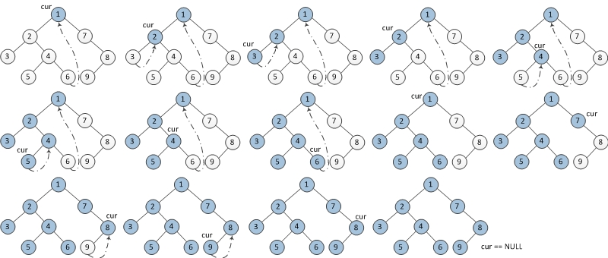
Preorder Traversal - (Morris)
Notes:
1. 如果当前节点的左孩子为空，则输出当前节点并将其右孩子作为当前节点。
2. 如果当前节点的左孩子不为空，在当前节点的左子树中找到当前节点在中序遍历下的前驱节点。
a) 如果前驱节点的右孩子为空，将它的右孩子设置为当前节点。输出当前节点（在这里输出，这是与中序遍历唯一一点不同）。当前节点更新为当前节点的左孩子。
b) 如果前驱节点的右孩子为当前节点，将它的右孩子重新设为空。当前节点更新为当前节点的右孩子。
3. 重复以上1、2直到当前节点为空。

Slide 21
Preorder Traversal - (Morris)
vector<Dtype> BItree<Dtype>::bt_travelMorris(TreeNode*& root) { vector<Dtype> result; TreeNode* cur = root, *prev = nullptr; while (cur != nullptr) { if (cur->left == nullptr) { result.push_back(cur->val); prev = cur; cur = cur->right; }else { TreeNode* node = cur->left; while(node->right != nullptr && node->right != cur) node = node->right; if (node->right == nullptr) { result.push_back(cur->val); node->right = cur; prev = cur; cur = cur->left; }else { node->right = nullptr; cur = cur->right; } } } return result; } // 时间复杂度 O(n), 空间复杂度O(1)
Notes:
1. 如果当前节点的左孩子为空，则输出当前节点并将其右孩子作为当前节点。
2. 如果当前节点的左孩子不为空，在当前节点的左子树中找到当前节点在中序遍历下的前驱节点。
a) 如果前驱节点的右孩子为空，将它的右孩子设置为当前节点。输出当前节点（在这里输出，这是与中序遍历唯一一点不同）。当前节点更新为当前节点的左孩子。
b) 如果前驱节点的右孩子为当前节点，将它的右孩子重新设为空。当前节点更新为当前节点的右孩子。
3. 重复以上1、2直到当前节点为空。

Slide 22
Postorder Traversal
In a postorder traversal, a node is visited after its descendants
Application: compute space used by files in a directory and its subdirectories
Algorithm postOrder(v)
for each child w of v
postOrder (w)
visit(v)
9
cs16/
8
3
7
homeworks/
programs/
todo.txt 1K
1
2
4
5
6
h1c.doc 3K
h1nc.doc 2K
DDR.java 10K
Stocks.java 25K
Robot.java 20K

Slide 23
Levelorder Traversal

Slide 24
Binary Tree
A binary tree is a tree with the following properties:
Each internal node has at most two children (degree of two)
The children of a node are an ordered pair
We call the children of an internal node left child and right child
Alternative recursive definition: a binary tree is either
a tree consisting of a single node, OR
a tree whose root has an ordered pair of children, each of which is a binary tree
Applications:
arithmetic expressions
decision processes
searching
A
B
C
D
E
F
G
H
I

Slide 25
BinaryTree ADT
The BinaryTree ADT extends the Tree ADT, i.e., it inherits all the methods of the Tree ADT
Additional methods:
position leftChild(p)
position rightChild(p)
position sibling(p)
Update methods may be defined by data structures implementing the BinaryTree ADT

Slide 26
Examples of the Binary Tree
Skewed Binary Tree
Complete Binary Tree
A
1
A
A
B
B
2
B
C
C
3
D
E
F
G
D
4
H
I
E
5

Slide 27
Differences Between A Tree and A Binary Tree
The subtrees of a binary tree are ordered; those of a tree are not ordered.
A
A
B
B
Are different when viewed as binary trees.
Are the same when viewed as trees.

Slide 28
Data Structure for Binary Trees
A node is represented by an object storing
Element
Parent node
Left child node
Right child node
∅
B
∅
∅
B
A
D
A
D
∅
∅
∅
∅
C
E
C
E

Slide 29
Arithmetic Expression Tree
Binary tree associated with an arithmetic expression
internal nodes: operators 操作符
external nodes: operands 操作数
Example: arithmetic expression tree for the expression (2 × (a − 1) + (3 × b))
+
×
×
2
−
3
b
a
1

Slide 30
Decision Tree
Binary tree associated with a decision process
internal nodes: questions with yes/no answer
external nodes: decisions
Example: dining decision
Want a fast meal?
Yes
No
How about coffee?
On expense account?
Yes
No
Yes
No
Starbucks
Spike’s
Al Forno
Café Paragon

Slide 31
Maximum Number of Nodes in a Binary Tree
The maximum number of nodes on depth i of a binary tree is 2^{i}, i>=0.
The maximum number of nodes in a binary tree of height k is 2^{k+1}-1, k>=0.
Prove by induction.

Slide 32
Relations between Number of Leaf Nodes and Nodes of Degree 2
For any nonempty binary tree, T, if n0 is the number of leaf nodes and n2 the number of nodes of degree 2, then n0=n2+1
PROOF:
Let n and B denote the total number of nodes and branches in T.
Let n0, n1, n2 represent the nodes with no children, single child, and two children respectively.
B+1=n
B=n1+2n2
n=n0+n1+n2
⇒ n₁+2n₂+1= n
⇒ n0=n2+1

Slide 33
Full Binary Tree
A full binary tree of a given height k has 2^{k+1}–1 nodes.
Height 3 full binary tree.

Slide 34
Labeling Nodes In A Full Binary Tree
Label the nodes 1 through 2^{k+1} – 1.
Label by levels from top to bottom.
Within a level, label from left to right.
1
2
3
4
5
6
7
8
9
10
11
12
13
14
15

Slide 35
Node Number Properties
1
2
3
4
5
6
7
8
9
10
11
12
13
14
15
Parent of node i is node i / 2, unless i = 1.
Node 1 is the root and has no parent.

Slide 36
Node Number Properties
1
2
3
4
5
6
7
8
9
10
11
12
13
14
15
Left child of node i is node 2i, unless 2i > n, where n is the number of nodes.
If 2i > n, node i has no left child.

Slide 37
Node Number Properties
1
2
3
4
5
6
7
8
9
10
11
12
13
14
15
Right child of node i is node 2i+1, unless 2i+1 > n, where n is the number of nodes.
If 2i+1 > n, node i has no right child.

Slide 38
Complete Binary Trees
A labeled binary tree containing the labels 1 to n with root 1, branches leading to nodes labeled 2 and 3, branches from these leading to 4, 5 and 6, 7, respectively, and so on.
A binary tree with n nodes and level k is complete if its nodes correspond to the nodes numbered from 1 to n in the full binary tree of level k.
1
1
2
3
2
3
4
5
6
7
4
5
6
7
8
9
10
11
12
13
14
15
8
9
Complete binary tree
Full binary tree of depth 3

Slide 39
Binary Tree Traversals
Let l, R, and r stand for moving left, visiting the node, and moving right.
There are six possible combinations of traversal
lRr, lrR, Rlr, Rrl, rRl, rlR
Adopt convention that we traverse left before right, only 3 traversals remain
lRr, lrR, Rlr
inorder, postorder, preorder

Slide 40
Inorder Traversal
In an inorder traversal a node is visited after its left subtree and before its right subtree
Algorithm inOrder(v)
if isInternal (v)
inOrder (leftChild (v))
visit(v)
if isInternal (v)
inOrder (rightChild (v))
6
2
8
1
4
7
9
3
5

Slide 41
Print Arithmetic Expressions
Specialization of an inorder traversal
print operand or operator when visiting node
print “(“ before traversing left subtree
print “)“ after traversing right subtree
Algorithm inOrder (v)
if isInternal (v){ print(“(’’)
inOrder (leftChild (v))}
print(v.element ())
if isInternal (v){
inOrder (rightChild (v))
print (“)’’)}
+
×
×
2
−
3
b
((2 × (a − 1)) + (3 × b))
a
1

Slide 42
Evaluate Arithmetic Expressions
recursive method returning the value of a subtree
when visiting an internal node, combine the values of the subtrees
Algorithm evalExpr(v)
if isExternal (v)
return v.element ()
else
x ← evalExpr(leftChild (v))
y ← evalExpr(rightChild (v))
◊ ← operator stored at v
return x ◊ y
+
×
×
2
−
3
2
5
1

Slide 43
Creativity: pathLength(tree) = Σ depth(v) ∀v ∈ tree
Algorithm pathLength(v, n)
Input: a tree node v and an initial value n
Output: the pathLength of the tree with root v
Usage: pl = pathLength(root, 0);
if isExternal (v)
return n
return
(pathLength(leftChild (v), n + 1) +
pathLength(rightChild (v), n + 1) + n)

Slide 44
Euler Tour Traversal (欧拉环游遍历)
Generic traversal of a binary tree
Includes a special cases the preorder, postorder and inorder traversals
Walk around the tree and visit each node three times:
on the left (preorder)
from below (inorder)
on the right (postorder)
+
L
×
R
×
B
2
−
3
2
5
1

Slide 45
Euler Tour Traversal
eulerTour(node v) {
perform action for visiting node on the left;
if v is internal then
eulerTour(v->left);
perform action for visiting node from below;
if v is internal then
eulerTour(v->right);
perform action for visiting node on the right;
}

Slide 47
AVL Tree
Definition:
binary search tree
For any node, the heights of left subtree and right subtree differ at most 1.
(if differ at most k, called BH(k) tree).
Theorem (Adel'son-Vel'skii and Landis 1962):
The height of an AVL tree with N internal nodes always lies between log (N +1 ) and 1..4404 log(N + 2) - 0.328

Slide 48
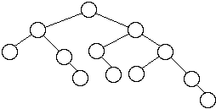
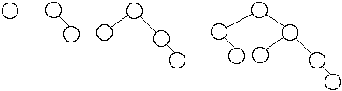
AVL Tree Examples
Worst case AVL trees
Figures in these slides are copied from:
http://www.eli.sdsu.edu/courses/fall96/cs660/notes/avl/avl.html#RTFToC2

Slide 49
AVL Tree
Insertion:
As normal binary search tree insertion
Reconstruct tree by rotation if some nodes become unbalanced
Deletion:
as normal binary search tree deletion
The node deleted will be either a leaf or have just one subtree (this is true for all binary search tree deletion)
if the deleted node has one subtree, then that subtree contains only one node
Traverse up the tree from the deleted node checking the balance of each node, balance the node by rotation if unbalanced
Theorem:
An insertion into an AVL tree requires at most one rotation to rebalance a tree. A deletion may require log(N) rotations to rebalance the tree.

Slide 50
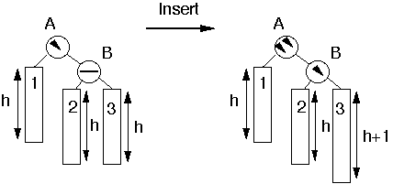
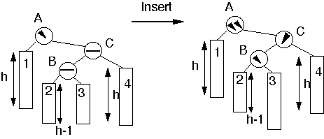
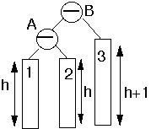
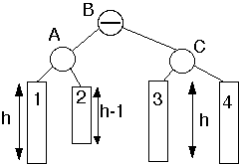
AVL tree insertion examples
Insert into subtree 3
Insert into subtree 2 or 3
Perform single rotation
Perform double rotation

Slide 51
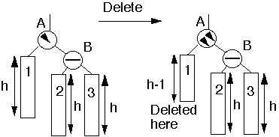
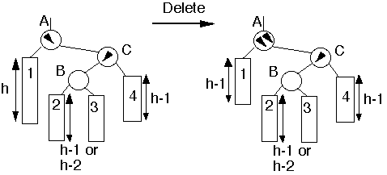
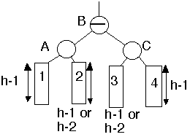
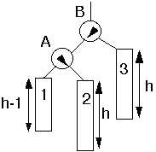
AVL tree deletion examples
Deletion from subtree 1
Deletion from subtree 1
Perform single rotation
Perform double rotation

Slide 53
Balanced Search Trees
To implement a symbol table, Binary Search Trees work pretty well, except…
The worst case is O(n) and it is embarassingly likely to happen in practice – if the keys are sorted, or there are lots of duplicates, or various kinds of structure
Ideally we would want to keep a search tree perfectly balanced, like a heap
But how can we insert or delete in O(log n) time and re-balance the whole tree?
Three approaches: randomize, amortize, or optimize

Slide 54
Randomized BSTs
The randomized approach: introduce randomized decision making.
Dramatically reduce the chance of worst case.
Like quicksort, with random pivot
This algorithm is simple, efficient, broadly applicable – but went undiscovered for decades (until 1996!) [Only the analysis is complicated.]
Can you figure it out? How to introduce randomness in the created structure of the BST?

Slide 55
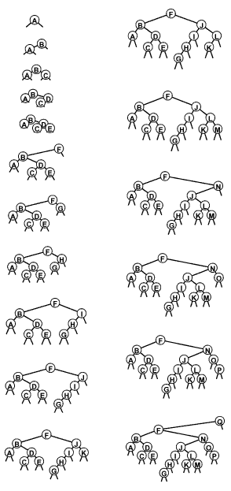
Random BSTs
Idea: to insert into a tree with n nodes,
with probability 1/(n+1) make the new node the root.
otherwise insert normally.
(this decision could be made at any point along the insertion path.)
result: about 2 n ln n comparisons to build tree; about 2 ln n for search
(that’s about 1.4 lg n)

Slide 56
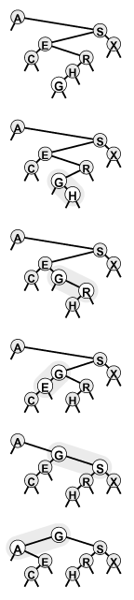
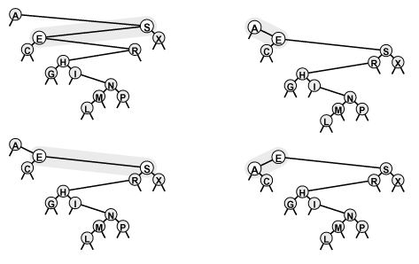
How to insert at the root?
You might well ask: “that’s all well and good, but how do we insert at the root of a BST?”
I might well answer: Insert normally. Then rotate to move it up in the tree, until it is at the top.
Left and Right rotations:
Rotate to the top!

Slide 57
Randomized BST analysis
The average case is the same for BSTs and RBSTs: but the essential point is that the analysis for RBSTs assumes nothing about the order of the insertions
The probability that the construction cost is more than k times the average is less than e^{-k}
E.g. to build a randomized BST with 100,000 nodes, one would expect 2.3 million comparisons. The chance of 23 million comparisons is 0.01 percent.
Bottom line:
full symbol table ADT
straightforward implementation
O(log N) average case: bad cases provably unlikely

Slide 58
Splay Trees 伸展树
Use root insertion
Idea: let’s rotate so as to better balance the tree
The difference between standard root insertion and splay insertion seem trivial: but the splay operation eliminates the quadratic worst case
The number of comparisons used for N splay insertions into an initially empty tree is O(N lg N) – actually, 3 N lg N.
amortized algorithm: individual operations may be slow, but the total runtime for a series of operations is good.

Slide 59
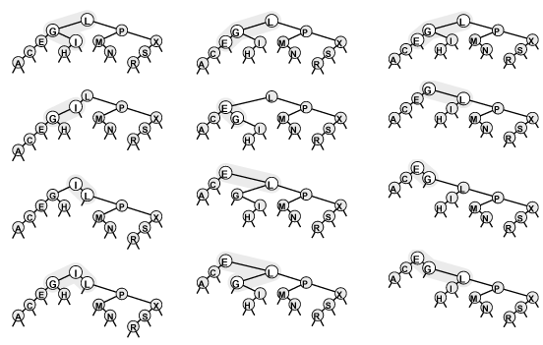
Splay Insertion
Orientations differ: same as root insertion
Orientations the same: do top rotation first
(brings nodes on search path closer to the root—how much?)

Slide 60
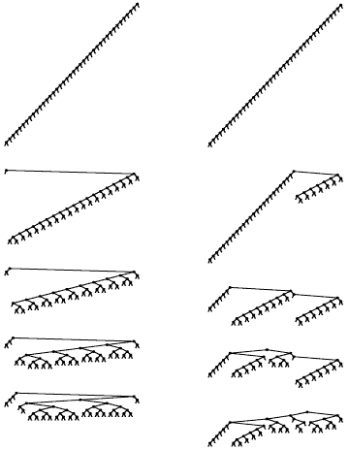
Splay Tree
When we insert, nodes on the search path are brought half way to the root.
This is also true if we splay while searching.
Trees at right are balanced with a few splay searches
left: smallest, next smallest, etc
right: random
Result: for M insert or search ops in an N-node splay tree, O((N+M)lg(N+M)) comparisons are required.
This is an amortized result.

Slide 61
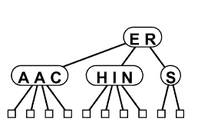
234 Intro
234 Trees are are worst-case optimal: Θ(log n) per operation
Idea: nodes have 1, 2, or 3 keys and 2, 3, or 4 links.
Subtrees have keys ordered analogously to a binary search tree.
A balanced 234 search tree has all leaves at the same level.
How would search work?
How would insertion work?
split nodes on the way back up?
or split 4-nodes on the way down?

Slide 62
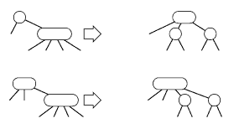
Top-down vs. Bottom-up
Top-down 2-3-4 trees split nodes on the way down. But splitting a node means pushing a key back up, and it may have to be pushed all the way back up to the root.
It’s easier to split any 4-node on the way down.
2-node with 4-node child: split into 3-node with two 2-node children
3-node with 4-node child: split into 4-node with two 2-node children
Thus, all searches end up at a node with space for insertion

Slide 63
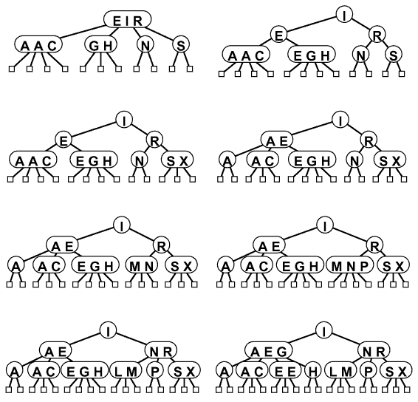
Construction Example

Slide 64
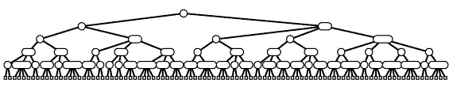
234 Balance
All paths from the top to the bottom are the same height
What is that height?
worst case: lgN (all 2-nodes)
best case: lgN/2 (all 4-nodes)
height 10-20 for a million nodes; 15-30 for a billion
Optimal!
(But is it fast?)

Slide 65
Implementation Details
Actually, there are many 234-tree variants:
splitting on the way up vs. down
2-3 vs. 2-3-4 trees
Implementation is complicated because of the large number of cases that have to be considered.
Can we improve the optimal balanced-tree approach, for fewer cases and strictly binary nodes?

Slide 66
B-trees
What about using even more keys? B-trees
Like a 234 tree, but with many keys, say b=100 or 500
Usually enough keys to fill a 4k or 16k disk block
Time to find an item: O(log_{b}n)
E.g. b=500: can locate an item in 500 with one disk access, 250,000 with 2, 125,000,000 with 3
Used for database indexes, disk directory structures, etc., where the tree is too large for memory and each step is a disk access.
Drawback: wasted space

Slide 67
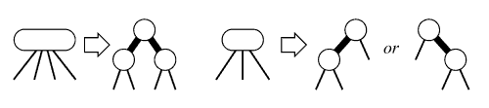
Red-Black Trees
Idea: Do something like a 2-3-4 Tree, but using binary nodes only
The correspondence it not 1-1 because 3-nodes swing either way
Add a bit per node to mark as Red or Black
Black links bind together the 2-3-4 tree; red links bind the small binary trees holding 2, 3, or 4 nodes. (Red nodes are drawn with thick links to them.)
Two red nodes in a row are not needed (or allowed)

Slide 68
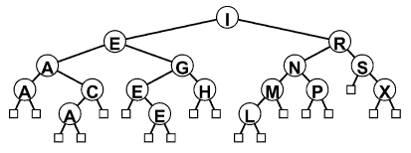
Red-Black Tree Example
This tree is the same as the 2-3-4 tree built a few slides back, with the letters “ASEARCHINGEXAMPLE”
Notice that it is quite well balanced.
(How well?)
(We’ll see in a moment.)

Slide 69
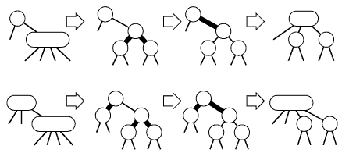
RB-Tree Insertion
How do we search in a RB-tree?
How do we insert into a RB-tree?
normal BST insert; new node is red
How do we perform splits?
Two cases are easy: just change colors!

Slide 70
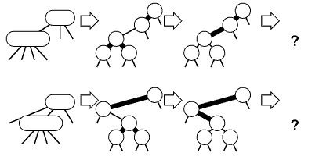
RB-Tree Insertion 2
Two cases require rotations:
Two adjacent red nodes – not allowed!
If the 4-node is on an outside link, a single rotation is needed
If the 4-node is on the center link, double rotation

Slide 71
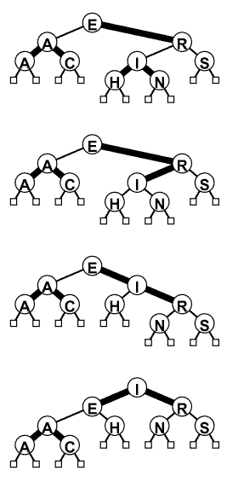
RB-Tree Split
We can use the red-black abstraction directly
No two red nodes should be adjacent
If they become adjacent, rotate a red node up the tree
(In this case, a double rotation makes I the root)
Repeat at the parent node
There are 4 cases
Details a bit messy:
leave to STL!

Slide 72
Red-Black Tree Insertion
link RBinsert(link h, Item item, int sw)
{ Key v = key(item);
if (h == z) return NEW(item, z, z, 1, 1);
if ((hl->red) && (hr->red))
{ h->red = 1; hl->red = 0; hr->red = 0; }
if (less(v, key(h->item)))
{
hl = RBinsert(hl, item, 0);
if (h->red && hl->red && sw) h = rotR(h);
if (hl->red && hll->red)
{ h = rotR(h); h->red = 0; hr->red = 1;
} else {
hr = RBinsert(hr, item, 1);
if (h->red && hr->red && !sw) h = rotL(h);
if (hr->red && hrr->red)
{ h = rotL(h); h->red = 0; hl->red = 1; }
return h;
}
void STinsert(Item item)
{ head = RBinsert(head, item, 0); head->red = 0; }

Slide 73
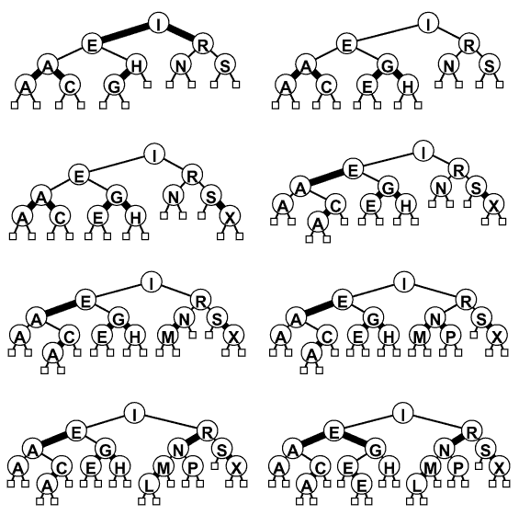
RB Tree Construction

Slide 74
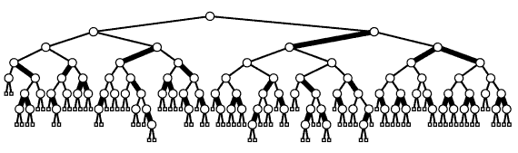
Red-Black Tree Summary
RB-Trees are BSTs with add’l properties:
Each node (or link to it) is marked either red or black
Two red nodes are never connected as parent and child
All paths from the root to a leaf have the same black-length
How close to being balanced are these trees?
According to black nodes: perfectly balanced
Red nodes add at most one extra link between black nodes
Height is therefore at most 2 log n.

Slide 75
Comparisons
There are several other balanced-tree schemes, e.g. AVL trees
Generally, these are BSTs, with some rotations thrown in to maintain balance
Let STL handle implementation details for you
Build Tree Search Misses
N BST RBST Splay RB Tree BST RBST Splay RB
5000 4 14 8 5 3 3 3 2
50000 63 220 117 74 48 60 46 36
200000 347 996 636 411 235 294 247 193

Slide 76
Summary
Goal: Symbol table implementation
O(log n) per operation
Randomized BST: O(log n) expected
Splay tree: O(log n) amortized
RB-Tree: O(log n) worst-case
The algorithms are variations on a theme: rotate during insertion or search to improve balance

Slide 77
STL Containers using RB trees
set: container for unique items
Member functions:
insert()
erase()
find()
count()
lower_bound()
upper_bound()
iterators to move through the set in order
multiset: like set, but items can be repeated

