Slide 1
Computer
Organization & Design
周二下午6-8节
周五上午1-2{双周}
紫金港校区西1-503
实验：周二（9-10）东4-509

Slide 2


Zhang Mingmin
  zhangmm95@zju.edu.cn
  Phone: 13958029312
  QQ群: 145412870

Slide 3


Assignment
Assignment：
  n/d
Assignment requirement
  Deadline: every week
  One or two exercises after class. I use the handwritten assignment to replace the on site roll-call. Each one should hand on one assignment book, no more no less. Otherwise, you will be punished on scores.
  If you have any graphics, you can draw it using graphic tools, and then put the result image into winword format and email to me.

Slide 4
Reference
Computer Organization & Design
  Chinese name：计组
  Oversea： computer system, computer principle
The teaching book: The third Edition
Reference:
  本书英文版第二版，第三版，第四版，以及第二版的两个中文版本
    计算机组成和设计 硬件/软件接口(第2版)
      译者：郑纬民 出版社：清华大学出版社2003-12-01
    计算机组成与设计
      作者:潘雪增等，出版社:浙江大学出版社2004-1
传统计算机组成原理教材
  白中英
  王爱英
  唐朔飞

Slide 5
考试评分
上课签到，上课发言，课程作业（课后练习题）占20%；
实验占30%（包括实验课签到，实验报告，实验验收）
期中闭卷考试占10%[ 若期末成绩高于期中成绩，则期中成绩不计，期末成绩占50%。]；
期末闭卷考试占40%[ 卷面成绩不到35分（满分100分）者，总评不及格。]；
附加分奖励（一般最高4分，特别优秀的由2位以上的教师讨论，不超过10分，均100分封顶）。

Slide 6
成绩
内容补充（光盘内容以下部分将作为考试内容）
  加法器进位方法
  Booth算法
  微程序
考试
  期中考在夏学期第一周的周一上午随堂考
考卷
  英文题目
  可以中英文作答

Slide 7
课程背景
计算机考研最重要的课程
  统考，4门课程，计组45，数据结构45，操作系统35，网络25
  本课程与考研课程的差异性
计算机硬件主要课程，学分比值很高
真正体现计算机科班出身的编程人员的内功
  充分利用不同平台机器的特性：并发，跨平台，高效利用内存，减少能耗（突破主频瓶颈）

Slide 8
考查目标
计算机学科专业基础综合考试涵盖
  数据结构(45分)
  计算机组成原理(45分)
  操作系统(35分)
  计算机网络(25分)
要求
  考生比较系统地掌握上述专业基础课程的概念、基本原理和方法
  能够运用所学的基本原理和基本方法分析、判断和解决有关理论问题和实际问题
计组是最重要两门课程之一

Slide 9
考试形式和试卷结构
试卷满分及考试时间
  满分150分，考试时间180分钟(3小时)
答题方式
  答题方式为闭卷、笔试
试卷内容分布
  数据结构 45分
  计算机组成原理 45分
  操作系统 35分
  计算机网络 25分
试卷题型结构
  单项选择题 80分(40小题，每小题2分)
  综合应用题 70分

Slide 10
计算机组成原理
考查目标
  1. 理解单处理器计算机系统中各部件的内部工作原理、组成结构以及相互连接方式，具有完整的计算机系统的整机概念。
  2. 理解计算机系统层次化结构概念，熟悉硬件与软件之间的界面，掌握指令集体系结构的基本知识和基本实现方法。
  3. 能够运用计算机组成的基本原理和基本方法，对有关计算机硬件系统中的理论和实际问题进行计算、分析，并能对一些基本部件进行简单设计。
目标1：以MIPS为主,本课程主要介绍的是RISC，补充CISC处理器(X86)
后续微机原理课程主要介绍X86结构
目标2：这部分包括了汇编，本课程介绍RISC汇编，CISC汇编在微机原理课程介绍中；内容还涉及到部分计算机体系结构课程，后面有详述
目标3：这部分涉及了数字电路知识，由逻辑与计算机设计基础课程介绍

Slide 11
大知识点分析
大纲涉及七大知识点
  一、 计算机系统概述
  二、 数据的表示和运算
  三、 存储器层次机构
  四、 指令系统
  五、 中央处理器(CPU)
  六、 总线
  七、 输入输出(I/O)系统
Outline of the course：
一、概述
二、 MIPS汇编语言（属于RISC指令集）
三、计算机代数（含数的表示、ALU设计）
四、数据通道（含控制器）设计*
五、存储层次
六、输入输出（含一小部分总线知识点）
结论：在大知识点上，本课程覆盖大纲
*三中的ALU设计，加上四的控制器，合在一起就是中央处理器设计

Slide 12
考研例题
  43题（13分）是针对考生对CPU数据通道和控制信号的了解
  从答题看，主要问题还是出在对总线结构、CPU数据通道和控制信号的关系的理解上。
  易错点：根据ALU的操作种类，确定操作控制信号ALUop的位数；三态门的工作原理。
44题（10分）是关于指令与机器码，以及控制信号的取值
  该题是上一题的延伸，如上一课不理解，这一题就无从下手
  主要问题根据以上的CPU数据通道及控制信号设置，则指令机器码如果设置？某指令所需最少周期？根据给出的有限状态机，则控制信号或取值如何？
  送分小题：指令操作码为7位，则最多可定义多少条指令？但这个7位不是直接给出的，是在图上标出的，还要做个减法才能算出
  16-3个寻址方式标志-3个寄存器*每个长2位=7

Slide 13
Chapter 1
Computer Abstractions
and Technology

Slide 14
Contents of Chapter 1
1.1 Introduction
1.2 Computer Language and Software System
1.3 Computer Hardware System
1.4 Integrated Circuits
1.5 Real Stuff: Manufacturing Pentium Chips
1.6 History of Computer Development

Slide 15
1.1 Introduction
Computers have led to a third revolution for civilization
The following applications used to be “computer science fiction”
  Automatic teller machines
  Computers in automobiles
  Laptop computers
  Human genome project
  World Wide Web
Notes:
………..
Computers in automobiles: reduce pollution via controlling the fuel nozzle by engine controls, increase safety through ABS to preventing dangerous skids, protect occupants in a crash through the inflation of the air bags.

Slide 16
？
Tomorrow’s science fiction computer applications
  Cashless society
    Digital cash from 2004 failed
  Automated intelligent highways
    ITS from 2003 failed
  Genuinely ubiquitous computing
    Embedded system from 1999 ?
    Mobile phone will kilo-core ?
  Cloud computing
    Grid computing
Notes:
Intelligent Transport System, ITS

Slide 17
The influence of hardware on software
  In the past
    Memory size was very small
    Programmers must minimize memory space to make programs fast
  Nowadays
    The hierarchical nature of memories
    The parallel nature of processors
    Programmers must understand computer organization more

Slide 18
Computer major
Theory/Software
  Algorithm, Language principle…
Hardware/System
  Organization, architecture…
Application
  Database, Web, graphics, mm…

Slide 19
The big family of computers
Desktop computer
Server
Supercomputer
Datacenter
Embedded computer
Computer
Analog computer
Digital computer
General computer
Special dedicated computer
supercomputer
Single chip
desktop
minicomputer
Notes:
…………
Desktop computers: The most popular one, which emphasizes delivery of good performance only within 30 years.
Servers: were once mainframes, minicomputers and supercomputers, but now there are different kinds of servers for different application. Usually the name “server” is used for the computer who does the service job and accessed via a network.
Supercomputers: consist of hundreds to thousands of processors and terabytes of memory and petabytes of storage.
Datacenters: usually considered as large clusters of computers, and processing shared data.
Embedded computers: often have unique application requirements that combine a minimum performance with stringent limitations on cost or power.

Slide 20
The performance of a program
The performance of a program depends on:
Hardware or software component | How it affects performance | Which topic
Algorithm | Statements and I/O operations | Other books
Programming language, compiler, architecture | Instructions for each source-level statement | Chapter 2, 3
Processor and memory system | How fast instructions can be executed | Chapter 4,5,7
I/O system (hardware and operating system) | How fast I/O operations may be executed | Chapter 6
Notes:
To maximum the performance of a computer, this chapter introduce the basic ideas and definitions, places the major components of hardware and software in perspective, and shows how to evaluate performance and power.

Slide 21
To support an application program
5.Application
4. Language processor
3.Operating system
2. Machine instruction
1. Microprogramme
Notes:
We should go from a complex application to some simple instructions. The whole flow involves several layers of software that interpret or translate high-level operations into simple computer instructions.

Slide 22
几个问题，征集同学们答案
哪个程序占了计算机那么多资源，为啥响应那么慢
我设置桌面图片对计算机性能有影响么
我能让计算机跑得更快么
病毒原理是什么
怎么判断一台计算机的性能（性价比）
四核比单核快么？ AMD与Intel的四核哪个好？

Slide 23
Case study
法国海军计算机遭病毒入侵战机受影响停飞
  Feb.15, 2009，virus:Conflicker ，MS 25万美元
Software solution
  Kill
    Kill virus manually
    Anti-Virus software upgrade the database
  Protect
    Protect the exe/htm/html/asp files
  How to respond the new virus and new version
Hardware/system solution
  Separate disk
    Data disk, BIN disk
    OS disk, user disk
  BIOS
  other？

Slide 24
Brief introduction to this course
  The internal organization of computers and its influence on the performance of programs
  The hierarchy of software and hardware
Brief introduction to Chapter 1
  Basic ideas and definitions
  Major components of software and hardware
  Introduction to integrated circuits
  Technology that fuels the computer revolution

Slide 25
1.2 Computer Language and Software System
Computer language
  Computers only understands electrical signals
  Easiest signals: on and off
  Binary numbers express machine instructions e.g. 1000110010100000 means to add two numbers
  Very tedious to write
Assembly language
  Symbolic notations e.g. add A, B
  The assembler translates them into machine instruction
  Programmers have to think like the machine

Slide 26
From high-level language to language of hardware
Binary machine language→ 0000000010100001
Assembly language → multi $2, $5.4
High-level language swap(int v[ ], int k)
Notes:
What is a language? It is the bridge from user to machine. We need a translator here. Just like the Chinese and English. Here is a funny story.

Slide 27
High-level programming language
  Notations more closer to the natural language e.g. A + B
  The compiler translates them into assembly language statements
  Advantages over assembly language
    Programmers can think in a more natural language
    Improve programming productivity
    Programs can be independent of hardware
  Subroutine library ---- reusing programs
Which one is faster?
  Asm、C、C++、Java
  Lower, faster

Slide 28
Categorize software by its usage
System software
  aimed at programmers
Application software
  aimed at users
System software includes
  Operation System
  Compiler
  Assembler

Slide 29
The software classification
Application
Application software
System software
Scientific computation
Automatic control
Industry design
Data process
Information retrieval
Language processor
Standard subroutine
Server
Database
Operating System
Notes:
Here we classify the software first.

Slide 30
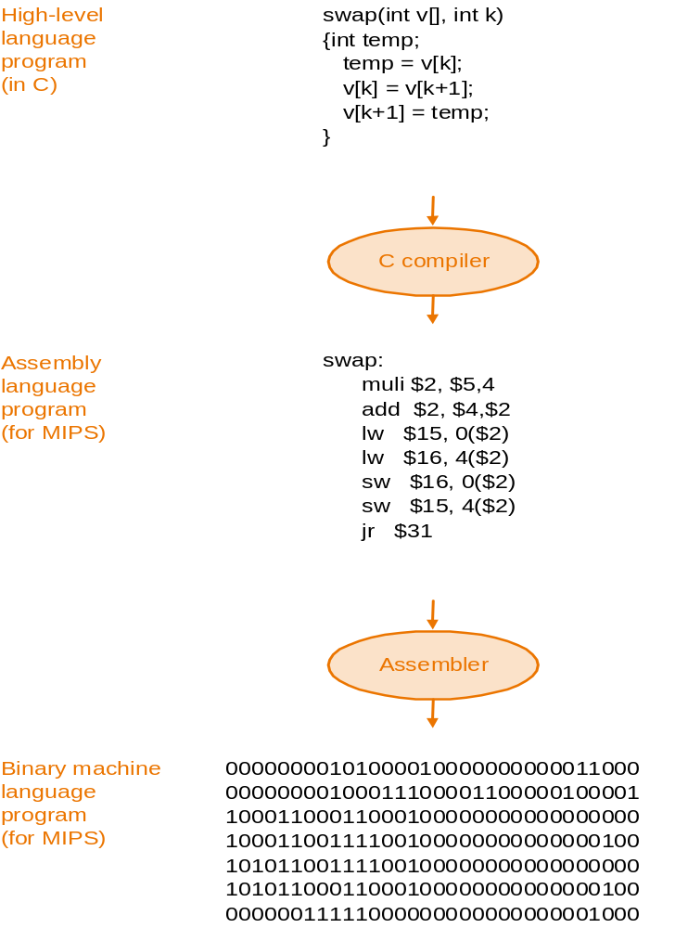
The process of compiling and assembling

Slide 31
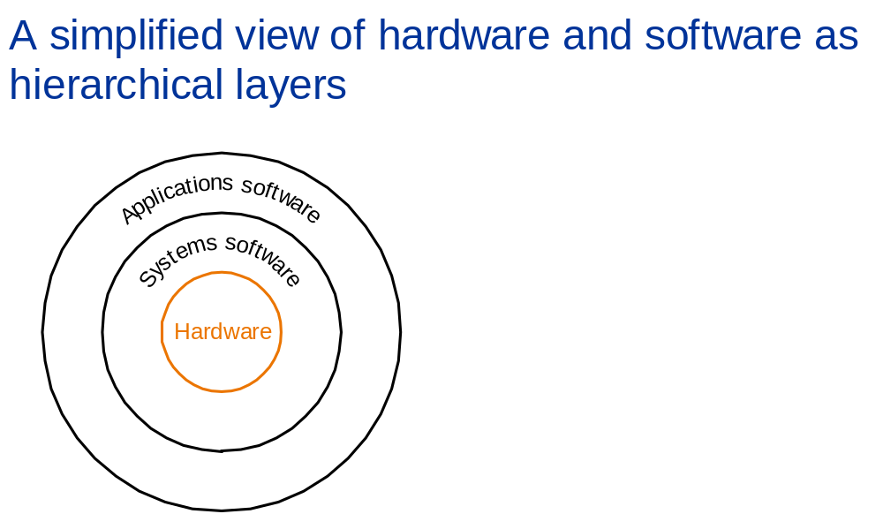
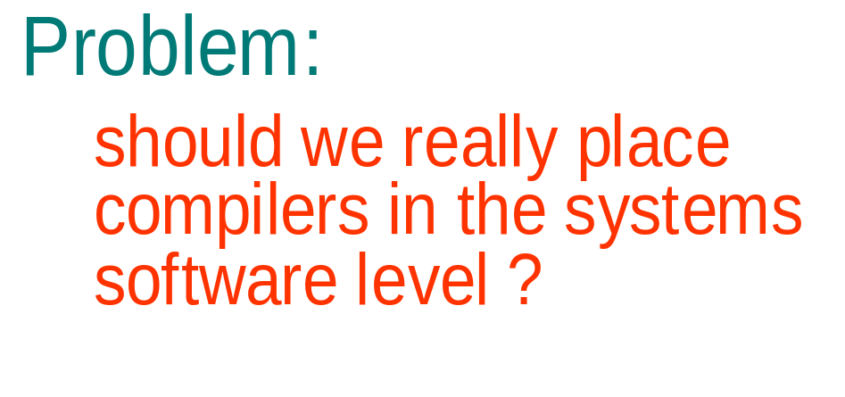

Slide 32
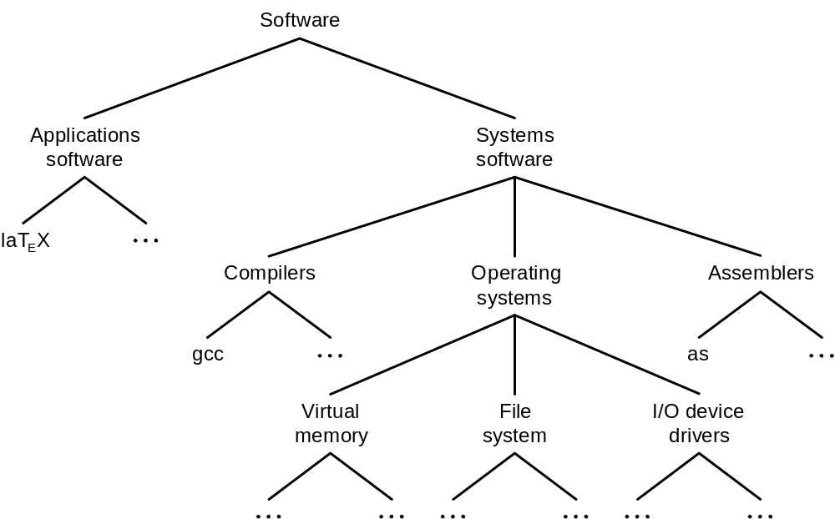
An example of the decomposability of computer systems

Slide 33
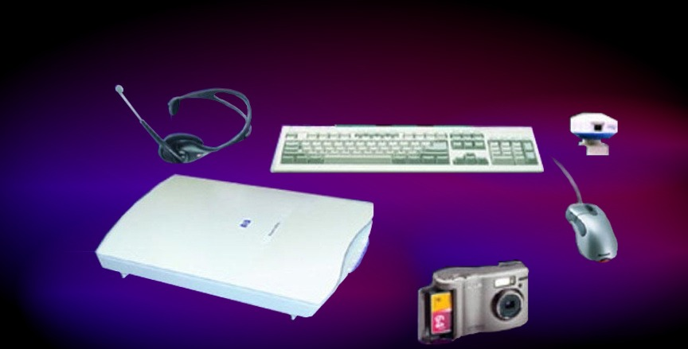
1.3 Computer Hardware System
Mouse
  The mechanical version
    Moving the mouse rolls the large ball inside
    The ball makes contact with an x-wheel and a y-wheel
    Decide the distance and direction the mouse moves according to the rotation of wheels
  The photoelectric version
    Better orientation and better precision
Notes:
……
the decreasing costs and higher reliability of electronics cause the replacement of electromechanical mouse

Slide 34
Display
  CRT (raster cathode ray tube) display
    Scan an image one line at a time, 30 to 75 times / s
    Pixels and the bit map, 512×340 to 1560×1280
    The more bits per pixel, the more colors to be displayed
  LCD (liquid crystal display)
    Thin and low-power
    The LCD pixel is not the source of light
    Rod-shaped molecules in a liquid that form a twisting helix that bends light entering the display

Slide 35
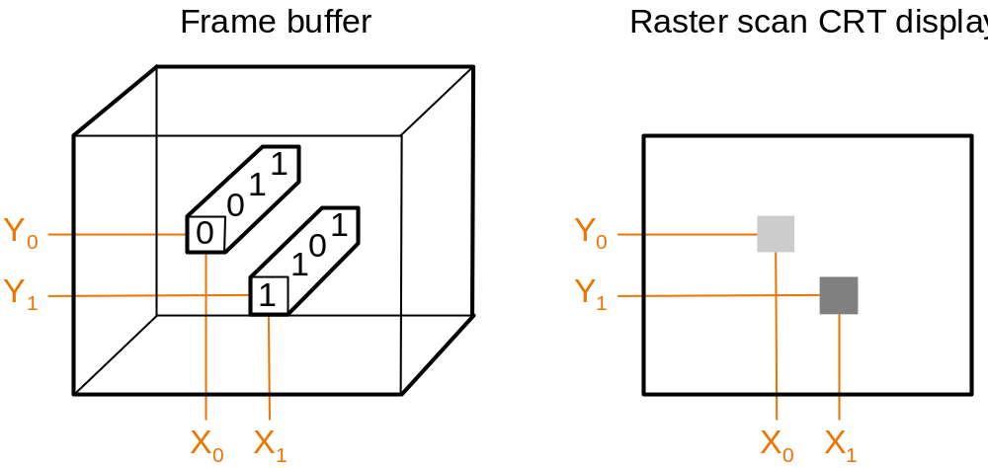
Hardware support for graphics ---- raster refresh buffer (frame buffer) to store bit map
Goal of bit map ---- to faithfully represent what is on the screen

Slide 36
New graphics hardware
GPU
  GPGPU
Parallel computing
  Graphics
  Mm
  Database
AMD
  CPU+GPU

Slide 37
Motherboard and the hardware on it
  Motherboard
    Thin, green, plastic, covered with dozens of small rectangles which contain integrated circuits (chips)
    Three pieces: the piece connecting to the I/O devices, memory, and processor
  Memory
    Place to keep running programs and data needed
    Each memory board contains 8 integrated circuits
    DRAM and cache
  Processor
    Add numbers, test numbers, and so on
    CPU (central processor unit)
Program platform of motherboard
  UEFI
  ASM/C/C++

Slide 38
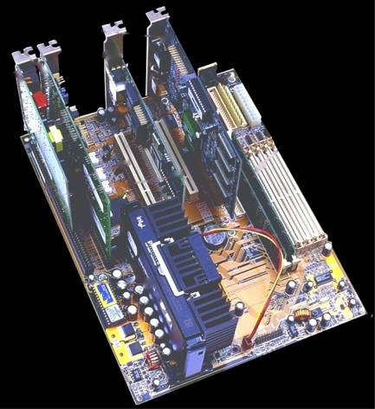
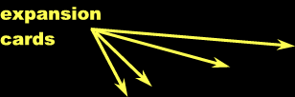
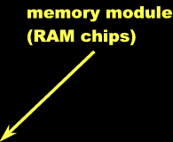
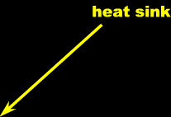



What is the motherboard?

Slide 39
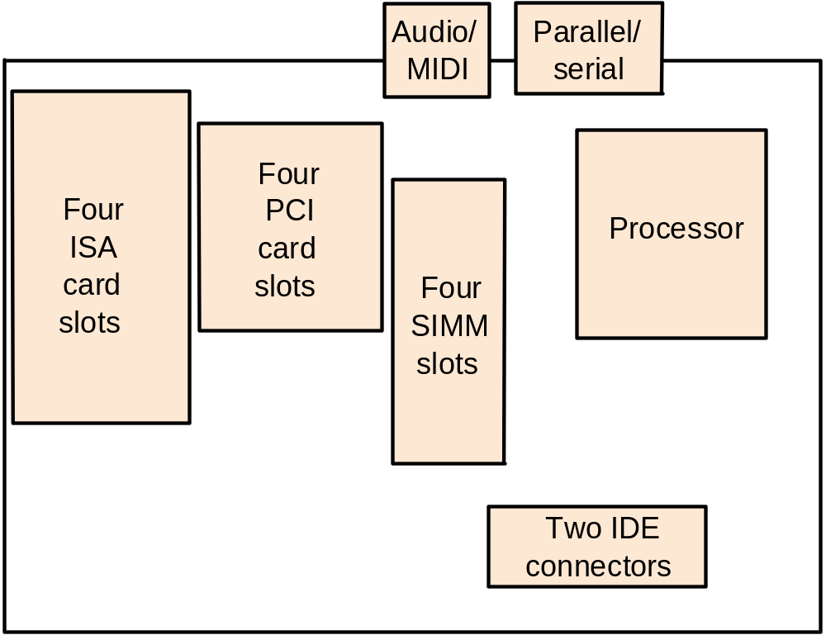
Close-up of PC motherboard
What diff
  Slot 0
  …
  Slot3
Speed
  0>1>2>3
Prime>slave
Notes:
ISA插槽是基于ISA总线(Industrial Standard Architecture)的扩展插槽，black, 比PCI接口插槽要长些，位于主板的最下端。其工作频率为8MHz左右，为16位插槽，最大传输率16MB/sec，可插接显卡，声卡，...
PCI插槽是基于PCI局部总线(Pedpherd Component Interconnect，周边元件扩展接口)的扩展插槽，其颜色一般为乳白色，位于主板上AGP插槽的下方，ISA插槽的上方。
Single-In-line-Memory-Modules,是我们经常用到的一种内存插槽，它是72线结构。如今的内存模块大部分是把若干个内存芯片颗粒集成在一小块电路板上，然后通过SIMM插槽与主板相连。
（Integrated-Drive-Electronics）是现在普遍使用的外部接口，主要接硬盘和光驱。采用16位数据并行传送方式，体积小，数据传输快。一个IDE接口只能接两个外部设备。

Slide 40
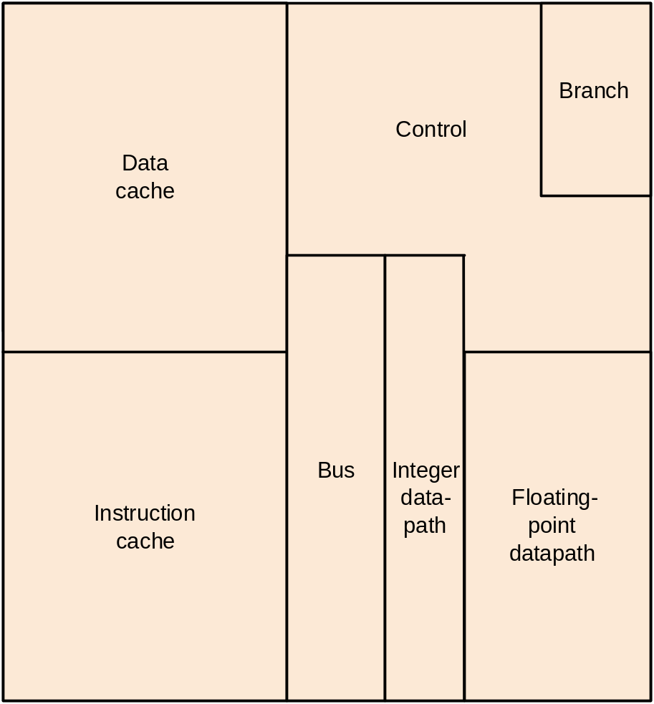
Inside the processor chip

Slide 41
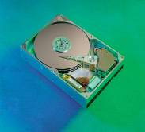
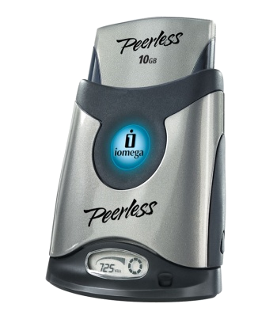
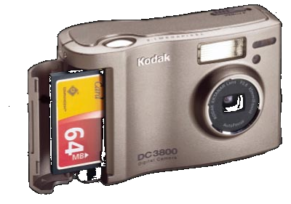
  Magnetic disk
    Rotating platter coated with a magnetic material
    Floppy disk
      Flexible mylar substance
      1.44~100MB
      Removable
    Hard disk
      Metal
      Commonly dozens of GBs
      Mostly not removable
      Rotate on a spindle at 3600 to 7200 r.p.m.
      Read/write head and movable arm
      Slower than DRAM, but cheaper for a given storage unit
  CD (optical compact disk)
  Magnetic tape
  flash
Notes:
Mylar: 聚脂薄膜
r.p.m.: rotation per minute

Slide 42
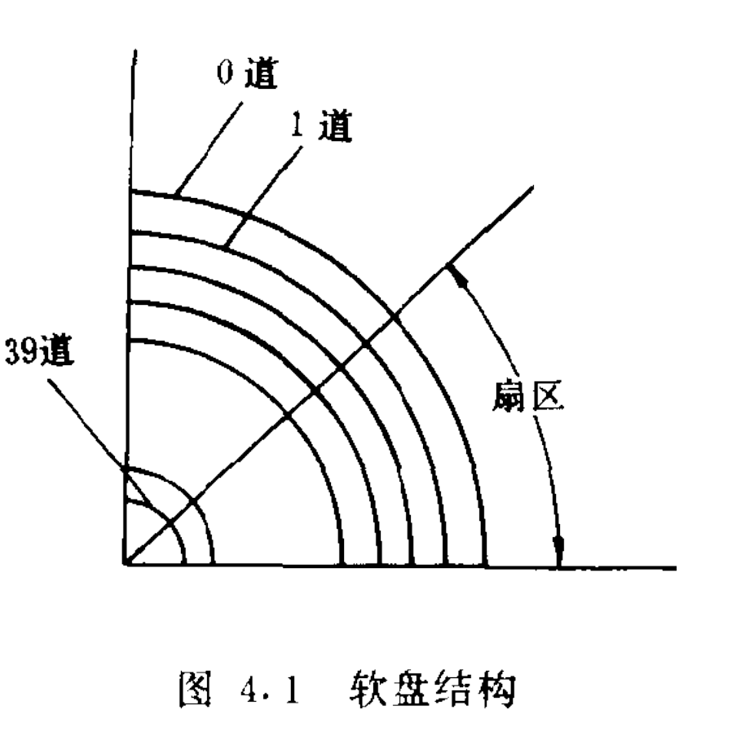
DISK
盘platter——>道 tracks——>扇区sectors.
HD 由2到20片组成
FD 由一片组成
柱面cylinder .由盘组中相同磁道构成
Notes:
HD: Hard disk,
FD: floppy disk

Slide 43
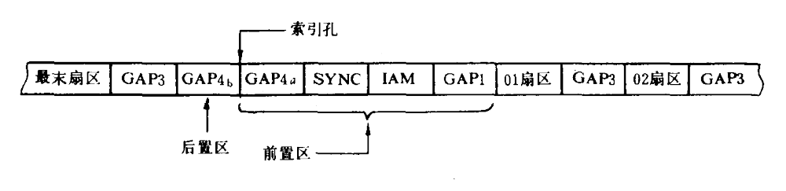
索引孔位于磁道的开头
孔的两边是前置区与后置区
前置区中包括索引地址标志IAM与索引地址标志同步区SYNC以及一些间隙(GAP)
information hiding

Slide 44
DM
  Disk management
  Low level format
High Level Format
undo
  Unformat
  UnDelete
FDisk

Slide 45
几个问题
1、磁道坏了，怎么办
2、哪个磁盘最快
  C盘快还是E盘快
3、怎么设计undelete软件
4、硬盘格式化为什么可以恢复
  手机通讯录格式化了，怎么恢复
5、flash是U盘、SD、SSD的基础器件，读写10-100万次就坏了，为什么能作为笔记本硬盘
6、硬盘容量一样，性能一样么？
7、硬盘灯为啥经常闪

Slide 46
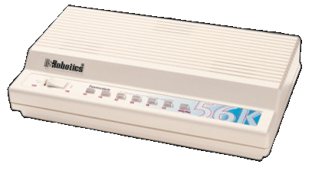
Computer network
  1. Major advantages:
    Communication
    Resource sharing
    Nonlocal access
  2. Two types:
    Ethernet and LAN (local area network)
    WAN (wide area network) and World Wide Web

Slide 47
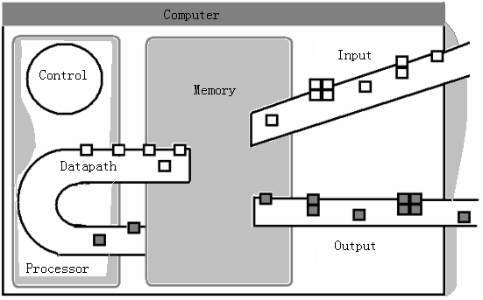
The five classic components of a computer

Slide 48
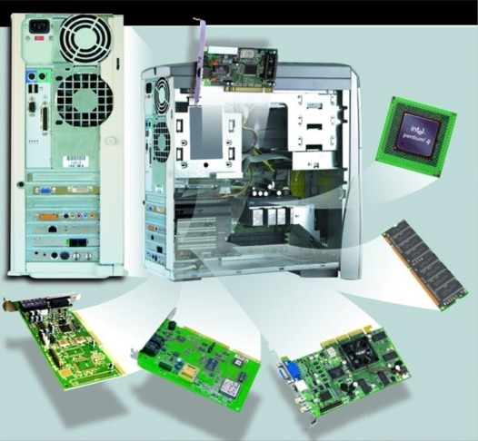
The System Unit
What are common components inside
the system unit?
Processor
Memory module
Processor
Memory module
Expansion cards
  Sound card
  Modem card
  Video card
  Network interface
  card
Ports and
Connectors
Processor
Memory module
Expansion cards
  Sound card
Processor
Memory module
Expansion cards
  Sound card
  Modem card
  Video card
Processor
Memory module
Expansion cards
  Sound card
  Modem card
  Video card
  Network interface
  card
Processor
Processor
Memory module
Expansion cards
  Sound card
  Modem card

Slide 49
Abstractions
  Lower-level details are hidden to higher levels
  Instruction set architecture ---- the interface between hardware and lowest-level software
  Many implementations of varying cost and performance can run identical software
A safe place for data ---- secondary memory
  Main memory is volatile
  Secondary memory is nonvolatile

Slide 50
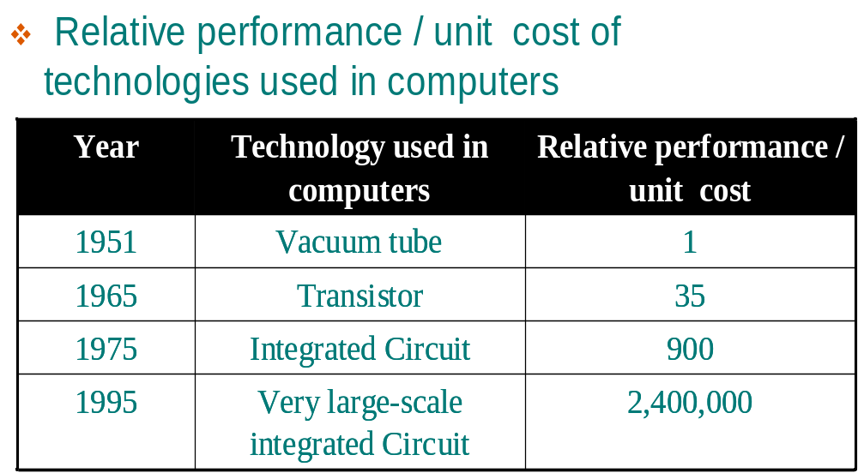
1.4 Integrated Circuits
1962, SSI（Small-Scale Integration） 12 transistors
1966, MSI（Medium-Scale Integration）,100－1k transistors
1967－1973年， LSI（Large-Scale Integration），1k~100k transistors
1977，VLSI（Very Large-Scale Integration），30m², 150k transistors
1993, ULSI (Ultra Large-Scale Integration) 16M FLASH and 256M DRAM which integrate 10M transistors
1994， GSI（Giga Scale Integration） 1G DRAM which integrates 100M transistors
2007: 2T flops 80core CPU

Slide 51
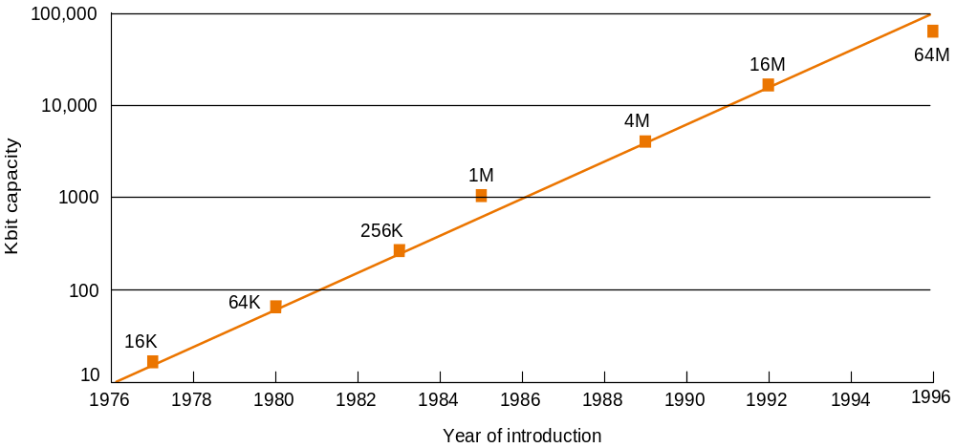
Growth of capacity per DRAM chip over time
tooooold

Slide 52
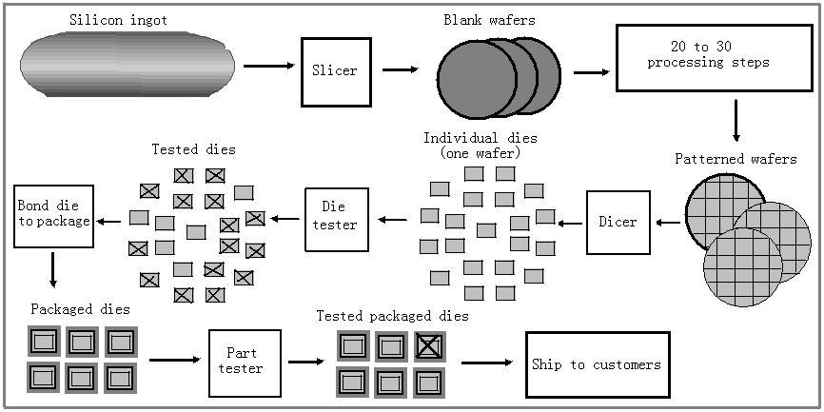
The semiconductor silicon and the chip manufacturing process

Slide 53
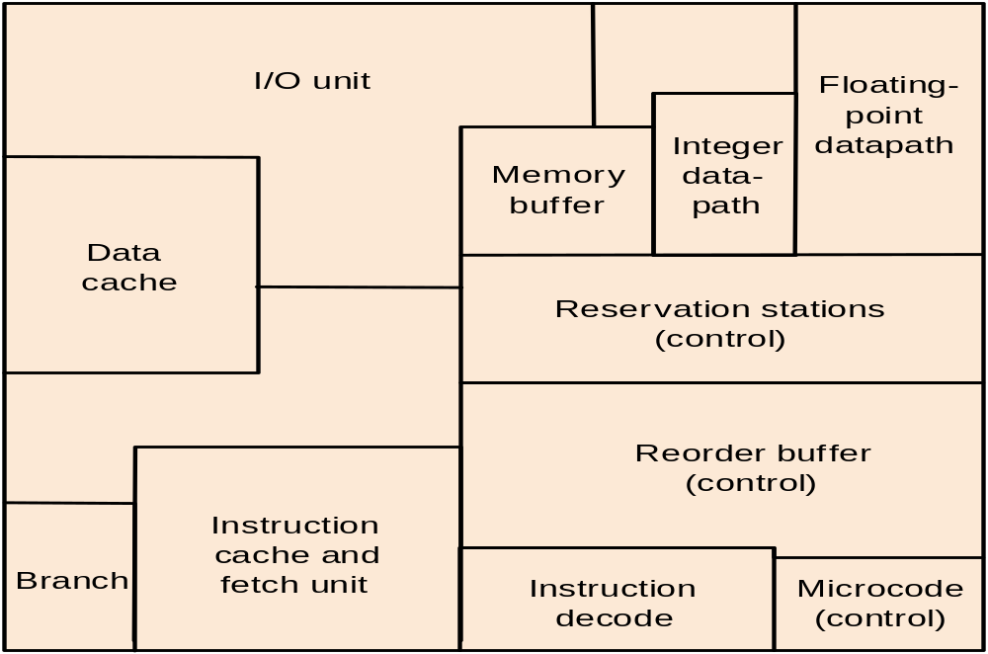
1.5 Real Stuff: Manufacturing Pentium Chips
Major blocks of a Pentium Pro die

Slide 54
Intel® Core® Micro-architecture Blocks
Fetch / Decode
To L2 Cache
Execute
Bus Unit
32 KB
Data Cache
32 KB
Instruction Cache
Next IP
SIMD
FP
Add
Instruction
Decode
(4 issue)
Branch Target
Buffer
Port
Integer
Arithmetic
Integer
Shift/Rotate
FP
Div/Mul
Port
Integer
Arithmetic
SIMD
Microcode
Sequencer
Port
SIMD
Reservation Stations (RS)
32 entry
Integer
Arithmetic
Scheduler / Dispatch Ports
Register Allocation
Table (RAT)
Port
Load
Memory
Order
Buffer
(MOB)
Store
Addr
Port
Retire
Store
Data
Port
Re-Order Buffer
(ROB) – 96 entry
Disclaimer: This block diagram is for example purposes only. Significant hardware blocks have been arranged or omitted for clarity. Some resources (Bus Unit, L2 Cache, etc…) are shared between cores.
IA Register Set

Slide 55
1.6 History of Computer Development
The first electronic computers
  ENIAC (Electronic Numerical Integrator and Calculator)
    J. Presper Eckert and John Mauchly
    Publicly known in 1946
    30 tons, 80 feet long, 8.5 feet high, several feet wide
    18,000 vacuum tubes
  EDVAC (Electronic Discrete Variable Automatic Computer)
    John von Neumann’s memo about stored-program computer
    von Neumann Computer
selfstudy course

Slide 56
  EDSAC (Electronic Delay Storage Automatic Calculator)
    Operational in 1949
    First full-scale, operational, stored-program computer in the world
  John Atanasoff’s small-scale electronic computer in the early 1940s
  A special-purpose machine by Konrad Zuse in Germany
  Colossus built in 1943
  Harvard architecture
  Whirlwind project
selfstudy course

Slide 57
Commercial Developments
  Eckert-Mauchly Computer Corporation
    Formed in 1947
    $1 million for each of the 48 computers
  IBM computers
    First one, the IBM 701, shipped in 1952
    Investing $5 billion for System/360 in 1964
  Digital Equipment Corporation (DEC)
    The first commercial minicomputer PDP-8 in 1965
    Low-cost design, under $20,000
  CDC 6600
    The first supercomputer, built in 1963
selfstudy course

Slide 58
Cray Research, Inc.
  Cray-1 in 1976
  The fastest, the most expensive, the best cost/performance for scientific programs
Personal computer
  Apple II
    In 1977
    Low cost, high volume, high reliability
  IBM Personal Computer
    Announced in 1981
    Best-selling computer of any kind
    Microprocessors of Intel and operating systems of Microsoft became popular
selfstudy course

Slide 59
Computer Generations
  First generation
    1950-1959, vacuum tubes, commercial electronic computer
  Second generation
    1960-1968, transistors, cheaper computers
  Third generation
    1969-1977, integrated circuit, minicomputer
  Fourth generation
    1978-1997, LSI and VLSI, PCs and workstations
  Fifth generation
    1998-?, micromation and hugeness
selfstudy course

Slide 60
New departure from computer hardware
Multicore
  From 2006
  IBM/SUN/AMD/Intel
  number of core
    2, 4, 8, 16
  Software
    adequate provision?
Embedded system
  embed PC into electronic product
  pervasive computing/Ubiquitous computing
I/O
  Device innovation
    WII
Communication
  3G/4G/WIMAX

Slide 61
Computer performance tools
CPU
Memory
DISK
Task manager
Service
System info

Slide 62
Defining performance
Response time (execution time): the total time required to complete a task, including disk accesses, memory accesses, I/O activities, operating system overhead, CPU execution time and so on.
Throughput (bandwidth): number of tasks completed per unit time

Slide 63
Measuring performance
CPU performance and its factors
CPU execution time for a program =
CPU clock cycles for a program * clock cycle time
Instruction performance
CPU clock cycles =
Instructions for a program * average clock cycles per instruction (CPI)
The classic CPU performance equation
CPU time = Instruction count * CPI * Clock cycle time

Slide 64
The basic components of performance
Components of performance | Units of measure
CPU execution time for a program | Seconds
Instruction count | Instructions executed for the program
Clock cycles per instruction (CPI) | Average number of clock cycles per instruction
Clock cycle time | Seconds per clock cycle

Slide 65

The power wall
Both clock rate and power increased rapidly for decades and then flattened off recently
The reason they grew together is they are correlated and the reason for their recent slowing is the practical power limit for cooling commodity microprocessors.
For CMOS, the dominant technology in integrated circuits, the primary source of power dissipation is dynamic power:
(Number_of_transistor, technology_of_wire&transistor connection)
Voltage leaking limits its decreasing.
To break down the wall: superconductive quantum computer
Notes:
{direct proportion, reverse proportion}
Superconduction can make the transistor cool, reduce the voltage leaky.
Quantum reduce the frequency-switch and increase the capacitive load.
New technology can make the dream come true.

Slide 66
Key words
server, supercomputer, Datacenter, embedded computer, multicore microprocessor
Gigabyte, Terabyte(2⁴⁰), petabyte(2⁵⁰)
Acronym
System software, operating system, compiler
Assembler, assembly language, machine language, high level programming language
Liquid crystal display, active matrix display, pixel
Motherboard, integrated circuit
dynamic random access memory, dual inline memory, datapath, static random access memory,

Slide 67
Abstraction, application binary interface, volatile memory,
CPI, instruction mix
Amdahl’s law
Million instructions per second(MIPS), FLOPS
RISC, CISC

Slide 68
END

