Slide 1
Lecture 14a LP in excel – postoptimality analysis III using macros
Dalia Patiño Echeverri
October 13, 2022

Slide 2
LP formulation of problem of amines production
We know how much can these coefficients change so the optimal solution remains equal
C1
C2
Max Z = 800X1 + 600X2
X1,X2
s.t.:
4X1 + 2X2 <= 60
2X1 + 4X2 <= 48
X1, X2 >= 0
We know the marginal worth of each unit of the scarce resources associated to these constraints
How do we know what is the effect of a change in the technical coefficients? (i.e., the usage of Machine A or Machine B hours by each product?
What happens if instead of needing 4 hours of Machine A, product 1 needs 4.1 hours or 4.2?
Need to solve the problem again!!
Can use a macro in excel!!

Slide 3
The need to solve the LP several times with different technical coefficients is a great excuse to talk about macros and loops
Intro to Macros
Macro RECORDER
Absolute
Relative
Loops
For
Do While
We are learning to do this with a simpler exercise that colors several tables in a workbook!!

Slide 4
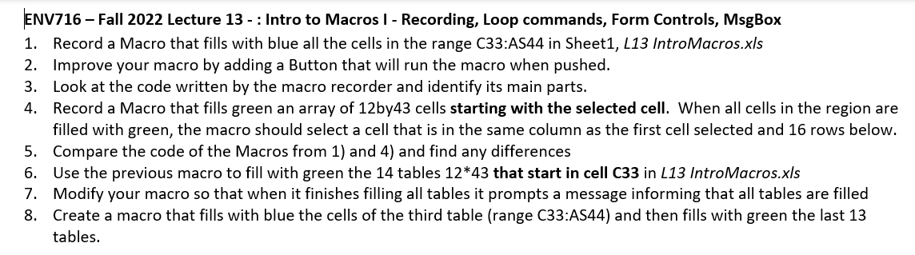
Handout H13
We did this last class
And also did this

Slide 5
L13-1. Recording a simple Macro
See excel
Specifying Pre y Post:
Precondition:
The cursor has selected any cell in the sheet where the table to color is located
Postcondition:
All cells in the range C33:AS44 are filled with blue. Cell C33 is selected
DO NOT select the UseRelativeReferences option

Slide 6
Running a Macro
You can only run macros that are in open workbooks, but they can be run from within any other workbook
Can run by pressing the shortcut
Can run by clicking the Macros button in the Developer tab of the Ribbon
Can run by selecting the macro name and clicking run
Can run by associating a Form Control to the macro

Slide 7
Macro security
Do not enable all Macros (viruses are Macros!)
Better:
Developer tab, Macro Security, Trust Center
Add a trusted location (i.e., a directory in your computer)
Macros you will always use can go into the Personal.xlsb

Slide 8
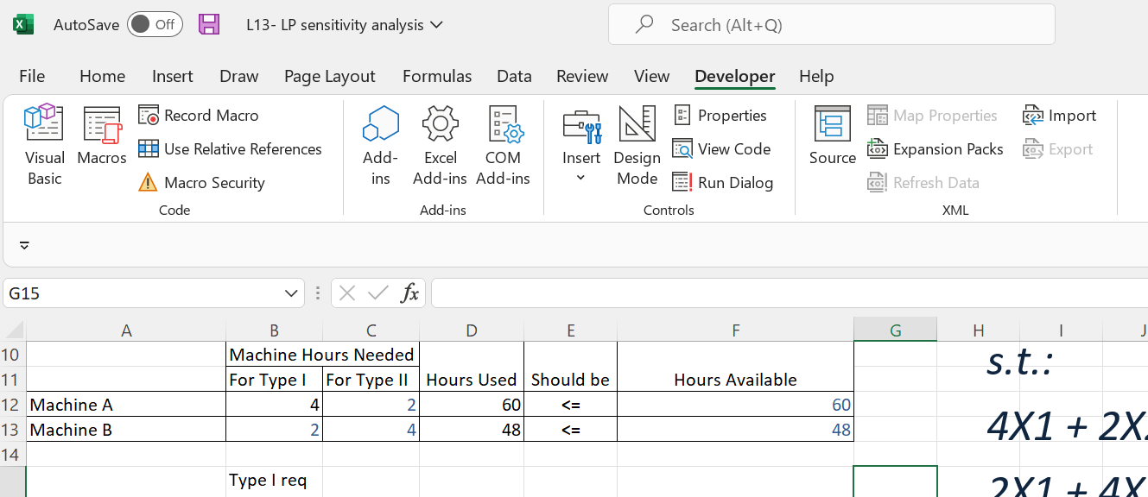
Developer Tab → Macro Security
Click

Slide 9
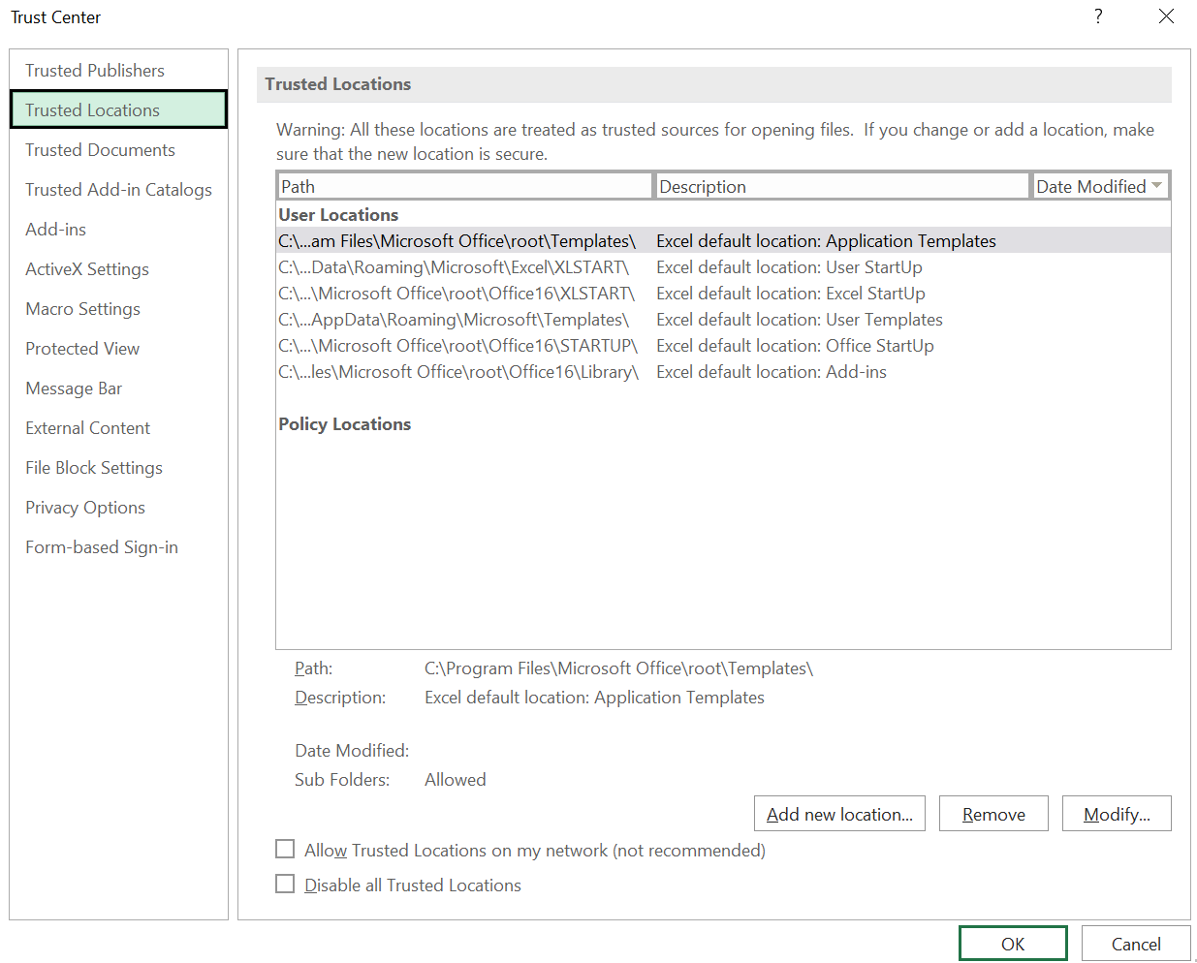
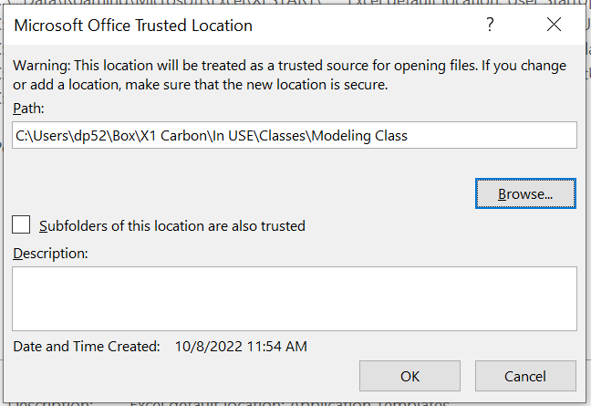
Developer → Macro security → Trusted Locations
Trusted Location
Set the path to the folder where you keep these files
Add New Location

Slide 10
Saving your Macro
Need to save the workbook as
Excel Macro-Enabled Workbook
Extension xlsm
Remember to save in the trusted location

Slide 11
L13-2: Running a macro clicking a Button
We did this last class
You can associate a macro to a Form Button
For example you can run the macro when the user clicks the associated Button.
To do this:
In the Developer tab --> Insert --> Button
The Message Box that opens allows you to specify the macro name
Change the format of the button as you wish

Slide 12
L13-3. Viewing the code of your first Macro
click the macro button in the Developer tab,
or
click the macros button in the view tab of the Ribbon. Select the macro name in the dialog box and click Edit

Slide 13
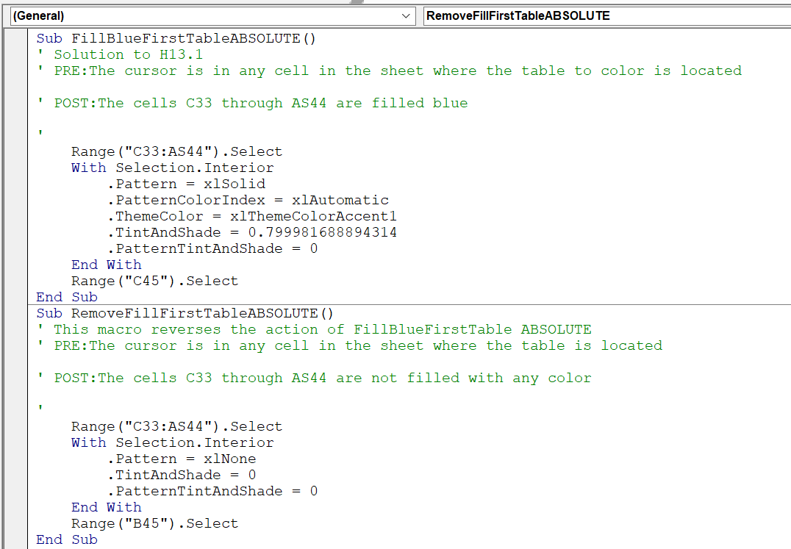

Slide 14
Code written by the Macro Recorder
Sub: The macro recorder produces "Sub" procedures (subroutines).
A "Sub" procedure starts with the key word "Sub" and ends with the key words "End Sub"
‘Comments’: Any line starting with a single quote is a comment line and it is ignored by the compiler and the editor. The other lines are the instructions that will be executed
Good practice: Use indentation to distinguish blocks of code. Not required but highly recommended

Slide 15
Absolute and relative recording
If the UseRelativeReferences button is selected, then the recorded macro will run selecting cells relative to the cell that is selected when the macro is run
If the UseRelativeReferences button is NOT selected, no matter which cell is selected when the macro is called, the macro will be always run as it was recorded

Slide 16
L13-4: Recording a relative Macro
Specifying Pre y Post:
Precondition:
First cell in the range to be filled is selected
Postcondition:
All cells in a region of 12 rows by 43 columns are filled with green. A cell 16 rows below from the initial cell is selected
Necessary to select UseRelativeReferences option

Slide 18
L13-5: Difference between the codes from the relative and absolute recording
Selecting the first cell ABSOLUTE:
Range("C33:AS44").Select
Selecting the first cell RELATIVE:
ActiveCell.Range("A1:AQ12").Select

Slide 19
L13-6: Repeating the Macro 14 times
Ideas?
Insert a button to run the macro and push it n times
Copy the relative instructions n times inside the macro
Use a computer command to repeat the instructions n times

Slide 20
A bit on coding basics before proceeding

Slide 21
Some basic definitions
Program
A sequence of statements that have been written to make the computer do something
Statement
An instruction for the computer to follow
Comment
A piece of code that is ignored by the computer
It is an explanation or a reminder for humans (other programmers)
Variable
A name that refers to a value
Values can be of different types (like numbers or letters)
For example, in Python
x=4
in Python
Print(x)
In VBA use ‘
In Python use #
For example, in Python, after writing
x=4
X is a variable that refers to the value 4

Slide 22
Variable Declaration
VBA does not require that you declare the data type stored in a variable, neither does Python
but the code will be clear and sometimes more efficient and less prone to erro if the variable type is declared
In VBA use the key word Dim to declare a variable. Example:
Dim NumTimes As Single
You can choose among several types
Key word to introduce a variable
Variable name. Choose a meaningful name
Key word to specify the type of variable

Slide 23
Some variable types
This is “bool” in python
Boolean (Takes the value True or False)
Integer (Takes values in the range -32,768 - 32,767)
Long (Long Integer) (Takes values in the range ~ -2billion-2billion)
Single (single-precision floating point, ranges from -3.4028235E+38 through -1.401298E-45 for negative values and from 1.401298E-45 through 3.4028235E+38 for positive values.)
Double (double precision floating point, -1.79769313486231570E+308 through -4.94065645841246544E-324 for negative values and from 4.94065645841246544E-324 through 1.79769313486231570E+308 for positive values.)
These are “int” in python
These are “float” in Python
Float: is a REAL number that has a comma separating the integer part from the decimals

Slide 24
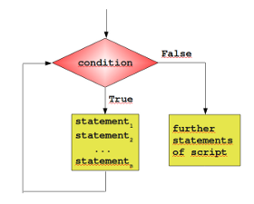
Loop commands
There are two ways to repeat a statement several times:
Do while statements, to repeat a set of commands when a logical condition is true (as many times as necessary):
For statements, to repeat a set of commands a fixed number of times.

Slide 25
Loop commands in VBA
Statements to repeat in VBA
Do while statements repeat a set of commands when a logical condition is true (as many times as necessary):
Do While <Logic condition>
Repeat the instructions that need to be repeated while
the logic condition is TRUE
End Loop
For statements repeat a set of commands a fixed number of times.
Dim i As Integer
For i = 1 To (number of times)
Repeat the instructions that need to be repeated
Next i

Slide 26
Loop command
Dim i As Integer
For i = 1 To (number of times) Step (increment)
Commands to be repeated
Next i

Slide 27
Repeating the Macro 14 times using the For command
For i = 1 To 14 Step 1
All the code from the relative macro
Next i
What happens if the Step value is 2?
→ it will only color the first 7 tables!

Slide 28
L13-6: Combine the instructions of the relative and absolute recordings in one macro to fill with green the last 14 tables of Sheet 1 (starting in cell “C33”)
We will combine the instruction of the relative macro of L5_4 with the instructions of the absolute macro of L5_1
the L5_4 macro fills green 14 tables in a row, but the selection of the first cell of the first table is relative to the active cell when we run the macro
The L5_1 macro selects the first cell: C:33

Slide 29
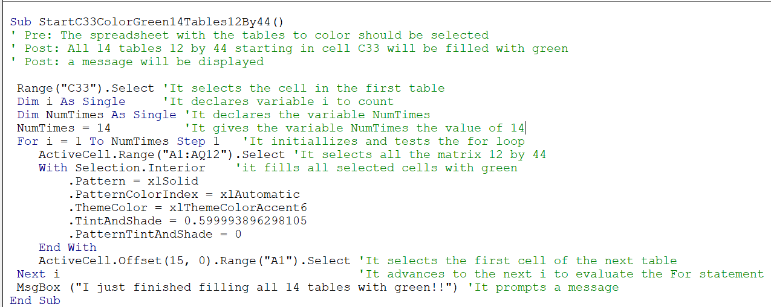
L13-6
This makes sure we always start with the cell C33 as the active celll
Select a range of cells relative to the active cell
15 rows below from the active cell
0 columns to the right of the active cell

Slide 30
Digression: ActiveCell.Offset(15,0).Range("A1").Select
Which cell would become the active cell with this command?
ActiveCell.Offset(3,0).Range("A1").Select
ActiveCell.Offset(0,3).Range("A1").Select
ActiveCell.Offset(3,3).Range("A1").Select
Play with the relative recorder to confirm your answers

Slide 31
Can you think of an alternative way to fill 14 tables using the Do While command?
Think about it. We will see that in our next class

Slide 32
L13-7: Prompting a message box from a macro
Use MsgBox
In the Sub Procedure write:
MsgBox “I just finished filling 14 tables with green"

Slide 33
L13_8: Do at home
Create a macro that fills with blue the cells of the third table (range C33:AS44) and then fills with green the last 13 tables

Slide 34
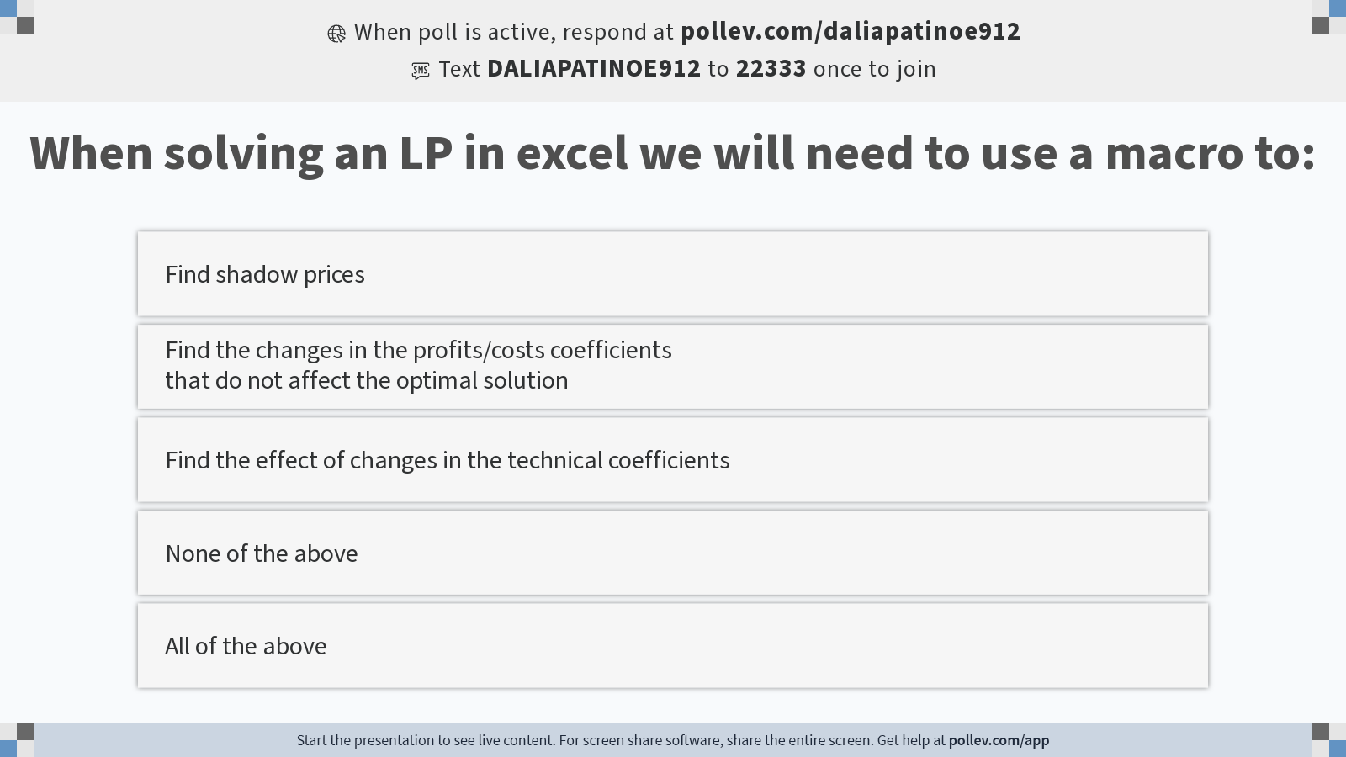
Notes:
Poll Title: Do not modify the notes in this section to avoid tampering with the Poll Everywhere activity. More info at polleverywhere.com/support When solving an LP in excel we will need to use a macro to: https://www.polleverywhere.com/multiple_choice_polls/j7A64FFrP3JiGJ3XCA5V7?display_state=instructions&activity_state=opened&state=opened&flow=Engagement&onscreen=persist

Slide 35
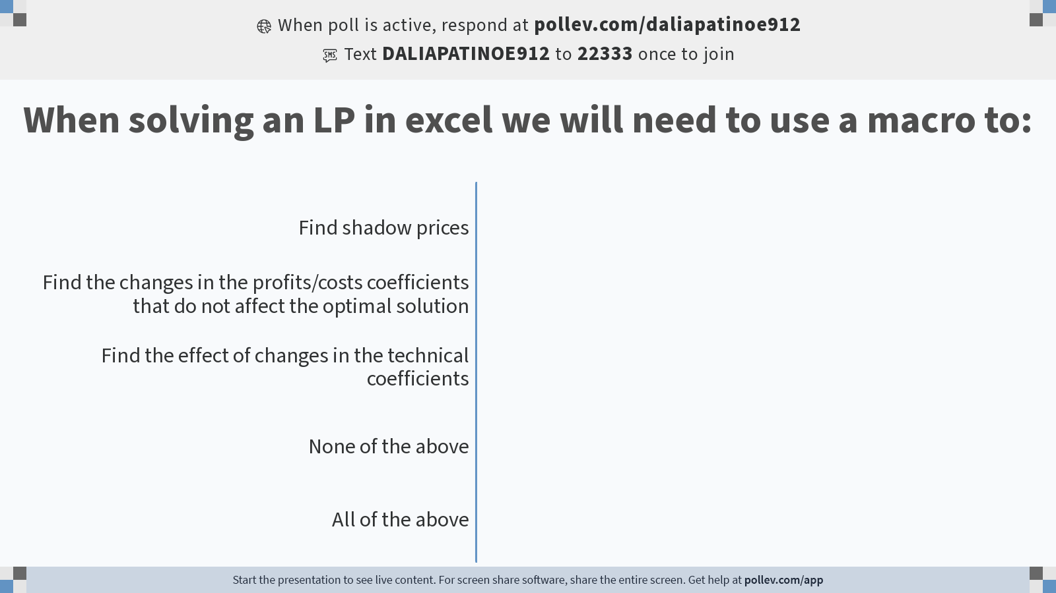
Notes:
Poll Title: Do not modify the notes in this section to avoid tampering with the Poll Everywhere activity. More info at polleverywhere.com/support When solving an LP in excel we will need to use a macro to: https://www.polleverywhere.com/multiple_choice_polls/j7A64FFrP3JiGJ3XCA5V7?display_state=chart&activity_state=opened&state=opened&flow=Engagement&onscreen=persist

Slide 36
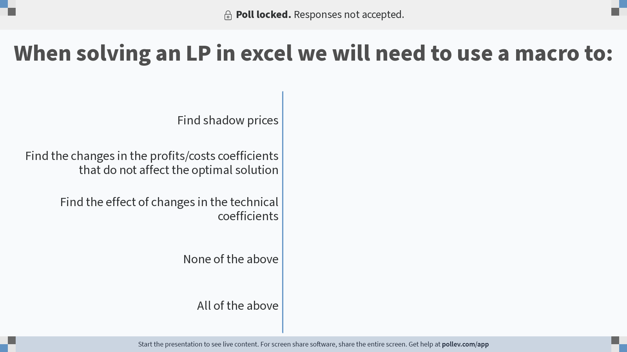
Notes:
Poll Title: Do not modify the notes in this section to avoid tampering with the Poll Everywhere activity. More info at polleverywhere.com/support When solving an LP in excel we will need to use a macro to: https://www.polleverywhere.com/multiple_choice_polls/j7A64FFrP3JiGJ3XCA5V7?display_state=chart&activity_state=closed&state=closed&flow=Engagement&onscreen=persist

Slide 37
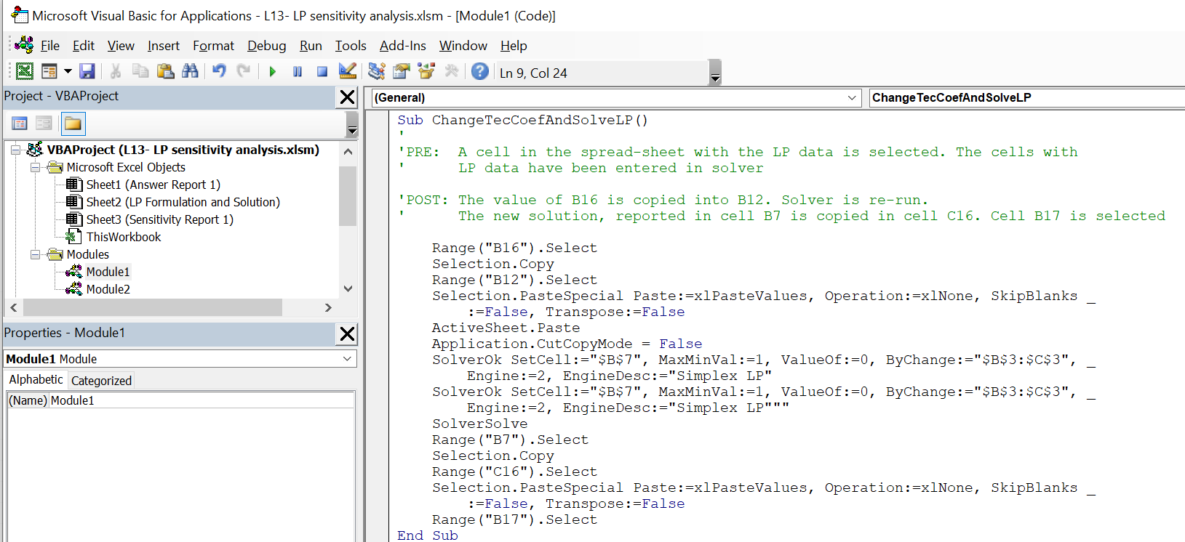
Back to the Sub that changes a technical coefficient and calls solver again
This macro will not run if we do not add a VBA reference to solver
Click on Tools -

Slide 38
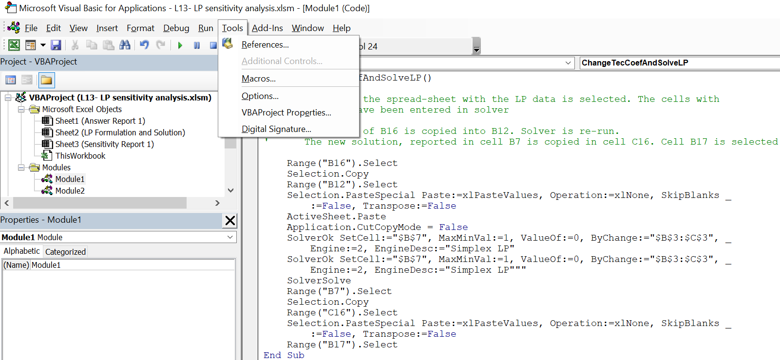
Click on References

Slide 39
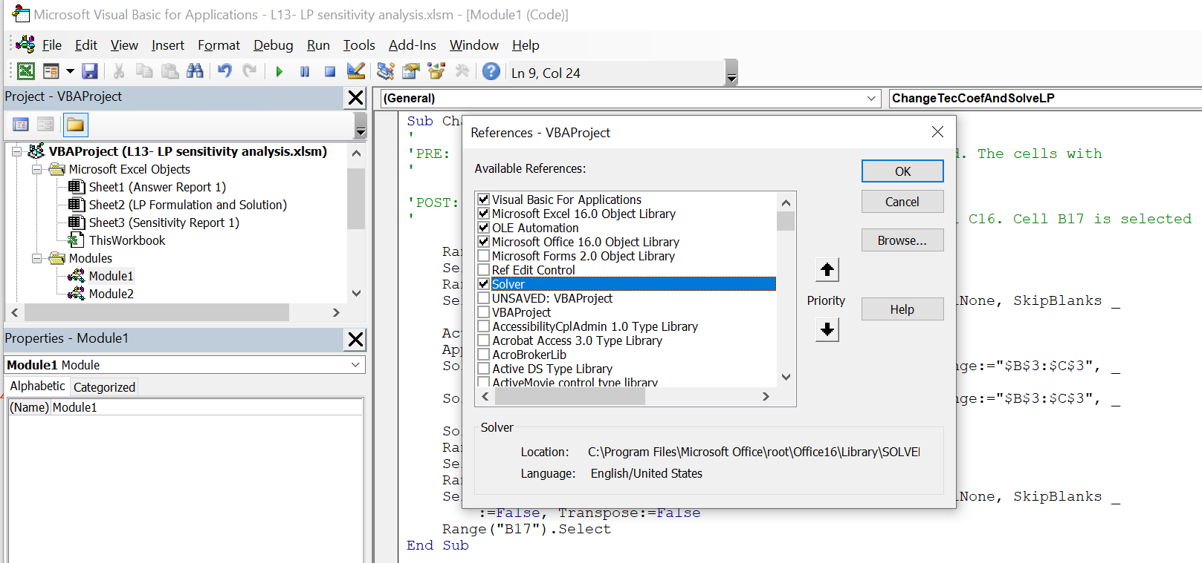
Select solver and click OK

Slide 40
Now it is your turn to test macros
Use what you learned developing the tables coloring macros to write a macro that solves several times the LP problem with different technical coefficients

