Slide 1
Cache
Memory Cache
Preferences
Cache
Disk Cache
Database
Internal Storage
File Storage
External torage

Slide 2
Memory Cache
set(key, value)
get(key)
remove(key)
removeAll()
isExist(key)
e.g., char/short/int/long/string/list<T>/map<T>/set<T>
setString(key,value)
getString(key)

Slide 3
Prefernces
get(key, defaultValue)
set(key,value)
isExisted(key)
E.g.,string/int/long/float/stringSet
getString(key, defaultValue)
setString(key, valye)

Slide 4
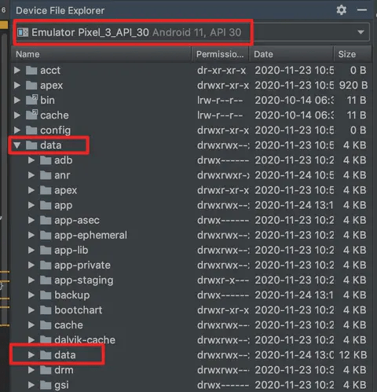
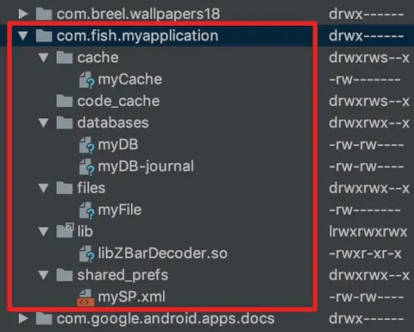
File Storage – Internal Storage
Get path of common dirs under
E.g., /data/data/package
cache/code_cache/databases/files/shared_prefs/lib
Read file from assert folder
Read file from raw folder

Slide 5
File Storage – Internal Storage
/sdcard/

Slide 6
File Storage – File operations
Is dir exist
Create dir / file
Move dir / file
Rename dir / file
Write to file with append / override ways
Zip dir / file
Unzip file

