Slide 1
MVC
1 Action / User event
3 Data
4 Update view
View
View
1
1
3
4
3
Controller
Model
Controller
Model
2
2
标准模式
变体：实际开发中使用，Controller 也可以更新View
1 -> 2 -> 3
1 -> 4
1 -> 2 -> 3

Slide 2
MVP
1 Action / User event
3 Data
4 Update view
View
1
4
Presenter
Model
2
3
1 -> 2 -> 3 -> 4

Slide 3
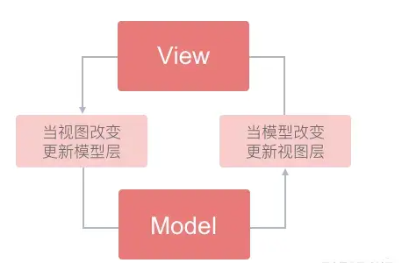
MVVM : 双向绑定
View
1
View Model
Model
2
3
1 -> 2 -> 3 -> 1
双向绑定的简化

