Slide 1
COMP 206 – Intro to Software Systems
Lecture 8 – Working with Strings
Sept 26, 2018

Slide 2
Plan today
Understand how text data is stored
How to represent single characters
How to build them into strings
Practice doing useful things with strings
Via basic C commands on the data itself
Using pointers.

Slide 3
Recall, different variable types. Char for text.
Description | Type | Bits | Range
Integer | short int long | 16 32 64 | +/-32 thousand +/-2.1 billion +- 9.2 x 10¹⁸
Floating point | float double long double | 32 64 128 | +/- 10³⁸ +/- 10³⁰⁸ +/- 10⁴⁹³²
Character | char unsigned char | 8 | -127 to 128 0 to 255
Pointer | char* int* (etc) | 64 | 0 to 1.8 x 10¹⁹

Slide 4
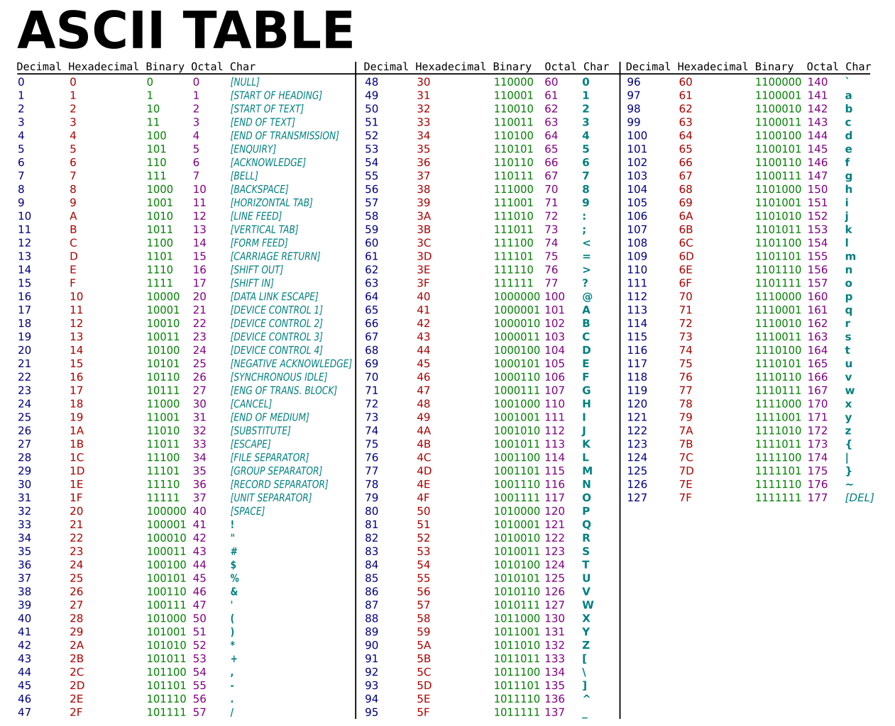
Memory is binary
Char type is really an 8-bit integer
The mapping to text characters is defined by a standard!

Slide 5
C Code to work with single characters
Single quotes for literals:
Math allows moving alphabetically forward or backwards, finding relative positions
Logic works via alphabetical order
char char_variable = ‘w’;
char_variable++; (it now = ‘x’);
char_variable - ‘a’ (tells you what position in alphabet, 23 here)
char_variable == ‘x’ (evals true)
char_variable > ‘z’ (evals false)

Slide 6
C Strings
Arrays of characters
E.g. char name[100] = “David”;
Each element is a character stored using the ASCII table
A mapping between our printable letters and the 0’s and 1’s in memory
Must be “null terminated” with the special ‘\0’ NULL value, with ASCII integer representation 0
Claim: Without the \0, printf could not work.
Do you agree? Why or why not?

Slide 7
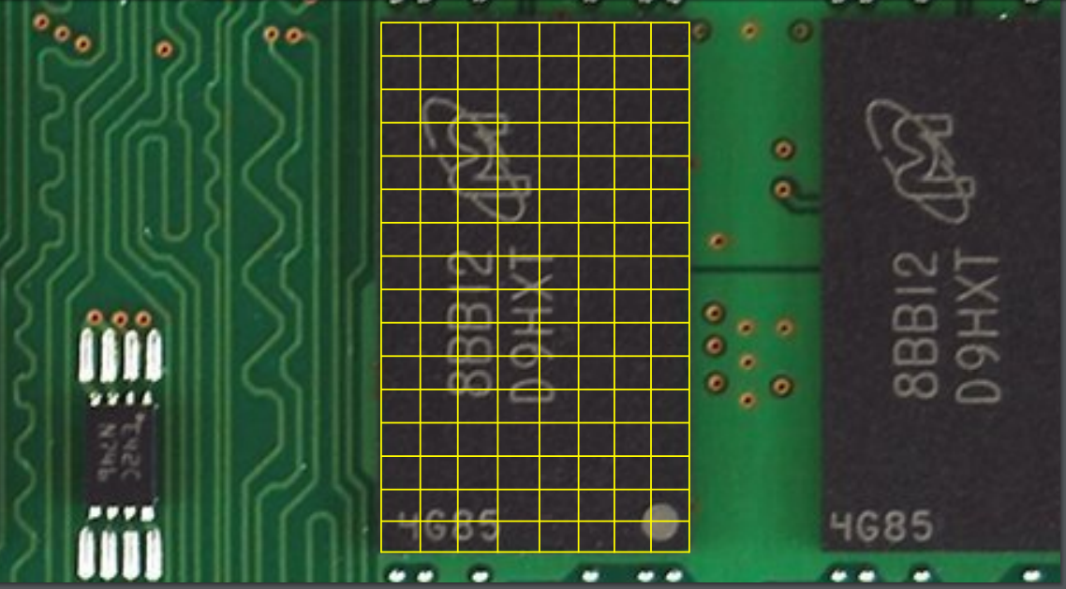
Arrays and Memory
Arrays take multiple “slots”, each of the underlying type
E.g. float array[2];
They are guaranteed to be stored in order
The number as you specify on array creation and does not change

Slide 8
Strings in memory
H
e
l
l
o
\0

Slide 9
C Code to work with char arrays
Double quotes for literals:
Doesn’t work with math
Logic operators don’t work
char str_var[100] = “hello”;
str_var++; (error);
str_var – “jello” (nothing related to ’h’ – ‘j’)
str_var == “hello” (incorrect)
str_var > “jello” (incorrect)

Slide 10
So what are the correct operations? Break down the string into its characters
To compare or change a string, we want to think about the characters inside. We will typically write loops that iterate char by char
Let’s build up to that, first off, print a string one char at a time:
char str_var[100] = ”hello”;
for( int pos=0; pos<100; pos++ ){
if( str_var[pos] == ‘\0’ ) break;
printf( “%c”, str_var[pos] );
}

Slide 11
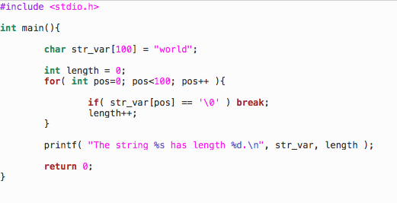
Building up, what about finding length?

Slide 12
Danger Young Programmer! Don’t forget the \0
We get \0 at the end of our string for free when we create it with the “…” syntax.
This can lead us to start forgetting to add it when we create, e.g.,
char str[10];
str[0] = ‘h’;
str[1] = ‘i’;
Hopefully you can see from our previous examples, this is not safe, we can get the wrong length and may print garbage data.

Slide 13
Danger Young Programmer! Don’t forget the \0
We get \0 at the end of our string for free when we create it with the “…” syntax.
This can lead us to start forgetting to add it when we create, e.g.,
char str[10];
str[0] = ‘h’;
str[1] = ‘i’;
str[2] = ‘\0’;
Hopefully you can see from our previous examples, this is not safe, we can get the wrong length and may print garbage data.
Correction!

Slide 14
More tools
You can do everything you’d like with the array representation of strings
However, they become a bit difficult to work with as we always need to keep the array index. Breaking up the string and moving around different parts of it requires many variables for book-keeping.
The ”Thinking in C” approach starts now, it’s easier to work with addresses!

Slide 15
C strings are also pointers. Wait… what is a pointer?
A pointer is variable that stores an address.
Pointers allow us to move around our strings (think iterators, lists indices):
char str_var[100] = “Hello”;;
char *start = str_var;
char *mid = str_var+3;
In future lectures: we will think about how pointers can be used with other types of variables
Address
1
7
0
8
H
e
l
l
o
\0
?
?
15
16
8
24
3
32
32
Note: all data is of course binary, but we display chars or ints in each byte to make life easier.

Slide 16
C Syntax for pointers
Declare a non-pointer variable with:
TYPE VARNAME;
Declare a pointer with:
TYPE * VARNAME;
Star can be anywhere between the type and var
VARNAME holds the value “the address of a variable or array of TYPE”

Slide 17
Pointers and Arrays
In some ways, they are interchangeable
An array in C is implemented as the address of its first entry. So, we “point to” the array
Example:
char array[4] = “abc”;
char *ptr = array;
ptr
24
array
a
b
c
\0

Slide 18
Pointers and Arrays
In some ways they differ:
The array variable holds the address to the start of this memory always, while the pointer is more flexible
Example:
char array[4] = “abc”;
char *ptr = array;
ptr++; ptr++; ptr++; ptr++; // These work
array++; // This is an error!
ptr
24, 25, 26, 27…
array
a
b
c
\0

Slide 19
Pointers and Arrays
Where do I point??
In some ways they differ:
An array says how much memory it requires at the beginning
A ptr declaration alone does not request memory to store real data
Example:
char array[4];
array[0] = ‘a’; // This line is OK
Char *ptr;
ptr[0] = ‘a’; // This line may seg fault
ptr
???
array
a
b
c
\0

Slide 20
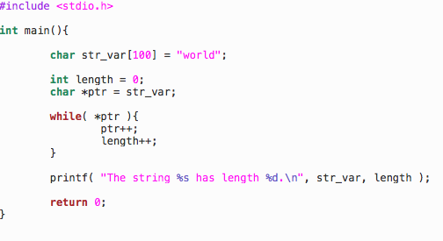
String length again, this time “the C way”
Note: Only the \0 character evals to “false”

Slide 21
String length again, this time “the C way”

Slide 22
C stings using pointers
char str_array[100] = “hello”;
char *ptr = str_array;
ptr = ptr + 3; // Now points to lo
ptr = ptr – 1; // Back to llo
char *ptr2 = str_array;
ptr – ptr2; // Gives position
// difference, 2 here
ptr = ptr2; // False, not same spots
ptr > ptr2; // True, ptr is farther along
Pointing to start of literal works
Pointer math moves us around the string and computes distances
Logic is based on the pointer position

Slide 23
The final step (for today)
We can now manipulate our strings ourselves
For you, take a look at <string.h> library. These functions let you do things the easy way!

Slide 24
Exercises
Write a C program to reverse the characters in its first argument and output to terminal
Assignment 2 2nd question

