Slide 1
Asset Allocation
(Portfolio Theory)
Measuring Risk and Return
Diversification
Efficient Portfolios
Capital Market Line

Slide 2
1. Preferences under uncertainty
Use Return ( ) and Risk ( )
to represent investment preferences Under uncertainty
Risk and return go hand in hand with each other
We can think of each investment having two dimensions :
risk and return.
The objective is to pick the investments that have the best risk/return combination (trade-off).
We measure “return” by using the expected return : E( R)
we measure “risk” by using the standard deviation of returns : σ_{R}
How do we put them into a single objective function?
Greed
Fear

Slide 3
Mean-Variance Utility Function
Modeling Preferences using Utility Fcn “U”
U ( E(R) , σ ²) =
k = Scale factor = 0.5 if decimals
0.005 if %
+
-
E(R )
- σ ²
A
k
A = Risk Aversion parameter
The higher the A is, the more risk averse an investor is..
.i.e as RA increases ►U decreases further as σ ² goes up

Slide 4
Example 1
Suppose a risk-free asset has an expected return of 4%, and a mutual fund has an expected return of 10% and a standard deviation of 16%.
Question
which will you prefer if your degree of risk aversion is 4 using the utility function U = E(r) - .5 *A*σ² ?

Slide 5
Example 1(cont’d)

Slide 6
Types of Investors
Risk Averse : A > 0
Given an equal increase of risk, she will require an increasing increments of expected return
E (R)
σ
Does he need to diversify and why?
Risk Return Trade offs
For given preference A=4
C
B
Indifferent between A, B & C
A
Indifference Curve
Δ
Δ
Yes, because he’s Risk Averse investor

Slide 7
Risk Neutral : A = 0
Given an equal increase of risk, she will require a constant expected return
E (R)
        σ
A
B
C
Δ
Δ
No
How about diversification?

Slide 8
Risk Lover : A < 0
Given an equal increase of risk, she will require a decreasing expected return
E (R )
σ
How about diversification?
A
B
C
Δ
Δ

Slide 9
2. Returns
Dollar returns vs. Percentage returns
0
1
Stock
D₁
P₀ =$10
=$1.5
P₁
=$15
    Total Dollar Return =
D₁ + (P₁ – P₀)
Annual Holding Period Return-HPR=

Slide 10
3. Predicting Return
Method 1 : Ex-ante Method: Prospective
Outcomes Probability R_{A}
Recession .30 0%
Normal .40 10
Boom 20
=HPR
.30
∑ = 1
Best guess ?

Slide 11
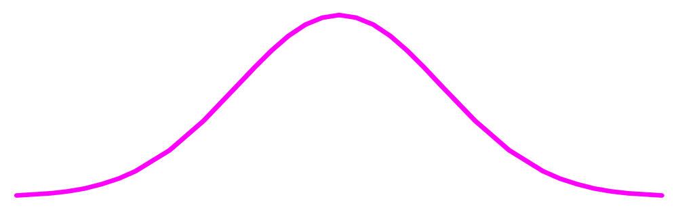
Assumption about Returns
- σ
+ σ
E (R )-σ
E ( R )
E( R) +σ
Rate of
return (%)
With 68% of chances
Notes:
3

Slide 12
Example 2
E (R_{A} )= Weighted average return
= Σ [ R_{t} * π_{t} ]
Variance of A = Σ { π*[ R_{t} - E(R)] ² }

Slide 13
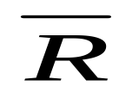
Method 2 : Ex-post method
Observe past (R₁, R₂, R₃…….R_{T} )
E ( R ) =
= ∑ R
T
VAR (R ) =
∑ ( R_{t} - R )²
(1/T-1)

Slide 14
Example 3
Year 1 2 3 4
Return(%) 15 0 5 20
E ( R ) =
VAR( R ) =

Slide 15
Interpretation
10% - 9.13%
10%
10% + 9.13%
2/3 of the time
Notes:
3

Slide 16
Average Annual Returns: 1948-1992
Av return St. deviation
Cnd com stocks 12.58% 16.82%
Bonds 7.04 10.02
Treasury Bills 6.19 4.26
Inflation 4.68
Important Principle
Higher the Return ►Higher the Risk
Higher Risk
►Lower Current Price

Slide 17
4.Portfolio of Stocks
How do we go from individual asset to portfolios?
We start from two risky assets. Most of the intuition carries to the case of more than two risky assets.
Suppose we have two stocks with the following information
Stock E (R) σ
A 10% 7.75%
B 18.5 16.6
Predicting the Return of the Portfolio?
W_{A}= % of the initial wealth invested in Stock A
W_{B}= % of the initial wealth invested in Stock B

Slide 18
The expected return of a portfolio is simply
the weighted average expected returns of all the individual assets in the portfolio
E(R_{P}) = W_{A} E(R_{A}) + W_{B} E (R _{B} )
W_{A} + W_{B} = 1
or
E(R_{P}) = W_{A} E(R_{A}) + (1-W_{A} ) E (R _{B} )

Slide 19
Variance is more complicated
Var(R_{P}) =
Var (W_{A}R_{A} + W_{B} R_{B})
VAR(R_{P})=
W_{A}² VAR(R_{A})
+W_{B}² VAR(R_{B})
+ 2W_{A}W_{B} COV(R_{A},R_{B})
Weighted average of individual risks
Co-movements
If > 0
If < 0
Standard deviation is the square root of variance

Slide 20
Key is
Covariance
Return
B
Portfolio
A
Cov < 0
Time

Slide 21
Estimation of Covariance
COV(R _{A},R_{B}) = Σ_{i} π _{i} (R _{Ai} -E(R _{A})) (R _{Bi} -E(R _{B}))
= Σ_{t} (1/T-1) (R _{A t} - R _{A}) (R _{Bt} - R _{B})
= σ _{A} σ _{B} ρ_{A,B}
-

Slide 22
Example 4
State Π R _{A} R _{B}
Boom .4 .10 .35
Normal .3 .00 .20
Recession .3 .20 -.05
E(R _{A})=.10, E(R _{B})=.185
COV (R_{A},R_{B})=
.

Slide 23
5. Diversification
Don’t put all eggs in the same basket,
because if the basket drops….?
Process of holding multiple assets in the same class
or across class of assets
Why?
prefer more predictable path of income

Slide 24
Covariance Variance Matrix
W_{A}
W_{B}
Stock A
Stock B
Cov (A,A)
W_{A}W_{B}
Cov(A,B)
Stock A
= σ² _{A}
W²_{A}
W_{A}
Stock B
W_{B}W_{A}
Cov (B,A)
Cov (B,B)
W²_{B}
W_{B}
= σ²_{B}
2 Var
+ 2 Cov
# terms?
4 terms =
W²_{A} σ ²_{A}+ W²_{B} σ ²_{B}+ 2 W _{A}W _{B} Cov (R_{A} ,R_{B})
σ_{P}² =

Slide 25
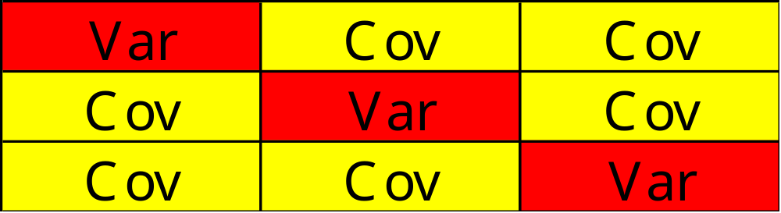
Some intuition
|<number>

Slide 26
Example 5
Stock W_{i} Var (R_{i}) std (R_{i})
A 0.3 0.16 0.40
B 0.6 0.25 0.50
C 0.1 0.09 0.30
Correlation Matrix A B C
A 1.0 … …
B 0.2 1.0 …
C 0.4 0.5 1.0
Var (Rp) =

Slide 27
Impact of diversification upon risk?
Sk Var Cov # of terms
1
1
1
2
2
2
4
3
3
6
9
4
4
12
16
N
N
N²-N
N²
∞
0
Left only with Cov
(Systematic Risk)

Slide 28
σ _{P} ² = Σ^{N}_{i} W²_{i} σ ²_{i}+ Σ^{N}_{j} W _{i}W _{j} Cov (R_{i} ,R _{j})
N terms
(N² – N) terms
Assume
N Stocks with W_{i} =1/N
All stocks have the same var, each = σ²
All cov are the same, each = cov
σ_{P}² =
( 1/N²
* cov )
N
* σ² ) +
(N²-N)
(1/N²
+
cov
σ_{P}² =
(1/N ) σ²
(1-1/N)
As N goes to infinity
►Left over with
σ_{P}² = cov

Slide 29
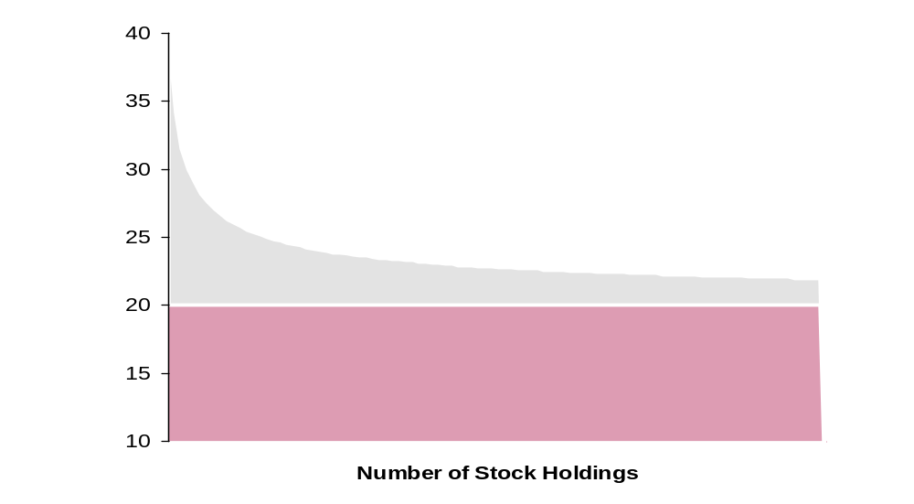
Unsystematic or firm specific risk
( Mgmt Skill, winning or losing contracts,Labor strike…)
Well Diversified Portfolio
Cov called systematic risk
(inflation, Taxation, interest rate…)
σ =Total risk=
Unsystematic + Systematic

Slide 30
Example 6
Based on data for 1982-2010, we find that
σ_{GE} = 6.49% and σ_{IBM}=8.10%
The correlation between GE and IBM is 0.377
Variance of an equally weighted portfolio

Slide 31
Conditions for Diversification?
Cov
Key to diversification is
But - ∞ ≤ cov ≤ + ∞
Use Cov(A,B) = σ_{A} σ_{B} ρ_{AB}
-1
+1
If ρ < 0
► cov < 0
If ρ > 0 ► cov > 0

Slide 32
Case 1 ρ_{A,B}= 1
cov
E(R_{P}) = W _{A} E(R _{A}) + W _{B} E (R _{B} )
σ_{P}² = W²_{A} σ ²_{A}+ W²_{B} σ ²_{B}+2 W _{A}W _{B}(σ_{A}*σ _{B}*ρ_{A,B})
a²
b²
2ab
σ²_{P}=
( a+b) ²=
(W_{A}σ_{A}+W_{B}σ_{B})²
σ_{P}=
(W_{A}σ_{A}+W_{B}σ_{B})
Max Risk
Feasible set?
Compute the expected return and σ of the portfolio for a series of portfolio weights
W_{A}
W_{B}
E(R_{P})
σ_{P}
1
0
…
…
Plot the feasible set

Slide 33
Graphically
W_{A} +W_{B} =1
Don’t gain from diversification
Long
Short
W_{B}>1
W_{A}<0
E (R_{P})
B
W_{A}=0,W_{B}=1
W_{A}=1/4, W_{B}=3/4
W_{A}=W_{B}=1/2
W_{A}=3/4, W_{B}=1/4
W_{A}=1, W_{B}=0
A
σ_{P}=0
σ_{P}
Zero Risk
Portfolio
W_{A}>1 W_{B}<0
P

Slide 34
Case 2 ρ _{A,B}= - 1
E(R_{P}) = W _{A} E(R _{A}) + W _{B} E (R _{B} )
σ_{P}² = W ²_{A} σ ²_{A}+ W²_{B} σ ²_{B} + 2 W_{A} W_{B} (σ _{A} *σ _{A} *ρ)
a²
+
b²
-
2ab
σ_{P}²
= (a – b) ²
σ _{P}
= (W_{A} σ_{A} – W_{B} σ_{B})
Min Risk
Feasible set & plot

Slide 35
Plot of the feasible set
E (R )
      σ
      σ
B
ρ=-1
W_{B}>1 W_{A}<0
ρ=1
P
A
W_{A} >1 W_{B} <0
W_{A}>0
W_{B}>0
ρ=-1
0

Slide 36
Question:
What is the asset allocation between A and B to achieve zero risk portfolio?
Method 1 set σ _{P} = 0 and solve for W_{A}and W_{B}
W_{A} σ_{A} – W_{B} σ_{B} = 0
Solving 2 equations 2 unknowns
W_{A} + W_{B} = 1
W*_{A} = σ_{B}
As σ_{B}
W_{A}
σ _{A} +σ_{B}

Slide 37
Method 2 Take the first derivative of σ ²_{P} with respect to W_{A}, set it equal to zero and solve for W_{A}
σ_{P}² = W²_{A}σ²_{A} + W²_{B}σ²_{B} + 2W_{A}W_{B}cov
W_{B}=1-W_{A}
∂σ²_{P}
= 0
and solve for W_{A}
∂W_{A}
σ²_{B} - cov
W*_{A} =
For any ρ
σ²_{A}+σ²_{B}-2cov
General formula for any MVP

Slide 38
Example 7
σ_{A}=10% σ_{B}=20% ρ = -1
W_{A} =
W_{B}=

Slide 39
Case 3 ρ _{A,B}= 0
E(R_{P}) = W _{A} E(R) _{A} + W _{B} E (R _{B} )
σ _{P} ² = W²_{A} σ ²_{A}+W²_{B} σ ²_{B}+[2 W _{A} W _{B} (σ _{A} *σ _{B} *ρ)]
E(R )
σ _{P}
0
MPV
Min σ

Slide 40
Solving MVP
σ²_{B}
W*_{A} =
σ²_{A}+σ²_{B}
Using general formula

Slide 41
Example 8
σ_{A}=10% σ_{B}=20% ρ = 0
W_{A} =
W_{B}=

Slide 42
Review of the 3 cases
E(R)
σ
ρ =-1
ρ =1
ρ =0
σ
σ
σ
As ρ goes down ►σ decreases
Gain from diversification because σ decreases

Slide 43
Diversification - Condition for Diversification
If add Ford
Corr (GM,FORD) = ?
►Assume ρ = 1
If add JJ instead
►Corr (GM,JJ) <1
σ
        Securities
GM
GM,Ford if ρ=1
σ
Gain from diversification if ρ < 1
GM,JJ if ρ < 1
1
2
?

Slide 44
6. Efficient Portfolios - Markowitz Method
An efficient portfolio is the one that:
Max Return given Risk or
Min Risk given Return
The set of efficient portfolios is called the efficient frontier

Slide 45
Mean Variance Model-Markowitz
Min Var (R_{p}) = Σ_{i}^{N} W_{i}²σ_{i}² +Σ_{i} Σ_{j} W_{i} W_{j} Cov (R_{i},R_{j})
Subject to: Σ_{i} ^{N}W_{i} E(Ri) = k
If N = 100 Stocks
100 R_{i}
100 σ_{i}²
10,000 -100 = 2
4,950 Cov
5,150 estimates

Slide 46
Case 1: Two Risky Assets
σ _{P} ² = W ²_{A} σ ²_{A}+ W²_{B} σ ²_{B}+ 2 W_{A}W_{B} Cov (R_{A},R_{B})
W _{A} E(R) _{A} + (1-W _{A}) E (R _{B} ) = k
decision variables?
inputs?
You can solve this using the Solver in Excel

Slide 47
Graphically
Efficient Frontier
MVP
B
B
E(Rp)
Less RA
MVP
A
More RA
σp
Next?
Solve for the asset allocation W_{A}? W_{B}?

Slide 48
Separation in Portfolio Management
Step 1 Derive the feasible set
Step 2 Determine the efficient set
Step 3 Investor will choose according to
his risk-return preferences
W_{A}? W_{B}?
y_{A}? y_{B}?

Slide 49
Example 9
Asset A Asset B
E (R ) 8% 13%
σ 12 20
Corr .3
Questions
What is the asset allocation if an investor requires 10%?
Risk level of the portfolio?

Slide 50
Graphically
E(R_{P})
σ _{P}
B
.10
Asset allocation
y_{A}= .60 y_{B}=.4
MVP
A
.123

Slide 51
Case 2 Two Risky Assets & One Risk Free Asset
σ_{P}² = W_{A}² σ_{A}² + W_{B}² σ_{B}²+ 2 W_{A}W _{B} Cov(R_{A},R_{B})
W_{A} E(R_{A}) + W_{B} E (R_{B} ) + (1-W_{A}-W_{B}) R_{F} = K
Portfolio of Risky Assets
Portfolio of Risk Free Assets
Asset allocation decision is concerned with how you allocate your funds in broad asset classes :
the risk free asset and the portfolio of risky assets.

Slide 52
Graphically
Step 1 Investment Process
E (R )
R_{F}
σ _{P}
CAL(M)
W*_{A} W*_{B}
B
M
MVP
CAL(MVP)
C
CAL(C)
A
CAL(A)
Slope=
E(R_{A})-R_{F}
Start with (R_{F},A)
Reward to risk
σ_{A}
Compared with (R_{F},C)
Slope=
E(R_{C})-R_{F}
σ_{C}
M most efficient portfolio of risky assets
…till highest slope =
E(R_{M}) - R_{F}
σ_{M}

Slide 53
Capital Allocation Line (CAL)
The slope of the CAL measures the excess return being earned per unit of risk.
This “reward-to-risk ratio” is commonly referred to as the Sharpe ratio.

Slide 54
Optimal Portfolio “M”
M is the optimal portfolio of risky assets which dominates all other risky portfolios (irrespective of risk preferences)
  ►This optimal risky portfolio is the same for everybody regardless of how risk averse you are
  ►Everybody holds a combination of risk-free
asset and the optimal risky portfolio
Note You can solve the optimal portfolio “M” using
Solver in Excel

Slide 55
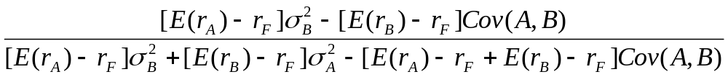
Optimal Portfolio “M”
the following formula which gives the weights for the optimal portfolio comprised of only two assets:
Equation 6.13-Page 180
W_{A}=
W_{B} = 1 - W_{A}
E (R_{M}) = W_{A} E(R_{A}) + W_{B} E(R_{B})
σ_{M} =
√W_{A}² σ_{A}² + W_{B}² σ_{B}²+ 2 W_{A}W _{B} Cov(R_{A},R_{B})
M
M
R_{F}

Slide 56
Step 2 Investor’s Choices
E (R )
M
R_{F}
σ_{P}
y
(1-y)
Asset Allocation: How Much Risk Can You Stand?
Once you have decided to hold a portfolio “M”,
you need to decide what mix of risky assets and risk free asset

Slide 57
For any efficient portfolio P on CAL(M)
E(R_{P}) = y E(R_{M}) + (1-y) R_{F}
(1)
σ _{P} ² = y ² σ ²_{M}
σ _{P} = y σ _{M}
(2)

Slide 58
Equation of CML
Capital Market Line (CML)
Substitute (1 ) into (2 ) and rearrange
E(R_{P}) = R_{F} + (E(R_{M}) – R_{F})
* σ _{P}
σ _{M}
Quantity of total risk
CAL(M)
Market Risk Premium
Risk Premium for P

Slide 59
Capital Market Line (CML)
E (R )
σ
CML
M
lender
borrower
y > 1
Unlevered
(1-y) < 0
0 < (1-y)≤ 1
y=1
0≤ y < 1

Slide 60
Risk Aversion and Asset Allocation
►Greater levels of risk aversion lead to larger proportions of the risk free asset (Rf)
► Lower levels of risk aversion lead to larger proportions of the portfolio of risky assets (M)
►higher levels of risk for high levels of returns result in leveraged combinations

Slide 61
Questions
What is expected return given σ _{P} = 10%?

Slide 62
2) Asset allocation ?
M
R_{F}
y
1-y
9.2% = y * 11% + ( 1 – y ) 5%
y=.70 (1-y) =.3
σ_{P} = y σ_{M}
►.10 = y * .142
► y =.70 and (1-y) =.3
E(R_{P}) = .7 * 11% + .3 * 5% = 9.2%

Slide 63
If initial wealth = $1,000

Slide 64
Example 10
Assume the following assets:
Asset A Asset B Rf
E (R ) 8% 13% 5%
σ 12 20
Corr(A,B) .3
% in M .4 .6

Slide 65
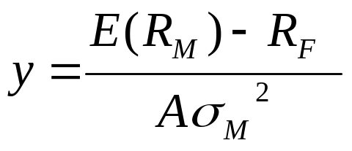
3) Asset allocation given A= 2?
= E(R_{P}) – k *A*σ_{P}²
Max U
y
y E(R_{M})+(1-y)R_{F}
y²σ²_{M}
½ * A*y²σ²_{M}
U = yE(R_{M})+(1-y)R_{F} -
∂ U/∂ y =
E(R_{M})-R_{F}-A* y *σ²_{M} = 0

