Slide 1
EQUILIBRIUM PRICING MODELS
CAPM
INDEX
APT

Slide 2
1. CAPM
Purpose?
Additional Assumption to CML:
M ≈ Tangent Portfolio ≈
Consists of all risky assets in the Universe!!
Composition? each asset is held in proportion to the market value (MV) of all securities.
Assume:
Universe MV of Securities
Asset 1 $25
Asset 2 $30
Asset 3 $20
Asset 4 $10
Asset 5 $ 5
Total $90
Price risk return at equilibrium
Universal market Portfolio
Fraction of Total
28%
33%
22%
11%
6%
100%

Slide 3
Risk of M?
Market Risk
M is well diversified→Relevant risk?
β_{M}
= 1
= W₁ β₁ + W₂ β₂ +……………+ W_{N} β_{N}
Market Risk of M
Contribution of stock 1 to the market risk
Beta is an appropriate measure of the stock's risk when it is part of a well diversified portfolio.

Slide 4
Beta?
Our measure of market risk is called beta, and is defined as
the covariance between the return of a stock and the return on
the market portfolio, divided by the variance of the return
on the market portfolio
Stock i ⇨ β_{i} = Cov (R _{i} , R _{M})
σ ²_{M}
This is an ex-ante estimate of the “non diversifiable risk” relative to the Market Portfolio
It is based on a theory in which there is a single investment period

Slide 5
Beta?
If β_{i} > 1
more risky than the market (Average Risk)
e.g. Technology sector
If β_{i} = 2,
Stock i fluctuates twice as much as the market
If β_{i} < 1
less risky than the market
e.g. blue chips, financial, consumer, utilities
If β_{i}= 1
e.g. GEE

Slide 6
Equilibrium CAPM
The equilibrium expected return on any security (or portfolio of securities) is equal to a risk-free return plus a risk premium.
E (R _{i}) =
R_{F} +
Risk Premium _{i}
E (R _{i}) =
R_{F} +
Market Risk Premium * β_{i}
E (R _{i}) =
R_{F} +
(E(R_{M}) – R_{F}) * β_{i}
Common to all stocks
Quantity of market risk specific to stock i
High beta→high risk →high expected return

Slide 7
Example 1
The expected market return is 12%. The risk free rate is 6%.
What is the expected return of a stock with a beta of 0.8?
What is the expected return of a stock with a beta of 1?
What is the expected return of a stock with a beta of 0?

Slide 8
Security Market Line
E(R _{i})
.
β_{i}
Underpriced
SML
M
E(R_{i})
Stock is at equilibrium
R_{F}
No incentive sell (buy)
Overpriced
►incentive to sell
0
β_{i} =.8
1

Slide 9
Mispricing?
Expected Return ⋚ Required Return
HPR = [ D₁ + (P₁-P₀) ]/P₀
E(R_{i})=R_{F}+β_{i} * MRP
If HPR < E(R_{i})
►Overpriced
P₀
Expect that investors will sell the stock
Expected return
till equilibrium
Price
HPR = [ D₁ + (P₁- P₀ ) ]/ P₀

Slide 10
Separation (portfolio management)
y = % of Wealth invested in M (1-y) = % of Wealth in Risk free
E (Ri)
Lending Portfolios
0 < (1-y) ≤ 1
0 ≤ y < 1
Borrowing Portfolios
y >1 (1-y) < 0
R_{F}
Unlevered Portfolio
y =1
1
β_{i}

Slide 11
along the SML
E(R ) = y E (R_{M}) + (1-y) R_{F}
E(R ) = R_{F} + y ( E (RM) – R_{F})
β
in CAPM

Slide 12
Example 2
β_{i}= .8, E(R_{M}) = .12, R_{F}= .07,P₁ = $21.5, P₀ = $20
Questions:
1. Position of the stock?
Expected Return =
Required Return =

Slide 13
Example 2(cont’d)
2. Equilibrium price? Prediction?
Price =
PV of Expected CF

Slide 14
Example 2 (cont’d)
3. Any arbitrage oooprtunity?
Look for mispricing?
Arbitrage Profit
E(R)
- Shortsell Sk
E(R_{i}) = 7% + β_{i} [5%]
- Buy Portfolio of M and R_{F}
M
12%
With y = & (1-y)=
11%
7.5
Spread =
7%
β_{i}=.8
Beta
1.0

Slide 15
Graphic Comparison of CML & SML
E(R_{i})
E(R_{i})
All systematic
All systematic
M
M
A
R_{F}
R_{F}
σ_{A’}
σ_{A}
σ_{i}
β_{i}
1.5
Unsystematic = σ_{A}-σ_{A’}

Slide 16
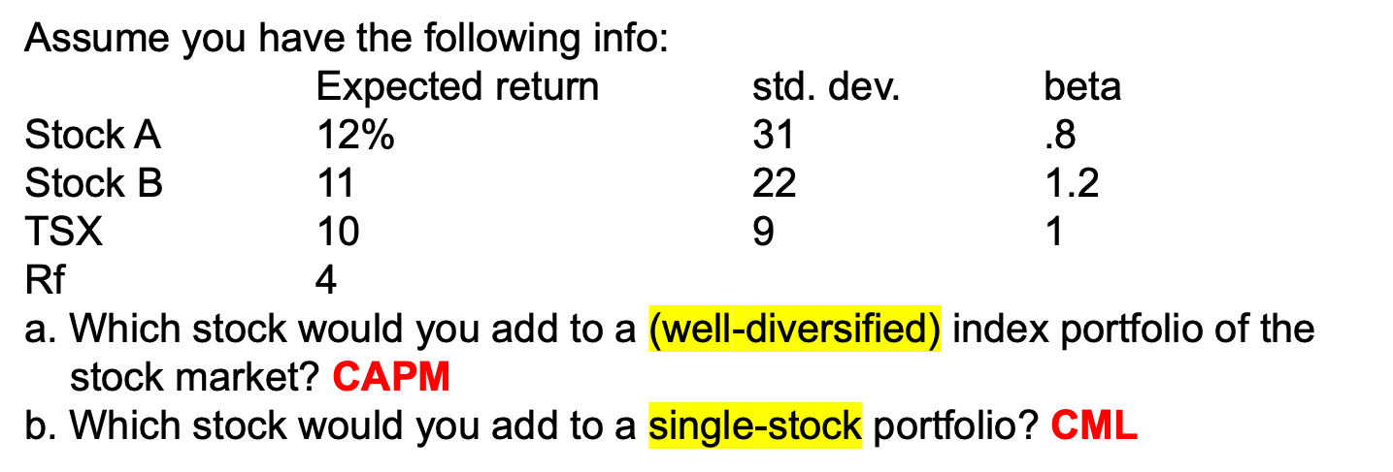
Example 3
a. Use CAPM
b. Use Sharp ratio (CML)

Slide 17
Testing the CAPM?
Positive relationship between risk and return
►Theory is correct
But the Model is not consistent with reality
►There are many missing factors such as dividend yield, size, earnings…

Slide 18
2. INDEX MODEL
Single Index Model (SIM) for one stock
r_{i} = α_{i} + β_{I} r_{I} + e_{i}
Properties
Cov (r_{I}, e_{i})=0
E(e_{i} )=0
Cov(e_{i}, e_{J})=0
unsystematic
GNP or Interest..
Systematic
2 effects
An expected event
α_{i}
Firm specific effects
Random event
e_{i}
r_{i}
Systematic effect
with β_{i} =Cov(r_{i,}r_{I})/σ_{I}²

Slide 19
Systematic & Firm specific Risk of an Asset according to the SIM
Expected Return,
E(r _{i} ) = α_{i} + β _{i} E(r_{I}), has 2 parts:
a. Firm specific return: α_{i}
b. Systematic return (index driven): β _{i} E(r_{I})
2. Variance =
σ _{i} ² = β _{i} ² σ_{I}² + σ²_{e i} , has similarly 2 parts:
a. Systematic risk (index driven): β _{i} ² σ_{I}²
b. Unique risk (asset specific): σ²_{e i}
3. Covariance between securities’ returns is due to only the systematic source of risk (if you form portfolio):
Cov(r_{j}, r_{i}) =Product of betas × Index risk
Cov(r_{j}, r_{i}) = β_{j} β_{i} σ_{I}²
Covariance depends only on single-index risk
Systematic risk + Firm-specific risk

Slide 20
Graphic Comparison of CML & SML
E(R_{i})
E(R_{i})
All systematic
All systematic
M
M
A
R_{F}
R_{F}
σ_{A}
σ_{i}
β_{i}
1.5
Systematic
β _{i} ² σ_{I}²
Unsystematic
σ²_{e i}

Slide 21
Estimation of Beta (CAPM)?
►CAPM
if Index= Stock Market
Use a regression equation of SIM
r _{it} = α + β (r_{M} _{t}) + e _{i t}
R_{i1}
R_{i2}
….
R_{iT}
R_{M1}
R_{M2}
…
R_{MT}
Single Index Model or Sharpe Model or Market Model
HPR(Sk)
HPR(Mt)

Slide 22
Excel
Load and activate the Analysis ToolPak
Click the File tab, click Options, and then click the Add-Ins category.
In the Manage box, select Excel Add-ins and then click Go.
In the Add-Ins box, check the Analysis ToolPak check box, and then click OK.
  If Analysis ToolPak is not listed in the Add-Ins available box, click Browse to locate it.
  If you are prompted that the Analysis ToolPak is not currently installed on your computer, click Yes to install it.

Slide 23
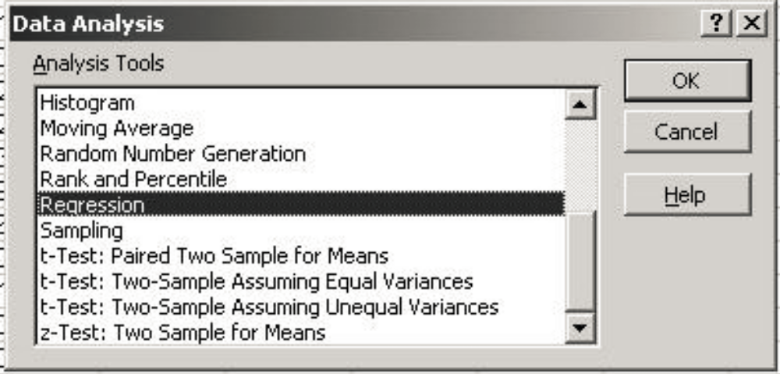
Excel

Slide 24
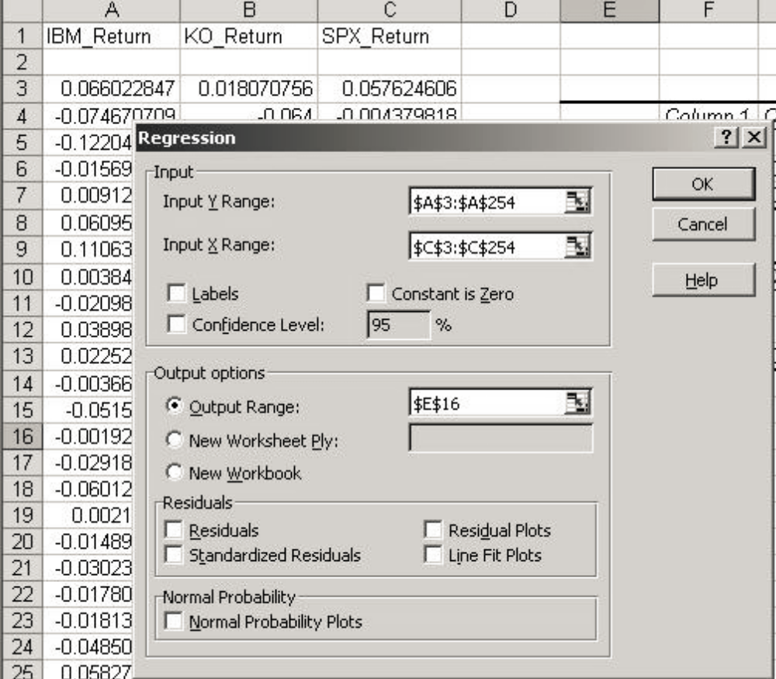

Slide 25
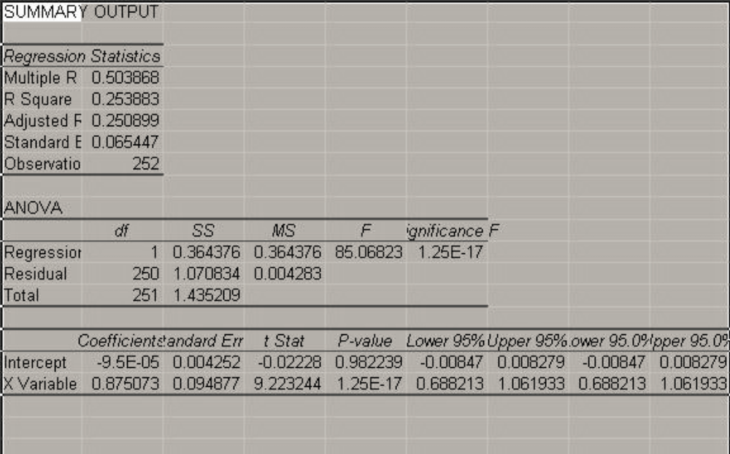
Excel

Slide 26
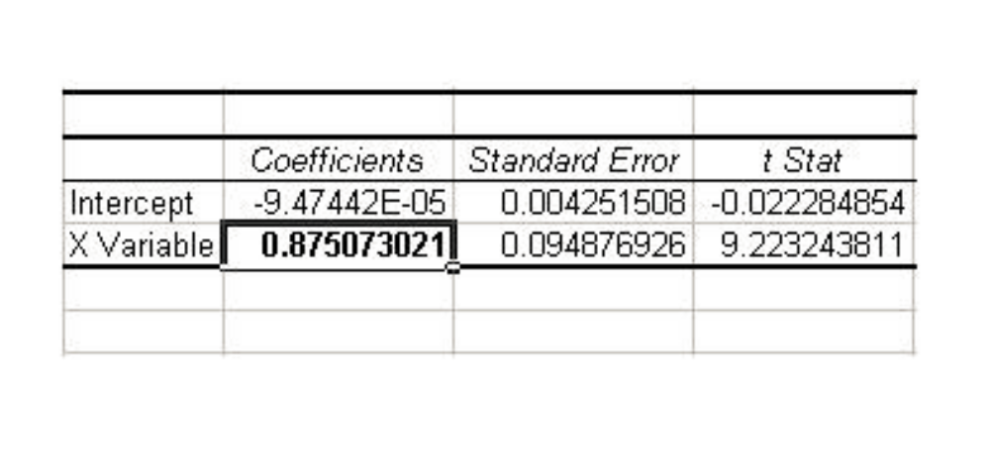
Excel

Slide 27
The Characteristic Line
Ri
Characteristic Line
^
^
β
α
Return on Market, R_{M}

Slide 28
Graphically
Ri
R_{M}

Slide 29
Adjusted Beta
Merrill Lynch
β_{i} = 2/3 * sample β + 1/3 * 1
^
True Beta
Lower Beta if Sample Beta > 1
Increase Beta if Sample Beta < 1
Reason : Beta of the stock should converge toward “1” overtime
As firms grows, it tends to diversify and starts to look like the market

Slide 30
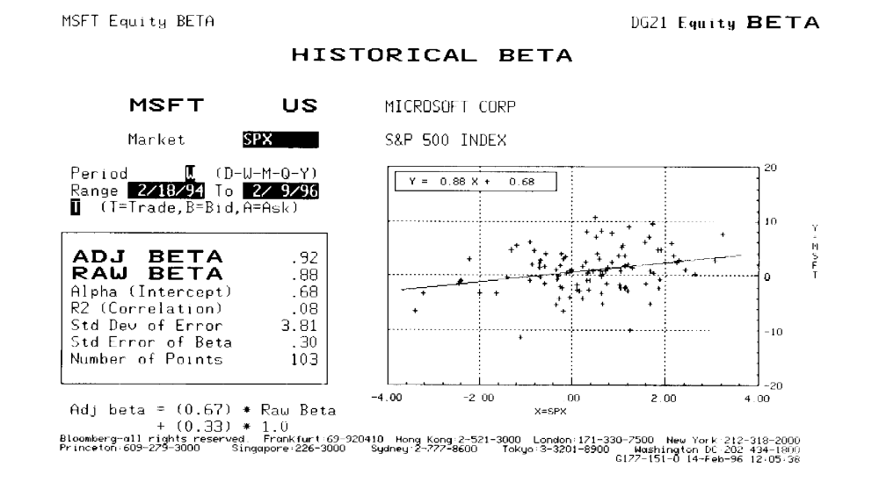
Predicting Risk-Return of MSFT

Slide 31
Predicting Return of MSFT
¯
^
^
¯
R_{MSFT} = α_{MSFT} + β_{MSFT} R_{M}
R _{i}
Predicted Return=9.48%
^
^
α_{i} =0.68%
β_{i}=.88
10%
R_{M}

Slide 32





Risk of MSFT
Over the sample, σ_{M} = 1.28% (from data)
0.88²1.28²+3.81² = 15.79%
R² =

Slide 33
Example 4
Consider the two index-model regression results for Stocks A and B:
R_{A} = 1% + 1.2R_{M}
R-square (A) = 57.6%
Std. Dev. Of Error(A)=10.3%
(Residual standard deviation (A))
R_{B} = -2% + 0.8R_{M}
R-square (B) = 43.6%
Std. Dev. Of Error (B) = 9.1%
a. Which stock has more firm-specific risk?
b. Which stock has greater market risk?
c. For which stock does the market explain a greater fraction of return variability?

Slide 34
Portfolio
R_{P} = α _{P} + β_{P} R_{I} + e_{P}
E(R_{P} )= α _{P} + β_{P} E(R_{I} )
Var(R_{P} ) = β²_{P} Var(R_{I} )+ Var(e_{P})
Var (e_{P}) = Σ_{i} W_{i}²σ_{ei}²
α_{P} = Σ W _{i} α_{i}
β_{P} = Σ W _{i} β_{i}
e_{P} = Σ W _{i} e_{i}
The Index Model Helps us to Derive the Optimal Portfolio for Asset Allocation (the Tangent Portfolio M) by Reducing the Necessary Inputs to the Markowitz Portfolio Selection Procedure

Slide 35
Multi-index Model
R_{i} = α_{i}+ β_{i1}R_{I1} +….. +β_{iN}R_{IN} + e_{i}

Slide 36
3. ARBITRAGE PRICING THEORY
R_{i} = E(R_{i}) + Unexpected return (Surprises)
Systematic Factors
Unsystematic Factors
(Interest Rate, GDP,.etc)
(Death of CEO, losing contract, labor strike..etc)

Slide 37
Systematic
Unsystematic
R_{i} = E(R_{i}) + [β_{i1}F₁ + … β_{iK} F_{K}] +e_{i}
where β_{i1} is called Factor loading which measures the sensitivity of F₁ to R_{i}
and F₁ is called Factor price which is the source of macro-surprise from factor 1
Ex: F₁= F _{GNP}
F _{GNP} = Surprise in the growth rate of GNP
= Actual Growth in GNP – E(GNP growth)
= 1 % - 2 % = - 1%
If β_{GNP}=2 =>
Ri decreases by 2 (-1%) = - 2%

Slide 38
Risk-return of one factor Model-One Stock
Return
R_{i} = E(R _{i}) + β_{i} F + e_{i} same Properties as the Index Model
Risk
Var (R_{i}) = Var ( E(R_{i})+ β_{i} F + e_{i})
σ_{Ri}² = β_{i}² σ_{F}² + σ_{ei}²
Total Risk = Systematic Risk + Unsystematic Risk
Cov (R_{i}, R_{j}) =
~
~
~
~
β_{i} β_{j} σ_{F}²

Slide 39
Risk-return of One Factor Model-
Portfolio of stocks
Return:
Given R_{i} = E(R_{i}) + β_{i}F + e_{i}
Form a portfolio P
R_{P}= Σ^{N}_{i} W_{i} R_{i} → W_{i} = 1/N
= Σ^{N}_{i} W_{i} ( E(R_{i}) + β_{i}F + e_{i})
=E(R_{P}) + β_{P} F + e_{P}
Risk
σ_{P}² = Var ( E(R_{P}) + β_{P} F+ e_{P} )
σ_{P}² = β_{P}² σ_{F}² + σ_{eP}²
        σ²_{e P} = Var ( e_{P} ) = Σ_{i} W_{i}²σ_{ei}²

Slide 40
Risk-return of One Factor Model-
Portfolio of stocks
If P is well diversified,
R _{P} = E(R_{P}) + β_{P} F
σ² _{P} = β_{P}² σ_{F}²

Slide 41
Risk-return of Multi-factor Model-
Portfolio of stocks
Return
Rp = E(R_{P}) +[ β_{P1} F₁+ β_{P2} F₂+… +β_{PK} F_{K} ]+ [ e_{P} ]
Risk
σ_{P}² = [ β²_{P1} σ_{F1} ² + β²_{P2} σ_{F}² +…+ β²_{PK} σ_{F}² ]+[σ_{eP}² ]
If P is diversified?

Slide 42
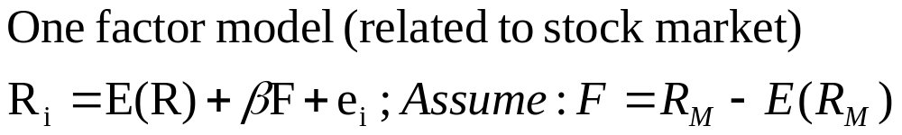
Example 5
ii) If we have an infinite # of asset A i.e well diversified portfolio

Slide 43
Equilibrium APT-Expected Return APT
The Law of One Price : This is the fundamental economic principle underlying APT
Two identical goods must sell at the same price
or there would be arbitrage profits available
Strict Arbitrage consists of:
No Investment
No Risk
Positive Return

Slide 44
Example 6
APT
Stock E(Ri) Beta
A 10% .5
B 12% 1
C 30% 2
R_{A}= 10% +.5 F + e_{A}
R_{B}= 12%+ F + e_{B}
R_{C}= 30% + 2 F + e_{C}
Arbitrage Profit ?

Slide 45
E(R )
β
Z(A+B)
30%
C
12%
B
10%
A
E(R_{Z})
.5
1
2
βp=0
R_{Z} < R_{B}

Slide 46
Example 6(cont’d)
Arbitrage Profit

Slide 47
Example 6(cont’d)
E(R )
β
Equilibruim
C
B
A
E(R_{Z})
.5
1
2
E(R_{A}) = E(R_{Z}) + .5 F
E(R_{B}) = E(R_{Z}) + F
E(R_{C}) = E(R_{Z}) + 2 F

Slide 48
APT Expected Returns
Expected return on stock i equals a Risk-Free rate plus:
sensitivity of security i to Factor 1 times expected Factor 1
plus sensitivity of security i to Factor 2 times expected Factor 2
plus sensitivity of security i to Factor 3 times expected Factor 3
plus ……….
plus sensitivity of security i to Factor N times expected Factor N
E(R_{it} ) = a_{0t} + b_{i1} (F_{1t}) + b_{i2} (F_{2t}) + ….. + b_{iK} (F_{Kt})

Slide 49
Differences: CAPM vs APT
APT
CAPM
K Factors
1 Factor
Don’t know the factors
Unobservable Market Portfolio
Testing APT (3 factors)
Testing CAPM
Industrial Production
Inconsistent
Unexpected Inflation
Bond Risk Premium

