Slide 1
PERFORMANCE VALUATION
PROJECT

Slide 2
1. Performance Valuation
Jensen Index ~ α_{P} or J_{P}
α_{P} =
R_{P} -
[R_{F}+ β_{P} * MRP]
Av MRP
Actual Return
Av T-bill
∑ W_{i}β_{i}

Slide 3
Performance Valuation (cont’d)
Can use Regression over the trading period
R_{Pt} -R_{Ft}
vs
R_{Mt}-R_{Ft}
Regression Model
α_{P}
R_{Pt} –R_{Ft} =
+ β (R_{Mt}-R_{Ft} ) + e_{t}
If α_{P} > 0
Earn more than expected
If α_{P} < 0
~ able to beat the market

Slide 4
Performance Valuation (cont’d)
Example MRP =8%, σ_{M} = 10%, R_{F}=6%
“P” R_{P}= 12%, β_{P}= .5, σ_{e} = 3%, σ_{P}=8%
“Q” R_{Q}= 20%, β_{Q}= 1.5, σ_{e} = 0%, σ_{Q}=11%
α_{P}=
α_{Q}=
Critique?

Slide 5
Performance Valuation (cont’d)
E(R )
β
20%
18%
12%
Q
10%
M
R_{F}
P
0.5
1.5

Slide 6
Treynor Index
Performance Valuation (cont’d)
T_{P} =
Slope of SML
Risk Premium per Unit of Market Risk
Assume well diversified portfolio
Example revisited

Slide 7
Performance Valuation (cont’d)
P
E(R)
β
Q
P
can leverage P by shortselling R_{F} and go long P such that P’ do minates Q
R_{F}
0.5
1.5

Slide 8
Sharpe Index
Performance Valuation (cont’d)
Excess return per unit of total risk
Sp =
Use CML as benchmark
Example revisited

Slide 9
Appraisal Ratio
Performance Valuation (cont’d)
Example revisited
Critique?

Slide 10
Modigliani-Modigliani ~ M²
Performance Valuation (cont’d)
R_{M} ≶ R_{HP}
= y R_{P} +(1-y) R_{F}
given σ_{M} = σ_{HP}
or σ_{M} = y σ_{P}
If R_{M} < R_{HP} outperform the market
If R_{M} > R_{HP} underperform the market

Slide 11
Performance Valuation (cont’d)
Example revisited
P
Solve for y using σ_{M} = y σ_{P}
► 0.10 = y 0.08
►y=1.25 (1-y)= -0.25
Compare returns
R_{M}= 0.14 > R_{HP} = 1.25 *0.12-0.25*0.06 = 0.135
Underperform M
Q
Solve for y using σ_{M} = y σ_{Q}
► 0.10 = y 0.11
►y= 0.91 (1-y)= 0.09
Compare returns
R_{M}= 0.14 < R_{HP} = 0.91*0.20+0.09*0.06 = 0.1874
Outperform M

Slide 12
Performance Valuation (cont’d)
E(R)
σ
Q
.1874
.14
.135
M
R_{F}
P
0.08
0.1
0.11

Slide 13
2. Performance Attribution
Look at the decisions
that result in superior or inferior performance
Asset Allocation, Stock Selection

Slide 14
Performance Attribution (cont’d)
Actual Benchmark”I”
Assets R^{A}_{i} W^{A}_{i} R^{I}_{i} W^{I}_{i}
S 2% .7 2.5% .6
B 1 .2 1.2 .3
Cash .5 .1 .5 .1
Performance?
Actual Return=
Bench Return=

Slide 15
Security Selection
Performance Attribution (cont’d)
Assets R^{A}_{i}-R^{I}_{i} W_{i}
S 2%-2.5% .7
B 1%-1.2% .2
Cash .5-.5 .1
Security Selection =

Slide 16
Asset Allocation Selection
Performance Attribution (cont’d)
Assets W^{A}_{i}-W^{I}_{i} R^{I}_{i}
S .7-.6 2.5%
B .2-.3 1.2
Cash .1-.1 .5
Asset Selection =

Slide 17
3. Project
Efficient Portfolio
●
Rebalancing
● Current Position

Slide 18
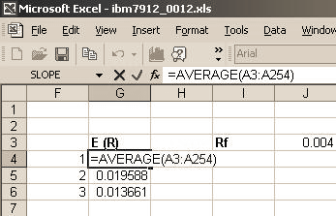
Project (cont’d)
Steps to solve for the optimal risky portfolio weights using Solver in Microsoft Excel
Example using 3 stocks
1. Compute the average return for each stock

Slide 19
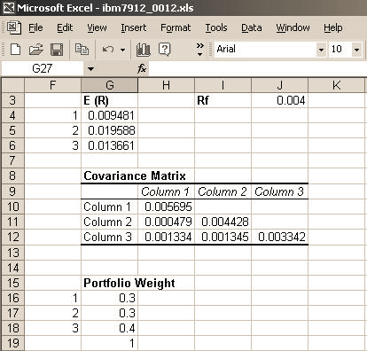
2. Compute the variance covariance matrix using excel function 3. Define an initial portfolio weight with a constraint equal to 1.
Project (cont’d)

Slide 20
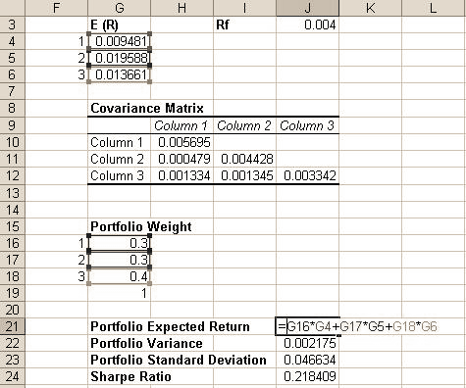
4. Compute the expected return of the initial portfolio
Project (cont’d)

Slide 21
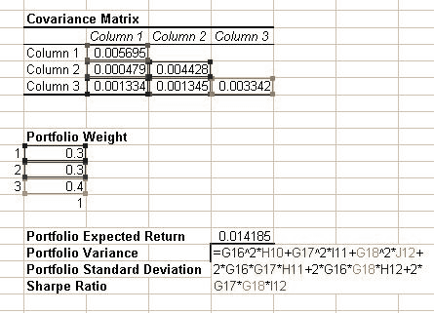
5. Compute the variance of the portfolio
Project (cont’d)

Slide 22
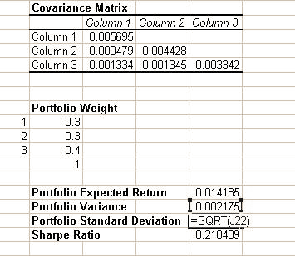
6. Compute the standard deviation of the portfolio
Project (cont’d)

Slide 23
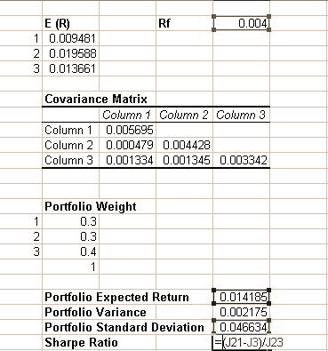
7. Compute the Sharpe Ratio
Project (cont’d)

Slide 24
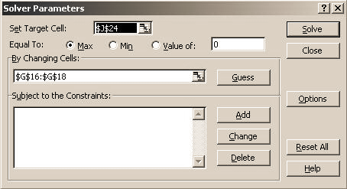
8. Under “data” click on Solver and input the cells of sharpe ratio and initial set weights
Project (cont’d)

Slide 25
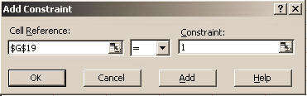
9. Add the constraint
Project (cont’d)

Slide 26
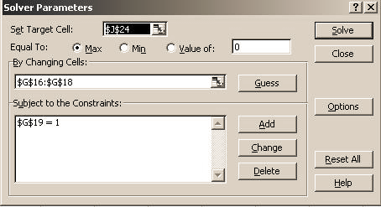
10. Click on Solve
Project (cont’d)

Slide 27
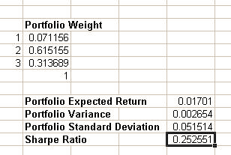
11.The optimal portfolio of risky assets
Project (cont’d)

Slide 28
Project (cont’d)
The efficient Set
Draw the efficient set by combing the risk free asset and the optimal portfolio of risky assets
Pick any portfolio of your choice on the efficient set and solve for the weights (target)

Slide 29
Project (cont’d)
Final Report
Trading Report
Buying and selling, Shortsale, Margin, Options
Performance Valuation (6 stocks)
Jensen, Treynor and Sharpe
Efficient Portfolio (6 stocks)
Appendix

