Slide 1
OPTIONS
TRADING STRATEGIES

Slide 2
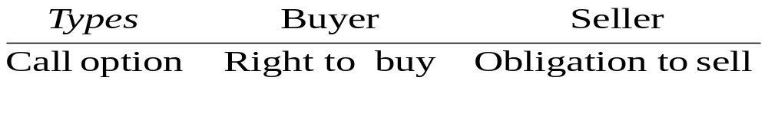
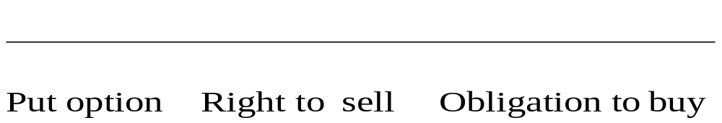
1. Terminology
Underlying option ~ Stock
Exercise Price ~E
# shares per contract (organized, OTC)
Expiration date
Price of the option ~ Premium c/p
American vs European

Slide 3
2.Option Strategies
Take a position in:
1. The option alone – Naked Position
2. The option and the underlying – Non Combined
Two or more options of the same type
This is known as a spread
A mixture of calls and puts
This is known as a combination

Slide 4
A. Naked Poistions
Buy a call
Write a call
Call
Call
S
E
S
E
S
S
S
S

Slide 5
Naked Positions (Cont’d)
Buy a Put
Write a Put
Put
E
S
S
S
S
S
E

Slide 6
B. Long S & P : Protective Put
Price Long P Long S
at Mat. P(55)=3 at 55 Portfolio
0
50
55
58
60

Slide 7
Case Shortsell S and buy C
Price Shortsell Buy
at Mat. at 55 C(55)=2 Portfolio
0
50
55
60
70

Slide 8
C. Combination Strategy :combine Put and Call on the same Stock
Price Buy Buy
at Mat. C(30)=2 P(30)=2 Portfolio
0 -2 30-2=28 26
20 -2 10-2=8 6
26 -2 4-2=2 0
30 -2 -2 -4
34 4-2=2 -2 0
40 10-2=8 -2 6

Slide 9
D. Spread buy Call that is financed by another Call on the same SK
Price Short C Buy
at Mat. C(35)=7 C(45)=2 Portfolio
0 7 -2 5
35 7 -2 5
40 7-5=2 -2 0
45 7-10=-3 -2 -5
70 7-35=-28 25-2=23 -5

Slide 10
Long1 C Short 2 C Long 1 C
Price C(35)=7 C(40)=4 C(45)=2 Portfolio
0 -7 2*4=8 -2 -1
35 -7 2*4=8 -2 -1
36 1-7=-6 2*4=8 -2 0
40 5-7=-2 2*4=8 -2 4
44 9-7=2 2*(4-4)=0 -2 0
50 15-7=8 2*(4-10)=-12 5-2=3 -1

