Slide 1
Ch.10 The z-Transform
1. The z-Transform (Ch.10.1)
2. The Region of Convergence for z-Transform (Ch.10.2)
3. The Inverse z-Transform (Ch.10.3)
4. Properties of z-Transform (Ch.10.5)
5. Analysis of LTI systems using z-Transform (Ch.10.7)
6. System Function Algebra and Block Diagram
7. Unilateral z-Transform (Ch.10.9)
Note: complex domain analysis for discrete-time, but what properties for discrete-time complex exponential signals?

Slide 2
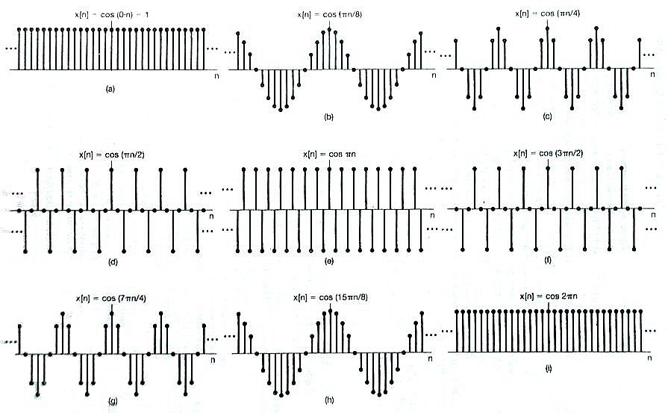
Periodicity Properties of Discrete-time Complex Exponentials e ^{jω0n} (periodic or aperiodic)
For discrete-time complex exponential signals, only need to consider a frequency interval of 2π.
Lowest oscillation rate
Highest oscillation rate

Slide 3
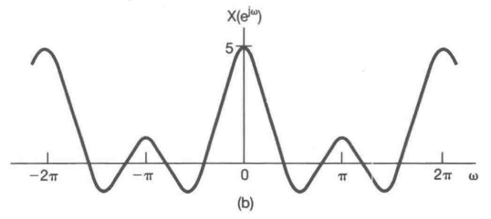
Ch.10 The z-Transform
Difference between LT and z-Transform?
Difference between continuous-time and discrete-time:
s-plane is replaced with z-plane, still a complex plane
For discrete-time signal, its spectrum is periodic with 2π
Question: where is the discrete-time Fourier transform on the z-plane with a periodic structure?

Slide 4
Ch.10 The z-Transform
Review from Chapter 3 (Fourier series)
y[n]=H(z)z^{n}
h[n]
For any complex number with converging summation
System function
--- z-transform of h[n].
Connection with DTFT, or the frequency response:
if converging on r = 1
For LT
if converging on Im

Slide 5
1. The z-Transform
Basic requirements:
1. Definition of z-Transform
2. Concept of ROC: difference from LT
3. Commonly-used ZT pairs
4. How to find the ZT of a signal
5. Concept of zeros and poles
Note: be careful with the difference between LT and ZT

Slide 6
1. The z-Transform
(1) Definition
(2) Definition based on Fourier transform
Write z in polar-axis as
DTFT
determines the convergence.
Note: The ROC is only determined by r, the radius of z.

Slide 7
1. The z-Transform
(3) Region of Convergence ( ROC )
ROC: Range of values of z for X(z) to converge
Representation: A. Inequality
B. Region in z-plane
Im
Always a circular ROC in the z-plane.
ROC is only determined by r, the radius of z.
Re
-1
a
1
unit circle

Slide 8
1. The z-Transform
(4) Relationship between discrete-time Fourier transform and z-transform
If the ROC includes the unit circle |z| = 1.
Very important z-Transform pairs:
Note: the same ZT expression, but different ROC’s. Only one of them has FT transform

Slide 9
1. The z-Transform
Example 10.1: Find z-transform of
Solution:
Finished?
NO! Don’t forget the ROC.
The condition of convergence:
or

Slide 10
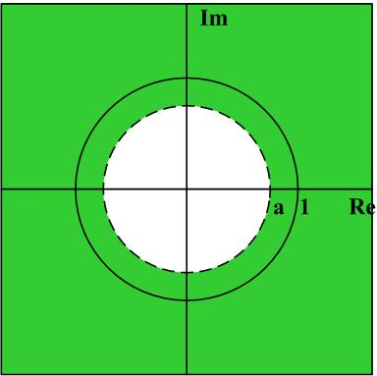
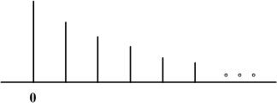
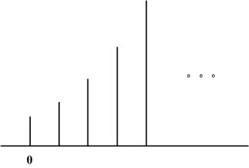
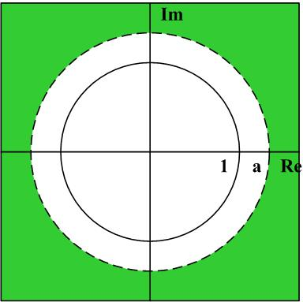
Example 10.1:
1).
2).
Note: which parameter determines the ROC?

Slide 11
Example 10.1:
Note the following:
The ROC consists of circular rings centered around the origin
If | a | < 1, x[n] is absolutely summable and has DTFT; also, the ROC for X(z) includes the unit circle.
If the DTFT exists, then

Slide 12
1. The z-Transform
Example 10.2: Find z-transform of
Solution:
The condition of convergence:
or

Slide 13
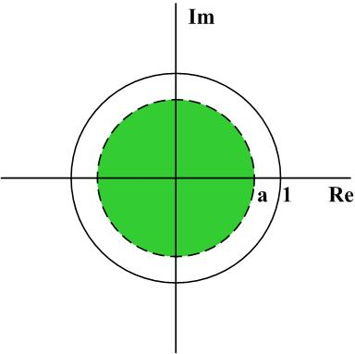
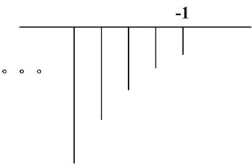
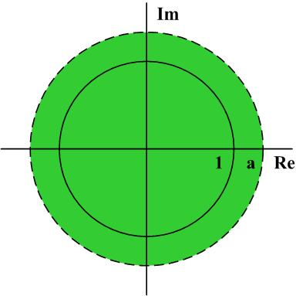
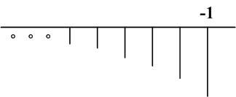
Example 10.2:
1).
2).

Slide 14
1. The z-Transform
From the above two examples, we know that
Right-sided
outside
Left-sided
inside
Like the Laplace transform, two different discrete-time signals might have the same expression for their z-transforms. The only difference is from the different ROC’s.
Both forms might be used.

Slide 15
Group discussion:
1. Given an LTI system with , determine the possible output signal if the input signal is
2. Given an LTI system with , determine the possible output signal if the input signal is

Slide 16
1. The z-Transform
Example 10.3: Find z-transform of
z-Transform is linear.
Solution:
ROC for both terms to converge

Slide 17
Example 10.3 (Cont’d):
After simplification, we obtain
rational form
Pole-zero plot: polynomial of z, not z⁻¹
zeros --- roots of numerator polynomial and X(z) = 0;
poles --- roots of denominator polynomial and X(z) = infinity.
Note that there might exist poles or zeros at infinity.

Slide 18
Example 10.3:
Two poles at z = 1/3 and z = 1/2;
Two zeros at z = 0 and z = 3/2.
Pole-zero plot:
ROC includes the unit circle, DTFT exists.
1/2
1

Slide 19
Example 10.4: Find z-transform of
Solution:
Note: the ROC is determined by |a|.

Slide 20
Example 10.4 (Cont’d):
Two poles:
Two zeros: one at z = 0 and another at z = infinity.

Slide 21
Example 10.4 (Cont’d):
Pole-zero plot:
ROC includes the unit circle, DTFT exists.
1/3
1
Real signal: poles in conjugate pair

Slide 22
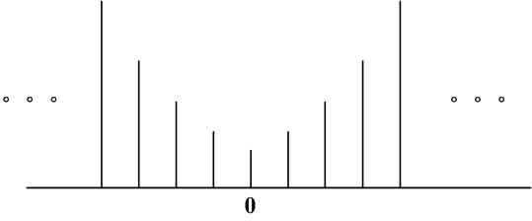
1. The z-Transform
Note that: some discrete-time signals do not have ZT
z-domain:
Time-domain:
The two ROC don’t overlap.
Another example:

Slide 23
1. The z-Transform
Summaries:
1. Definition of z-Transform and its connection with DTFT, system function
2. Concept of ROC and its importance
3. Commonly-used ZT pairs
4. How to find the ZT of a signal
Linear property of ZT, ROC intersection
5. ZT in rational form
6. Concept of zeros and poles

Slide 24
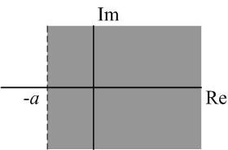
S-plane:
Z-plane:
Im
Re
-1
a
1
jω-axis:
Unit circle
Left plane:
Inside unit circle
Right plane:
Outside unit circle

Slide 25
1. The z-Transform
Im
LT and ZT:
0
Re
Poles:
Im
Poles:
Re
Mapping:

Slide 26
1. The z-Transform
LT and ZT: unit impulse sampled signals

Slide 27
Group discussion:
1. For the signal , its z-transform has ( ) number of zeros in the finite z-plane.
2. For the signal , the ROC of its z-transform is ( ).

Slide 28
2. The Region of Convergence for z-Transform
For DTFT, we need absolutely sumable for its convergence; here, we need to study the ROC.
Basic requirements:
Based on the properties of ROC, can determine the ROC of a signal’s ZT from its time-domain property (four types of signals).
Understanding and flexible usage of the properties
Should focus on the difference between ZT and LT.

Slide 29
2. The Region of Convergence for z-Transform
Property 1: The ROC of X(z) consists of a ring in the z-plane centered about the origin.
(Since the convergence is determined by r.)
Property 2: The ROC does not contain any poles. (Because at the pole, X(z) = infinity.)

Slide 30
2. The Region of Convergence for z-Transform
Property 3: If x[n] is of finite duration, then the ROC is the entire z-plane, except possibly at z = 0 and/or z = ∞.
Example 10.5:
1
It is clearly a signal of finite duration.
0
The ROC:
the entire z-plane.
Why the red part in property 3?

Slide 31
Example 10.5 (Cont’d):
1
1
Finite duration, but a pole at z = 0, so ROC:
Finite duration, but a pole at z = infinity, so ROC:
Note: time shifting will not change the ROC of Laplace transform.

Slide 32
2. The Region of Convergence for z-Transform
Any non-zero impulse in negative time gives pole at z=infinity since X(z) = infinity for that term, for example x[-2]z²;
Any non-zero impulse in positive time gives pole at z=0 since X(z) = infinity for that term, for example x[2]z ⁻².

Slide 33
2. The Region of Convergence for z-Transform
Property 4: If x[n] is a right-sided sequence, and if the circle |z| = r₀ is in the ROC, then all finite values of z for which |z| > r₀ will also be in the ROC.
r₀
However, not necessarily the boundary!
Why only finite values of z ? May not include z = .

Slide 34
2. The Region of Convergence for z-Transform
Property 4: If x[n] is a right-sided sequence, and if the circle |z| = r₀ is in the ROC, then all finite values of z for which |z| > r₀ will also be in the ROC.

Slide 35
2. The Region of Convergence for z-Transform
Property 5: If x[n] is a left-sided sequence, and if the circle |z| = r₀ is in the ROC, then all values of z for which 0 < |z| < r₀ will also be in the ROC.
r₀
However, not necessarily the boundary!

Slide 36
2. The Region of Convergence for z-Transform
Property 6: If x[n] is two-sided, and if the circle |z| = r₀ is in the ROC, then the ROC will consist of a ring in the z-plane that includes the circle |z| = r₀.
Check the properties with
Example 10.6 10.7
r₀

Slide 37
2. The Region of Convergence for z-Transform
Example 10.6:
Finite duration, ROC is the entire z-plane except N-1-order pole at z = 0.
z = a looks like another pole, but not.
N-1 zeros:

Slide 38
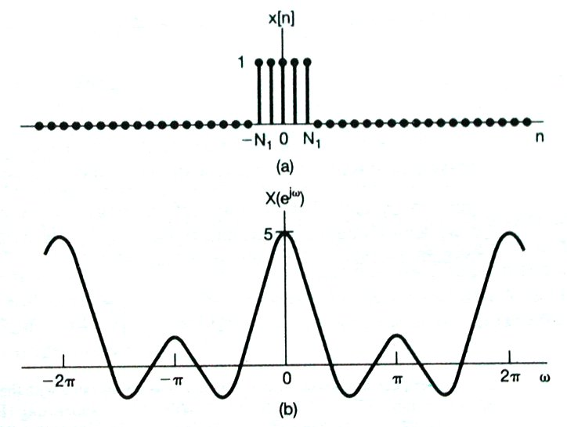
2. The Region of Convergence for z-Transform
Example 10.6:
N-1 zeros:
Discrete-time square wave: a = 1

Slide 39
2. The Region of Convergence for z-Transform
Example 10.7:
A two-sided sequence, write it as sum of a right-sided sequence and a left-sided sequence
If b > 1, then the two ROC’s have no overlap, and the z-transform does NOT exist.

Slide 40
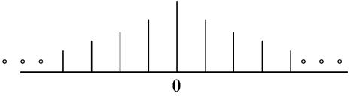
Example 10.7 (Cont’d):
If b < 1, then the two ROC’s have overlap, and the z-transform exists.
b
1
1/b
ROC includes the unit circle, DTFT exists.
Property 7: If the z-transform X(z) of x[n] is rational, then its ROC is bounded by poles or extends to infinity.

Slide 41
2. The Region of Convergence for z-Transform
Property 8: If the z-transform X(z) of x[n] is rational, and if x[n] is right sided, then the ROC is the region in the z-plane outside the outermost pole --- i.e., outside the circle of radius equal to the largest magnitude of the poles of X(z). Furthermore, if x[n] is causal, then the ROC also includes z = . (If x[n] is causal, the signal is always zero for negative time.)
Causal
Non-causal

Slide 42
2. The Region of Convergence for z-Transform
Property 9: If the z-transform X(z) of x[n] is rational, and if x[n] is left sided, then the ROC is the region in the z-plane inside the innermost nonzero pole --- i.e., inside the circle of radius equal to the smallest magnitude of the poles of X(z) other than any at z = 0 and extending inward to and possibly including z = 0. In particular, if x[n] is anticausal, then the ROC also includes z = 0.
Anti-causal
Non anti-causal

Slide 43
Example 10.8:
Find its poles and zeros and discuss possible ROC.
1. One way to define zeros and poles is to use the definition:
Note that both numerator and denominator should be in polynomials of z, not z⁻¹, thus,
Two poles at z = 1/3, z = 2; and a 2nd-order zero at z = 0.
No poles or zeros at infinity.

Slide 44
Example 10.8:
2. Another way:
To get X(z) = infinity,
To get X(z) = 0,
Causal
1/3
1
2

Slide 45
Example 10.8:
1/3
1
2
1/3
1
2
Anti-causal
Two-sided with DTFT
Two poles give three possible ROC’s, each one of them corresponds to a different signal.

Slide 46
2. The Region of Convergence for z-Transform
Summaries:
ROC: circular ROC around origin
Four different types of signals, correspond to four different types of ROC
For rational ZT, ROC is bounded by poles
Causal and anti-causal signal vs. right-sided and left-sided signals
Different from LT, be careful with poles at 0 or infinity

Slide 47
Group discussion:
1. For the signal , the ROC of its z-transform is ( )
2. For the following absolutely sumable signal with X(z), the signal is ( )

Slide 48
3. The Inverse z-Transform
Basic requirements:
Understanding the concept of inverse ZT: a contour integral in the ROC;
Inverse ZT based on partial fraction expansion
Expand X(z) in polynomials

Slide 49
3. The Inverse z-Transform
Write X(z) as a DTFT with suitable chosen magnitude:
Based on the one-to-one mapping property of FT:
Note: 1) the integral is done within any 2π interval
2) any fixed r within the ROC could be used

Slide 50
3. The Inverse z-Transform
Fix r and change ω in 2π period, is a circle in the z-plane inside the ROC.
In general

Slide 51
3. The Inverse z-Transform
The calculation for inverse z-transform:
(1) Integration of complex function.
(2) Compute by partial fraction expansion.
Here, expansion with z⁻¹
ROC outside the pole
ROC inside the pole

Slide 52
3. The Inverse z-Transform
Example 10.9:
Partial fraction expansion with z⁻¹

Slide 53
Example 10.9 (Cont’d):
For both terms, the ROC |z| > 1/3 is an outside ROC. So, both terms are right-sided sequences.
ROC outside the pole
ROC inside the pole
Causal and DTFT exists.

Slide 54
3. The Inverse z-Transform
Example 10.10:
Example 10.11:

Slide 55
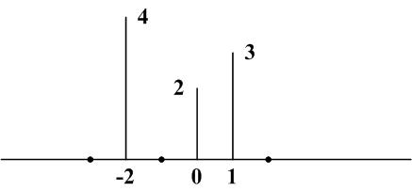
3. The Inverse z-Transform
(3) Expand X(z) in polynomial in z⁻¹
Example 10.12:
ROC?
Both z = 0 and infinity are poles:

Slide 56
3. The Inverse z-Transform
Example 10.13:
Inside ROC, we have |az⁻¹| < 1, so we can do an expansion as
However, for
Inside the ROC, |az⁻¹| > 1, how to do the expansion?

Slide 57
Example 10.13 (Cont’d):
Instead, |a⁻¹z| < 1, so we can do an expansion as
Key: how to do the expansion inside the ROC.

Slide 58
3. The Inverse z-Transform
Example 10.14:
log(1+v) has a nice Taylor expansion as
Inside the ROC, we have |az⁻¹| < 1, so we have

Slide 59
3. The Inverse z-Transform
Summaries:
Partial fraction expansion or polynomial expansion
Determine the ROC of the ZT: poles and other conditions;
Partial fraction expansion of the ZT
For each term, do the inverse ZT with the determined ROC based on
ROC outside the pole
ROC inside the pole

Slide 60
3. The Inverse z-Transform
Extra examples:
Given
and x[n] has DTFT , determine x[n].
2. Given and
determine x[n].

Slide 61
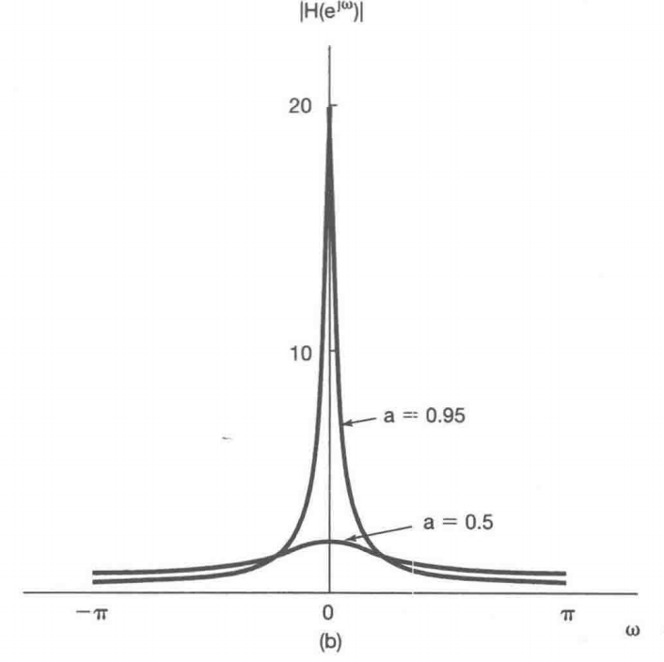
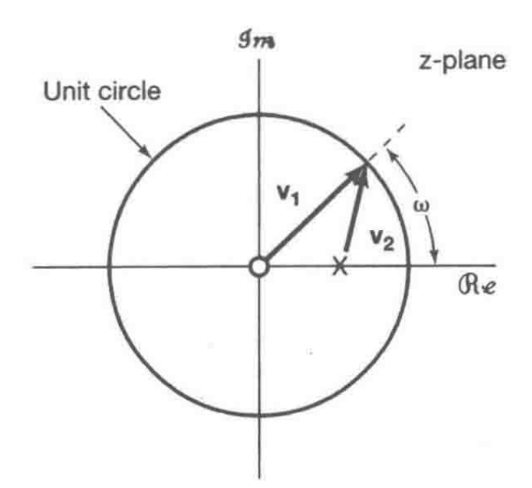
10.4 Geometric Evaluation of DTFT
10.4.1 First-order systems
10.4.2 Second-order systems
Please read this part yourself.

Slide 62
Group discussion:
1. Do partial fraction on , the result is ( )
2. Do the inverse ZT for the following signal if the signal has DTFT.

Slide 63
4. Properties of z-Transform
Basic requirements:
1. Understanding each property: how the time change affects both X(z) and its ROC;
2. Flexible usage of the properties:
Computing ZT, inverse ZT
Determine the ROC
LTI system analysis
……

Slide 64
4. Properties of z-Transform
Change in the ROC is also important.
1). Linearity:
With ROC containing R₁ ∩ R₂,
NOT ROC = R₁ ∩ R₂
Note that the ROC of x[n] is at least the intersection of R₁ and R₂. It could be empty, and it could be larger than the intersection.
Why?
Pole-zero cancellation

Slide 65
1). Linearity:
With ROC containing R₁ ∩ R₂
Pole-zero cancellation:
Note: only works for sum with finite terms.

Slide 66
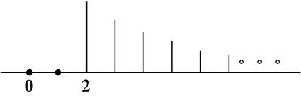
4. Properties of z-Transform
2). Time shifting:
with ROC = R, except for the possible addition or deletion of the origin or infinity.
One pole at z = a
One zero at z =0
One pole at z = a
One pole at z =0
n₀ > 0,
Poles introduced at z=0

Slide 67
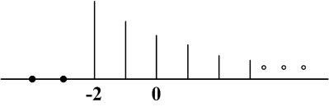
4. Properties of z-Transform
2). Time shifting:
with ROC = R, except for the possible addition or deletion of the origin or infinity.
One pole at z = a plus one 2nd-order pole at z = infinity
n₀ < 0,
Poles introduced at z=∞

Slide 68
4. Properties of z-Transform
3). Scaling in the z-domain:
with ROC = |z₀| R.
|z₀| R is a scaled version of R. It means if z is in the original ROC, R, then |z₀|z is inside the new ROC.
Proof:
Note: the original poles are moved to |z₀| z_{p} , and the new ROC is determined by the new poles

Slide 69
4. Properties of z-Transform
3). Scaling in the z-domain:
with ROC = |z₀| R.
Example:
with ROC = R/2.

Slide 70
3). Scaling in the z-domain:
with ROC = |z₀| R.
Example:
with ROC = R/2.
For right-sided signal x[n],
helps for a faster decreasing
rate with enlarged ROC.
For left-sided signal x[n],
gives a slower decreasing rate
with smaller ROC.

Slide 71
4. Properties of z-Transform
4). Time reversal:
with ROC = 1/R.
Proof:
1/2
2

Slide 72
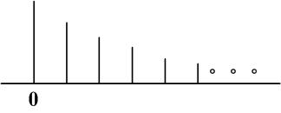
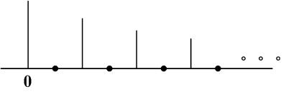
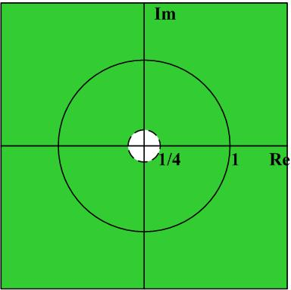
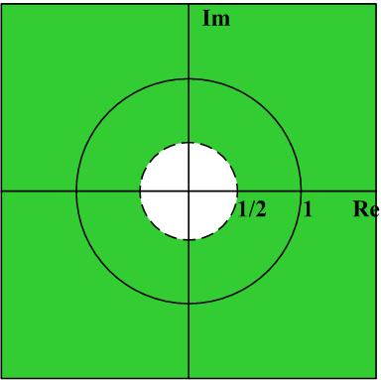
4. Properties of z-Transform
5). Time Expansion:
with ROC = R^{1/k}.
k positive integer

Slide 73
4. Properties of z-Transform
6). Conjugation:
with ROC = R.
Two steps: take conjugate of X(z) and replace z with z*
Proof:
Replace z with z*
ROC does NOT change.

Slide 74
6). Conjugation:
with ROC = R.
Example:
From the property,
Replace z with z*

Slide 75
4. Properties of z-Transform
6). Conjugation:
with ROC = R.
For real signal x[n], we have
For real signal x[n] with X(z) in rational form, the poles and zeros must come in conjugate pair.
Proof:
Similar proof for poles.

Slide 76
6). Conjugation:
with ROC = R.
Two poles:

Slide 77
Group discussion:
1. A real signal x[n] is known to have three poles for X(z). Two of them are at z = -2 and . It is also given
The ROC of X(z) can be determined to be ( ).
2. It is given that
It is known a stable LTI system has
The ROC of X(z) can be determined to be ( ).

Slide 78
4. Properties of z-Transform
7). Convolution:
With ROC containing R₁ ∩ R₂.
Basis for LTI system analysis with ZT.
LTI
Different from DTFT, Y(z) is valid for the correct choice of ROC.

Slide 79
7). Convolution:
With ROC containing R₁ ∩ R₂.

Slide 80
4. Properties of z-Transform
Ex 10.15: Difference system
h[n] = ? The output when the input is unit impulse.
ROC:
|z|>0
On the other hand, do z-transform of both sides:
Basis for ZT analysis on LTI systems described by constant-coefficient difference equations.

Slide 81
4. Properties of z-Transform
Ex 10.16: Accumulation
h[n] = ? The output when the input is unit impulse.
Note: Difference system and accumulation are reverse to each other

Slide 82
4. Properties of z-Transform
8). Differentiation in the z-domain:
Example 10.17: From Example 10.14,
Can also obtain this result using differentiation in the z-domain.

Slide 83
Example 10.17 (Cont’d):
Then, find the inverse z-transform for
With time shifting property,

Slide 84
4. Properties of z-Transform
Example 10.18:
Do a differentiation in the z-domain,
A second-order pole at z=a.

Slide 85
4. Properties of z-Transform
9). The Initial-Value Theorem
If x [n] = 0 for n < 0, then
Proof: If x [n] = 0 for n < 0,

Slide 86
9). The Initial-Value Theorem
If x [n] = 0 for n < 0, then
Example 10.19:

Slide 87
4. Properties of z-Transform
Table 10.2 for commonly-used z-transform pairs:
Why don’t we have z-transform for signals like
For x[n] = 1, we can write it as x[n] = u[n] + u[-n-1].
The intersection of the two ROC’s is empty.

Slide 88
4. Properties of z-Transform
Summaries:
1. Understanding each property: how the time change affects both X(z) and its ROC;
2. Flexible usage of the properties:
Computing ZT, inverse ZT
Determine the ROC
LTI system analysis
……

Slide 89
Partial fraction expansion for z-transform
First way:

Slide 90
Partial fraction expansion for z-transform
Second way:
Try to do partial fraction expansion with 1/z instead of z. What happens if we do partial fraction expansion with z?

Slide 91
Partial fraction expansion for z-transform
Third way:
Fourth way:

Slide 92
Partial fraction expansion for z-transform

Slide 93
Group discussion:
1. A causal signal X(z) has two poles at z=1/2, 1/3 and two zeros at z=0, z=1 plus x[0]=2. The signal is determined to be ( ).
2. Given that and a system The ROC for Y(z) of the output signal is ( ).

Slide 94
5. Analysis of LTI systems using z-Transform
LTI
H(z)
Requirements:
Comprehensive understanding and application of knowledge about ZT.
Determine the input X(z) plus it ROC: …
Determine the system function H(z) and its ROC: …
Y(z) and its ROC, the inverse ZT for y[n]
Key is flexible usage of ZT and ROC properties.

Slide 95
5. Analysis of LTI systems using z-Transform
1). ROC from Causality property:
From time-domain: h[n] = 0 for n < 0.
A). A discrete-time LTI system is causal if and only if the ROC of its system function is the exterior of a circle, including infinity.
No matter whether the system function is in rational form or not.

Slide 96
5. Analysis of LTI systems using z-Transform
1). ROC from Causality property:
B). A discrete-time LTI system with rational system function H(z) is causal if and only if:
a). The ROC is the exterior of a circle outside the outermost pole; and
b). With H(z) expressed as a ratio of polynomial in z, the order of the numerator cannot be greater than the order of the denominator.
Condition b) implies that after the expansion, no terms like z, z², z³, etc. They refer to non-zero h[-1], h[-2], h[-3], etc. It is equivalent to ROC including ∞.

Slide 97
5. Analysis of LTI systems using z-Transform
Example 10.20:
ROC for right-sided sequence?
For this rational system function H(z), it is NOT causal since the order of the numerator is one order higher than the order of the denominator. Thus, after expansion, we will have a term like z, which refers to a nonzero h[-1].

Slide 98
5. Analysis of LTI systems using z-Transform
Example 10.21:
The ROC is an outer ROC for both poles, so we can easily get the inverse z-transform as
It is clearly causal. To confirm it with the above statement, we need to write H(z) as polynomial in z and compare the order of the numerator and the denominator.

Slide 99
5. Analysis of LTI systems using z-Transform
2). ROC from Stability property:
A). An LTI system is stable if and only if the ROC of its system function H(z) includes the unit circle. (The DTFT then exists too.)
B). A causal LTI system with rational system function H(z) is stable if and only if all of the poles of H(z) lie inside the unit circle – i.e., they must all have magnitude smaller than 1.

Slide 100
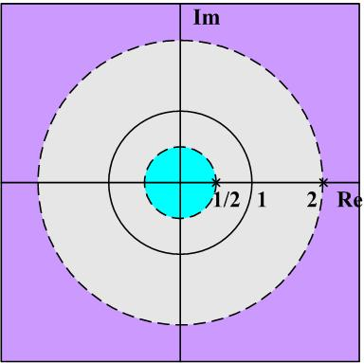
5. Analysis of LTI systems using z-Transform
Example 10.22:
Poles and zeros plus possible ROC?
Two poles: z = ½ and z = 2
Three possible ROC.
Two zeros: z = 5/4 and z = 0
For each ROC, causal or stable?

Slide 101
Example 10.22:
(1) |z| > 2, causal, unstable
Causal: an outside ROC including infinity.
Not stable: unit circle not included in the ROC.
Both terms are causal, but the second one is the reason for the system to be not stable.

Slide 102
Example 10.22:
(2) ½ < |z| < 2, not-causal, stable
Stable: unit circle included in the ROC.
Not causal: two-sided sequence
(3) |z| < ½ , anti-causal, not stable

Slide 103
5. Analysis of LTI systems using z-Transform
Example 10.23: causal first-order system
Stable:
Real system: a real number
Example 10.24: causal and real second-order system
Two conjugate poles:
Stable:

Slide 104
5. Analysis of LTI systems using z-Transform
Linear constant-coefficient difference equation:
Take z-transform of both sides,
Basis of ZT analysis on LTI system described by constant-coefficient difference equations.

Slide 105
5. Analysis of LTI systems using z-Transform
Can be expressed in a rational form and can also be determined by its poles and zeros except for a constant factor.
However, no ROC can be derived from the difference equations. If at initial rest, then the system is causal and the ROC is outside the outermost pole.

Slide 106
Group discussion:
1. A rational system with only two poles at z = -1/2 and z = +2 plus the information that the output y[n]=0 when input x[n]=cos(πn). Determine which one of the following choice ( ) is true.
(a) Causal and stable
(b) Causal and not stable
(c) Not causal but stable
(d) Not causal and not stable
2. A system with real and causal h[n] and two poles for rational H(z) with one at z = (-1+j)/2. For system , determine which one of the following choice ( ) is true.
(a) Causal and stable
(b) Causal and not stable
(c) Not causal but stable
(d) Not causal and not stable

Slide 107
5. Analysis of LTI systems using z-Transform
Example 10.25:
Solution: take z-transform on both sizes
One pole with two possible ROC’s
Causal and stable

Slide 108
5. Analysis of LTI systems using z-Transform
Example 10.25:
Solution (cont’d):
Not causal and not stable
Question: why in the equation, only y[n-1], x[n-1] etc., no y[n+1], x[n+1]?
Causal requirement: y[n+1], x[n+1] refer to output and input signal for future time

Slide 109
5. Analysis of LTI systems using z-Transform
Example 10.26: Determine the system given
Solution: from the first piece of information,

Slide 110
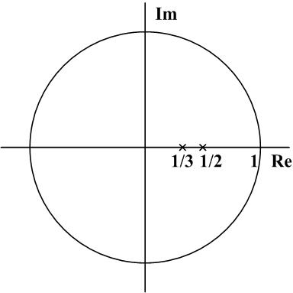
Example 10.26 (Cont’d):
Using the convolution property:
ROC for H(z)?
Still two poles at:

Slide 111
Example 10.26 (Cont’d):
Question: how to use the second information to find a?
(-1)^{n} is a discrete-time complex exponential signal with z^{n} and z = -1. Using system function, the output should be

Slide 112
Example 10.26 (Cont’d):
To write out the difference equation, we have
Or,

Slide 113
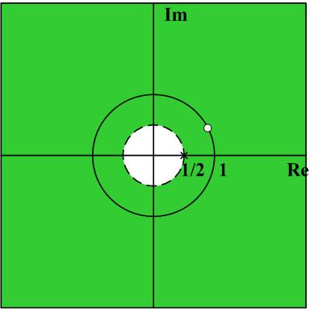
Example 10.27:
Consider a stable and causal system. Its H(z) is rational, contains a pole at z = ½ , and a zero somewhere on the unit circle. The locations of other poles and zeros are unknown.
For each of the following statements, determine whether it is true, or false, or can’t determine.
What do we know?
Stable, the ROC of H(z) includes the unit circle.
Rational and causal, an outside ROC.
One pole at z = ½ , ROC can NOT be inside |z| < ½ .

Slide 114
Example 10.27 (Cont’d):
F{(1/2)^{n} h[n]} converges.
Need to know whether the ROC of (1/2)^{n} h[n] includes the unit circle.
What is the ROC of {(1/2)^{n} h[n]:
(1/2) R = R/2.
h(n)
(1/2)^{n} h[n]
stable
1/2
1
1/2
Answer: True.

Slide 115
Example 10.27 (Cont’d):
(b) H(e^{jω}) = 0 for some frequency.
We need to study the behavior of H(z) on the unit circle.
Answer: True. Because there is a zero on the unit circle.
(c) h[n] has finite duration.
Answer: False. If it has finite duration, then the ROC should be the entire z-plane except the origin or infinity. However, H(z) has a pole at ½ .

Slide 116
Example 10.27 (Cont’d):
(d) h[n] is real.
For real signal with rational H(z), the poles and zeros must come in conjugate pairs or in real, but we only know that ½ is a real pole and we don’t know anything else about its poles and zeros.
Answer: Can NOT determine. No sufficient information.

Slide 117
Example 10.27 (Cont’d):
(e) g[n] = n[h[n]*h[n]] is the impulse response of a stable system.
For a stable system, the unit circle should be included in the ROC of G(z). What is the ROC of G(z)?
Answer: True. ROC still includes the unit circle.

Slide 118
5. Analysis of LTI systems using z-Transform
Summaries:
Comprehensive understanding and application of knowledge about ZT.
1. Determine the input X(z) and its ROC
2. Determine the system function H(z) and its ROC: …
zeros, poles; difference equations;
given special input-output pair;
if x[n] = 1, y[n] = 0 … …
causal, stable; input-output pair;
3. Y(z) and its ROC, inverse ZT for y[n]

Slide 119
Group discussion:
1. For the following system under initial rest
Determine which one of the following choice ( ) is true.
(a) Causal and stable
(b) Causal and not stable
(c) Not causal but stable
(d) Not causal and not stable
2. For the following system with
Determine which one of the following choice ( ) is true for the system.
(a) Causal and stable
(b) Causal and not stable
(c) Not causal but stable
(d) Not causal and not stable

Slide 120
6. System Function Algebra and Block Diagram
Basic requirements:
Can derive the system function from the system block diagram;
Several equivalent block diagrams are possible. Given a system function in rational form, can draw a block diagram, especially the direct-form.
Location of poles plus causal and stable properties
Inter-connection of sub-systems: will new poles be generated with new ROC?

Slide 121
6. System Function Algebra and Block Diagram
Interconnections of LTI systems:
1) Determine the input and output of the system;
2) Decompose the system into subsystems, and find the input-output relationship for each subsystem;
3) Obtain the overall input-output relationship.

Slide 122
6. System Function Algebra and Block Diagram
Series:
Parallel:
ROC? Causal or stable?
Convolution property and linear property: ROC no change
Plus, location of poles not change. Still outside ROC for causality and still ROC include the unit circle for stability

Slide 123
6. System Function Algebra and Block Diagram
Feedback:
Get rid of W(z), we have
ROC? Causal or stable?
ROC: If the two subsystems are causal, the whole system will be causal. But, location of poles will change. ROC determined by new largest pole.

Slide 124
Feedback system
Location of poles might change completely.
Examples: stable, causal
A delayer:
Unstable.
Stable.

Slide 125
6. System Function Algebra and Block Diagram
Basic elements:
adder
multiplication by a coefficient
Unit delay for difference
Examples 10.28 10.29 10.30 10.31

Slide 126
6. System Function Algebra and Block Diagram
Examples 10.28：

Slide 127
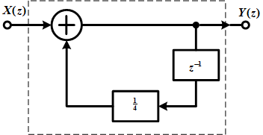
6. System Function Algebra and Block Diagram
Examples 10.28：
Adder:
Note: No ROC is given here. The ROC is determined by new poles.

Slide 128
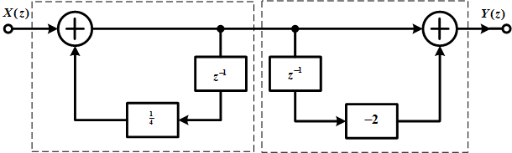
6. System Function Algebra and Block Diagram
Examples 10.29：

Slide 129
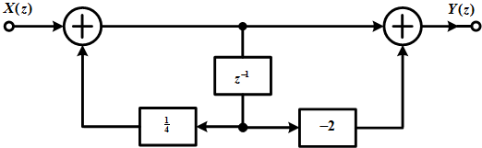
Examples 10.29：
Feedback
Feed-forward

Slide 130
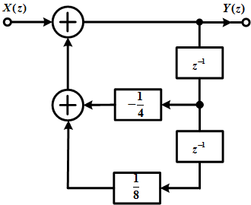
6. System Function Algebra and Block Diagram
Examples 10.30：
ROC determined by poles
Feedback

Slide 131
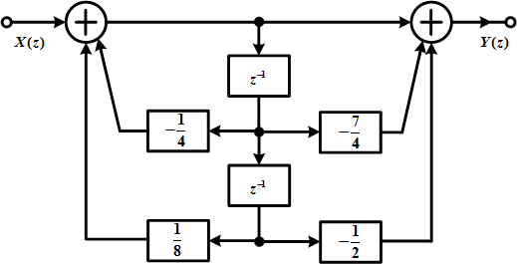
6. System Function Algebra and Block Diagram
Examples 10.31：
Feedback
Feed-forward

Slide 132
6. System Function Algebra and Block Diagram
Examples 10.31：

Slide 133
Group discussion:
1. The following system function is for a causal system, its unit impulse response is ( )
2. Draw a system block diagram for the following system in direct form.

Slide 134
7. Unilateral z-transform
Summation starts at n = 0.
Basic requirements:
Concept of UZ and its difference from bilateral ZT
Time-difference property of UZ and its application

Slide 135
7. Unilateral z-transform
ROC: always an outside ROC.
If x[n] = 0 for n<0, then the unilateral z-transform of x[n] is the same as the bilateral z-transform of x[n]. Otherwise, the two might be different.

Slide 136
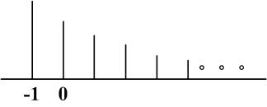
Example 10.33: Find the bilateral and unilateral z-transform for
Bilateral z-transform:
Unilateral z-transform:

Slide 137
Example 10.34: inverse z-transform
Bilateral z-transform: two poles with three possible ROC’s and one different signal for each ROC
Unilateral z-transform: only one possible ROC with the same inverse z-transform result as above

Slide 138
7. Unilateral z-transform
Example 10.35:
Note: for unilateral z-transform, the degree of the numerator polynomial must be no bigger than the degree of the denominator.

Slide 139
7. Unilateral z-transform
Properties: similar to the bilateral z-transform. Here, we focus on the differences.
Convolution: If x₁[n] = x₂ [n] = 0 for n<0, then
Time delay:
Time advance:
Why?

Slide 140
7. Unilateral z-transform
Time delay:
Proof:
Note that for UZ of x[n-1], x[-1] is shifted into the range of the summation now.

Slide 141
7. Unilateral z-transform
Time advance:
Proof:
Now, the summation starts at x[1], not x[0].

Slide 142
7. Unilateral z-transform
Solving difference equations using unilateral z-transform:
For system at initial rest, the system is causal and thus H(z) is the same for the bilateral and unilateral z-transform.
The nice thing about unilateral z-transform is that it can be used to solve difference equations not at initial rest. (Now the system is NOT an LTI.)

Slide 143
7. Unilateral z-transform
Example 10.36:
Under initial rest condition and
Solution:

Slide 144
Example 10.37:
with
and
Solution:
To find y[n], do unilateral z-transform of both sides:
Zero-state response
Zero-input response

Slide 145
Example 10.37:
with
and
Solution:
In practice, to find the output
Output at previous time, state

Slide 146
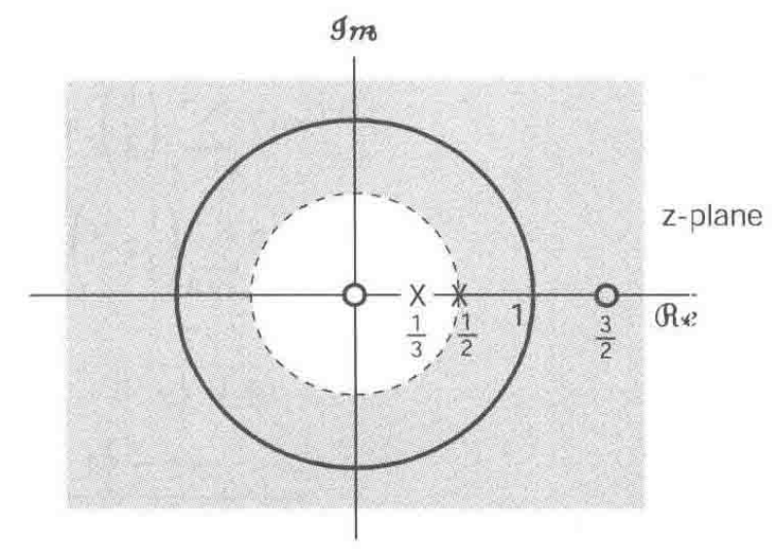
Summary
1. Concept of z-transform: extension of DTFT to the complex domain
Convergence: ROC determined by magnitude of z, pole-zero plot
LTI system:
If …,
Commonly-used FT pairs:

Slide 147
Summary
2. ROC properties:
(1) Four types of time-domain signals, four types of ROC
(2) ROC determined by poles, how to determine the ROC from possible ROC’s
(3) Origin or infinity point removed from the ROC or not?
3. Inverse ZT
Inverse LT based on partial fraction expansion
ROC outside the pole
ROC inside the pole

Slide 148
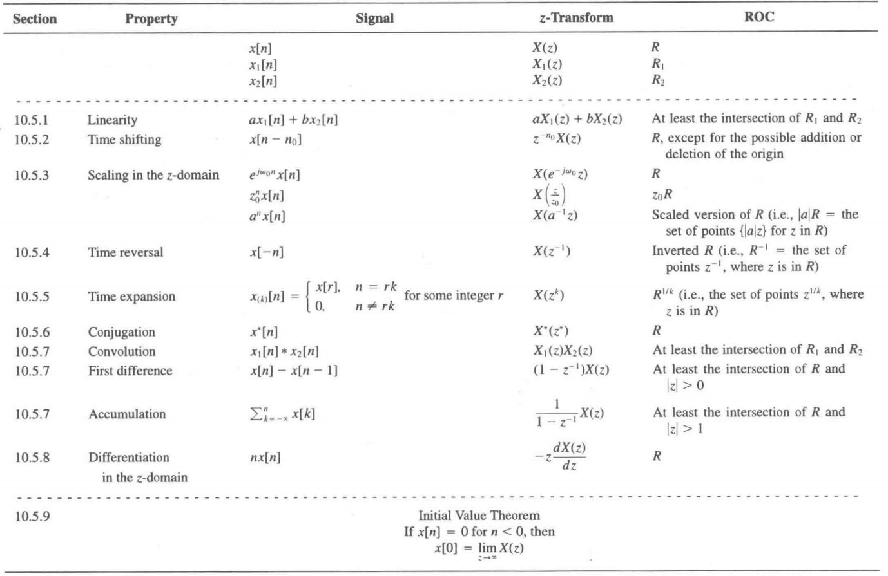
Summary
4. Properties of ZT: be careful of ROC change

Slide 149
Summary
5. ZT-based system analysis
(1) Causal or stable property determined from ROC
(2) Systems of linear constant-coefficient difference equations
(3) Flexible usage of ZT properties
6. System Function Algebra and Block Diagram
(1) Series, parallel, feedback interconnection: ROC? Causal? Stable?
(2) Block diagram: system function
7. Unilateral z-transform
(1) Concept of unilateral ZT and difference from bilateral ZT
(2) Solving difference equations with non-zero initial conditions

Slide 150
Group discussion:
1. The unilateral ZT for signal is ( )
2. Which signals ( ) have the following unilateral ZT ?

